Slide 1


Medical Esthetics
Types of Skin Cancer

Slide 2
FACTS :
Skin cancer is caused by damage to DNA.
Skin cancer form when cells begin to divide rapidly and unevenly.
UV exposure increases the risks of skin cancer
If detected early, these abnormal growths can be removed. If not taken care of, they can be deadly.

Slide 3
Skin Cancer Facts With Dr Brian Connolly

Slide 4
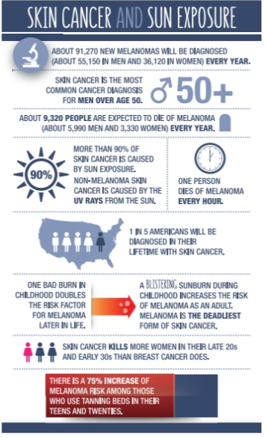

Slide 5
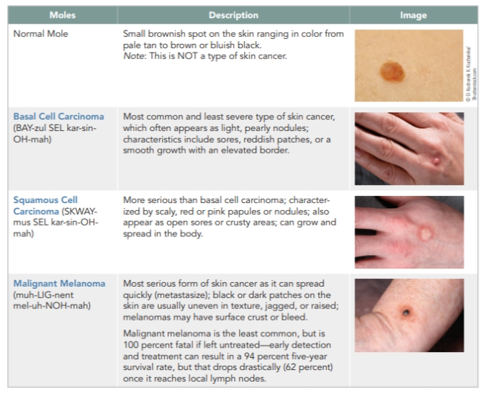

Slide 6
ONCOLOGY ESTHETICS
A medical niche has emerged for the esthetician certified in oncology esthetics. As referenced in chapter 1, oncology is the medical study of cancer, its causes and treatments. Treating skin that has been exposed to radiation and chemotherapy requires a depth of knowledge beyond basic esthetics. The skin can be much more fragile and reactive. Additionally, you don’t want to provide any treatment or skin care products that could be contraindicated with their cancer treatment. Clients with cancer still need the healing benefits of touch and can additionally benefit from skin care treatments that are soothing and calming.

Slide 7
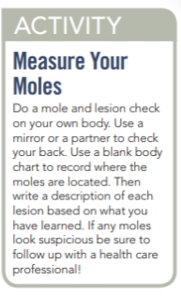
ABCDEs of Melanoma Detection
A: Asymmetry—The two sides of the lesion are not identical.
B: Border—The border is irregular on these lesions.
C: Color—Melanomas are usually dark and have more than one color or colors that fade into one another.
D: Diameter—The lesion in a melanoma is usually at least the size of a pencil eraser.
E: Evolving—Melanoma as a lesion often changes appearance

Slide 8
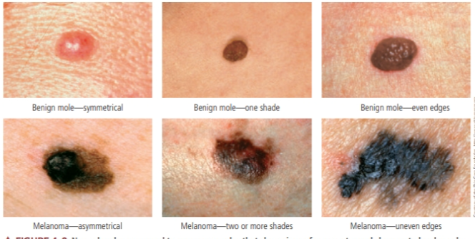
Normal moles compared to cancerous moles that show signs of asymmetry and changes to border, color, and diameter.

Slide 9
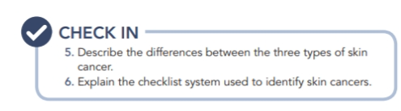

Slide 10

QUESTIONS?

