Slide 1


Medical Esthetics
The Skeletal System

Slide 2
OUR JOURNEY TODAY
Did you know?
Estheticians focus primarily on the muscles, bones, nerves, and circulation of blood and lymph? Understanding this anatomy and physiology helps estheticians understand how the body functions as an integrated whole.
Also, this knowledge will be deeply applied in the Medical Esthetics field, when working for Cosmetic Surgeons and or Dermatologists

Slide 3
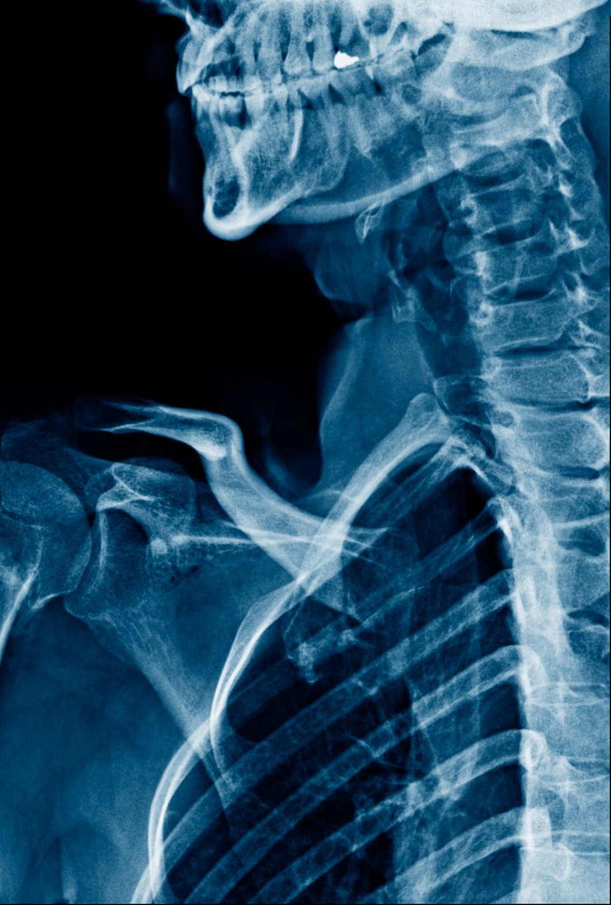
The Five Functions of the Skeletal System

Slide 4
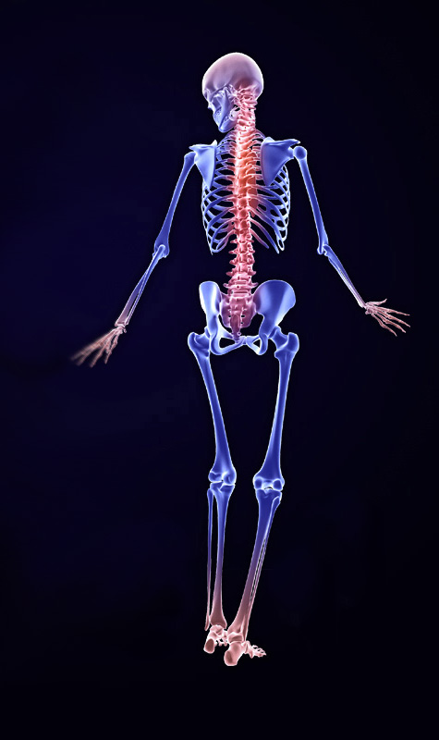

Let’s see !

Slide 5
The Number of Bones and Composition
The adult skeleton has 206 bones that form a rigid framework to which the soft-er tissues and organs of the body are encased and acts as anchor points for muscles and ligaments to provide sup-port for movement.
It is the structure of the whole body and it also serves to protect our inner organs

Slide 6
Functions
Give shape and support to the body
1
Protect various internal structures and organs
2
Serve as attachments for muscles and act as levers to produce body movement
3
Help produce both white and red blood cells (one of the functions of bone marrow)
4
Store most of the body’s calcium supply as well as phosphorus, magnesium, and sodium.
5

Slide 7
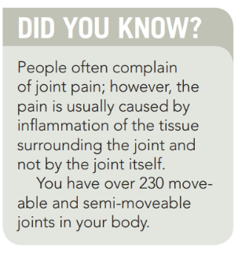

Slide 8
Bones of the Skull
The human head contains 22 bones divided into two groups:
The cranium and the facial bones. The cranium is formed by 8 bones
The face consists of 14 bones, including the maxilla (upper jaw) and mandible (lower jaw). Small openings in the skull allow the cranial nerves to extend to various locations on the head.

Slide 9
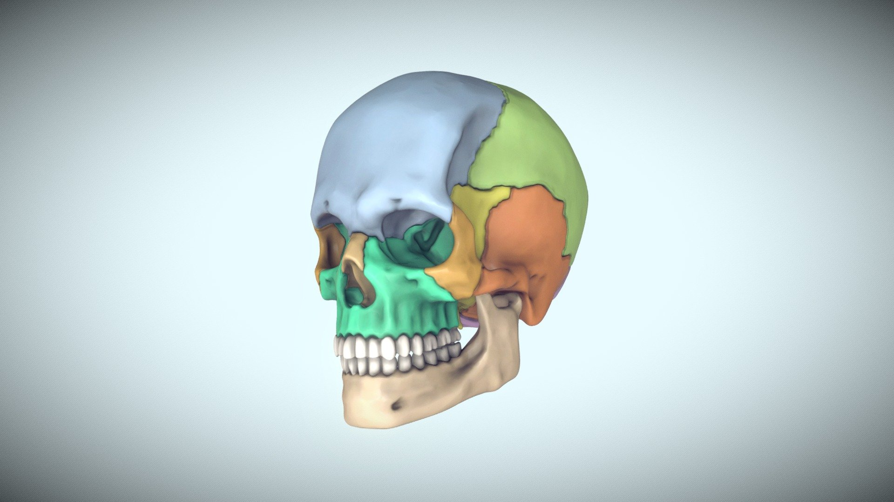
BONES OF THE CRANIUM

Slide 10
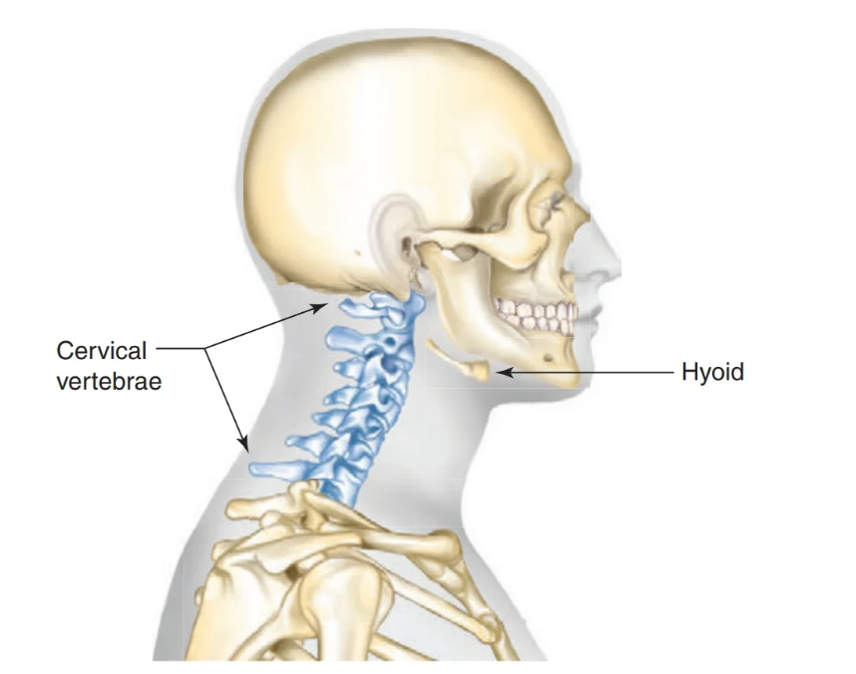
Bones of the Neck

Slide 11
Hyoid bone, a U-shaped bone at the base of the tongue that supports the tongue and its muscles
Cervical vertebrae , the seven bones of the top part of the vertebral column located in the neck region

Slide 12
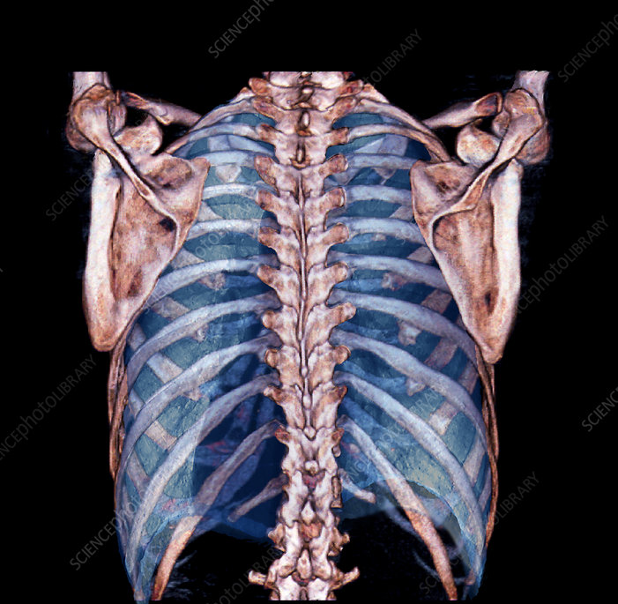

Bones of the Chest
Let’s take a look

Slide 13
Bones of the Arms and Hands
The humerus is the uppermost and largest bone of the arm, extending from the elbow to the shoulder.
The ulna is the inner and larger bone of the forearm (lower arm), attached to the wrist and located on the side of the little finger.
The radius is the smaller bone in the forearm on the same side as the thumb.
The carpus , also known as wrist , is a flexible joint composed of eight small, irregular bones (carpals) held together by ligaments.
The metacarpus, also known as palm, con-sists of five long, slender bones called metacarpal bones.
The phalanges(singular: phalanx), also
known as digits, are the bones in the fingers, three in each finger and two in each thumb, totaling 14 bones

Slide 14
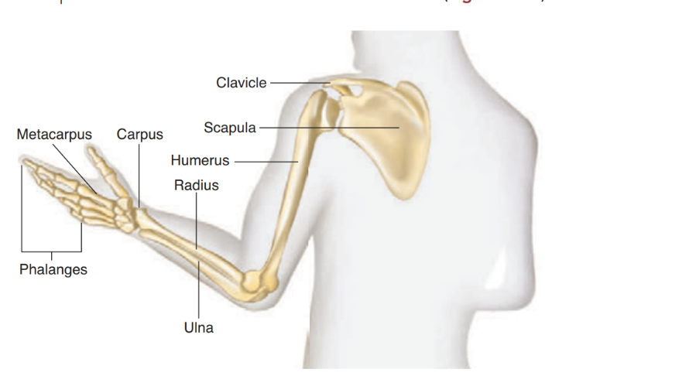

Slide 15
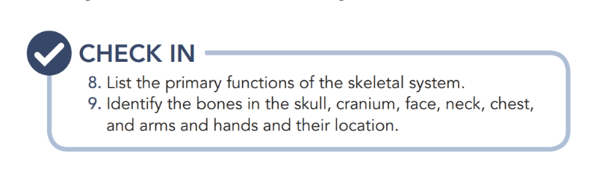

Slide 16
Recap !

Slide 17

QUESTIONS?

