Slide 1


Thermotherapy for Clogged Pores

Slide 2
Implements and Materials
Cleanser to remove makeup
Stimulating massage product
Toner
Standard facial lounge setup with linens and towels
Gloves
Disposable compresses, cloths, or sponges for removing product
Water and bowl
LDR enzyme peel
Cotton swabs
Serum to soothe or calm the skin
Hydrating serum
High-frequency
Very warm wet towels
Cool wet towels
Sun protection

Slide 3
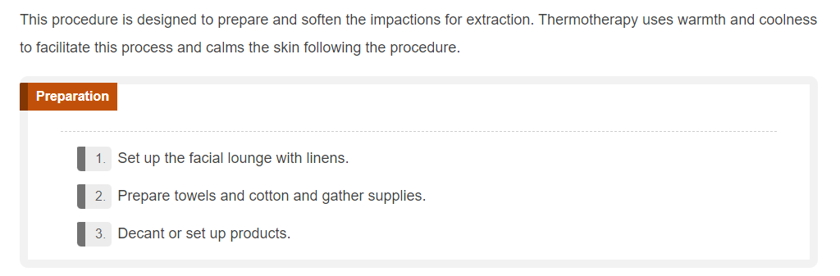

Slide 4

Get Ready
Step by Step

Slide 5
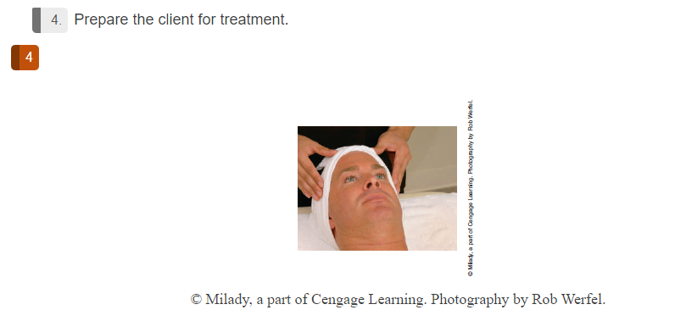

Slide 6
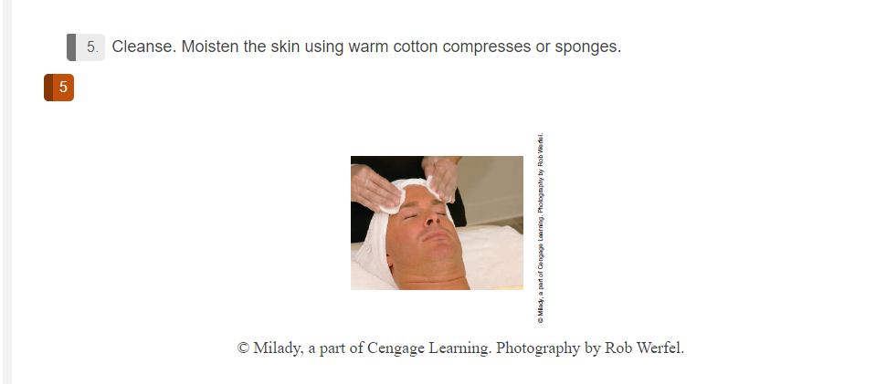

Slide 7
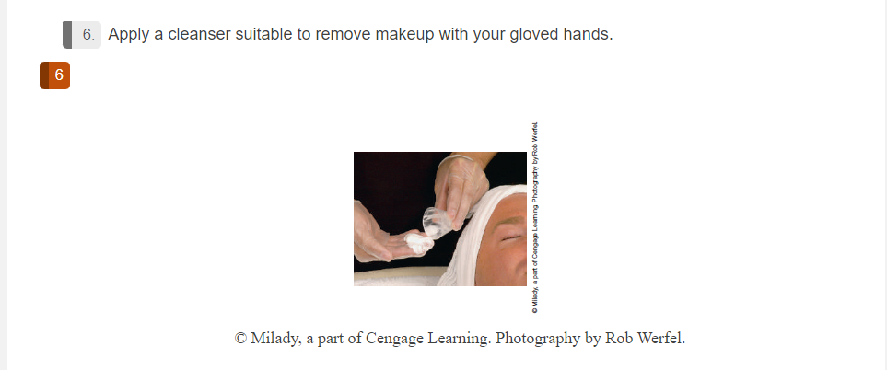

Slide 8
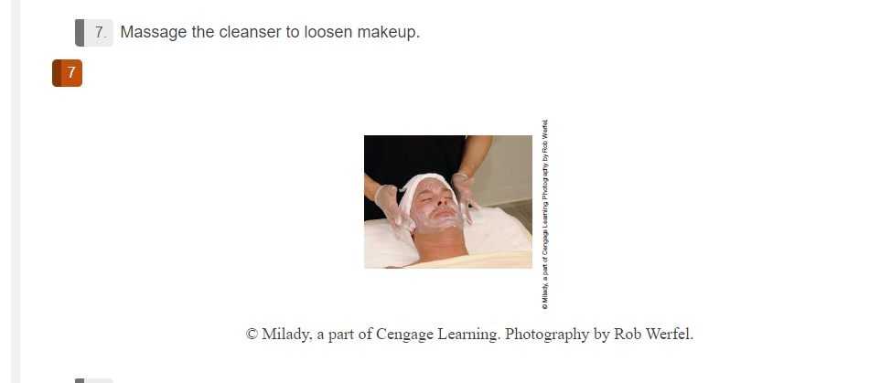

Slide 9
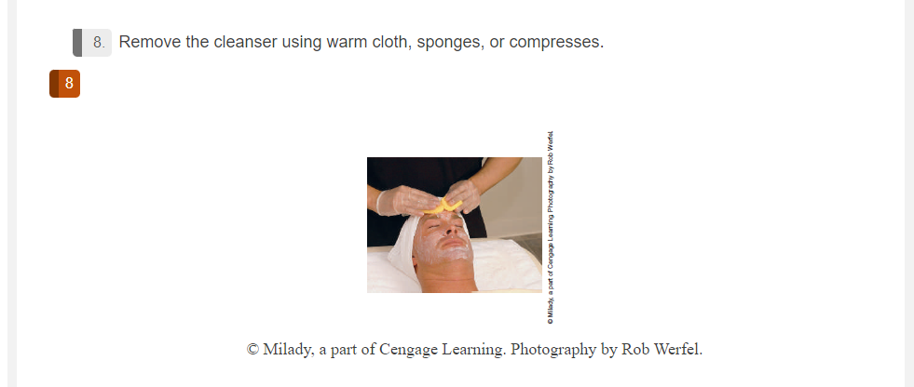

Slide 10
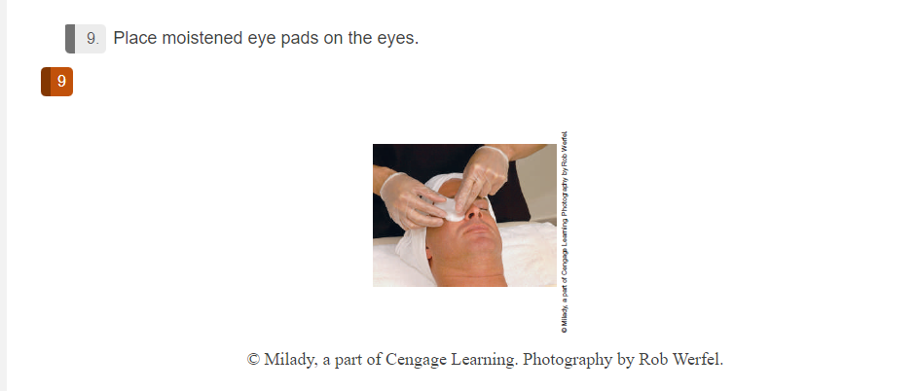

Slide 11
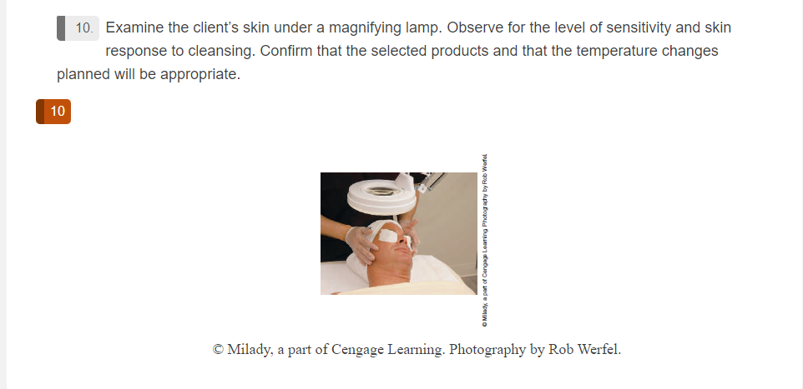

Slide 12
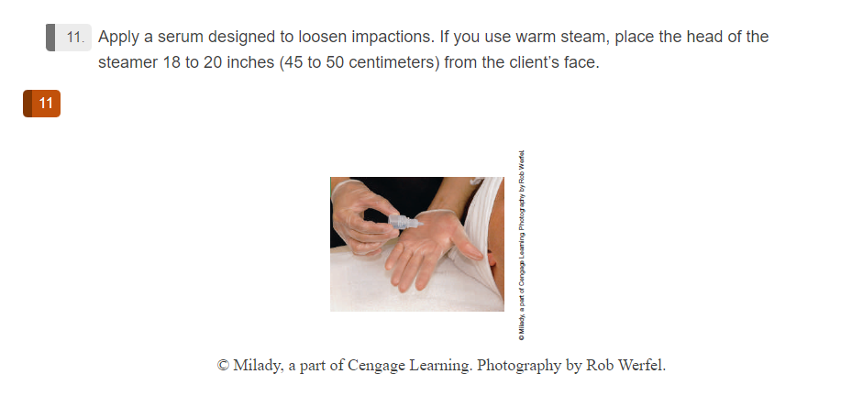

Slide 13
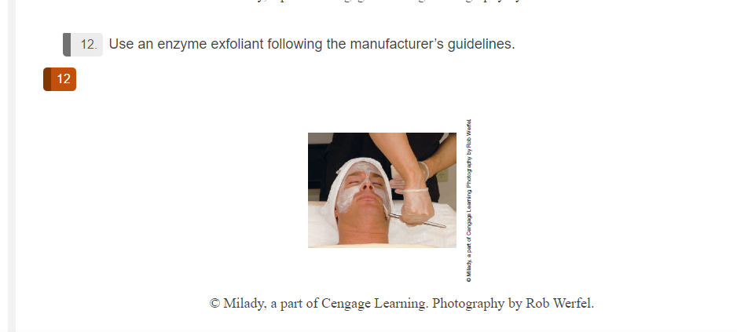

Slide 14
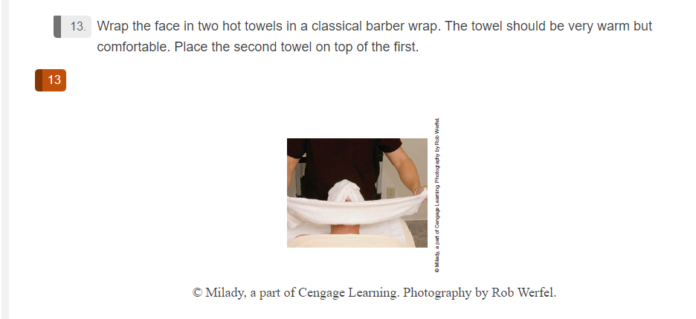

Slide 15
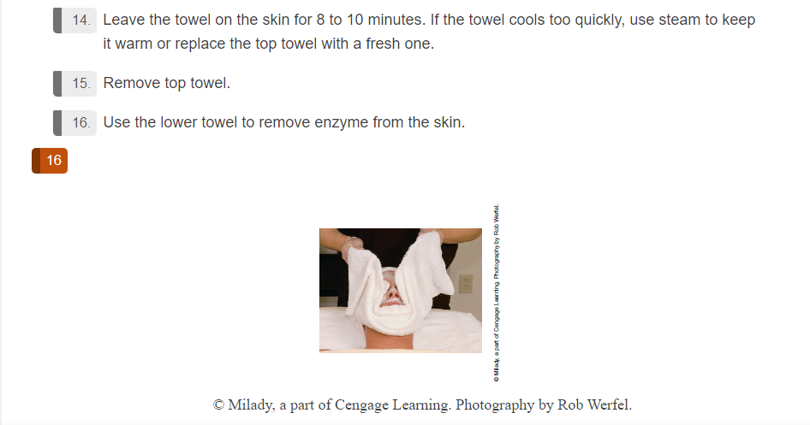

Slide 16
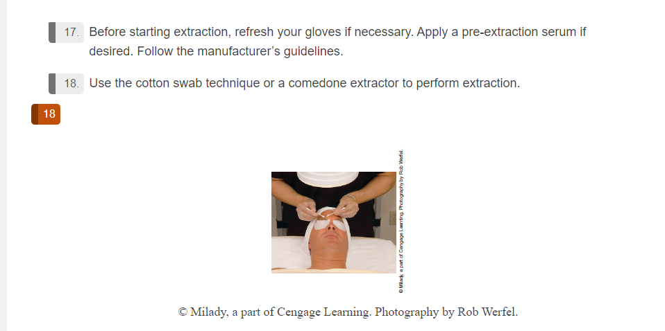

Slide 17
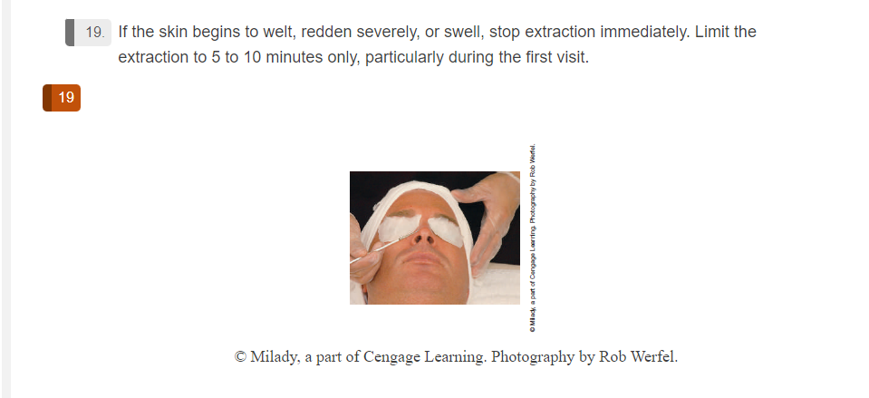

Slide 18
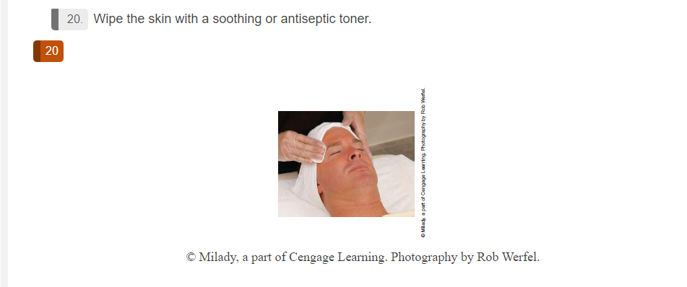

Slide 19
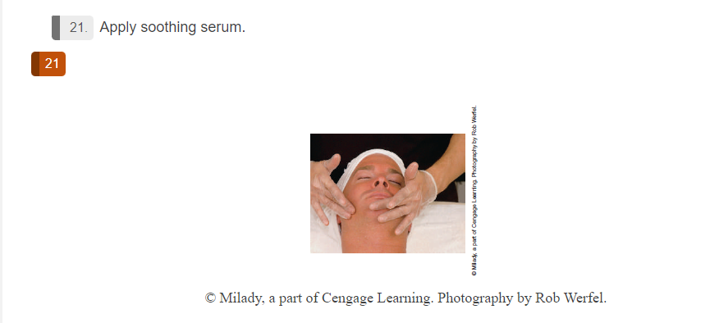

Slide 20
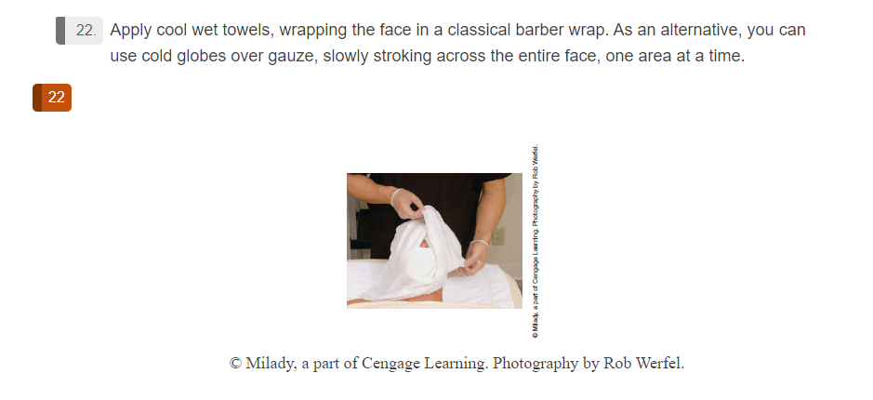

Slide 21
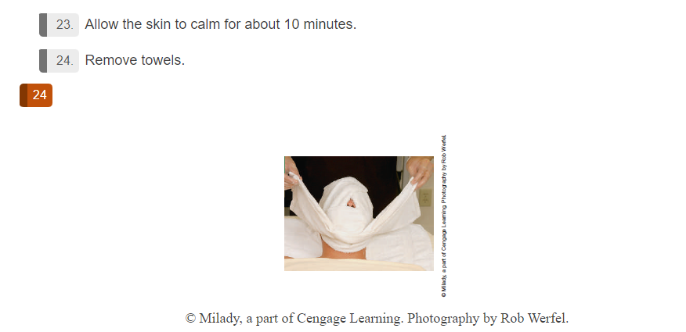

Slide 22
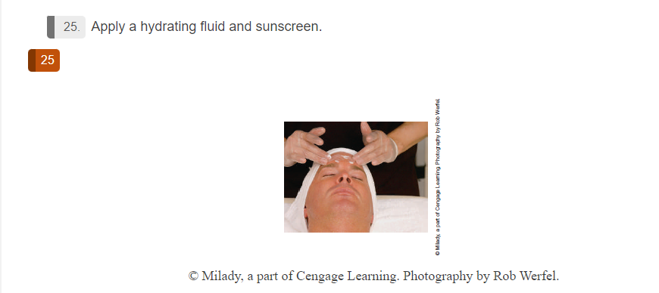

Slide 23
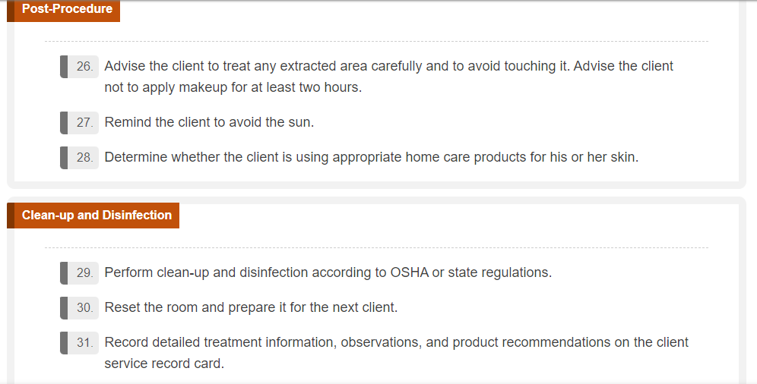

Slide 24

QUESTIONS?

