Slide 1
APPH 226:
Density
Objectives: 3.1-3.4, 4.3, 5.2, 5.4

Slide 2
Latent Image
Occurs immediately after exposure, but before processing
Invisible
This happens to all images, regardless of how it is acquired
  DR – digital radiography
  CR – computed radiography
  Film

Slide 3
Image Formation
How do we get it?
  Result of differential absorption of the x-ray beam
Differential absorption is:
  Process where some of the beam is absorbed and some is transmitted
  It’s called differential because the beam is not absorbed to the same degree over the entire area exposed

Slide 4
Differential Absorption
Creates an image that represents the structures of anatomy
  Results from the variation between absorption and transmission
When an image is created this way, several processes are required

Slide 5
Beam Attenuation
When the primary x-ray beam passes through tissue and loses some of its energy
  This reduction is known as attenuation
Attenuation consists of
  Absorption
  Scattering

Slide 6
Absorption
    Complete absorption of x-ray photon
    Inner shell electron ejected
      Photoelectron
    Outer shell electron drops to fill the spot
    Characteristic radiation emitted
      Low energy – usually remains in the body
    Atom is ionized

Slide 7
Scattering
  Incoming x-ray photon is not absorbed
  Ejects outer shell electron
    Compton electron, secondary electron
  X-ray photon loses energy, changes direction
    Can go onto interact with IR (image receptor)
    Can leave body

Slide 8
Scattered Photons
Why is this an issue?
If they reach the IR:
  Degrade image
  Contribute nothing useful to the image
  Also known as image fog

Slide 9
kVp and Image Fog
When kVp is increased, there are:
  Fewer interactions in total
  Increased amount of x-rays transmitted
  Increased Compton scattering
Scatter radiation creates unwanted exposure on the image called fog
  Does not offer any useful information

Slide 10
Scatter and Image Fog
Therefore when kVp is increased, the amount of fog is increased
  How is density affected?
    Increased fog will increase overall image density
  How is contrast affected?
    Increased fog leads to a decrease in contrast

Slide 11
Scattered Photons
If they are absorbed:
  Contribute to the patient’s radiation exposure and increases their dose
If they leave the body and don’t reach the IR:
  Contribute to the dose of anyone near the patient

Slide 12
Transmission
Defined as: the x-ray photon passes through to the image receptor
Amounts of absorption and transmission are varied
  Differential absorption

Slide 13
On the Image…
White
  Areas of Absorption
  Photoelectric Interactions
Black
  Transmission
  High radiographic density
Grey
  Mix of both absorption and transmission

Slide 14
Exponential Absorption
As x-rays pass through tissue, there is no fixed range to describe how far they go
Attenuated photons
For every increment of thickness, the x-rays are decreased in number, by a certain percentage
Never reaches zero

Slide 15
Factors
In order to select an optimal radiographic technique, three groups of factors must be considered:
  Image Quality factors
  Exposure Technique factors
  Patient factors

Slide 16
Distance and Density
SID
  Source to Image Distance
  Intensity changes with distance
    Inverse Square Law

Slide 17
SID
As the distance between the focal spot and the image receptor changes – the intensity of the radiation will change also
  You’ll notice as the distance is increased, the light covers a larger area

Slide 18
SID
What happens to the number of photons as the area is increased?
  The same number of photons
  Larger area means:
    Same number of photons covering a larger area, so less density

Slide 19
SID
What happens to the image?
  Because it is receiving less radiation, there will be less radiographic density
What if we have a very short SID?
  The reverse is true
  More photons in a smaller area – increased intensity
  More radiographic density

Slide 20
OID
Object to Image Distance
Increased OID allows less scatter to reach the IR
Increased OID, results in decreased radiographic density

Slide 21
Patient Factors
Most difficult
Large influence on radiographic technique
Requires experience and training on the part of the technologist

Slide 22
Body Habitus
Used to classify patients when discussing patient factors
Descriptors:
  Aesthenic – very slender
  Hyposthenic – between aesthenic and sthenic
  Sthenic - average
  Hypersthenic – larger body build

Slide 23
Thickness
Calipers
With increased thickness, how should exposure factors be adjusted?
Must increase factors
  Can change mAs or kVp
  In most situations, would choose to adjust mAs

Slide 24
Composition
What does the area consist of?
  Bone?
  Fluid?
  Fat?
  Muscle?
Additional judgment required
  Tissue thickness not linear due to many variables
  Atomic number and density of part
Chest vs. abdomen

Slide 25
General Rule of Technical Factors
Chest
  High kVp
Soft tissue
  Low kVp, high mAs
Bony extremities
  Low kVp

Slide 26
Pathology
Another patient factor to be considered
Radiographic technique needs to be adjusted in cases with known pathology
We will see cases with pathologies in clinical practice

Slide 27
Filtration
Three types:
  Inherent
  Added
  Compensating

Slide 28
Inherent Filtration
Glass or metal envelope
Collimator usually provides some additional filtration
Technologist has no control of this
Built into the unit
Designated amount by SC 35

Slide 29
Added Filtration
Can be adjusted or selected
Aluminum is the material most commonly used
Technique charts are based on units using the lowest allowable added filtration
  Set by the SC 35
When filtration is added, the technique must be adjusted to compensate
  Usually increase filtration for areas with high subject contrast
  Can decrease dose

Slide 30
Compensating Filters
Sole purpose is to balance the intensity of the x-ray beam to deliver a more uniform exposure to the IR, uniform density on image
Can be attached at the collimator
Can be placed on the patient, to even out the density.

Slide 31
More to keep in mind
Grids
Collimation
Generators

Slide 32
Grids
Device placed between patient and image receptor
Purpose
  Absorb scatter exiting the patient
Why do we use it?
  Improve image quality
  High ratio grid can absorb 80-90% of scatter

Slide 33
Grids and Density
How will a grid affect radiographic density?
  It will decrease the amount of density on the image
So then
  mAs must be adjusted when adding, removing or changing a grid.
  This is to maintain appropriate density.

Slide 34
Beam Restriction - Collimation
Collimation is
  Adjusted by the technologist
What does this affect?
  The amount of tissue being irradiated
  The amount of scatter reaching the image receptor
What does this mean for density?
  Less scatter reaching the image receptor results in decreased radiographic density (collimating the area of the beam)

Slide 35
Generators and Density
Exposure techniques (technical factors) that we use are developed based on the type of generator in the room.
Generator output (voltage)- efficiency of the generator

Slide 36
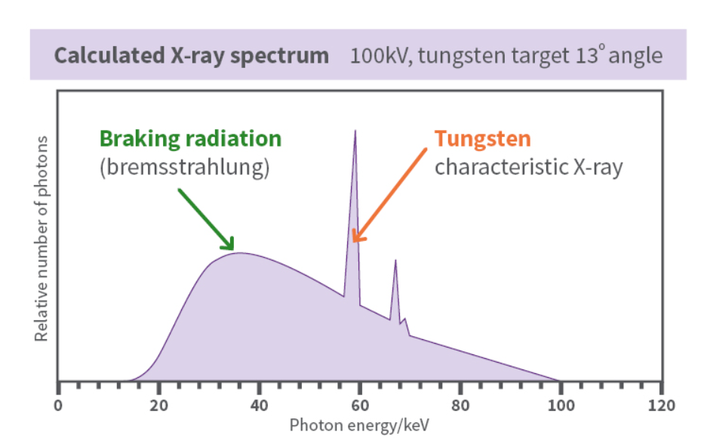
Emission Spectrum – energy distribution of the radiation produced in an x-ray exposure
https://www.arpansa.gov.au/understanding-radiation/what-is-radiation/ionising-radiation/x-ray

Slide 37
Emission Spectrum
If the generator output (voltage) is more efficient, what happens to the quantity of x-ray photons?
  there will be more x-ray photons
With increased generator output, what will happen to the average energy of the photons?
  the average energy will be higher

Slide 38
Emission Spectrum – energy distribution of the radiation produced in an x-ray exposure (generator, kVp and filtration)
When filtration is added, low energy photons are removed
If photons are removed, what happens to the emission spectrum?
  The amplitude will decrease (amplitude = quantity)
If the low energy photons are removed, what happens to the average energy of the photons?
  The average energy will increase
If the average energy is affected, what will the emission spectrum look like?
  The peak will move to the right

Slide 39
Readings
Bushong: Radiologic Science for Technologists, 11th ed.
  Pg 54-55 (Inverse Square Law)
  Pg 131 (Effect of added filtration)
  Pg 132 (Effect of voltage waveform)
  Pg 136-143 (don’t worry about HVL)
  Chapter 9
  Pg 187-195 (up until Grids)
  Pg 240-246

