Slide 1


Medical Esthetics
Dermatitis

Slide 2
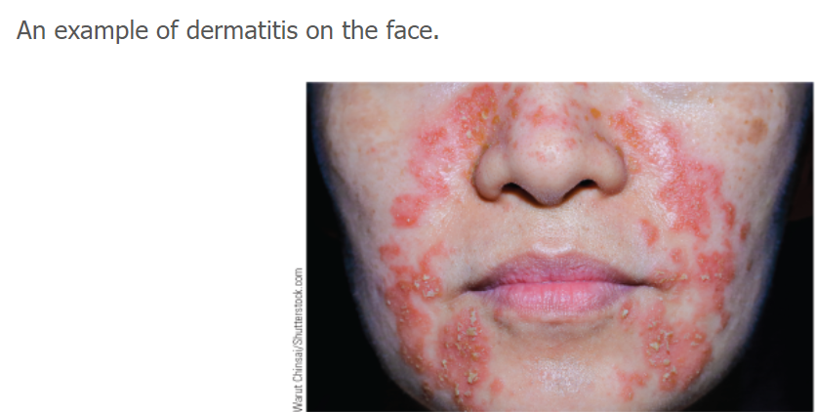
Dermatitis is a generalized term to refer to an inflammatory condition of the skin; various forms include lesions such as eczema, vesicles, or papules . Dermatitis has many forms, and symptoms of one form can be confused with symptoms of another form. Referral to a medical professional is recommended for appropriate diagnosis.

Slide 3
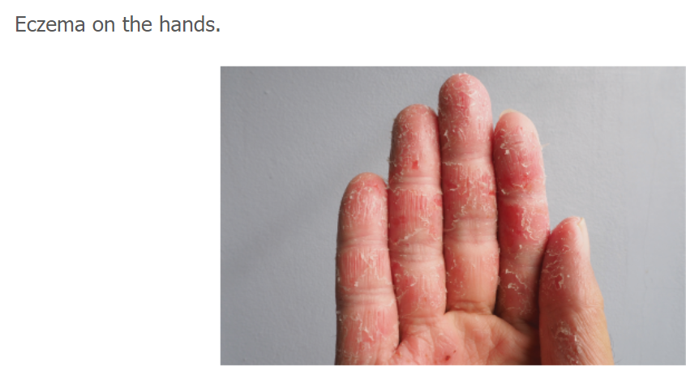
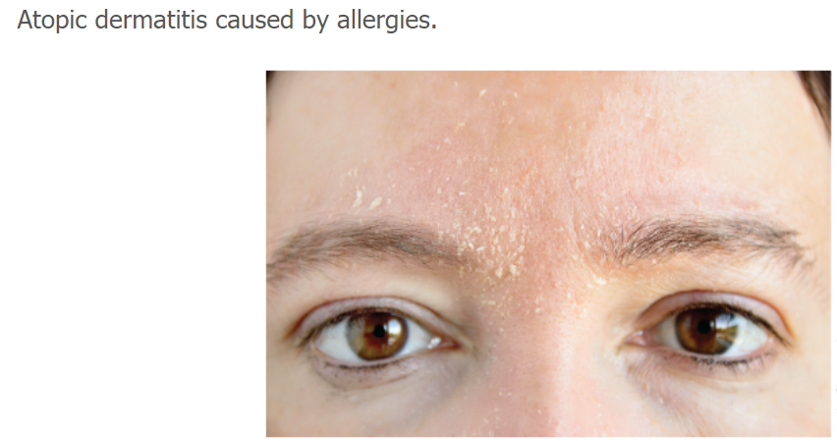
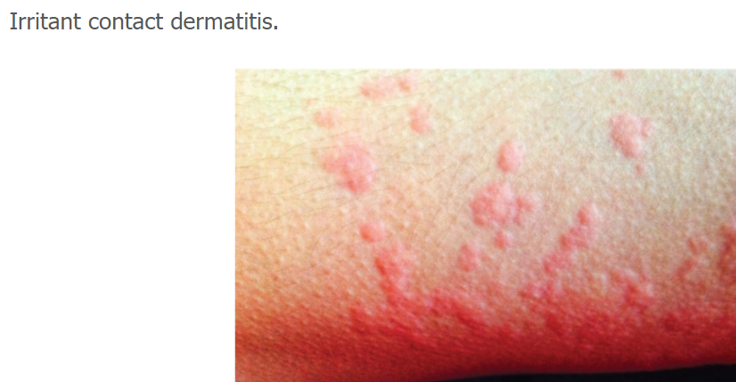
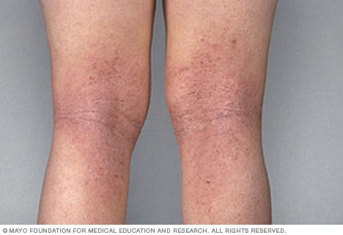
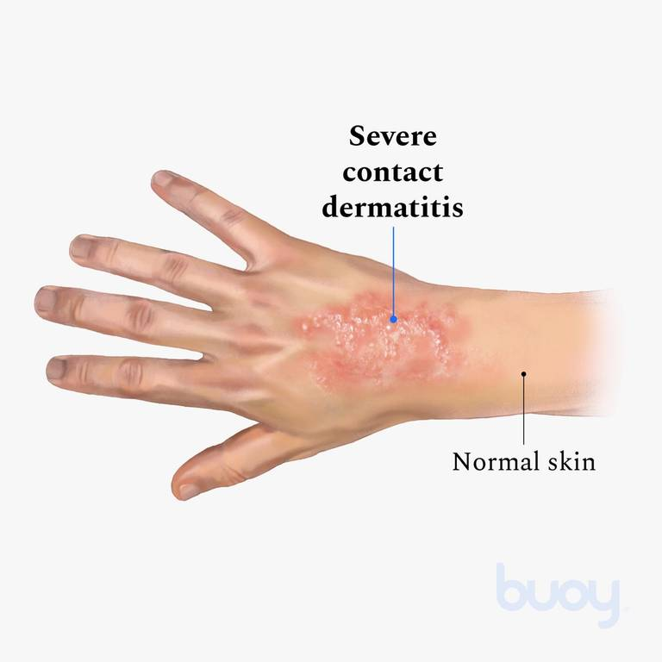
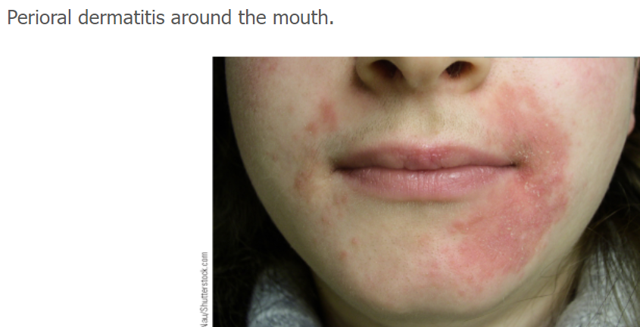
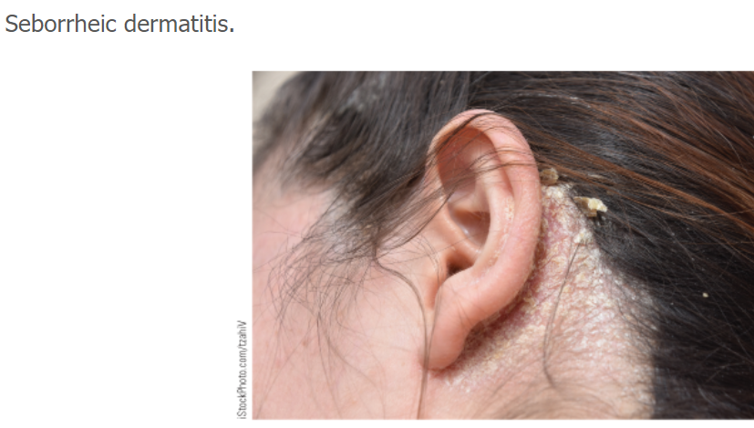
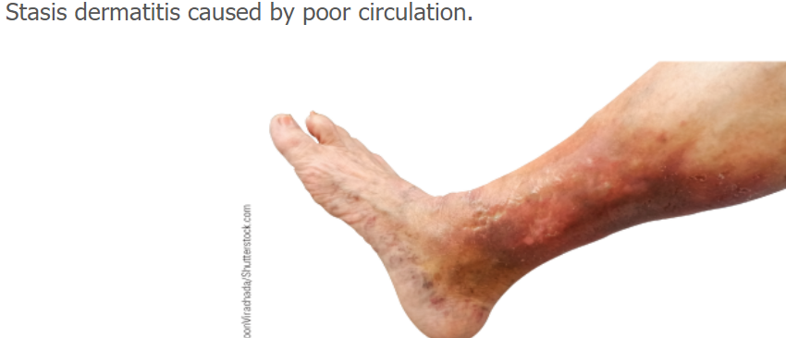
Types of dermatitis or inflammations of the skin include the following:

Slide 4

Watch :
Dermatitis: What Type Do You Have?
Dermatology - Inflammatory Skin Conditions

Slide 5

QUESTIONS?

