Slide 1
MRAD 204:
Radiographic Technique 1
Outcome 1-5:
Image Critique – Elbow & Humerus

Slide 2
Affiliated Readings
Bontrager
Pgs: 164→170
Pgs: 187 → 188
Emphasis on the “pink box” Evaluation Criteria

Slide 3
Overview
Elbow – image critique
Humerus – image critique
Tips & Tricks

Slide 4
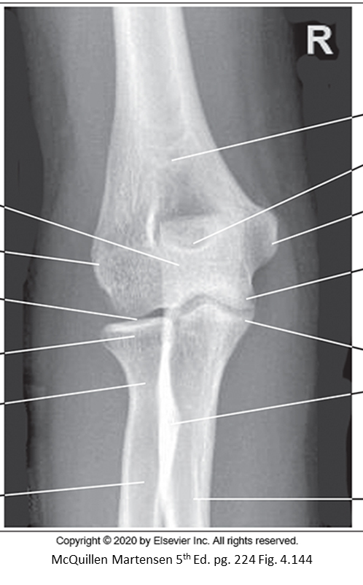
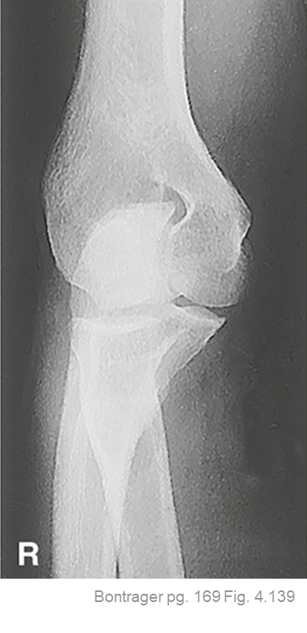
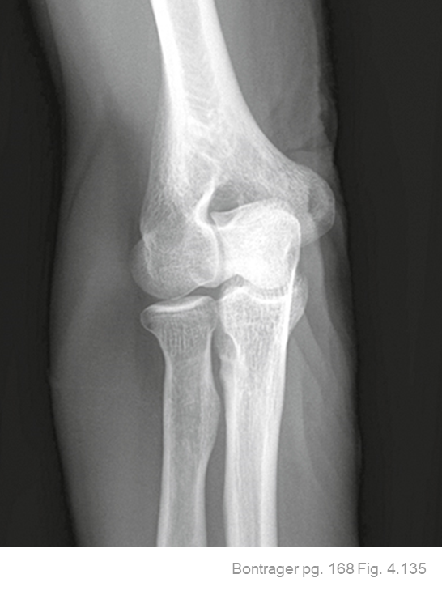
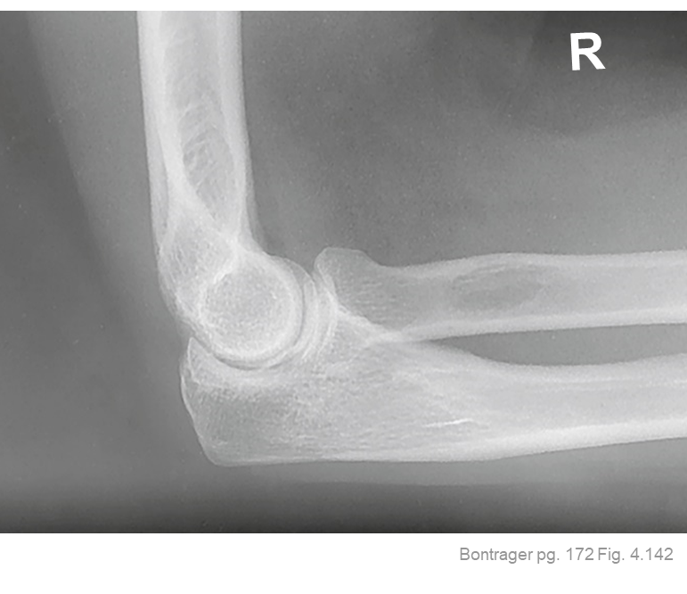
Image Critique – Routine Elbow Projections
Note: hanging protocol
R
R
Anatomy
Ideally, ALL elbow radiographs should display:
1/3rd of the proximal radius and ulna (to include radial tuberosity)
Soft-tissue
~¼ Distal humerus
Elbow joint

Slide 5
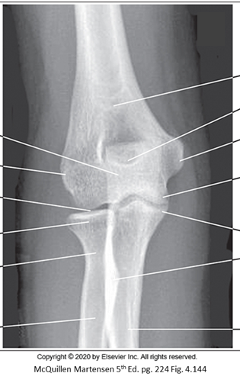
Image Critique – Routine Elbow Projections
R
R
Exposure & Technique
ALL routine elbow radiographs should display:
kVp range of 65→75
Optimal density and contrast:
  no motion (i.e. blur)
  soft tissue margins visible
  clear bony trabecular markings

Slide 6
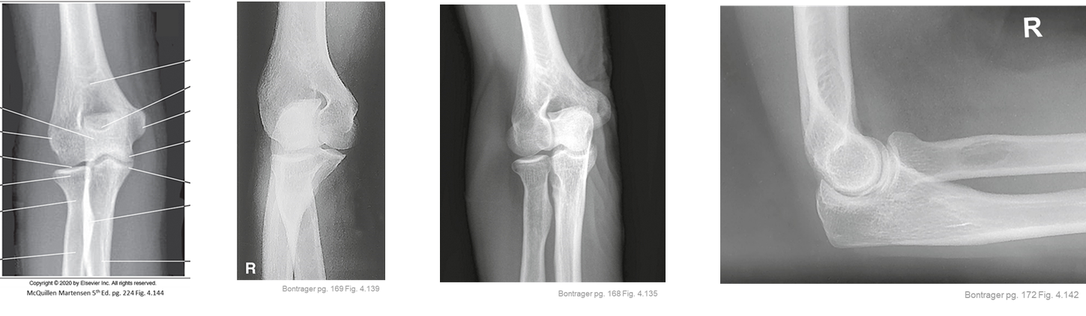
Image Critique – Routine Elbow Projections
Marker Placement &/or artifacts
Marker placement; not obscuring anatomy of interest
AP, & AP Oblique’s (with Internal & External Rotation)
  Lateral side
Lateral
  Anterior side
No removable artifacts are visible
R
R

Slide 7
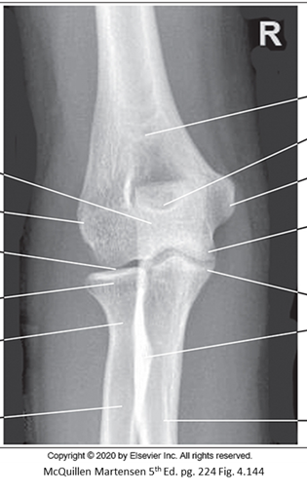
Image Critique – AP Elbow
Position
@ 65 kVp
Slight superimposition of radial head, neck & tuberosity, over the proximal ulna
Humeral epicondyles in profile
Open elbow joint
Olecranon process within the olecranon fossa
Anatomy aligned parallel to IR
R

Slide 8

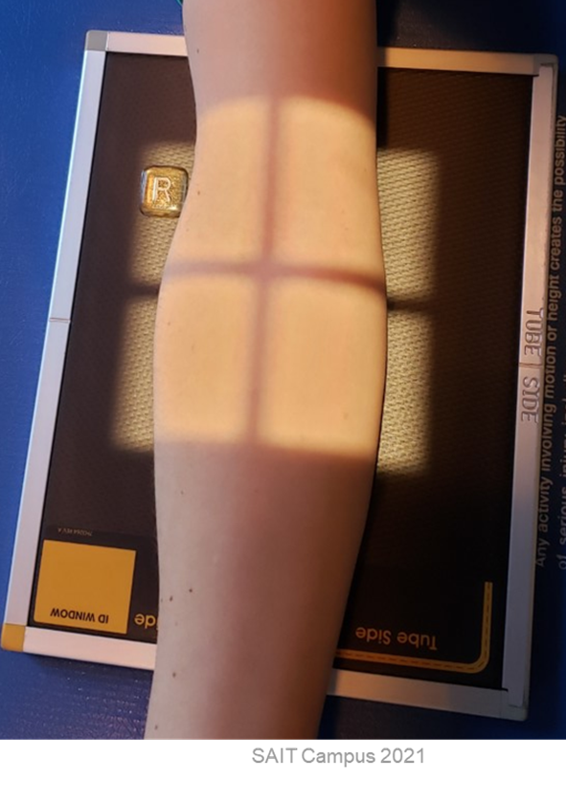
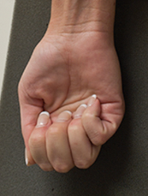
Image Critique – AP Elbow
CR & Collimation
Four sided collimation centered to mid-elbow joint
R

Slide 9
Image Critique – AP Elbow: Internal Rotation
Position
@ 65 kVp
Coronoid process in profile & free of superimposition
Radial head & neck centered over posterior portion of proximal ulna
Medial epicondyle and trochlea elongated and in partial profile
Olecranon process within the olecranon fossa
Anatomy aligned parallel to IR
R

Slide 10
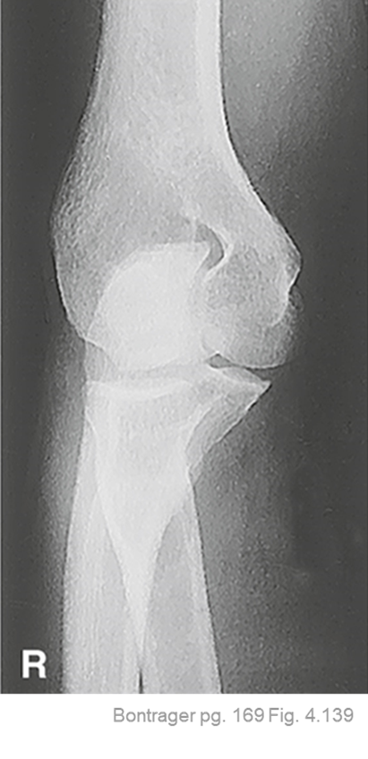
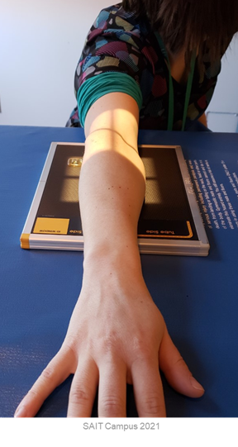
Image Critique – AP Elbow: Internal Rotation
CR & Collimation
Four sided collimation centered to mid-elbow joint

Slide 11

Image Critique – AP Elbow: External Rotation
Position
@ 65 kVp
Lateral epicondyle & capitulum in partial profile and elongated
Radial head, neck, and tuberosity free of superimposition by the ulna
Olecranon process within the olecranon fossa
Anatomy aligned parallel to IR
R

Slide 12
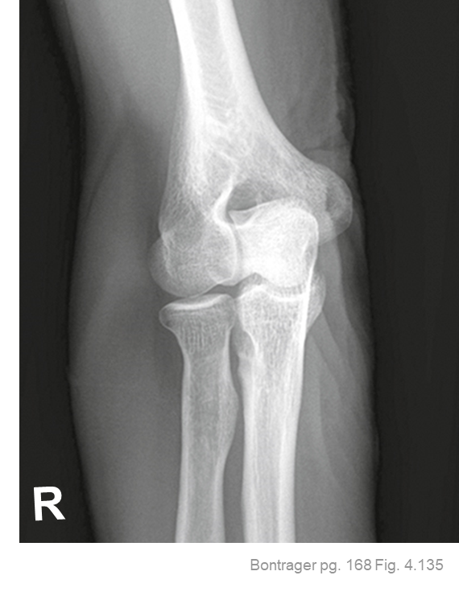
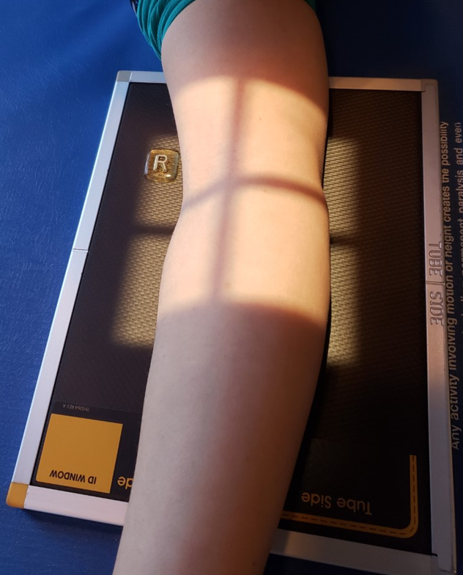
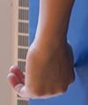
Image Critique – AP Elbow: External Rotation
CR & Collimation
Four sided collimation centered to mid-elbow joint

Slide 13

Image Critique – Lateral Elbow
Position
Superimposed humeral epicondyles
Radial tuberosity superimposed over radial shaft
½ of radial head superimposing the coronoid process
Olecranon process seen in profile
90⁰ Elbow flexion
@ 65 kVp

Slide 14

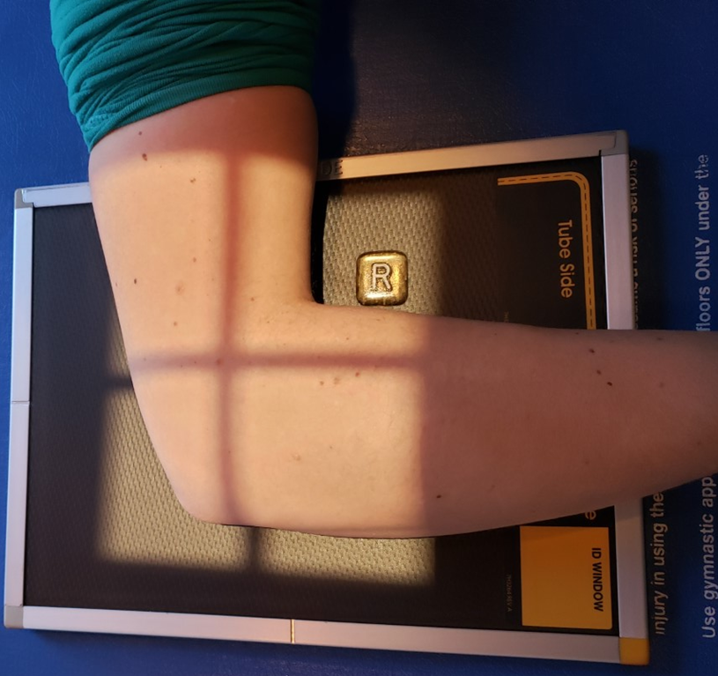
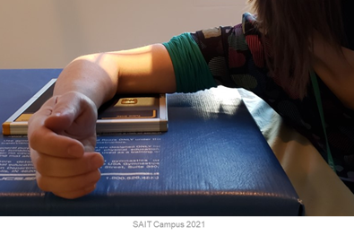
Image Critique – Lateral Elbow
CR & Collimation
Four sided collimation centered to mid-elbow joint

Slide 15
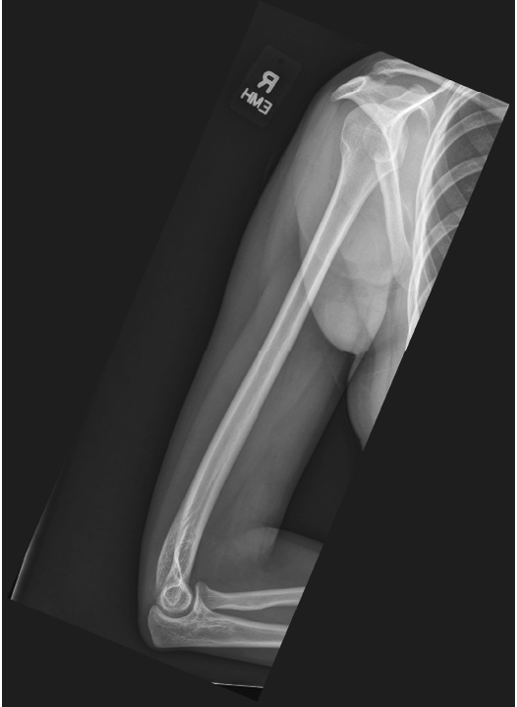
Image Critique – Routine Humerus Projections
Ideally, both projections should include:
Entire humerus
Elbow joint
Soft tissue
SAIT MRT Image Critique Handbook
Bontrager pg. 188 Fig. 5.33
Shoulder joint
L
Anatomy
15⁰

Slide 16
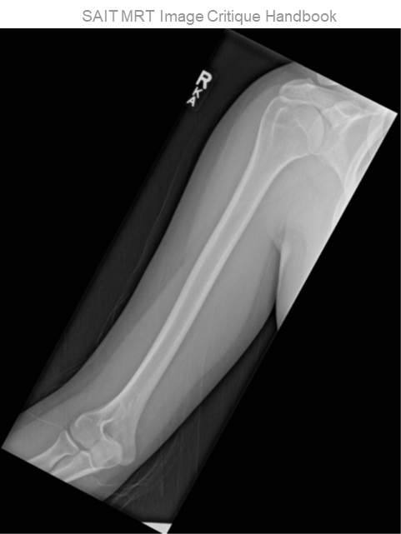
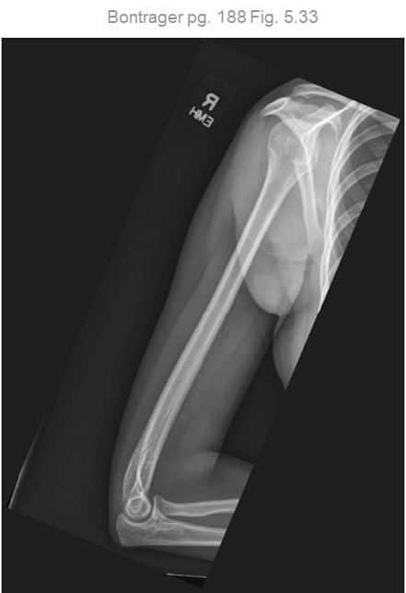
Image Critique – Routine Humerus Projections
Both routine humerus radiographs should display:
kVp range of 70→85
R
Optimal density and contrast:
  no motion (i.e. blur)
  soft tissue margins
  bony trabeculae
Exposure & Technique

Slide 17
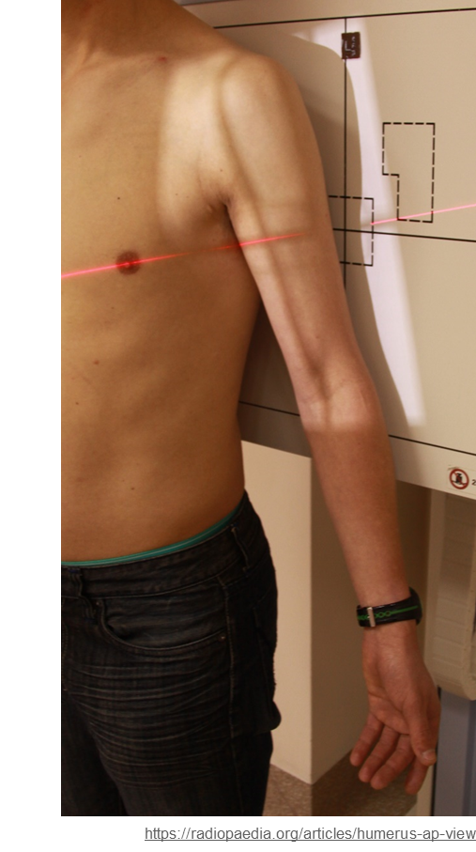
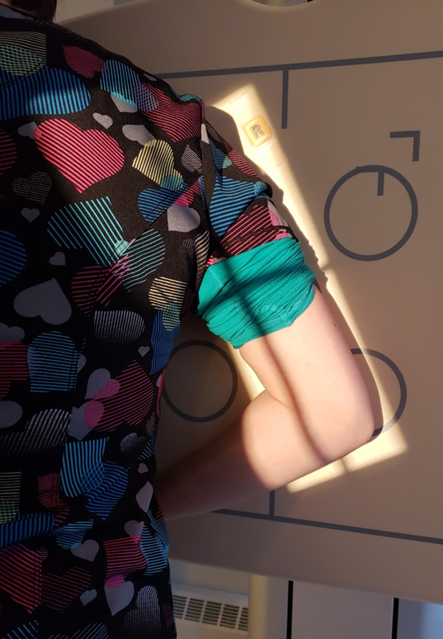
Image Critique – Routine Humerus Projections
CR & Collimation
R
Four sided collimation centered to mid-humerus

Slide 18
Image Critique – Routine Humerus Projections
Marker Placement &/or artifacts
Marker placement; not obscuring anatomy of interest
AP = Lateral side
Lateral = Posterior side
SAIT MRT Image Critique Handbook
Bontrager pg. 188 Fig. 5.33
No removable artifacts are visible
L
15⁰

Slide 19
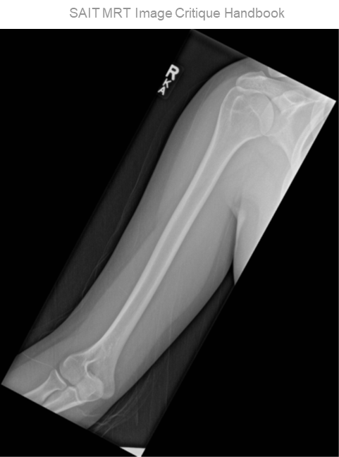
Image Critique – AP Humerus
@ 70 kVp
Position
Epicondyles in profile
Greater tuberosity and humeral head in profile
Minimal superimposition of glenoid cavity and humeral head
Collimation “tilt” parallel to length of anatomy

Slide 20

Image Critique – Lateral Humerus
@ 70 kVp
Position
Superimposed epicondyles
Lesser tuberosity shown in profile medially
Collimation “tilt” parallel to length of anatomy

Slide 21
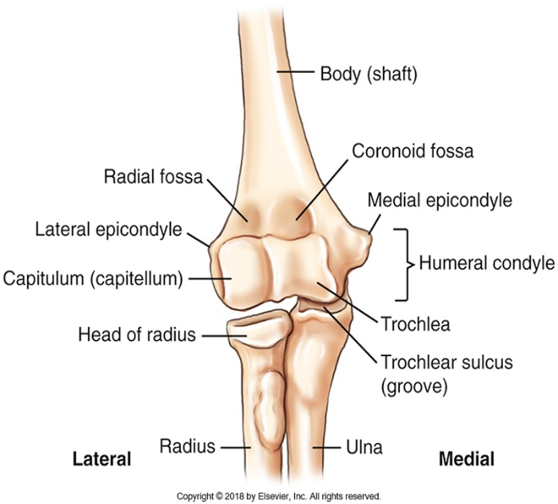
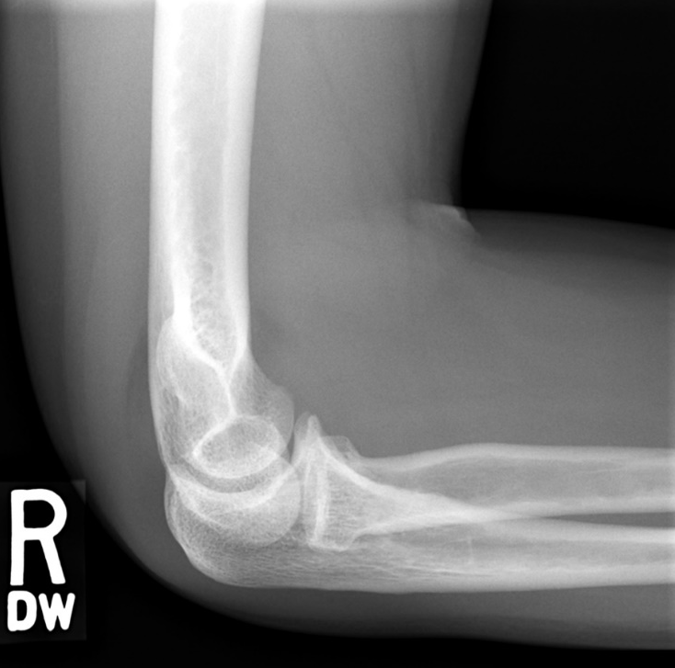

Tips & Tricks
Lateral elbow critiques #1:
Capitulum articulates with the proximal radius (head of radius)
Trochlea of the humerus articulates with the proximal ulna
  Superimposition = no articulation = no joint space
SAIT imaging library
SAIT imaging library
Bontrager pg. 131 Fig. 4.16

Slide 22
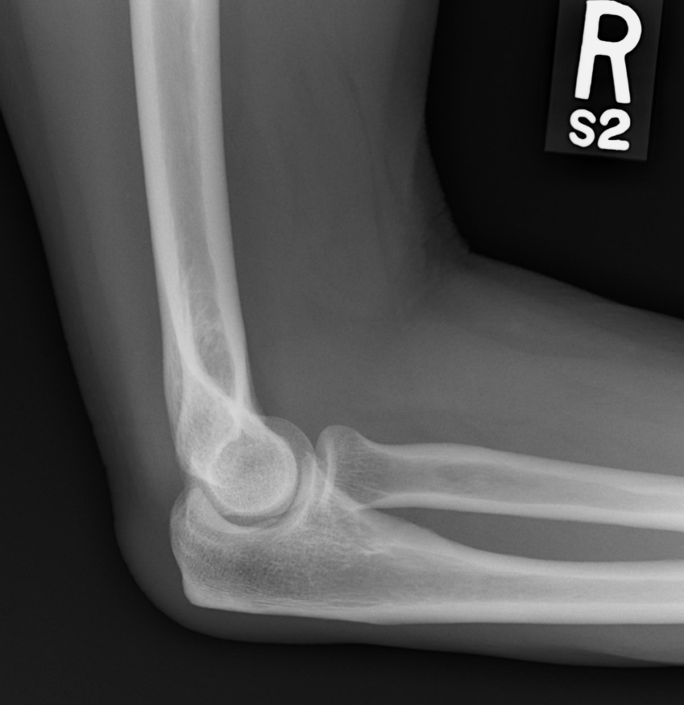

Tips & Tricks
Lateral Elbow critiques #2:
Recall position of the capitulum = lateral side
Trochlea = medial side
Anterior/Posterior position of the capitulum in relation to the trochlea = wrist elevated/depressed. Wrist is depressed on this image.
Superior/Inferior position of the capitulum in relation to the trochlea = shoulder elevated/depressed. Shoulder elevated on this image.
Capitulum projected anterior to trochlea = wrist was depressed below elbow
Wrist
Shoulder
VS
Capitulum projected inferior to trochlea = shoulder was elevated above elbow
SAIT imaging library
SAIT imaging library

Slide 23
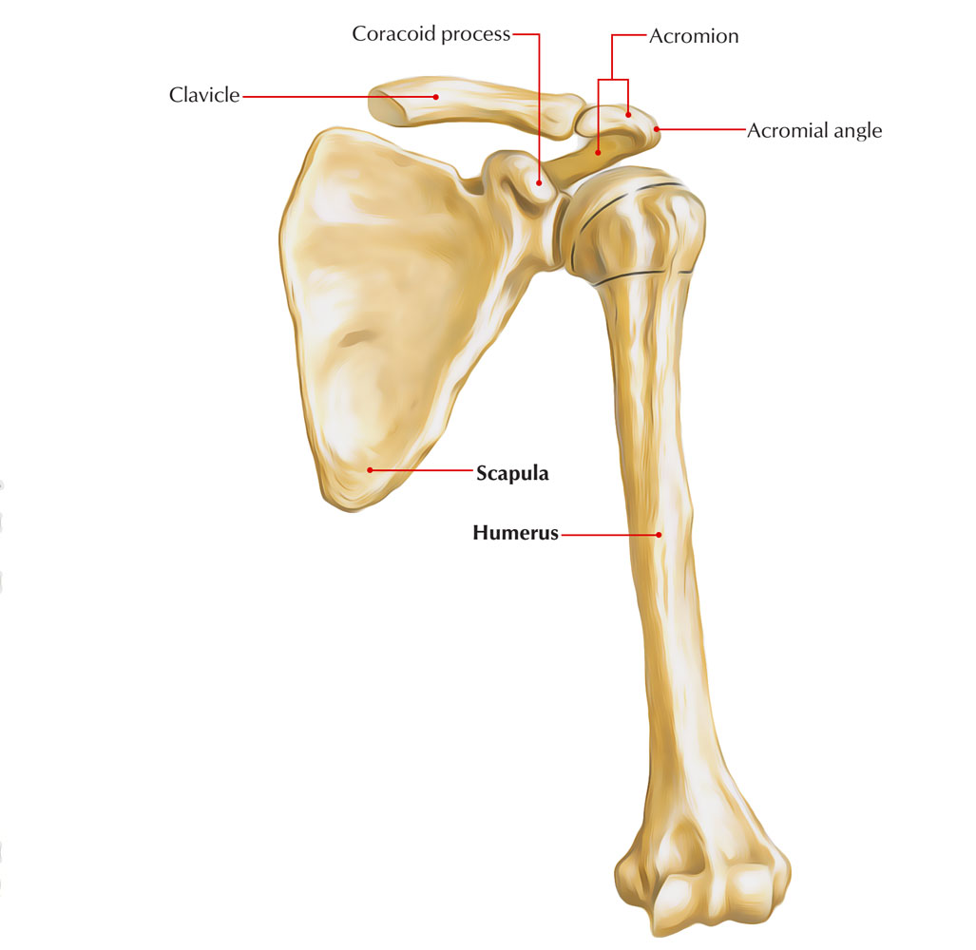
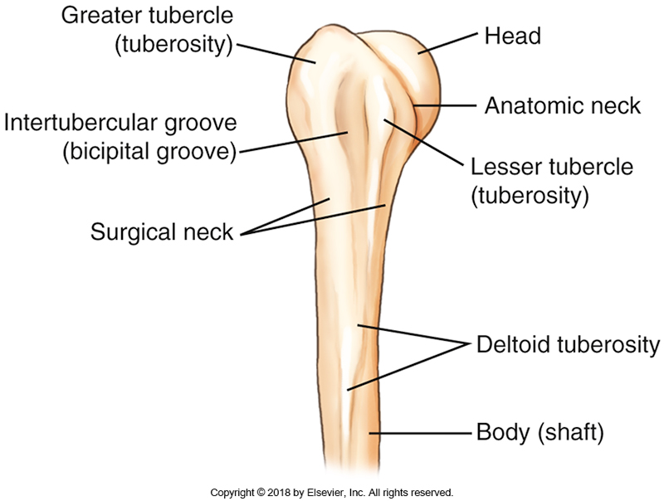
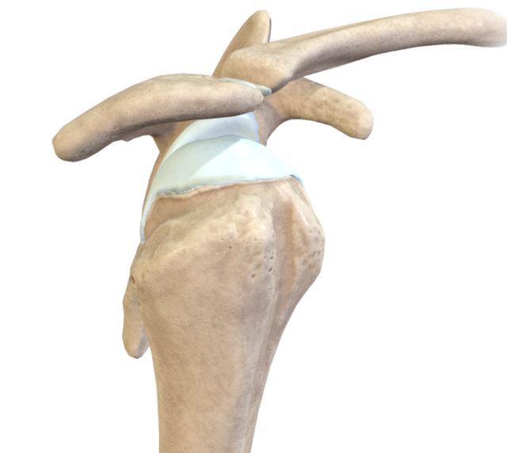
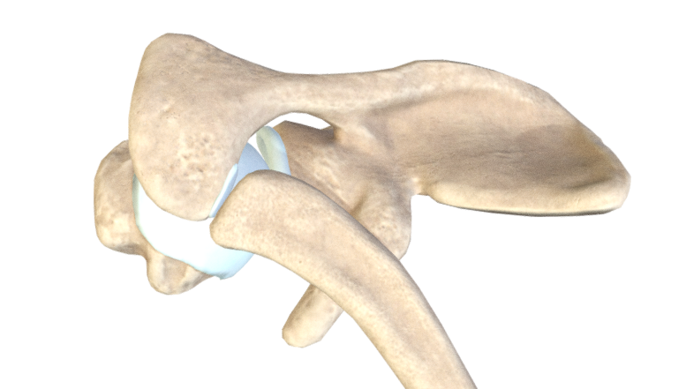
Tips & Tricks
Proximal Humerus critiques #1:
Greater tubercle/tuberosity is superior to the lesser tubercle
Lesser tubercle/tuberosity is always closest to the coracoid process
https://sketchfab.com/3d-models/bony-elements-of-the-glenohumeral-joint-577fc05f069046d6a5759633587d5119
AP
Lateromedial
Superoinferior
https://www.earthslab.com/wp-content/uploads/2017/07/Scapula-intro-front.jpg
Bontrager pg. 178 Fig. 5.2

Slide 24
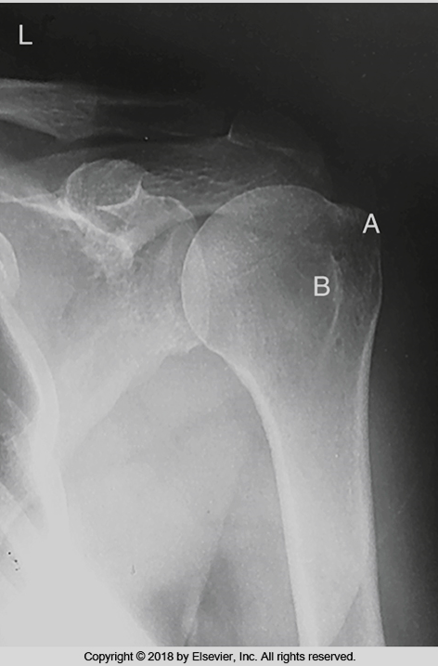
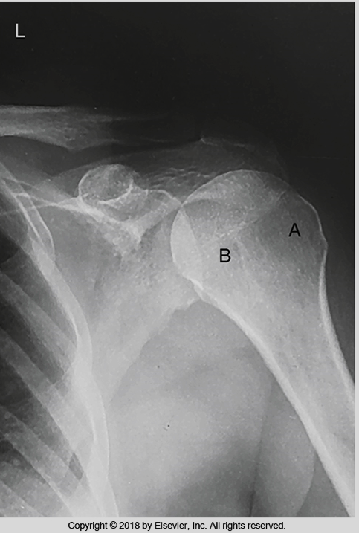
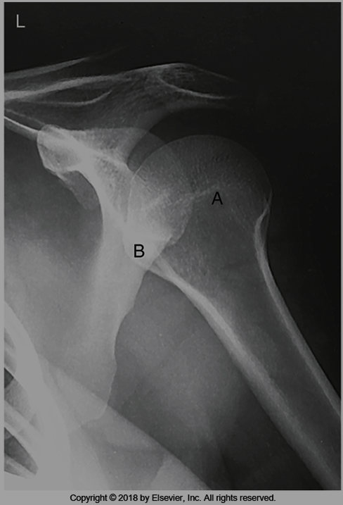
Tips & Tricks - Humerus
Greater tubercle superimposing humeral head = A (internal rotation, back of hand to femur)
Lesser tubercle in profile medially = B
Greatest amount of glenoid fossa superimposition
Greater tubercle lateral = A (external rotation, palm facing forward, anatomical)
Lesser tubercle medial = B
Greater tubercle anterior = A (neutral rotation, palm facing femur, side of body)
Lesser tubercle medial = B
Bontrager pg. 183 Fig 5.16, 5.18 & 5.20
Notes:
Lesser tubercle is always medial – but in profile medially with internal rotation
Greater tubercle is in profile laterally on external rotation
Note: obvious “bump” when greater tubercle is in profile laterally with external rotation
With neutral rotation the humeral head looks fairly rounded, with a general greater tubercle superimposition on the anterior side
With internal rotation their becomes a more obvious “lump” on the media side

Slide 25
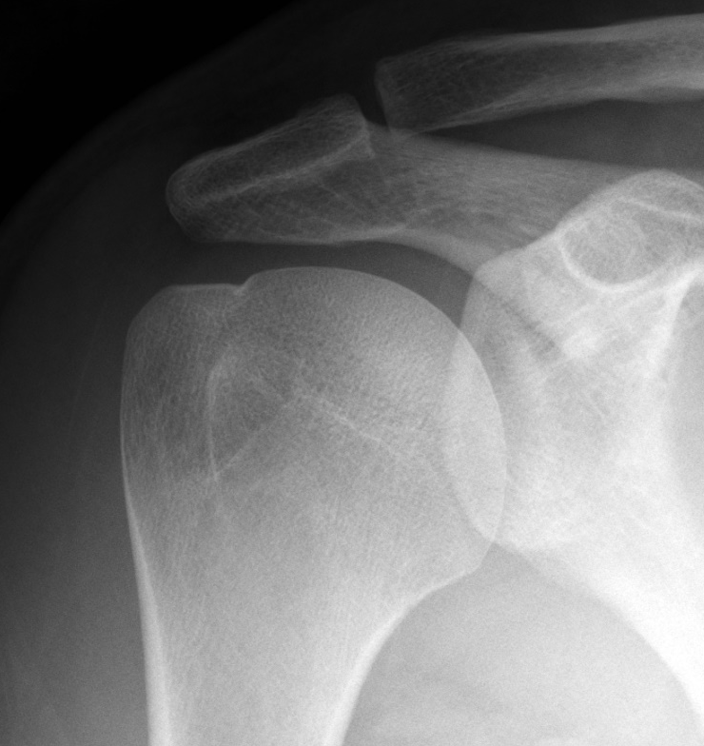
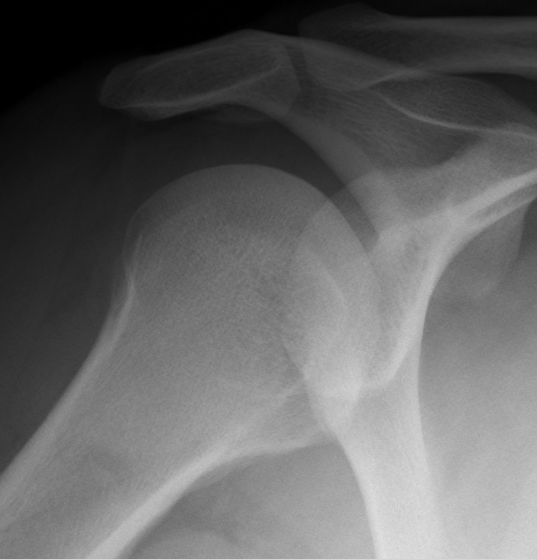
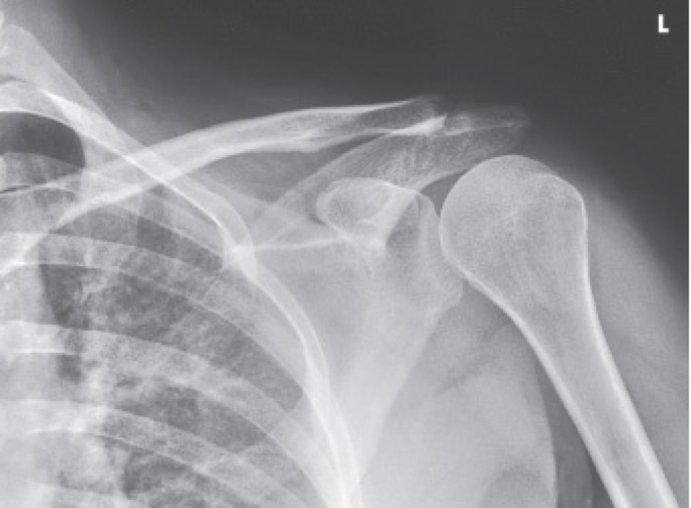
Tips & Tricks – Which is Which?
Proximal Humerus critiques #2:
Remember anatomical relationships
https://quizlet.com/241427979/ap-shoulder-neutral-rotation-diagram/
Sait Imaging Library
Sait Imaging Library
Note appearance of greater and lesser tubercles as the humerus is rotated

