Slide 1


Medical Esthetics
Accessory Organ to the Skin

Slide 2
The Integumentary System
Did you know? of all your organ systems, you know your integument the best! It has 5 accessory organs and they are the following

Slide 3
Skin
The human skin weighs approximately 9 pounds
The skin has the largest surface area of any organ
The word integument means a natural covering. So, you can think of the skin as a protective overcoat for your body against the outside elements that you encounter every day such as germs, chemicals, and sun exposure
Holds in moisture, and fixes small cuts and burns.
Regulate body temperature, and signals from its sensory receptors help the brain assess what’s going on in the outside world.
Human skin also makes cholecalciferol, a precursor of vitamin D

Slide 4
Oil glands (or sebaceous glands)
Are everywhere except on the palms and the soles of the feet. The oily substance they release, called sebum, softens and lubricates the hair and skin. Other secretions kill harmful bacteria.

Slide 5
Sweat Glands
When the body becomes warm, sudoriferous glands produce sweat to cool the body. Sweat glands develop from epidermal projections into the dermis and are classified as merocrine glands; that is, the secretions are excreted by exocytosis through a duct without affecting the cells of the gland. There are two types of sweat glands, each secreting slightly different products.

Slide 6
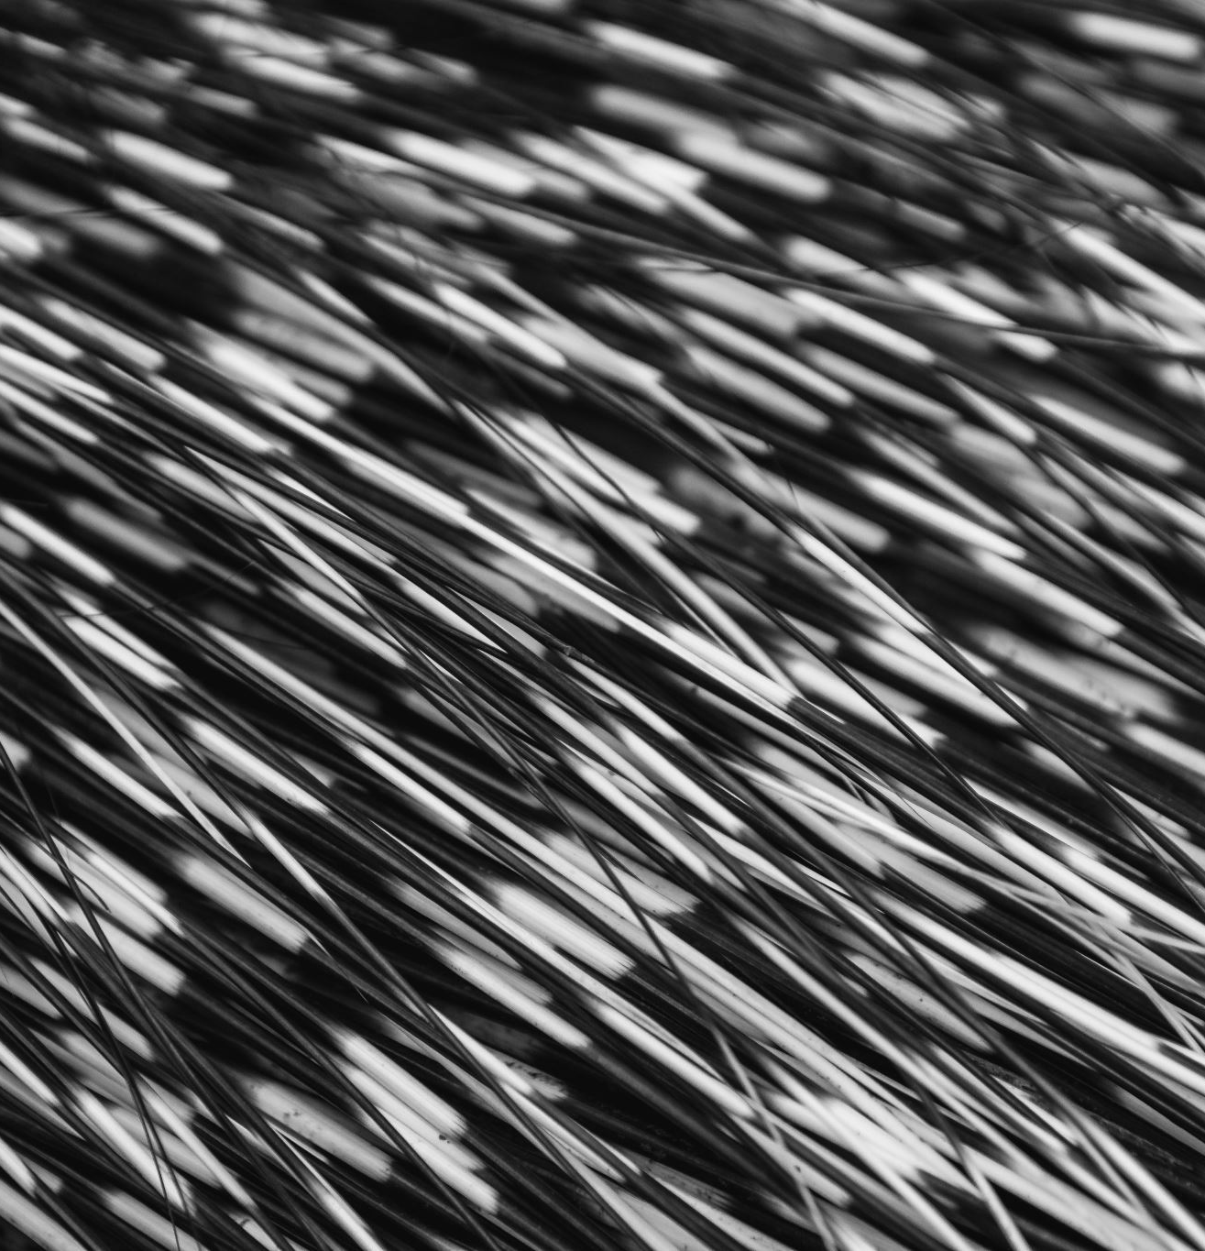
Hair
.
t is primarily made of dead, keratinized cells. Strands of hair originate in an epidermal penetration of the dermis called the hair follicle. The hair shaft is the part of the hair not anchored to the follicle, and much of this is exposed at the skin’s surface. The rest of the hair, which is anchored in the follicle, lies below the surface of the skin and is referred to as the hair root. The hair root ends deep in the dermis at the hair bulb, and includes a layer of mitotically active basal cells called the hair matrix. The hair bulb surrounds the hair papilla, which is made of connective tissue and contains blood capillaries and nerve endings from the dermis

Slide 7
Nails
The nail bed is a specialized structure of the epidermis that is found at the tips of our fingers and toes. The nail body is formed on the nail bed and protects the tips of our fingers and toes as they are the farthest extremities and the parts of the body that experience the maximum mechanical stress. In addition, the nail body forms a back-support for picking up small objects with the fingers.

