Slide 1


Microdermabrasion by Type of Device

Slide 2
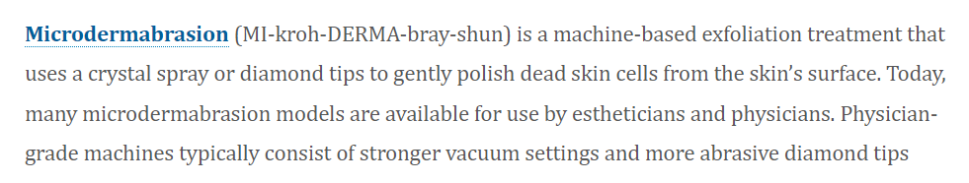

Slide 3
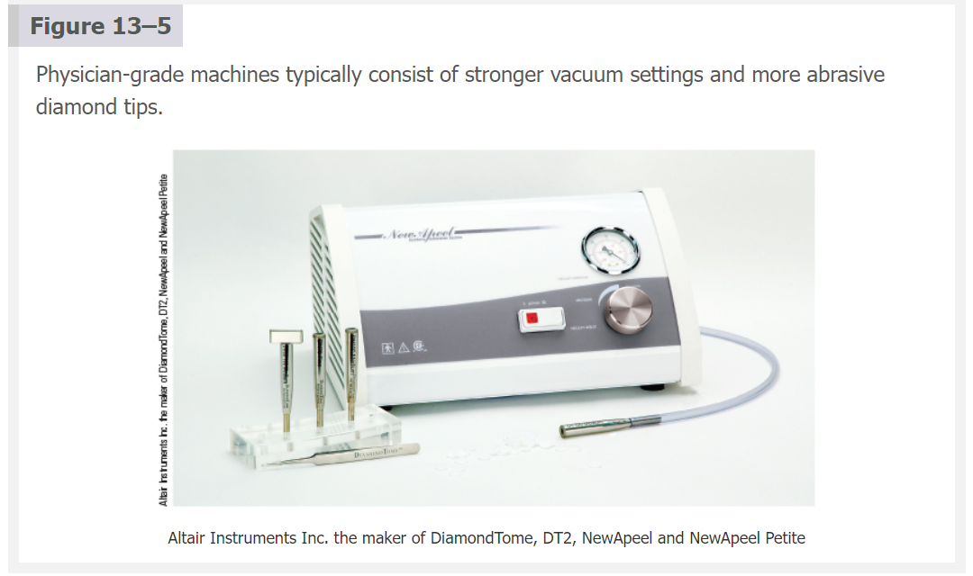

Slide 4
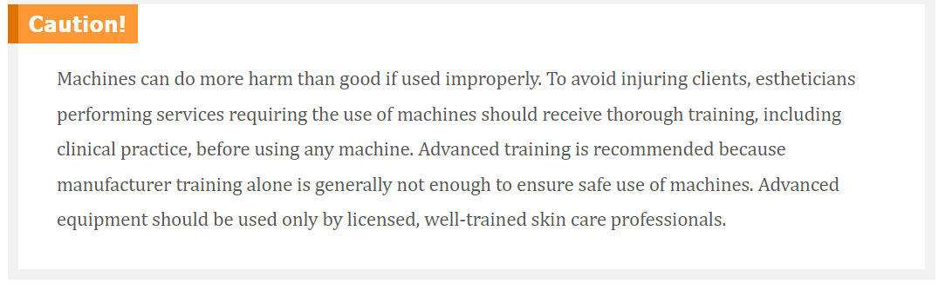

Slide 5
Crystal Microdemabrasion
The crystal microdermabrasion procedure is achieved by spraying high-grade microcrystals, composed of corundum powder, aluminum oxide, or a similar abrasive material across the skin’s surface through a hand piece.
The crystal microdermabrasion technique is similar to running the vacuum/suction machine across the face. Crystals are first sprayed on the skin through the hand piece, and then are vacuumed off simultaneously
Crystals can also be used manually without the machine—this process is considered gentler on the skin and is called manual microdermabrasion.

Slide 6

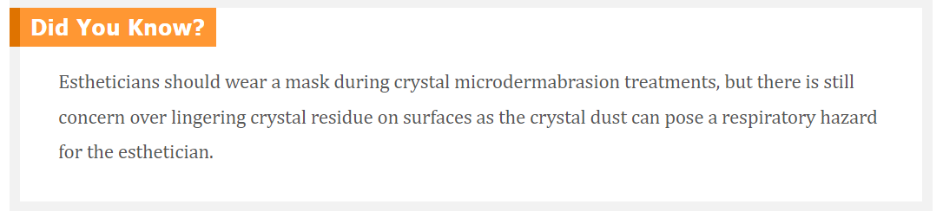

Slide 7
Crystal-Free Microdemabrasion
The crystal-free microdermabrasion technique consists of a diamond-tip applicator that gently polishes away the upper layers of the skin without the use of messy crystals and has gained popularity over the crystal option as it yields the same results without the clean-up or expense of crystals

Slide 8
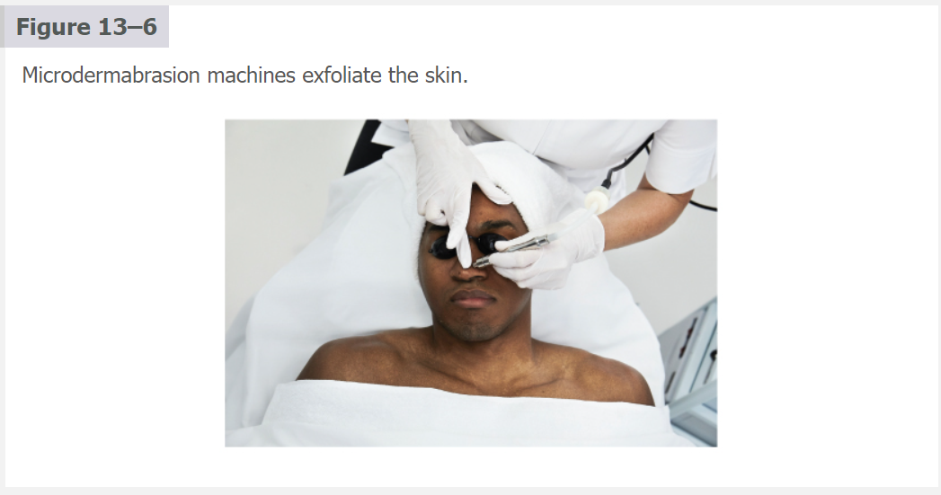

Slide 9
Procedure 13-4:Perform
Crystal-Free
Microdermabrasion
(Diamond Tip)

Slide 10
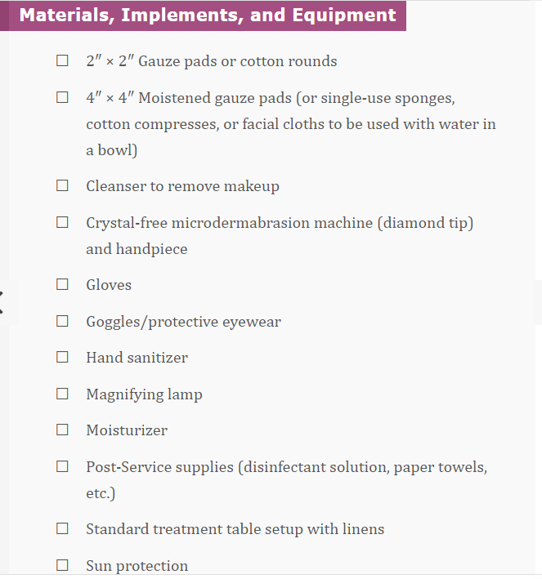

Slide 11
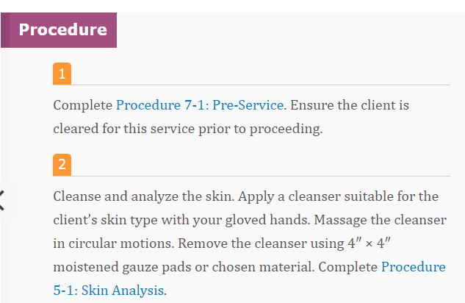

Slide 12
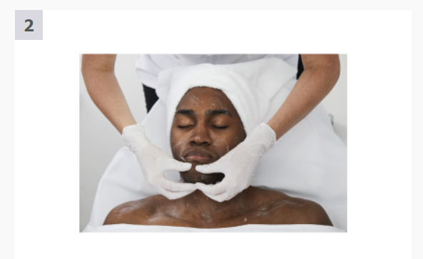

Slide 13
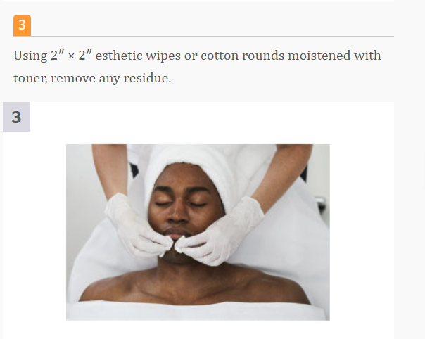

Slide 14
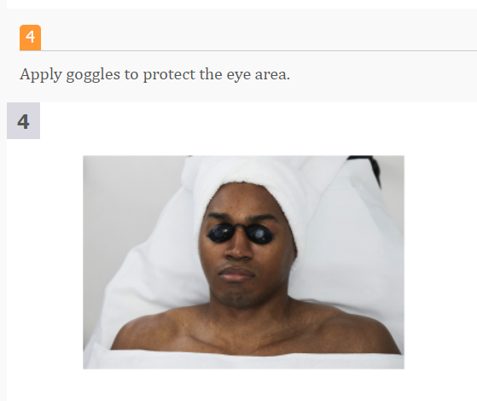

Slide 15
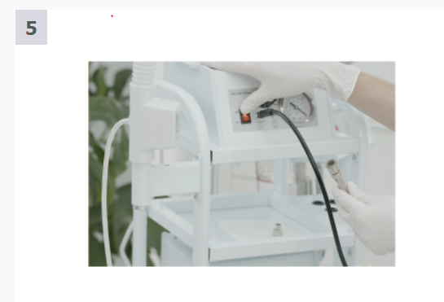

Slide 16
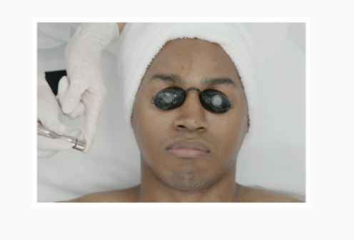

Slide 17
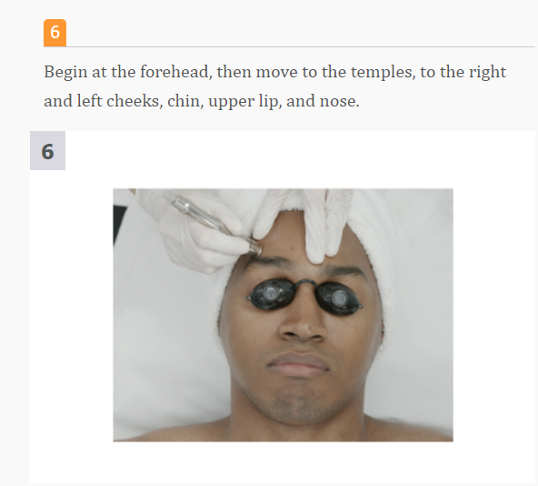

Slide 18
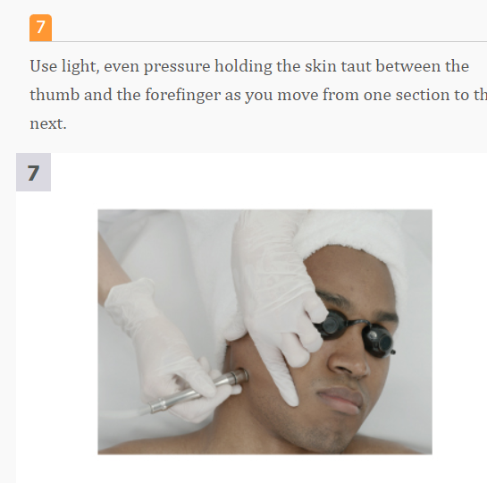

Slide 19
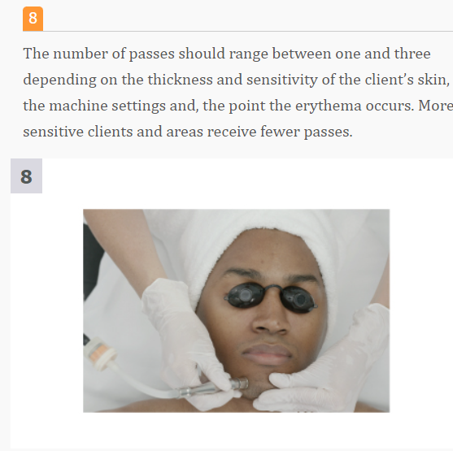

Slide 20
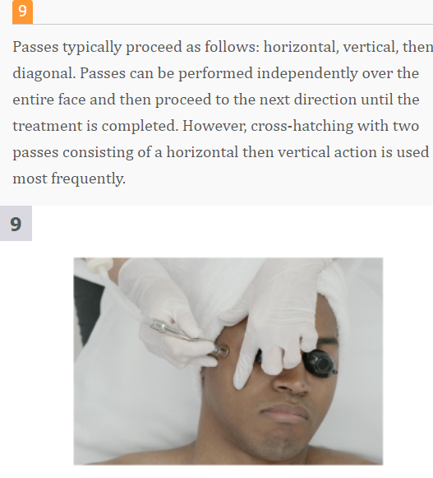

Slide 21
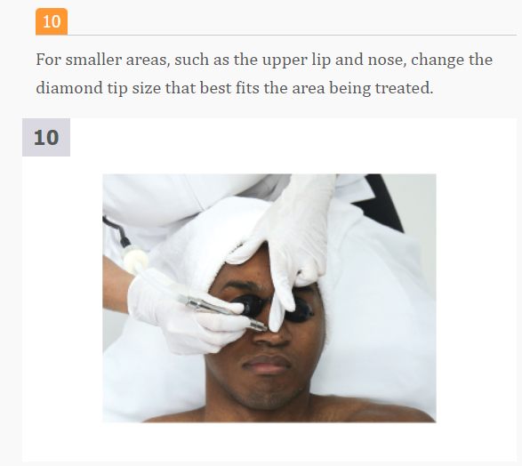

Slide 22
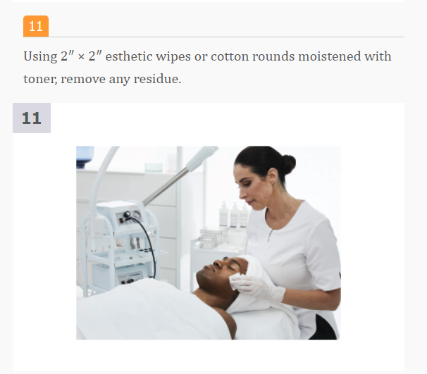

Slide 23
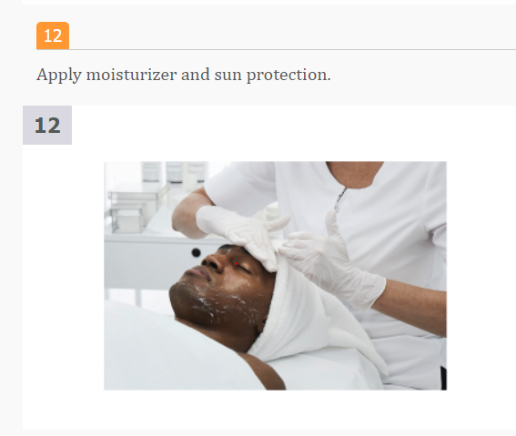

Slide 24
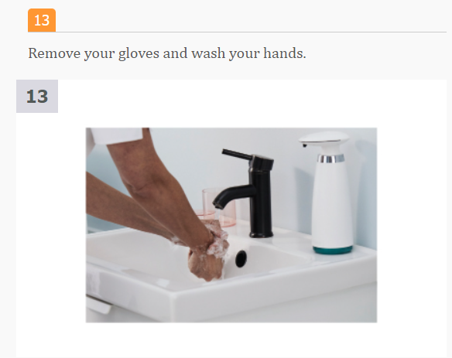

Slide 25
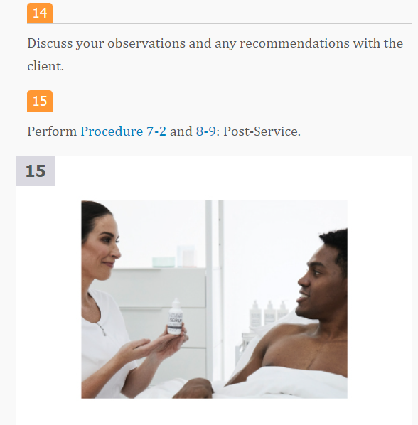

Slide 26
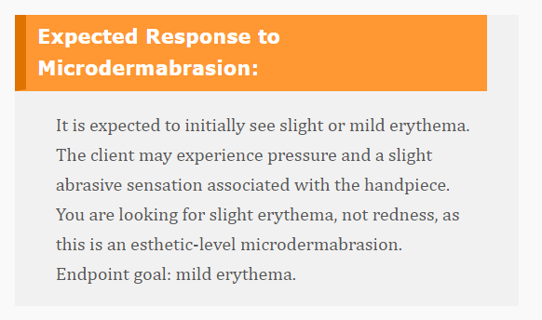

Slide 27
Timing
Quick 30-minute services
Offered alone or as part of a facial
A mask must be added at the end of the treatment, mask can be customized at extra charge
Serums can be customized at extra charge
Extractions can also be added
Service can be upgraded to a 1 hour including massage or ultrasound or any electrotherapy device for extra charge

Slide 28
Technique
Technique plays a vital role in creating optimal outcomes with the microdermabrasion machine.
The number of passes used during the treatment will be determined by the client’s skin type and condition, the presence of erythema, and how the client tolerates the treatment
Typically passes consist of horizontal, vertical, and diagonal directional applications

Slide 29
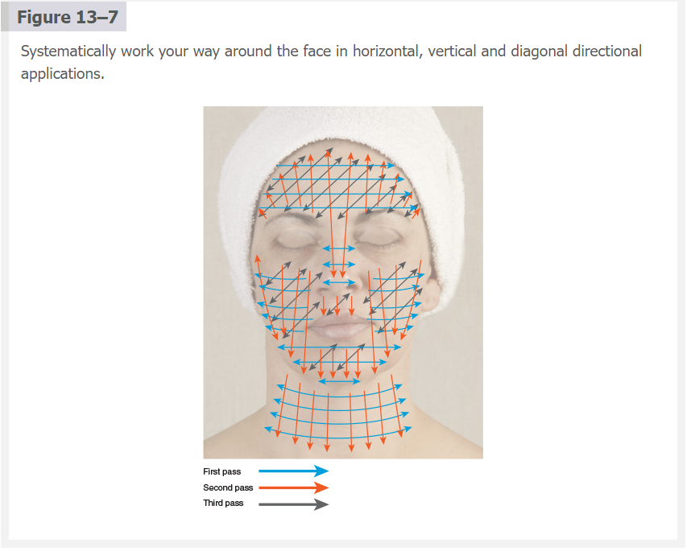

Slide 30
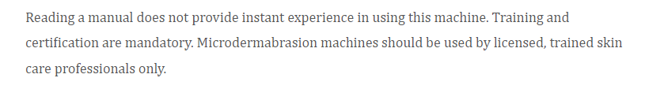

Slide 31
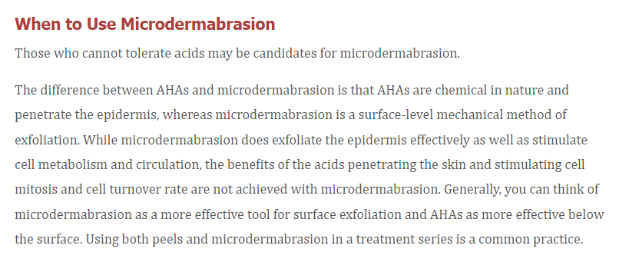

Slide 32
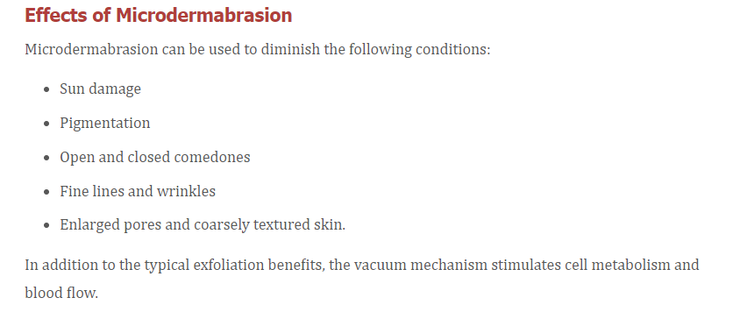

Slide 33

Recent cosmetic surgeries, laser resurfacing, chemical peels, or dermabrasion
Recent injectables, fillers, or Botox®
Use of Retin-A, or other medications that exfoliate or thin the skin
Allergies or sensitivities to products or ingredients
Pregnancy (some healthcare providers may clear client for service)
Active herpes simplex
Hyperpigmentation tendencies
Inflamed rosacea or acne
Infectious diseases
Open sores or suspicious lesions
Sunburn or irritated skin
Fragile skin, couperose skin
Photosensitizing medications (makes skin very sensitive to sun)
Other contraindicated drugs or medications.

Slide 34
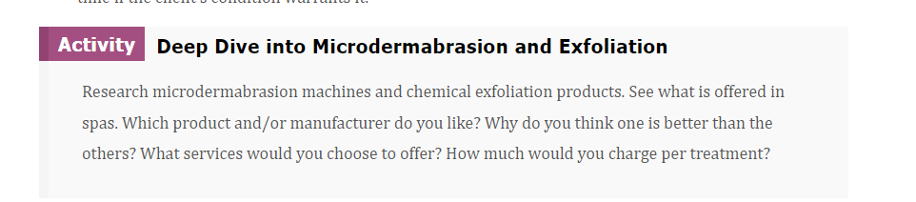

Slide 35
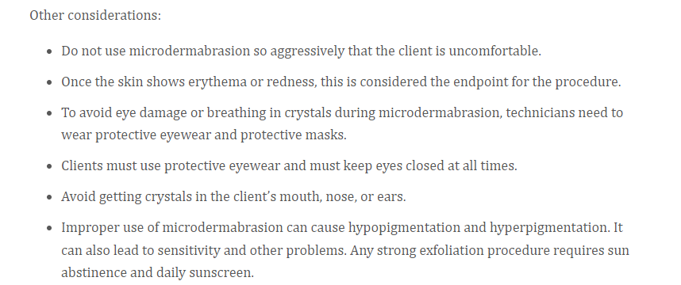

Slide 36
Discuss the issues and contraindications during the consultation, procedures, the expected outcome, and realistic goals.
In a diagnostic facial or skin analysis before scheduling treatments, note on the client intake form the condition of the skin, including dehydration, hyperpigmentation, open lesions, and any other skin conditions. Also choose the level of exfoliation with the microdermabrasion treatment based on the client’s skin condition and the results desired.
Eyewear is always recommended to protect the client and technician. A mask for the technician is also required.
Avoid inadvertent exposure during their daily activities.
It is preferred (but not required) that clients begin on a home care regimen to prepare the skin for microdermabrasion
Home care plans that work in tandem with the in-office clinical treatment plan are very important.
Treatment plans begin with a series of treatments to jump-start progress.
During the maintenance phase, you maintain the results by administering a monthly
Photo documentation before and after treatments and during the series is advantageous
Important reminder: The treatment schedule will depend on the client’s tolerance to the procedure

Slide 37
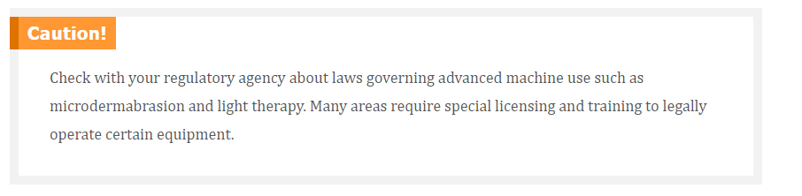

Slide 38
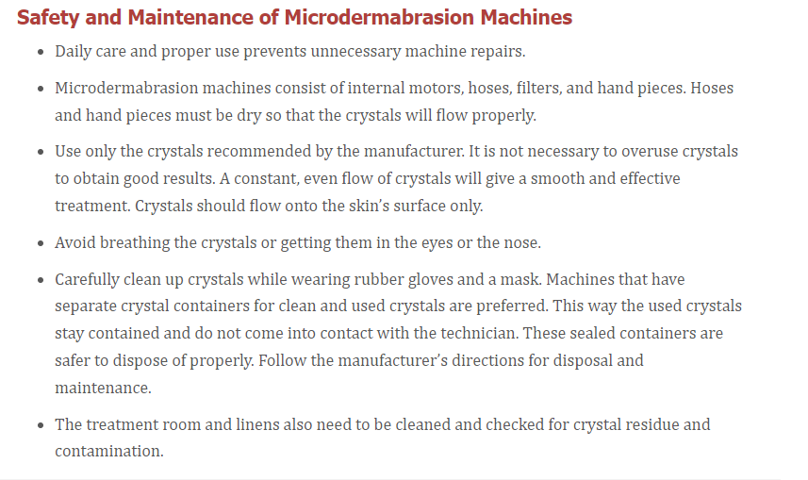

Slide 39


Slide 40
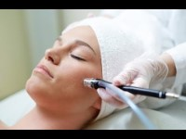

Slide 41

QUESTIONS?

