Slide 1
MRAD 204:
Radiographic Technique 1
Outcome 1-5:
Positioning –Wrist & Scaphoid

Slide 2
Affiliated Readings
Module 3
Bontrager
Pgs: 153→156
Pgs: 162→163

Slide 3
Overview
Guidelines/Considerations
Protocols
Positioning

Slide 4
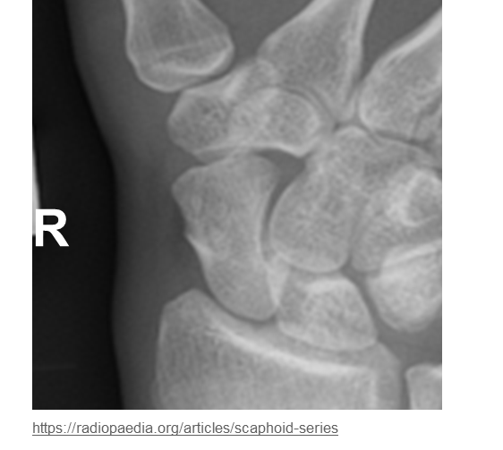
Guidelines/Considerations
Identify required anatomy
R
Scaphoid radiographs require metacarpal bases, and distal radius
SAIT Image Critique Handbook
Wrist radiographs require 2’ of distal forearm AND ½ of the metacarpals

Slide 5
Guidelines/Considerations
2. Select appropriate equipment/technical factors
*For CR, always use the smallest cassette size
100cm SID, measured manually
On the console, select:
  “free cassette”
  the projection you will begin positioning
*Wrist technique = *55→70 kVp (PA = 55-65; Obl. & Lat. = 60-70)
*Scaphoid technique = 55→65 kVp

Slide 6
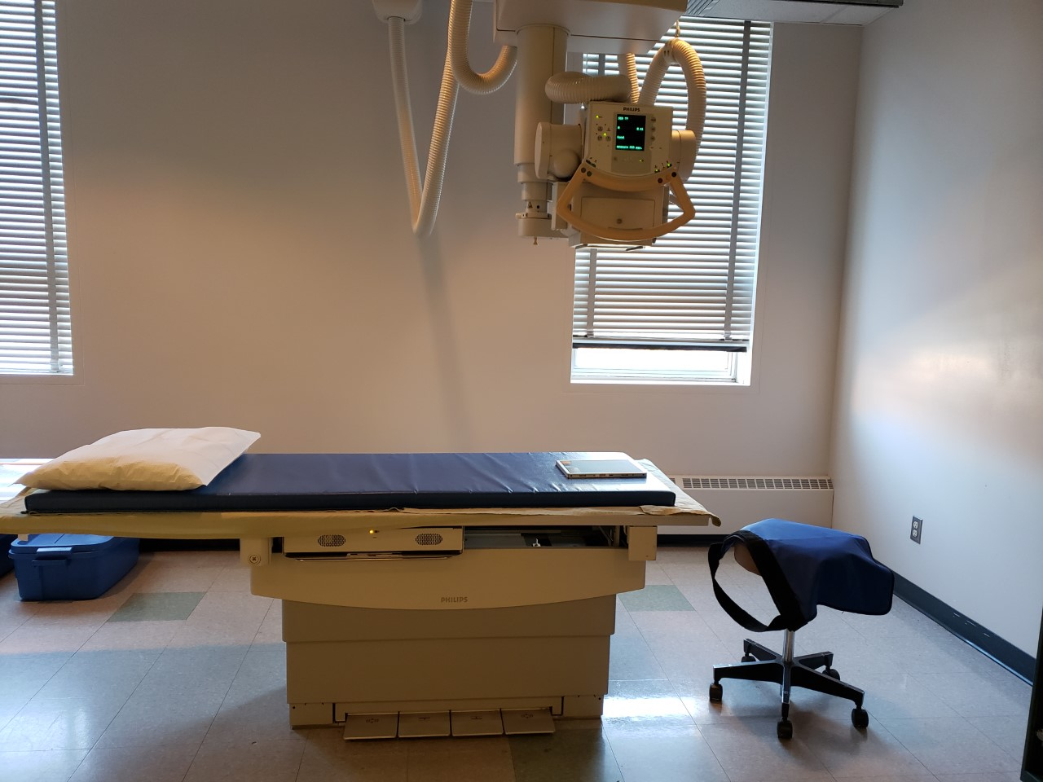
Guidelines/Considerations
Setup room before bringing the patient in
  Note: can be done at either end of table
Tube and IR aligned using 100cm SID
Field size matches size of IR
Correct anatomical marker selected
Ensure the table IR is not directly under the cassette

Slide 7
Guidelines/Considerations
3. Artifact Removal
Only anatomy of interest should appear in the light field & over the active surface of the image receptor
Ensure the marker is NOT placed under “anatomy shadow”
Notes: when the patient is in the room:
Best practice to have patient facing you
Do NOT let their legs go under the x-ray table/IR
Use external landmarks when positioning

Slide 8
Wrist Protocol
Routine:
PA
PA Oblique (45º anterior oblique)
Lateral

Slide 9
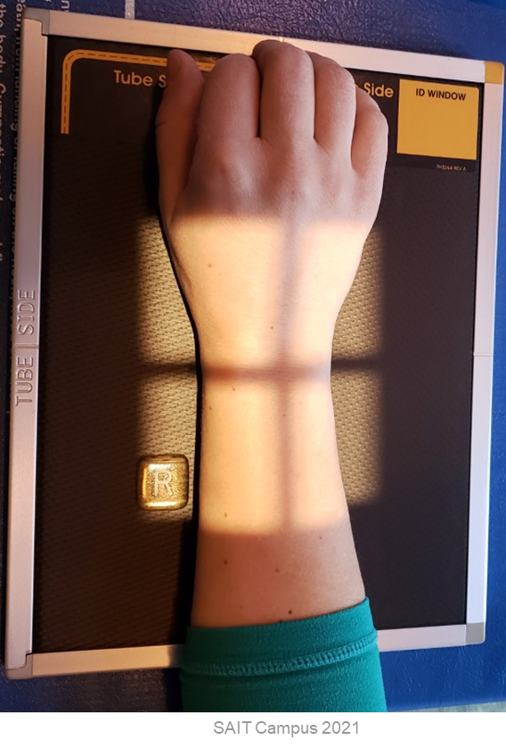
Positioning – PA Wrist
Center the anatomy on the IR
Align the length of anatomy with the length of IR
Position the forearm on the same horizontal plane & ensure the elbow and wrist are aligned
“Arch” hand slightly (make an arch)
Use external landmarks to set an appropriate field size
Place an anatomical marker (using Anderson Marker Rules), & adjust collimation as needed

Slide 10
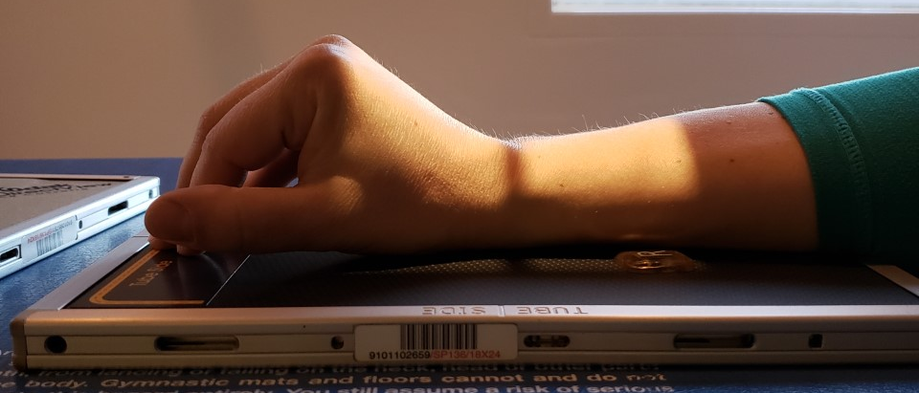
Positioning – PA Wrist
CR is over the “bend” in the wrist (aka. halfway between the ulnar styloid process and base of 1st metacarpal)
Fingers flexed to place entire wrist flat against IR
*At least 1/2inch of light beyond required anatomy*
Hand & Wrist parallel to length of IR
Marker on lateral side
Radiograph must include @ least ½ metacarpals & 2 inches of distal forearm
*At least 1½ inches of anatomy proximal to the ulnar styloid process must be over the active surface of the IR
(ensures 2 inches of distal forearm included)

Slide 11
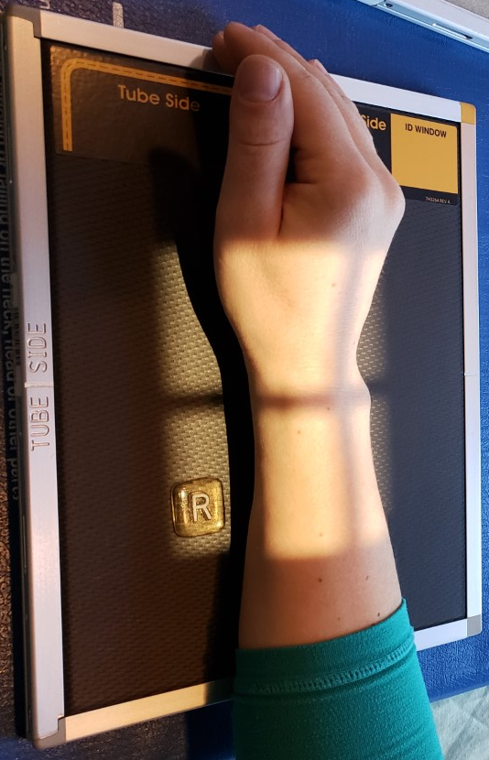
Positioning – PA Oblique Wrist
Remember to change cassettes
Center the anatomy on the IR
Align the length of anatomy with the length of IR
Position the forearm on the same horizontal plane & ensure the elbow and wrist are aligned
Rotate wrist laterally 45⁰
Use external landmarks to set an appropriate field size
Place an anatomical marker (using Anderson Marker Rules), & adjust collimation as needed

Slide 12
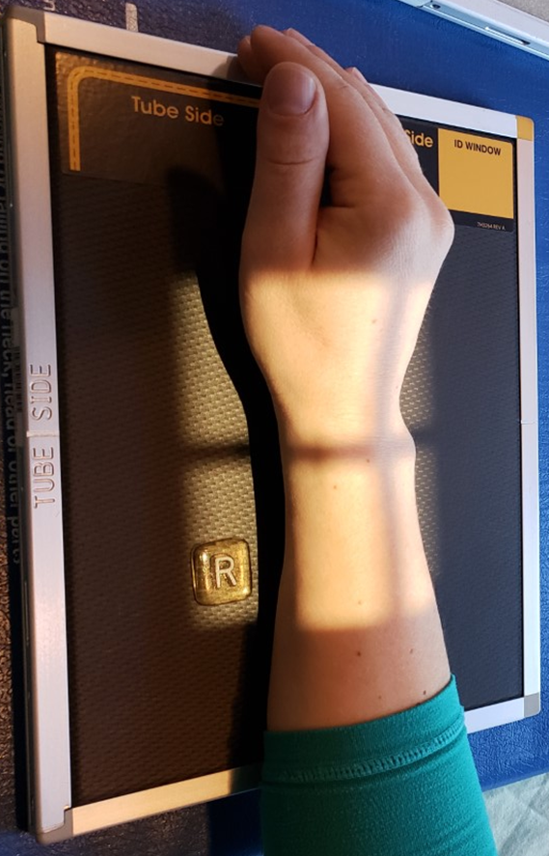
Positioning – PA Oblique Wrist
CR is over the wrist joint
(aka. halfway between the ulnar styloid process and base of 1st metacarpal)
Hand & Wrist parallel to length of IR
*At least 1/2inch of light beyond required anatomy*
Styloid processes (of radius & ulna) form a 45⁰ angle to the anterior surface of the IR
Marker on lateral side
Radiograph must include @ least ½ metacarpals & 2 inches of distal forearm
*At least 1½ inches of anatomy proximal to the ulnar styloid process must be over the active surface of the IR
(ensures 2 inches of distal forearm included)

Slide 13
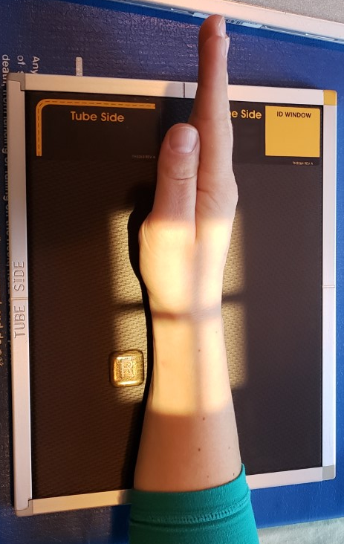
Positioning – Lateral (lateromedial) Wrist
Remember to change cassettes
Center the anatomy on the IR
Align the length of anatomy with the length of IR
Position the forearm on the same horizontal plane & ensure the elbow and wrist are aligned
Position styloid processes perpendicular to IR
Use external landmarks to set an appropriate field size
Place an anatomical marker (using Anderson Marker Rules), & adjust collimation as needed

Slide 14
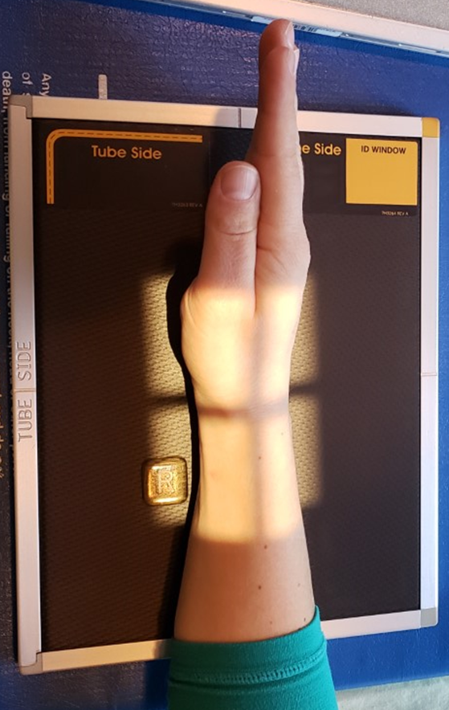
Positioning – Lateral Wrist
*Thumb in a PA position* (not superimposing metacarpals)
Hand & Wrist parallel to length of IR
*At least 1/2inch of light beyond required anatomy*
CR is over the wrist joint
(aka. halfway between the ulnar styloid process and base of 1st metacarpal)
Styloid processes (of radius & ulna) perpendicular to the anterior surface of the IR
Marker on anterior side
Radiograph must include @ least ½ metacarpals & 2 inches of distal forearm
*At least 1½ inches of anatomy proximal to the ulnar styloid process must be over the active surface of the IR
(ensures 2 inches of distal forearm included)

Slide 15
Scaphoid Protocol
Routine:
PA with ulnar deviation
15⁰ PA Axial
Note: number of views/projections (and angles used) is work-site dependent

Slide 16
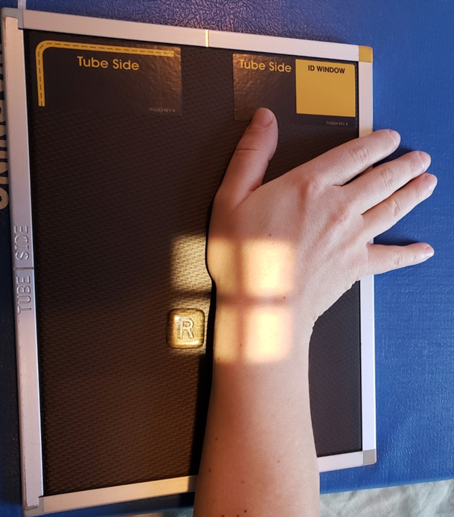
Positioning – PA Scaphoid
Set a field size (just large enough for a “clear” anatomical marker to fit into each square of light)
Center the anatomy on the IR
Ensure the elbow and wrist are aligned, and on the same horizontal plane
Have the patient apply ulnar deviation
Place an anatomical marker (using Anderson Marker Rules), & adjust collimation as needed

Slide 17
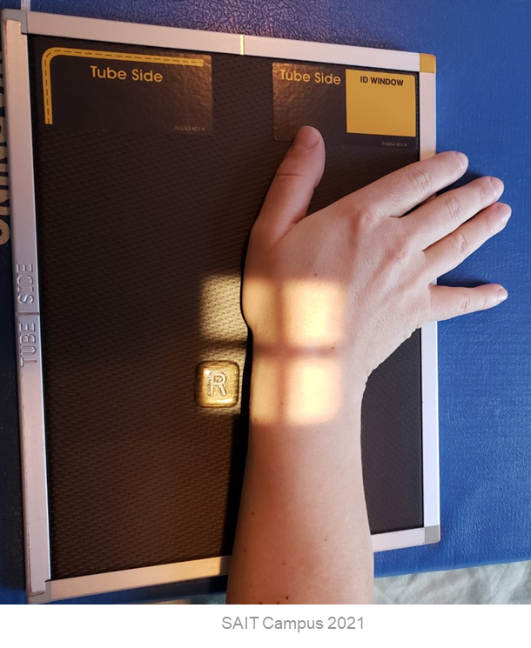
Positioning – PA Scaphoid
Wrist ulnar deviated
(until 1st metacarpal aligned with distal radius)
Light-field extends:
Laterally: to include entire marker
Medially: to ~ mid-wrist (or “edge” of ulnar styloid process)
CR is over the scaphoid
(aka. halfway between the ulnar styloid process and base of 1st metacarpal)
Light-field extends:
Distally: to ~½ of 1st metacarpal
Proximally: to ~ level of ulnar styloid process
Marker on lateral side

Slide 18
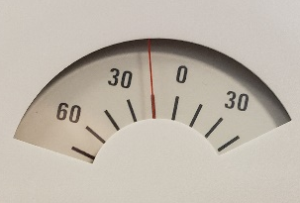
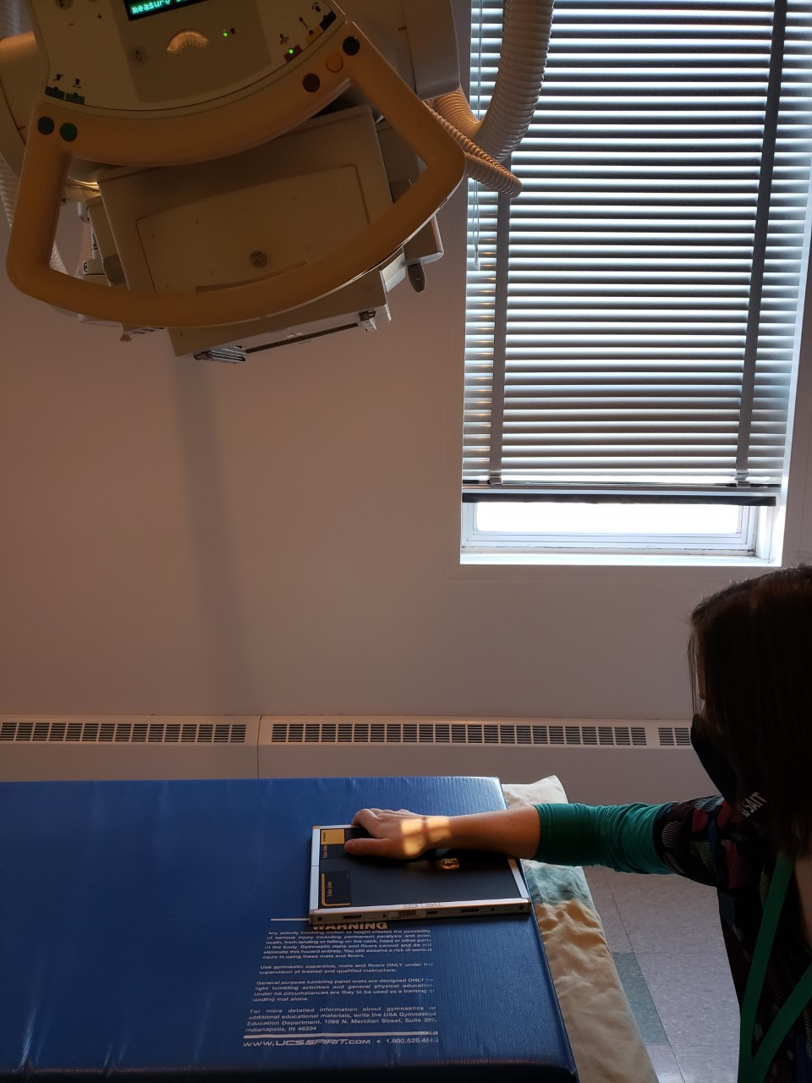
Positioning – 15⁰ PA Axial Scaphoid
Remember to change cassettes
Note: CR must be angled “towards the elbow”
Set a field size (just large enough for a “clear” anatomical marker to fit into each square of light)
Center the anatomy on the IR
Ensure the elbow and wrist are aligned, and on the same horizontal plane
Have the patient apply ulnar deviation
Place an anatomical marker (using Anderson Marker Rules), & adjust collimation as needed

Slide 19
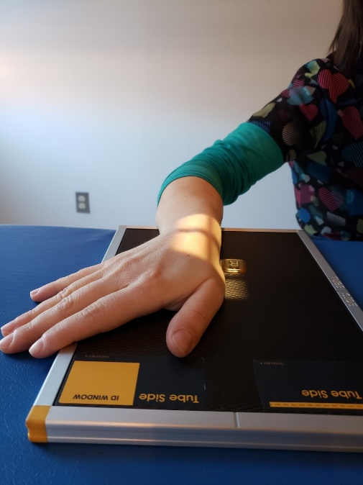
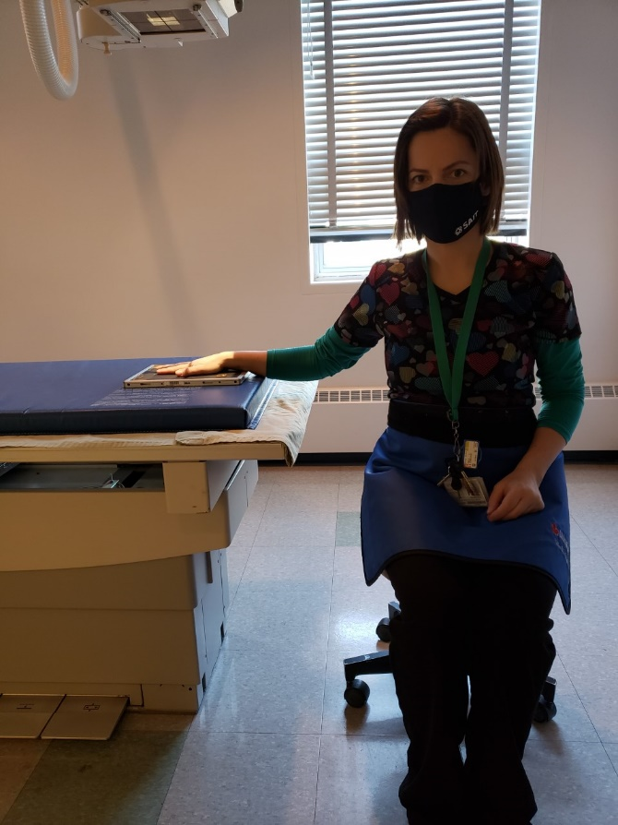
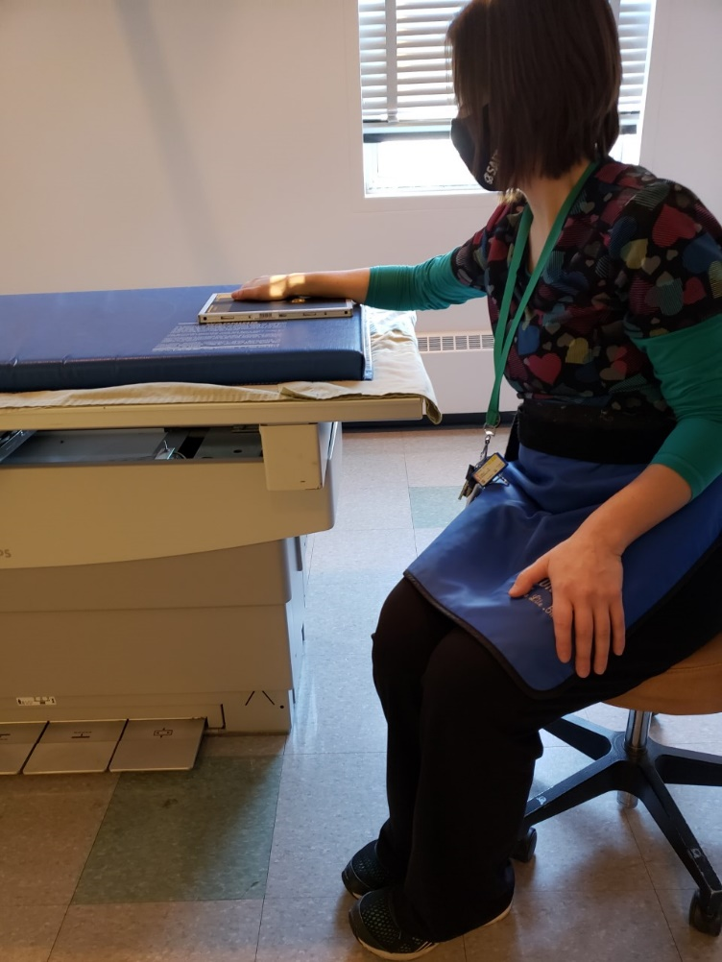
Positioning – 15⁰ PA Axial Scaphoid: Notes
Move the patients body, so the tube is only aiming towards the elbow

Slide 20
Positioning – 15⁰ PA Axial Scaphoid
Wrist ulnar deviated
(until 1st metacarpal aligned with distal radius)
Light-field extends:
Laterally: to include entire marker
Medially: to ~ mid-wrist (or “edge” of ulnar styloid process)
CR is over the scaphoid
(aka. halfway between the ulnar styloid process and base of 1st metacarpal)
Light-field extends:
Distally: to ~½ of 1st metacarpal
Proximally: to ~ level of ulnar styloid process
Marker on lateral side

Slide 21
Guidelines/Considerations - Notes
For Forearm imaging, follow all the same guidelines/considerations outlined earlier, making note of these differences:
Identify required anatomy
  Joints proximal (elbow) and distal (wrist) to long bones MUST be included in the radiograph
Forearm radiographs require the proximal row of carpal bones, AND ½ inch proximal to the humeral epicondyles (to ensure olecranon process is included)
2. Select appropriate equipment/technical factors
  Largest cassette is more commonly used for an adult forearm
*Forearm technique = 65→75 kVp

Slide 22
Forearm Protocol
Routine:
AP
Lateral

Slide 23
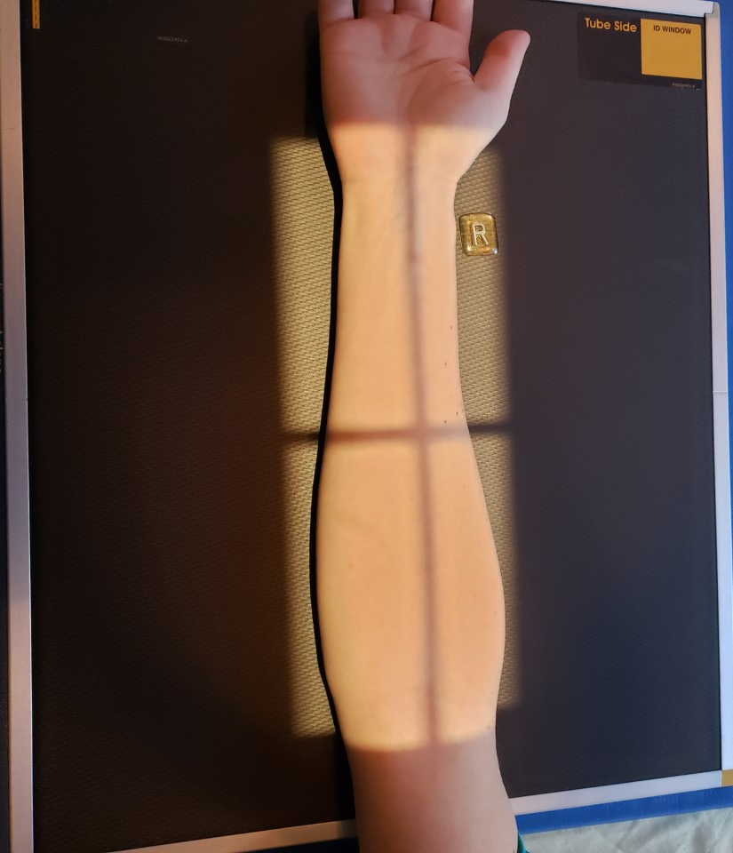
Positioning – AP Forearm
Center the anatomy on the IR
Align the length of anatomy with the length of IR
Position the entire upper limb on the same horizontal plane
Supinate the hand
Ensure humeral epicondyles are parallel to IR
Use external landmarks to set an appropriate field size
Place an anatomical marker (using Anderson Marker Rules), & adjust collimation as needed

Slide 24
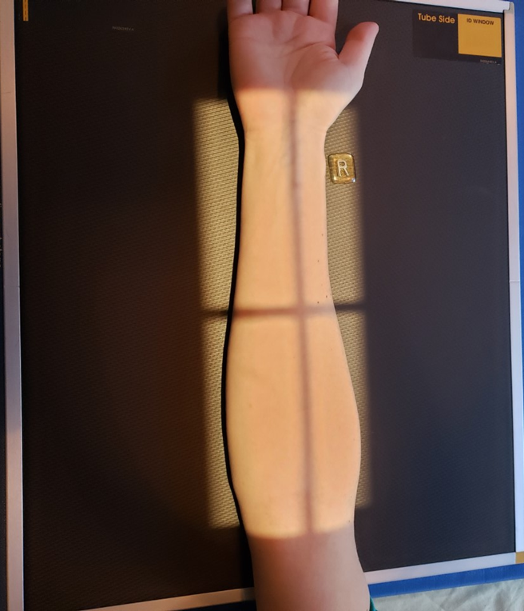
Positioning – AP Forearm
Hand supinated
Marker on lateral side
CR is ~mid forearm
Light-field extends:
Distally: to base of metacarpals
Proximally: to ~ level of humeral epicondyles (aka. ~ ½ inch proximal to the elbow joint/”crease”)
Entire upper limb on same horizontal level
Light-field extends “side-side” to include @ least ½ inch beyond soft-tissue margins
Humeral epicondyles parallel to IR

Slide 25
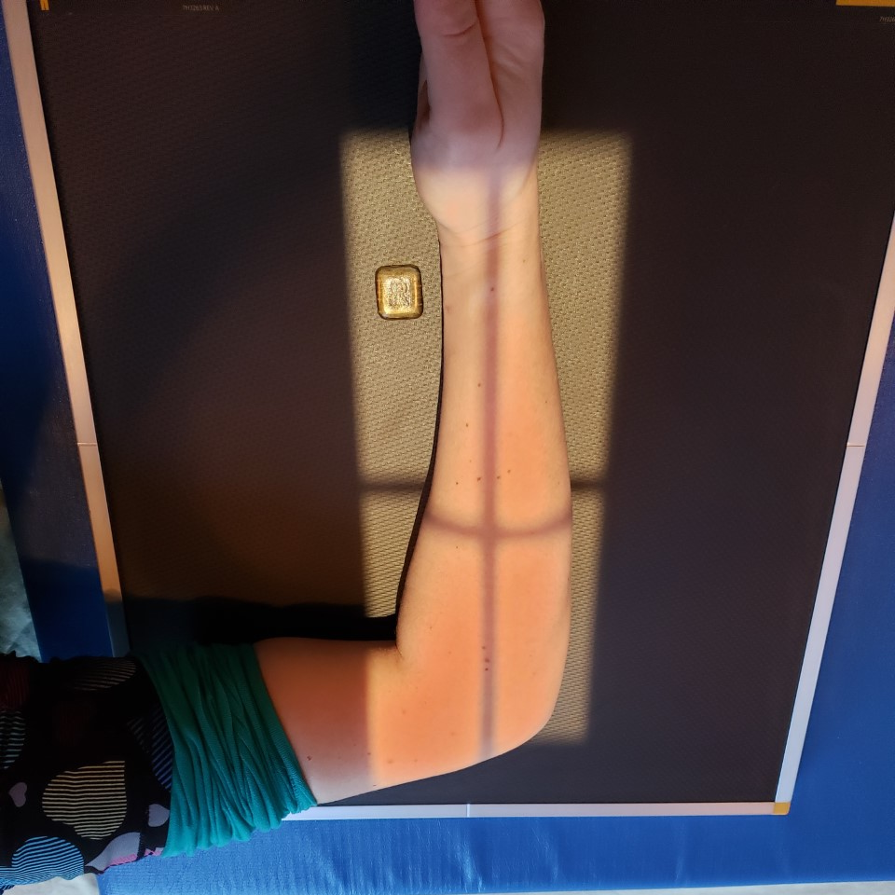
Positioning – Lateral Forearm
Center the anatomy on the IR
Remember to change cassettes
Align the length of anatomy with the length of IR
Position the entire upper limb on the same horizontal plane
Flex the elbow 90⁰
Ensure styloid processes (of radius/ulna) & humeral epicondyles are perpendicular to IR
Use external landmarks to set an appropriate field size
Place an anatomical marker (using Anderson Marker Rules), & adjust collimation as needed

Slide 26
Positioning – Lateral Forearm
Marker on anterior side
Styloid processes of radius & ulna perpendicular to IR
CR is ~mid forearm
Entire upper limb on same horizontal level, with elbow flexed 90⁰
Light-field extends:
Distally: to base of metacarpals
Proximally: to ~ ¼ distal humerus
Light-field extends “side-side” to include @ least ½ inch beyond soft-tissue margins
Humeral epicondyles perpendicular to IR

