Slide 1


Photodynamic Therapy

Slide 2
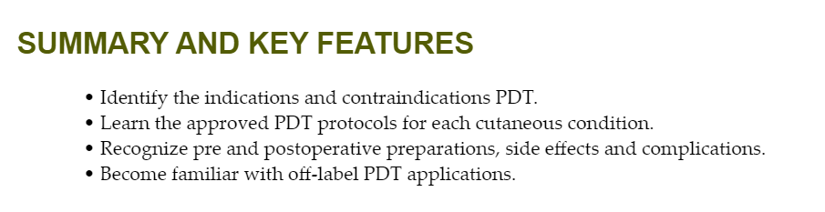

Slide 3
Introduction
Photodynamic therapy (PDT) involves the application of a photosensitizer, a light-absorbing compound, which accumulates in a subset of cells or tissues, followed by illumination with specified wavelengths, which triggers a reaction that destroys the target.
The PDT reaction requires photosensitizer, a light source, and oxygen with reactive oxygen species generated that lead to apoptosis and necrosis.
PDT has been conducted using a variety of photosensitizers and light sources.
Systemic photosensitizers, such as hematoporphyrin, followed by irradiation with broadband red and blue light were used to treat a variety of cutaneous neoplasms.
In 1995, the first US Food and Drug Administration (FDA) approval for PDT was with porfirin sodium for treatment of esophageal carcinoma.
Topical 5-aminolevulinic acid (ALA) was introduced in the 1980s for cutaneous applications and eliminated the complication of generalized cutaneous photosensitivity observed with systemic PDT.

Slide 4
Principles
The light source used for PDT is determined by the absorption spectrum of the photosensitizer and the wavelength and penetration depth of the light.
Broadband light sources in the red and blue range dominate in PDT applications.
Topical ALA has been paired with red and blue light, the latter FDA-approved for the treatment AK in 1999. Various lasers, light sources and incubation protocols have been introduced to treat cutaneous neoplasms and inflammatory disorders.
Methyl aminolevulinic acid (MAL) was approved with red light in the European Union (EU) countries starting in 2001 for the treatment of hyperkeratotic AK and basal cell carcinoma (BCC), and in the United States in 2004 for the treatment of hyperkeratotic AK.
A nano-emulsion of ALA was introduced and approved for use with red light in the EU in 2011 for the treatment of AK and BCC and FDA-approved in the United States in 2016.

Slide 5
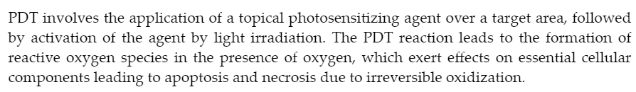
Mechanisms of Actions

Slide 6

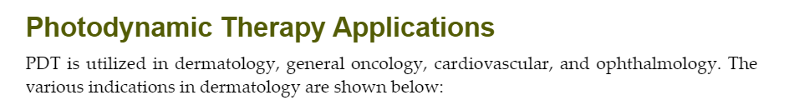

Slide 7
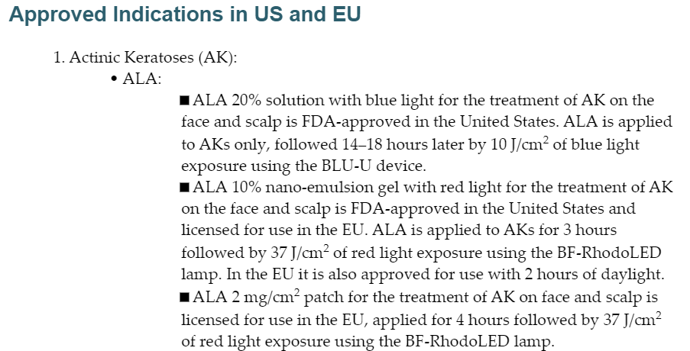

Slide 8
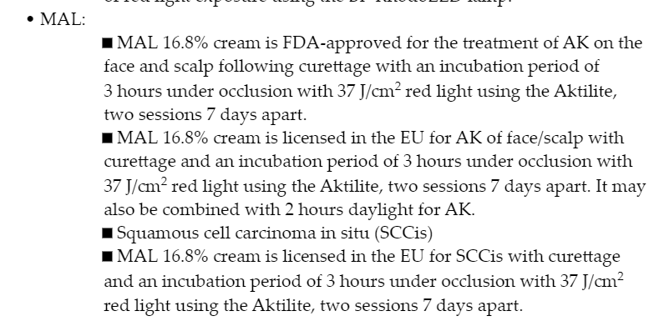

Slide 9
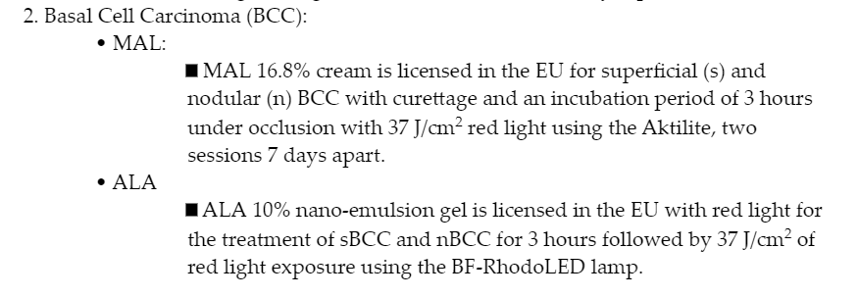

Slide 10
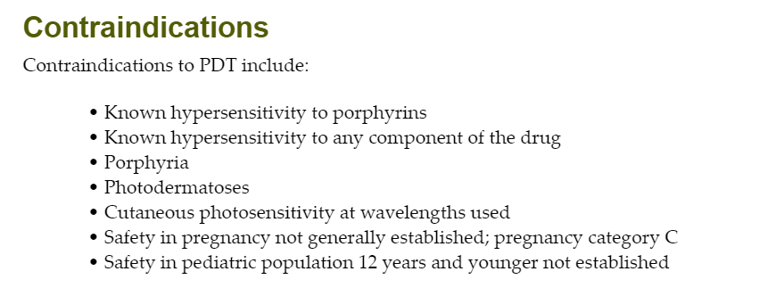

Slide 11
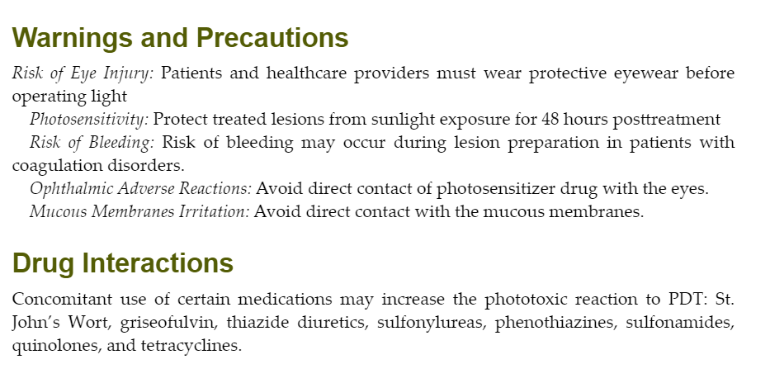

Slide 12
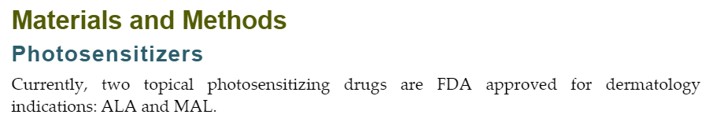

Slide 13
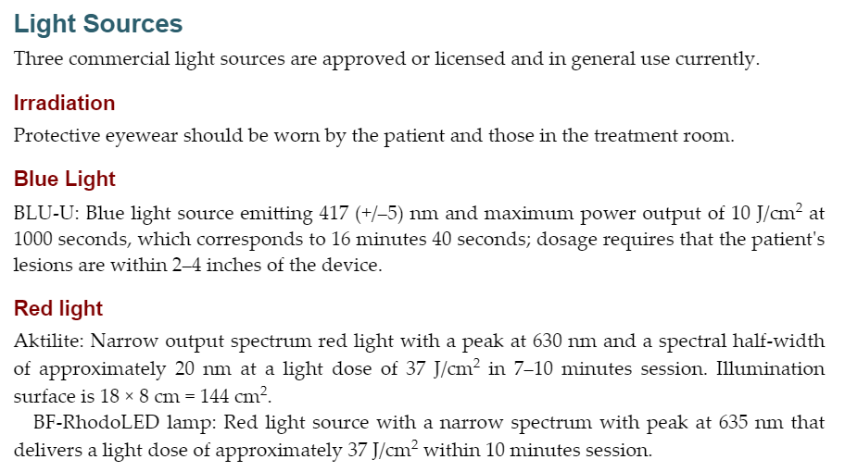

Slide 14
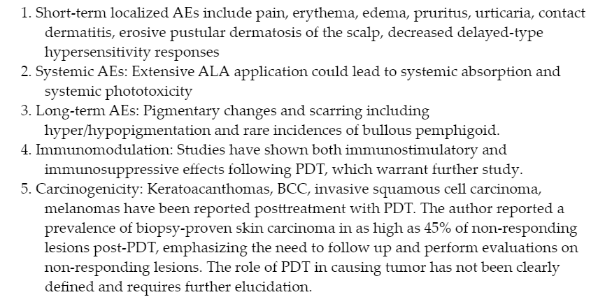

Slide 15
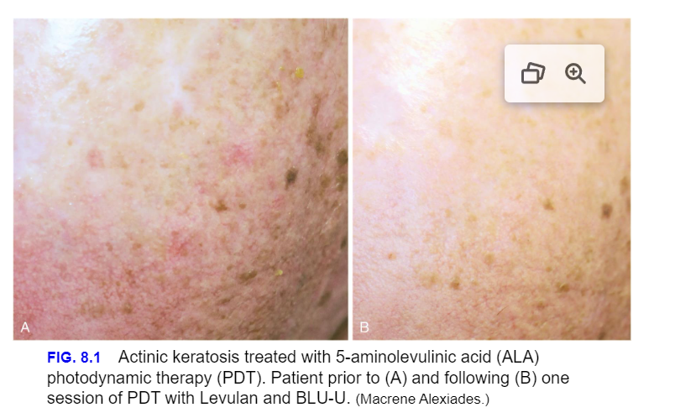

Slide 16
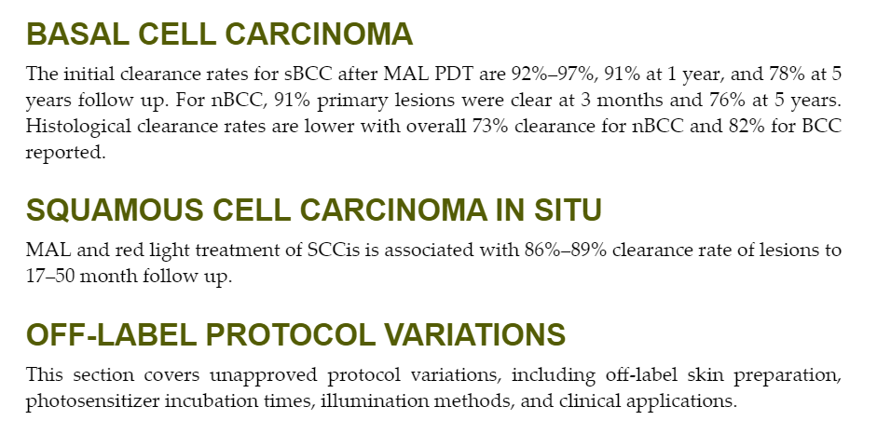

Slide 17
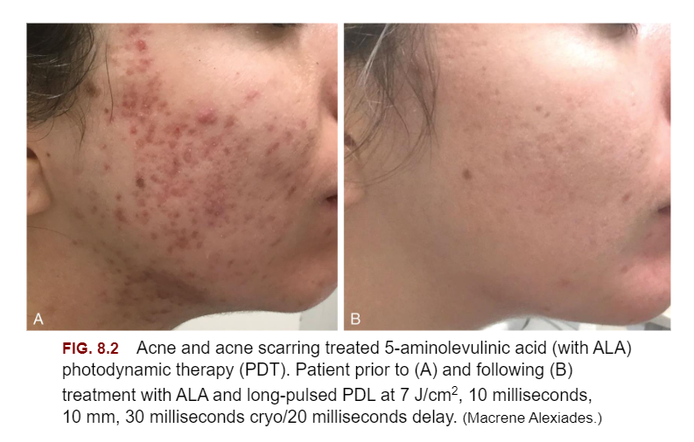

Slide 18
Alternative Clinical Application

Slide 19
Conclusion

Slide 20

QUESTIONS?

