Slide 1


Business Operations
Unit 10

Slide 2
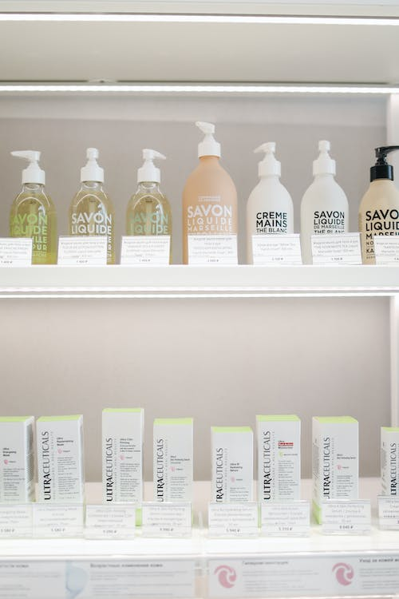
Before you decide how to price your product, let’s learn the basic
Some of the following typical models of pricing options:

Slide 3
Cost-plus pricing:
The retailer purchases a product from a supplier, and the MSRP is set at a particular formula. In this case, you would know your fixed costs, and an example would be the retail products you offer to your clients. Generally, spas use a keystone markup; we purchase the product for $10 and sell it to the customer for $20.

Slide 4
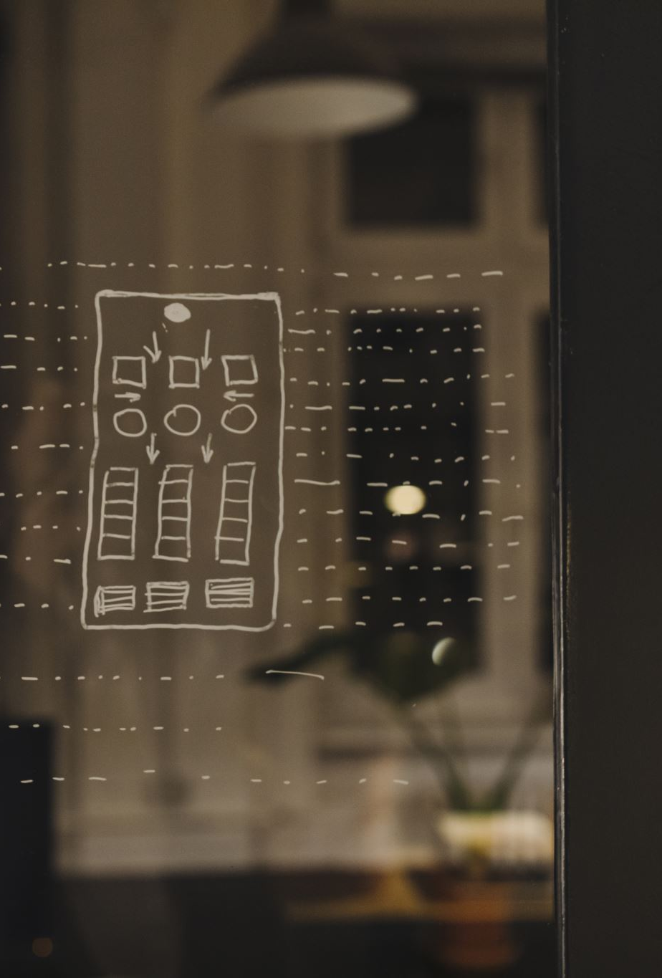
Value-based pricing:
More for a developed brand, this involves a thorough understanding of the product and brand proposition, and how sought after that product is. If you want to stay at the Plaza Hotel in New York City, you’re going to pay the price; the prestige and location outweigh the small guest room.

Slide 5

Anchor pricing:
This is a strategy that uses a high initial price to frame consumer perception. We’ve all seen the commercial; buy our Ginsu knife, regularly priced at $29.99, on sale for $19.99! And get two if you buy now!

Slide 6

Decoy pricing:
Decoy pricing models are utilized when there are three or more options to purchase a particular item, and the decoy is used to drive sales to the more profitable version. Popcorn sales at a movie theater is a perfect example— a small bag costs $3, a medium bag is $6, and a large bag is $7. The medium bag is the decoy that leads the consumer to buy the large size, for only $1 more than the medium. But without the medium option, consumers would opt for the small.

Slide 7

Variable pricing:
This is what we see in the hospitality and travel industry examples; prices that fluctuate based on supply and demand. Often uses a higher published or “rack” rate just as a basis to set discounts from.

Slide 8

Competitive pricing:
This model only considers market dynamics; pricing is based on what competitors are charging for a similar product or experience. This is what we see most often in salons and spas; pricing is based on what consumers are accustomed to paying in our locale rather than a scientific approach.

Slide 9

Now that you understand pricing strategies:
What strategy would you chose for your business?
Why?

Slide 10

QUESTIONS?

