Slide 1
CT Theory
Head Anatomy

Slide 2
CT Imaging of the Head
Module Objectives
Review anatomy of the cranium, facial bones, and brain
Label anatomical structures on a CT image
Scanning protocols including:
  Positioning
  Indications & Contraindications
  Exposure Factors
Most common CT Head exams done
Pathology

Slide 3
CT Imaging of the Head
Review Anatomy
Kelley textbook goes into a lot of detail!
Focus on:
  Cranial & Facial bones
  Paranasal Sinuses
  Meninges
  Ventricular System
  Cerebrum & Cerebellum
  Diencephalon
  Brainstem
  Cerebral Vasculature
Complete anatomy ID exercises on D2L Brightspace

Slide 4
CT Imaging of the Head
Cranial Bones
8 cranial bones – what are they?

Slide 5
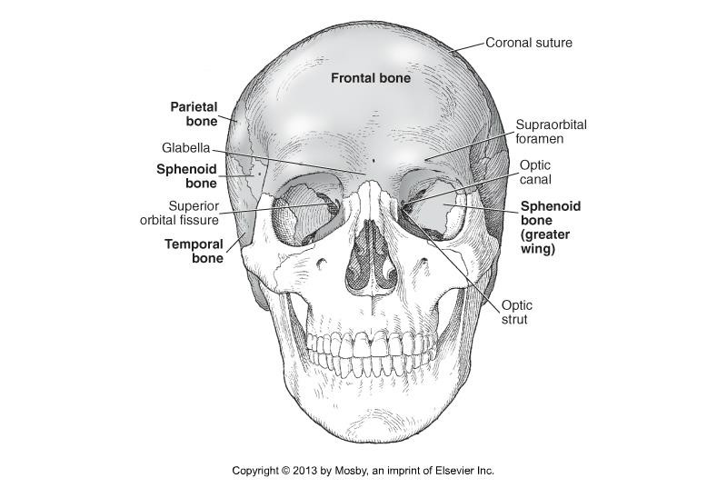
CT Imaging of the Head
Cranial Bones

Slide 6
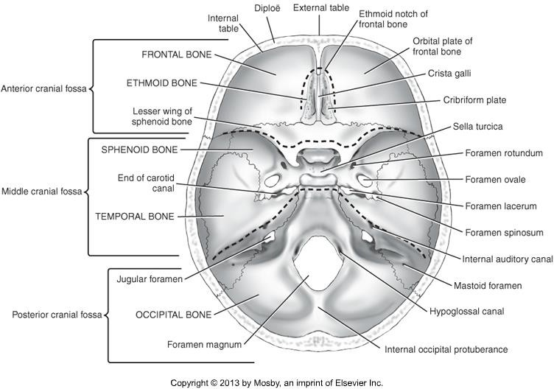
CT Imaging of the Head
Cranial Bones

Slide 7
CT Imaging of the Head
Ethmoid bone is visualized very well when performing a CT scan of the sinuses.
Important structures:
  Ethmoid air cells
  Paranasal sinuses
  Cribiform plate
  Perpendicular plate
  Crista galli

Slide 8
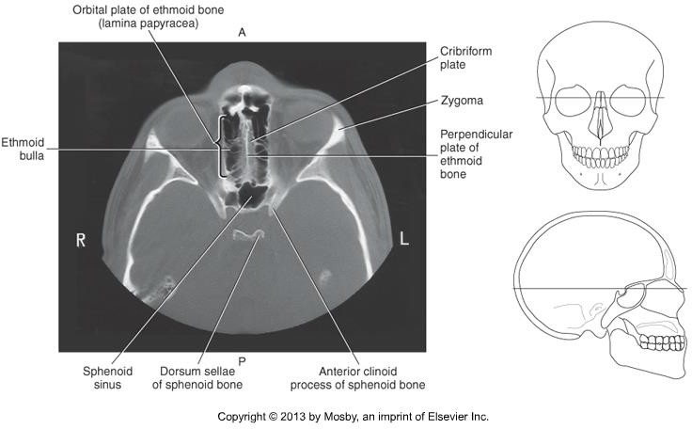
CT imaging of the Head

Slide 9
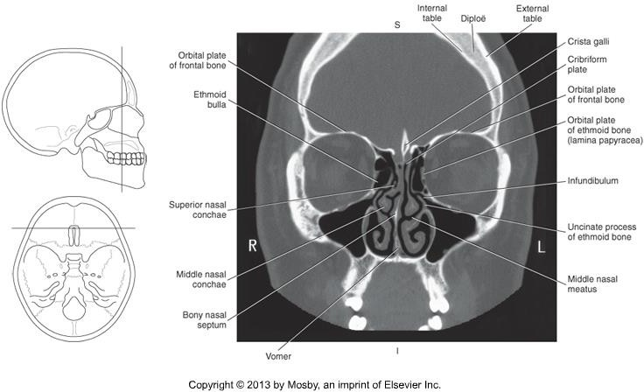
CT imaging of the Head

Slide 10
CT imaging of the Head
Sphenoid Bone sits within middle cranial fossa
Articulates with all cranial bones
Important structures:
  Sella Turcica
  Greater & Lesser wings
  Tuberculum sellae & Dorsum Sellae
  Posterior and Anterior clinoid processes

Slide 11
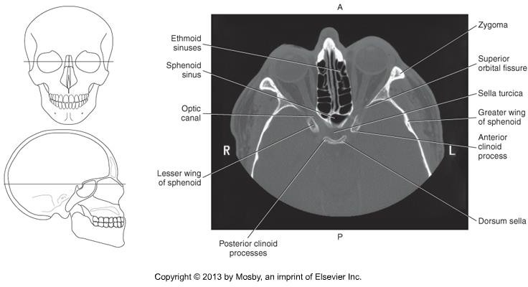
CT imaging of the Head

Slide 12
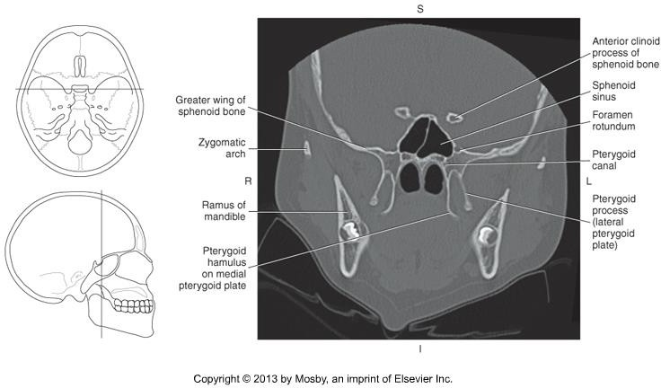
CT imaging of the Head

Slide 13
CT imaging of the Head
Occipital bone forms the inferoposterior aspect of the cranium.
Important structures
  Occipital condyles
  Foramen Magnum
  Hypoglossal canal(s)
  Clivus
  Internal occipital protuberance

Slide 14
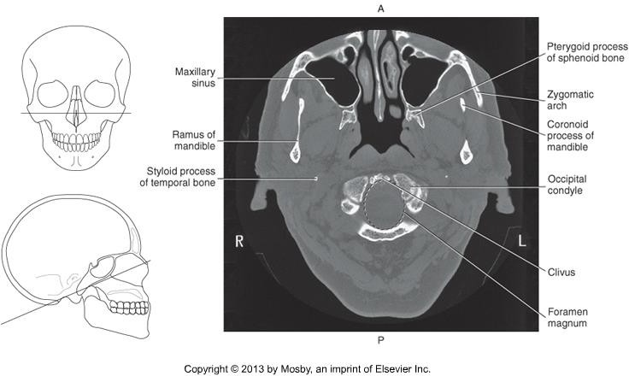
CT imaging of the head

Slide 15
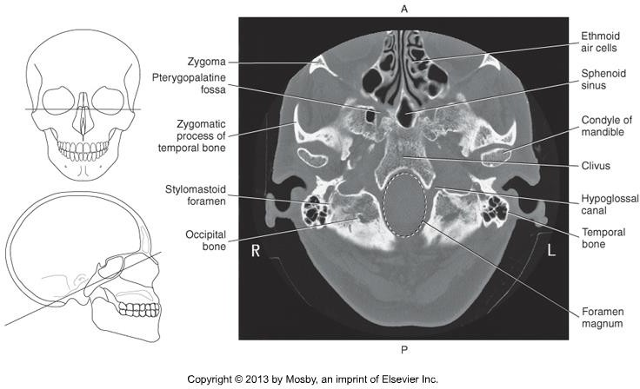
CT imaging of the head

Slide 16
CT imaging of the head
Temporal bones are sometimes scanned on their own as well, to image tiny structures and to demonstrate fine detail.
Within the middle cranial fossa
Important structures:
  Zygomatic process
  Mandibular fossa
  External auditory meatus
  Mastoid process
  Petrous portion
  Internal auditory canal

Slide 17
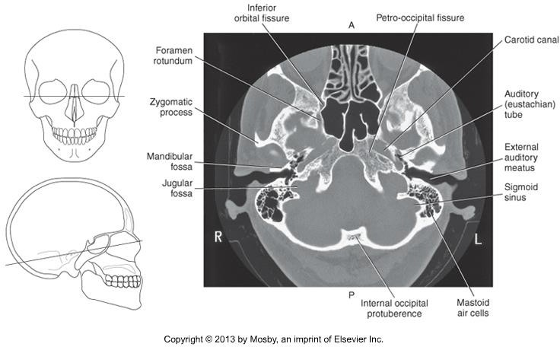
CT Imaging of the Head

Slide 18
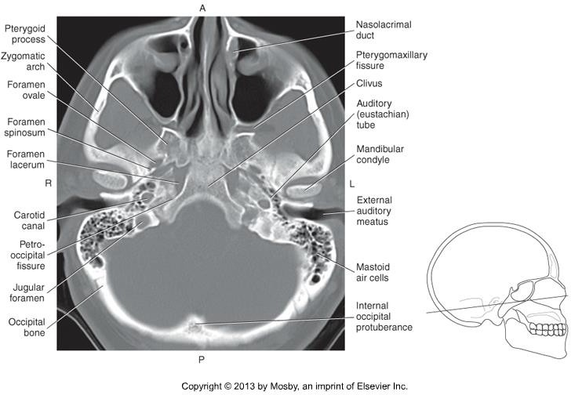
CT Imaging of the Head

Slide 19
CT Imaging of the Head
Facial Bones
14 facial bones – what are they?

Slide 20
CT Imaging of the Head
2 Nasal -
2 Lacrimal – posterior to the nasal bones and form the wall of each orbit.
2 Palatine – L-shaped, between the and the
bones

Slide 21
CT Imaging of the Head
Maxillary bones – largest immovable facial bones
Fuse at the midline to form the anterior nasal spine.
Important Structures
  Maxillary sinuses
  Frontal & zygomatic processes
  Alveolar process
  Palatine process

Slide 22
CT Imaging of the Head
2 Zygomatic bones – create the prominence of the cheek, the
.
2 Inferior Nasal Conchae - project from
the maxilla into the nasal cavity. Have a “scroll-like” appearance.
Vomer - on the midsaggital line, forms the portion of the bony nasal septum.

Slide 23
CT Imaging of the Head
Mandible – largest facial bone
The angle formed between the horizontal and vertical portions is termed the __.
Important Structures:
  Body
  Alveolar process
  Ramus
  Coronoid process
  Condyloid process
  Mandibular notch
  TMJ

Slide 24
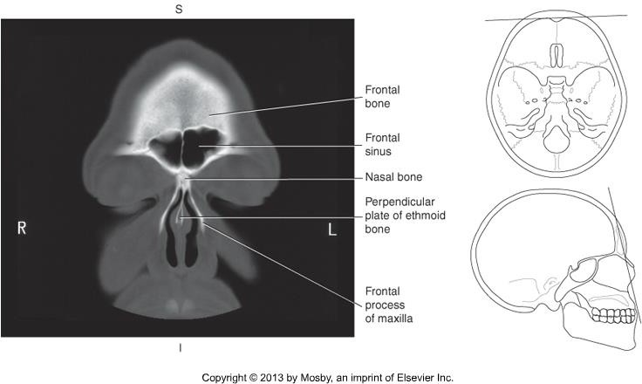
CT Imaging of the Head

Slide 25
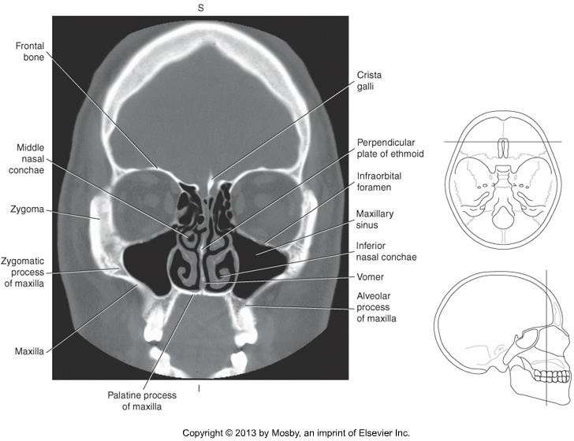
CT Imaging of the Head

Slide 26
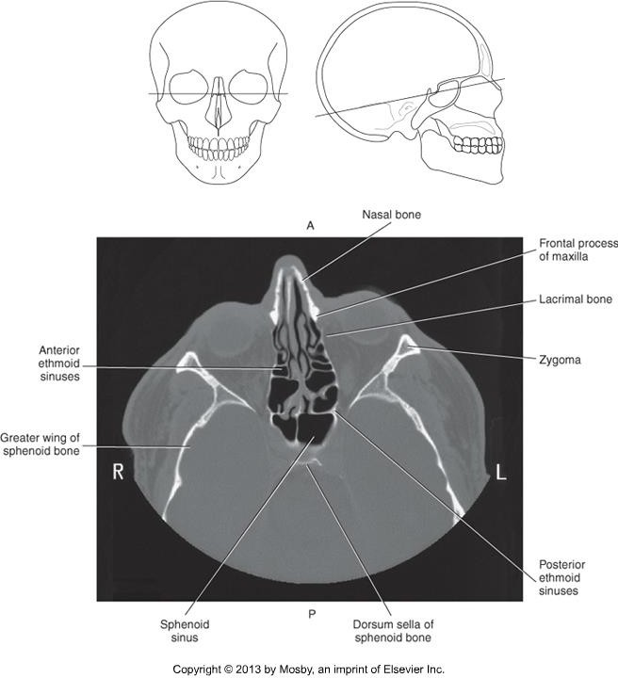
CT Imaging of the Head

Slide 27
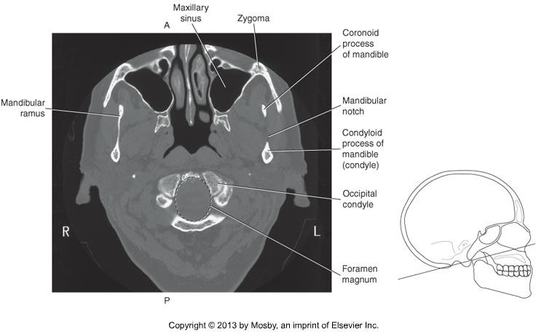
CT Imaging of the Head

Slide 28
CT Imaging of the Head
Helpful video – Learn the Bones of the Skull
https://www.youtube.com/watch?v=WRmNC_yPQZ8

Slide 29
CT Imaging of the Head
Brain
Important Structures
  Meninges
  Ventricular System
  Cerebrum
  Diencephalon
  Brainstem
  Cerebellum
  Cerebral Vasculature

Slide 30
CT Imaging of the Head
Meninges
  Three membranes surrounding the brain, providing protection.
  What are these layers?

Slide 31
CT Imaging of the Head
Dura mater
Epidural Space
Dural folds separate structures of the brain, provide cushioning and support.
  Falx Cerebri
  Tentorium Cerebelli
  Falx Cerebelli

Slide 32
CT Imaging of the Head
Arachnoid mater
Subdural space – between the and the
.

Slide 33
CT Imaging of the Head
Pia mater
  Inner layer
•
  Adheres closely to brain’s contours
Subarachnoid space – Between the and the _ _ _ _ .
Subarachnoid space contains CSF.

Slide 34
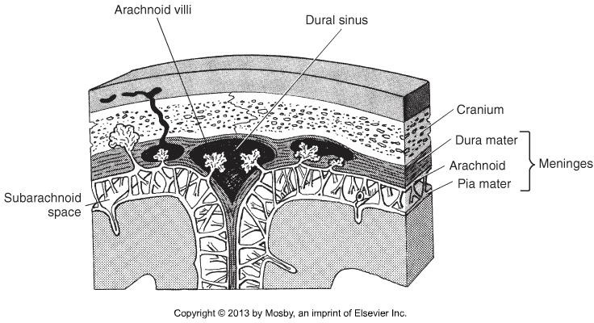
CT Imaging of the Head

Slide 35
CT Imaging of the Head
IMPORTANT!
If a skull fracture causes rupture of the meningeal arteries, it can cause a potentially life-threatening collection of blood within the meningeal layers
Epidural hematoma
Subdural hematoma

Slide 36
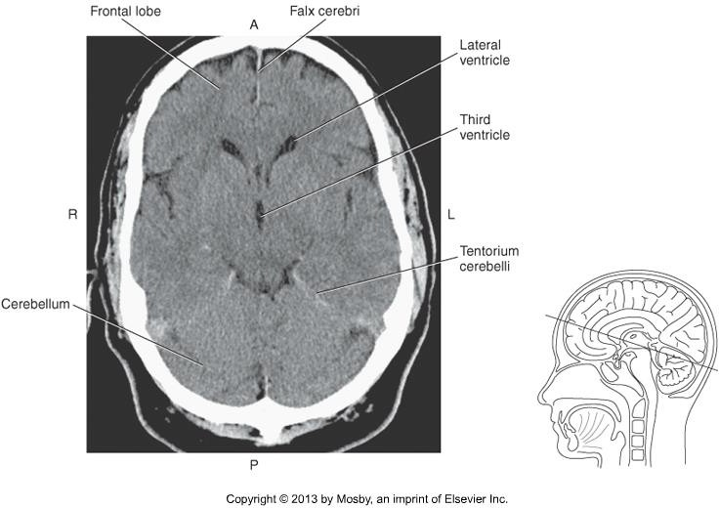
CT Imaging of the Head

Slide 37
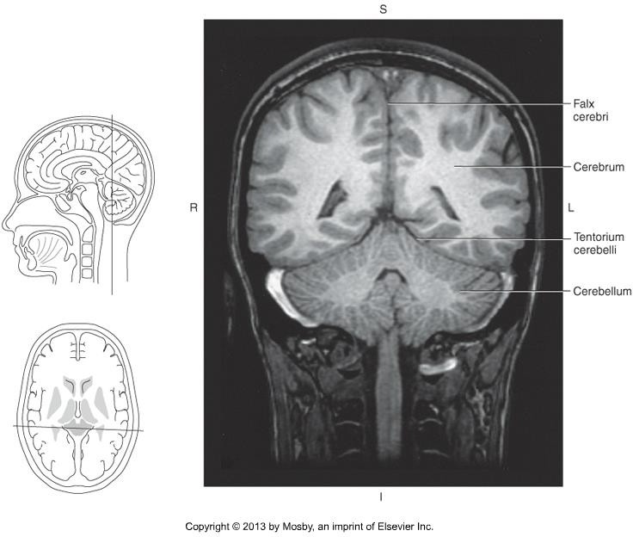
CT Imaging of the Head

Slide 38
CT Imaging of the Head
Ventricles
  Pathway for circulation of CSF
  Four, fluid filled cavities located deep within the brain.
  What are the 4 ventricles?

Slide 39
CT Imaging of the Head
Right & Left Lateral Ventricles
  Paired, within each cerebral hemisphere
  Separated at the midline by the .
  Three Extensions
•
•
    Temporal / Inferior horns
Third Ventricle
•
Fourth Ventricle
  Diamond-shaped structure. Located anterior to the cerebellum and posterior to the pons.

Slide 40
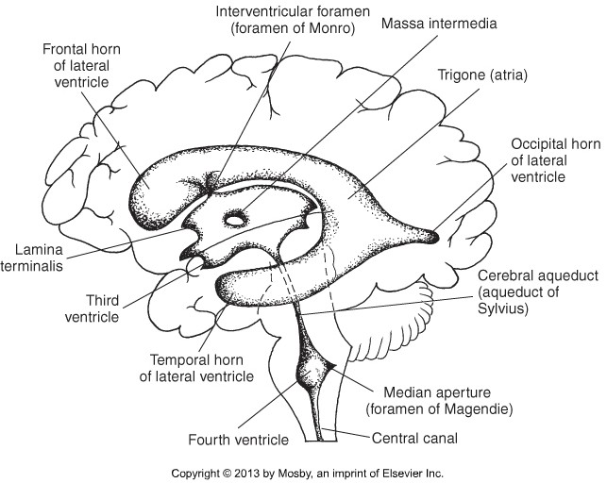
CT Imaging of the Head

Slide 41
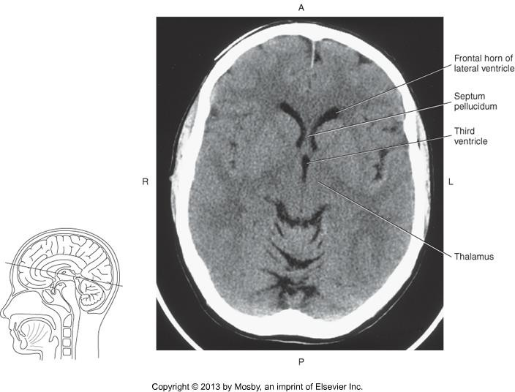
CT Imaging of the Head

Slide 42
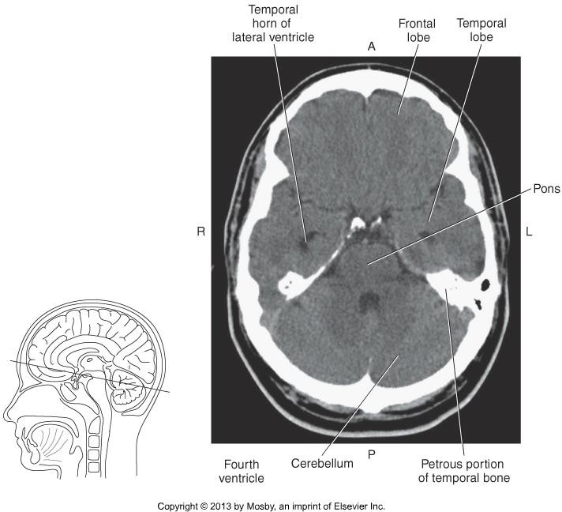
CT Imaging of the Head

Slide 43
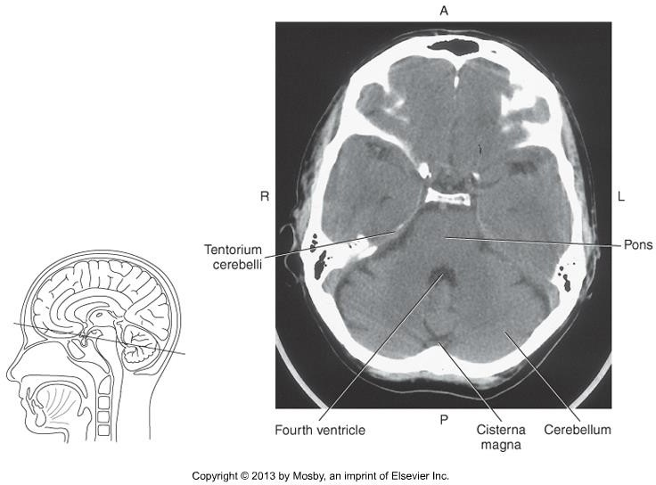
CT Imaging of the Head

Slide 44
CT Imaging of the Head
Cerebrum
Important Structures
  Central Sulcus
  Longitudinal Fissure
  Lateral (Sylvian) Fissure
  Grey & White matter
  Corpus Callosum
  Cerebral Lobes
Define Gyri –
Define Sulcus -

Slide 45
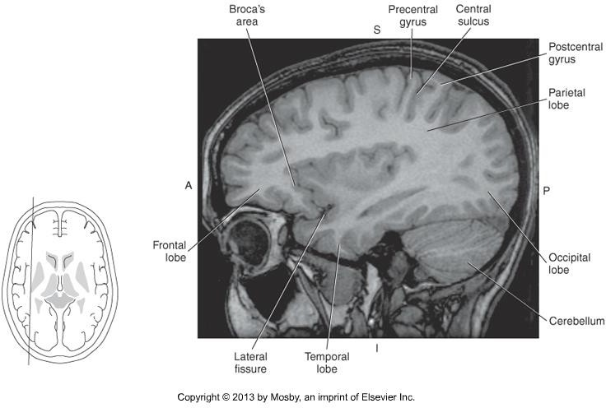
CT Imaging of the Head

Slide 46
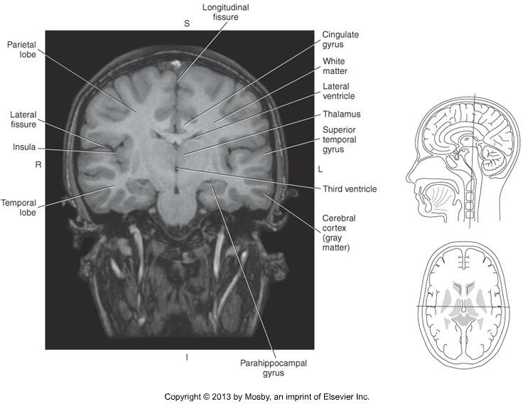
CT Imaging of the Head

Slide 47
CT Imaging of the Head
Grey & White Matter
CT numbers differ
  Grey Matter:
White Matter:
(Romans, p 240)
Why does grey matter have higher attenuation than white matter?
Largest and most dense collection of white matter is the corpus callosum
  Sits in the midline
  Forms the roof of the lateral ventricles
  Connects the:
  4 segments:

Slide 48
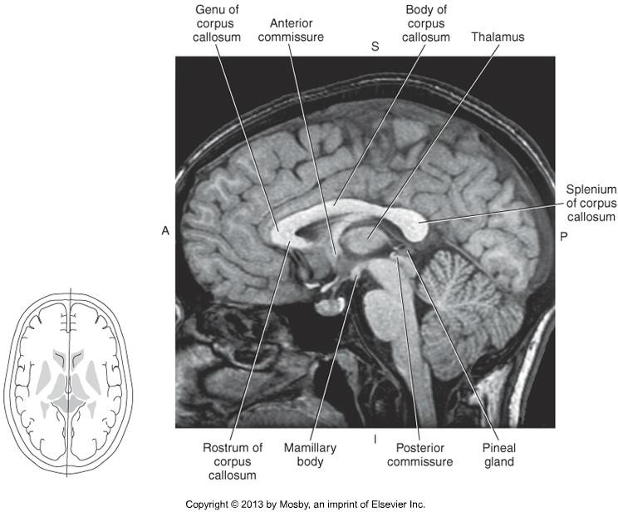
CT Imaging of the Head

Slide 49
CT Imaging of the Head
Cerebral Lobes
  4 lobes
  Correspond in location to the cranial bones
Frontal Lobe
  Most anterior
Parietal Lobes
  Middle portion of each cerebral hemisphere
  Posterior to central sulcus
Occipital Lobe
  Most posterior
Temporal Lobes
  Anterior to occipital lobe
  Separated from the parietal lobes by the lateral fissure

Slide 50
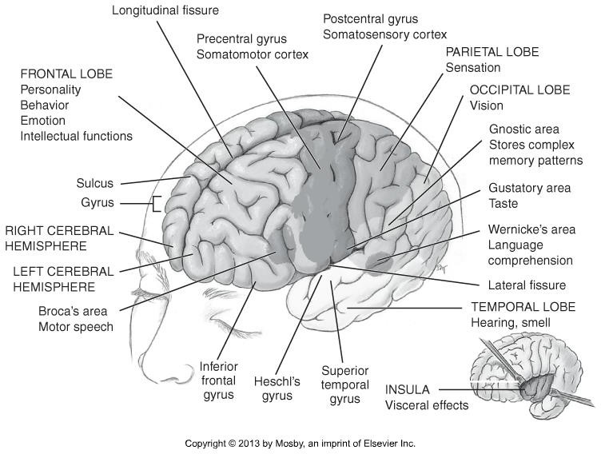
CT Imaging of the Head

Slide 51
CT Imaging of the Head
Diencephalon –major components are:
  Thalamus-
  Hypothalamus - cluster of small nuclei. Sits below the thalamus and forms the floor of the 3rd ventricle.
  Pituitary gland - connected to the thalamus by the . Located within the sella turcica.
  Epithalamus - sits most posteriorly. The sits on the roof of the midbrain just posterior to the 3rd ventricle and inferior to the splenium of the corpus callosum.

Slide 52
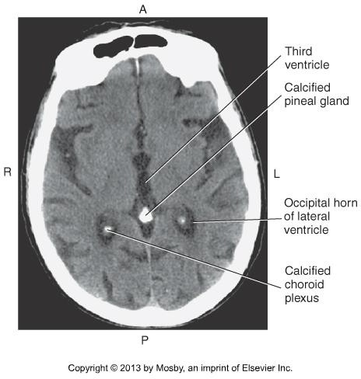
CT Imaging of the Head

Slide 53
CT Imaging of the Head
Brainstem – major segments are:
  Midbrain – most superior aspect of brainstem.
Pons – middle aspect of the brainstem.
Medulla Oblongata – extends inferiorly from the pons and through the foramen magnum where it continues as the spinal cord.

Slide 54
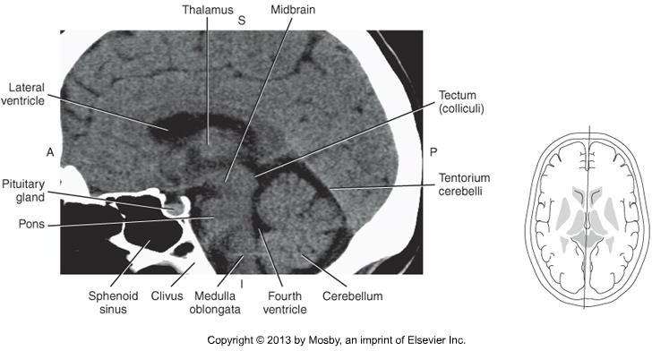
CT Imaging of the Head

Slide 55
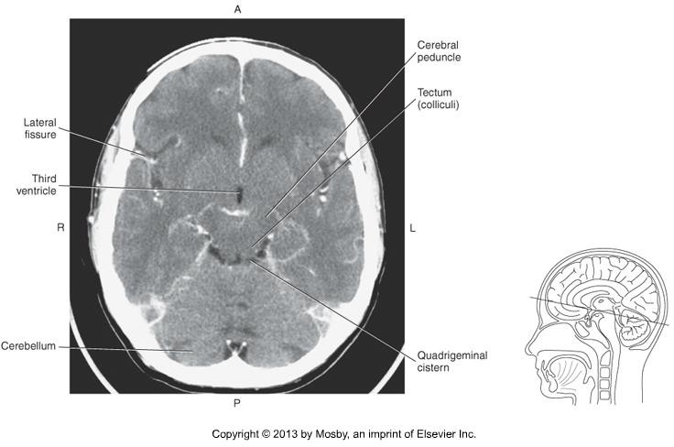
CT Imaging of the Head

Slide 56
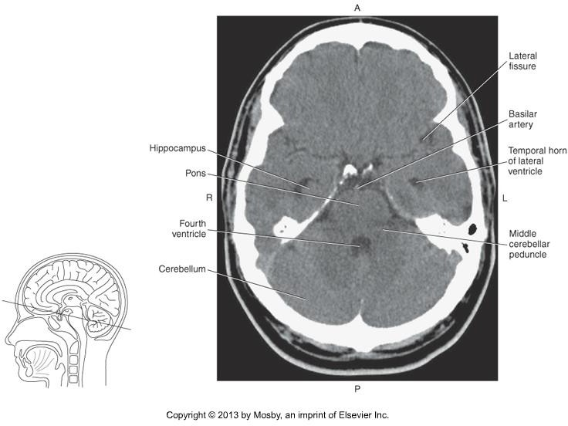
CT Imaging of the Head

Slide 57
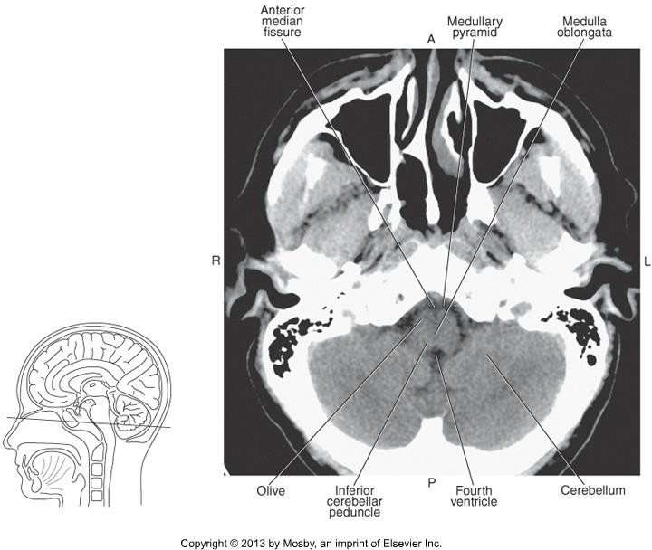
CT Imaging of the Head

Slide 58
CT Imaging of the Head
Cerebellum - occupies the posterior cranial fossa, and attaches posteriorly to the brainstem.
Important structures:
  Lateral hemispheres – folds of grey matter resemble cauliflower
  Vermis – connects the lateral hemispheres
  Cerebellar tonsils – two rounded prominences on the inferior surface
  Cerebellar peduncles – nerve fiber tracts connecting to the brainstem.

Slide 59
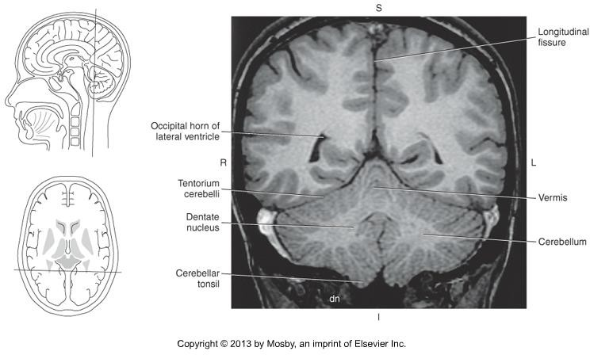
CT Imaging of the Head

Slide 60
CT Imaging of the Head
Helpful videos – Learn the anatomy of the brain!
https://www.youtube.com/watch?v=7jrjM90-B3k (just watch the first half!)

Slide 61
CT Imaging of the Head
Cerebral Vasculature – two main pairs of arteries supply blood to the brain:
  Internal Carotid arteries
  Vertebral arteries
Internal Carotids –
Vertebral –

Slide 62
CT Imaging of the Head
Internal Carotid Arteries
Arise from the bifurcation of the _ _ arteries in the neck.
Enter the base of the brain through the _ _ __ of the temporal bone.
Branches into the _ _ _ and the (larger)
.

Slide 63
CT Imaging of the Head
Vertebral arteries
Arise from the _ _ _ _ artery in the neck.
Ascend vertically through the _ _ foramina of the C- spine, curve around the atlanto-occipital joints and enter the base of the brain through the _ _ _ _.
Unite ventral to the pons to form the __ artery.

Slide 64
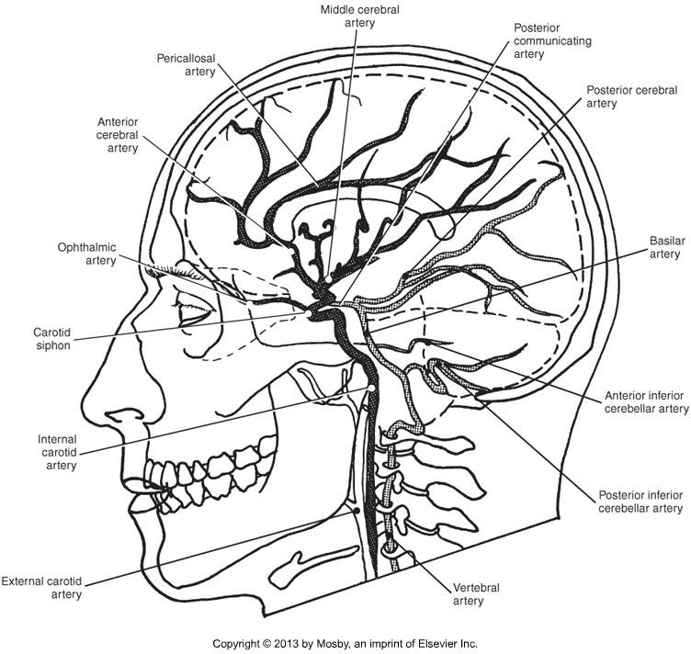
CT Imaging of the Head

Slide 65

CT Imaging of the Head

Slide 66
CT Imaging of the Head
Circle of Willis
Important junction of the four major arteries feeding the brain.
Comprised of
  Anterior and posterior cerebral arteries
  Anterior and posterior communicating arteries
•

Slide 67
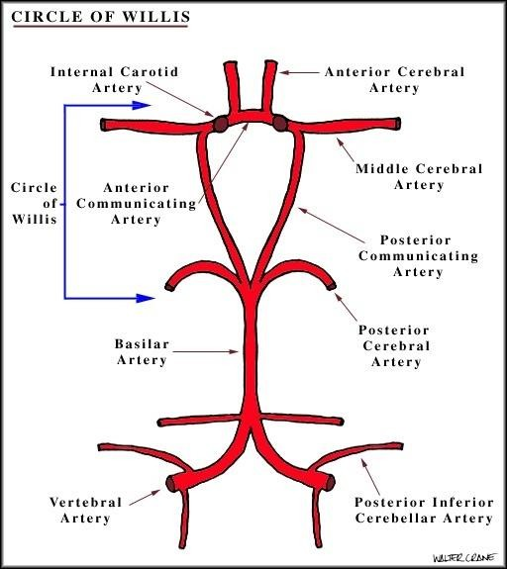
CT Imaging of the Head

Slide 68
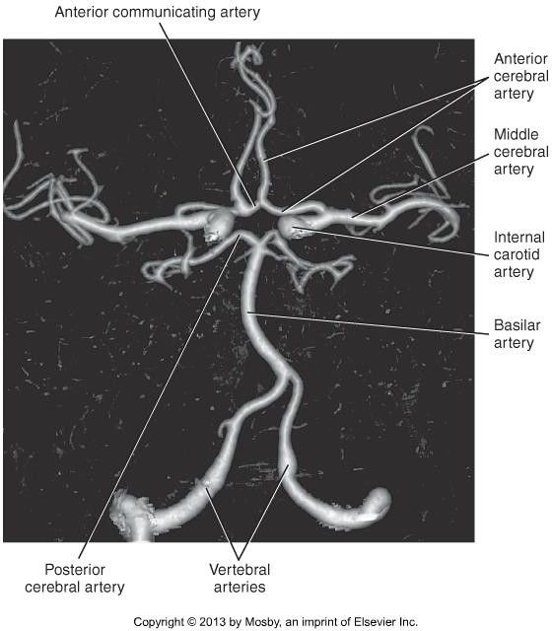
CT Imaging of the Head

Slide 69
CT Imaging of the Head
Venous Drainage
Dural sinuses – large veins within the dura mater of the brain.
All veins drain into the dural sinuses, and ultimately into the internal jugular veins in the neck.
Major dural sinuses are:
•
•
•

Slide 70
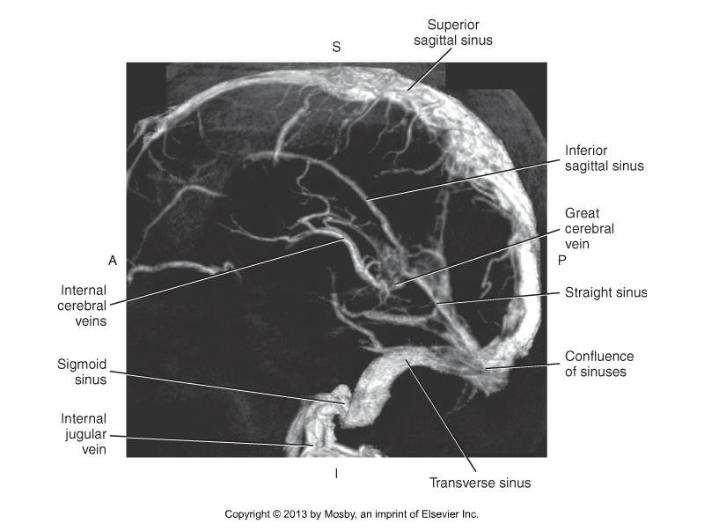
CT Imaging of the Head

Slide 71
CT Imaging of the Head
Helpful video – Circle of Willis anatomy
https://www.youtube.com/watch?v=9hhfM7rQHiM

Slide 72
CT Imaging of the Head
Summary
Review anatomy of the cranium, facial bones, brain, and cerebral vasculature.
The Limbic System & Cranial Nerves will not be tested on.
Use knowledge of relational anatomy to find structures when given a single CT image.
Use online sources for images/scans

