Slide 1
MRAD 256:
Radiographic Technique 2
Thoracic Spine Anatomy

Slide 2
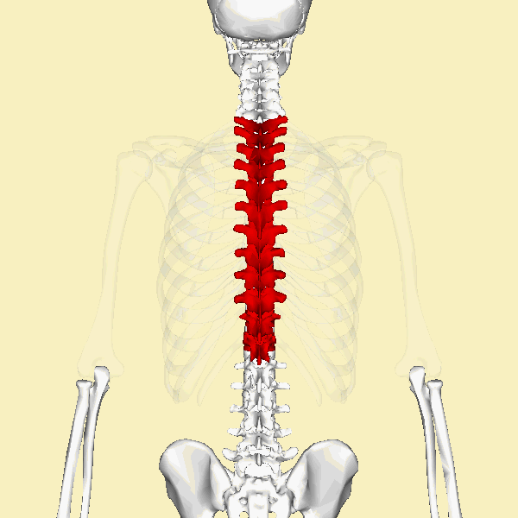

Slide 3
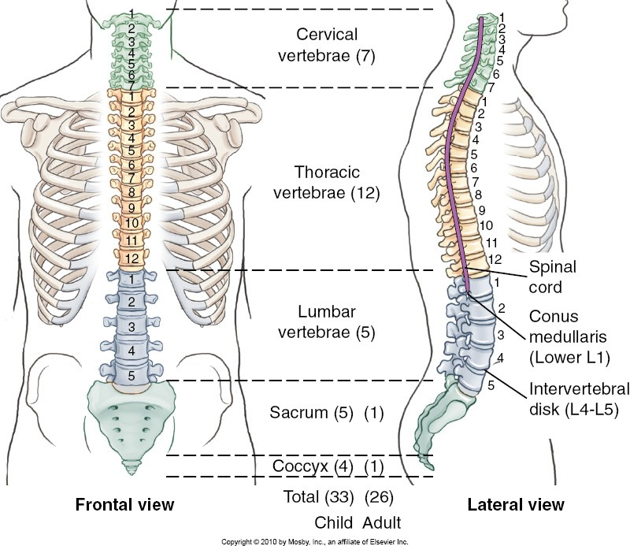
Thoracic Spine

Slide 4
Thoracic Vertebrae
The thoracic vertebrae increase in size from the first to the last.
T1 – T4 are similar to cervical vertebrae
T5, T6, T7, T8 are typical thoracic vertebrae
T9 – T12 are similar to the lumbar vertebrae

Slide 5
Thoracic Vertebrae
Body
Heart shaped
Vertebral Foramen
Circular
Transverse Processes
Have facets (transverse costal facets) that articulate with the tubercles of the ribs (except for T11 and T12)

Slide 6
Thoracic Vertebrae
Superior and Inferior articular facets
  Lie in the frontal plane preventing flexion and extension, but allows the spine in this region to rotate
Spinous Process
  Long and pointed inferiorly
  Corresponds with vertebra below

Slide 7
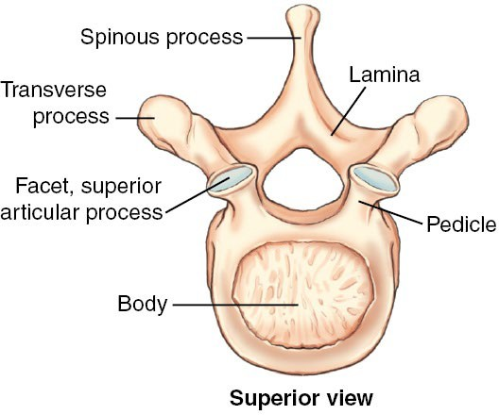
Typical Thoracic Vertebrae

Slide 8
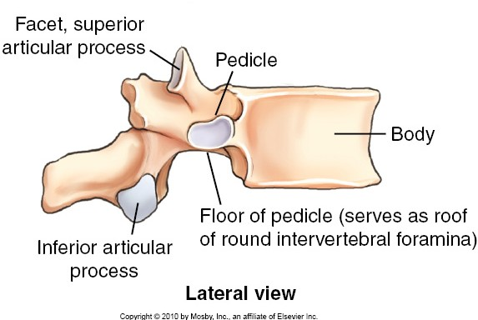
Typical Thoracic Vertebrae

Slide 9
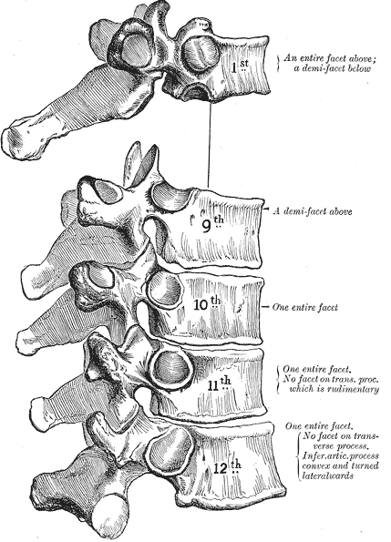
T1 has a full facet above and a demi facet below
T2-8 have demi facets above and below, T9 only has a demi-facet above
T1-10 have a facet on
each transverse process
to articulate with the
tubercles of the ribs
T10 has a full facet above
T11-12 have only a full facet, for the costovertebral joint, no facet on the transverse process

Slide 10
Rib Articulations
All thoracic vertebrae have facets for articulation with ribs, each associated with 1 pair of ribs
The costovertebral joints accept the head of the rib.
T1 has a full facet and demi facet inferiorly
T2-8 have demi facets in the upper and lower margins, where they share articulations of the ribs
When a rib articulates with demifacets rather than full facets, it straddles two vertebral bodies
ie: the head of the fourth rib articulates with the demifacet inferiorly on T3 and the demifacet superiorly on T4
T10 – T12 have a single full facet, rib 11 and 12 only articulate with T11 and T12 respectively
Notes:
Presenter
2021-01-29 14:43:58
--------------------------------------------
T1 has a full facet and a demifacet for articulation with the second rib
T2 – T8 have demifacets on upper and lower margins
T9 has only demifacet on its upper margin
T10 – T12 have full facets only
*** When a rib articulates with demifacets rather than full facets, it straddles two vertebral bodies.

Slide 11
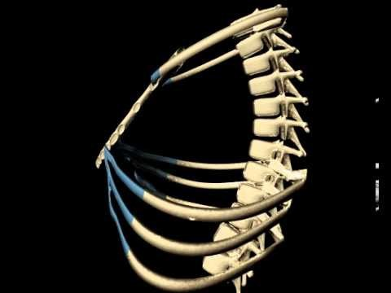
Costotransverse Joints
T1-10 have facets on each transverse process that articulate with the tubercles of ribs
These are diarthroidal joints and allow slight gliding movements , such as those required for breathing

Slide 12
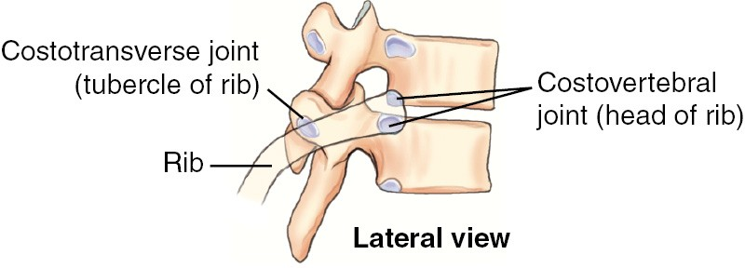
Costovertebral and Costotransverse Joints

Slide 13
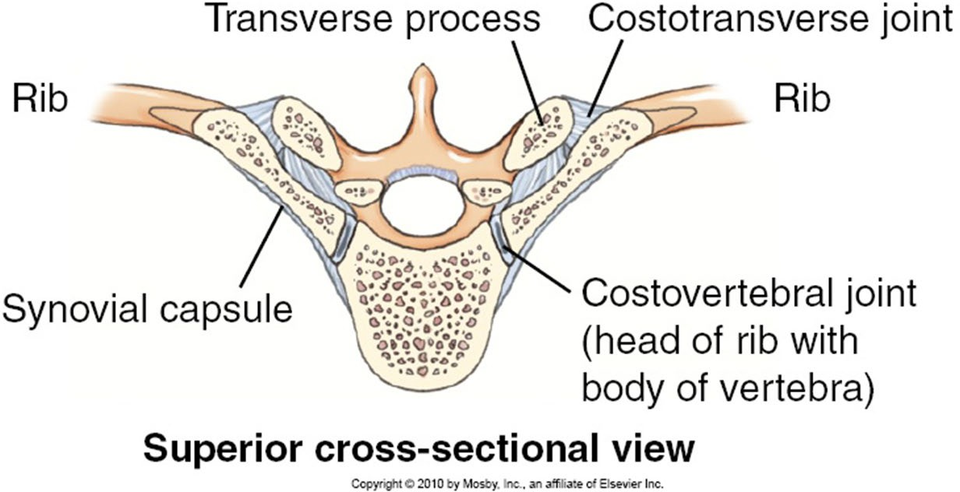

Slide 14
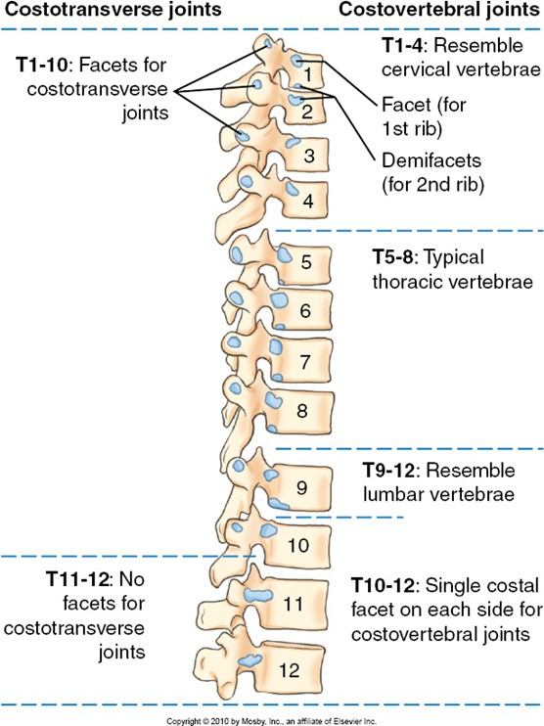
Thoracic Spine

Slide 15
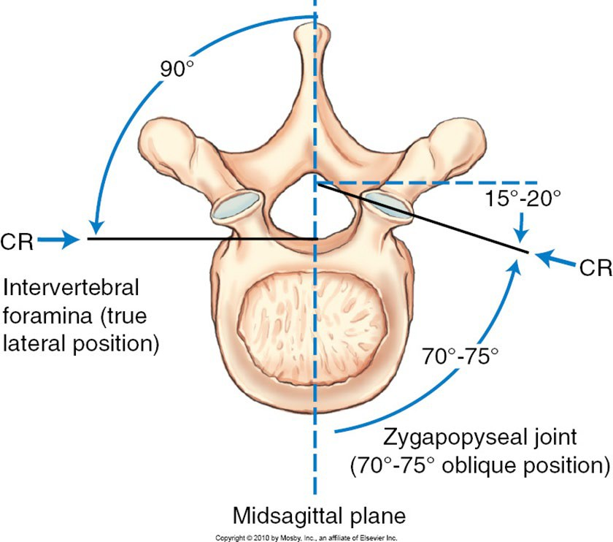
Zygapophyseal Joints
Formed by the superior and inferior articular processes
Form an angle of 70° to 75° from the midsagittal plane
These four articular processes allow for intravertebral articulation

Slide 16
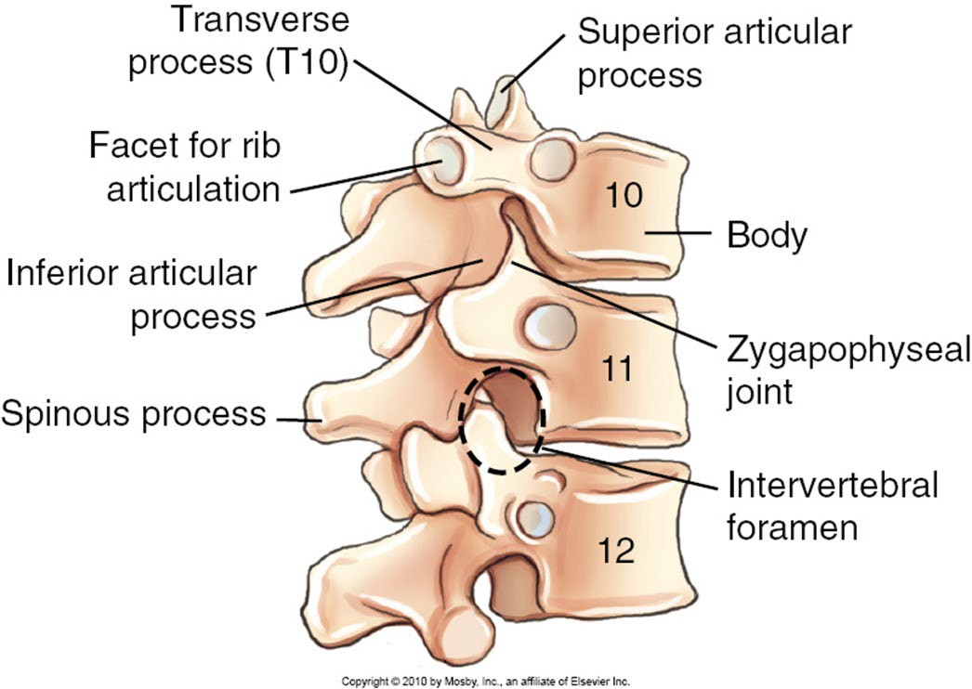
Intervertebral Foramina
Defined by superior and inferior margins of the pedicles
Located at 90° to the midsagittal plane

Slide 17
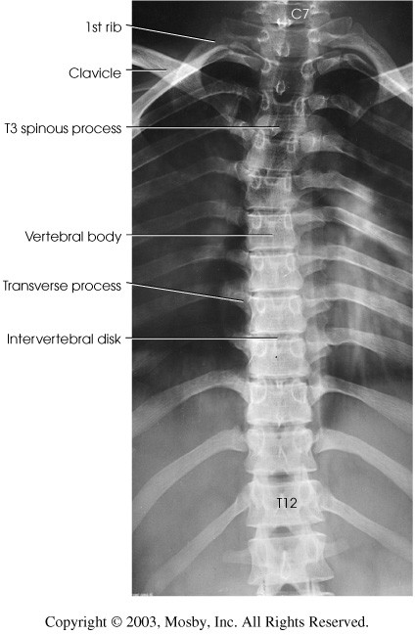
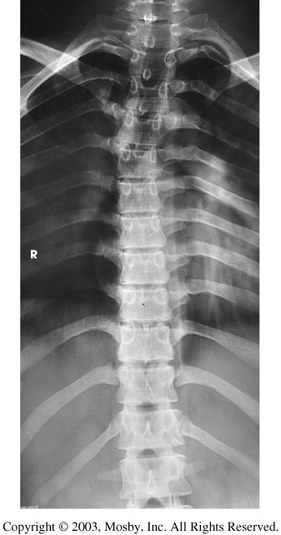

Slide 18
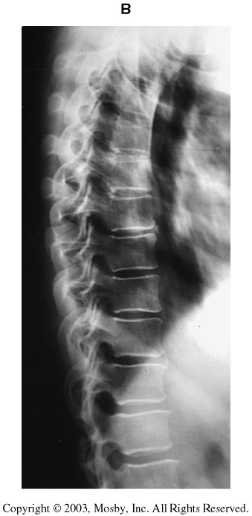
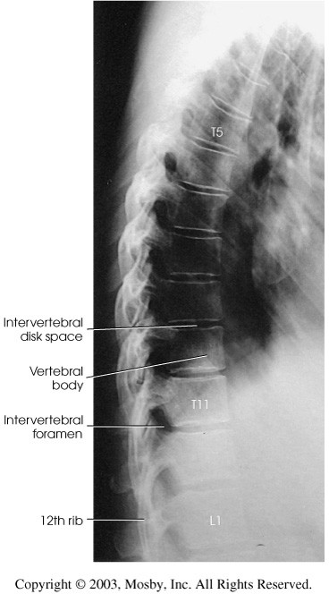

Slide 19
Summary of Vertebral Joints of the Thoracic Spine
Joints
Classification
Movement Type
T1-12 Intervetebral
Cartilaginous (symphysis)
N/A
Plane(gliding)
Plane(gliding)
Plane(gliding)
T1-12
Zygapophyseal
Synovial
T1-12
Costovertebral
Synovial
T1-10
Costotransverse
Synovial

