Slide 1

ANPH 202: Anatomy and Pathology I
Pathologies of the Central Nervous System

Slide 2
CNS Infections
Meningitis
Encephalitis

Slide 3
Meningitis
Meningitis is an acute inflammation of the pia mater and arachnoid.
Infecting organisms can reach the meninges via:
  Infection in the middle ear, upper respiratory tract, or frontal sinus
  Spread through the bloodstream (hematogenously)
  Infection in the lungs (or other site)
It is caused by bacteria and viruses.
Bacterial meningitis (pyogenic) is the most common form.

Slide 4
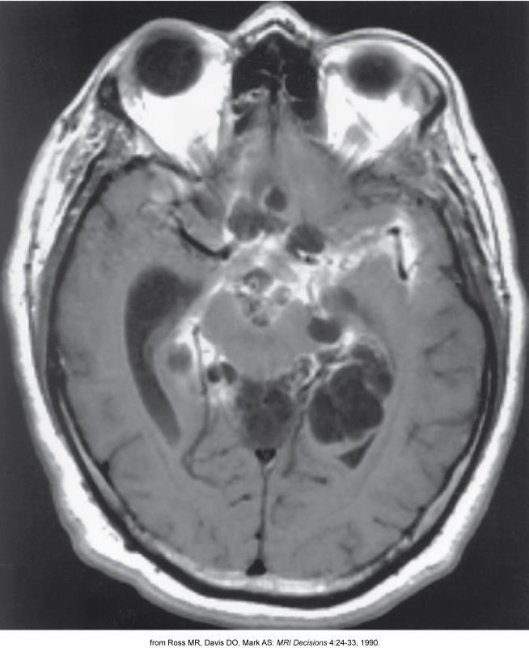
Meningitis – MRI

Slide 5
Encephalitis
Encephalitis is a viral inflammation of the brain and meninges (meningoencephalitis).
It produces a wide range of symptoms, ranging from mild headache and fever to severe cerebral dysfunction, seizures, and coma.
Herpes simplex virus can cause a sudden, severe, and fatal process.

Slide 6
CNS Tumors
Glioma
Acoustic Neuroma
Pituitary Adenoma
Metastatic Carcinoma

Slide 7
Glioma
Gliomas are the most common primary malignant brain tumors.
They are composed of glial cells (supporting connective tissues in the CNS).
They are spread by direct extension.
Can cross from one cerebral hemisphere to the other through connecting white matter tracts, such as the corpus callosum.

Slide 8
Glioma
Peak age incidence – middle-age adults
  Infrequent in persons less than 30 years of age
Types:
  Glioblastoma – highly aggressive
  Astrocytoma – most common
Less common types:
  Ependymoma
  Medulloblastoma
  Oligodendrocytoma

Slide 9
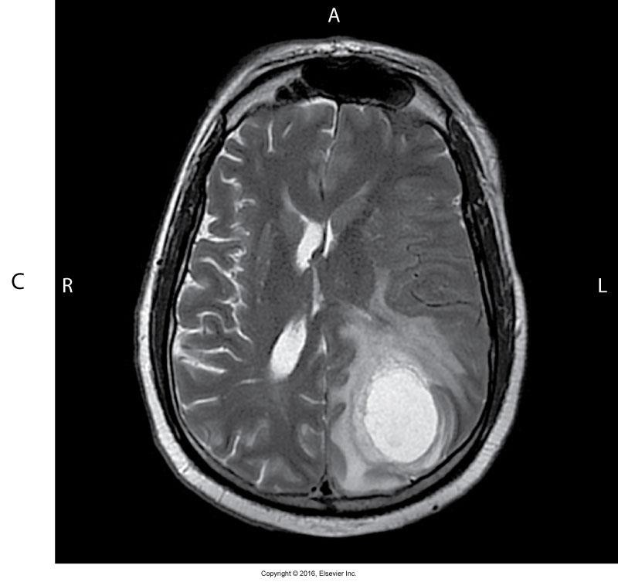
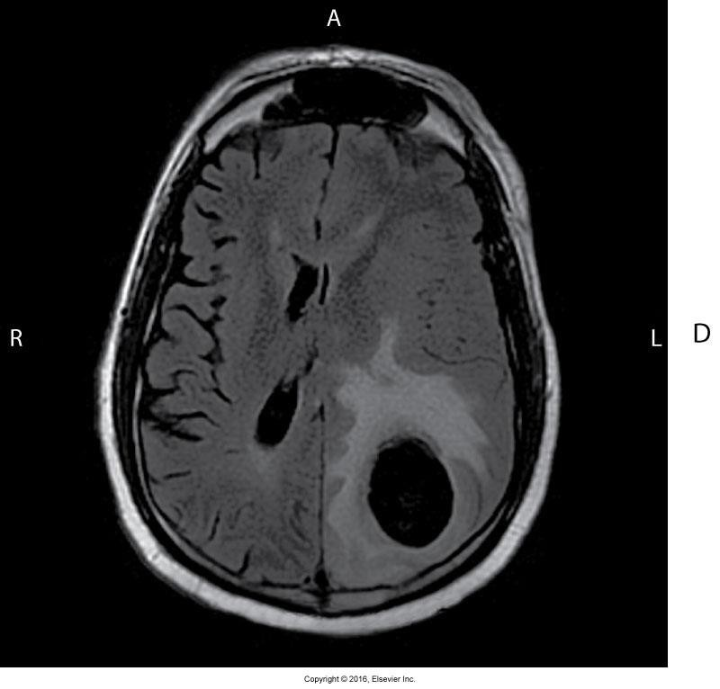
Glioblastoma Multiforme – MRI

Slide 10
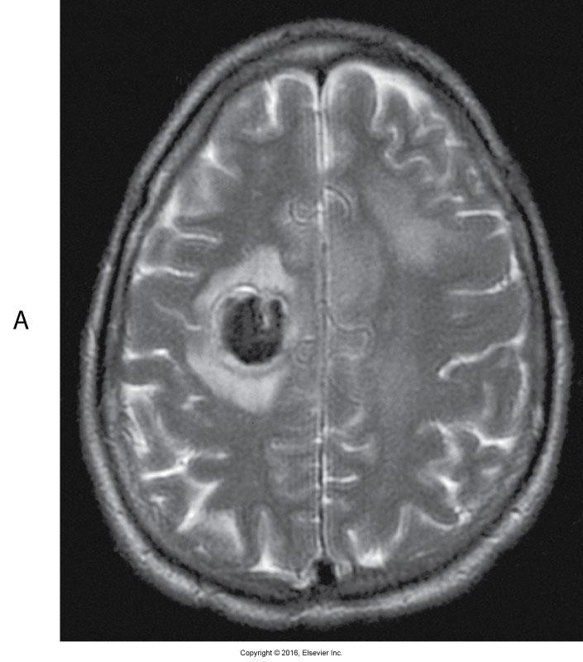
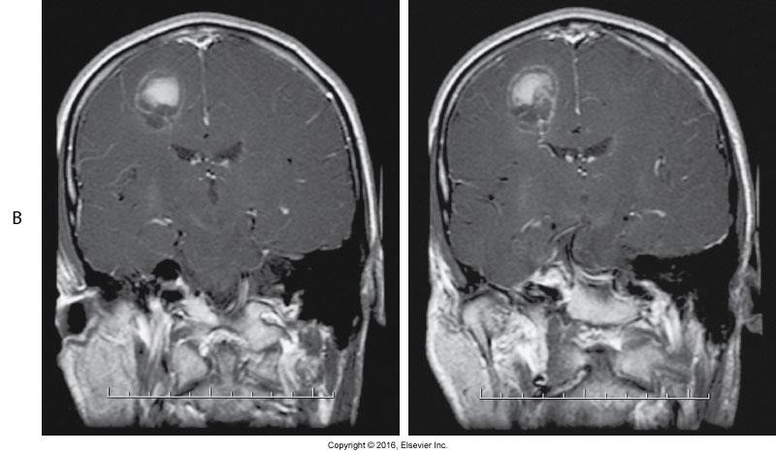
Glioma – MRI

Slide 11
Acoustic Neuroma
Acoustic neuroma is a slowly growing benign tumor.
•
  It may occur as a solitary lesion or as part of the syndrome of neurofibromatosis.
It arises from Schwann cells in the vestibular portion of the auditory (eighth cranial) nerve.
It most often originates in the internal auditory canal and extends into the cerebellopontine angle cistern.

Slide 12
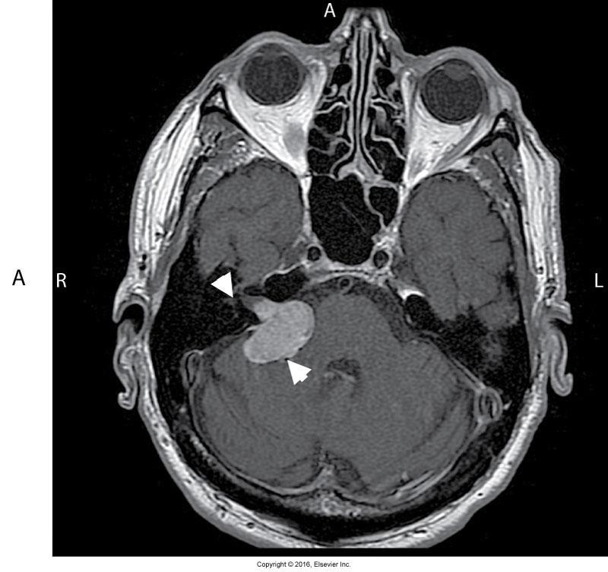
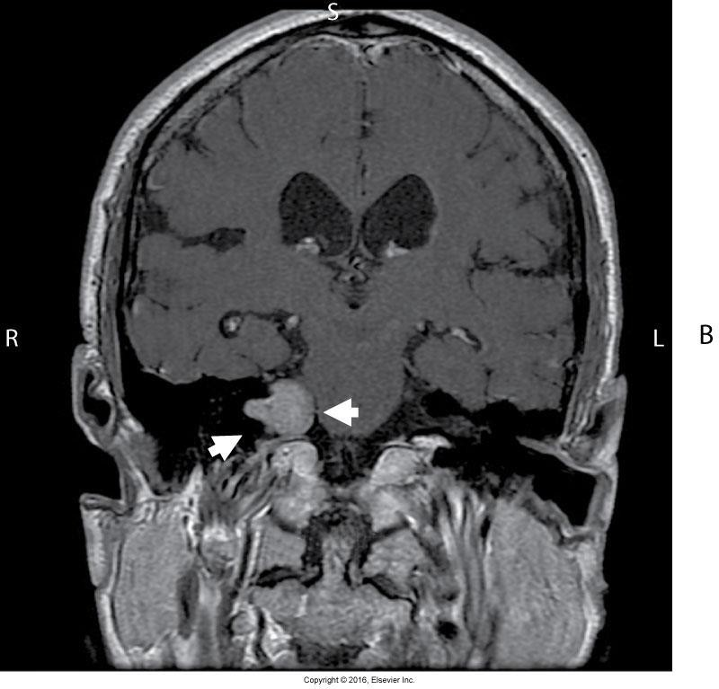
Acoustic Neuroma – MRI

Slide 13
Pituitary Adenoma
Pituitary adenomas usually arise in the anterior lobe.
Most common type – nonsecreting chromophobe adenoma
  Mass effect of tumor suppresses pituitary hormone secretions.
Hormone-secreting pituitary adenomas produce symptoms related to excess hormones, rather
than mass effect.
  Gigantism in adolescents
  Acromegaly in adults

Slide 14
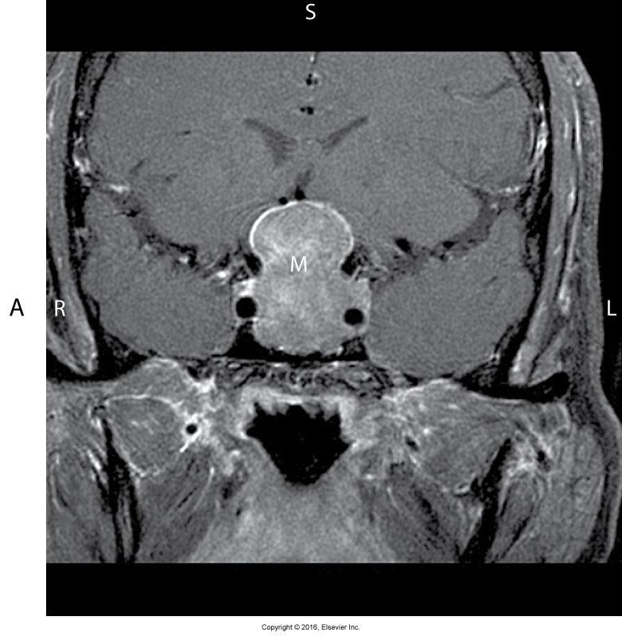
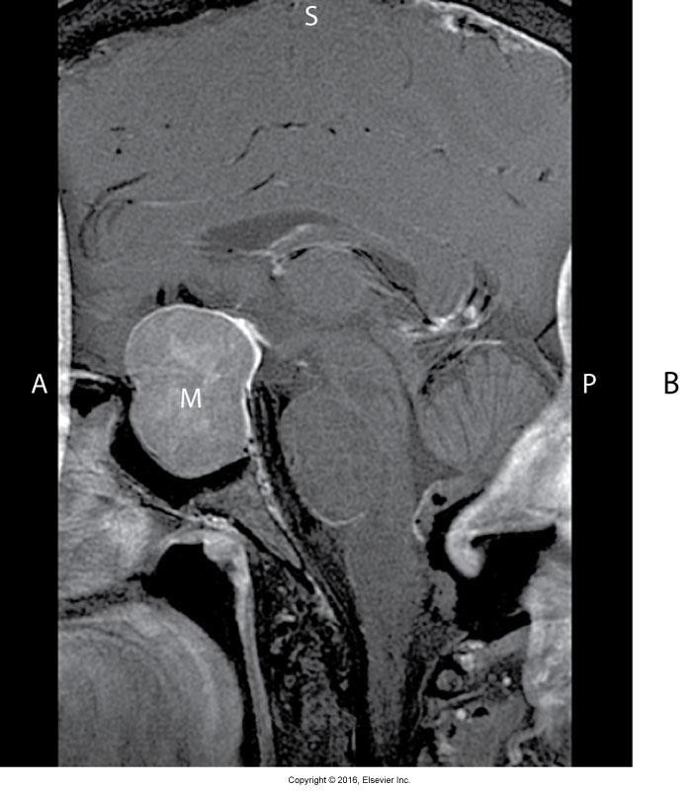
Pituitary Adenoma – MRI

Slide 15
Metastatic Carcinoma
The most common primary cancers to spread to the brain are
  Lung
  Breast
They usually reach the brain by hematogenous spread.
Melanomas, colon carcinomas, and testicular and kidney tumors also cause brain metastases.

Slide 16
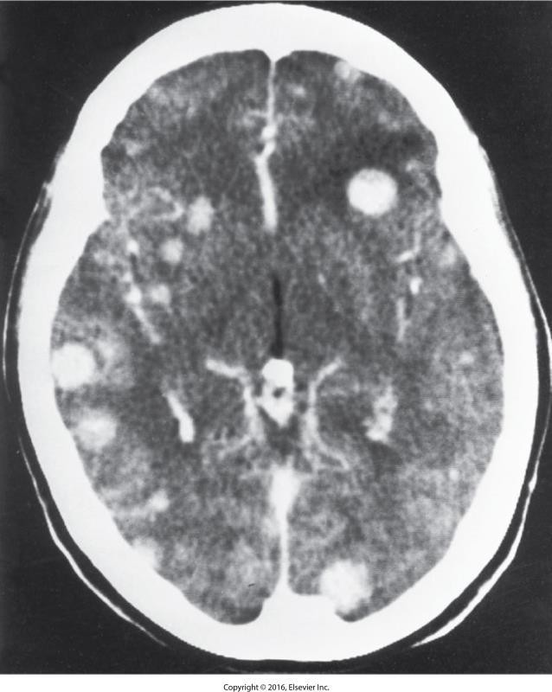
Brain Metastasis – CT

Slide 17
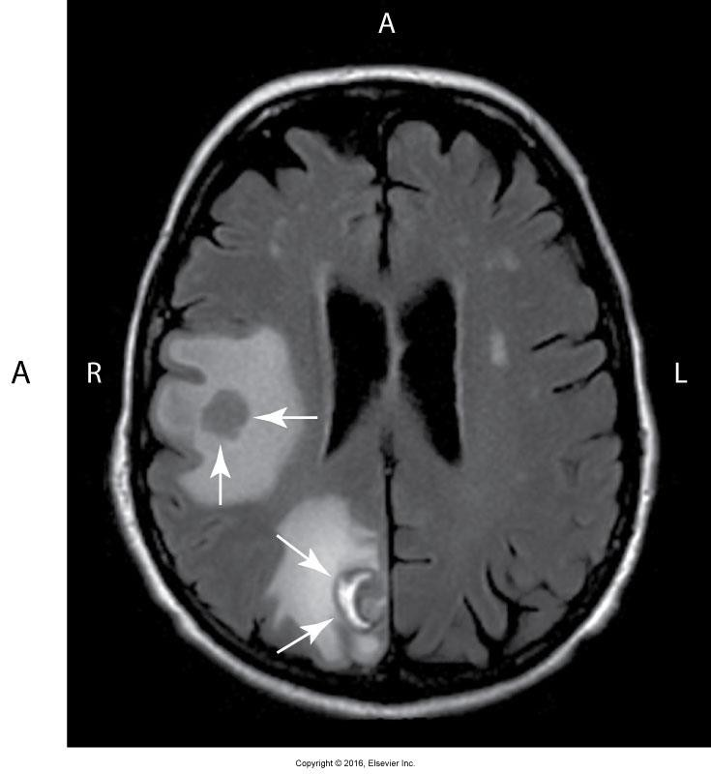
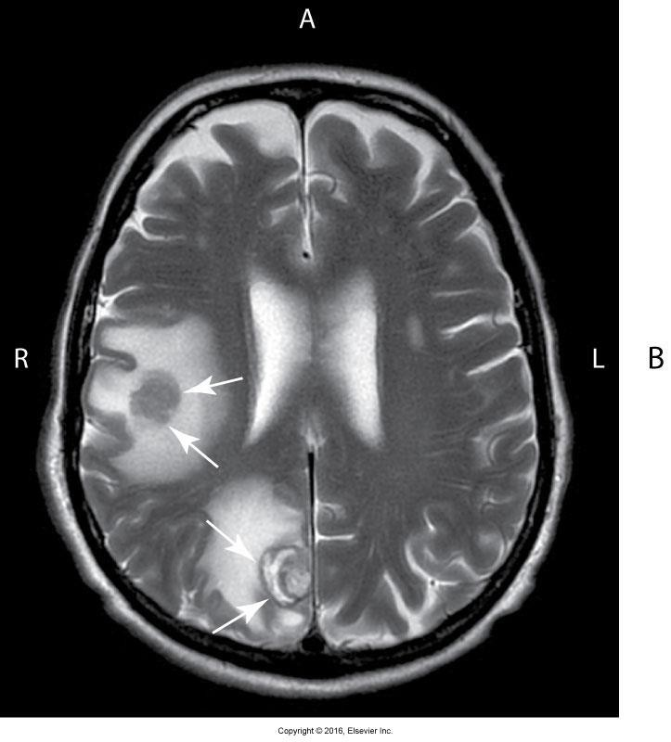
Brain Metastasis – MRI

Slide 18
What is the most common type of glioma?
  Ependymoma
  Craniopharyngioma
  Astrocytoma
  Oligodendrocytoma

Slide 19
Traumatic Processes
Skull Fracture
Epidural Hematoma
Subdural Hematoma
Cerebral Contusion
Intracerebral Hematoma
Carotid Artery Injury
Subarachnoid Hemorrhage

Slide 20
Skull Fracture
The presence or absence of a skull fracture does not correlate with intracranial abnormalities.
  Plain radiographs of the skull are no longer indicated in head trauma.
Emergency CT is modality of choice for head trauma.

Slide 21
Skull Fracture
Types of skull fractures:
  Linear
    Appears on a plain radiograph as a sharp lucent line that is often irregular or jagged and occasionally branches
  Diastatic
    A linear fracture that intersects a suture and courses along it, causing sutural separation

Slide 22
Skull Fracture
Depressed
  They are often stellate (star shaped) with multiple fracture lines radiating outward from a central point.
  When viewed face on, the fragment overlap makes the fracture line appear denser than the normal bone.
  Tangential views are required to determine the amount of depression

Slide 23
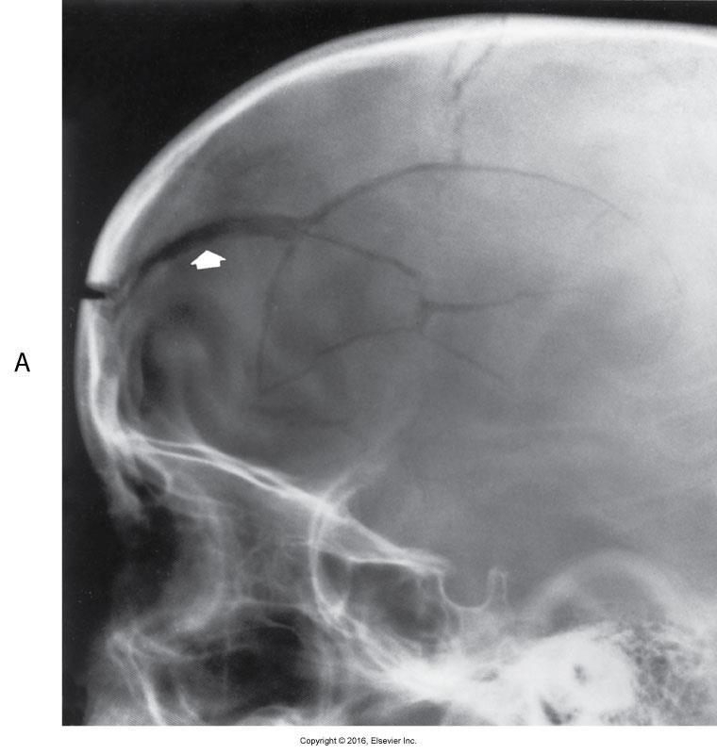
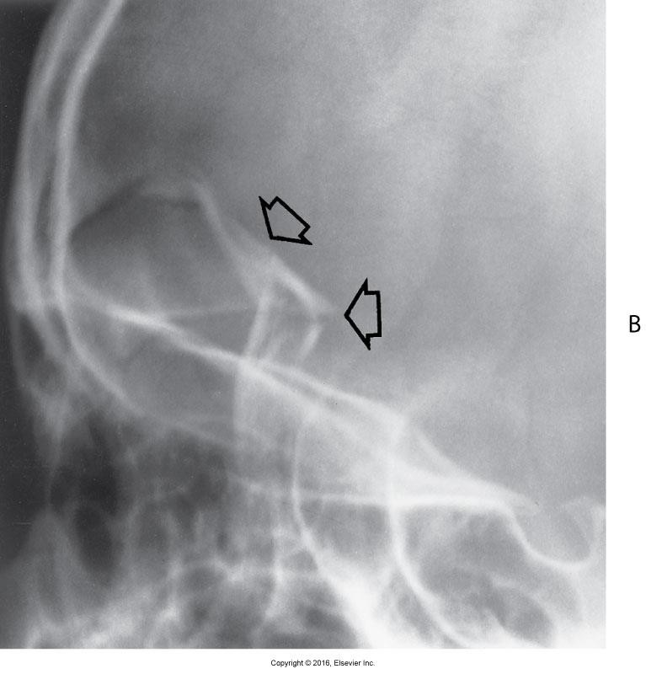
Skull Fractures – Radiography

Slide 24
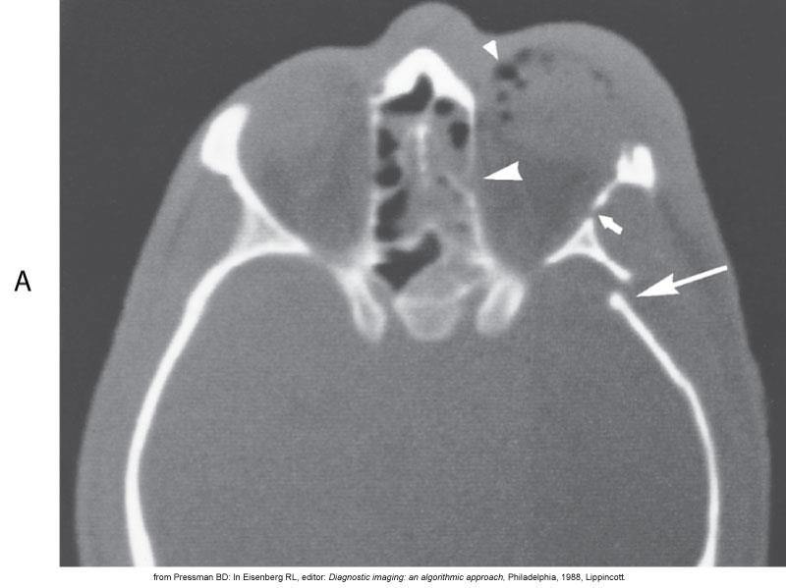
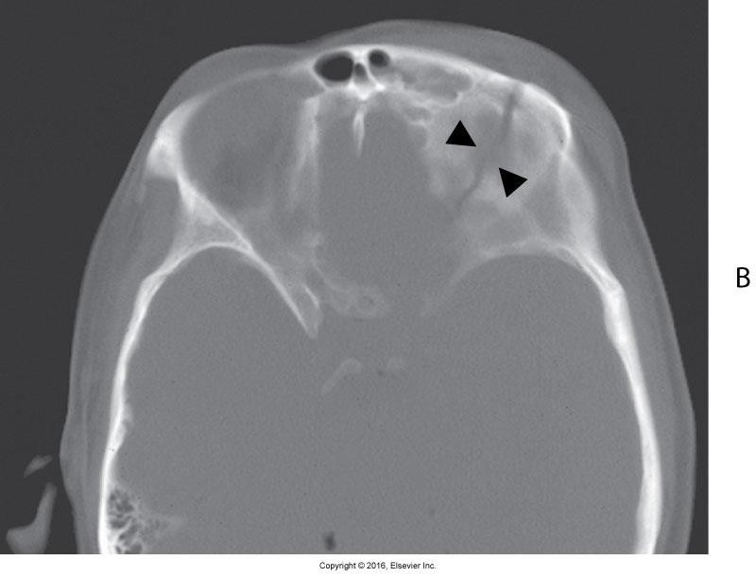
Skull Fracture – CT

Slide 25
Epidural Hematoma
Epidural hematoma is caused by acute arterial bleeding, usually from a laceration to the middle meningeal artery.
Cause “mass effect”
  focal lesion or contusion causes surrounding areas of brain tissue
or brain structures to be compressed and injured due to the degree of space that leaking blood, cerebrospinal fluid, or edema takes up within the restricted skull space.
Typically appears as a biconvex (lens-shaped), peripheral, high-density lesion.

Slide 26
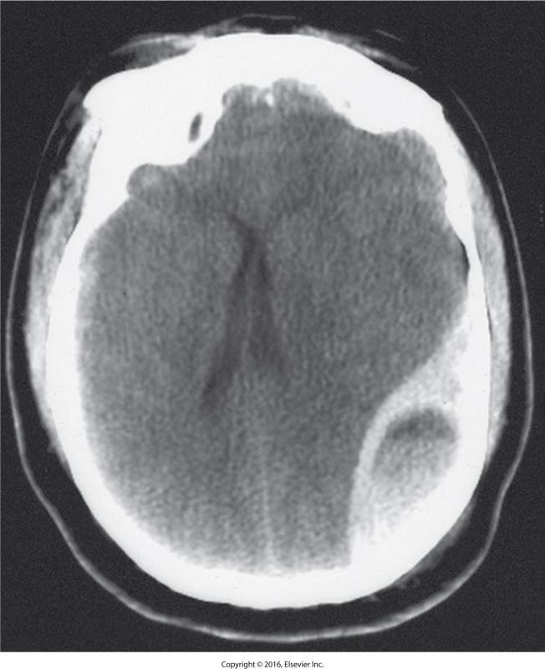
Epidural Hematoma

Slide 27
Subdural Hematoma
Subdural hematoma is caused by venous bleeding.
  Usually it is a vein between the dura and the other meninges.
It typically appears on CT scans as a crescent-shaped, peripheral zone of increased density.
  It follows the surface of the brain.
  It lies adjacent to the inner table of the skull.

Slide 28
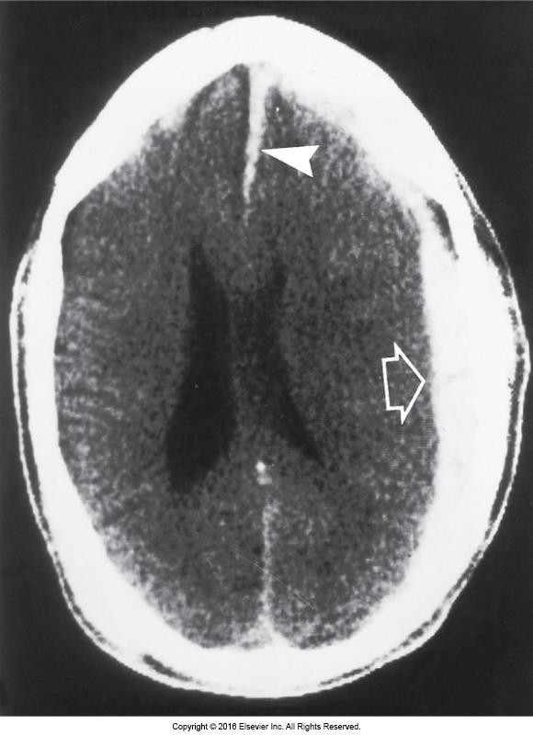
Acute subdural hematoma. A high- density, crescent-shaped lesion (arrow) is adjacent to the inner table of the skull. Hematoma extends into interhemispheric fissure (arrowhead).
Figure 08-36 Eisenberg

Slide 29
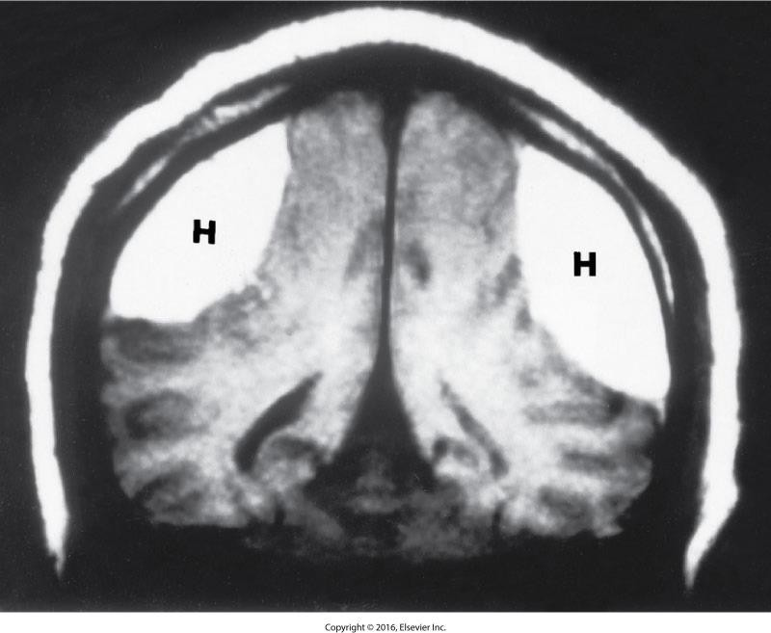
Subdural Hematoma – MRI
Bilateral subdural hematomas marked “H”

Slide 30
Cerebral Contusion
Cerebral contusion is an injury to brain tissue caused by movement of the brain within the calvaria after blunt trauma to the skull.
It occurs when the brain contacts rough skull surfaces.
Cerebral contusions typically appear on CT scans as low-density areas of edema and tissue necrosis.
  They may or may not have areas of mixed densities that indicate small, multiple hemorrhages.

Slide 31
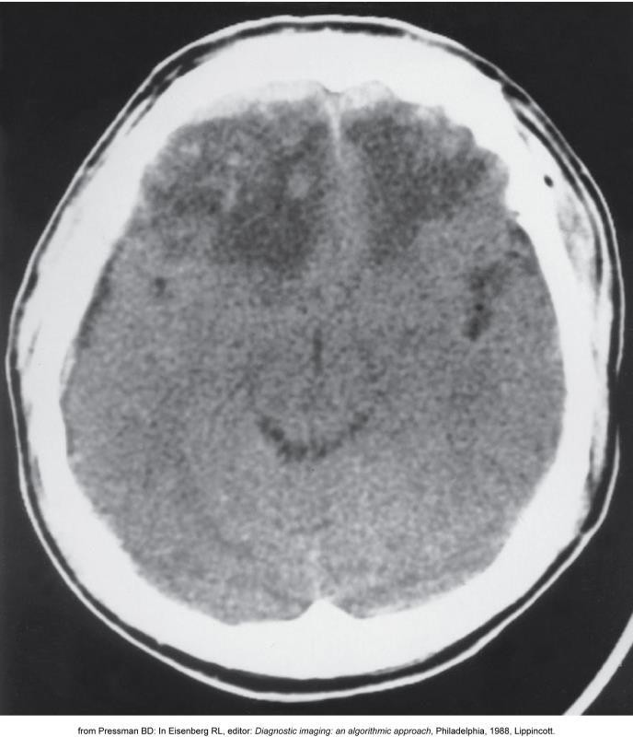
Cerebral Contusion – CT

Slide 32
Intracerebral Hematoma
Intracerebral hematoma is a traumatic hemorrhage into the brain parenchyma.
It results from shearing forces to intraparenchymal arteries.
  It usually occurs at the junction of the gray and white matter.
On CT, it appears as a well-circumscribed, homogeneous, high- density region often surrounded by low-density edema.

Slide 33
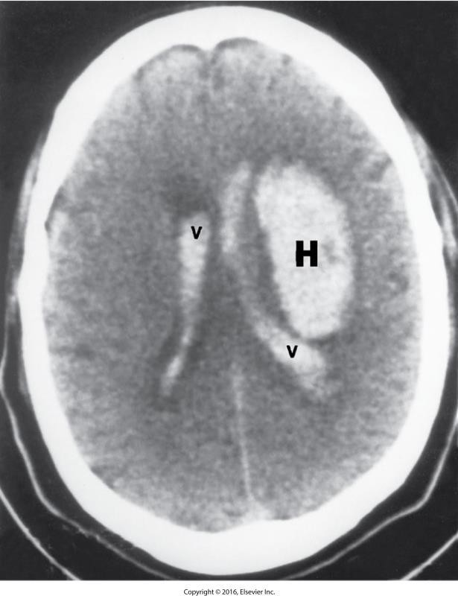
Intracerebral Hematoma – CT

Slide 34
Subarachnoid Hemorrhage
Subarachnoid hemorrhage is bleeding into the ventricular system due to injury to surface veins, cerebral parenchyma, or cortical arteries.
CT shows increased density within the basilar cisterns, cerebral fissures, and sulci.

Slide 35
Carotid Artery Injury
Extracerebral carotid arteries injured by penetrating trauma to the neck
  Gunshot wounds
  Stabbing
The internal carotid artery is implicated in 50% of traumatic fistulas, between the IC artery and cavernous sinus

Slide 36
CNS Vascular Diseases
Stroke Syndrome
Transient Ischemic Attacks
Intraparenchymal Hemorrhage
Subarachnoid Hemorrhage

Slide 37
Stroke
Stroke denotes the sudden and dramatic development of a focal neurologic deficit.
  It is also termed an acute brain infarction.
It varies from dense hemiplegia and coma to only a trivial neurologic disorder.
Specific neurologic defect depends on the affected arteries.
  Internal carotids are most commonly involved.

Slide 38
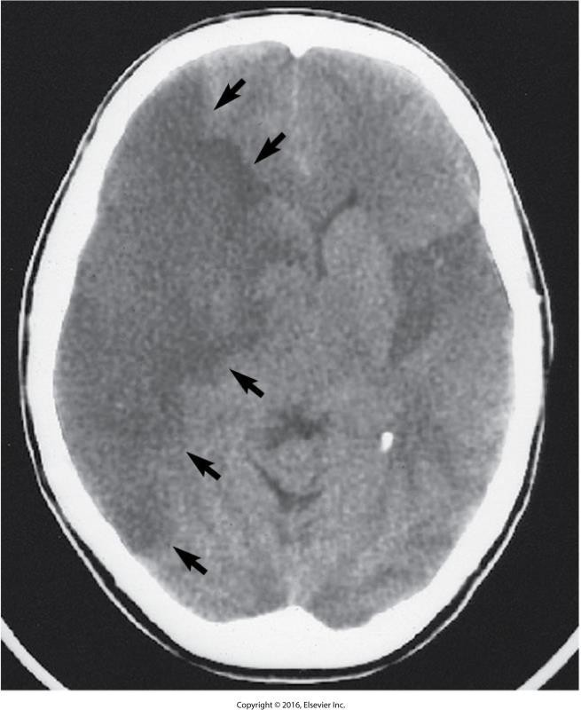
Middle Cerebral Artery Infarct

Slide 39
Transient Ischemic Attacks (TIAs)
TIAs are focal neurologic deficits that completely resolve within 24 hours.
They result from emboli originating from the surface of an arteriosclerotic ulcerated plaque (embolic stroke) or from stenosis of an extracerebral artery.

Slide 40
Transient Ischemic Attacks
Almost 2/3 of strokes are preceded by TIAs.
It is important to diagnose since 5-year cumulative risk of stroke in patients with TIAs may be as high as 50%.
The most common location of surgically treatable arteriosclerotic disease causing TIAs is the region of the carotid bifurcation in the neck.

Slide 41
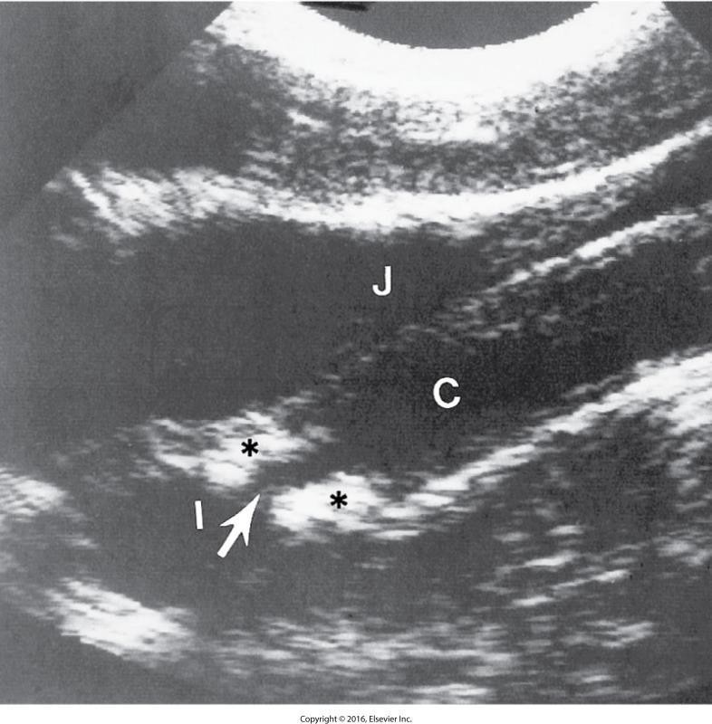
Carotid Artery Stenosis – US

Slide 42
Intraparenchymal Hemorrhage
Intraparenchymal hemorrhage is also termed hemorrhagic stroke.
Causes:
  Head trauma
  Hypertensive vascular disease
  Congenital berry aneurysm rupture
  Arteriovenous malformation
Hypertensive hemorrhages result in oval or circular collections that displace the surrounding brain and can cause a significant mass effect.

Slide 43
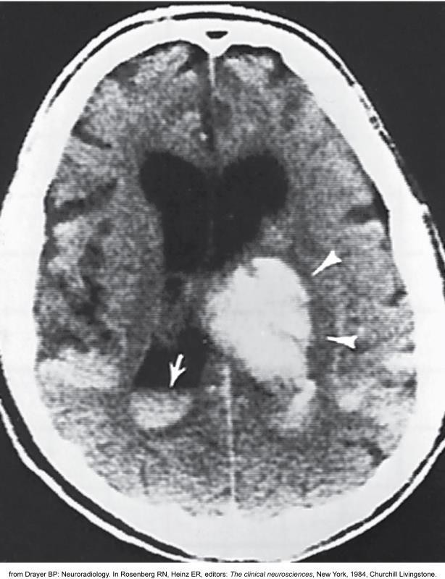
Intraparenchymal Hematoma

Slide 44
Subarachnoid Hemorrhage
Subarachnoid hemorrhage is another form of hemorrhagic stroke.
Primary cause is a ruptured berry aneurysm.

Slide 45
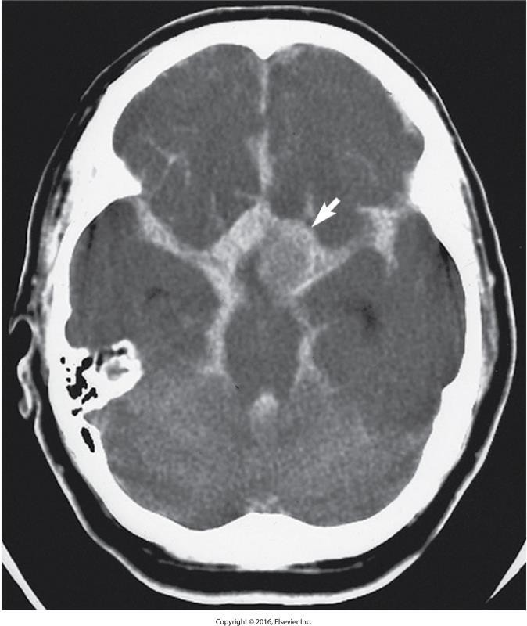
Subarachnoid Hemorrhage – CT

Slide 46
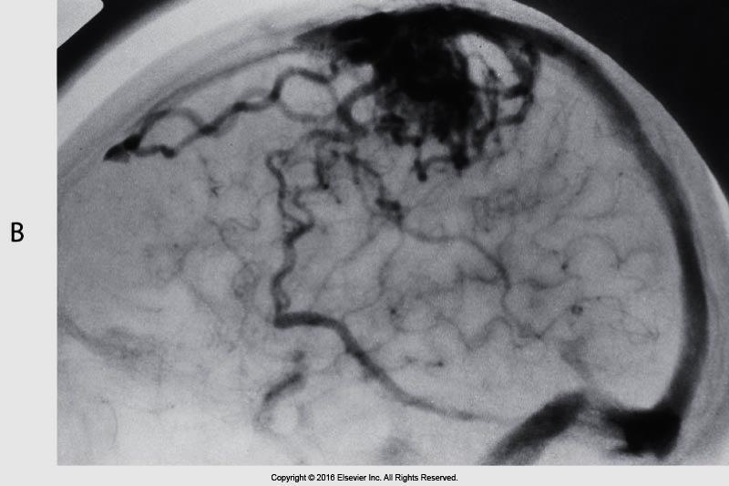
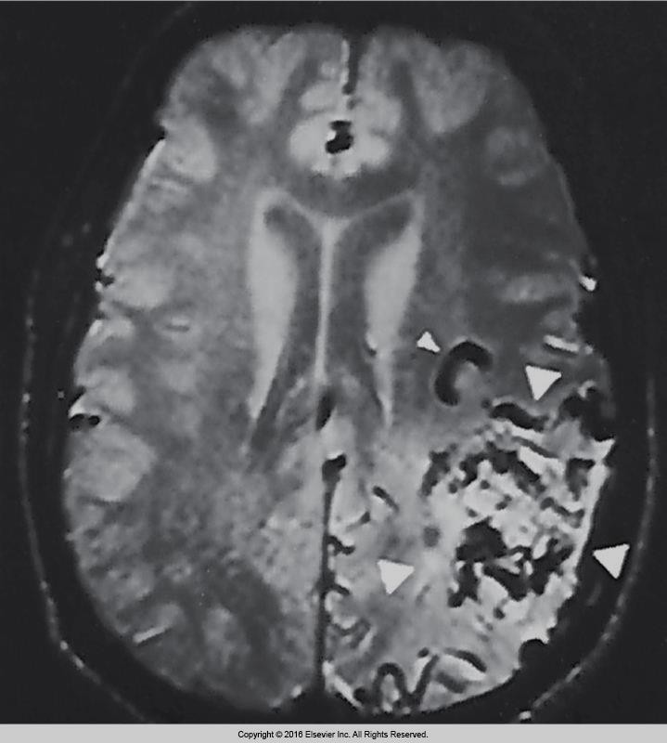
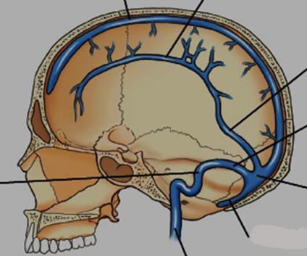
AVM-(arteriovenous malformation)
Eisenberg 8-60, 8-61
And Bontrager 17-19

Slide 47
Degenerative Diseases
Normal Aging
Alzheimer’s Disease
Huntington’s Disease
Parkinson’s Disease
Cerebellar Atrophy
Amyotrophic Lateral Sclerosis (Lou Gehrig’s Disease)

Slide 48
Normal Aging
Normal aging is evidenced on images as enlargement of the ventricular system and sulci.
  Caused by a gradual loss of neurons

Slide 49
Alzheimer’s Disease
Alzheimer’s disease is a diffuse form of progressive cerebral atrophy that develops at an earlier age than the senile period.
CT and MRI demonstrate nonspecific findings of cerebral atrophy, including symmetrically enlarged ventricles with prominence of the cortical sulci.

Slide 50
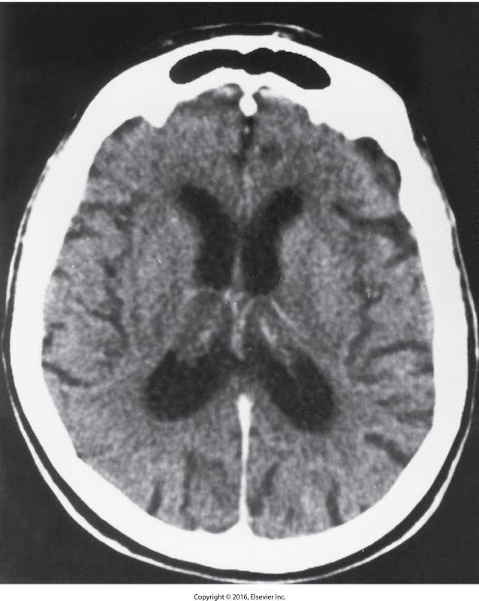
Alzheimer’s Disease – CT

Slide 51
Parkinson’s Disease
Parkinson’s disease is a progressive, degenerative disease.
Characterized by:
  Stooped posture
  Stiffness and slowness of movement
  Fixed facial expression
  Involuntary rhythmic tremor of the limbs that disappears with voluntary movement

Slide 52
Parkinson’s Disease
Parkinson’s disease shows up in middle or later life.
It is very gradually progressive and exhibits a prolonged course.

Slide 53
Which is caused by venous bleeding as a complication of head trauma?
  Epidural hematoma
  Intracranial hemorrhage
  Subdural hematoma
  TIA

Slide 54
Herniation of Intervertebral Disks
Protrusion of a portion of the disk
Most common sites:
  L4–L5
  L5–S1
  C5–C6
  C6–C7
  T9–T12

Slide 55
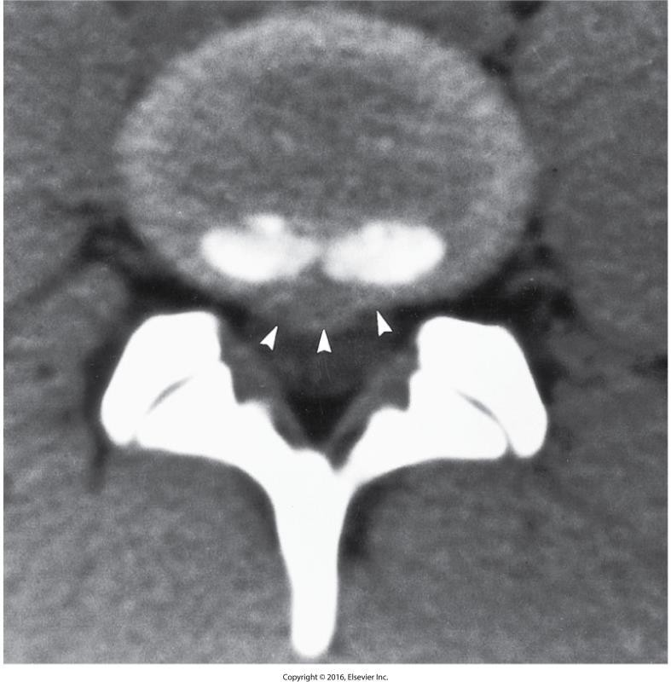
HNP – CT

Slide 56
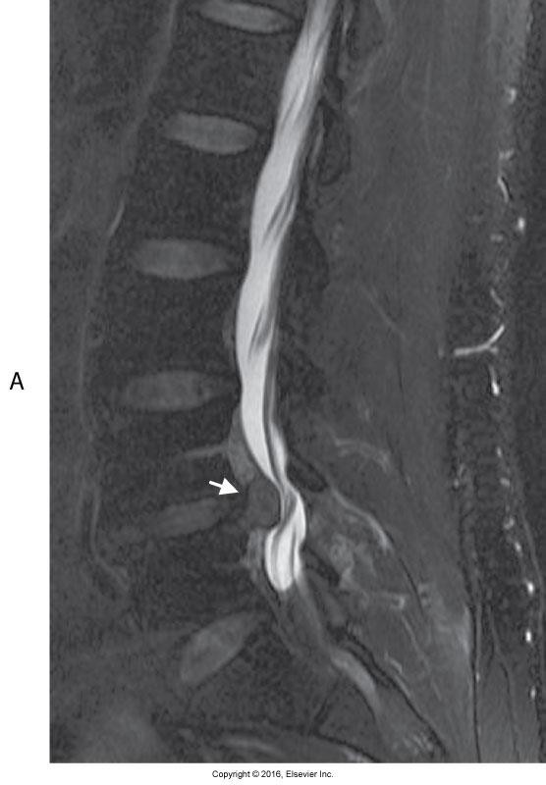
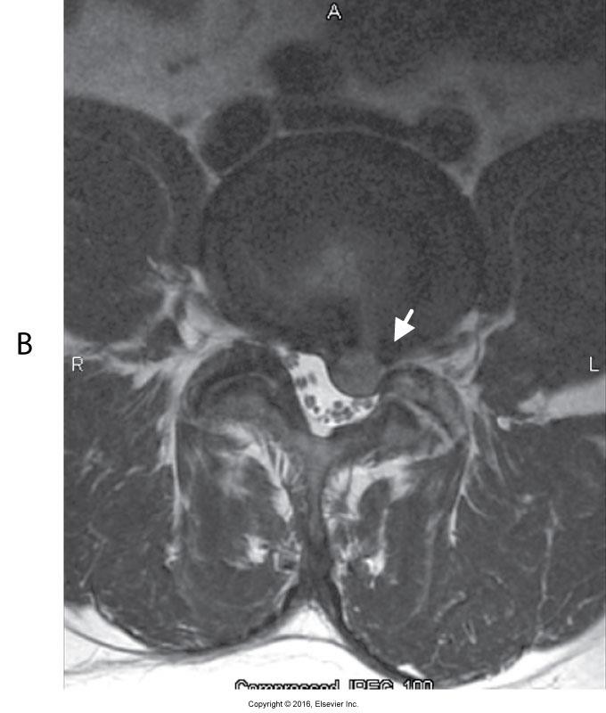
HNP – MRI

Slide 57
Hydrocephalus
Hydrocephalus is dilatation of the ventricular system that is usually associated with increased intracranial pressure.
Two types:
  Noncommunicating (obstructive)
    CSF flow blocked somewhere in its normal path
  Communicating
    CSF flows into extraventricular subarachnoid space
Pattern of ventricular enlargement and other characteristics seen on images help in identifying type or location of obstruction.

Slide 58
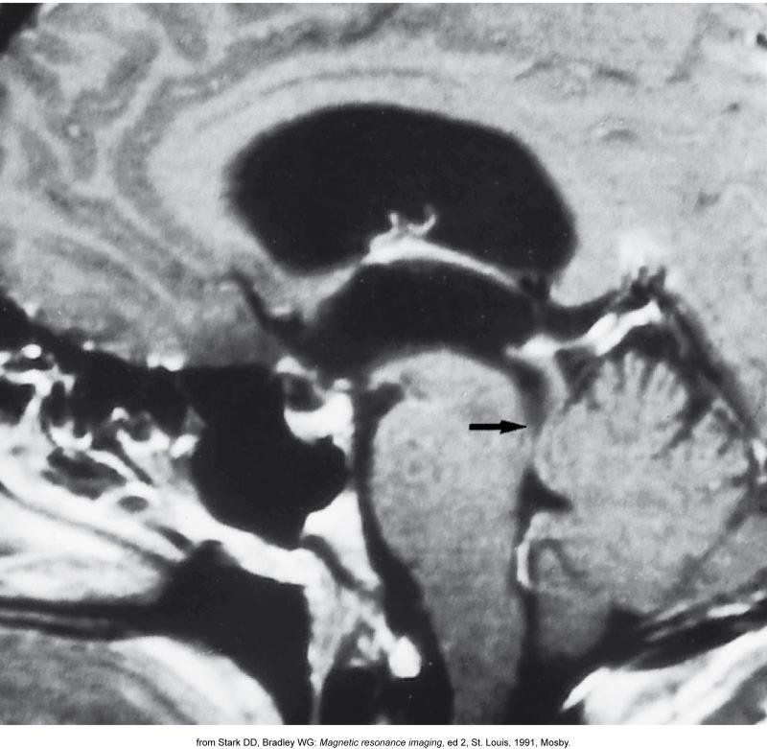
Hydrocephalus – MRI

Slide 59
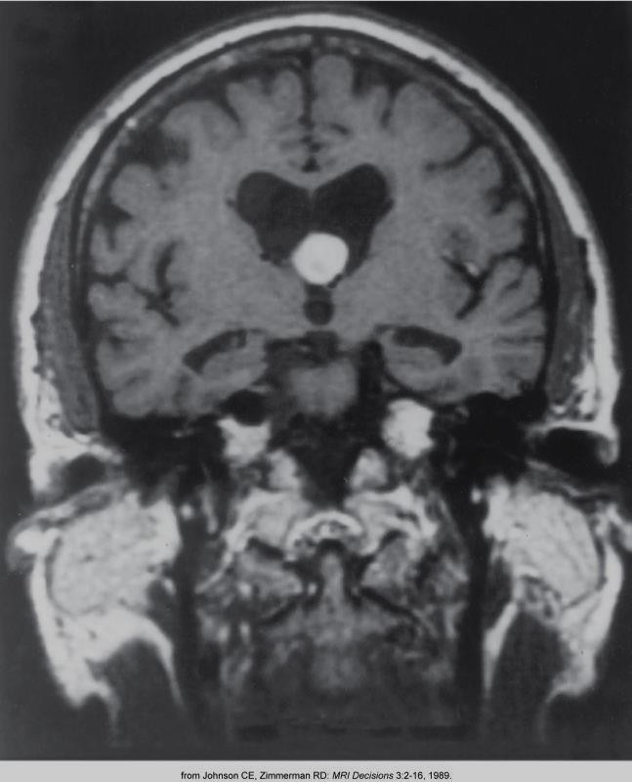
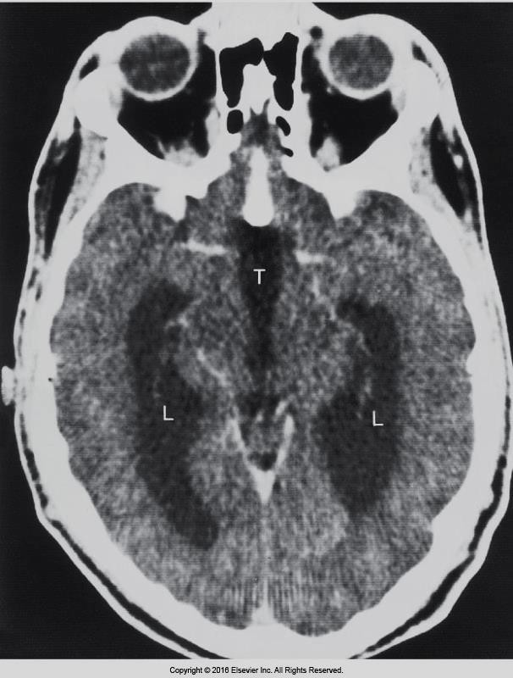
Hydrocephalus
Eisenberg 8-73, 8-74

Slide 60
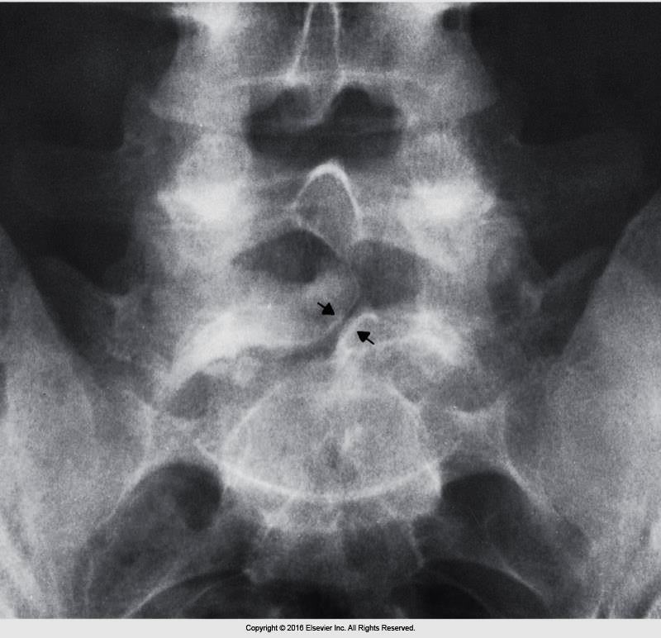
Spinal Bifida…
Eisenberg 4-4

