Slide 1
MRAD 204:
Radiographic Technique 1
Outcome 1-5:
Positioning – Shoulder & Clavicle

Slide 2
Affiliated Readings
Module 5
Bontrager
Pgs: 183, 191→193, 196, 199 & 201
Pg: 204

Slide 3
Overview
Guidelines/Considerations
Protocol
Positioning

Slide 4
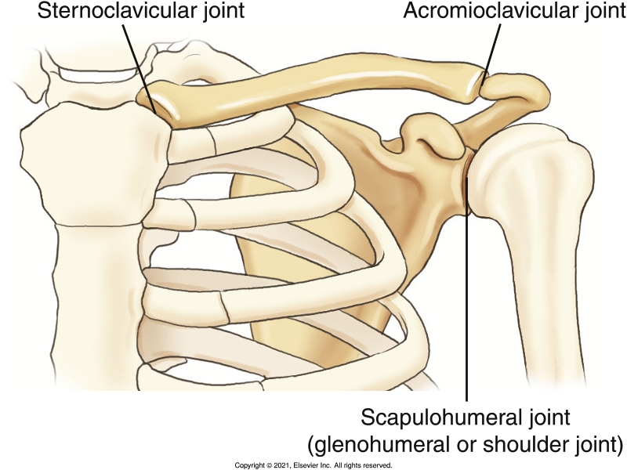
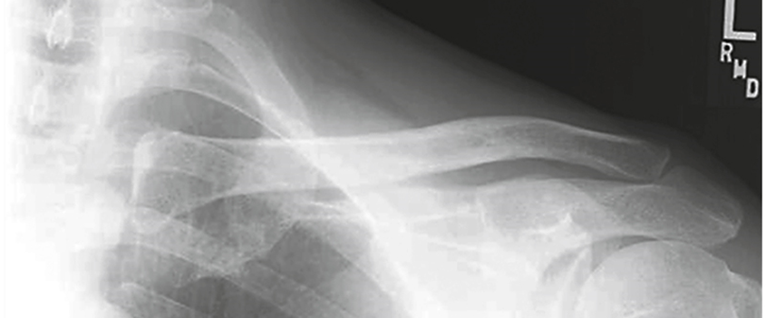
Guidelines/Considerations - Clavicle
Identify required anatomy
Bontrager pg. 182 Fig. 5.14
To ensure entire clavicle is visualized, radiographs require SC joint & Acromion
Bontrager 9th Ed. pg. 204 Fig. 5.87A

Slide 5
Guidelines/Considerations - Clavicle
2. Select appropriate equipment/technical factors
Wall IR
*Using the smallest field size possible, collimate
110cm SID, measured electronically using détentes (i.e. green lock must be engaged)
On the console, select:
  “Wall IR”
  the projection you will begin positioning
*Clavicle technique = *70→85 kVp

Slide 6
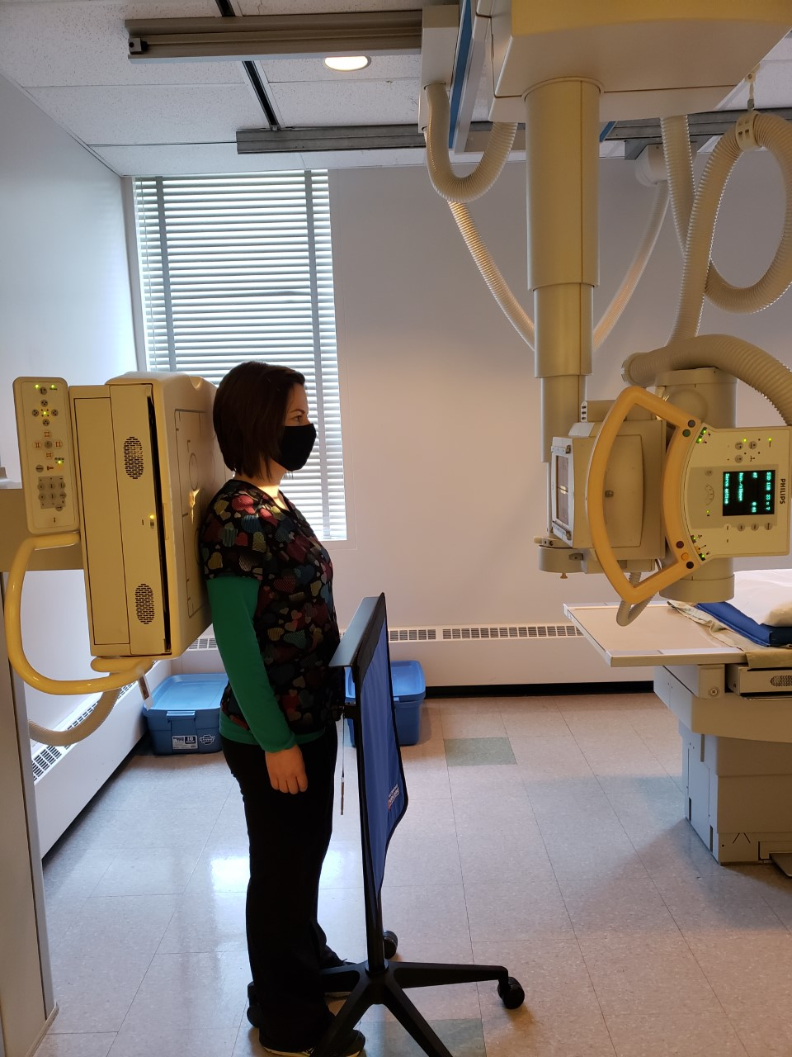
Guidelines/Considerations - Clavicle
Setup room before bringing the patient in
Tube and IR aligned @ 110cm SID
  Lock and set SID
  Center tube to IR laterally/medially
  Laser light: centers tube to IR superiorly/inferiorly
Correct anatomical marker selected
Ensure the correct “green” détente is used

Slide 7
Guidelines/Considerations - Humerus
3. Artifact Removal
    *Patient must be given gowning instructions*
“Everything from the waist up”
  Tops (i.e. shirt/sweaters), bra, necklace(s), long earrings, wet or braided hair
Ensure the marker is NOT placed under “anatomy shadow”
Notes:
Upright or seated position is best
SC, AC joints, & entire Clavicle can be used as external landmarks
Expose, when patient has suspended respiration on full inspiration

Slide 8
Protocol - Clavicle
Routine:
AP
AP Axial
  Note: a 15→30⁰ tube angle can be used
    Tube angle required is dependent on body habitus
      Example: less tube angle is required for “larger” hypersthenic patients

Slide 9
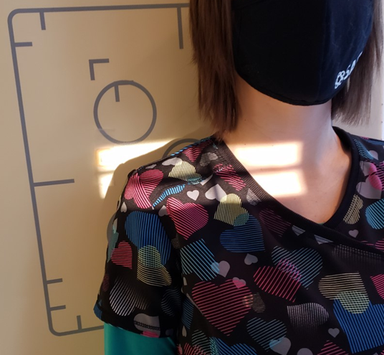
Positioning – AP Clavicle
Horizontal x-ray beam
Light-field extends:
Superiorly: ~ ½ inch “above” AC joint
Inferiorly: ~ ½ inch “below” SC joint
Medially: jugular notch
Laterally: ~ ½ inch beyond AC joint
CR is ~mid clavicle
*check centering with patient inhalation*
Marker on lateral side
R
Shoulder “relaxed” (not depressed or elevated)
Note: suspend respiration @ end of inhalation

Slide 10
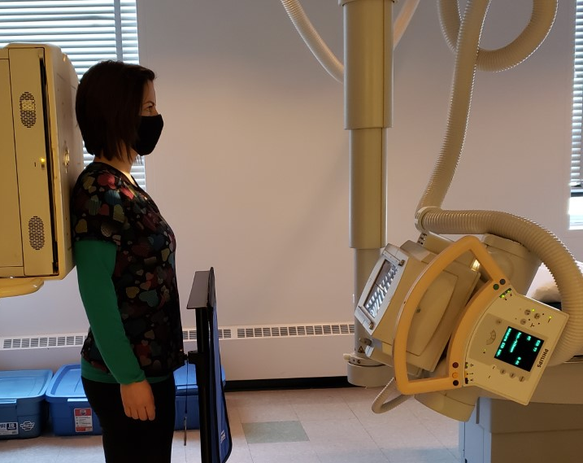
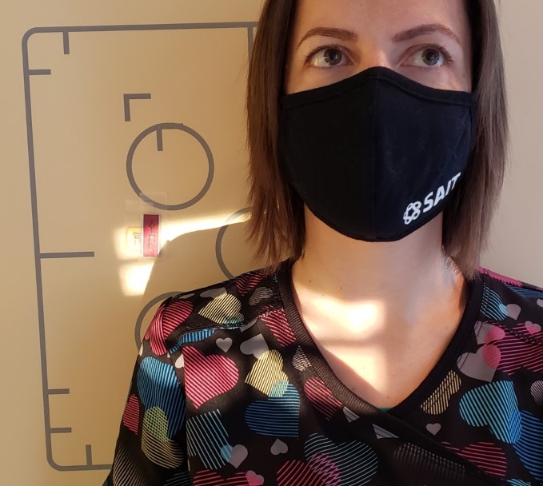
Positioning – AP Axial Clavicle
Tube angled 15⁰ cephalad
Light-field extends:
Superiorly: ~ ½ inch “above” AC joint
Inferiorly: ~ ½ inch “below” SC joint
Medially: jugular notch
Laterally: ~ ½ inch beyond Acromion
Marker on lateral side
& “up” arrow used
CR is ~mid clavicle
*check centering with patient inhalation*
Shoulder “relaxed” (not depressed or elevated)
Note: suspend respiration @ end of inhalation

Slide 11
Guidelines/Considerations
Identify required anatomy- each projection requires visualization of different amounts of anatomy
Gowning instructions – with artifact removal
Select appropriate equipment/technical factors
  Wall IR (for CR, 8x10 Cassette will be needed)
Patient care
  *People with shoulder injuries are susceptible to fainting – seated position may be best
Breathing instructions
  All images require suspended respiration
Use external landmarks

Slide 12
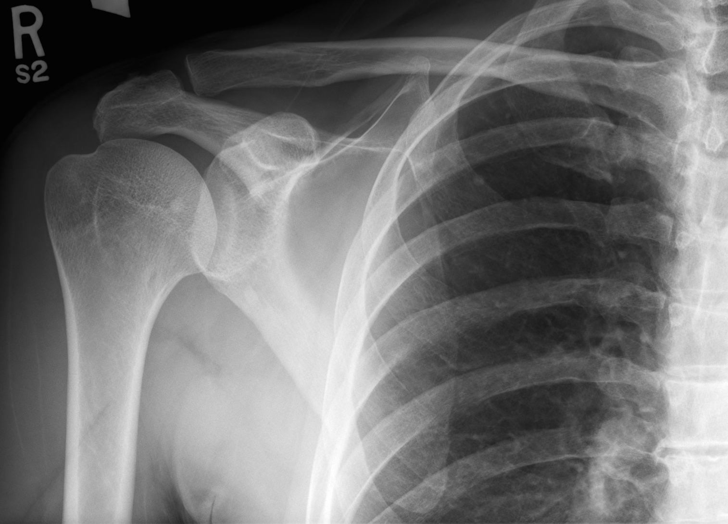
Shoulder Girdle – External Landmarks
AC joint
Superior angle of scapula
SC joint
Medial border of scapula
Scapulohumeral joint
Inferior angle of scapula

Slide 13
Protocol
Routine:
AP shoulder with external rotation
AP Oblique for glenoid cavity
PA Scapular Y (lateral)
Superoinferior axial
Non-Routine:
AP shoulder with neutral rotation
AP shoulder with internal rotation
Adaptive Projections:
Inferosuperior axial
AP Scapular Y (lateral)

Slide 14
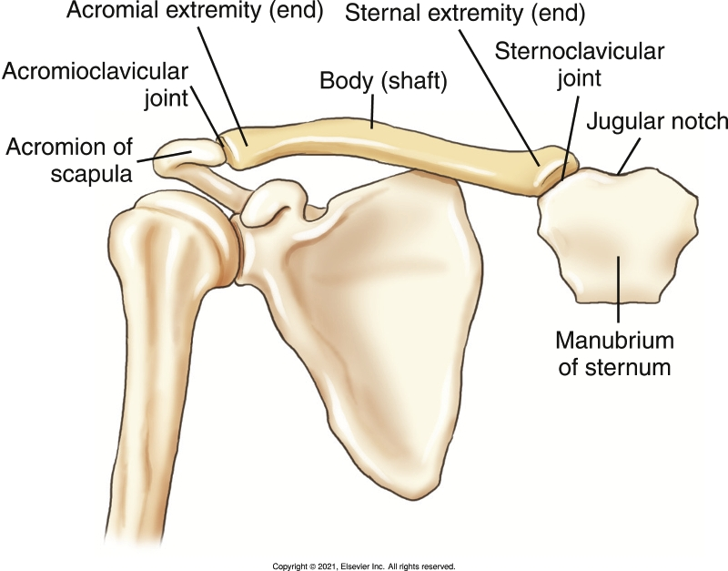
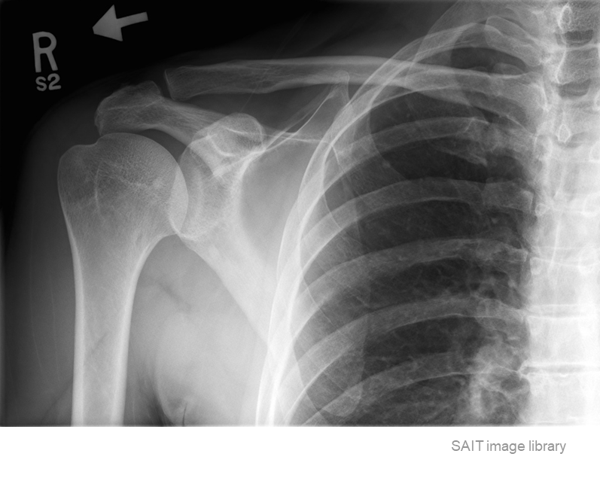
AP Shoulder - Considerations
AP Shoulder radiographs require ½ the sternum, entire scapula, entire clavicle, & the proximal humerus
Bontrager pg. 179 Fig. 5.4
Identify required anatomy

Slide 15
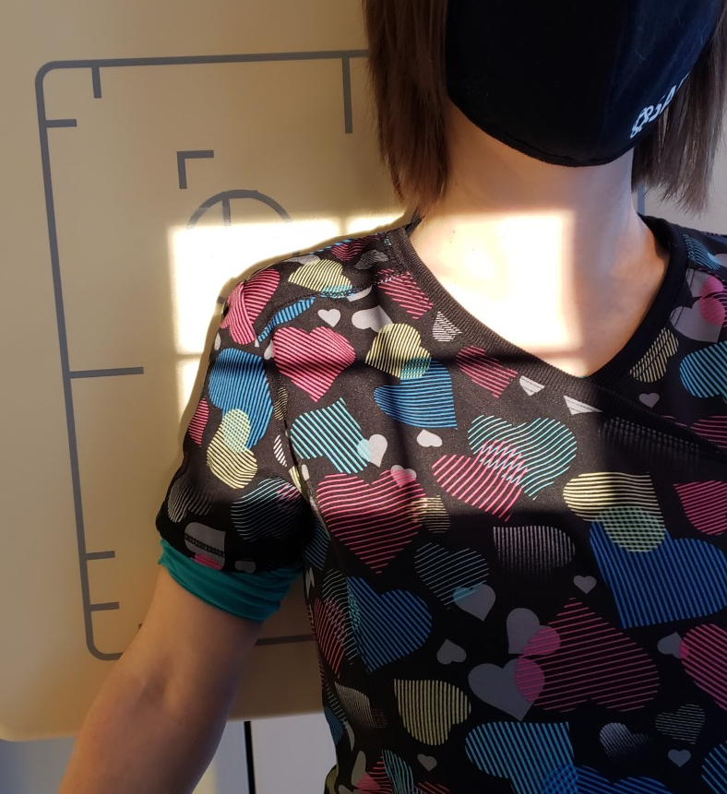
Positioning – AP (external rotation)
Align collimator light to the length of required anatomy (i.e. crosswise field size)
Center the anatomy on the IR and/or in the light field
“Externally rotate” epicondyles of humerus until they are parallel to the IR
Place an anatomical marker (using Anderson Marker Rules), and make final adjustments, as needed
R
Note: suspend respiration

Slide 16
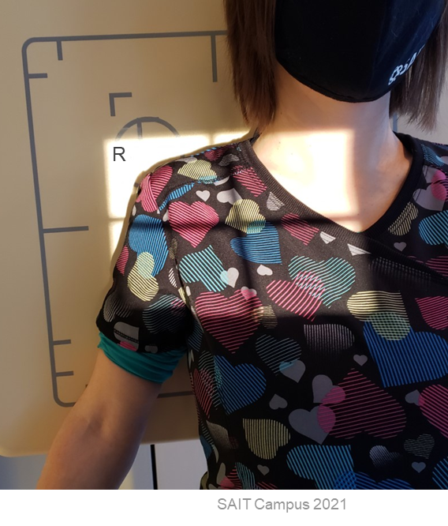
Positioning – AP Shoulder (external rotation)
Marker on lateral side
Light-field extends:
Superiorly: ~ ½ inch “above” AC joint
Inferiorly: ~ ½ inch “below” inferior angle
Medially: ~ mid sternum
Laterally: ~ ½ inch beyond soft-tissue margins of “superior-portion” of humeral head
CR is ~1 inch (2.5cm) inferior to coracoid process
*aka. ~ mid clavicle (side-side) & ~2 inches inferior to clavicle
Note: ensure inferior angle of scapula is included by comparing palpated anatomy height to level of light on the IR
Humeral epicondyles parallel to IR

Slide 17
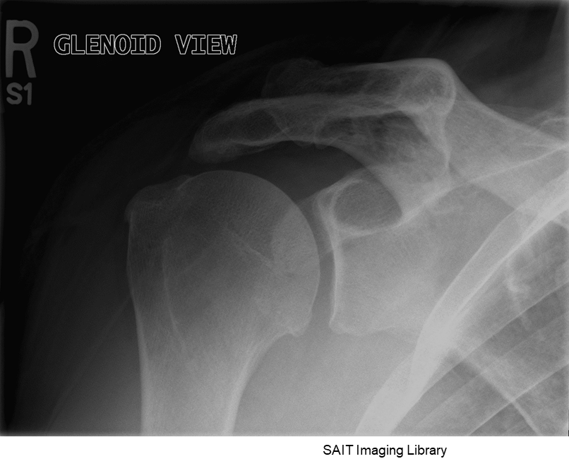
AP Oblique (aka. Glenoid) - Considerations
Identify required anatomy
Glenoid Shoulder radiographs require coracoid process, acromion, & humeral head with surrounding soft-tissues

Slide 18
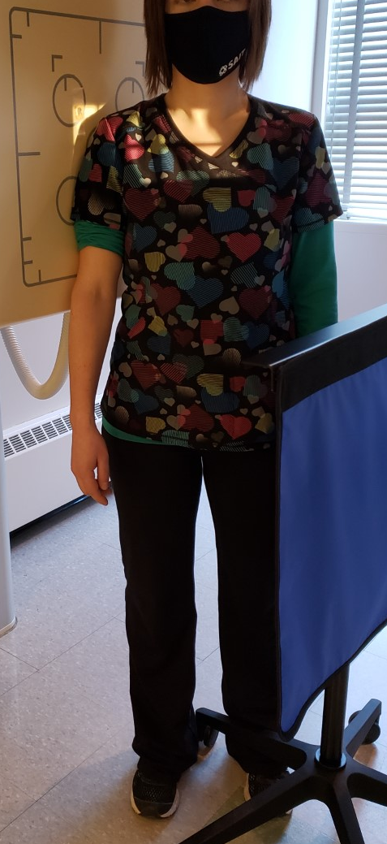
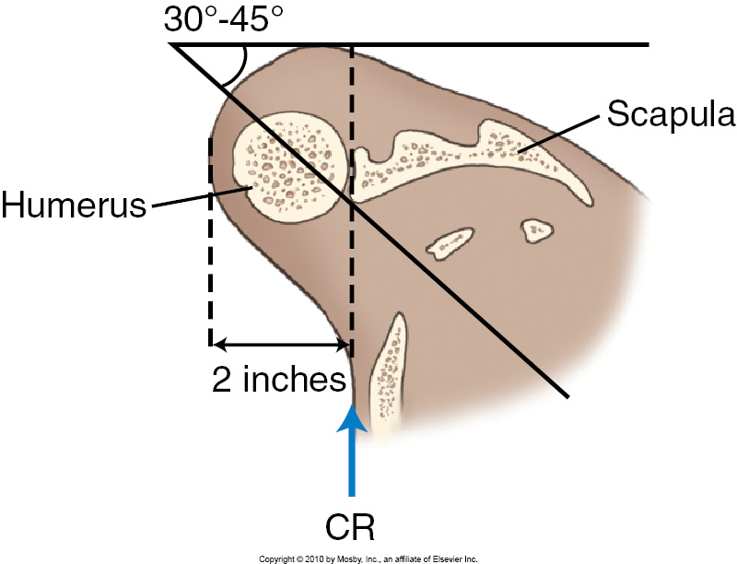
Positioning – Glenoid Cavity (45º RPO or LPO)
Rotate hips & shoulders 45º toward affected side
(placing body of scapula parallel to IR)
Ensure neutral rotation of arm
Center over the scapulohumeral joint
Follow Marker Rules
Bontrager pg. 196 Fig., 5.55
Note: suspend respiration

Slide 19
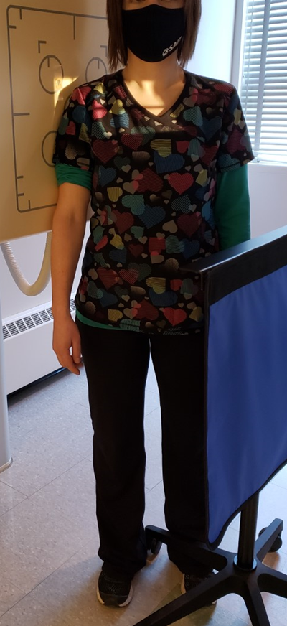
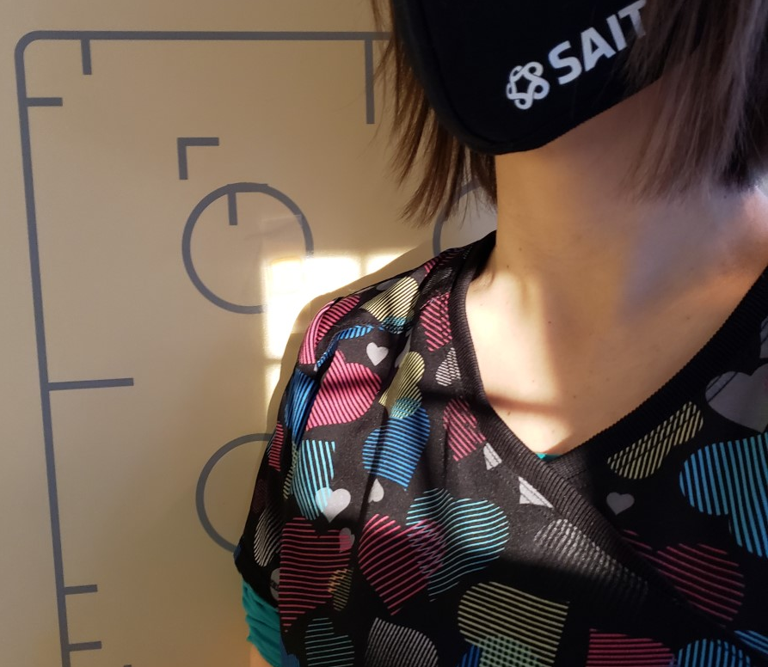
Positioning – Glenoid Cavity
Hips & Shoulders rotated 45⁰ towards IR
Light-field extends:
Superiorly: ~ ½ inch “above” AC joint
Inferiorly: ~ level of axilla
Laterally: ~ ½ inch beyond soft-tissue margins
Medially: “whatever you get” = ~ mid clavicle
Note: light-field on the patient appears distorted; radiograph will only include ~½ clavicle, but the light will appear to “cover” entire clavicle
R
Arm in “neutral” rotation
Marker on lateral side
CR is ~mid scapulohumeral joint

Slide 20
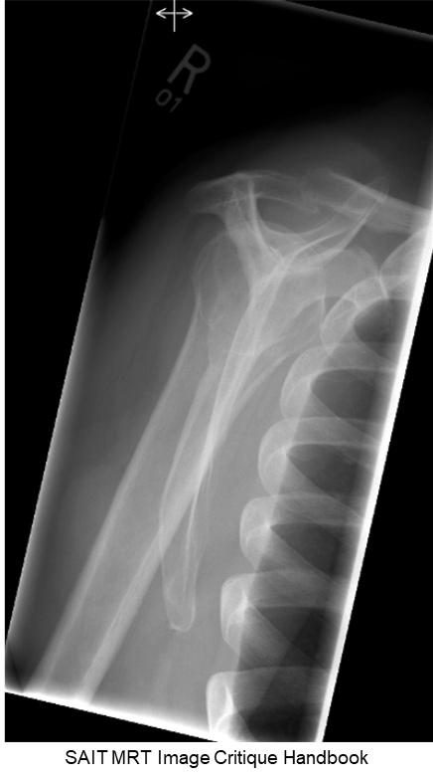
PA Oblique (Scap Y Lateral) - Considerations
Identify required anatomy
Anterior: humeral head beneath coracoid process
Note: this projection is used to demonstrate dislocations
Posterior: humeral head beneath acromion
Scap Y Shoulder radiographs require entire scapula

Slide 21
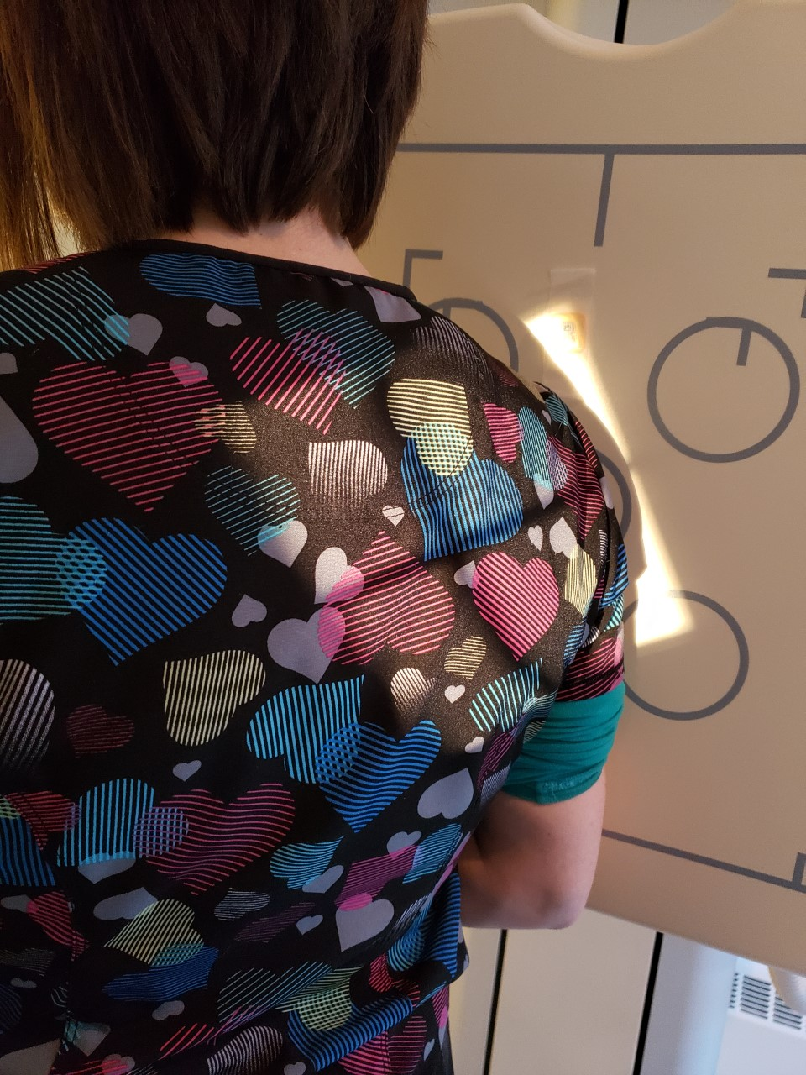
Positioning – PA Scap Y(RAO or LAO position)
Face patient towards IR, with arm flexed 90⁰
Rotate patient posteriorly until the AC joint AND superior angle are perpendicular to IR
Align collimator light to the length of required anatomy (i.e. tilt as required)
Center the anatomy on the IR and/or in the light field
Follow Anderson’s Marker Rules
R
Note: suspend respiration

Slide 22
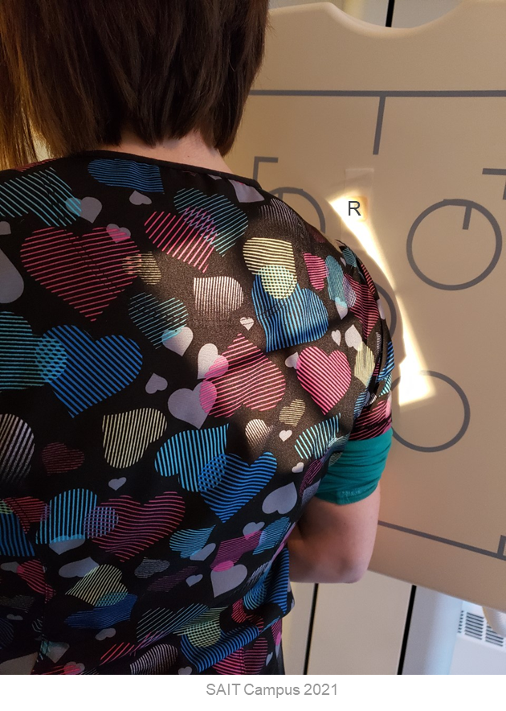
Positioning – PA Scap Y
Collimator light matches angle of medial border
Marker on lateral side
AC joint AND superior angle perpendicular to IR
Light-field extends:
Superiorly: ~ ½ inch “above” AC joint
Inferiorly: ~ ½ inch “below” inferior angle of scapula
Laterally: ~ ½ inch beyond lateral edge of acromion
Medially: “whatever you get”
CR is mid scapula; parallel to medial border
Note: light-field on the patient appears distorted (medial border of light will “look” larger than it really is)
Arm flexed 90⁰

Slide 23
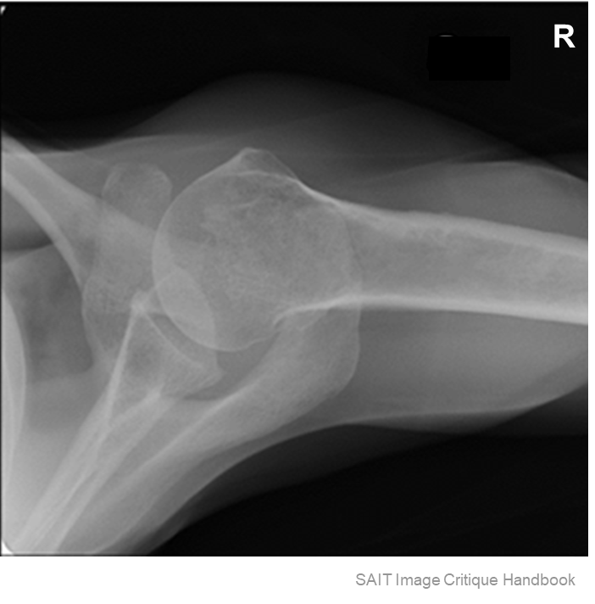
Superoinferior “Axial” - Considerations
Identify required anatomy
Superoinferior Shoulder radiographs require ~¼ of the proximal humerus, entire coracoid process, and anterior/posterior soft-tissue margins

Slide 24
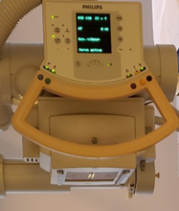
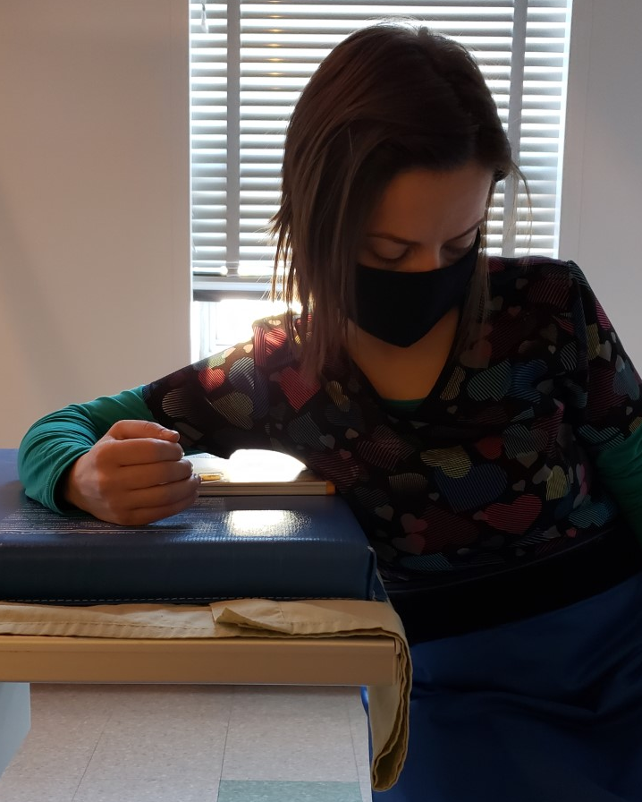
Positioning – Superoinferior (0-15º) Axial
Seat patient at end of table on a stool/chair
Flex patient’s elbow 90º
Get patient to lean laterally, to place shoulder joint over a small cassette
  Notes: lowering the table helps place the joint “on top” of the IR
  If shoulder joint does not extend over the IR, angle the x-ray tube (not to exceed 15⁰) towards the elbow, until the joint “lands on top” of the IR
*CR over shoulder joint – use “laser light” to help center
Note: suspend respiration

Slide 25
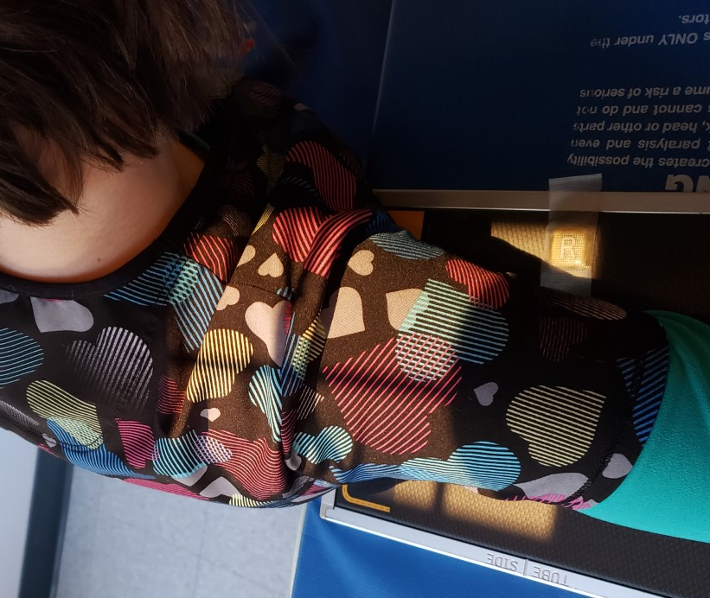
Positioning – Superoinferior (0-15º) Axial
Locating the shoulder joint:
  Gently palpate contour of humeral head anteriorly
  Move your fingers medially, until humerus ‘ends’
Collimate to include anterior and posterior soft tissue, coracoid and entire humeral head
Place anatomical marker in the light-field, to “walk-along” the humerus (anteriorly)
Ask patient to rotate and tilt their head towards their unaffected shoulder

Slide 26
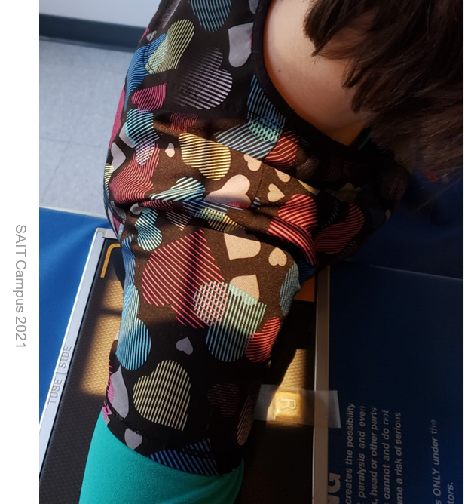
Positioning – Superoinferior (0-15º) Axial
Light-field extends:
Anteriorly & Posteriorly: ~ ½ inch beyond soft tissue margins
Distally: ~ ¼ proximal humerus
Medially: “whatever you get”
Head & Neck rotated and tilted towards opposite shoulder
Note: cannot center anatomy on IR:
*ensure shoulder joint is at least 1-inch beyond medial edge of IR*
If shoulder joint is less than 1-inch beyond medial edge of IR: Add a tube angle (towards the elbow)
CR over shoulder joint
Elbow & Shoulder parallel to length of IR
Marker on anterior side “walking-along” humerus

Slide 27
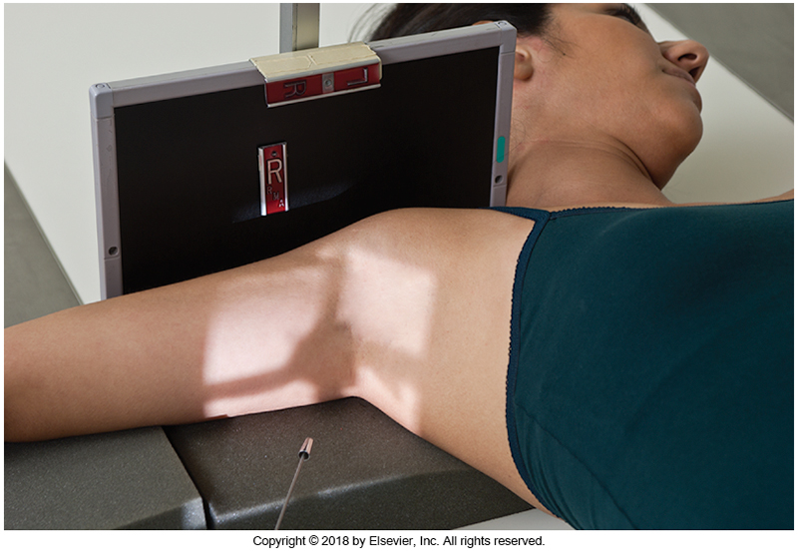
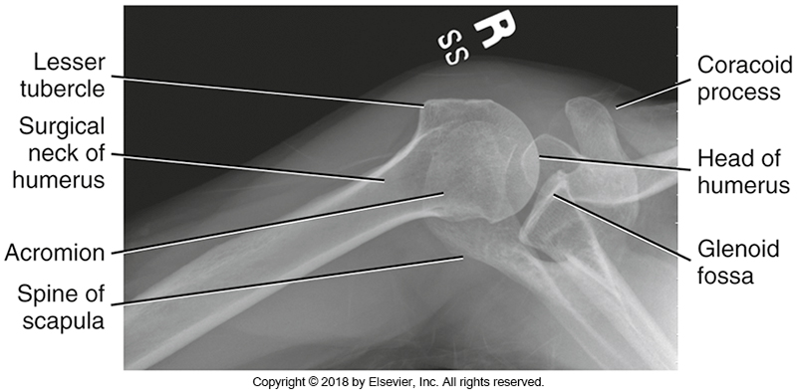
Adaptive Projection – Inferosuperior Axial
Typically performed when the patient cannot sufficiently extend their arm causing excessive OID
Bontrager pg. 193 Fig. 5.46 & 5.49
More abduction requires greater CR angles

Slide 28
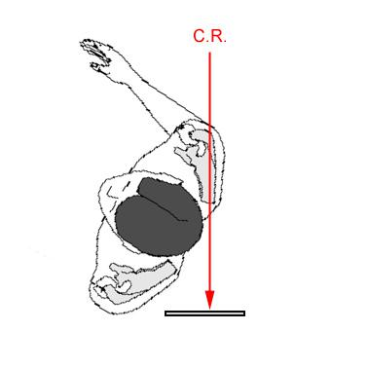
Adaptive Projection – AP Scap Y(RPO or LPO position)
Alternate to PA Scap Y
Performed on trauma patients
Notes:
IR behind patient
Reverse position from PA
http://www.wikiradiography.net/page/Lateral%20Scapula%20Radiography

Slide 29
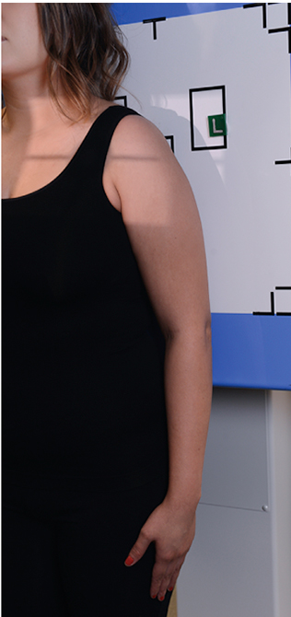
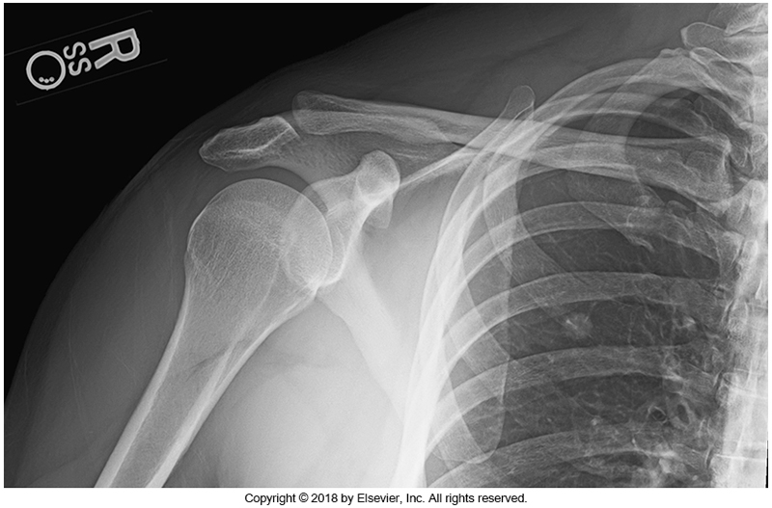
Non-Routine: AP Shoulder Neutral Rotation
Bontrager pg. 183 & 199 Fig. 5.19 & 5.68
Performed when trauma (i.e. fracture or dislocation are suspected) OR when dictated by site protocol
hand pronated on thigh

Slide 30
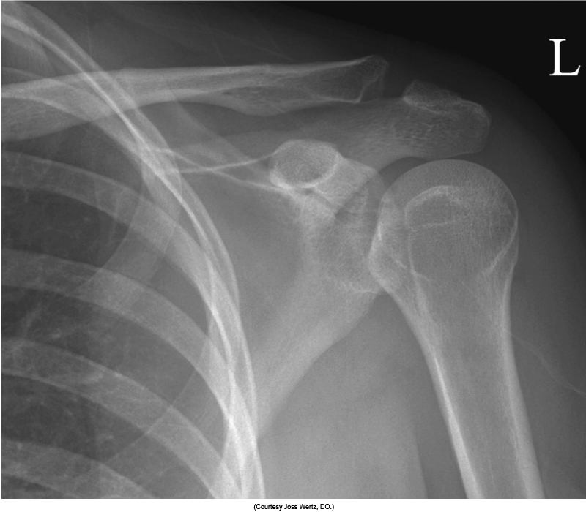
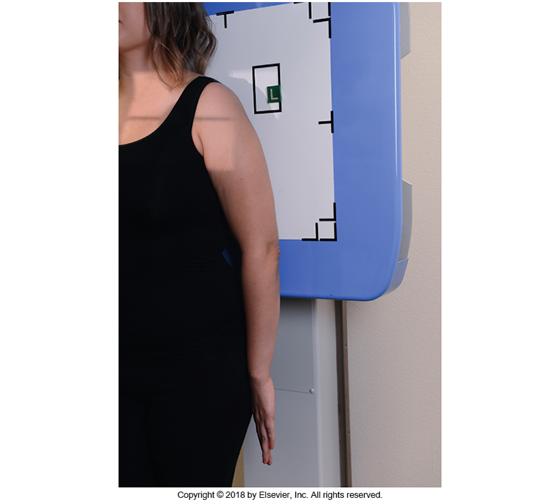
Non-Routine: AP Shoulder Internal Rotation
Bontrager pg. 183 & 192 Fig. 5.17 & 5.44
Performed when dictated by site protocol
hand supinated on thigh

