Slide 1


Facial Ultrasound

Slide 2
OUR JOURNEY TODAY
Ultrasound and ultrasonic are synonymous terms referring to a frequency that is above the range of sound audible to the human ear. This equipment uses noninvasive sound waves to create results-oriented treatments. Ultrasonic equipment is based on high-frequency mechanical oscillations produced by a metal round or spatula like tool

Slide 3
How it Works
Ultrasound penetrates deeply and it stimulates tissue, increases blood flow, and promotes oxygenation.
The lower the frequency, the greater the penetration
A higher frequency has less penetration.
Heat is created, and the vibration in the cells stimulates circulation, metabolism, and lymph drainage.
The heat damage from ultrasound and other modalities (such as lasers) is what stimulates collagen production.
Ultrasound also sends waves and vibrations through the skin increasing product penetration, This process is called sonophoresis (SAHN-oh-for-EE-sus), which is like iontophoresis.
Advanced training and technical research on equipment claims are necessary before using any advanced esthetic machine.
Because of its gentle, nonabrasive nature, this treatment can be a viable choice for clients with sensitive skin conditions or rosacea versus other exfoliating services. As gentle as ultrasonic therapy is, some clients are still not good candidate

Slide 4

Ultrasound Facts
Some esthetic ultrasound equipment is rated as an FDA Class II device and may not be within an esthetician’s scope of practice outside of a medical facility.
Different frequencies of ultrasound are also used for medical imaging, physical therapy, and pain management. Lower-frequency ultrasonic devices are used for toothbrushes and jewelry cleaners.
Hand-held devices for a consumer’s personal skin care that are used at home are milder but should be used in moderation to avoid damaging the skin.

Slide 5
Ultrasound Indications and Benefits
For the Face and body
Product penetration
Blood microcirculation
Collagen production
Muscle tone
Slight lifting on the skin tissues
Aids in cellulite treatments

Slide 6
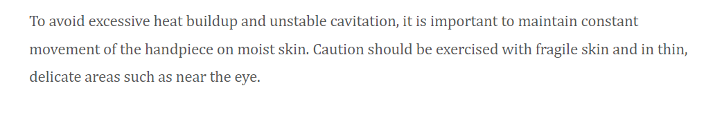
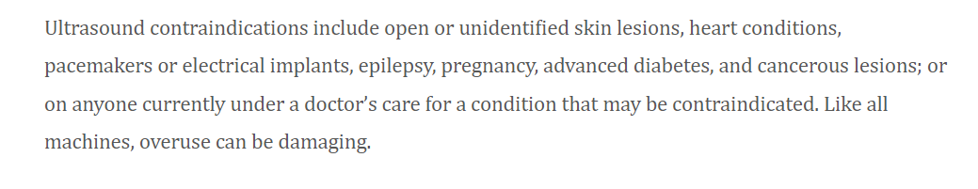
Contraindications

Slide 7
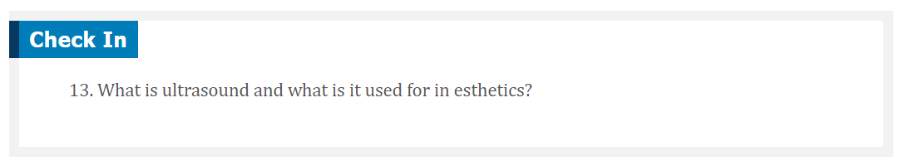

Slide 8

QUESTIONS?

