Slide 1

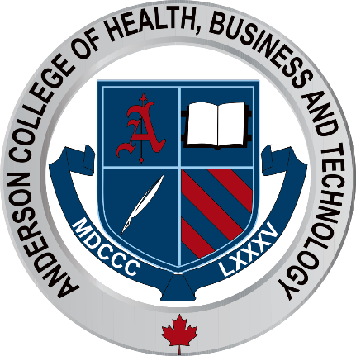
Laser Vascular Lessions

Slide 2
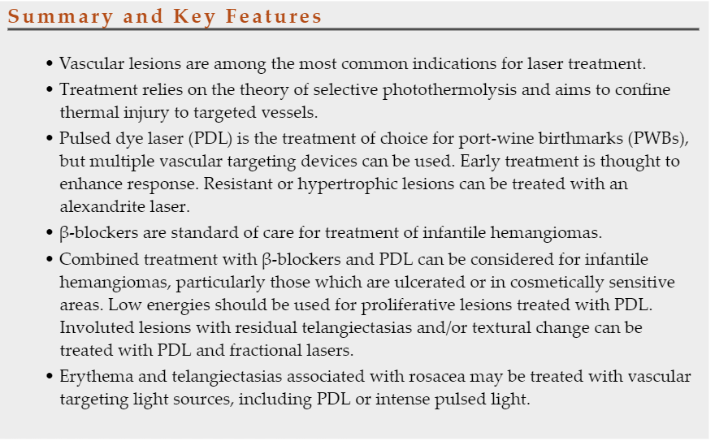

Slide 3
Introduction and History
The treatment of vascular lesions was among the first applications of lasers in dermatology. Laser surgery has since become the treatment of choice for many vascular lesions, including port-wine birthmarks (PWBs), rosacea, and poikiloderma. Laser can also be used for infantile hemangiomas (IH).
Three components are necessary for selective photothermolysis: a laser wavelength with preferential absorption of the target chromophore (RED) appropriate pulse duration matched to the target size, and a fluence that both treats the target and minimizes nonspecific thermal injury.

Slide 4
The target chromophore for vascular lesions is oxyhemoglobin which has greatest absorption peaks at 418, 542, and 577 nm
Laser light is absorbed by oxyhemoglobin and converted to heat, which is transferred to the vessel wall causing coagulation and vessel closure.
Other hemoglobin species can also be targeted. For example, venous lesions may benefit from wavelengths that target deoxyhemoglobin.
The alexandrite laser at 755 nm is close to a deoxyhemoglobin absorption peak and has been used for refractory or hypertrophic PWBs, venocapillary malformations, and venous lakes.
Methemoglobin absorption (which forms after 585 or 595 nm treatment at or above 5 J/cm2) has been recognized as another potential target chromophore.

Slide 5

Define:
Methemoglobin
Oxyhemoglobin
Deoxyhemoglobin
Hemoglobin
Research Time!

Slide 6
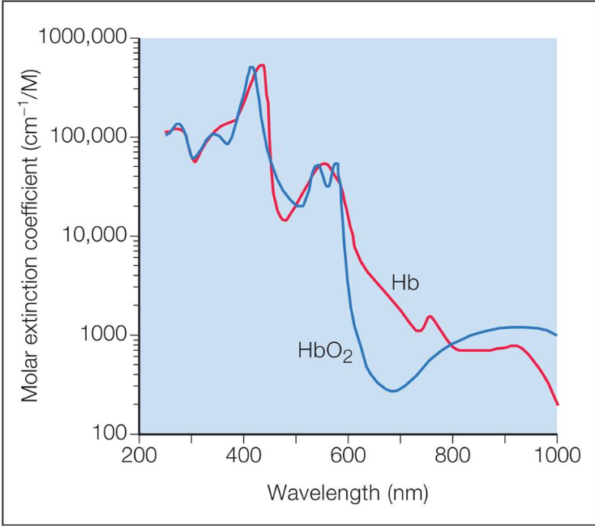

Slide 7
The pulsed dye laser (PDL) became available in 1986 and was initially developed at 577 nm to target oxyhemoglobin’s yellow absorption peak.
It was later realized that selective photothermolysis could be achieved with wavelengths near absorption peaks, if preferential absorption still occurred. PDLs shifted to 585 nm, allowing for a depth of penetration of approximately 1.16 mm
595 nm PDLs later became available to achieve greater depth of penetration.
PDLs also evolved to incorporate longer pulse durations. Early PDLs had a fixed pulse duration of 0.45 ms, whereas currently available PDLs have pulse durations from 0.45 to 40 ms.
Longer pulse durations can minimize posttreatment purpura.

Slide 8
Epidermal cooling was introduced in the 1990s to protect the epidermis, minimizing pigmentary changes and scarring. Cooling also permits use of higher fluences and provides greater treatment efficacy while minimizing discomfort. Modern cooling methods include cryogen spray, contact, and forced cold air.
Because PDL reaches a depth of only 1–2 mm, other lasers can be used to treat vascular lesions with greater depth.
For example, the 755 nm alexandrite laser and 1064 nm neodymium:yttrium-aluminum-garnet (Nd:YAG) laser penetrate up to 50%–75% deeper into the skin.
Given that the absolute absorption of hemoglobin is lower at these wavelengths, higher fluences are required and risk of injury is greater.
Intense pulsed light (IPL) devices emit polychromatic noncoherent broadband light from 420 to 1400 nm with varying pulse durations.
Filters are implemented to remove unwanted wavelengths.

Slide 9
Do you know…
In general, smaller objects cool faster than larger ones. For example, 0.5- to 1.0-lm melanosomes have a thermal relaxation time of approximately 1 microsecond whereas 10- to 100-lm capillaries have a thermal relaxation time of approximately 1 millisecond.5
If the pulse width is greater than the thermal relaxation time, nonspecific thermal damage occurs because of heat diffusion.
Finally, the energy delivered to the site (fluence/Jouls) must be high enough to destroy the chromophore within the pulse duration.
Based on the theory of selective photothermolysis, pulse duration/width , and fluence of a laser can be tailored to result in selective damage to the lesions without nonspecific thermal damage to the surrounding tissues.

Slide 10
Other potential vascular targeting lasers include potassium titanyl phosphate (KTP) (532 nm), other near-infrared, long-pulsed lasers such as diode (including 800–810 nm, 940 nm), and dual wavelength lasers such as PDL and Nd:YAG (595 nm and 1064 nm).

Slide 11
Vascular Anomalies Classification
The International Society for the Study of Vascular Anomalies (ISSVA) publishes a widely accepted standard for classification of vascular anomalies that was updated in 2018.
Lesions are broadly grouped as either vascular tumors or vascular malformations.
IH, a type of vascular tumor, and PWB, a type of vascular malformation are common vascular anomalies that present to the dermatologist

Slide 12
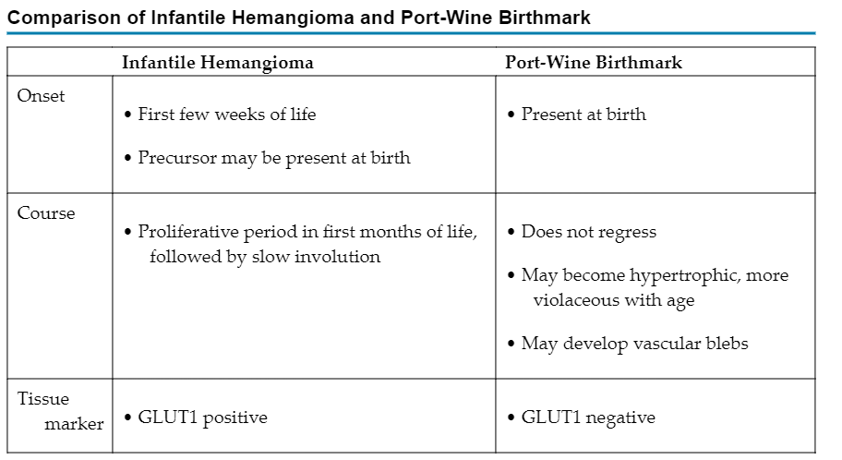

Slide 13
Port-Wine Birthmarks
PWBs are vascular malformations that are composed of ectatic capillaries and postcapillary venules in the superficial vascular plexus.
PWB vessels vary in size from 7 to 300 µm, with older patients, particularly those naive to laser treatment, tending to demonstrate larger vessels.
In most cases, PWBs are congenital, although acquired cases are reported.
PWBs occur in approximately 0.3%–0.5% of newborns
If left untreated it gets darker with age

Slide 14
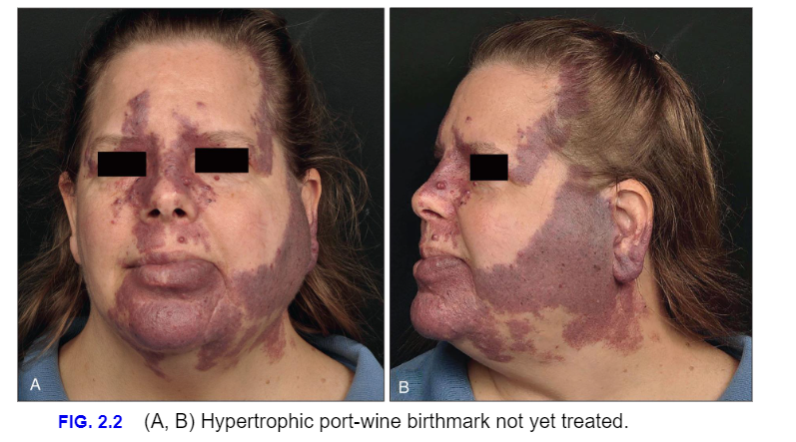

Slide 15
Treatment
This type of condition can only be treated by dermatologists !
Treatments are typically performed at 3- to 6-week intervals for 10 or more treatments until a plateau is reached or the lesion clears (Fig. 2.3). When choosing settings, it is advisable to determine the fluence threshold on the darkest portion of the PWB with one or two test pulses. The fluence is adjusted to achieve the desired end point, which in the case of PDL using short pulse durations (e.g., 1.5 ms) is immediate purpura. If instead a gray color appears, the fluence is too high. Careful monitoring for tissue response is essential.

Slide 16
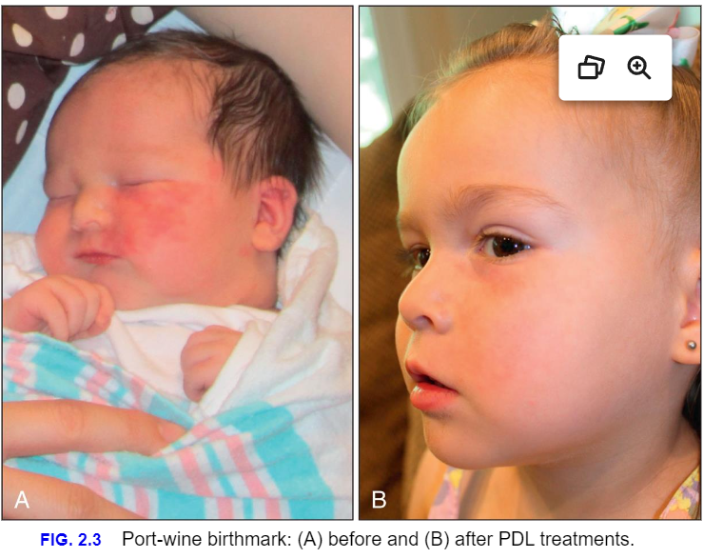

Slide 17
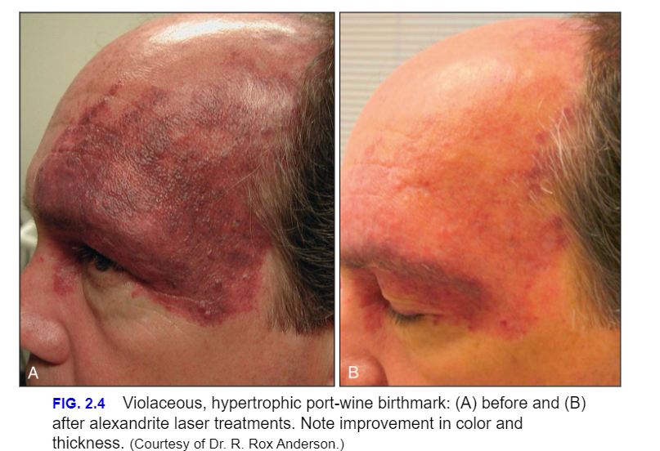

Slide 18
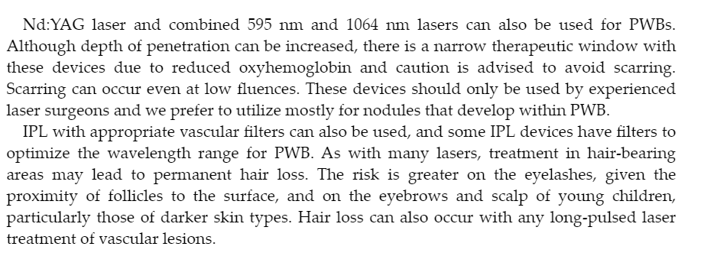

Slide 19
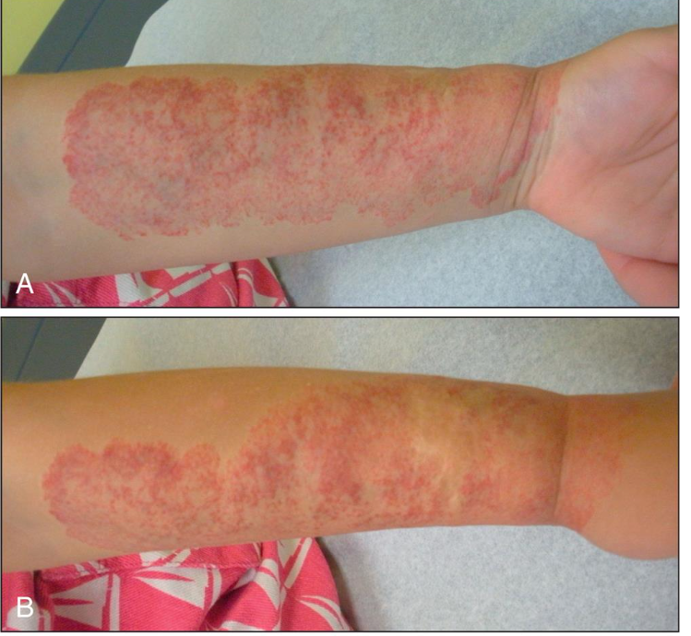
Infantile hemangomas
IH are benign endothelial cell proliferations that represent the most common tumor of infancy, occurring in 4%–10% of infants

Slide 20

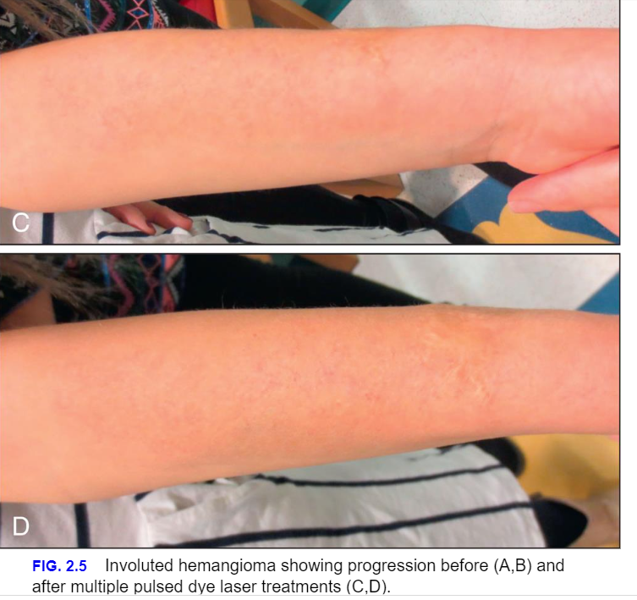
Only by Prescription by Dermatologist
Medication
Topical Medications
Lasers

Slide 21
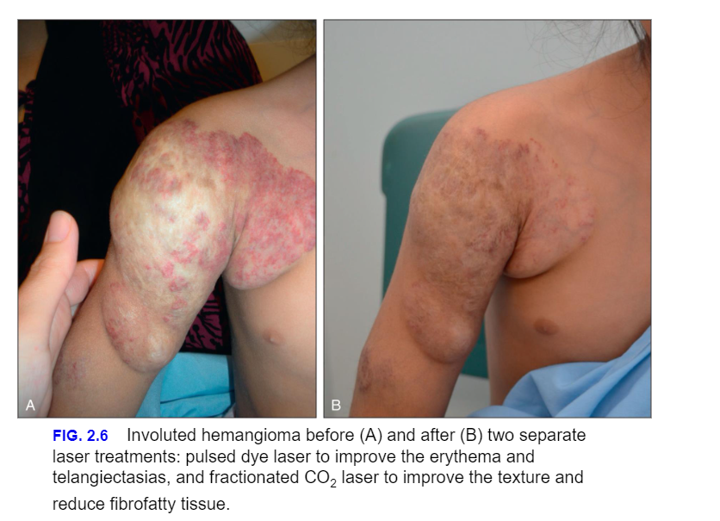

Slide 22

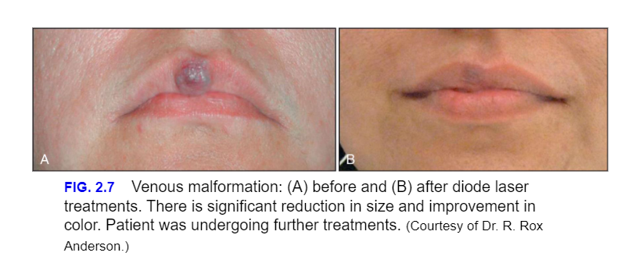
Venous malformations

Slide 23
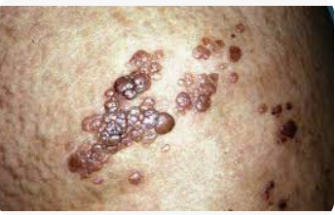
Lymphangioma circumscriptium

Slide 24

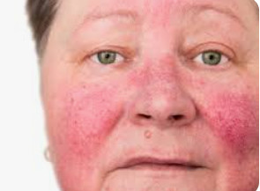
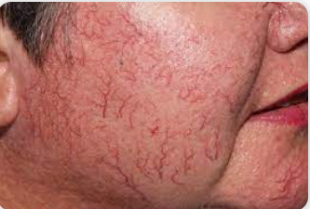
Rosacea and telangiectasa
Rosacea
telangiectasia

Slide 25
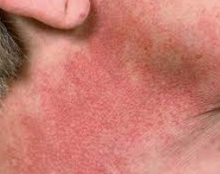
Poikiloderma of Civatte

Slide 26
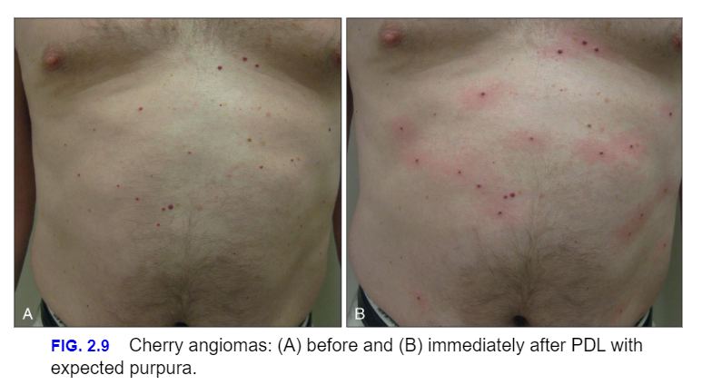
Cherry Angiomas

Slide 27
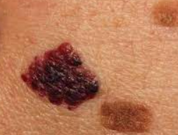
Angiokeratomas

Slide 28
Approach to treatment of vascular lesions
Pre-Treatment consultation is needed
The only vascular conditions an esthetician can help with laser are Rosacea and Telangiectasias
Procedures options should be discussed with the clients
Post op care should be reviewed
Treatment options like using IPL or NYDAG depending on the procedure

Slide 29
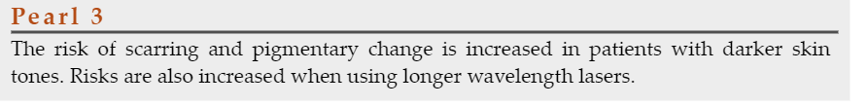

Slide 30

QUESTIONS?

