Slide 1
CT Theory
Spine Anatomy & Procedures

Slide 2
CT Imaging of the Spine
Module Objectives
Review anatomy of the spine
Label anatomical structures on a CT image
Scanning protocols including:
  Positioning
  Indications & Contraindications
  Exposure Factors
Most common CT Spine exams done

Slide 3
CT Imaging of the Spine
Review Anatomy
Kelley textbook goes into a lot of detail!
Focus on:
  Vertebral bodies
  Intervertebral discs
  Spinal Cord
  Meninges
Complete anatomy ID exercises on D2L Brightspace

Slide 4
CT Imaging of the Spine
All vertebral bodies have a common structure, with some variations. Their features include:
  Body
  Vertebral Arch
  Transverse Process
  Spinous Process
  Pedicle
  Lamina
  Superior & Inferior Articular Processes

Slide 5
CT Imaging of the Spine
Cervical Vertebrae
  Distinguishable because of the in the transverse processes. The transverse foramina allow passage of
.
  Spinous processes are bifid, except C7.
  First 2 cervical vertebrae have no intervertebral disc between them.
  C1 = atlas: Has no body, no spinous process, short transverse process. Consists of anterior & posterior arch and two large articular lateral masses.
  C2 = axis: Has the dens (or odontoid process) that acts as a pivot for rotation of the head.

Slide 6
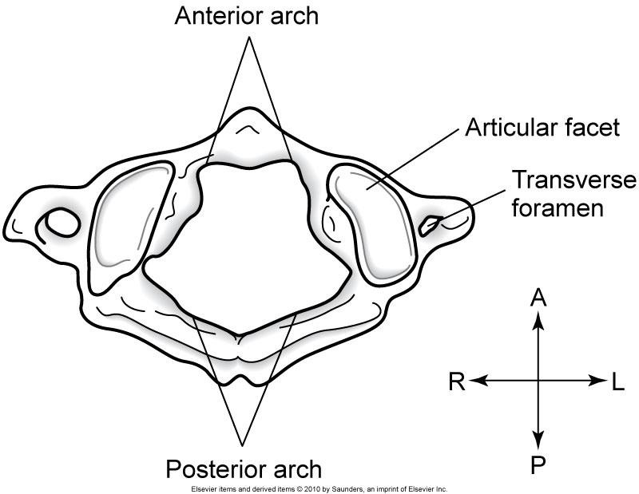
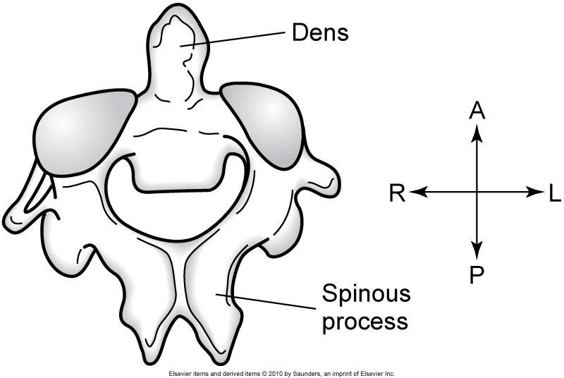
CT Imaging of the Spine
C1 = atlas
C2 = axis

Slide 7
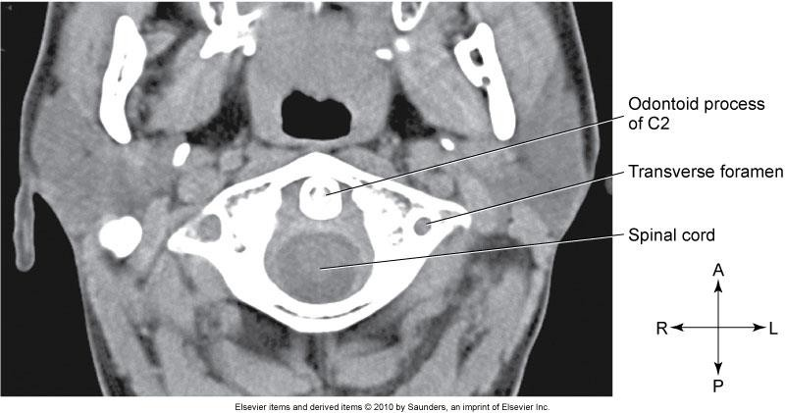
CT Imaging of the Spine

Slide 8
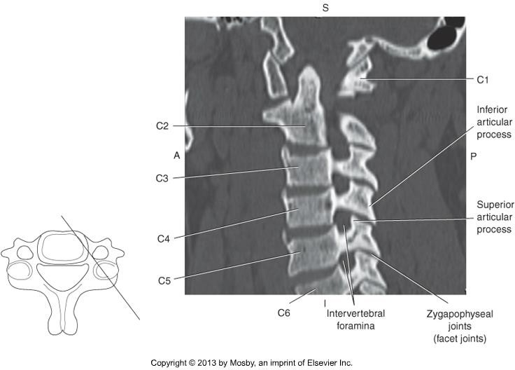
CT Imaging of the Spine

Slide 9
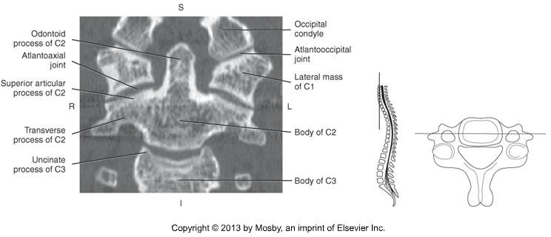
CT Imaging of the Spine

Slide 10
CT Imaging of the Spine
Thoracic Verebrae
  Distinguishable by the costal facets, or rib articulations located on the
and .
  The head of the rib articulates with the vertebral body and the tubercle of the
rib articulates with the transverse process.
  Long pointed spinous processes.

Slide 11
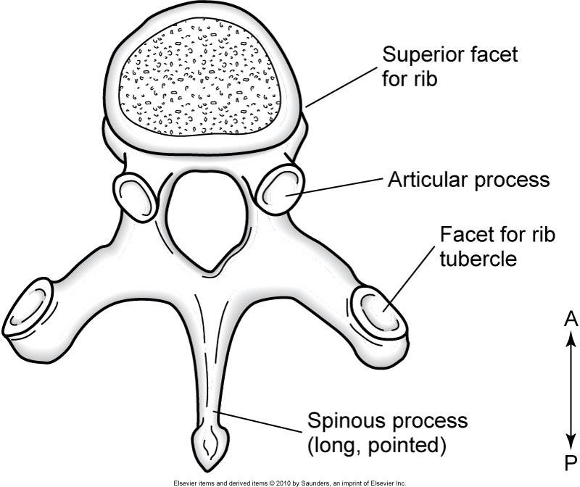
CT Imaging of the Spine

Slide 12
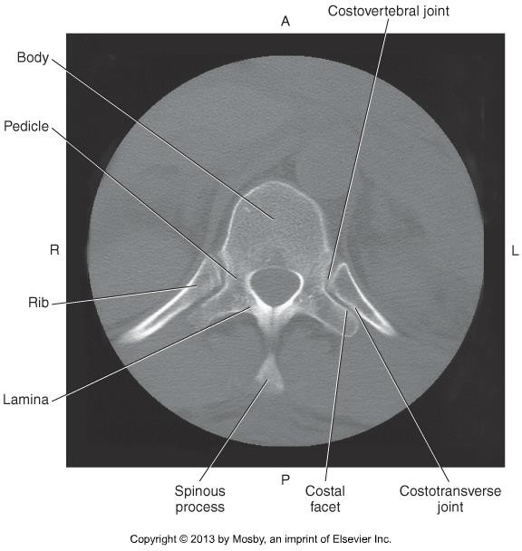
CT Imaging of the Spine

Slide 13
CT Imaging of the Spine
Lumbar Vertebrae
  Distinguishable by large, heavy bodies.
  Many muscles surrounding and supporting L1-L5, supports much of the body weight.
  spinous processes.

Slide 14
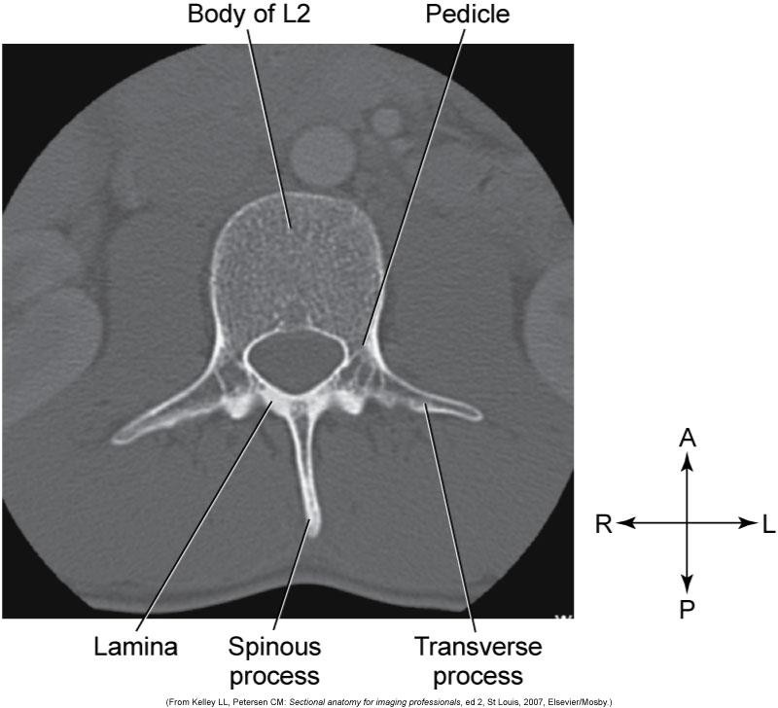
CT Imaging of the Spine

Slide 15
CT Imaging of the Spine
Intervertebral discs
Fibrocartilaginous pads between vertebral bodies classified as symphysis joints.
Each disc has a soft central core, called the
.
  Acts as a shock absorber and a ball bearing during flexion, extension and lateral bending of the spine.
Each disc has a firm outer ring, called the .
  Composed of rings of fibrocartilage that run obliquely from one vertebra to the next to form strong bonds.
A herniated disc occurs when the nucleus pulposis protrudes through the outer ring.

Slide 16
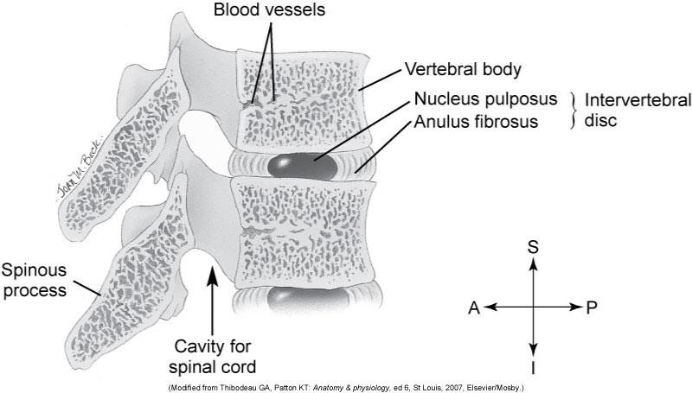
CT Imaging of the Spine

Slide 17
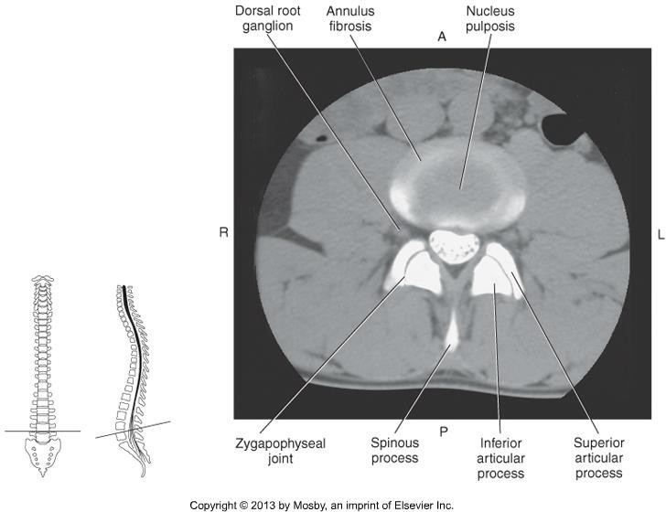
CT Imaging of the Spine

Slide 18
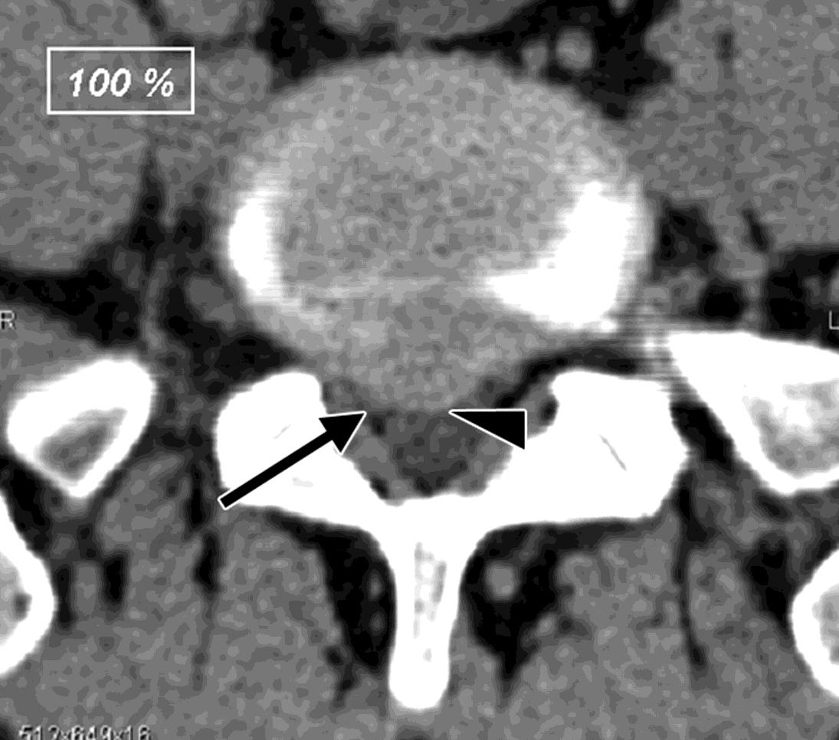
CT Imaging of the Spine
This axial slice through a lumbar vertebra shows a herniated disc.
The disc is protruding posteriorly and causing pressure on the spinal cord.
The pressure caused by a herniated disc often also compresses nerves running through the spinal canal, causing the patient back and leg pain.

Slide 19
CT Imaging of the Spine
Sacrum & Coccyx
Sacrum
  5 vertebrae that fuse together
  Fused transverse processes form the ala / lateral masses
  Articulate with the pelvis at the sacroiliac joints
  Sacral foramina, within the ala, allow for passage of
.
  Sacral prominence is the bony landmark that separates the abdominal cavity
from the pelvis cavity.

Slide 20
CT Imaging of the Spine
Sacrum & Coccyx
Coccyx
  Inferior to the fifth sacral segment
  3-5 small, fused, bony segments
  Projection off the first coccygeal segment called the is an
attachment point for ligaments.

Slide 21
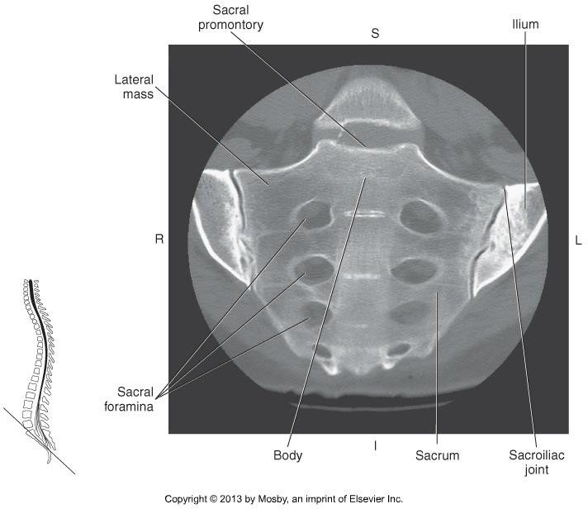
CT Imaging of the Spine

Slide 22
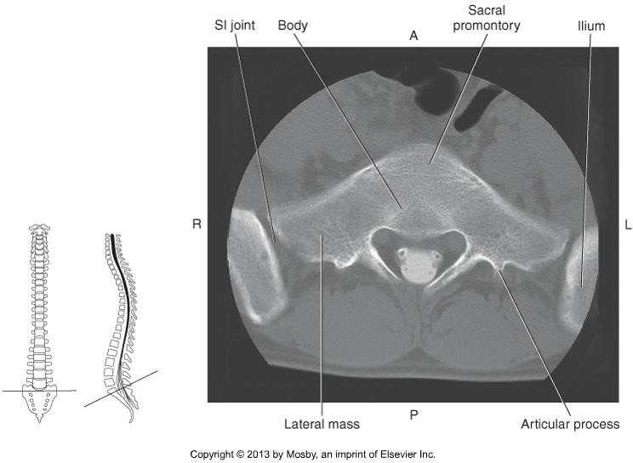
CT Imaging of the Spine

Slide 23
CT Imaging of the Spine
Spinal Cord
Continuation of the _ & _, continues downward until it terminates at the level of the .
Distally at T12 - L1, the spinal cord terminates in a triangular region called the
conus medullaris.
At the distal end of the spinal cord, many spinal nerves extend beyond the conus medullaris to form a collection of nerves called the .

Slide 24
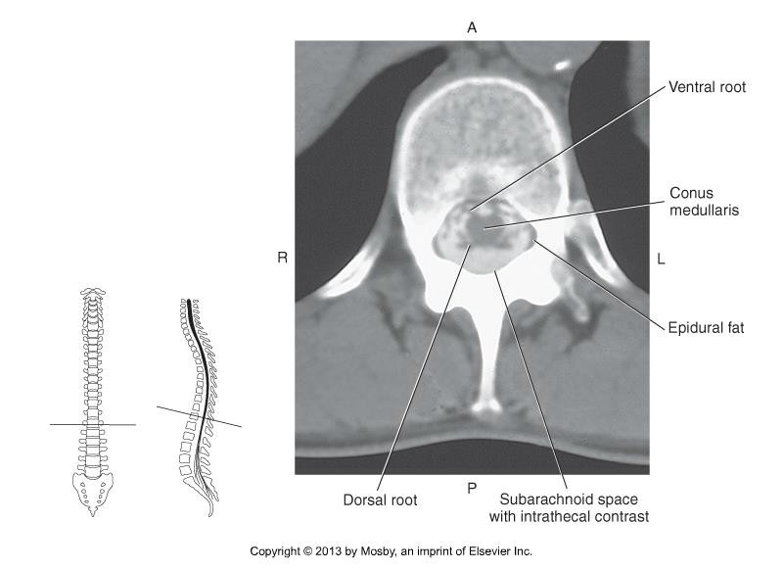
CT Imaging of the Spine

Slide 25
CT Imaging of the Spine
The spinal cord is composed of white and grey matter.
  Grey Matter:
  White Matter:
Cord is made of a core of gray matter that resembles a butterfly, surrounded by white matter.
The core of gray matter is divided into:

Slide 26
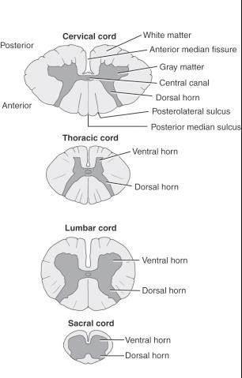
CT Imaging of the Spine

Slide 27
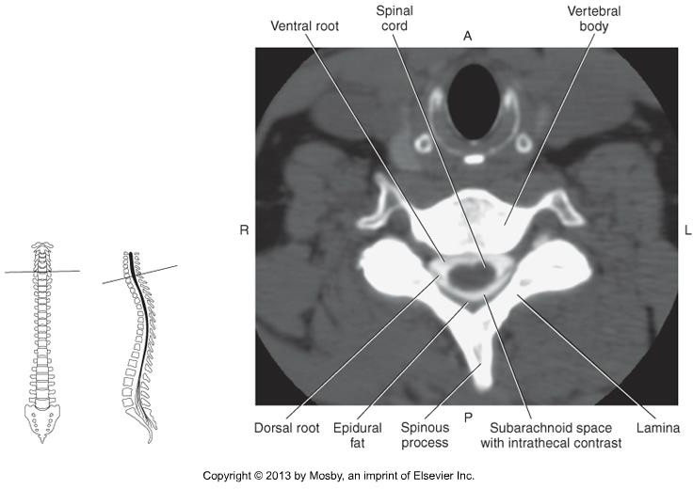
CT Imaging of the Spine

Slide 28
CT Imaging of the Spine
Spinal Meninges
  Consistent with cranial meninges
  Provide protection and cushioning for the cord
Dura Mater
  Outer layer
  Space between vertebral canal and dura mater is called the .
Arachnoid Mater
  Middle layer
  Space between the dura and arachnoid mater is called the .
Pia Mater
  Inner layer
  Space between the arachnoid and pia mater is called the .

Slide 29
CT Imaging of the Spine
Anatomy Summary
Review anatomy of the spine
The ligaments, muscles, nerves, and spinal plexuses will not be tested on.
Use knowledge of relational anatomy to find structures when given a single CT image.

Slide 30
CT Imaging of the Spine
Positioning for a CT C-spine
Patient Position
  Head holder or molded sponge
•
  Reduce patient motion
  Ask patient to depress their shoulders
Anatomy Position
  No rotation, neck slightly extended
  Angle patient so gantry and hard palate are parallel
Scan direction:

Slide 31
CT Imaging of the Spine
Positioning for a CT T-spine
Patient Position
  Supine, Feet First into the gantry
•
  Reduce patient motion
Anatomy Position
  No rotation
•
Scan direction:

Slide 32
CT Imaging of the Spine
Positioning for a CT L-spine
Patient Position
  Supine, Feet First into the gantry
  Raise arms over the head
•
Anatomy Position
  No rotation
•
Scan direction:

Slide 33
CT Imaging of the Spine
How are CT images of the spine acquired?
  Helical
  Very rarely contrast enhanced
  Thin slices
•
How are CT images of the spine viewed?
  MPR – coronal, sagittal, and planes
  3D rendering (useful for )
  Bone Window, WW 2000, WL 500

Slide 34
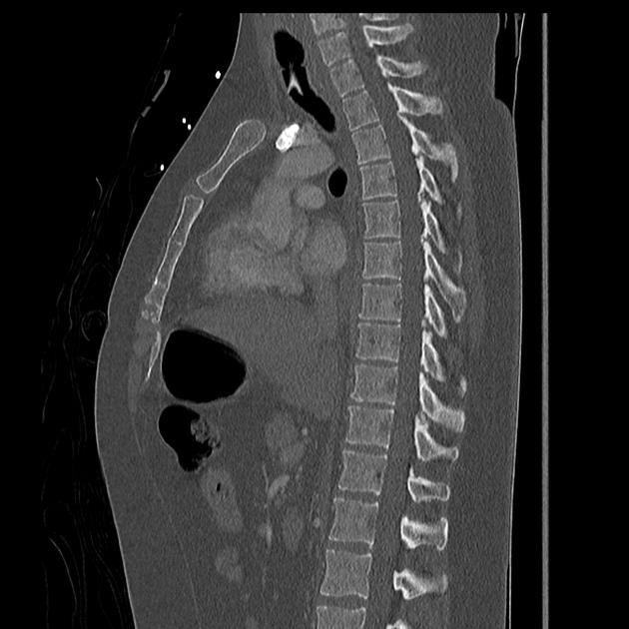
CT Imaging of the Spine

Slide 35
CT Imaging of the Spine
Challenges in scanning
Hardware in spine
  Management – Split the scan, acquire conventional method, tilt gantry.
  Smooth filter
•
  Extensive hardware is tough, causes major artifact. Can sometimes be a contraindication for CT of the spine.

Slide 36
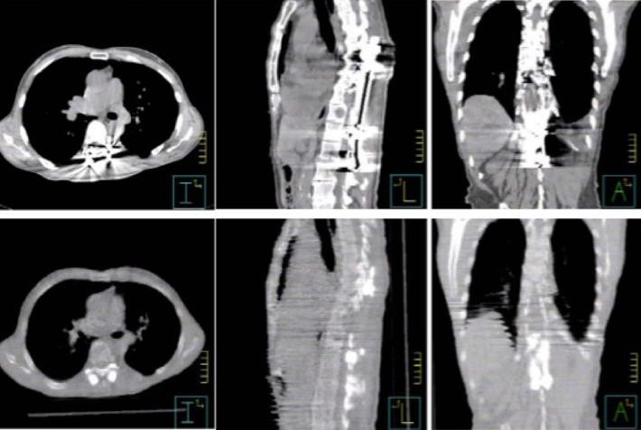
CT Imaging of the Spine
Image Source: http://iopscience.iop.org

Slide 37
CT Imaging of the Spine
Common Indications for CT Spine
•
•
Contraindications for CT spine
  Pregnancy (weigh risk vs. benefit)
  Extensive hardware

Slide 38
CT Imaging of the Spine
NECT Cervical Spine
Scouts: AP & Lateral
Anatomy Included:
Thin slices
Pitch < 1.0

Slide 39
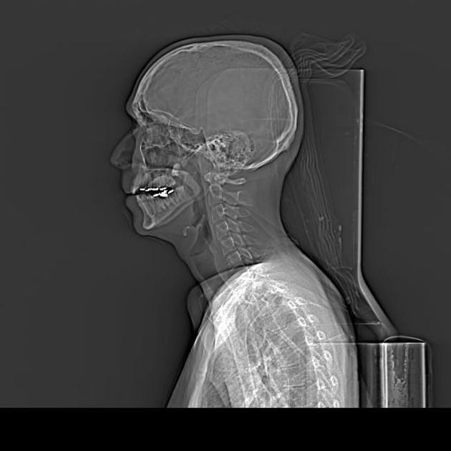
CT Imaging of the Spine

Slide 40
CT Imaging of the Spine
NECT Cervical Spine
SFOV: Large body
DFOV: 14 cm
Algorithm: Bone
  Window: WW WL

Slide 41
CT Imaging of the Spine
NECT Cervical Spine
Acquisition kVp:
Acquisition mA:
  use ATCM
Reconstruction details will vary
  MPR – oblique reconstructions
  Slice Thickness
  Windowing
  Filters – high resolution spine filters
  3D, if indicated

Slide 42
CT Imaging of the Spine
NECT Thoracic Spine
Scouts: AP & Lateral
Anatomy Included:
Thin slices
Pitch < 1.0

Slide 43
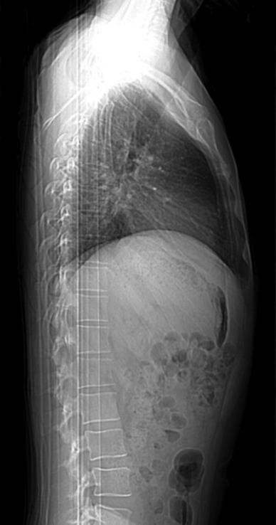
CT Imaging of the Spine

Slide 44
CT Imaging of the Spine
NECT Thoracic Spine
SFOV: Large
DFOV: 16 cm
Algorithm: Bone
  Window: WW WL

Slide 45
CT Imaging of the Spine
NECT Thoracic Spine
Acquisition kVp:
Acquisition mA:
  use ATCM
Reconstruction details will vary
  MPR – oblique reconstructions
  Slice Thickness
  Windowing
  Filters – high resolution spine filters
  3D, if indicated

Slide 46
CT Imaging of the Spine
NECT Lumbar Spine
Scouts: AP & Lateral
Anatomy Included:
Thin slices
Pitch < 1.0

Slide 47
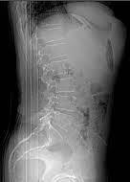
CT Imaging of the Spine

Slide 48
CT Imaging of the Spine
NECT Lumbar Spine
SFOV: Large
DFOV: 14-16 cm
Algorithm: Bone
  Window: WW 2000 WL 500

Slide 49
CT Imaging of the Spine
NECT Lumbar Spine
Acquisition kVp 140
Acquisition mA 150-500
  use ATCM
Reconstruction details will vary
  MPR – oblique reconstructions
  Slice Thickness
  Windowing
  Filters – high resolution spine filters
  3D, if indicated

Slide 50
CT Imaging of the Spine
No contrast typically, unless indicated and approved by a Radiologist
IV contrast protocol, if required:
  100 ml at 1.5ml/sec
  Scan delay =

Slide 51
CT Imaging of the Spine
Summary
  Review sectional anatomy of the spine
  Review indication, contraindications, and technical factors involved in different CT examinations of the spine.
  Ligaments, muscles, plexuses, and vasculature will not be tested on.

