Slide 1


Medical Esthetics
Factors Influencing Skin Health

Slide 2
The Immune System and the Skin
The immune system is activated when antigens (foreign invaders) are identified
Antibodies are molecules formed to fight and neutralize bacteria, viruses, and antigens.
Langerhans cells are dendritic in form. They are present predominantly in the stratum spinosum, but also other layers of the skin. They work to absorb, process, and carry antigens to the nearest lymph node for further immune system action.
Another part of the immune system involves leukocytes the white blood cells that have enzymes to digest and kill bacteria and parasites. These white blood cells also respond to allergies.
T cells play an important role in the immune system by attacking virus-infected cells, foreign cells, and cancer cells. T cells get their name from the thymus gland, where they mature.

Slide 3
Skin Nourishment
Blood and lymph are the fluids that nourish the skin
Networks of arteries and lymphatics send essential materials for growth and repair throughout the body
Blood supplies nutrients and oxygen to the skin. Nutrients are molecules from food such as protein, carbohydrates, and fats. Topical products with small molecules can nourish the epidermis.
Lymph, the clear fluid of the body that resembles blood plasma but contains only colorless corpuscles, bathes the skin cells, removes tox-ins and cellular waste, and has immune functions that help protect the skin and body against disease. Networks of arteries and lymph vessels in the subcutaneous tissue send their smaller branches up to dermal papillae, follicles, and skin glands.

Slide 4
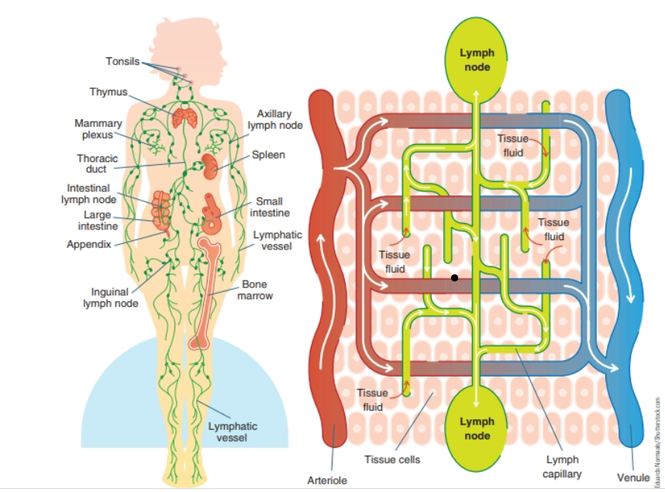

Slide 5
Cell Protection
The health of skin cells depends on the cellular membrane and the water-holding capacity of the stratum corneum. Phospholipids, glycolipids, cholesterol, triglycerides, squalene, and waxes are all different types of lipids found in the stratum corneum and cell membranes.
Intercellular lipids and proteins surround cells and provide protection, hydration, and nourishment to the cells.
Ceramides are a group of waxy lipid molecules such as glycolipids that are important to barrier function and water-holding capacity.
Fifty percent of the lipids in the stratum corneum are ceramides.
Fatty acids are also components of the intercellular substances.
Lipids are reduced if the skin is dry, damaged, or mature.

Slide 6
Cell Replacement Facts
The body replaces billions of cells daily. The cells of organs such as the skin, heart, liver, and kidneys are replaced every six to nine months. Cells of the bones are replaced every seven years. Unfortunately, elastin and collagen are not easily replaced by the body, and the skin does not regain its once pliable shape after being stretched or damaged by UV radiation and environmental pollution; however, research shows that certain skin care treatments and ingredients, such as vitamin A, alpha hydroxy acids (AHAs), alpha lipoeic acid, and other growth fac-tors stimulate skin cell turnover and reduce visible signs of aging. Regular cell turnover is necessary to keep skin healthy.

Slide 7
The Sun and the Skin
UV Radiation
The sun and your skin

Slide 8
Free Radical Damage
Oxidation and Antioxidants

Slide 9
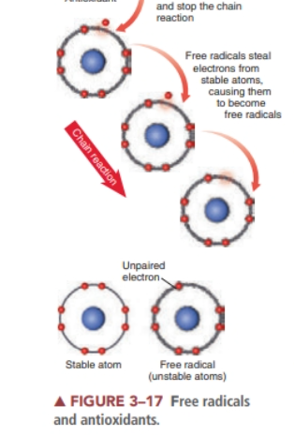
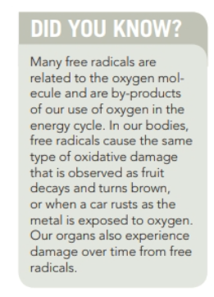

Slide 10

Skin Health and the Environment
Climate, humidity levels, and other environmental factors also affect the skin
Routine cleansing at night helps to remove the buildup of pollutants that have settled on the skin’s surface throughout the day
Applying daily moisturizers, antioxidants, growth factor serums, pep-tides, sunscreen, and even foundation products helps to protect the skin from airborne pollutants and the environment.

Slide 11
Skin Health and Lifestyle Choices
What we choose to put into our bodies significantly affects our overall health.
The impact of poor choices can be seen most visibly on the skin. Smoking, drinking, drugs, and an unbalanced diet with heavily processed foods all greatly influence the aging process.

Slide 12
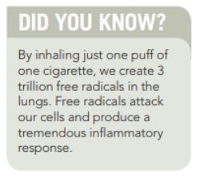

Slide 13
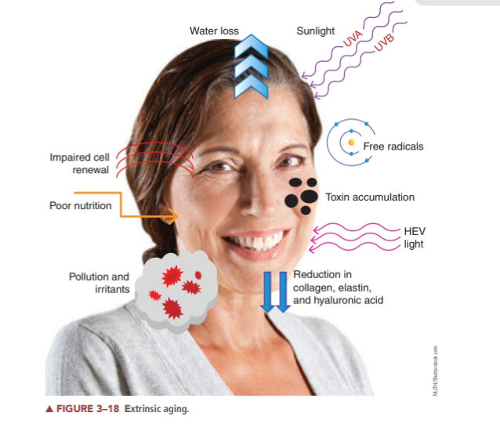

Slide 14
Using some prescription or illegal drugs also affects the skin.
Certain drugs have been shown to interfere with the body’s intake of oxygen, thus affecting healthy cell growth.
Some drugs can even aggravate serious skin conditions, such as acne. Other effects include dryness and allergic reactions on the skin’s surface.
The effects of inhaled cannabis should be a consideration in the skin’s aging processes as well.

Slide 15
Drinking and smoking
Both smoking and drinking contribute to the aging process on their own, but the combination of the two can be even more damaging to the tissues. The constant dilation and contraction of the tiny capillaries and other blood vessels, as well as the constant deprivation of oxygen and water to the tissues, quickly makes the skin appear lifeless and dull. It is very difficult for the skin to adjust and repair itself from this assault. Damage done by our habits can be hard to reverse or even diminished

Slide 16
Glycation
Recent research indicates that an intrinsic part of the aging process involves damaged structures and tissues that gradually accumulate in the body through a destructive process called glycation
Glycation is the binding of a protein molecule to a glucose molecule ( sugar ), resulting in the formation of damaged, nonfunctioning structures known as advanced glycation end products.
Glycation contributes to the aging of skin, contributing to wrinkles and hyperpigmentation.
Many age-related diseases such as arterial stiffening, cataracts, and neurological impairment are partially attributed to glycation.
Scientists have established that anything that causes a rise in our blood sugar results in inflammation on a cellular level. When blood sugar goes up rapidly and continually, the sugar can actually attach to the collagen in the skin, making it stiff and inflexible. This is glycation. When collagen is cross-linked by sugar, it leads to stiff and sagging skin.

Slide 17
Other Factors that age skin
Too much cortisol ( stress hormone)
Lack of sleep
Hormonal imbalances
Poor diet
Poor Microcirculation in the blood vessels

Slide 18
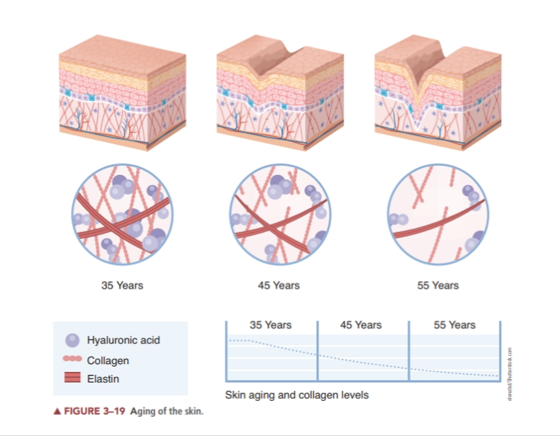

Slide 19
Hormone Replacement Therapy
Hormone replacement therapy (HRT) is often suggested to balance estrogen for women experiencing menopause; however, some HRT may be linked to breast cancer.
It is not within the scope of practice of an esthetician to make recommendations.
In addition to hormone balancing, sustaining good nutrition, the use of good skin care products and treatments, exercise, and a positive outlook can help keep skin looking radiant at any age.

Slide 20
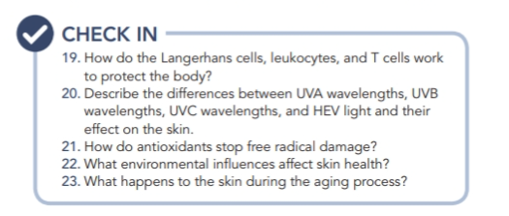
Research Time

Slide 21
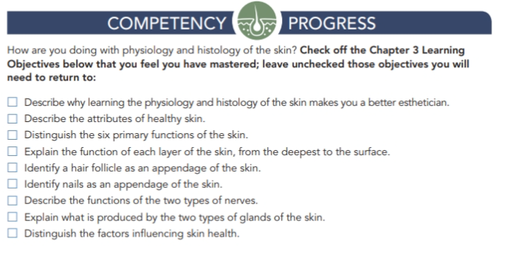

Slide 22

QUESTIONS?

