Slide 1
Early Somatic Effects
(ARS/Acute radiation syndrome and Lethal Dose)

Slide 2
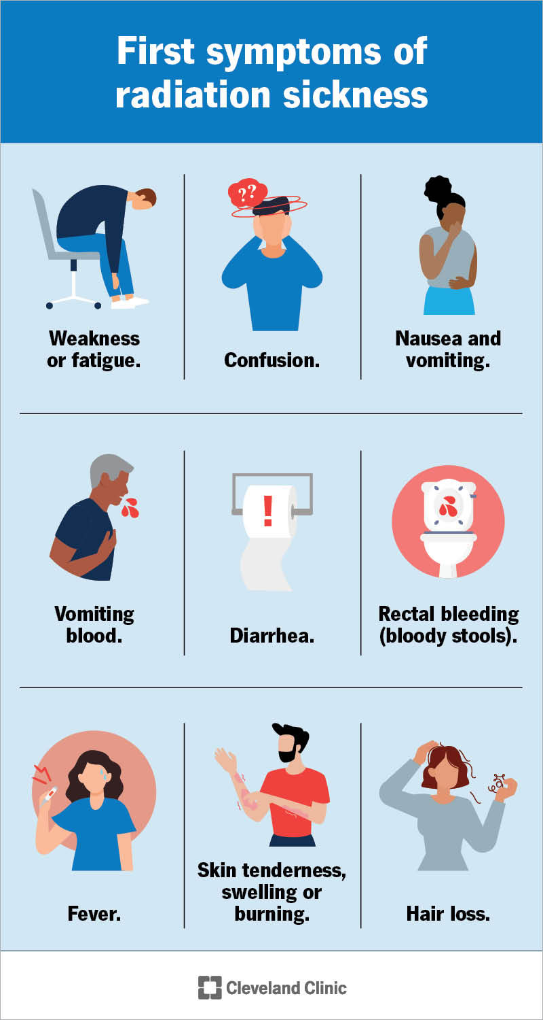
What is “ARS” (Acute Radiation Poisoning)
ARS is also known as Radiation sickness or Radiation Poisoning
ARS is a general term for symptoms regarding Radiation sickness
To be classified as having ARS, the total dose must be at or over 70 “rads” within a few minutes. This normally has no effect on the body; however, every person reacts differently
Symptoms can start within an hour and can be known to last several weeks to several months
Early symptoms present as nausea, vomiting and loss of appetite; these symptoms can subside, but new ones can show up such as hematemesis (vomiting blood), melena (blood in stool), fever and confusion.
There are 3 kinds of ARS; hematopoietic(blood), gastrointestinal(intestinal lining), and neurovascular (neurons/brain)

Slide 3
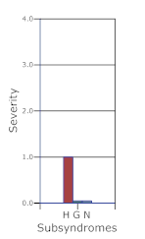

Stages of ARS
The first stage of ARS is called the Prodromal stage; this stage starts about an hour after exposure until roughly day 21
This is the stage in which vomiting and slight headaches occur
Hospitalization is not entirely needed unless the patient has an underlying medical condition or is immunocompromised as that could be detrimental to their health, however the patient should still be monitored for worsening conditions
This stage is followed shortly by the Latent stage, this stage last from roughly 21 days to 35 days.
During this stage, the patient appears to have no symptoms and may even have energy to do things they enjoy doing

Slide 4
Stages of ARS continued
The third stage of ARS is called the Systemic illness stage; this stage occurs after 35 days onward after exposure. Symptoms are different based on the type of radiation sickness you have.
This stage can last months depending on the dosage, as the minimum requirements to diagnose ARS is 0.7gy, which is the equivalent of roughly 70+ CT scans at once. The patient's general health can play a part in recovery times
The possible symptoms that can develop are as follows, fatigue, weakness and possibly fever
The odd of dying of radiation sickness with a low dose (0.7gy/700mgy)are quite low unless you have a pre-existing condition or are immunocompromised
As far as recovering from ARS the patient should monitor symptoms and wait for the symptoms to disappear and seek medical attention if symptoms remain or get worse

Slide 5
Lethal dosages
A lethal dose of radiation is varied on many factors including: how close the patient is to the machine, how long the patient is exposed and how much radiation the patient is exposed to
For a patient to die within an hour of being exposed to radiation they would have to have to have a dose of 10,000mgy/10gy or 1000 “rad” which would be the equivalent of roughly 1,000 CT scans at the same time
For the patient to have a risk of death within 60 days or less from ARS, the dose of radiation have to exceed 3-4gy or 300-400 “rad”
Doses less than 0.7-2gy or 70-200 “rad” are not considered lethal, but the patient does have a higher risk of developing cancer

Slide 6

Lethal dosages
A lethal dose of radiation is varied on many factors including: how close the patient is to the machine, how long the patient is exposed and how much radiation the patient is exposed to
For a patient to die within an hour of being exposed to radiation they would have to have to have a dose of 10,000mgy/10gy or 1000 “rad” which would be the equivalent of roughly 1,000 CT scans at the same time
For the patient to have a risk of death within 60 days or less from ARS, the dose of radiation have to exceed 3-4gy or 300-400 “rad”
Doses less than 0.7-2gy or 70-200 “rad” are not considered lethal, but the patient does have a higher risk of developing cancer

Slide 7
References
FEMA’s premier all-hazards training center - center for domestic preparedness. (n.d.). https://cdp.dhs.gov/shared/se/courses/default/AWR-923-W%2005122021%201.2-20210512144644/groups/113.html
Wikimedia Foundation. (2025, August 17). Acute radiation syndrome. Wikipedia. https://en.wikipedia.org/wiki/Acute_radiation_syndrome
Centers for Disease Control and Prevention. (n.d.). Acute radiation syndrome: Information for clinicians. Centers for Disease Control and Prevention. https://www.cdc.gov/radiation-emergencies/hcp/clinical-guidance/ars.html#:~:text=Latent%20stage:%20In%20this%20stage,hours%20up%20to%20several%20months.
Time phases of acute radiation syndrome (ARS) - dose range 1-2 gy. Time Phases of Acute Radiation Syndrome (ARS) - Radiation Emergency Medical Management. (n.d.). https://remm.hhs.gov/ars_timephases1.htm

