Slide 1
Patient Care
Blood Pressure

Slide 2
Objectives
Define Blood Pressure (BP)
List factors that effect BP
List normal ranges & how it’s charted
Describe equipment used for taking BP

Slide 3
Blood pressure is…
Measuring the forces of the circulating blood on the wall of the arteries
A blood pressure (BP) reading is usually expressed in two figures. i.e. 120/78
The top figure is the systolic pressure and is a measure of the pumping action of the heart muscle itself.
The bottom figure is the diastolic pressure, and indicates the ability of the arterial system to accept the pulse of blood forced into the system and when the left ventricle contracts.

Slide 4
Definitions
Systolic: The pressure with which the blood begins to flow represents the pressure of the heart's contraction
Diastolic: the pressure of the heart's relaxation
Hypertension: High blood pressure
Hypotension: Low Blood Pressure

Slide 5
Factors that affect Blood Pressure…
Controllable:
    Exercise
    Nutrition
    Alcohol
    Stress
    Smoking
    Body position
    Physical development
    Time of day
    Health status
Uncontrollable:
    Gender
    Race
    Hereditary
    Age

Slide 6
Other factors that affect BP
BP is usually lower in the morning, after sleep than later in the day after activity.
BP increases after a large intake of food
Emotions and strenuous activity usually cause systolic blood pressure to increase.
Men usually have higher BP than women.
Infants generally have higher BP compared to adults. Adolescents have the lowest overall BP.

Slide 7
Conditions that affect Blood Pressure…
Cardiac Output:
    the volume of blood ejected from the left side of the heart in one minute– also called minute volume
Peripheral Vascular Resistance:
    the resistance to flow that must be overcome to push blood through the circulatory system.
Blood Volume:
    total amount of circulating blood in the body, normally about 5.0 liters
Blood Viscosity:
    thickness of the blood
Arterial Elasticity:
    how flexible the arterial walls are
Notes:
Amount of blood in body is about 5 liters. Pg. 680 Tortora

Slide 8
Physiologic Factors which Increase BP
Blood Pressure increases when:
Cardiac Output ↑
Peripheral Vascular ↑
Resistance
Blood Volume ↑
Blood Viscosity ↑
Arterial Elasticity ↓

Slide 9
Physiologic Factors which Decrease BP
Blood Pressure decreases when:
Cardiac Output ↓
Peripheral Vascular ↓
Resistance
Blood Volume ↓
Blood Viscosity ↓
Arterial Elasticity ↑

Slide 10
Normal Ranges of BP
Normal systolic pressure in adults
  95 to 120 mm Hg
Normal diastolic pressure in adults
  60 to 79 mm Hg
Pre hypertension systolic pressure
  120-139 mm Hg
Pre hypertension diastolic pressure
  80 to 89 mm Hg
Hypertension systolic pressure
  140-159 mm Hg
Hypertension diastolic pressure
  90-99 mm Hg

Slide 11
Patient considerations
Blood pressure should be taken 3 times to ensure accuracy
Blood pressure can vary depending on the which of the patient’s arm was used.
Blood pressure taken “manually” is considered more accurate compared to the automatic blood pressure machines.

Slide 12
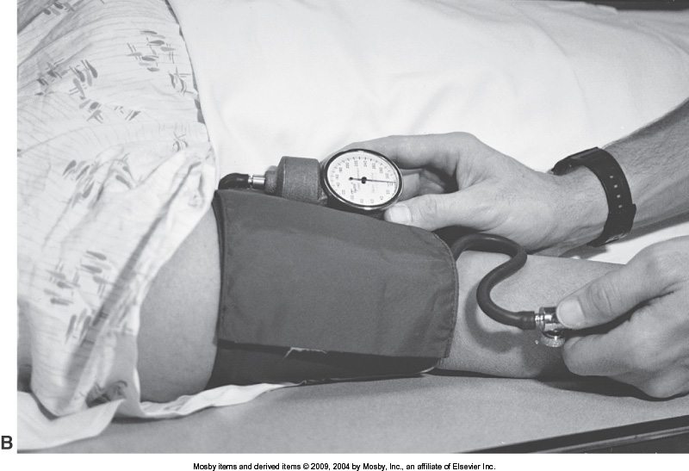
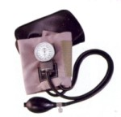
Blood Pressure Equipment
Sphygmomanometer used in lab was an aneroid manometer (most common in x-ray dept.)
  Rubber tubing
  Pressure bulb
  Gauge
  Cuff

Slide 13
How to chart BP
Blood pressure is measured in mmHg which stands for millimeters of mercury
While watching the sphygmomanometer, you would record the first number as being the systolic number, and the second as being the diastolic number
The blood pressure recorded is written as “BP systolic/diastolic”, ex: BP 120/80

