Slide 1
MRAD 204:
Radiographic Technique 1
Introduction to Positioning

Slide 2
Affiliated Readings
Bontrager
Pgs: 15→16
Pgs: 23 →24
Pgs: 26 →30

Slide 3
Overview
Body Habitus
General Terms
“Special” Projections
Terms Related to Movement

Slide 4
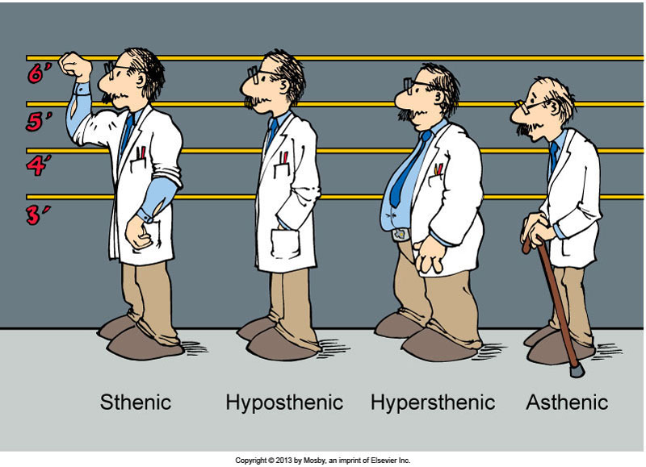
Body Habitus
“Average” Size
“Thin”
“Broad Frame”
Very Thin
Collimation should be adjusted according to body habitus
Bushong 10th Ed. Fig. 13-03

Slide 5
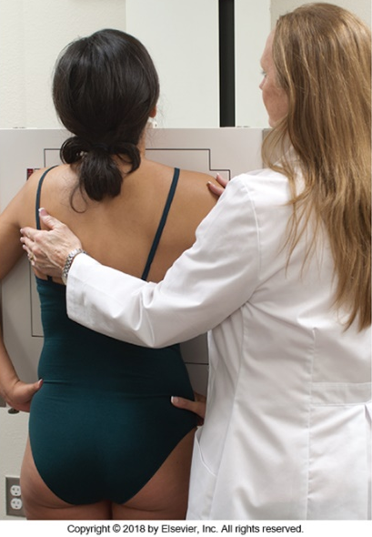
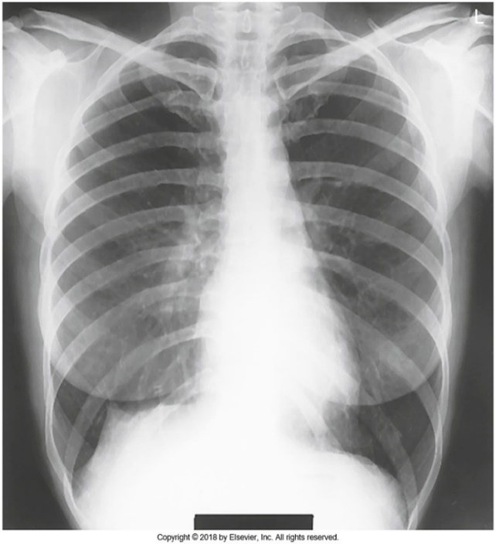
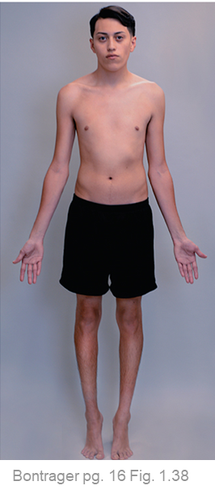
General Terms
Radiography
Radiograph
Bontrager pg. 16 Fig. 1.38
Bontrager pg 16 Fig. 1.39
Aka. the x-ray image
The steps required to create a radiograph
Display as the patient facing the viewer, in anatomic position
Include patient positioning, IR selection & placement

Slide 6
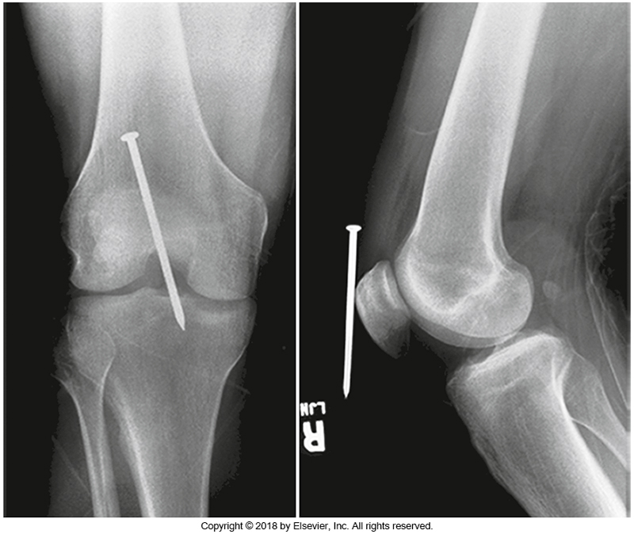
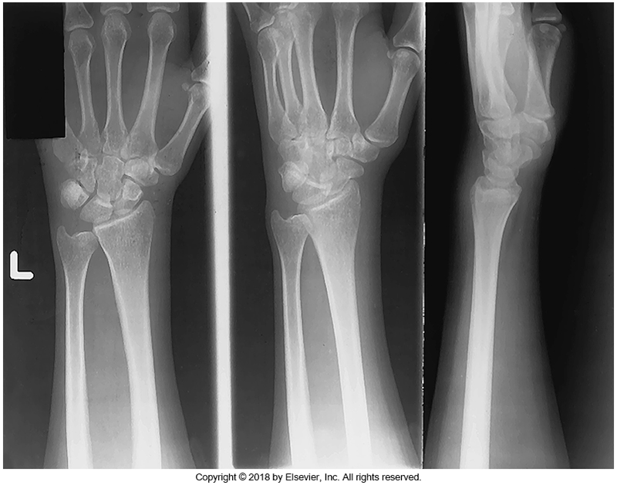
General Terms
View is used to identify which image (from a routine) is displayed
Common to take at least 2 radiographs (at different angles) of the same body part
  Taking images at different angles can improve: localization of foreign bodies, and determining alignment of fractures etc.
AP Knee
Lateral Knee
PA
Oblique
Lateral
Bontrager pg. 35 Fig. 1-112
3 views of the wrist
Bontrager pg. 34 Fig. 1-109

Slide 7
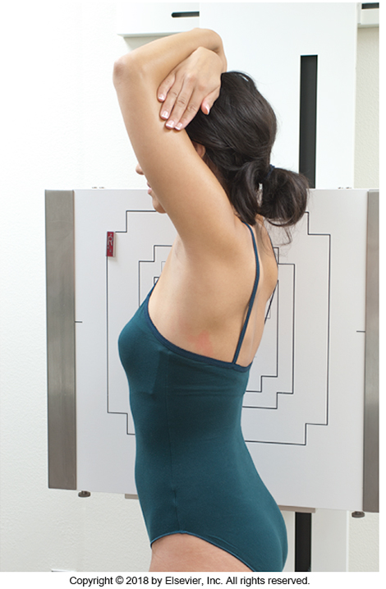
General Terms
Position relates to the patient; describes how they are posed in relation to the IR
Imagine you could not see this patient. How should you describe their position, to someone else?
Standing with their right side against the IR
Erect Right Lateral
Right Lateral
Standing straight, with arms elevated
Bontrager pg. 21 Fig. 1.61

Slide 8
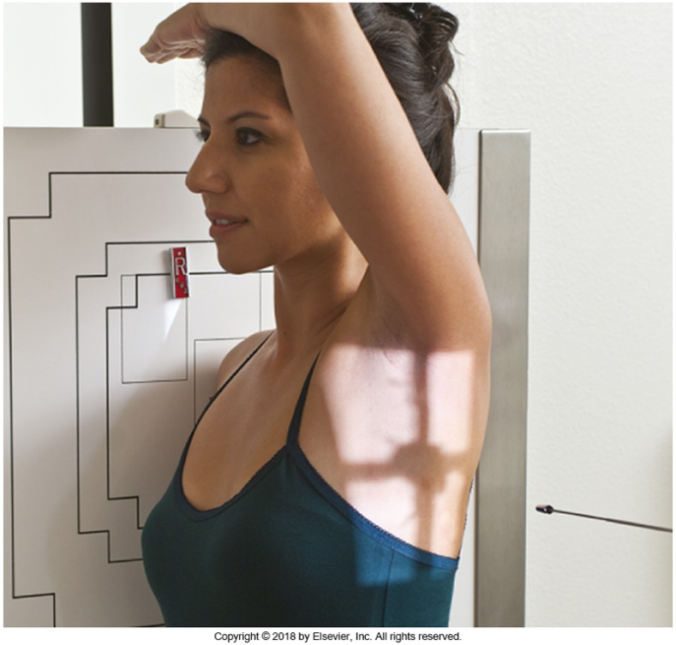
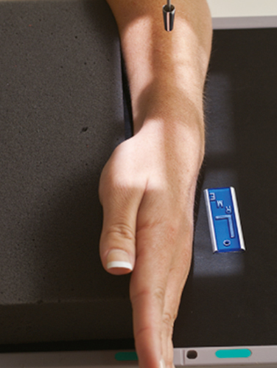
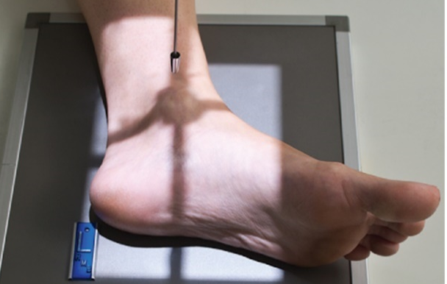
General Terms
Projection relates to the x-ray tube and IR; describes how the x-ray beam is moving through the patient’s body
Lateral projections of the appendicular skeleton: path of the CR must be defined as medial→lateral or lateral→medial
Lateromedial
Mediolateral
Bontrager pg. 24 Fig. 1.77
Lateral projections of the axial skeleton are typically defined more simply as “lateral”
Bontrager pg. 19 Fig. 1.53 & 1.54

Slide 9
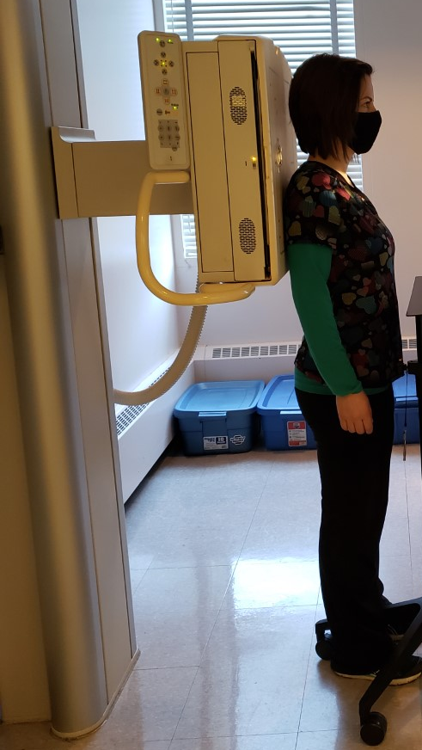
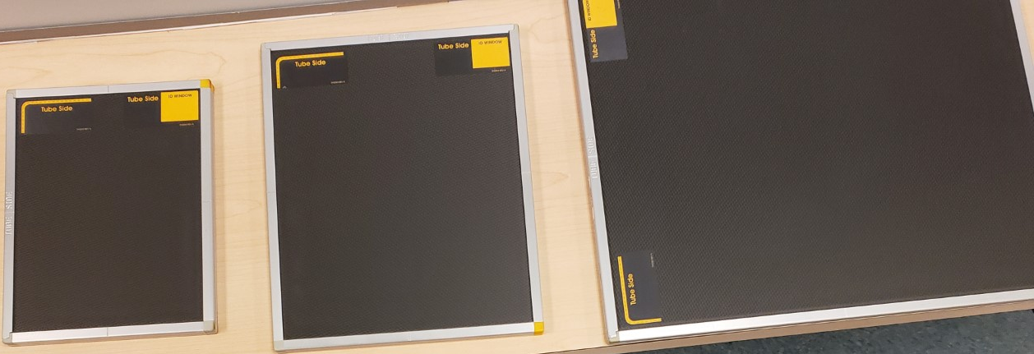
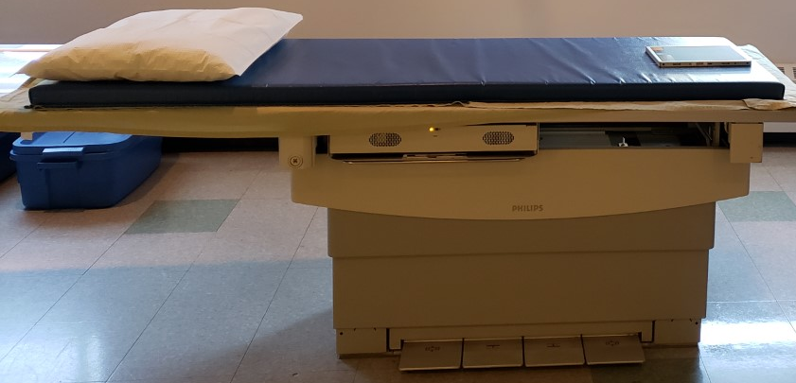
Image Receptor (IR): aka. Detector
DR or CR:
CR Cassettes have 3 sizes
  Small (8x10in or 20x25cm)
  Medium (10x12in or 24x30cm)
  Large (14x17in or 35x43cm)
For CR, must be placed in a CR reader to view a radiograph
Can be moved more freely
Active surface is “black”
Table & Wall IR
SAIT Campus 2021

Slide 10
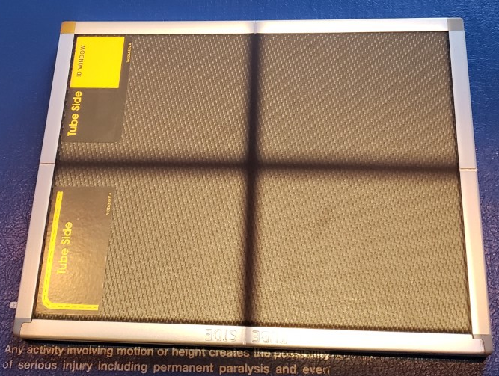
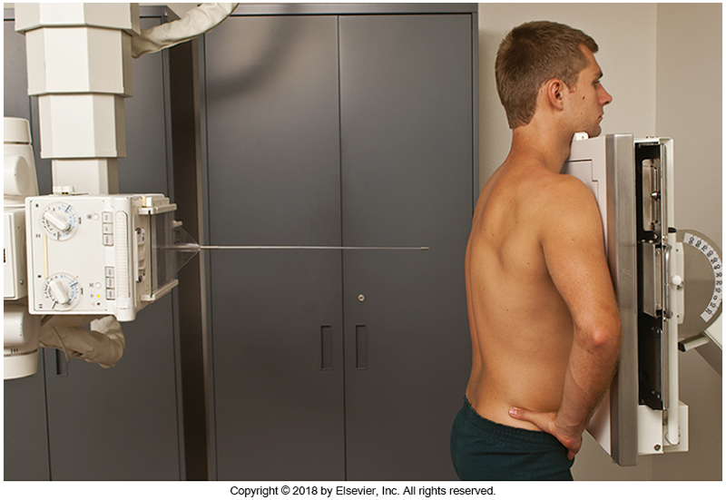
Central Ray (CR)
Indicates the middle of the x-ray beam
SAIT Campus 2021
When turned on, the collimator light displays dark crosshairs. The middle of the x-ray beam (Central Ray) is located where the dark crosshairs intersect
Bontrager pg 19 Fig. 1.49
Note: Your textbook uses a metal rod to demonstrate the Central Ray (CR)

Slide 11
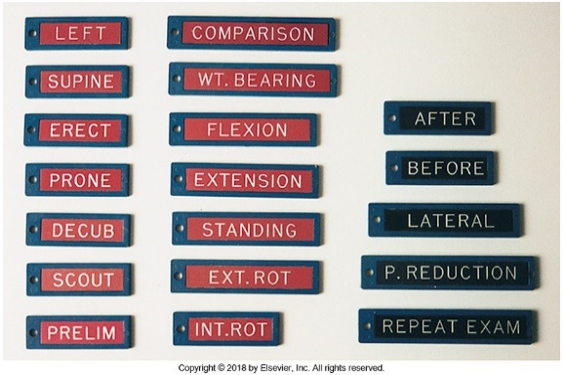
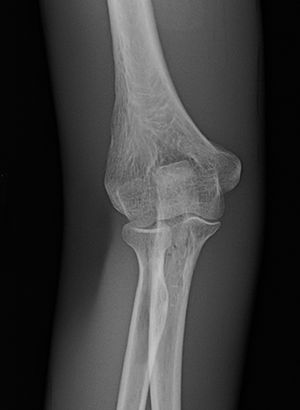
Markers
Is this a Right or Left elbow? (right)
Can be added electronically, or directly using radiopaque lead
  Use of lead is best practice
  When used, radiopaque lead markers, appear white on a radiograph
Most commonly used to identify the anatomic side that was radiographed
Bontrager pg.32 & 164 Fig. 1.108 & 4.121

Slide 12
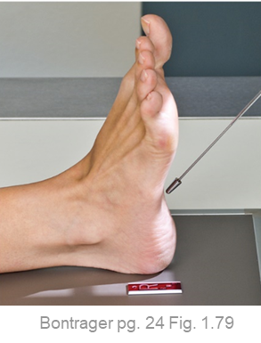
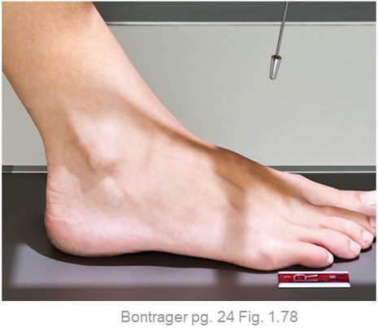
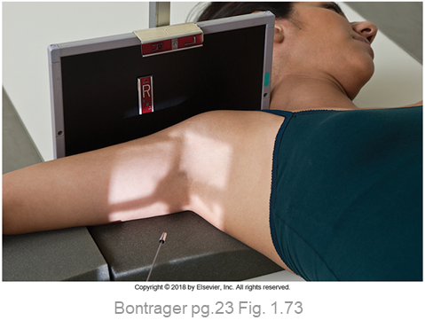
“Special” Projections
Axial projections refer to radiographs that are taken using an x-ray tube angle
axial Plantodorsal
Dorsoplantar
Inferosuperior axial
Projection rules apply: must describe how the Central Ray (CR) moves through the patients body to the IR
Exception: AP Foot Projection
  Axial is not used as a descriptor, despite the tube angle

Slide 13
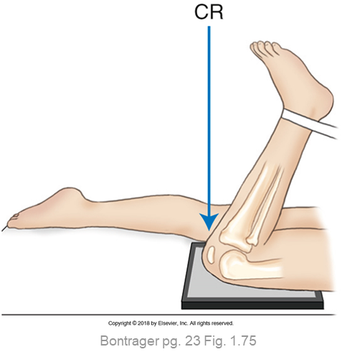
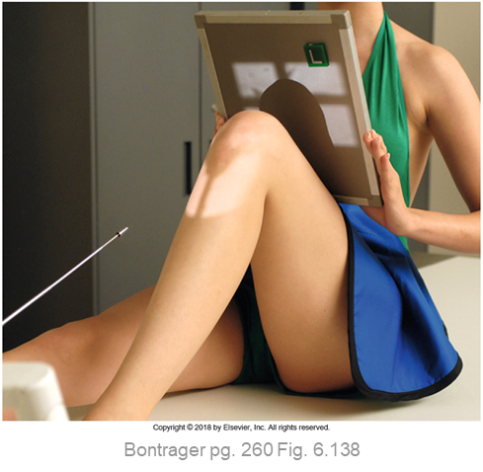
“Special” Projections
Tangential projections use either an exaggerated patient position, and/or tube angle (that follows a body part of interest) to remove superimposition
Example: Tangential patella (aka. knee cap) projections
  CR matches angle of the patella (adapted to patient position)
  Radiographically will display the patella “away” from other bones

Slide 14
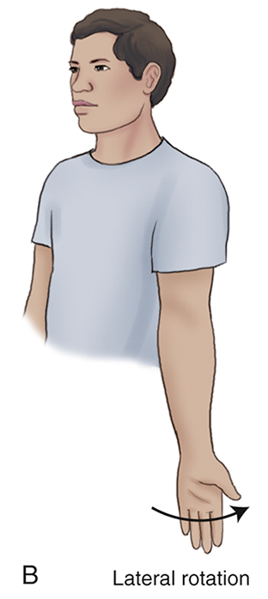
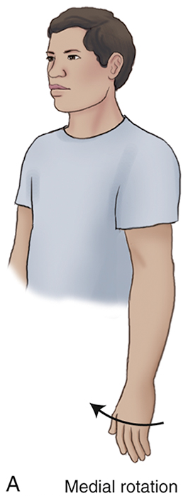
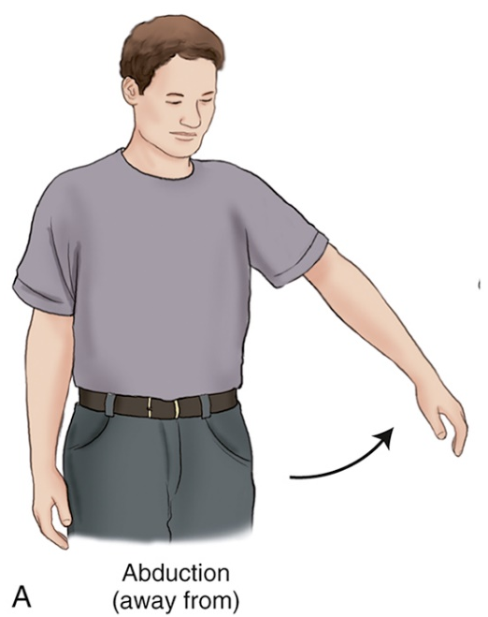
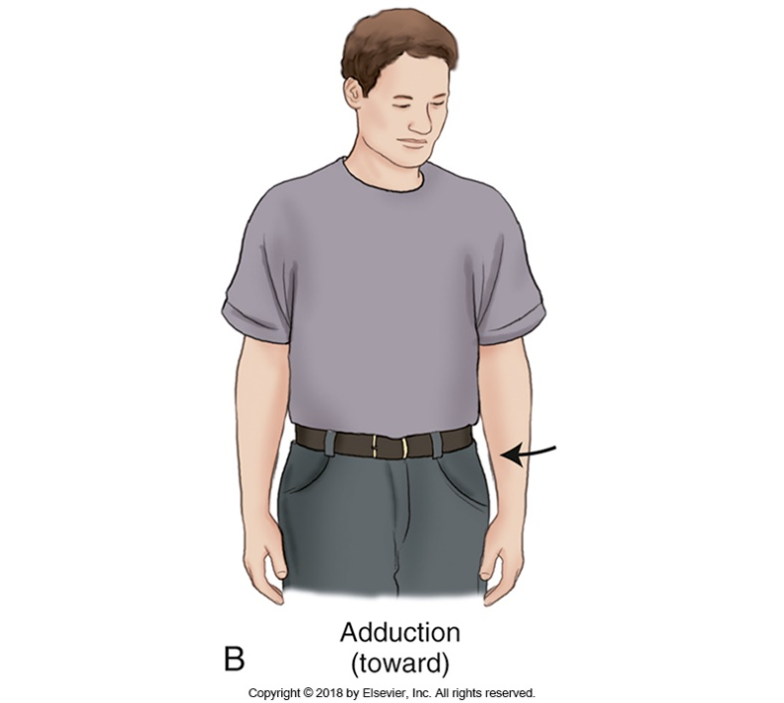
Terms Related to Movement
Medial = towards the midline of the body
Bontrager pg. 27 Fig. 1.95
Bontrager pg. 28 Fig. 1.96
Lateral = away from the midline of the body

Slide 15
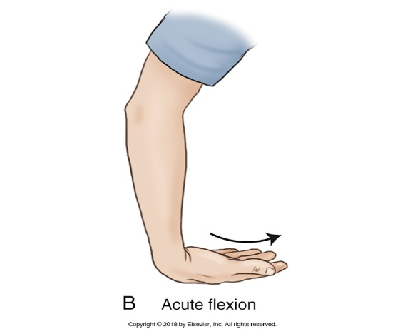
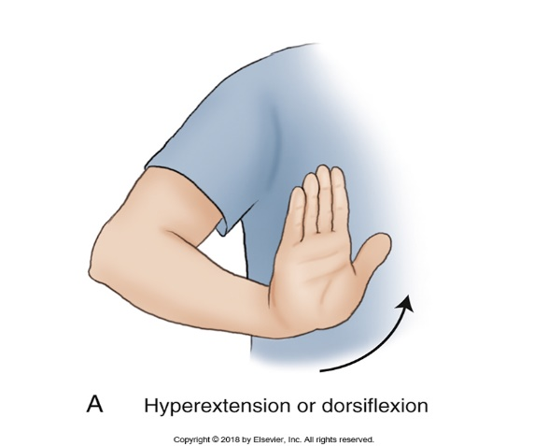
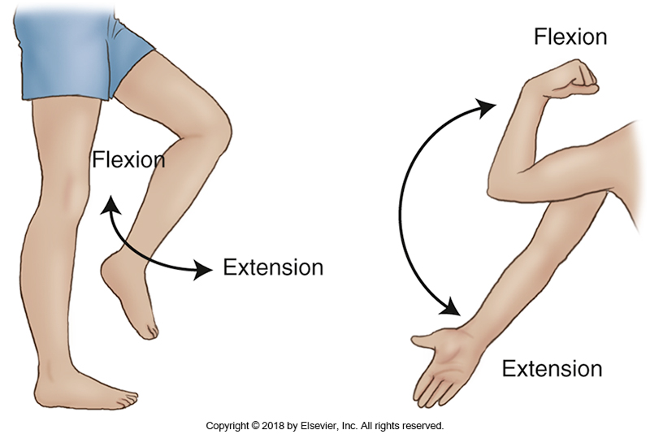
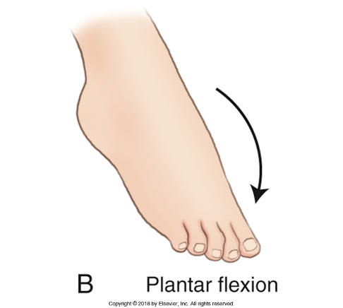
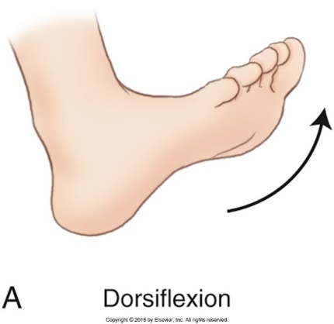
Terms Related to Movement
Acute flexion = 90º wrist “bend”
Hyperextension = movement past neutral
Flexion moves body parts, above and below a joint, closer together
Extension refers to straightening a joint (into a neutral position)
Exception = Foot movements are considered flexion
Defined by direction of flexion
Bontrager pg. 26 & 27 Fig. 1.88, 1.90 & 1.92

Slide 16
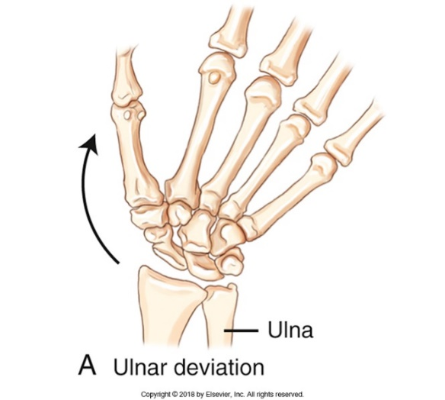
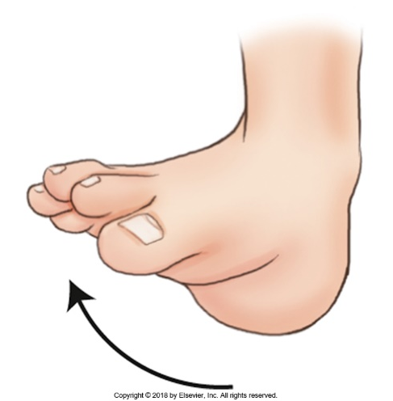
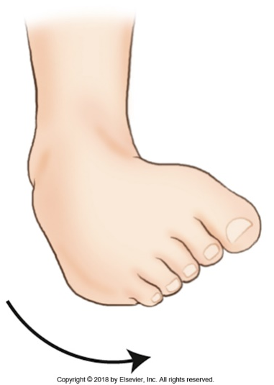
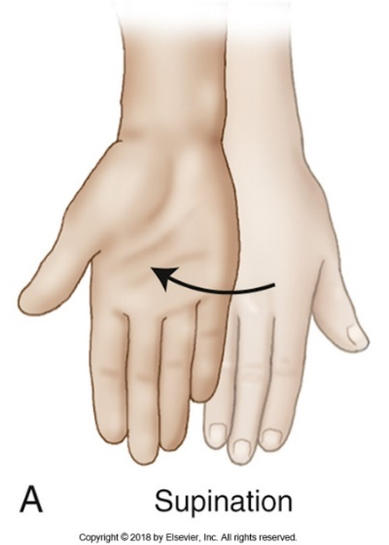
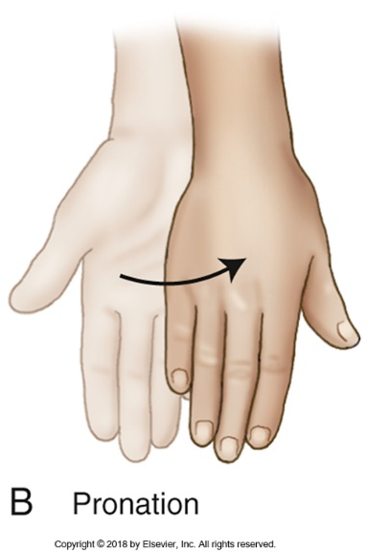
Terms Related to Movement
Movement of the wrist (from neutral) towards the ulna
Eversion
Inversion
Palm is “face-up”
A “twisting” motion of the foot only (ankle remains in a neutral/straight position)
Palm is “face-down”
Bontrager pg. 26, 27 & 28 Fig. 1.91, 1.93, 1.94, & 1.97

Slide 17
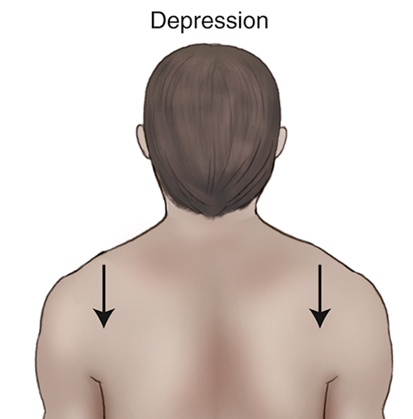
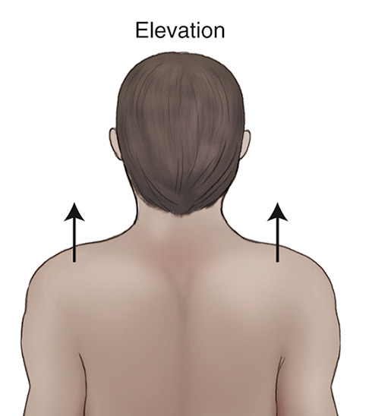
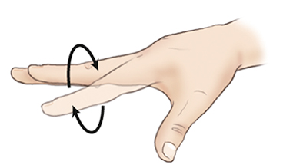
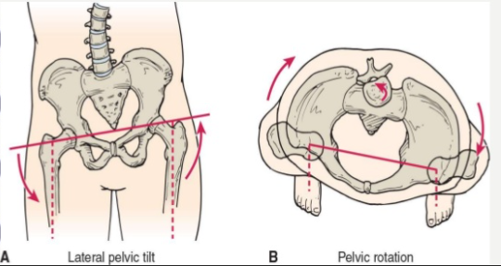
Terms Related to Movement
Shrugging shoulders “up”
Circumduction = Circular motion
Bontrager pg. 29 Fig. 1.99
Bontrager pg. 29 Fig. 1.100
Reaching towards the toes
https://www.slideshare.net/KRUPARAITHATHA/hip-joint-80278864
Tilt occurs when the body part is not parallel to the long edge of the IR
Rotation occurs when the body part is not flat against the surface of the IR (one part is elevated off the IR surface)

