Slide 1
ANPH 252: Anatomy and Pathology 2
Pathology of the Urinary System
Neoplasms

Slide 2
Terminology
Hematuria -Blood in Urine
Pyuria - Pus in Urine
Anuria - No Urine
Dysuria - Difficult/Pain to Urinate
Polyuria – Large/Excessive amounts of urine
Notes:
Hematuria – Blood in Urine
Pyuria – Pus in Urine
Anuria – Lack of Urine
Dysuria – Difficult/Pain to Urinate
Polyuria – Large/Excessive amount of Urine

Slide 3
Malignant Hypernephroma
Also known as Renal Cell Carcinoma (RCC)
Originates in the proximal convoluted tubule
Most common malignant tumor of the kidneys (approximately 90-95% of cases)
Disease is often advanced by the time it is diagnosed
Symptoms include hematuria, flank pain, mass/ bloating of abdomen or flank
Treated with surgical removal of kidney (or portion) and chemotherapy and radiation therapy to the metastatic cancers
Chemotherapy for the renal cancer itself has only a 4-5% success rate
Metastasizes (in this order) to lung, bone, lymph nodes, liver, adrenals and brain
Notes:
Can develop secondary malignant growths from primary site
Malignant – life threatening

Slide 4
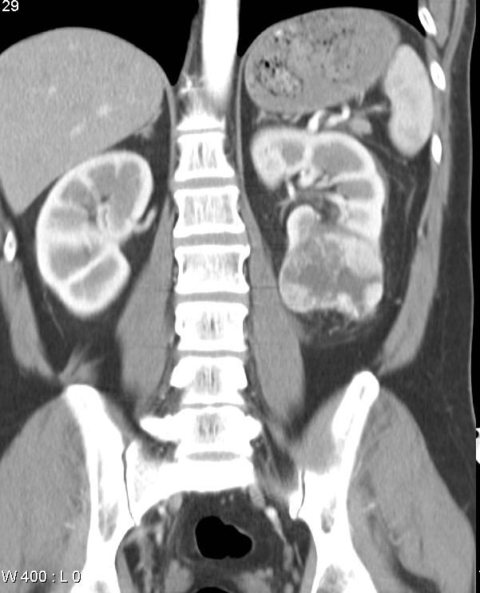
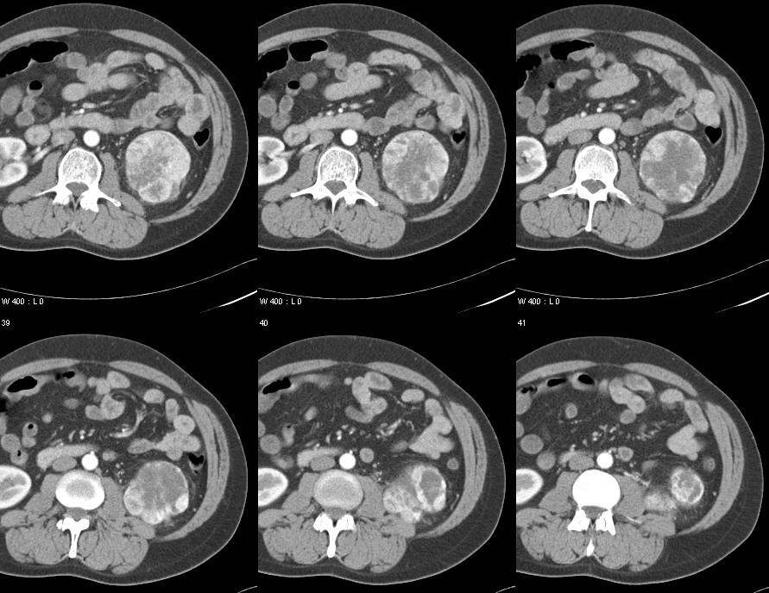
Case courtesy of Assoc Prof Frank Gaillard, Radiopaedia.org, rID: 3046

Slide 5
Carcinoma of the bladder
Typically found in men older than age 50
A lot of industrial chemicals and smoking have been linked to bladder cancer, as the carcinogens are excreted into the urine

Slide 6
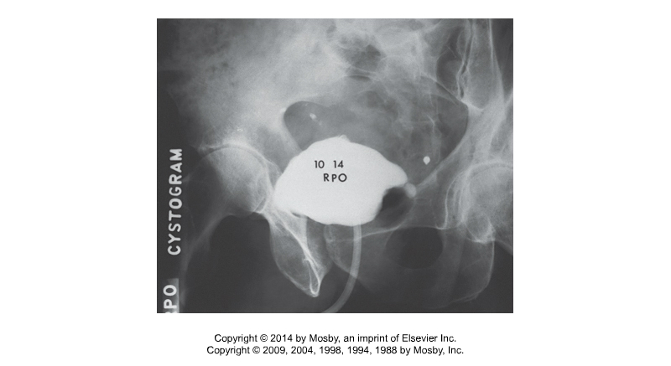
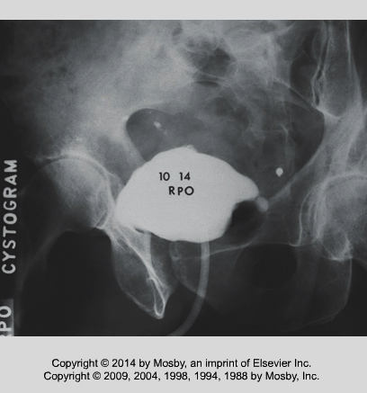
Bladder Cancer
Etiology is smoking or exposure to industrial chemicals
Painless hematuria is main symptom, but also tenderness and polyuria
Filling defect in the bladder on x-ray
Fig. 7-56 Kowalczyk
Notes:
In men more then women

Slide 7
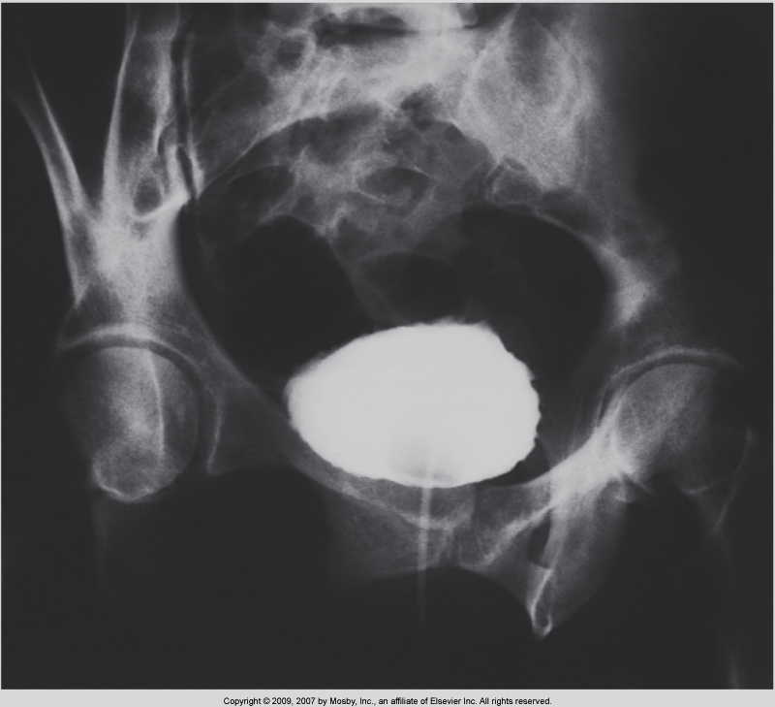
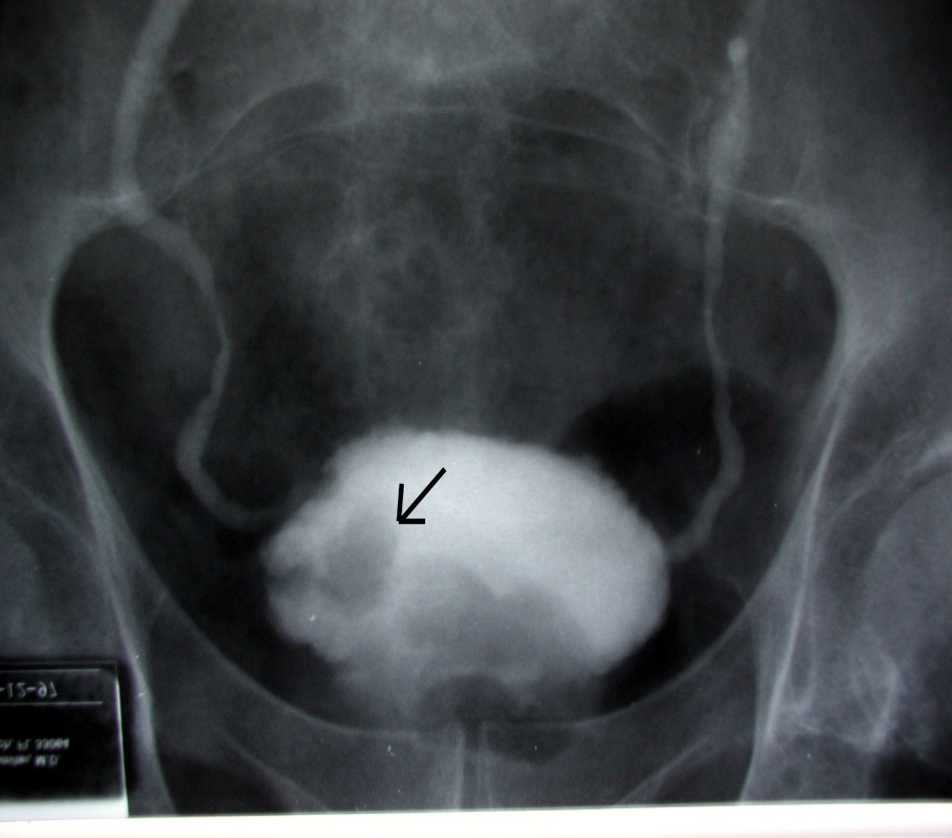
Bladder Cancer vs Cystitis
Title | Muscle-Invasive Bladder Cancer Treatment
Author | Heather Goltz et al. (2012)
Link | https://heathergoltz.files.wordpress.com/2011/12/bladder-tumor-on-ivp.jpg
Fig 7-38 Kowalczyk

