Slide 1


Medical Esthetics
Infection and Control Lesson #3

Slide 2
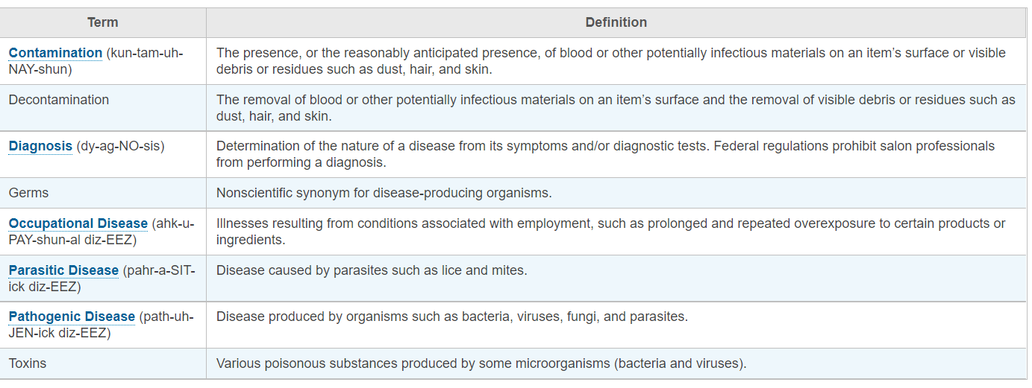


Slide 3

Interactive
Game

Slide 4
Let’s Play a Game
Click Here

Slide 5
The presence or the reasonably anticipate presence of blood or other potentially infectious materials on an item's surface or visible debris or residues such as dust, hair, and skin describes.
Contamination
Sanitation
Diagnosis
Parasites
Bacteria
Virus

Slide 6
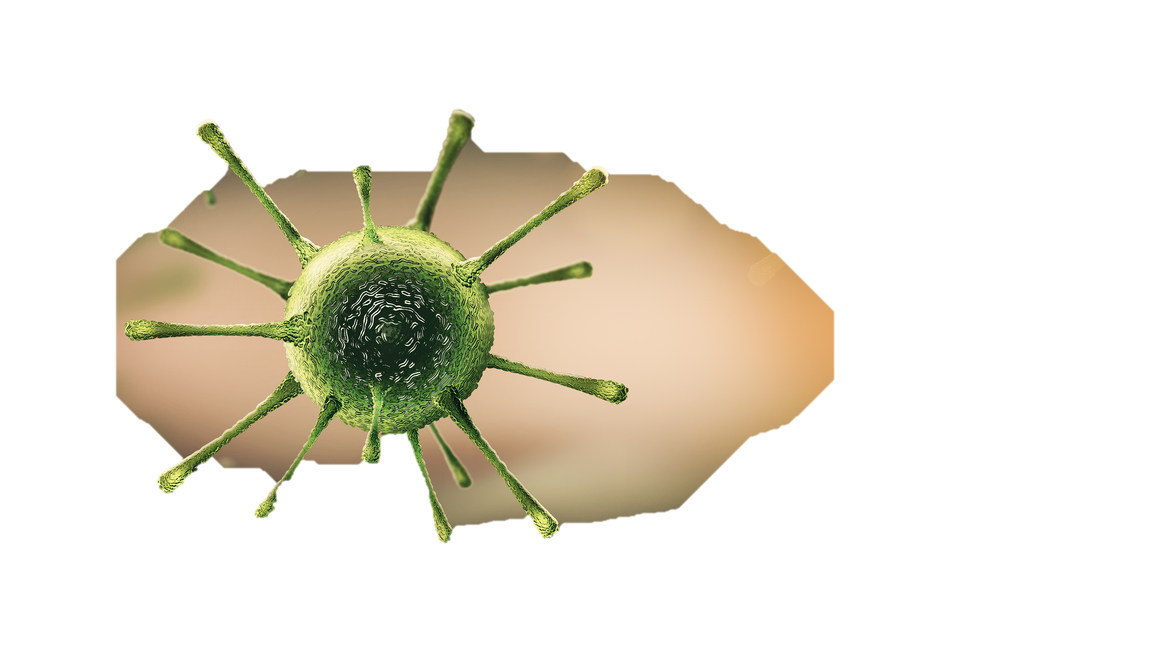
Good Job that is the right answer!

Slide 7
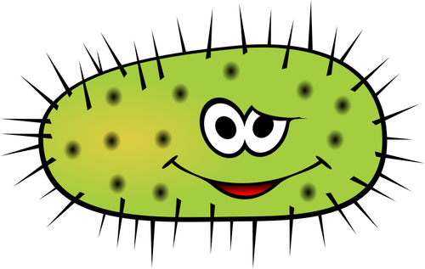
Oops wrong answer, click the icon and go back!

Slide 8
When it comes to preventing the spread of infectious disease, beauty professionals must understand and be prepared to deal with five types of potentially harmful organisms
BACTERIA
Virus
Parasites
Biofilms
Fungi
END

Slide 9
When it comes to preventing the spread of infectious disease, beauty professionals must understand and be prepared to deal with five types of potentially harmful organisms
BACTERIA
Virus
Parasites
Biofilms
Fungi
END

Slide 10
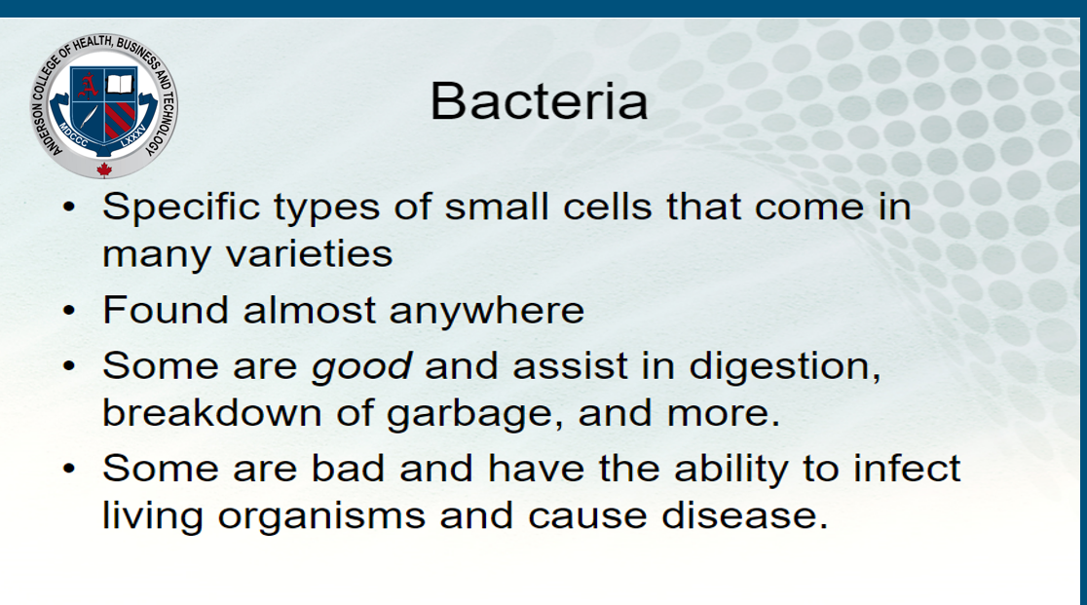

Slide 11
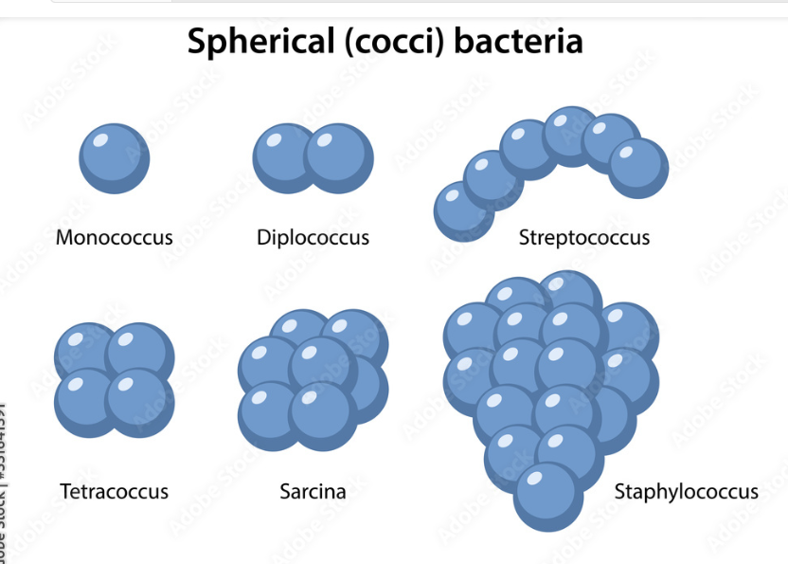
Classification of pathogenic bacteria
Spherical (cocci)

Slide 12
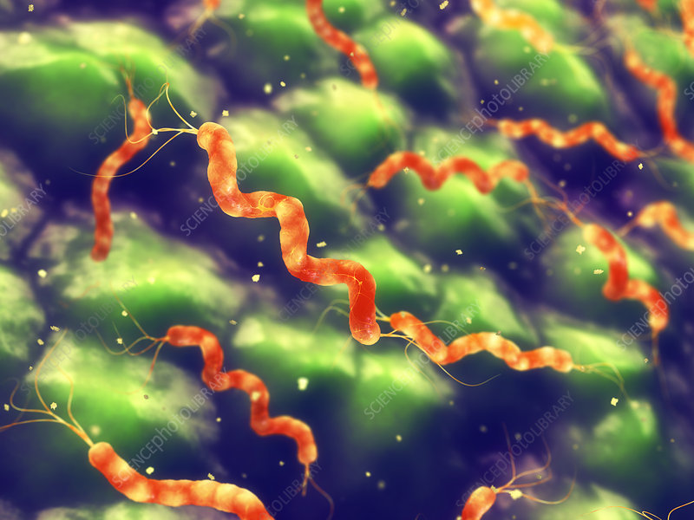
Spiral (spirilla) spiral shaped bacteria

Slide 13
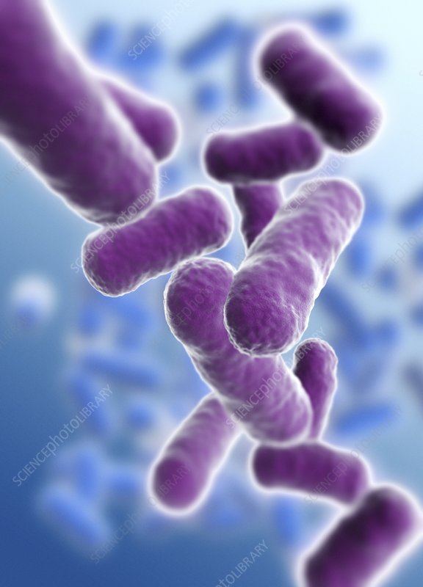
Rod (bacilli) rod shaped bacteria

Slide 14
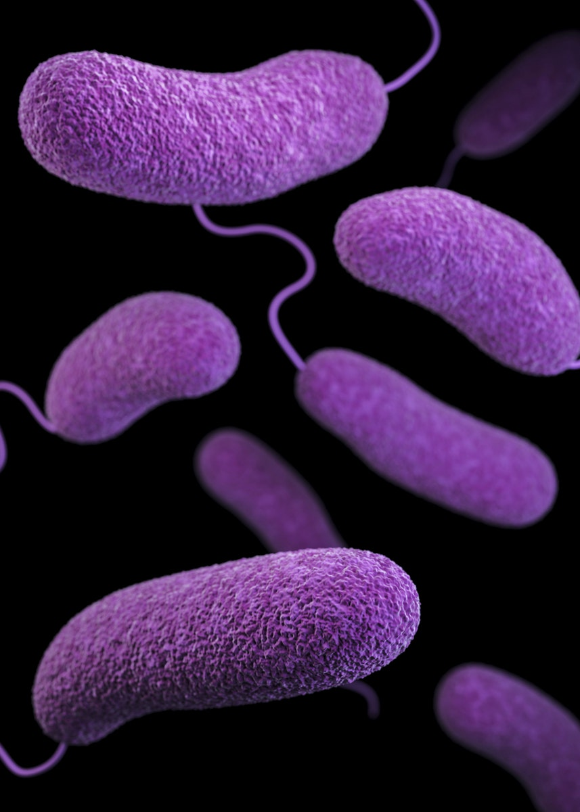
Comma (vibrios) or corkscrew (spirochaetes)

Slide 15
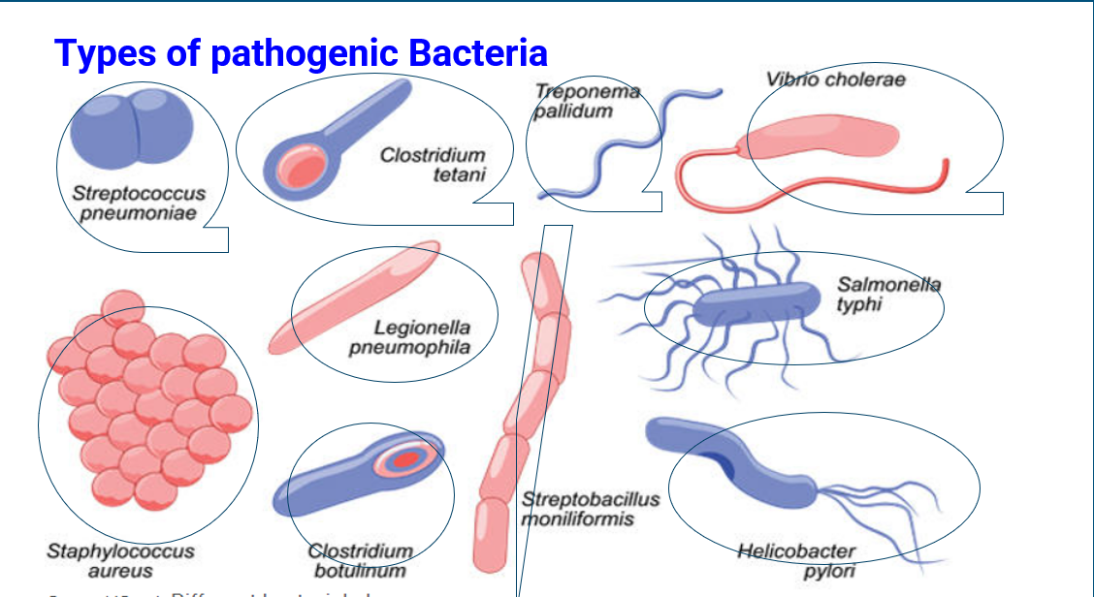

Slide 16
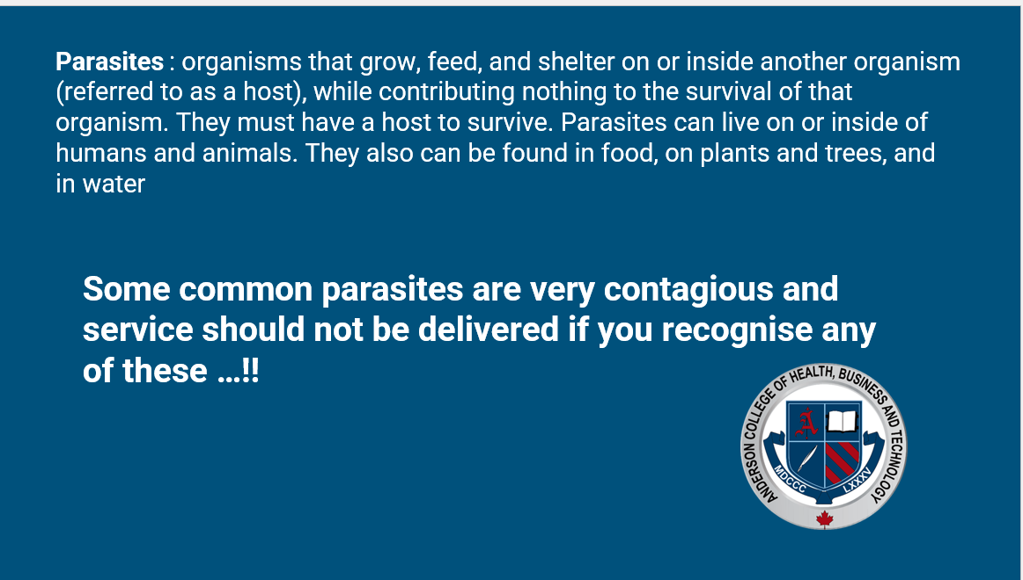

Slide 17
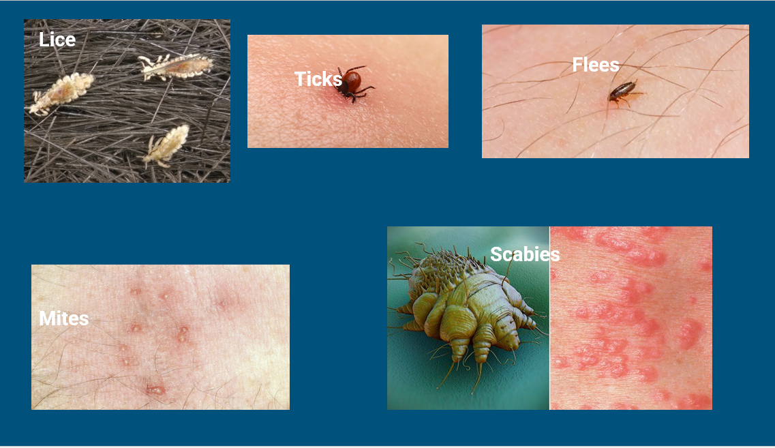

Slide 18
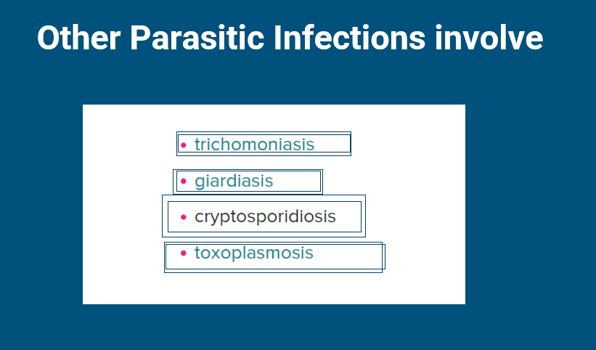

Slide 19
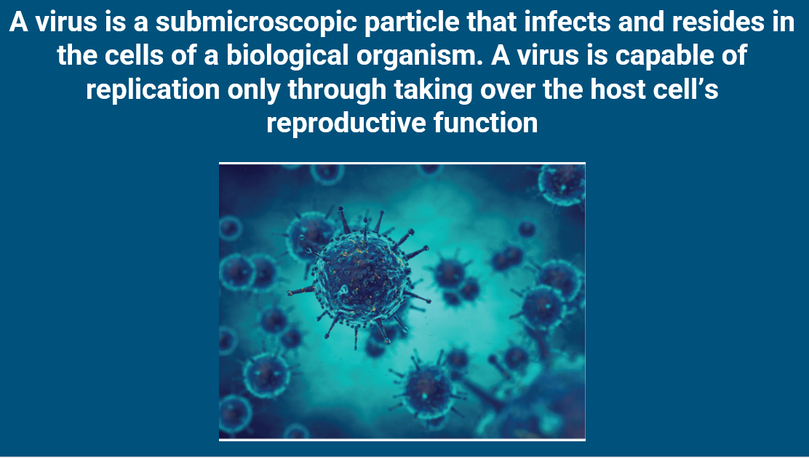

Slide 20



Slide 21
There is no cure for virus but we can prevent them through :
-Prevention through proper cleaning, disinfection and sterilization process
-Prevention through properly following all procedures
-Preventions through hand washing and safe handling
- Prevention through vaccination
- Class exercise:
Make a list of viruses that can be easily transmitted on a Spa or salon setting

Slide 22
Types of Bacteria that Can Be Found on Medical Spa Settings and Salons
-Staphylococcus
-Streptococcus
-Pseudomonas

Slide 23
Groups Exercise and Research Time!
-Form 3 different groups
- Each group should represent the following
Group 1 Staphylococcus
Group 2 Pseudomonas
Group 3 Streptococcus
Each subgroup should research what are the most contagious channels that can be found on the workplace
Each group should draw the research findings and present to class

Slide 24

What about Biofilms?

Slide 25
End of lesson group discussion
Why you think is important to understand Infection control?
What new information have you learned?
Why you think is important to chose wisely when going to a Spa or Salon
Why you think is important you understand all the different contagious pathogens?

Slide 26
QUESTIONS?

