Slide 1

ANPH 202: Anatomy and Pathology I
Outcome Three: Central Nervous System

Slide 2
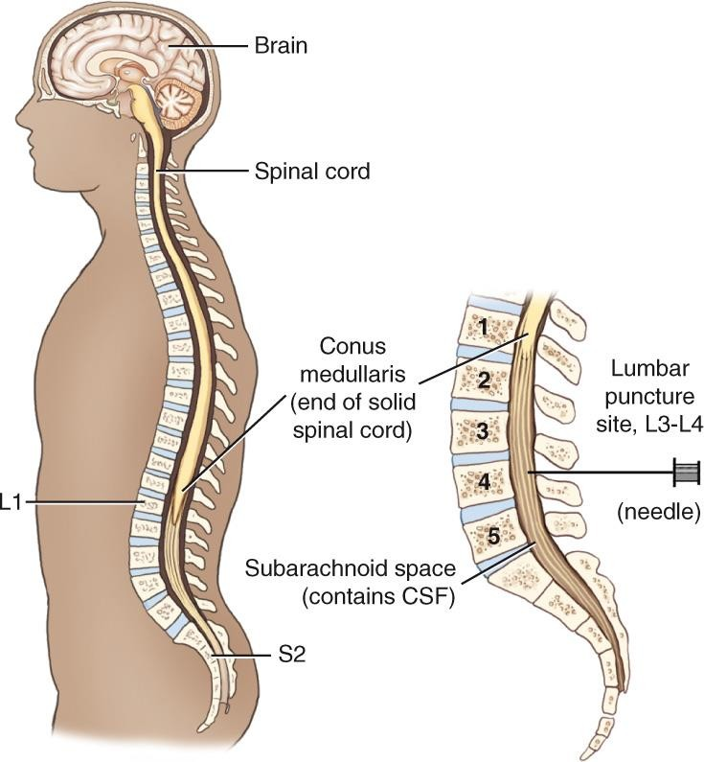
Central Nervous System
Two divisions:
  Brain (encephalon)
  Spinal cord (medulla spinalis)
2

Slide 3
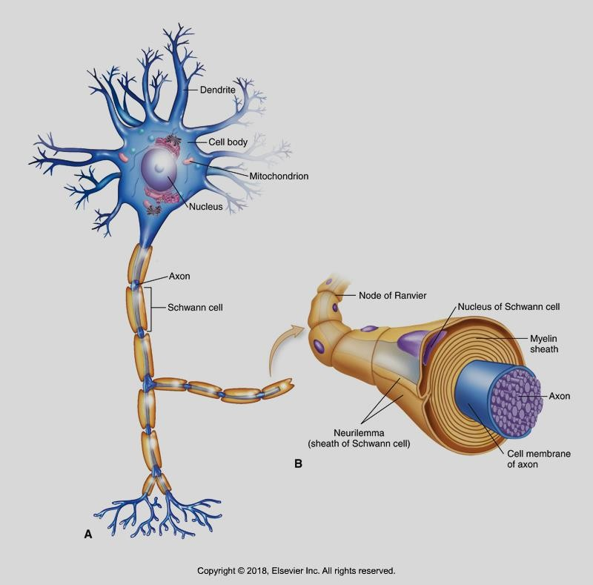
Neurons
Consist of dendrites, a cell
body, and an axon
The axon may be coated in a myelin sheath which speeds up the transmission of electrical impulses
Sensory neurons carry impulses from all parts of the body to the brain
and spinal cord
Motor neurons carry impulses from the CNS to muscles and glands
Patton and Thibodeau 10-2

Slide 4
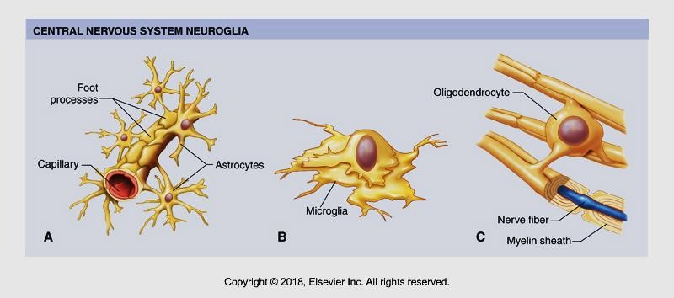
Neuroglia
Support cells; “glia” means “glue” in Greek language
They hold neurons together and protect them
Astrocytes help to form the blood brain barrier
Microglia move through brain tissue consuming microbes, and damaged cells
Oligodendrocytes hold nerve fibres together and produce myelin

Slide 5
Brain Anatomy
Principal parts of the brain that you need to know:
Lobes of the brain
Fissures, sulci, gyri
Cerebrum, cerebellum, vermis
Meninges
Falx cerebri and falx cerebelli,
Ventricles and cerebral aquaducts
Choroid plexus
Brainstem (midbrain, pons, medulla oblongata)
Thalmus and hypothalamus
Corpus collosum
Pituitary and pineal glands
Basal ganglia
Cisterna magna

Slide 6
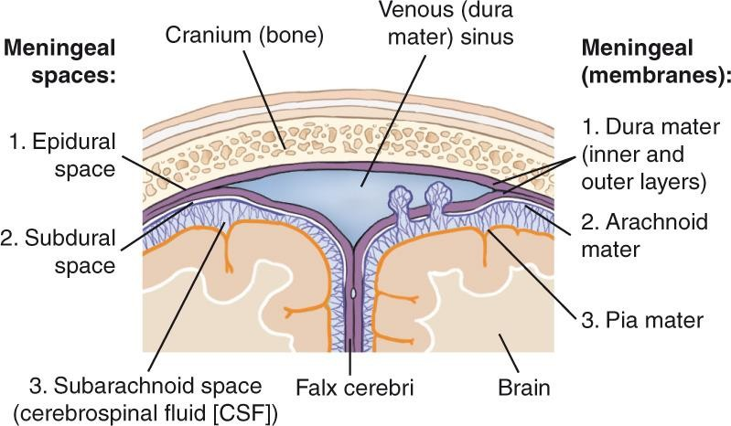
Meninges and Meningeal Spaces (Brain and Spinal Cord Coverings)
6

Slide 7
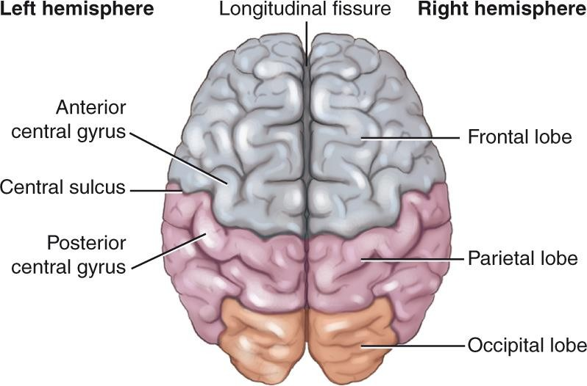
Cerebral Hemispheres
Longitudinal fissure
Gyrus (gyri, plural)
Sulcus
Corpus callosum
Falx cerebri
7

Slide 8
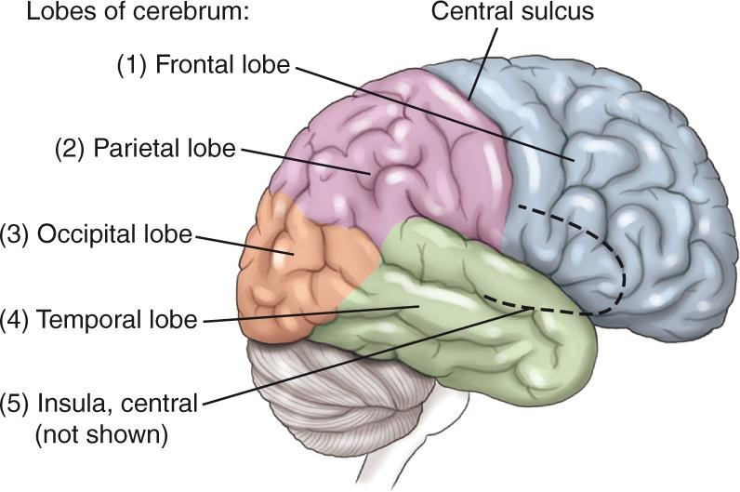
Cerebral Hemisphere
8

Slide 9
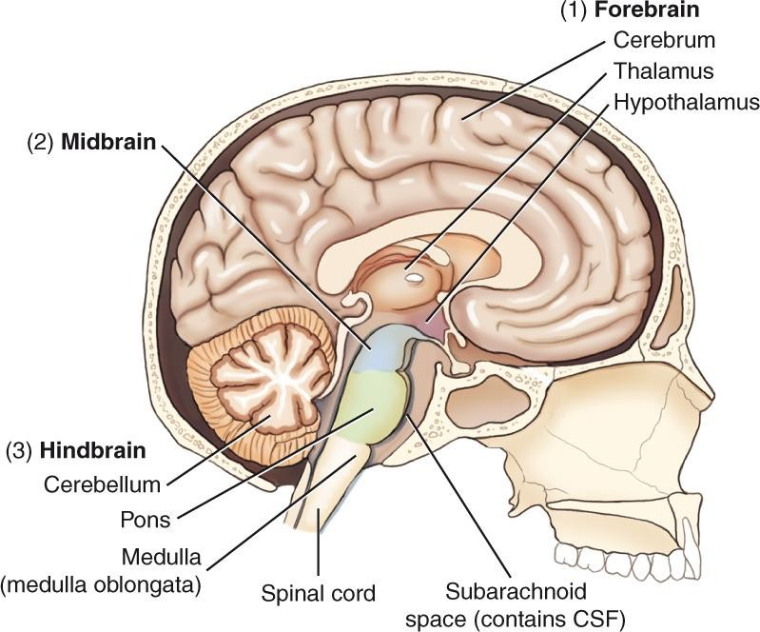
Divisions of Brain
9

Slide 10
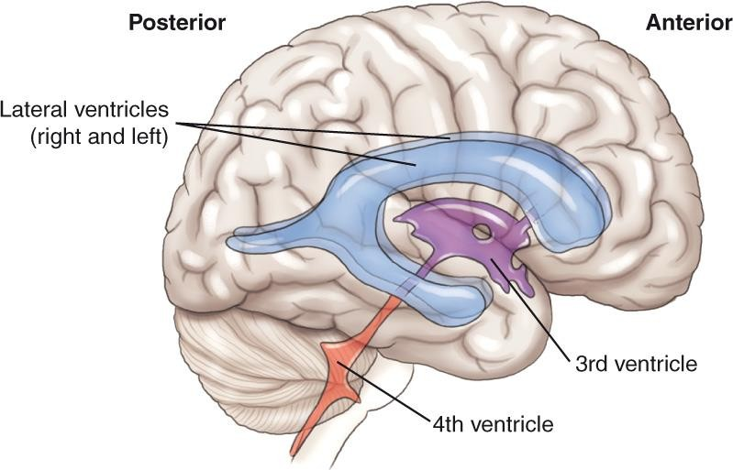
Cerebral Ventricles
Discuss formation, pathway, and role of CSF
10

Slide 11
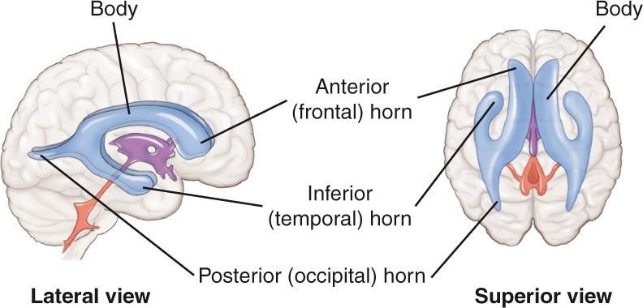
Lateral Ventricles
11

Slide 12
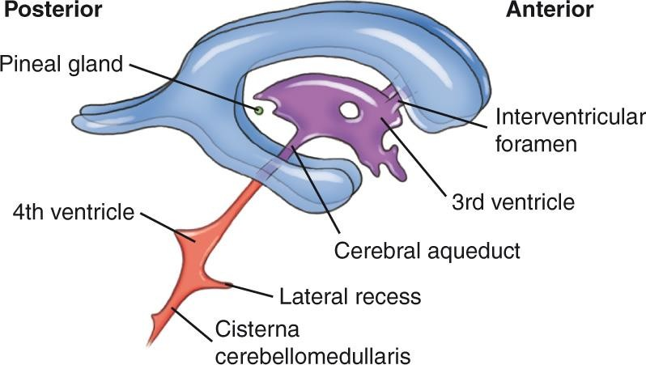
Third and Fourth Ventricles
12

Slide 13
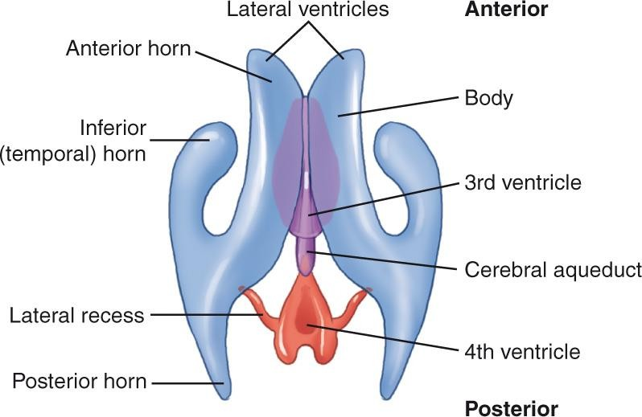
Ventricles and Connecting Ducts
13

Slide 14
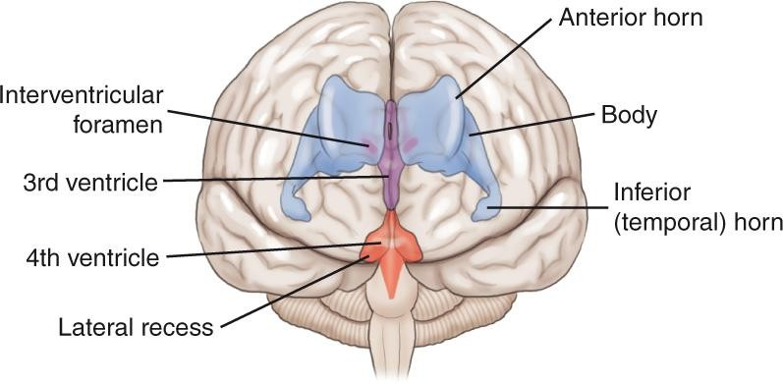
Anterior View
14

Slide 15
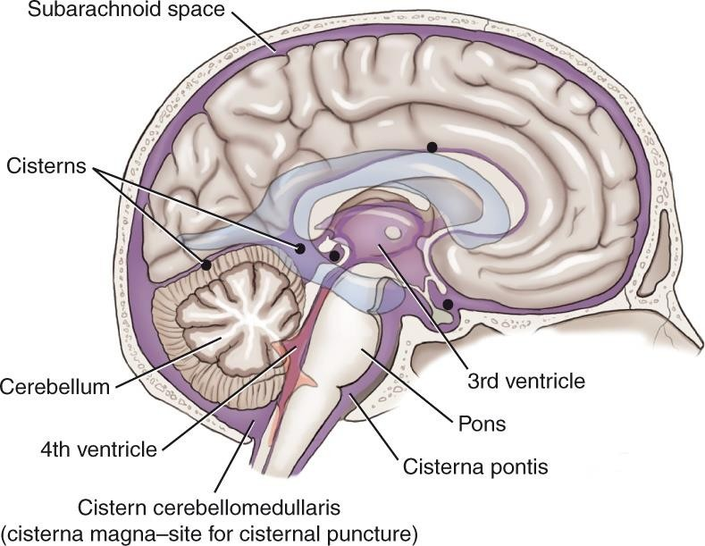
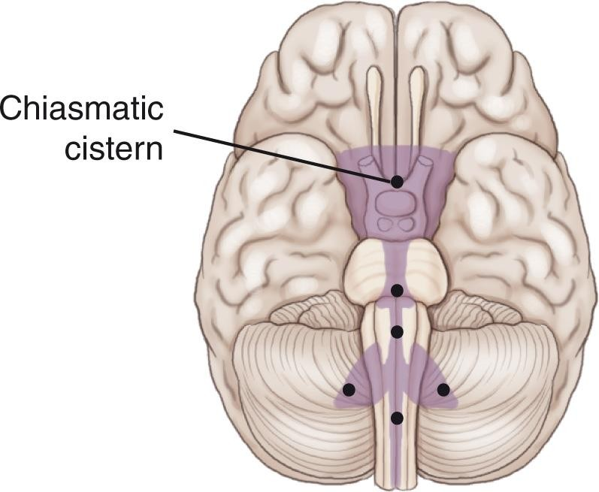
Subarachnoid Cisterns
15

Slide 16
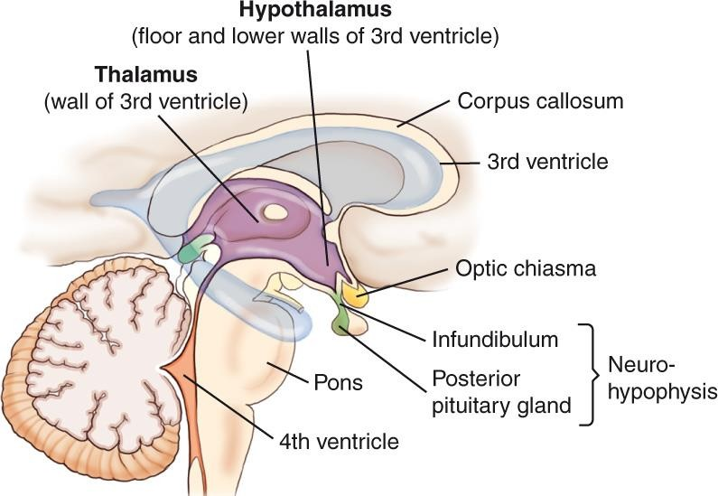
Thalamus
Interpretation center for sensory impulses (pain, temperature, and touch)
16

Slide 17
Hypothalamus
Controls important bodily functions (homeostasis)
Neurohypophysis: infundibulum and posterior pituitary gland
17

Slide 18
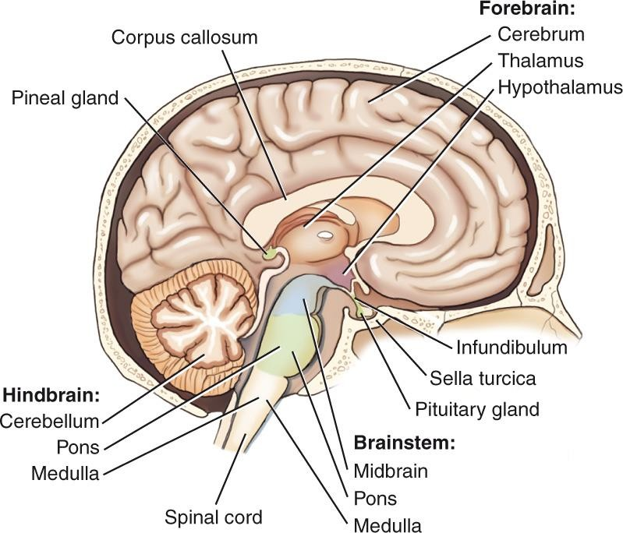
Midbrain and Midline Structures
18

Slide 19
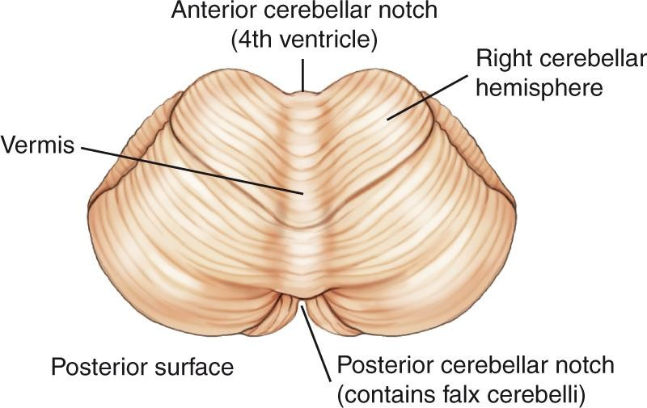
Cerebellum
19

Slide 20
The blood-brain barrier
Is formed by astrocytes that create protective barriers around blood vessels in the brain
Only water, oxygen, carbon dioxide, and few other substances (eg. alcohol) can cross the BBB into the interstitial space of the brain tissue
Some medications cannot cross the BBB, which makes some
brain conditions difficult to treat.

Slide 21
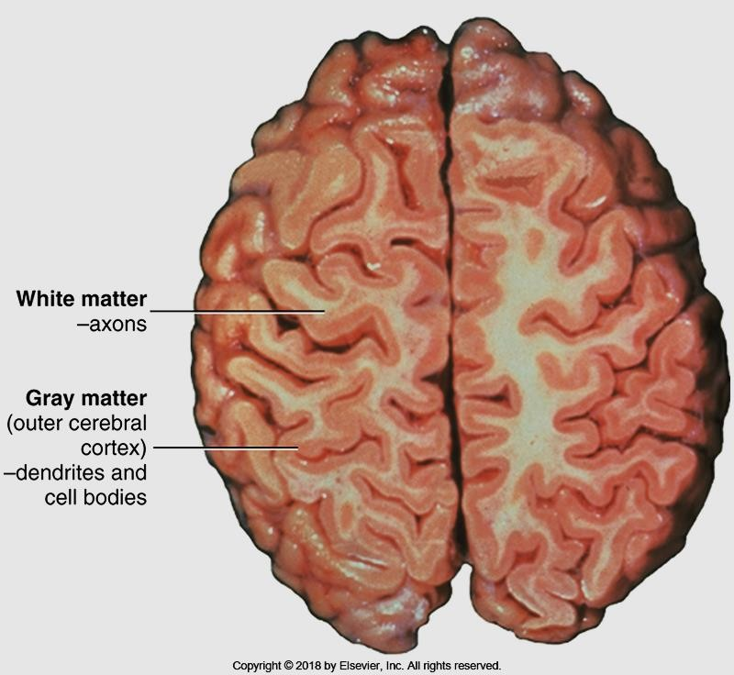
Cerebral cortex
Bontrager Fig. 18.18

Slide 22
Hemispheric Lateralization

Slide 23
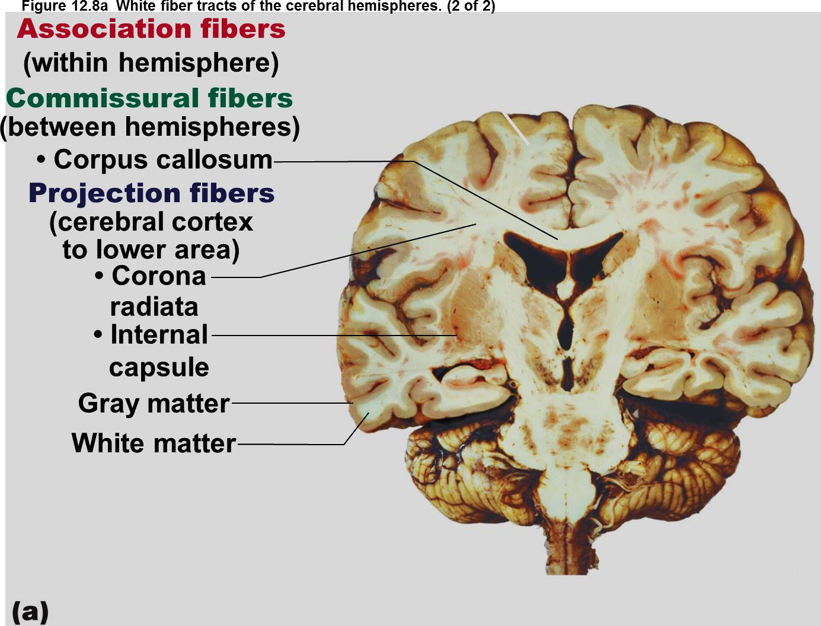
The corpus callosum allows communication between the right and left hemispheres of the cerebrum
Marieb, E. and Hoehn K. (2013 Human Anatomy and Physiology (9th ed.) Glenview, IL. Pearson Education, Inc. p. 438

Slide 24
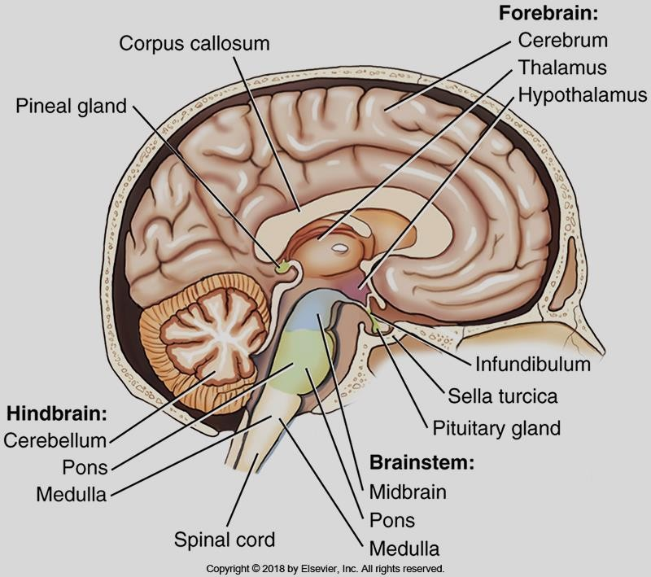
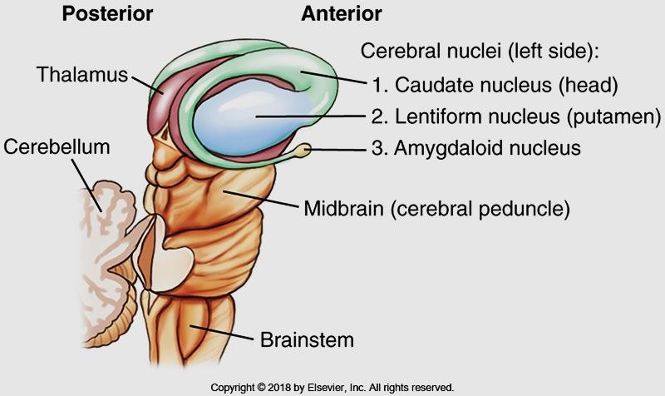
Diencephalon and brainstem
Diencephalon:
Thalmus : relays sensory info to the cerebral cortex, assigns an emotion to feelings, regulates LOC, regulates complex reflex movements
Hypothalmus: hormonal “head quarters”: controls heartbeat, blood pressure, digestion, water balance, body temperature, and sleep cycles and hormone secretion
Pineal gland: maintains body’s “clock” through daily, monthly, and seasonal cycles.
Bontrager Fig. 18.16, and 18.20

Slide 25
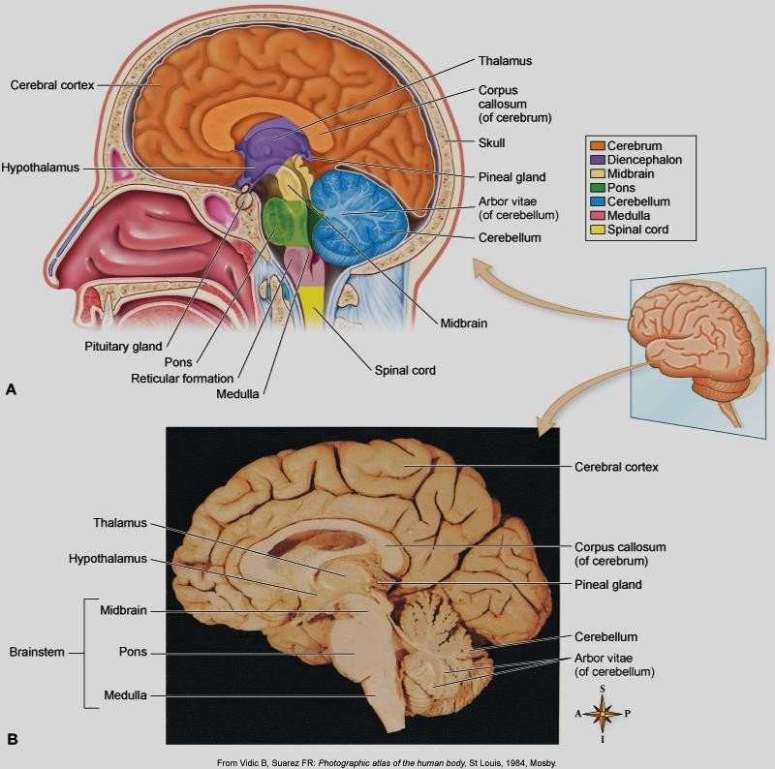
Brainstem
Brainstem:
Midbrain
Pons
Medulla oblongata
The “oldest” part of the
brain
Relays sensory and motor impulses between spinal cord and brain.
Controls heartbeat, respiration and vessel diameter

Slide 26
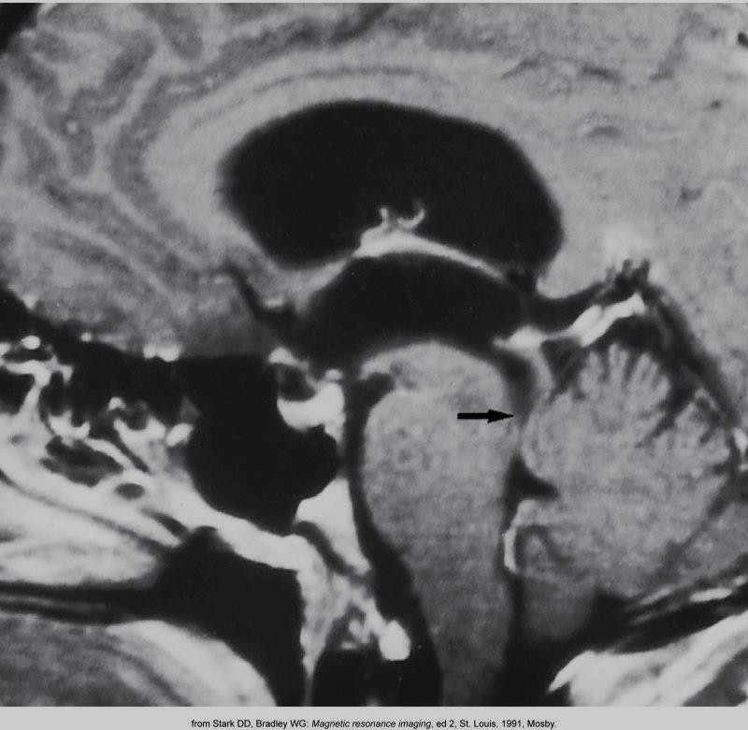
Eisenberg 8-75

Slide 27
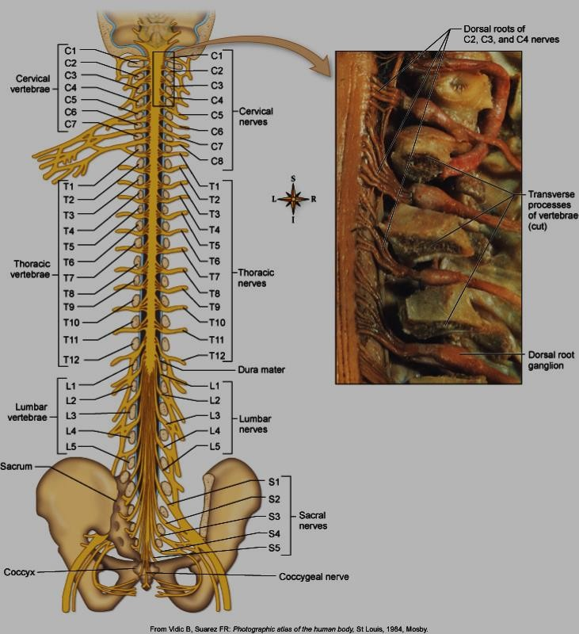
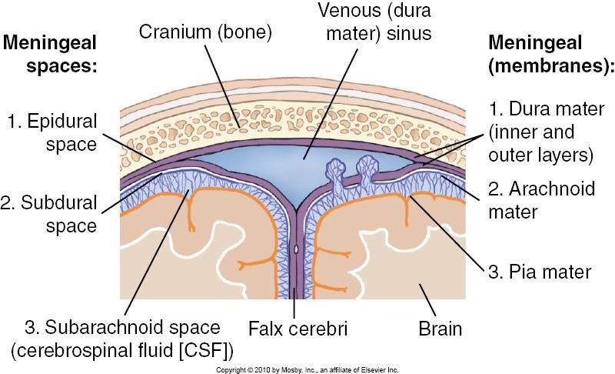
Meninges and falx cerebri etc…
Bontrager 18-3

Slide 28
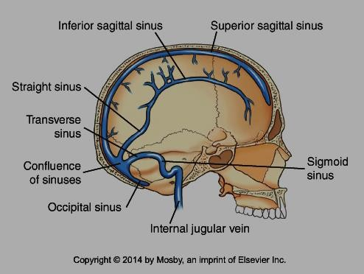
The dural sinuses are venous channels that lie between the two layers of the dura mater

Slide 29
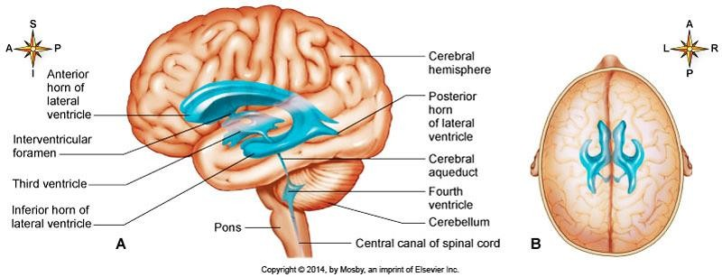
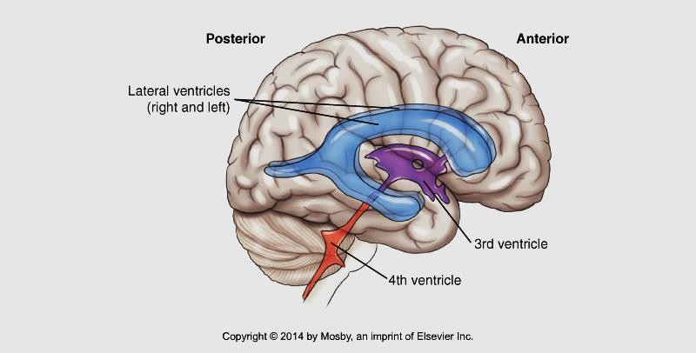
Ventricular system…
Cerebrospinal fluid (CSF) is made from fluid, filtered out of the blood by a network of brain capillaries known as the choroid plexus
Bontrager 18-7, Patton and Thibodeau10-20

Slide 30
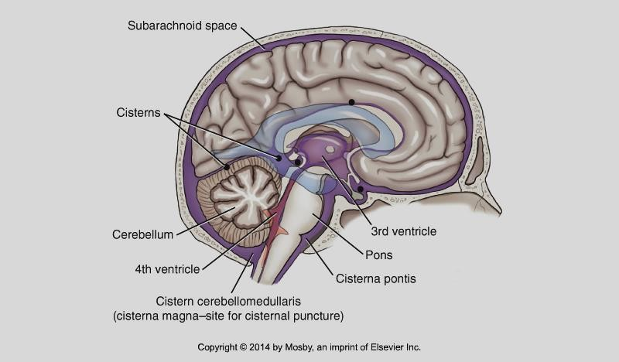
The CSF filled spaces in and around the brain are important in CT, as these fluid filled areas can be used to determine slice level or location.
Flow of CSF…
Patton and Thibodeau 10-21
Bontrager 9th ed. 18.13

