Slide 1


LDR EXFOLIATION

Slide 2


Slide 3
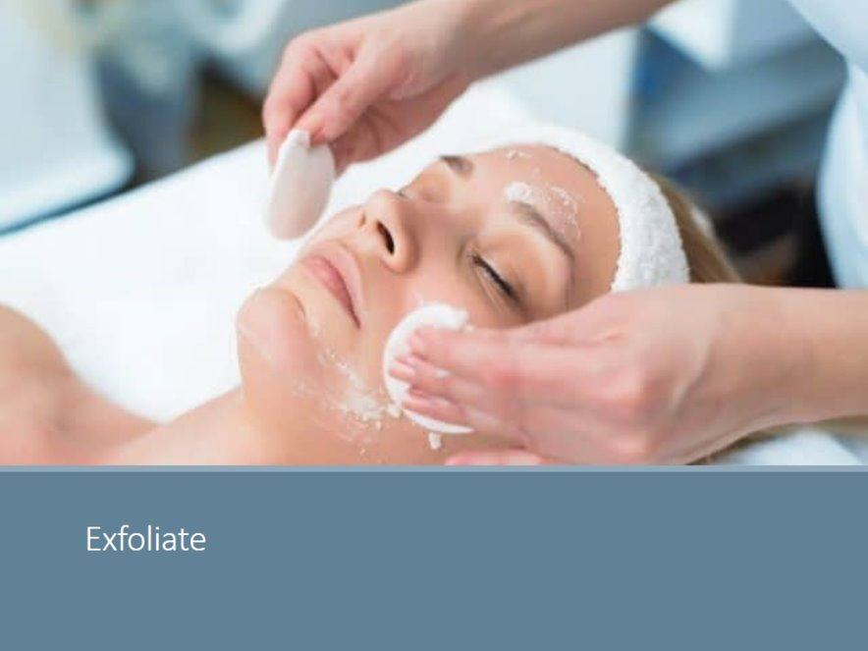
Exfoliation is the very base of key component during a facial
The Benefits of Exfoliation are many, like :
Removes excessive accumulation of dead cells from the stratum corneum
It promotes blood circulation to the skin surface which promotes oxygenation
It allows for product penetration
It makes the skin glow
It promotes a good PH balance on the skin when the right products are used
Unclog pores from cell buildup
Help with different conditions when the right technique is used

Slide 4
Types of exfoliation
Mechanical
Performed by friction using a cloth, a product with exfoliating beads or other tools.
Chemical Exfoliation
Products that include active chemical ingredients usually acids.

Slide 5
Exfoliation by Skin Type
Oily skin, for example, typically benefits from exfoliation every other day to prevent grime from settling into the pores as well as dry skin.
Sensitive skin, however, requires a higher lever of care, and exfoliation should be done weekly or by weekly
Acne Skin with active breakouts, should never use a mechanical method, as this can spread bacteria further into the pores,
Mature skin benefits from often exfoliation, using hydrating agents, to promote cell turnover

Slide 6
Exfoliation Dos and Don'ts
For mechanical manual exfoliation: Don’t scrub aggressively, instead, use firm but gentle circular motions
Do not use large quantities of product, this will not help exfoliate more, on the contrary, it will only build up in the skin, less is more.
Do not over exfoliate every day
Do apply thin layers and massage the product gently
For chemical exfoliation, apply thin layers and follow always the instructions

Slide 7
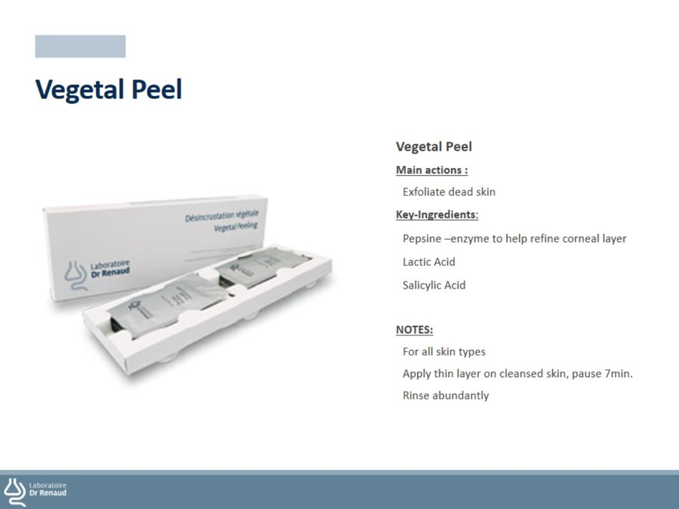

Slide 8
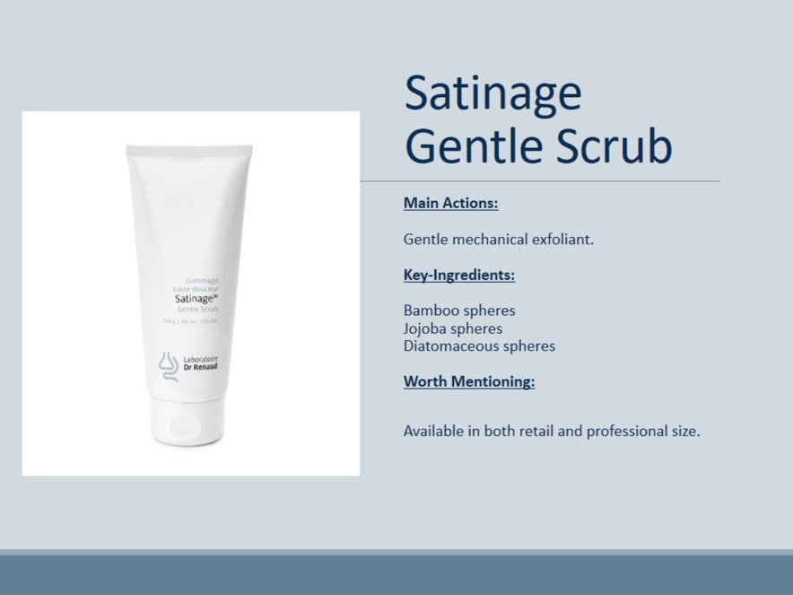

Slide 9

QUESTIONS?

