Slide 1


Laser Hair Removal Part 2

Slide 2
Post-Procedure Care
Perifollicular erythema and This generally persists for 2 days but can last for up to 1 week
LHR treatments with longer pulse durations may leave behind many hairs that appear to “grow” following treatment. It is important to reassure the patient that these “growing” hairs are dislodged from the hair follicle and require 1–2 weeks to be completely shed
Use of topical sunscreens, ultraviolet light impermeable garments, and, most importantly, sun avoidance.
Avoid Heated Saunas for a couple of days
Avoid Waxing or tweezing
Avoid chemical depilatories

Slide 3
Medical Conditions Treated with Laser
Hair Removal
Several studies have demonstrated safety and efficacy of LHR for pseudofolliculitis barbae, a chronic inflammatory skin condition often affecting patients with coarse, curly hair commonly in the beard and neck area as a result of shaving. At least 50% improvement in inflammatory papules can be expected following several sessions of LHR.
Laser hair removal has also demonstrated improvement in pilonidal sinus disease. Sinuses in the sacrococcygeal region can become inflamed and infected over time, leading to painful and debilitating abscesses. Although surgical removal of the sinus tract is the treatment of choice for persistent or complicated disease, adjunctive LHR can decrease disease recurrence and improve quality of life. One study supports 4 sessions of LHR for the best results, with fewer sessions resulting in a higher relapse rate.

Slide 4
Multiple studies support the use of LHR for hidradenitis suppurativa. Although benefit has been reported with diode, Nd:YAG and IPL devices, Nd:YAG is preferred due to deeper tissue penetration. A case-control study examining treated and untreated sites on same patient demonstrated a 32% improvement in the Lesion Area and Severity Index Score for treated areas (2 months after second treatment.)
Reconstruction following head and neck cancer surgery often employs the use of hair-bearing flaps and grafts which can be especially bothersome to patients. Several case reports and case series demonstrate effective hair reduction following LHR for intraoral flaps using alexandrite and Nd:YAG lasers with standard treatment parameters. It is important to note that access to the particular area may be challenging depending on the intraoral location of the flap/graft and the size and shape of the laser handpiece.

Slide 5
Laser hair removal is also an important part of gender affirming surgery and transgender health. Terminal hair distribution on the beard and neck is often treated in male to female transition. Additionally, genital reconstruction may require the use of hair-bearing flap. For transgender women, creation of vaginoplasty with a neovaginal cavity creation requires preoperative hair removal from the penis. LHR is superior to electrolysis for hair removal prior to gender affirming surgery. Preoperative permanent hair removal of skin flap is also required prior to phalloplasty and urethral lengthening for transgender men as skin flap is often harvested from ventral forearm or anterolateral thigh

Slide 6
Long-Term Efficay
A head-to-head trial comparing an LPDL to a long-pulsed alexandrite laser found a 49%–94% hair reduction at 1-year follow-up after four treatments
Another head-to-head trial of a high-fluence LPDL (9-mm spot size, pulse duration of 30 ms, fluences of 20–50 J/cm2) versus a low-fluence LPDL (12- × 10-mm spot size, pulse duration of 20 ms, fluences of 5–10 J/cm2) in 22 subjects showed similar, 94% and 90% hair reduction at 18-month follow-up following five treatments spaced 6–8 weeks apart, respectively. Finally, the authors reported statistically significant hair clearance, 54% and 42%, at 6- and 15-month follow-up visits following three monthly treatments using a LPDL with a large handpiece in the largest prospective trial to date. Remaining hairs were found to also grow back less thick and lighter.

Slide 7
Complications
epidermal damage
pigmentary alterations, including hyper- and hypopigmentation
This may result from selecting a nonoptimal wavelength, pulse duration, or fluence, using improper epidermal cooling, or treating a tanned patient
Pigmentary alterations may also occur even when optimal treatment parameters are used. These changes are often transient and improve with time, although permanent hypopigmentation can occur
Zones of untreated hairs can result from a lack of overlapping between laser pulses
Scarring is an exceedingly rare complication but can occur when an inappropriate wavelength is used on skin of color, excessive fluences, and/or pulse stacking are used.

Slide 8
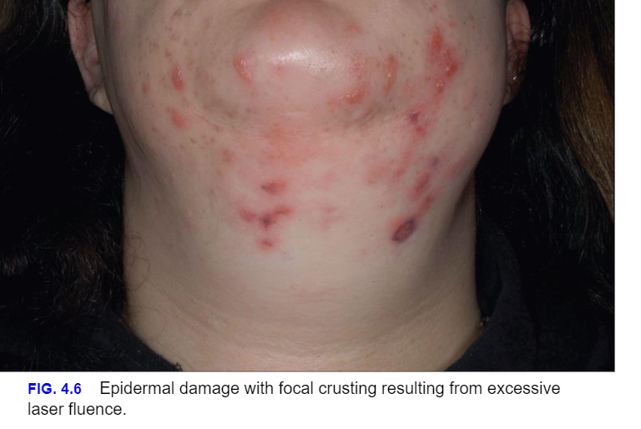

Slide 9
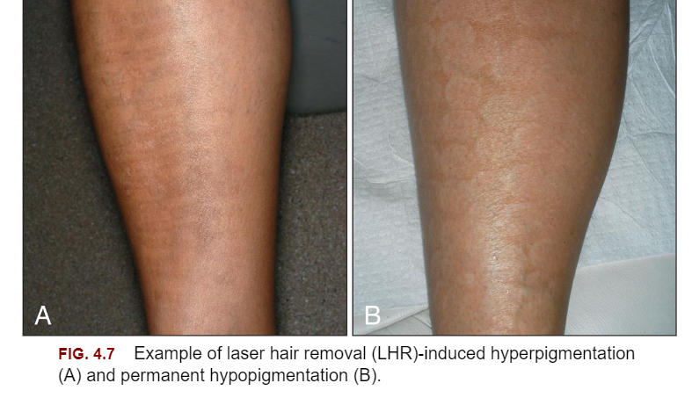

Slide 10
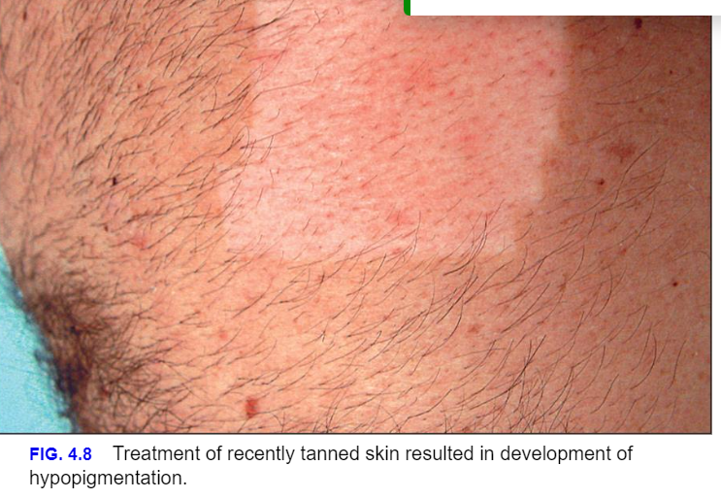

Slide 11
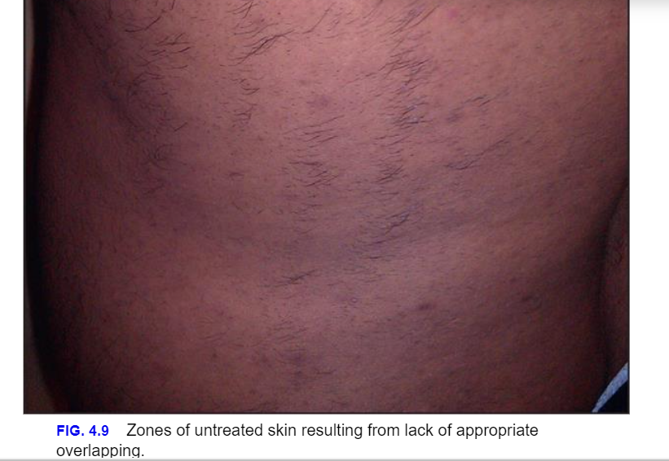

Slide 12
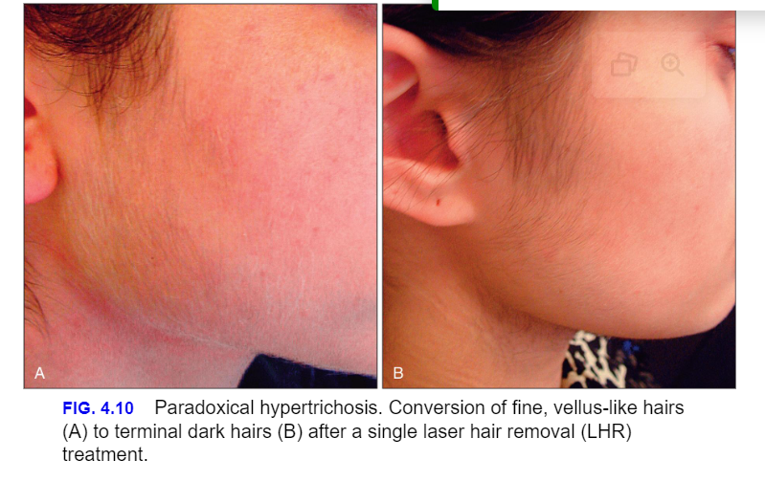

Slide 13
Home-Use Laser and Light Source
Devices for Hair Removal
The evidence behind such devices is scant and limited to small noncontrolled studies.
A study demonstrated that a thermally based, home-use device was no better than shaving in removing hair, reducing hair density, or slowing hair regrowth.
In addition, the risk for devastating eye injuries with improper use of laser- and IPL-based devices and lack of medical training raises a dilemma of how much autonomy a patient should have with potentially harmful devices.
The appeal of having a personal device to remove unwanted hair in the privacy of one's home without the expense and inconvenience of multiple dermatologist or spa visits will likely drive the development of additional home-use devices.

Slide 14

QUESTIONS?

