Slide 1


The Chemistry of Peels

Slide 2
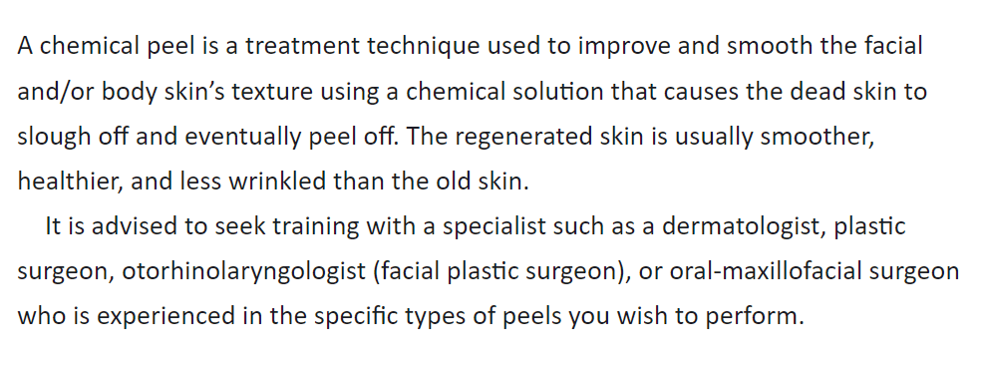

Slide 3
Introduction
1. Acidity
2. Toxicity
3. Metabolic interactions

Slide 4
Useful Elements of Basic Chemistry
Acids
Arrhenius Acids
Brønsted Acids
Lewis Acids
Dissociation and Equilbrium
The stronger of two acids will have a higher K a than the weaker acid; the ratio of hydrogen ions to acid will be higher for the stronger acid because the stronger acid has a greater tendency to lose its proton

Slide 5
Acid Strength
For peelers, the notion of acid strength is very important, because stronger acids have a higher K a and a lower pK a than weaker acids.
For our classification, two parameters have to be taken into consideration for peelers:
1. The pK a, a synonym of the acid’s strength.
2. The pH, a synonym of the penetration for the selected acid.

Slide 6

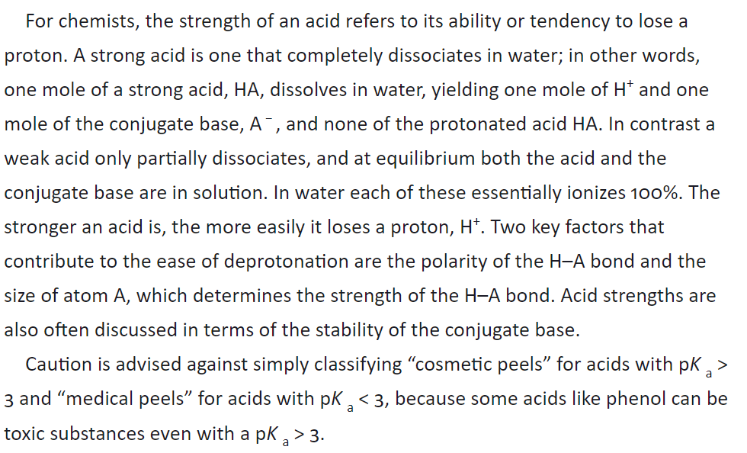

Slide 7
Polarity and the Inductive Effect
Polarity refers to the distribution of electrons in a bond, the region of space between two atomic nuclei where a pair of electrons is shared.
When two atoms have roughly the same electronegativity (ability to attract electrons), the electrons are shared evenly and spend equal time on either end of the bond.
When there is a significant difference in electronegativities of two bonded atoms, the electrons spend more time near the nucleus of the more electronegative element and an electrical dipole, or separation of charges, occurs, such that there is a partial negative charge localized on the electronegative element and a partial positive charge on the electropositive element.
Hydrogen is an electropositive element and accumulates a slightly positive charge when it is bonded to an electronegative element such as oxygen or chlorine.

Slide 8
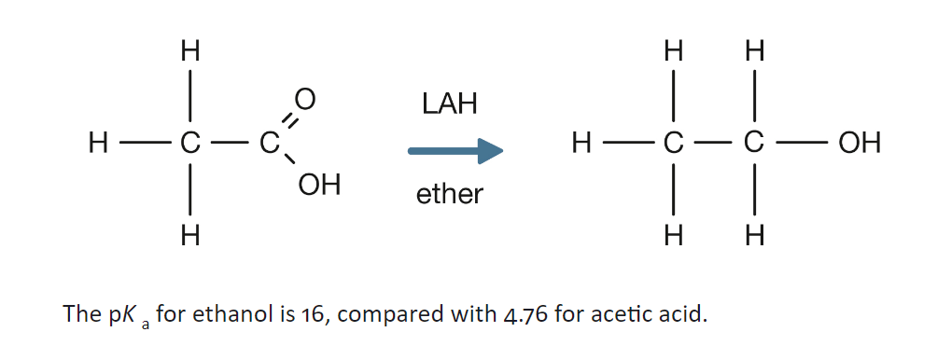
Do you know…

Slide 9
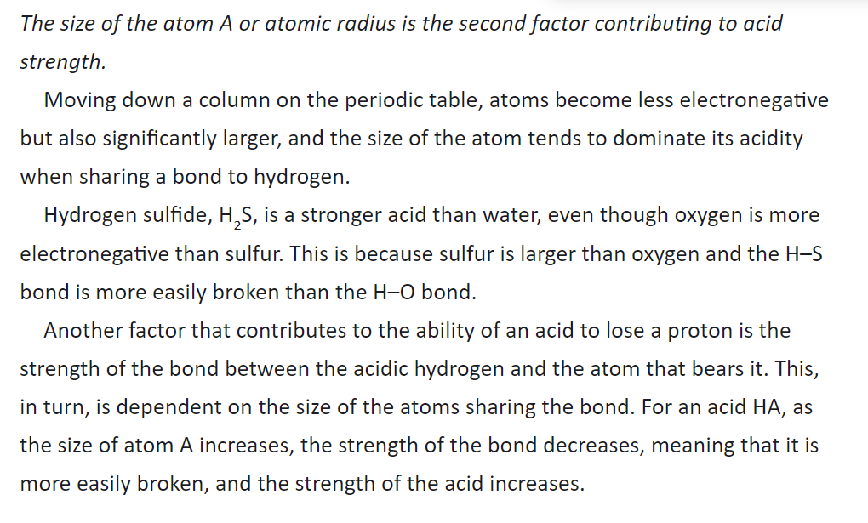

Slide 10
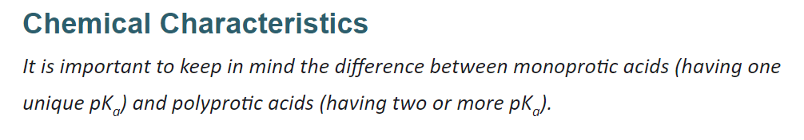

Slide 11
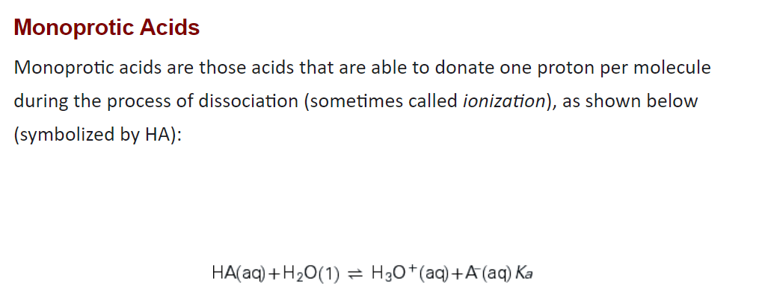

Slide 12
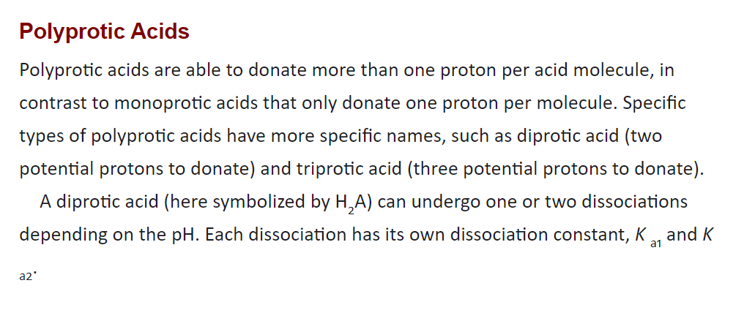

Slide 13
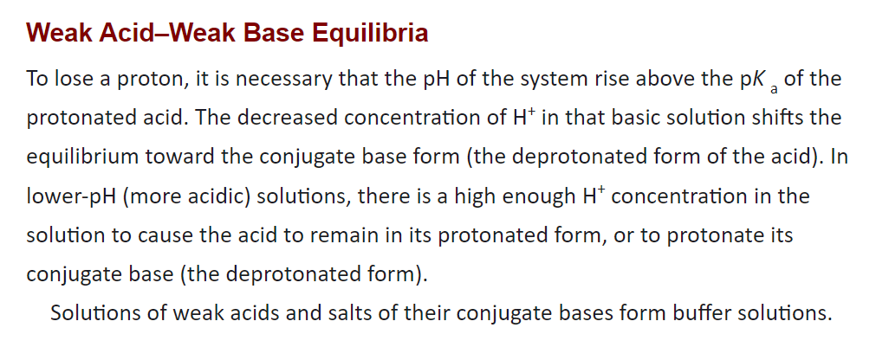

Slide 14
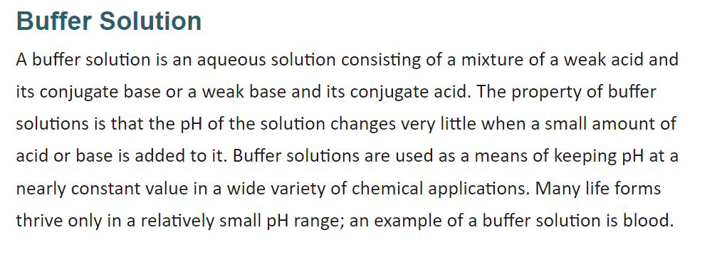

Slide 15
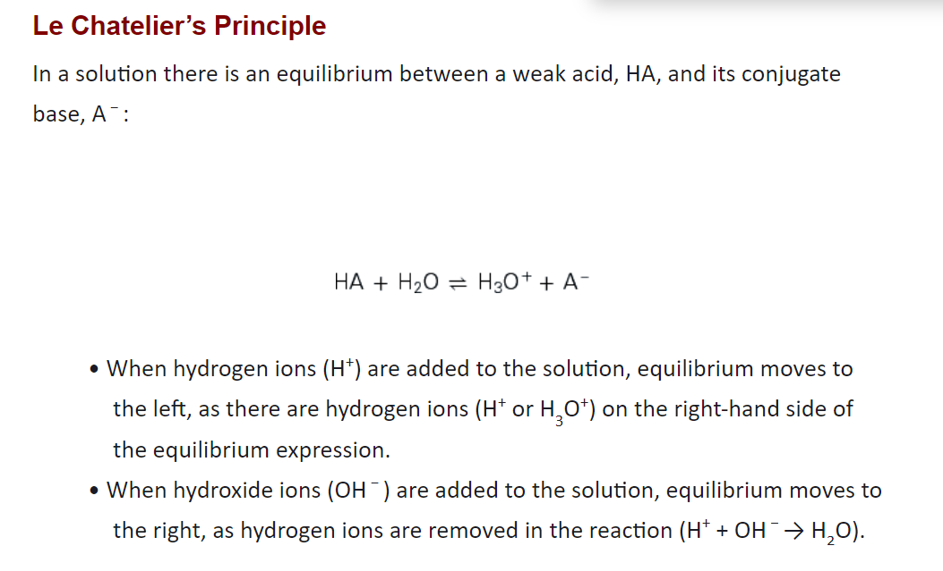

Slide 16
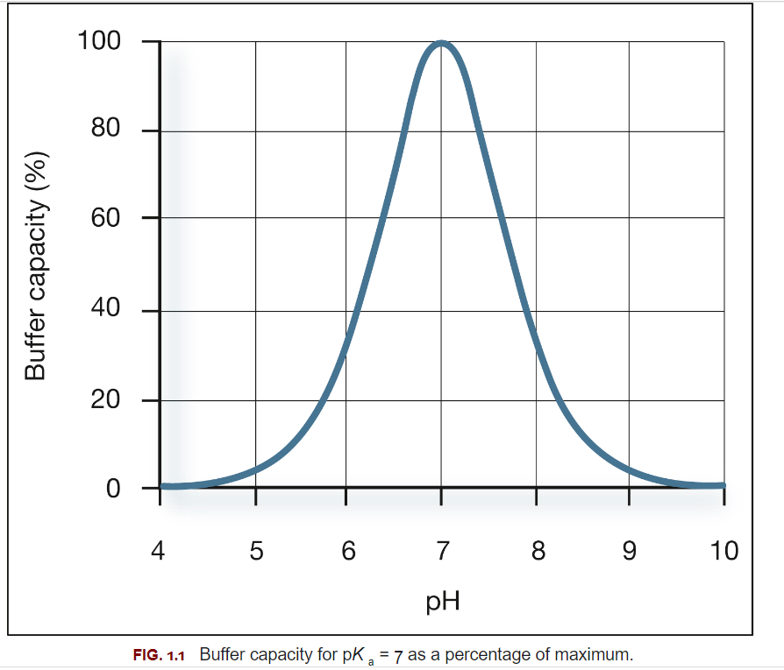

Slide 17
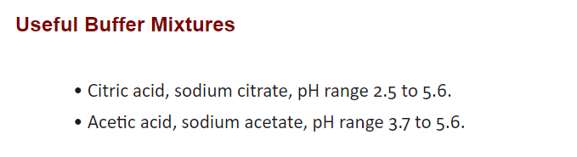

Slide 18
Neutralization
Neutralization of the chemical peeling agent is an important step, the timing of which is determined by either the frost in the skin or how much contact time the peel has with the skin. Neutralization is achieved by a majority of peelers applying cold water or wet, cool towels to the face following the frost. According to physical chemistry, using water just after the frost provokes an exothermic reaction that can provoke a “cold” burn. Other neutralizing agents that can be used include bicarbonate spray or soapless cleansers. Peeling agents for which this neutralization step is less important include salicylic acid, Jessner’s solution, TCA, and phenol.

Slide 19
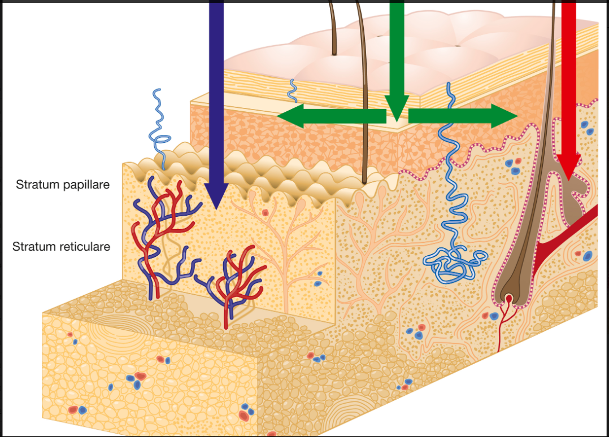

Slide 20
Anatomy of the Skin
There is more water in the dermis than in the epidermis. This is due to the presence of blood, glycosaminoglycans (GAGs), and lymph in the dermis, all of which have a high water content, as well as the fact that the epidermis is in contact with a more or less dehydrated environment.
There are more proteins (keratin) in the epidermis than in the dermis, whereas more carbohydrates and lipids exist in the dermis, and there are even more in the subcutaneous layer than in the dermis.
The most important molecule in the epidermis is a fibrous and corneal protein, keratin, that protects and takes part, through its continuous production by the keratinocytes, in the complete replacement of the epidermis every 27 days.
The most important molecules of the dermis are collagen, elastin, GAGs, and the proteoglycans. Collagen and elastin are proteins, whereas GAGs (e.g., hyaluronic acid) and the proteoglycans are biological polymers formed mainly by sugars that retain water.
Collagen constitutes the skin’s structural resource and is the most abundant protein in the human body. It is formed mainly by glycine, proline, and hydroxyproline. It is one of the most resistant natural proteins and helps give the skin structural support. Elastin is similar to collagen, but it is an extensible protein responsible for elasticity; hence its name. It has two unique polypeptides, desmosine and isodesmosine.

Slide 21
The GAGs contain specific sugars such as glucosamine sulfate, N-acetylglucosamine, and glucosamine hydrochloride, all very capable of attracting water. They form long chains of molecules, such as hyaluronic acid, keratin sulfate, heparin, dermatin, and chondroitin, that retain up to 1000 times their weight in water.
The hypodermis or subcutaneous tissue consists mainly of fat, although this tissue accounts for a completely different chemical interaction with peeling solutions. Chemical peels are not meant to extend down into the subcutaneous layer, so this is not discussed.
The different molecular composition of the different levels of the skin may explain the variability of the interactions and the results obtained. These benefits are correlated to the penetration level achieved when using a given peeling agent.

Slide 22
It is likewise for the pH. Although the pH of the epidermis is a well-established number, the pH of the dermis is not an exact value and has been difficult to measure precisely.
The epidermal acid layer or mantel is the result of sebum secretion and sweat. It protects the skin and makes it less vulnerable from attacks by microorganisms such as bacteria and fungi. A healthy epidermis has a slightly acidic pH with a range between 4.2 and 5.6. It varies from one part of the skin to another and, in general, is more acidic in men than in women.
The pH of the epidermis also varies depending on its different layers. For a “skin” pH of around 5 we will find a pH near 5.6 in the corneal layer and one of 4.8 in the deep layers of the epidermis, which are rich in corneocytes and melanocytes. Finally, dry skin is more acidic than oily skin, which can reach pH 6.
Because the dermis contains a significant amount of fluid and blood, we can presume the pH to be 6 to 6.5, and it is slightly less acidic than the epidermis, with a pH of 6 for the papillary dermis and 7 for the vascular reticular dermis.

Slide 23
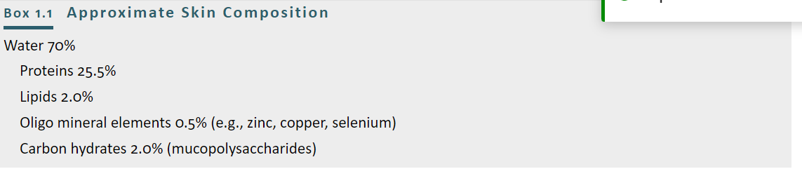

Slide 24
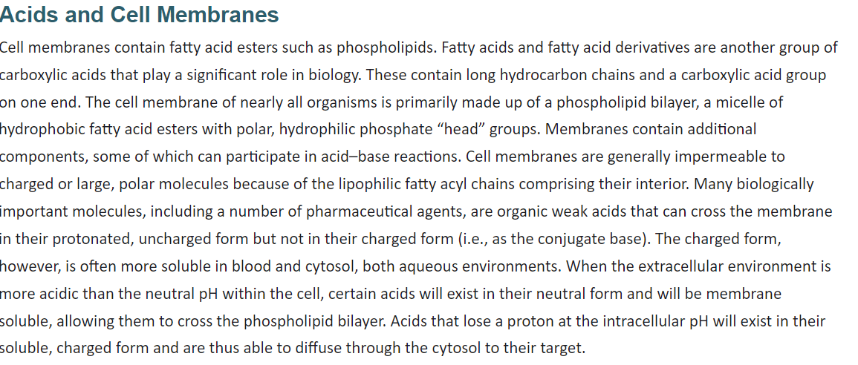

Slide 25
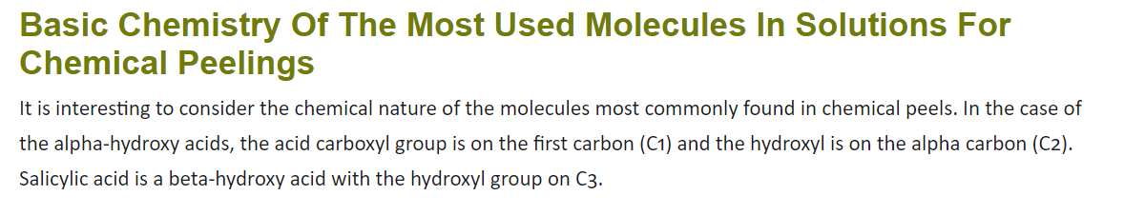

Slide 26
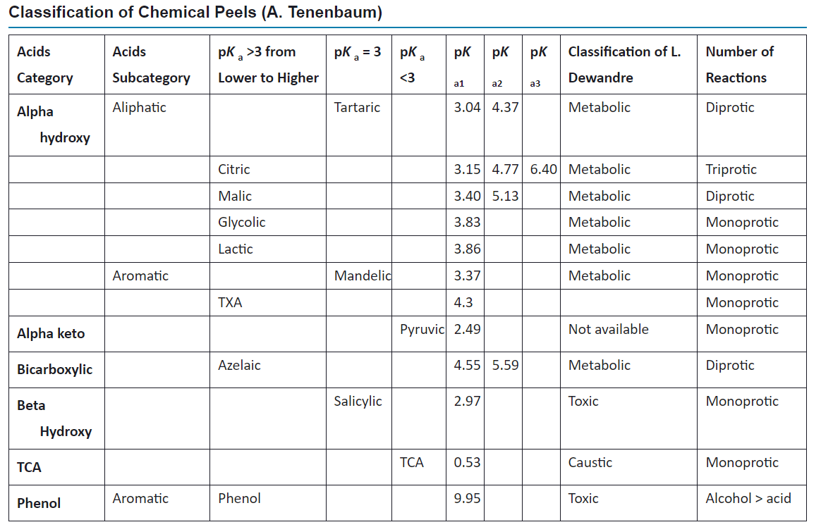

Slide 27
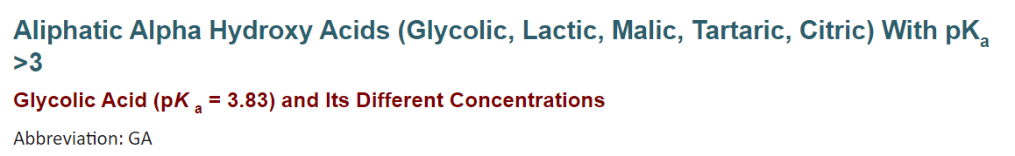

Slide 28
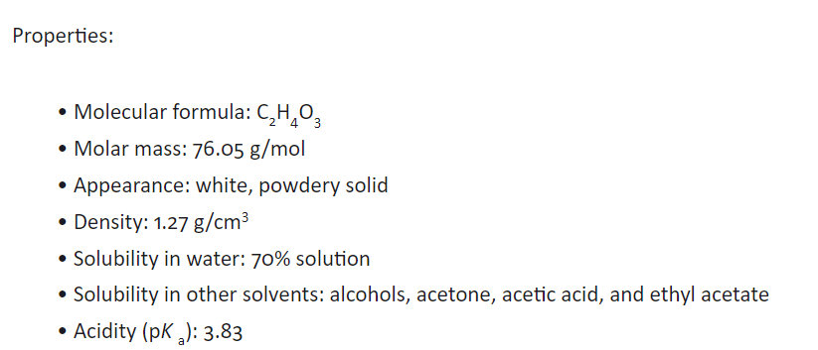

Slide 29
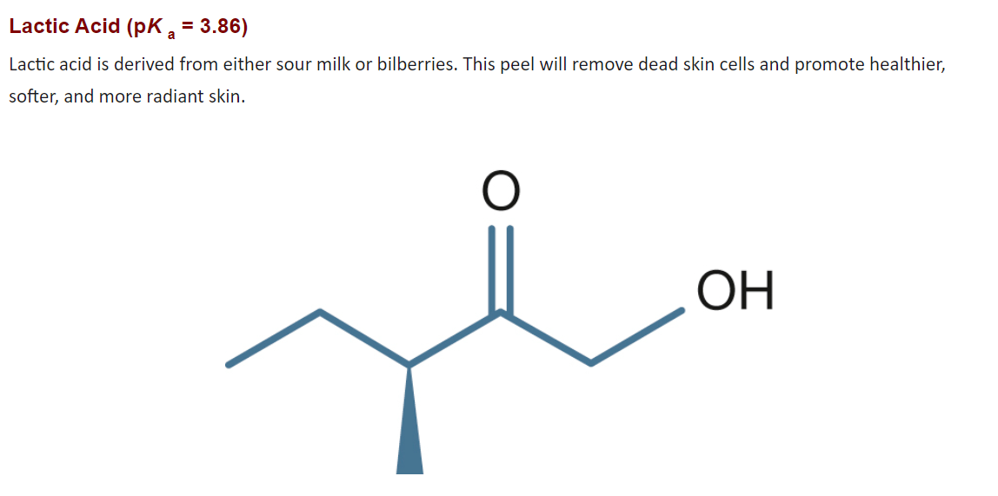
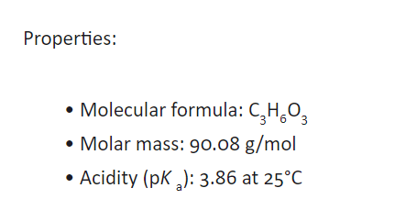

Slide 30
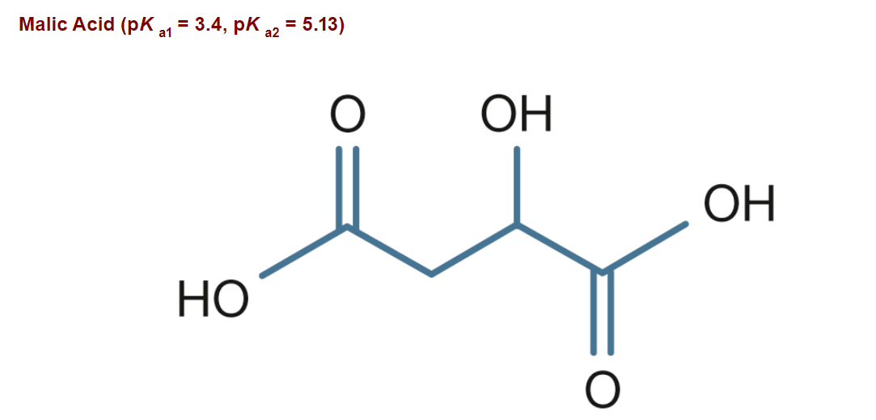

Slide 31
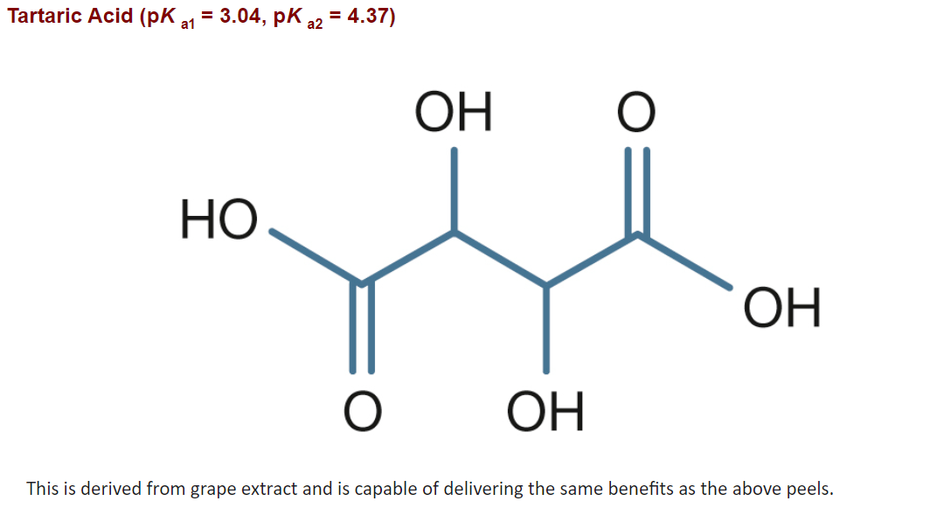

Slide 32
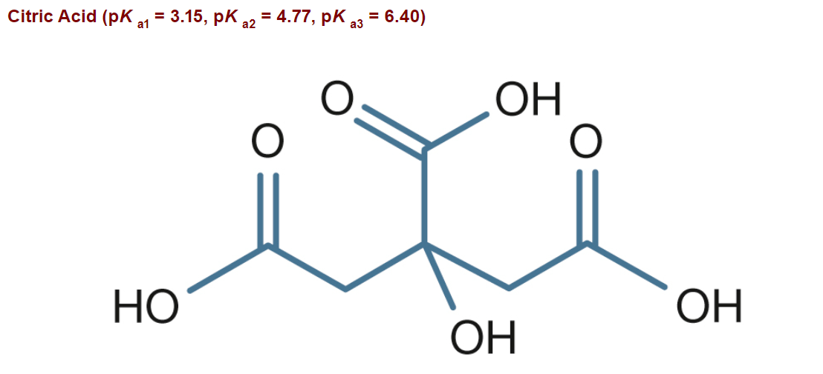

Slide 33
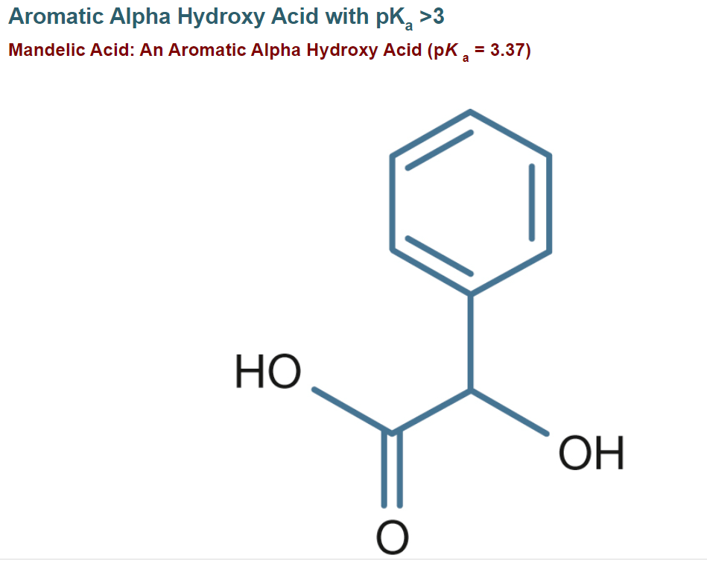

Slide 34
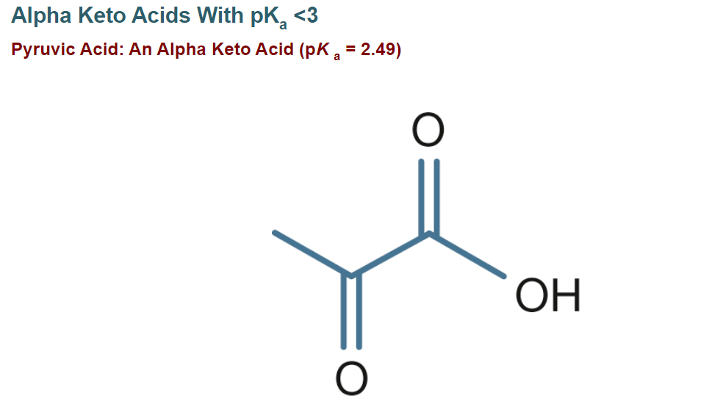

Slide 35
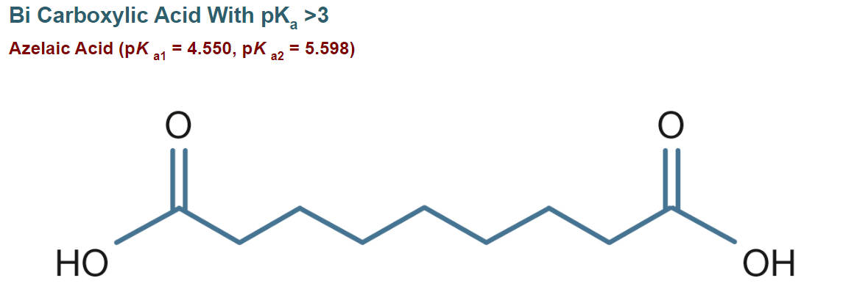

Slide 36
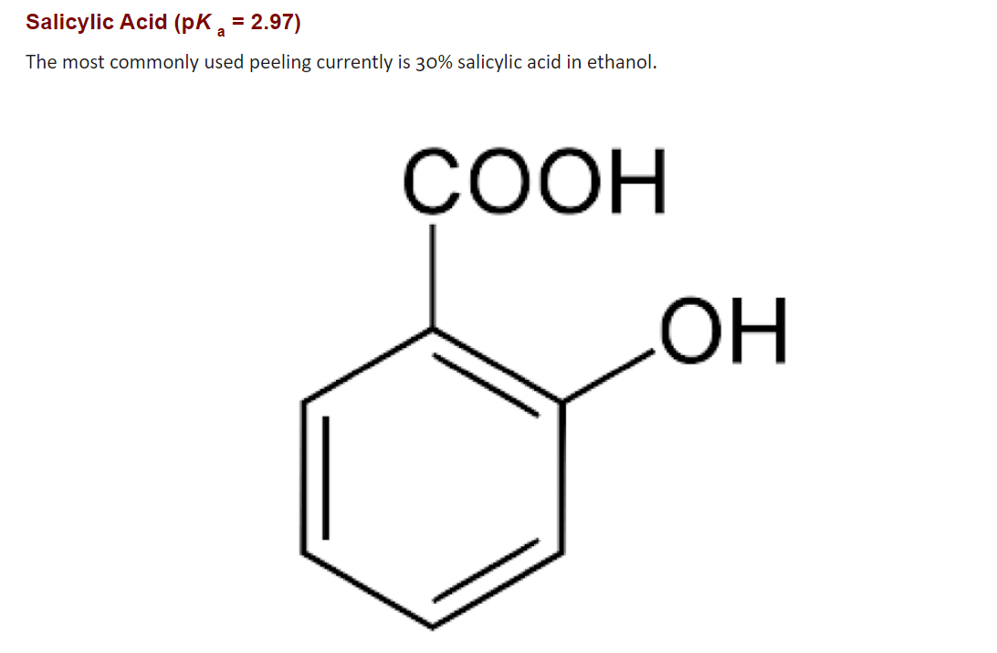

Slide 37
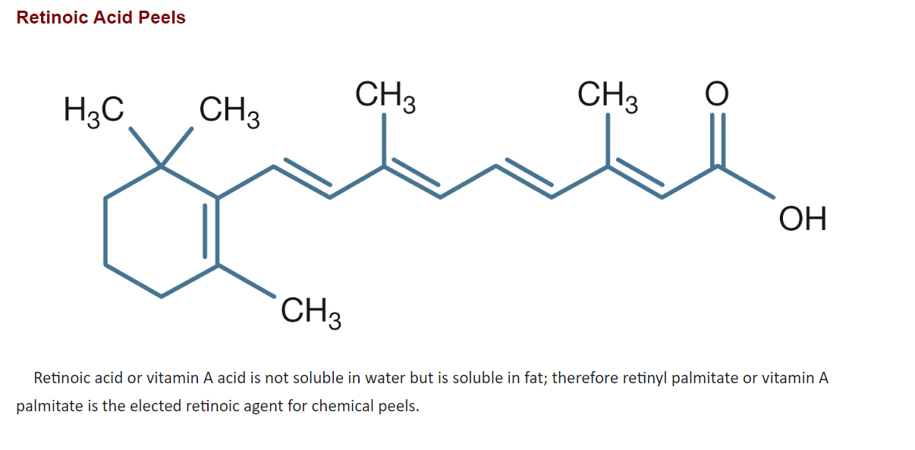

Slide 38
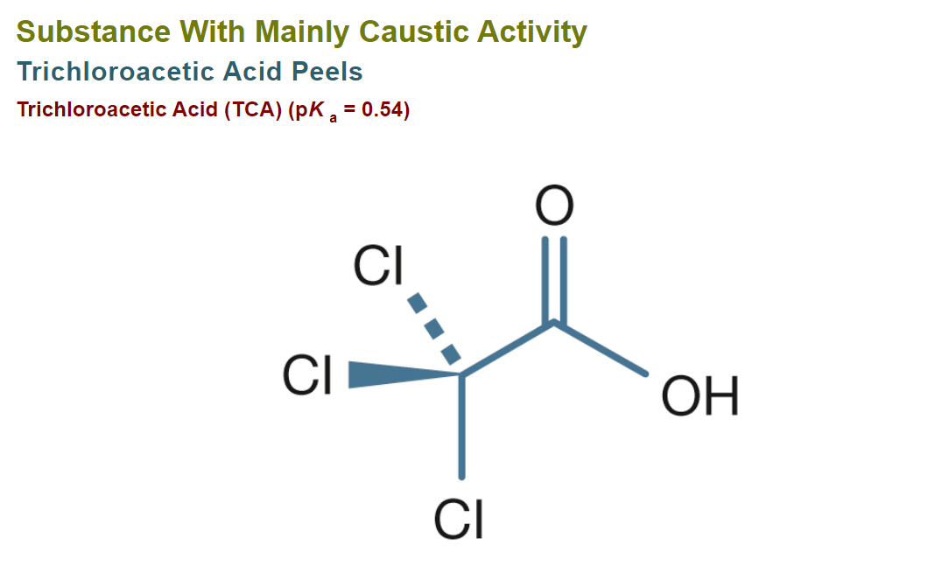

Slide 39
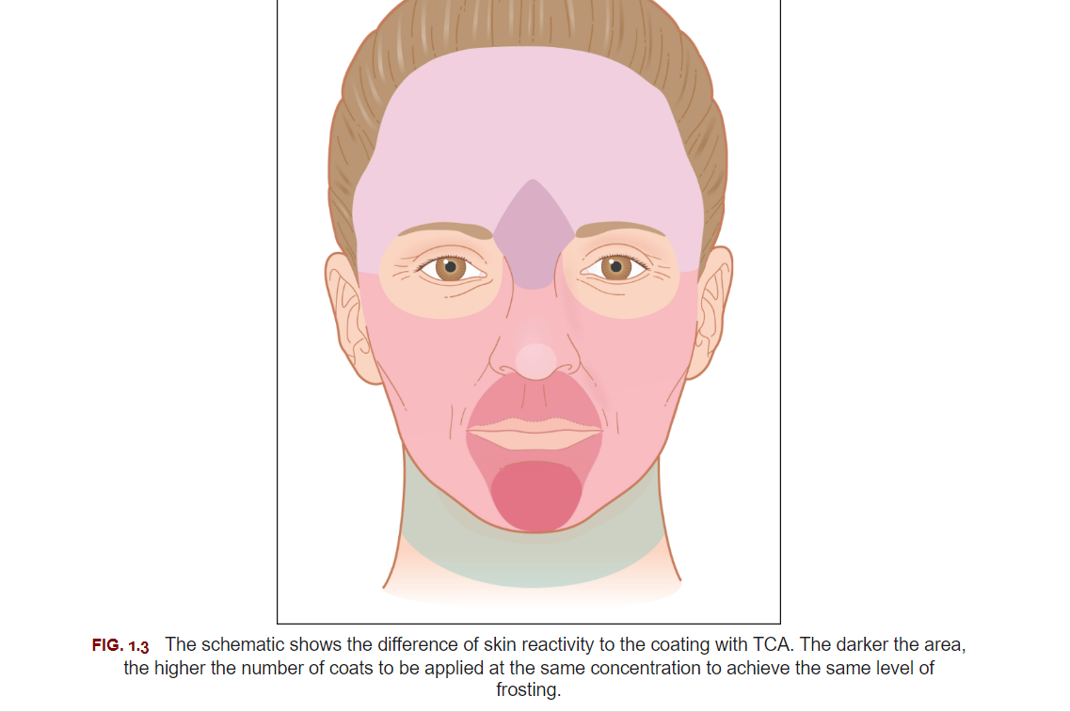

Slide 40
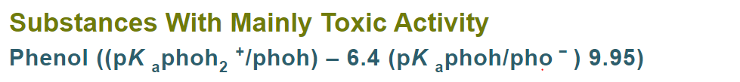

Slide 41
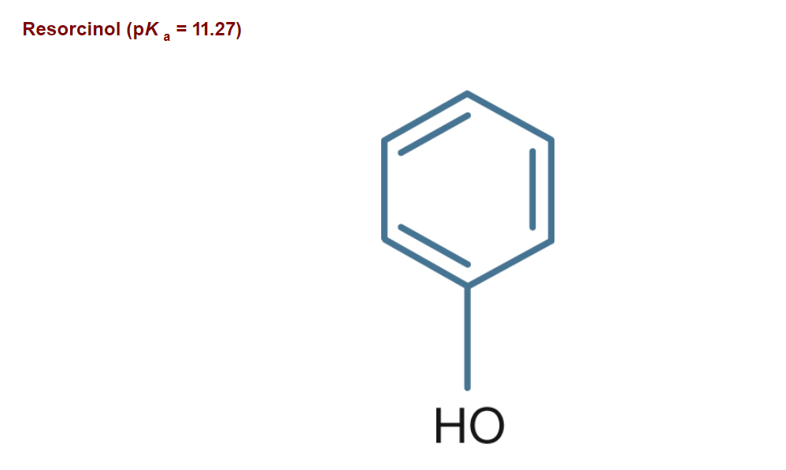

Slide 42
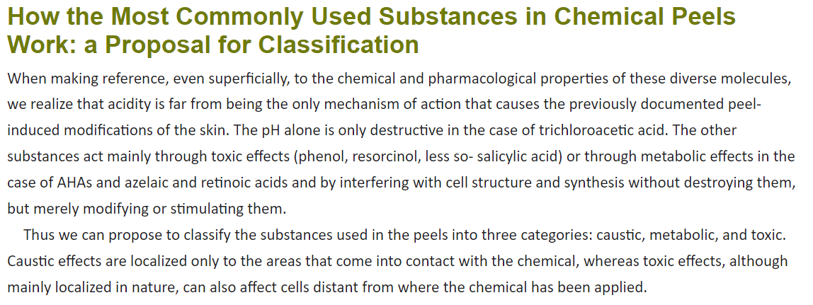

Slide 43
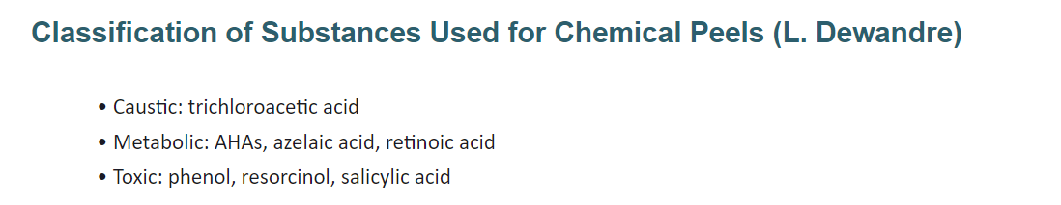

Slide 44
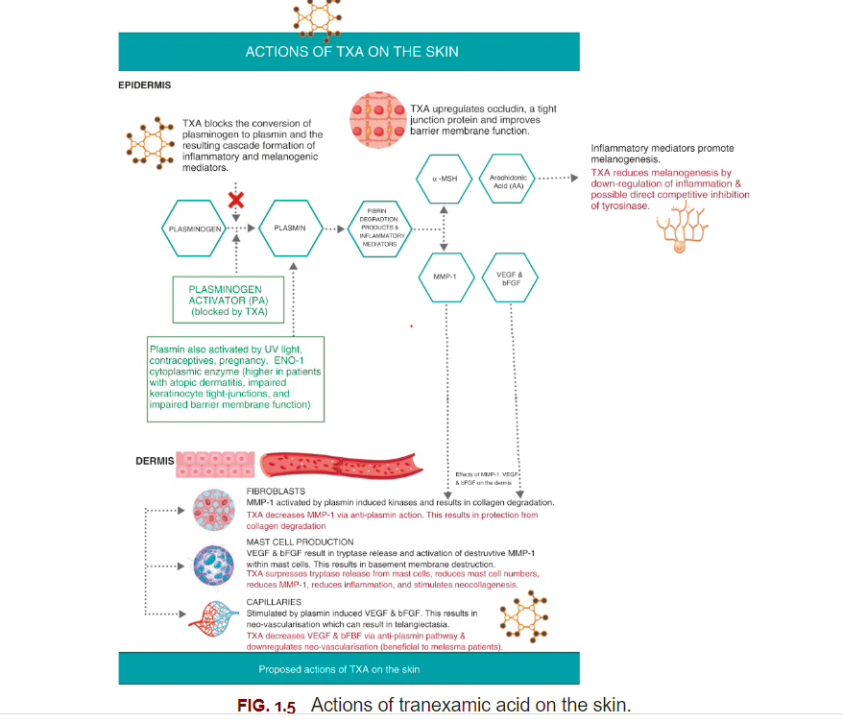

Slide 45
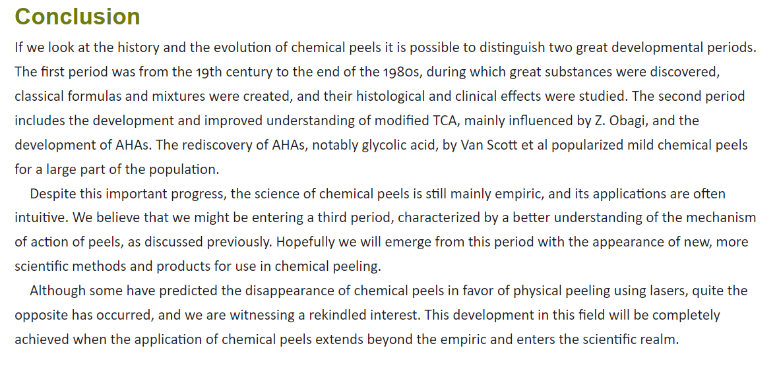

Slide 46

QUESTIONS?

