Slide 1


Light Peels

Slide 2
Introduction
Very light or very superficial peels are those that lead to a necrosis of the epidermis at the level of the stratum corneum.
In contrast, light peels or superficial peels are those that penetrate through the epidermis and lead to necrosis of the entire epidermis down to the level of the stratum granulosum or the basal lamina.
Light peels cause reduced corneocyte adhesion and increase the collagen formation in the dermis. In this way they improve the skin’s radiance and luminosity.

Slide 3
Light peels are used to treat pigmentary disturbances like solar lentigines, melasma and hyperpigmentation, papulopustular rosacea, superficial acne scars and photoaged or light-damaged skin, as well as to improve skin tone.
The type of chemical peel and depth of the peel is selected according to the severity of the wrinkling, laxity, and the patient’s downtime expectations. To enhance cosmetic improvement, topical skin-rejuvenating creams and dermal fillers can be used. Light peels should be repeated to achieve the best possible cosmetic improvement and to obviate recurrence of the skin lesions being addressed.

Slide 4
Very superficial peels can be repeated every 1 to 2 weeks, and light peels can be repeated every 2 to 4 weeks. Peeling too frequently can result in an increased risk for complications, in particular persistent erythema, postinflammatory hyperpigmentation, infections, and scarring. Because of the simplicity, low morbidity, cost effectiveness and simple availability of solutions, chemical peels still play an important role in treating photoaging and pigmentary disturbances, even though there are more modern techniques available such as lasers.

Slide 5
Peeling Agents: Chemistry and Chemical Formulations
Apha Hydroxy Acids
Including glycolic acid from cane sugar
Citric acid from citrus fruits
Malic acid from apples
The AHAs used for a chemical peeling are produced in chemical laboratories.
Additional AHAs also include lactic and mandelic acid.
Lactic acid moisturizes and brightens the skin and improves superficial acne scarring by improving the skin texture and appearance of the scars.
Mandelic acid has slow skin penetration due to its large molecule size. Therefore, it is considered a safe, light peeling agent. In concentrations of 20% to 50% it has a skin-rejuvenation and lightening effect.

Slide 6
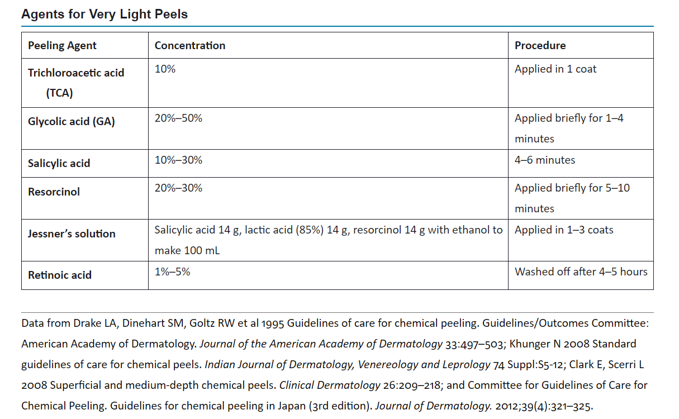

Slide 7
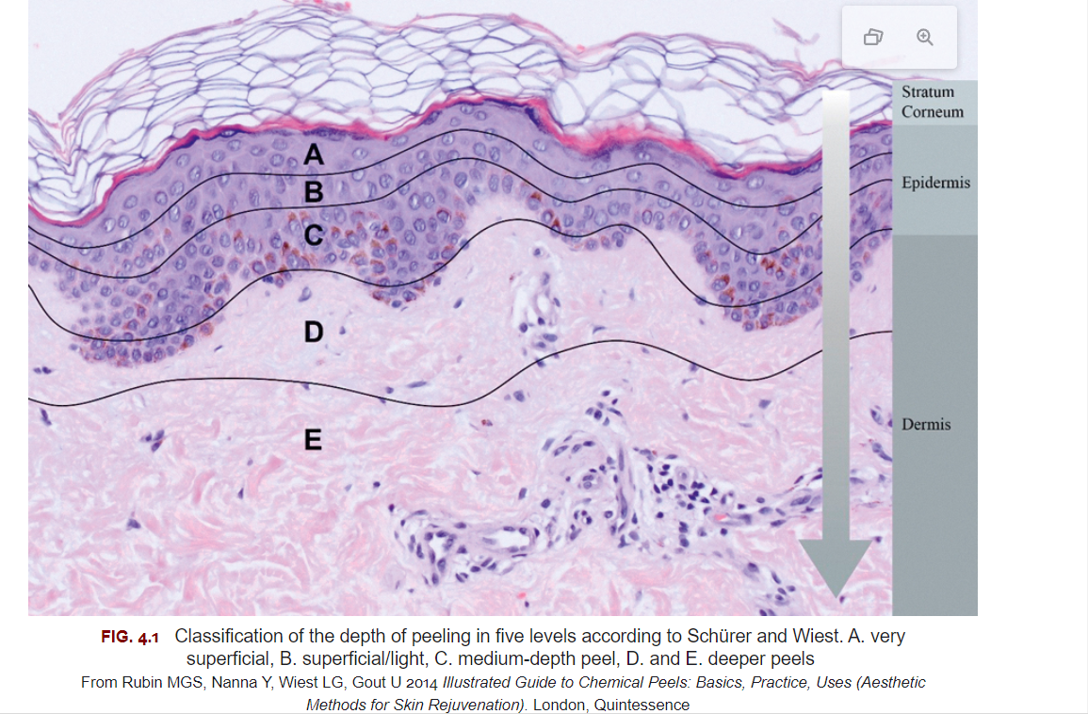

Slide 8
Beta-Hydroxy Acid
Both salicylic acid (SA) and beta-lipohydroxy acid (LHA)have antibacterial, antiinflammatory, antifungal, and anticomedogenic properties.
LHA penetrates well into the sebaceous follicle and through the epidermis, but less deeply into the skin compared with glycolic acids and SA.
It is particularly effective in the superficial layers of the stratum corneum, specifically the stratum compactum/disjunctum interface, and focuses its effects on the follicle and epidermis.
Neutralization is neither necessary nor possible when peeling with LHAs

Slide 9
Retinoic Acid
Retinoic acids (RAs) are usually used alone or in combination with AHAs or other ingredients.
RAs lead to a thinner and more compact stratum corneum and a thicker epidermis.
They can help to improve
Dyschromias
Atypical keratinocytes,
Actinic keratosis
Production of collagen and capillary branching in the dermis
Skin texture and superficial dyschromias
Pinker, rosier complexion.

Slide 10
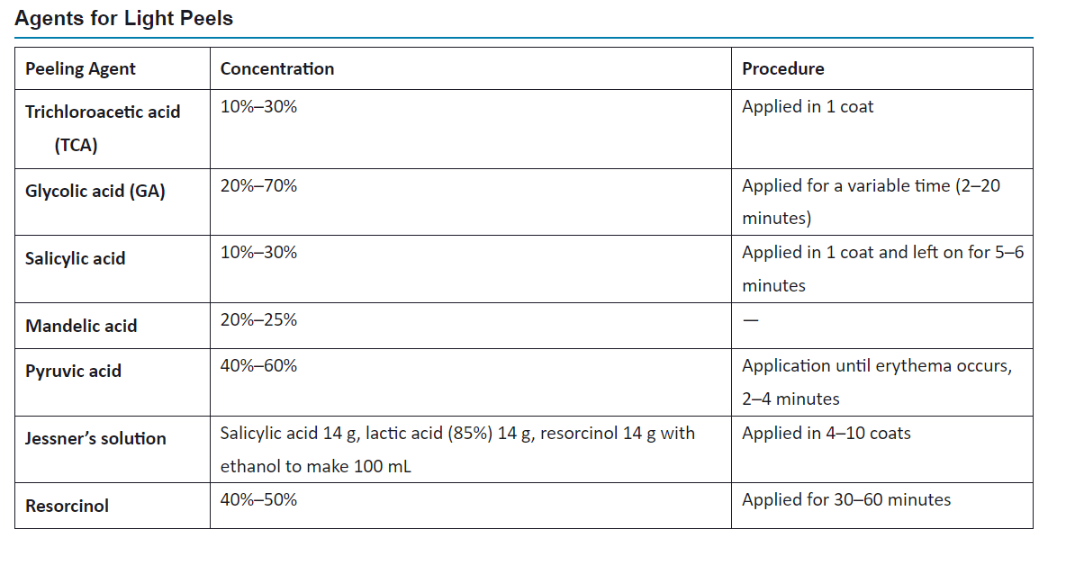

Slide 11
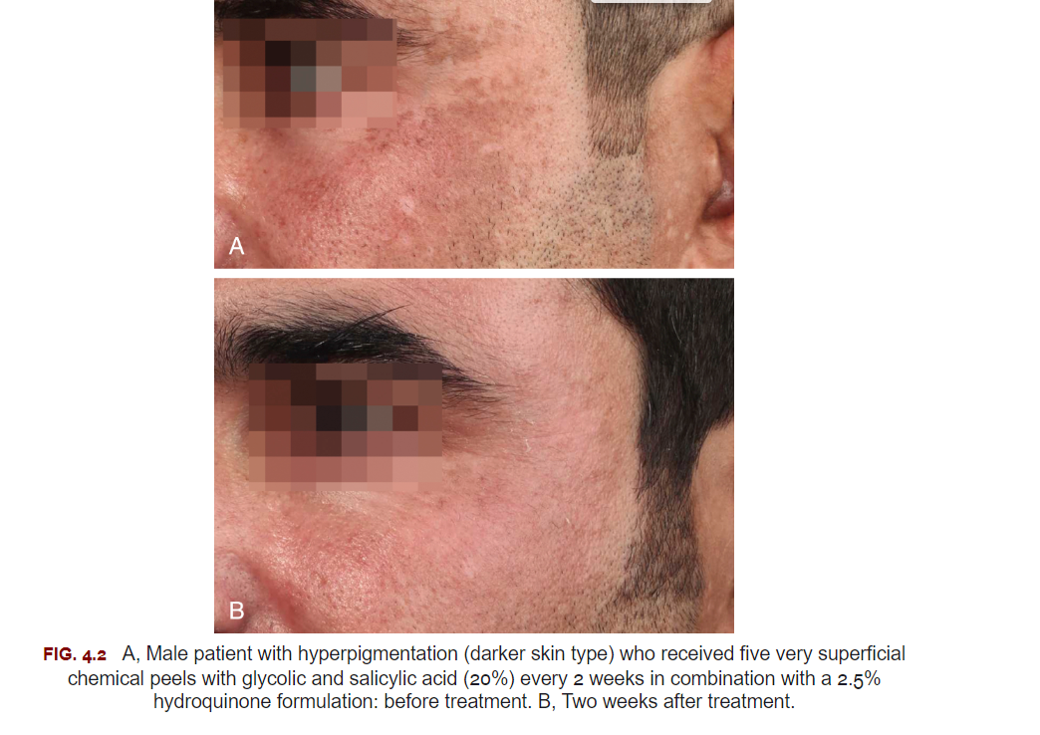

Slide 12
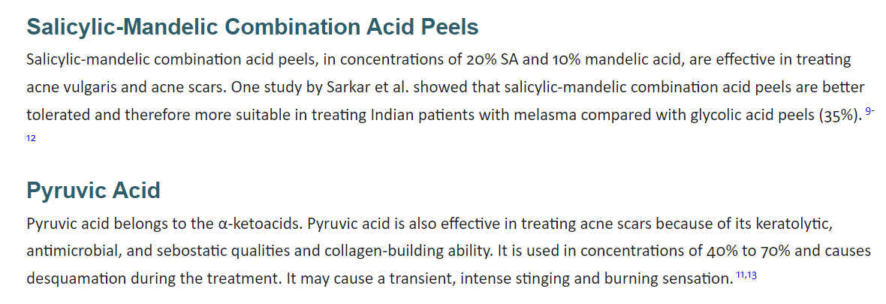

Slide 13
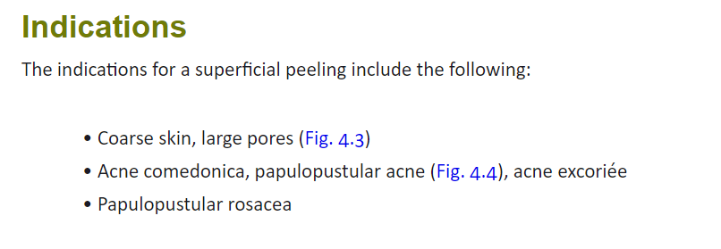
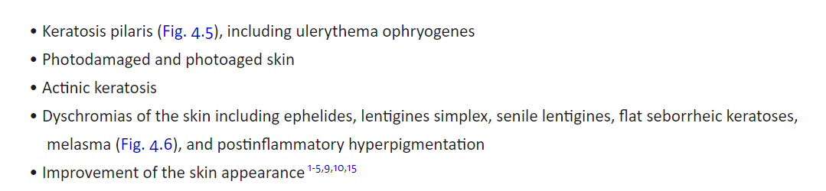

Slide 14
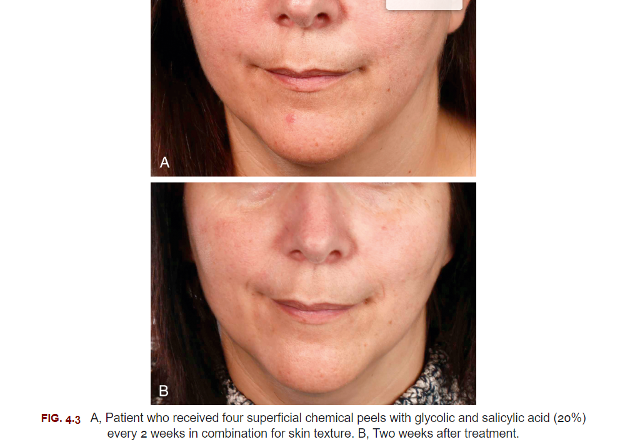

Slide 15
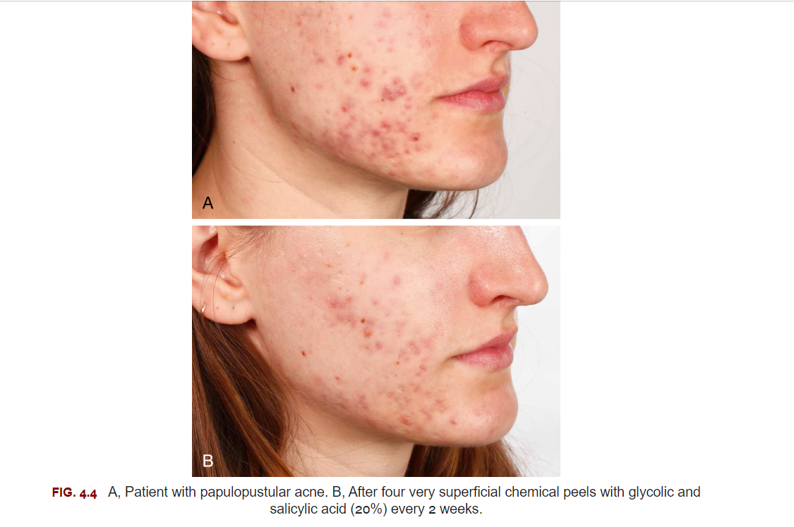
Patient Preparation

Slide 16
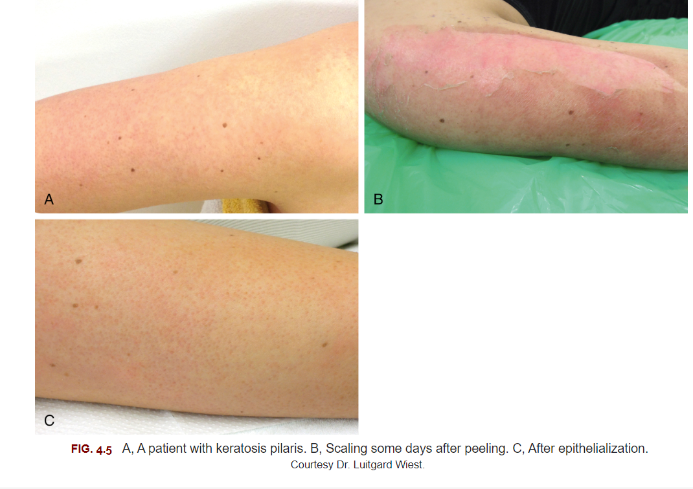

Slide 17
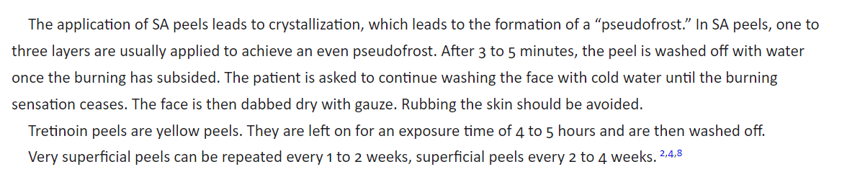
Peeling Technique
Salicyclic Acid and General Instructions

Slide 18
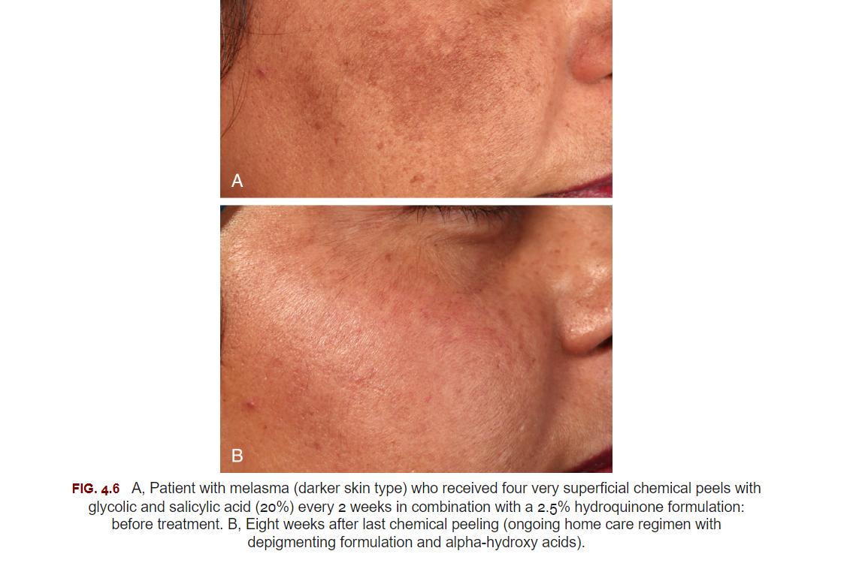

Slide 19
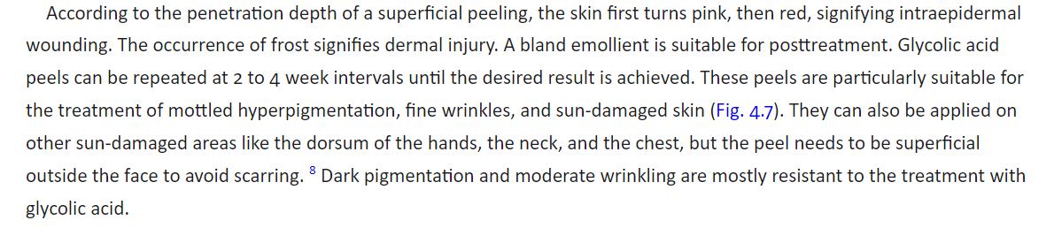
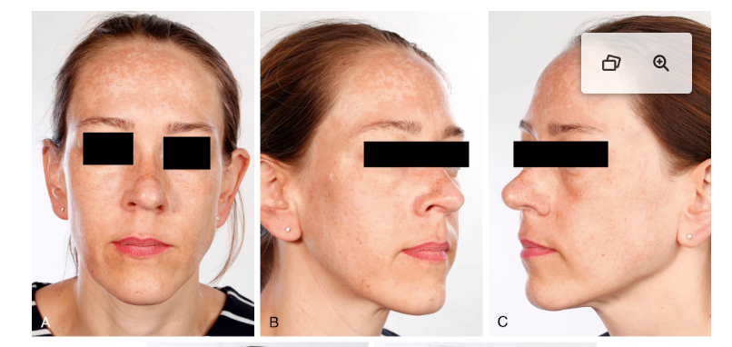
Glycolic Acid Peels

Slide 20
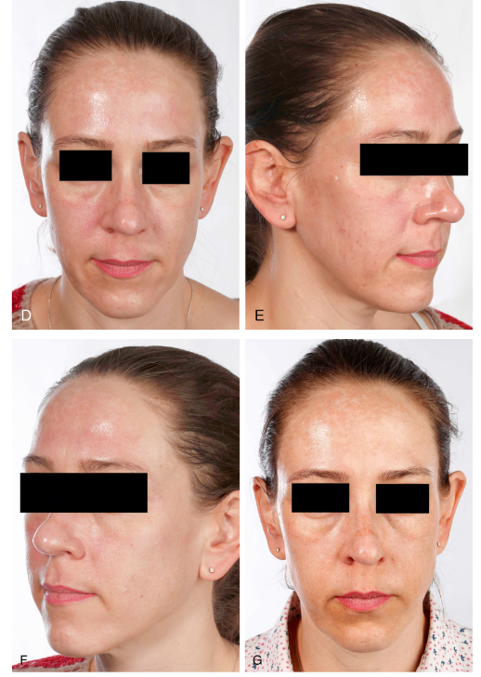
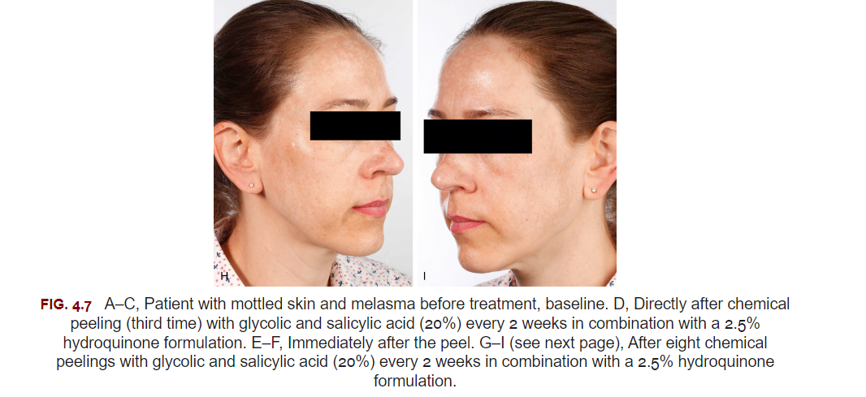

Slide 21

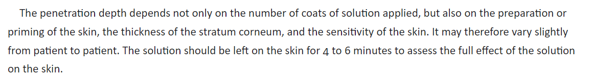
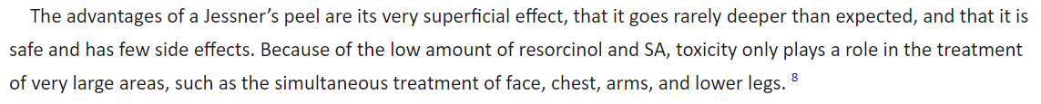
The Jessner's peel is a safe and effective solution for reducing the appearance of acne, hyperpigmentation, smoothing out fine lines and wrinkles, and enhancing skin texture and tone, leading to an overall improved complexion of the skin

Slide 22
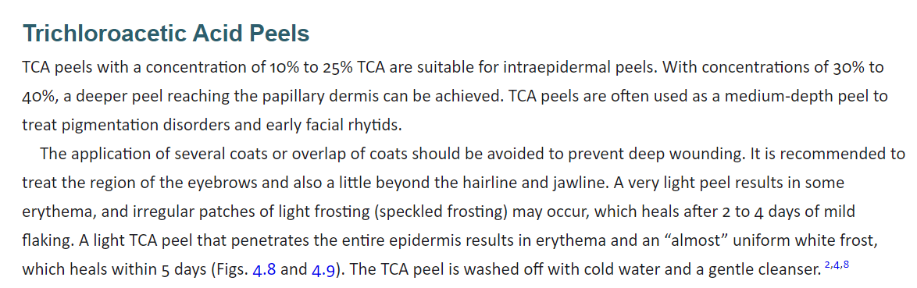

Slide 23

A mild soap or gentle nonsoap cleanser can be used.
In case of crusting, a topical antibacterial (like polisporyn)
To soothe the skin, cold compresses can be used.
Daily use of broad-spectrum sunscreen (SPF 50+) and sun avoidance
Avoid manipulating, picking, or scratching the skin or treated areas.
Avoid all sports and sweating during the healing process
In addition, patients should be informed of early warning signs of complications
Severe and prolonged erythema, edema, burning sensation, crusting
Hyperpigmentation, or formation of pustules or vesicles.
Patients should be instructed to immediately report any early signs of complications to initiate a therapy at an early stage.
Patients should be given a contact number for such emergencies.

Slide 24
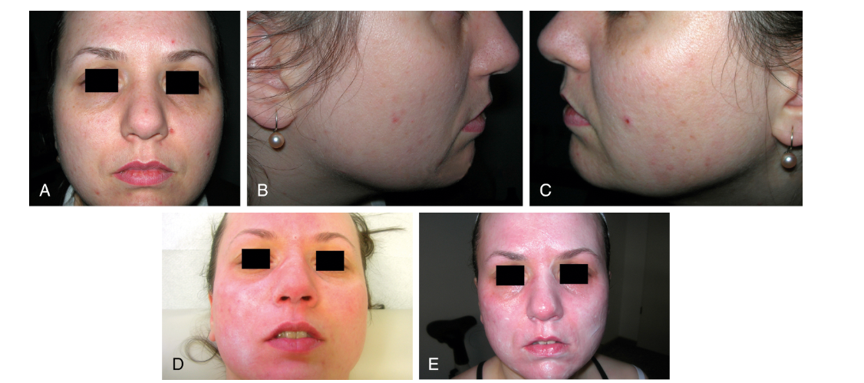

Slide 25
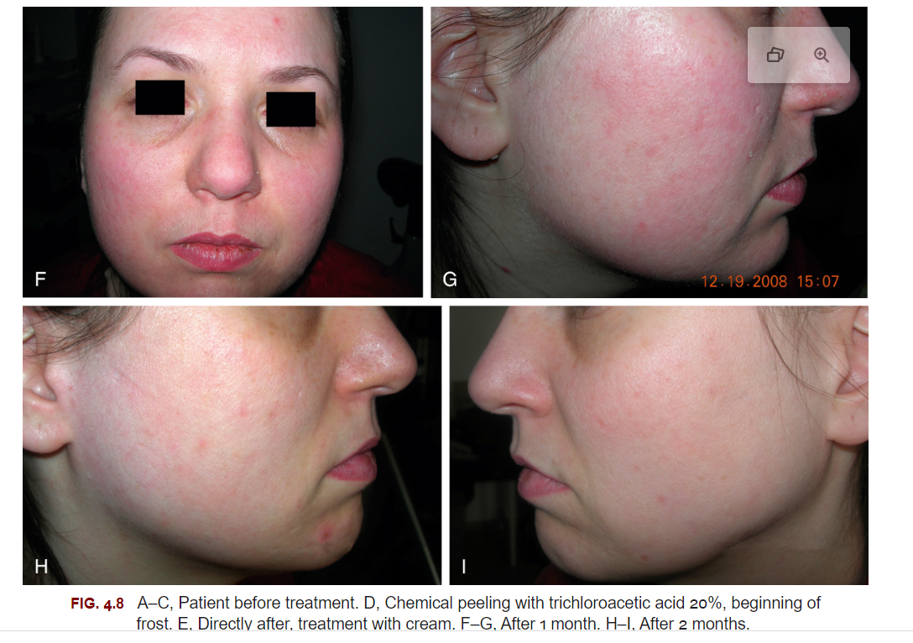

Slide 26
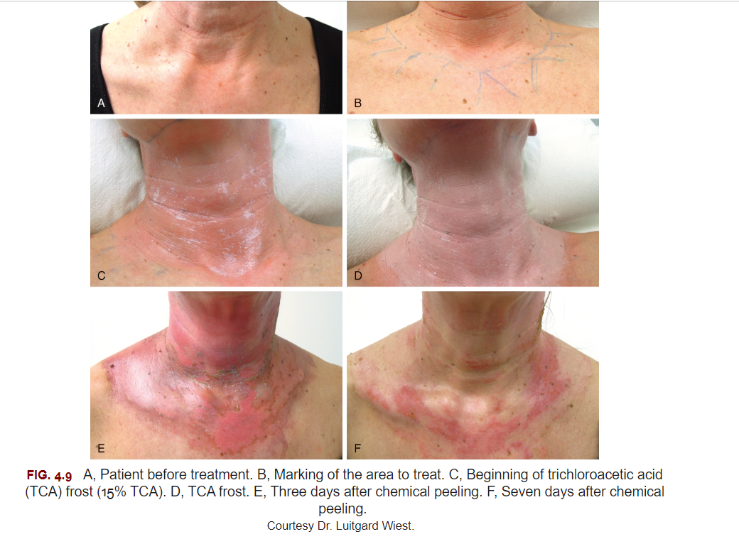

Slide 27
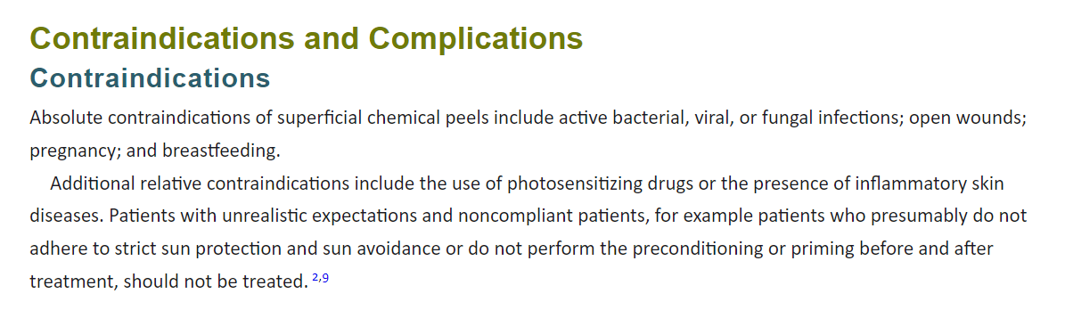

Slide 28
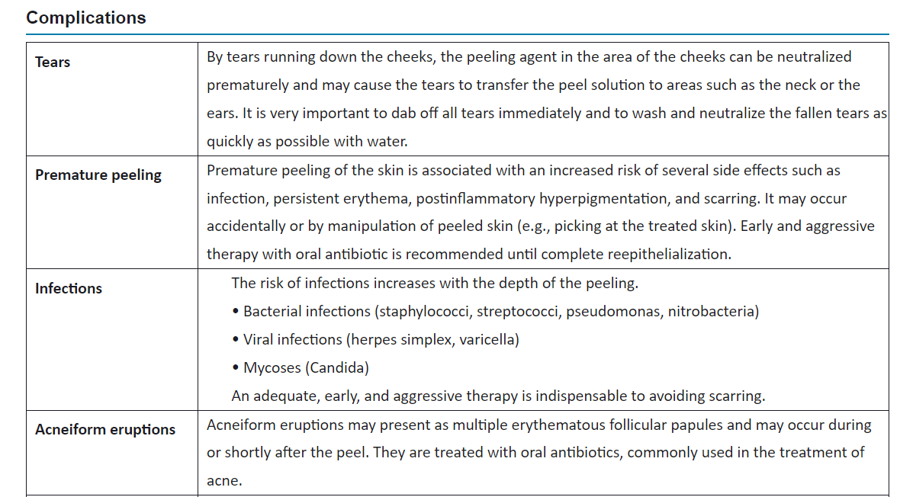

Slide 29
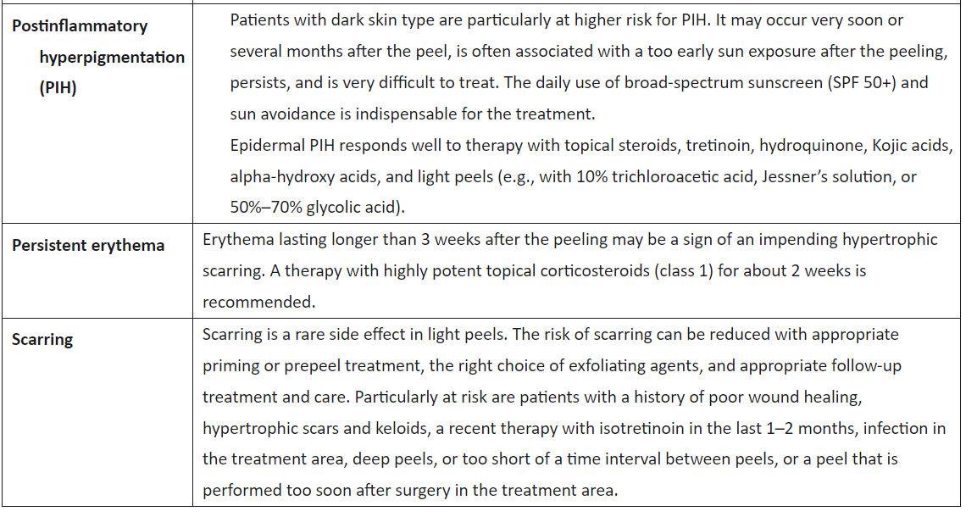

Slide 30
Practical Tips and Conclusion
AHAs
Patients with very sensitive skin, reddish complexion, or telangiectasias or patients with severe sun exposure.
Sun-damaged areas like the neck, dorsum of the hands, and the chest but are currently most popular in the treatment of melasma.
Mottled hyperpigmentation and fine wrinkling.
Acne
postinflammatory hyperpigmentation
shallow acne scars
papulopustular rosacea
seborrheic and actinic keratoses
keratosis pilaris
some verrucae that are resistant to conventional treatments.
AHAs increase ultraviolet (UV) sensitivity, whereas LHA leads to an increased resistance of the skin to UV-induced damage

Slide 31
Beta-hydroxy acids peels
Excellent for acne because of their lipophilic and strong comedolytic effect.
Dyschromias like melasma and postinflammatory hyperpigmentation
oily skin
rough skin texture
mild photodamage
less effective in patients with significant photodamage.
Salicylic-mandelic combination acid peels, in concentration of 20% SA and 10% mandelic acid, are proven effective in treating acne vulgaris and acne scars and seem to be well tolerated and therefore suitable in treating Indian patients with melasma, compared with glycolic acid peels (35%)

Slide 32
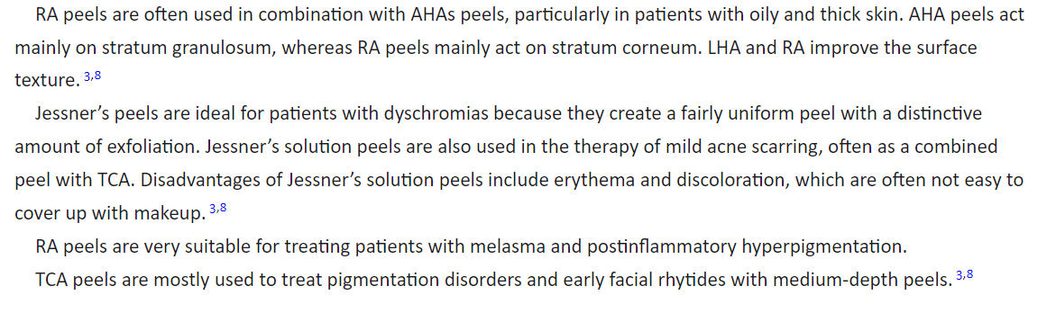

Slide 33

QUESTIONS?

