Slide 1
APPH 226:
Sampling, Histograms, LUT, and Exposure Indicators
Objectives: 4.1, 6.1, 6.4

Slide 2
Digital Imaging
Digital image receptors capture a wide range of exposures
If the entire range were digitized, the values at the extreme high and low ends would also be digitized, resulting in an extremely low contrast image
  Too many shades of grey
With the CR system
  To prevent this, only the optimal density exposure range is processed by the data recognition program

Slide 3
Data Recognition Program
Works by finding the collimation edges and eliminating the scatter outside the collimation
If the system fails to correctly locate the collimation edges, this can result in incorrect data collection and images may appear too bright or too dark
Anatomy needs to be centered to the imaging plate to help ensure the appropriate densities are located
  Failure to center properly may result in images that are too bright/dark

Slide 4
Image Sampling
Image sampling – the plate is scanned and determines:
  the image’s location
  the size of the signal
Values are assigned to each pixel
Histogram is then generated from the information gathered from the sampling

Slide 5
Histogram
Takes the image data from sampling, and a histogram is generated
System finds the useful signal by locating the minimum and maximum signal within the anatomic regions of interest on the image
All intensities of the signal are then plotted on the histogram
Shows the distribution of pixel values for any given exposure

Slide 6
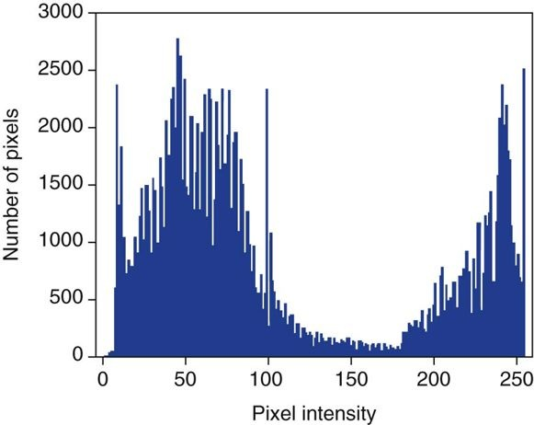
Histogram
Is a graphical representation of the optimal densities within the collimated area
Horizontal axis
  Amount of exposure
Vertical axis
  Number of pixels for each exposure
  Values at the left represent black
  Values at the right represent white
    ***This can vary between systems and textbooks
  Values in the middle are the medium tones

Slide 7
Histogram
How will a dark image appear?
  Most of the data points will be on the left
How will a light image appear?
  Majority of data points will be on the right
The information collected within the collimated area is the signal used for image data
  This is the source of information for the exposure data indicators

Slide 8
Histogram Analysis
Before displaying the image, the computer creates a histogram of the data set and then it is compared to a stored histogram
Shape of histogram is anatomy specific
  Should be fairly constant for each body part
    I.e. histogram of a knee image should look similar to another knee image of a different patient
Technologist responsibility – important to select the correct ‘body part’ before processing the IP
Raw data (from IP) is compared with a ‘normal’ histogram of the same body part, and image correction will occur as needed
  Automatic rescaling also occurs during this process

Slide 9
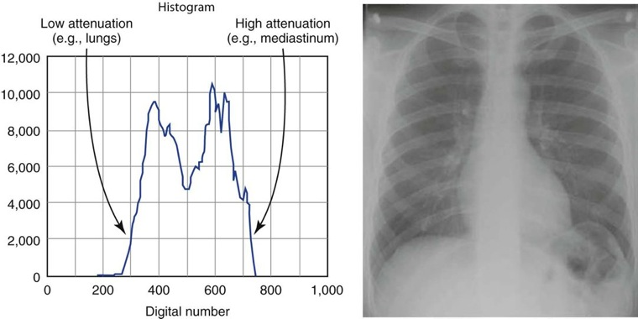

Slide 10
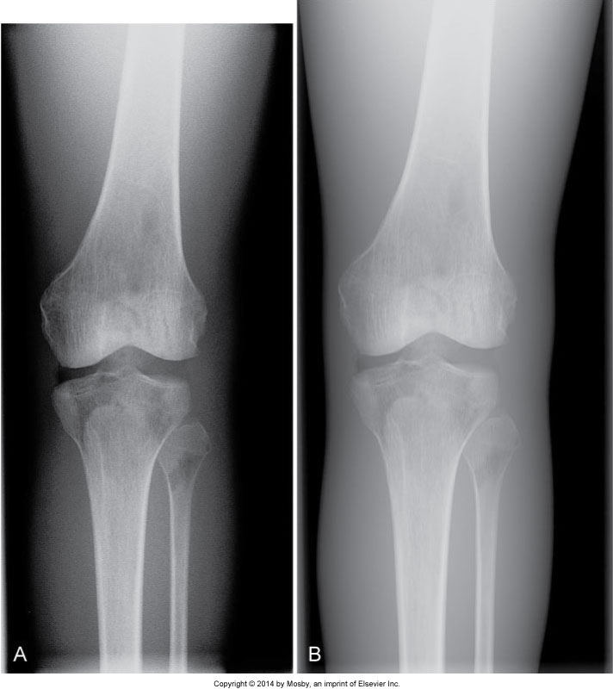
Histogram
Knee
Histogram
Skull
Histogram

Slide 11
Automatic Rescaling
Used for high or low exposures
Attempts to correct pixel display
The computer rescales the image based on the comparison of the histograms – maps the greyscale and presents a specific display of brightness
  Produces images with uniform density and contrast – regardless of exposure
    Dose creep
Exposure is too small
  Quantum mottle will occur
Exposure is too large
  Loss of contrast and edge sharpness due to increased scatter

Slide 12
Nyquist Theorum
States that:
  When sampling a signal, the sampling frequency must be greater than twice the frequency of the input signal so that the reconstruction of the original image will be as accurate as possible
What does that mean for us?
  In digital imaging, at least twice the number of pixels needed to form the image must be sampled
  If there are too few sampled, there will be a loss of resolution
  If oversampling occurs, there will not be an additional useful information gained – no need

Slide 13
Nyquist Theorum
PSP imaging – many conversions, with every conversion, detail is lost
Also, imaging plate stores electrons for a while, but the longer they are stored, they start to lose energy
  Cassettes should be read as soon as possible to prevent signal loss
FPD systems have less signal loss to light spread vs PSP systems, but the Nyquist theorem still applies to ensure that sufficient signal is sampled

Slide 14
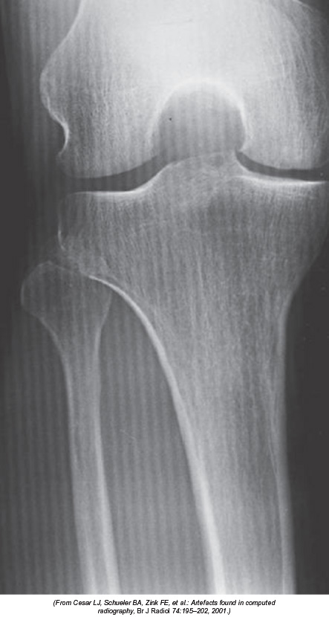
Aliasing
When the spatial frequency is greater than the Nyquist frequency – sampling occurring less than twice per cycle or exactly at the Nyquist frequency
  Information is lost and a fluctuating signal is produced
Aliasing – produces an image that looks like two superimposed images just slightly misaligned
  Moiré effect
  Can get a similar effect with grid errors, tech needs to investigate

Slide 15
Look Up Tables
Input value
LUT
Output Value
Used as a reference to evaluate the raw information and correct the pixel values during processing
Mapping function, in which pixels are changed to a new gray value
  Tells us what new value to ‘substitute’ in for each pixel value
Results in an image that will have the ‘appropriate’ look for the anatomic part
Appearance of the image is modified

Slide 16
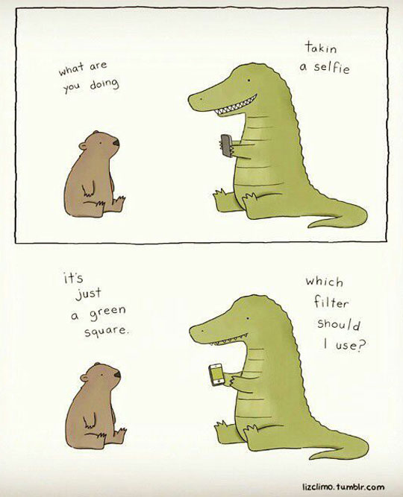
http://themetapicture.com/pic/images/2014/09/29/funny-cartoon-selfie-short-arms.jpg

Slide 17
Look Up Tables
Raw data does not change
Values are manipulated to change what the ‘output’ values are going to be displayed as
There is an LUT for every anatomic part
Contrast can be increased/decreased
  changing the slope of the graph
Brightness (density) can be increased/decreased
  moving the line along the y-axis

Slide 18
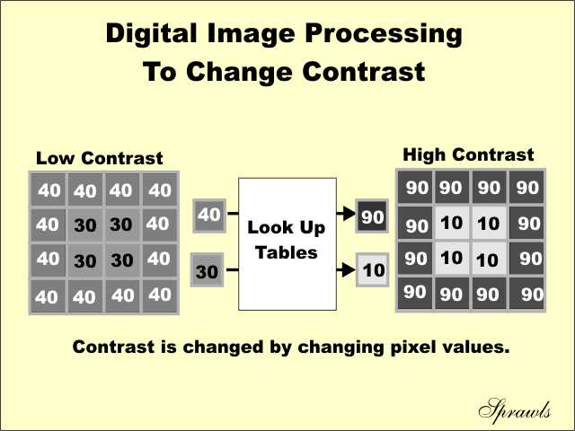

Slide 19
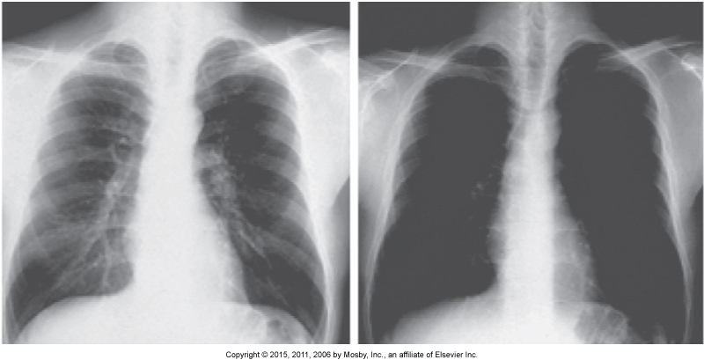
Contrast Enhancement

Slide 20
LUT
Indicates what number is to be substituted for each pixel value after applied to the image (processing)
Straight line LUT does not change the image
  Shows the substituted number is the same as the original value

Slide 21
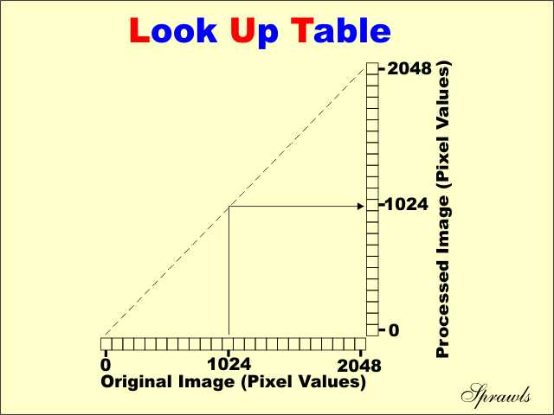

Slide 22
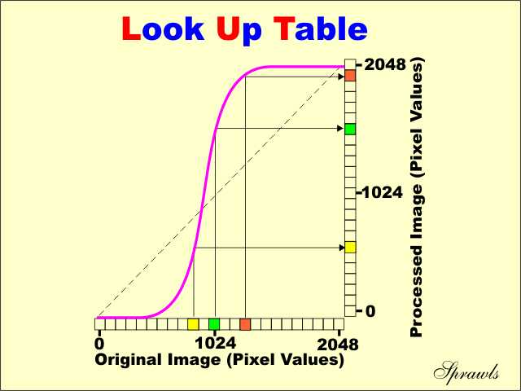

Slide 23
LUT
In order for the display characteristic to change, the LUT needs to substitute numbers that are different than the original values
Shape of the curve is similar to a characteristic curve
  Intentional
  After processing with this LUT, the image takes on a similar appearance as a radiograph on film

Slide 24
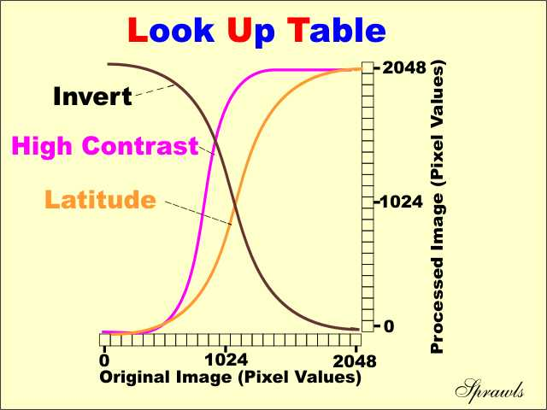

Slide 25
Advantages of LUT
Can produce images with different contrast characteristics
  Slope of the curve represents contrast
    Greater slope = high contrast
    Less slope = low contrast
    Inverted = black bone

Slide 26
LUT
General radiography rooms have a variety of LUTs installed
Technologist must select the appropriate procedure (algorithm), and then there will be an LUT automatically selected
  Ideal contrast characteristics for the procedure/part

Slide 27
Why do we need LUTs?
Original images recorded with digital systems are usually very low contrast
  Due to the wide dynamic range and response of the digital receptors
    Digital doesn’t suppress any of the contrast in the exposure range
Every density is displayed
Use LUT to increase contrast for some section of the exposure range

Slide 28
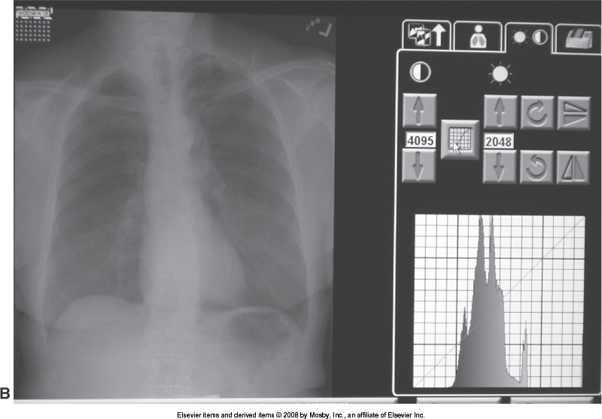
Raw Data Image

Slide 29
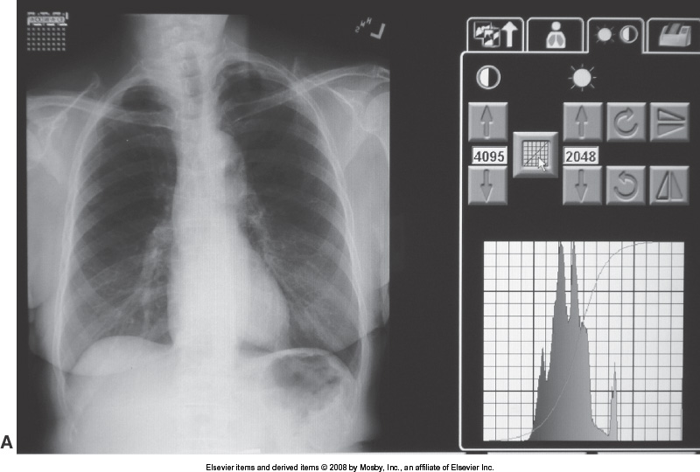
Chest LUT applied

Slide 30
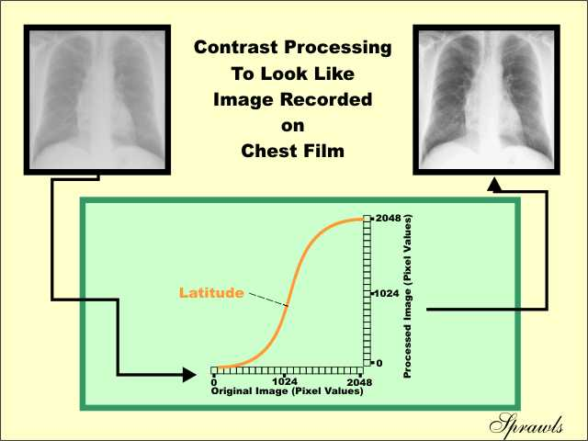

Slide 31
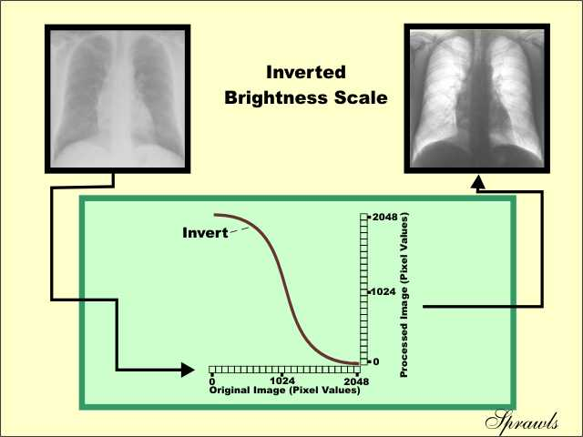

Slide 32
Exposure Indicators
Refers to the amount of exposure received by the IR
Can be used as a guide to monitor the dose to the patient while maintaining acceptable image quality
Knowledge of how exposure factors affect the exposure index is key to minimizing patient dose and providing enough exposure to the image receptor.

Slide 33
Exposure Indicators
Affected by many factors:
  Technical factors
  Histogram analysis error
  Patient positioning
  Image processing algorithms
  SID
  Collimation
  Beam Centering
  Artifacts

Slide 34
Exposure Indicators
Following an exposure:
  The IR is read and a histogram is formed
    “Counts & plots” all the densities from the exposure into a graph
  Exposure Indicators represent the average gray shade value of the image
    Value found by identifying the most exposed vs. the least exposed area detected over the ROI (region of interest)
    Based on collimated boundaries
  Compared to a pre-programmed histogram of the same anatomical part.
    Histograms are matched/combined (histogram analysis)

Slide 35
Exposure Indicators
Manufacturer/Vendor specific values:
  EI numbers (exposure index)
    Used in SAIT MRT lab with CR equipment
  S numbers (sensitivity numbers)
  EI_s numbers (Exposure index sensitivity)
    Used in SAIT MRT lab with DR rooms
  LGM (log numbers)
Values can be calculated by different relationships:
  Direct
  Indirect
  Linear

Slide 36
*Exposure Indicators*
EI_s numbers:
    As the exposure increases, the EI_s value increases
Acceptable limits are set by the manufacturers recommendations, and radiologist preferences
  Room #2-4 in the SAIT MRT lab (Philips):
    100-300
    CXR 450
    High value = overexposed
    Low value = underexposed
Direct relationship

Slide 37
*Exposure Indicators*
EI numbers:
  Direct relationship is vendor specific
  Carestream/Kodak (CR Reader):
    Double the exposure = the EI value increases by 300
    Half the exposure = the EI value decreases by 300
  Philips Digital Diagnost (Room #1):
    Double the exposure = Halve the EI value

Slide 38
*Exposure Indicators*
Carestream/Kodak vs. Philips Digital Diagnost
Ideal Range: - Ideal Range:
1500-1800 (all exams) 200-800
CXR 250-320
High value = overexposed - High value = underexposed
Low value = underexposed - Low value = overexposed
Direct response - Indirect response
Value changes: - Value changes:
2x mAs = +300 2x mAs = ½ EI
Notes:
CR vs. Room 1

Slide 39
*Exposure Indicators*
Other notable differences:
  Room #1 in MRT lab: Room #2-4 in MRT lab:
    200-800 100-300
    CXR 250-320 CXR 450
    High value = underexposed High value = overexposed
    Low value = overexposed Low value = underexposed
**Both use Philips equipment**

Slide 40
*Exposure Indicators*
LGM numbers:
  Direct relationship
    When the exposure is doubled, the LGM value increases by a factor of 0.3
    When the exposure is halved, the LGM value decreases by a factor of 0.3
Agfa CR acceptable limits:
    1.90-2.50 (all exams)
    High value = overexposed
    Low value = underexposed
Direct relationship

Slide 41
*Exposure Indicators*
S numbers:
  Indirect relationship
    When the exposure is doubled, the S value decreases by a value of 200
    When the exposure is halved, the S value increases by a value of 200
Konica-Minolta acceptable limits:
    100-400
    High value = underexposed
    Low value = overexposed
Indirect relationship

Slide 42
Exposure Indicators
Ideal Exposure Indicator value:
  Typically the “halfway” value
  The point between the maximum and minimum exposure value limits (unless specified by the manufacturer)
    Example: Ideal range = 200-800
    Ideal value = 500
    Provides the most diagnostic data for the least amount of patient exposure. (aka. perfect balance)

Slide 43
Exposure Indicators
With DR systems:
  The ideal exposure indicator value for the patient is the lowest possible technical factor selection that will enable the closest value to underexposure, without being outside the recommended limits.
    Example: ideal range = 200-800 (below 200 = underexposed)
    ideal value = 500
    ideal value for the patient = 200

Slide 44
Corrupt EI Numbers
Exposure Indicator numbers are easily corrupted
Images need to be critiqued for quality
  Collimation
  Positioning
  Field size/IR size
Do not repeat on the Exposure Indicator alone

Slide 45
SNR (Signal to Noise Ratio)
Images consist of two components:
  Signal - Meaningful pattern carrying information about the subject
  Noise - Chaotic pattern, carrying no information about the subject
    “Fuzzy, static, snowstorm effect”
    Quantum noise = quantum mottle
    Electronic noise is created during amplification of the signal
Both of these components make up the image

Slide 46
SNR
High signal to noise ratio:
  Signal is higher than the noise
Low signal to noise ratio:
  Signal is lower than the noise
  Information is lost

Slide 47
Critiquing Images
Techs need to magnify the image to check for noise (quantum mottle) or overexposure (burnout/saturation)
*Techs need to be able to post-process the image as needed *
If positioning and centering are accurate, the Exposure Indicator is a great tool for image assessment
Can no longer visualize the level of image quality on digital systems

Slide 48
Latitude in Digital Imaging
Refers to the amount of error that can be made and still maintain a quality image
In digital the exposure can be up to:
  200% above the ideal exposure
  50% below the ideal exposure

Slide 49
Readings
Radiologic Science for Technologists 10th Ed
  Pg 306-312 (SNR)
  Pg 357 (Image Histogram)
Digital Radiography and PACS 3rd Ed
  Pg 28-30, 32

