Slide 1
RADP 215: Radiation Protection
Introduction to Radiation Protection

Slide 2
Course Delivery of RADP 215
D2L
  Course outline
  Course schedule
  Reading list
  Pre lecture quizzes
  PPT
  Worksheets
  Assignments
  Attendance
  Gradebook

Slide 3
Course Assessment
Quiz #1: 15%
Quiz #2: 25%
Assignment: 30%
Final Exam: 30%

Slide 4
Textbooks
Required
Safety code 35: Safety procedures for the installation, use and control of x-ray equipment in large medical radiological facilities.
http://www.hc-sc.gc.ca/ewh-semt/pubs/radiation/safety-code_35-securite/index-eng.php
Statkiewica, S., Viscont, M. A., & Ritenour, E. R. (2018). Radiation protection in medical radiography (8th ed.). St. Louis, MO: Mosby Elsevier.
Recommended
Bushong, S. C. (2017). Radiologic science for technologists physics, biology and protection (11th ed.). St. Louis, MO: Mosby Elsevier.

Slide 5
Safety in the lab at clinical immersion
Best Practices will be used in the lab at clinical immersion.
Direct supervision when exposing.
Doors shut when exposing.
No one inside the room during exposure.
Only hold the rotor right before exposure.
Wear your personal dosimeter at all times.
An instructor must be with you at all times.
Lab safety session will be provided.

Slide 6
Safety at Hospital Sites
Hospital sites may have variations in safety procedures and may not be structured the same.
  You need to know and follow the policies.
  All policies should follow the Safety Code 35: Safety Procedures for the Installation, Use and Control of X-ray Equipment in Large Medical Radiological Facilities (SC 35).

Slide 7
Policy for Pregnancy
If a student becomes pregnant and is ready to declare the pregnancy:
Contact the Radiation Safety Officer.
All information will be kept confidential at the student’s request.
Precautions will be taken as per the SC 35.

Slide 8
Cardinal Rules of Radiation Protection
Time
  Reduce the exposure time.
  If you are not needed in the room, leave.
Shielding
  Always shield the patient and technologist with radiation-absorbent lead.
Distance
  Keep as far away from the radiation source as possible.

Slide 9
Four Main Aspects of Radiation Protection
Patient should not be subjected to unnecessary radiation.
Essential that the patient is protected from excessive radiation during an exam.
Staff need to be protected from excessive radiation when performing their work-related duties.
Non-radiation staff and general public in and out of the department need to be adequately protected.
Notes:
All procedures ordered need to be justified with a clinical exam.
Used when diagnostic information cannot be obtained any other way. For example:
Physical examination
Non-ionizing radiation imaging
Like Ultrasound (U/S) or Magnetic Resonance Imaging (MRI)

Slide 10
Radiation Protection
Radiation protection standards are set by international organizations including:
International Commission on Radiological Protection (ICRP)
United Nations Scientific Committee on the Effects of Atomic Radiation (UNSCEAR)
National Council on Radiation Protection and Measurements (NCRP)
National Research Council of the National Academies–Biological Effects of Ionizing Radiation (NRC/NAS-BEIR)
Notes:
Evolution of the system of radiological protection

Slide 11
Canadian Legislation
Government of Canada:
Radiation Emitting Devices Act and Regulations

Slide 12
Health Canada Safety Code 35
Radiation Protection in Radiology - Large Facilities
  Safety Procedures for the Installation, Use and Control of X-ray Equipment in Large Medical Radiological Facilities.
You can find it online:
  http://www.hc-sc.gc.ca/ewh-semt/pubs/radiation/safety-code_35-securite/index-eng.php
Notes:
Set outs requirements for safe use of radiation emitting equipment
Open SC 35
MUST and SHOULD definitions
objectives
Show Sections A B C

Slide 13
Principle Objectives of SC 35
SC 35 always prevails over other texts in Canada.
Its purpose is to:
  Minimize patient exposure to ionizing radiation while ensuring the necessary diagnostic information is obtained and treatment provided.
  Ensure adequate protection of staff operating X-ray equipment
  Ensure adequate protection other personnel and the general public in the vicinity of radiation areas.
Let’s take a look together!

Slide 14
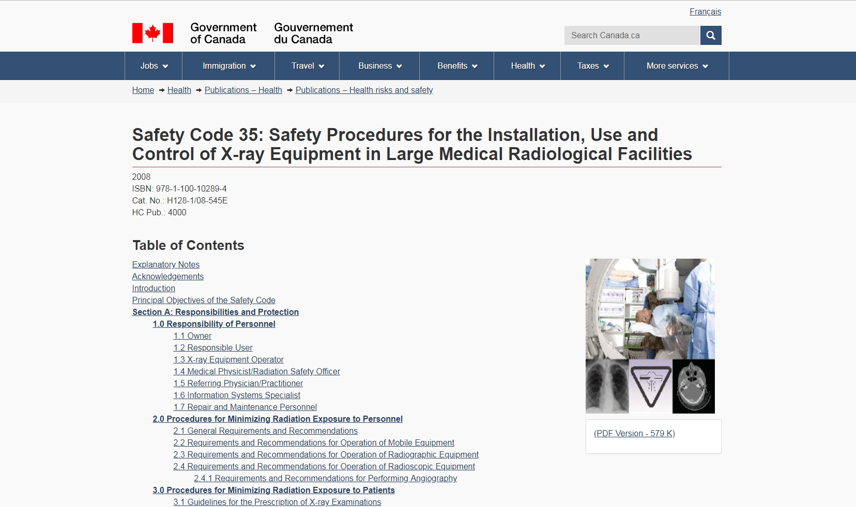
SC 35

Slide 15
Safety Code 35
In the SC 35 the words must and should have been chosen with purpose – explanatory notes
Must
  A requirement that is essential to meet the standards of protection.
Should
  An advisory recommendation that is highly desirable and should be implemented where applicable.

Slide 16
Main Sections of SC 35
Section A:
  Responsibilities & Protection
Section B:
  Facility & Equipment Requirements
Section C:
  Quality Assurance Program

Slide 17
Safety Code 35 & Technologist’s Role
MRT responsibilities may include any of the subparagraphs within Section A: 1.2 & 1.3 depending on his or her role within the department.
  1.2 – Responsible User
    Covers the entire scope of the responsibilities of medical radiation workers including general MRT.
  1.3 – X-ray Equipment Operator
    Covers the scope of the responsibilities of the registered MRT.
Notes:
Know all roles/responsibilities

Slide 18
ALARA Principle
As Low As Reasonably Achievable (ALARA)
Radiation risk model assumes that the health risk is proportionate to the dose.
Linear non-threshold (LNT) hypothesis has been widely adopted in radiological protection and led to the ALARA principle.
Low dose of radiation increases the risk minimally above background radiation.

Slide 19
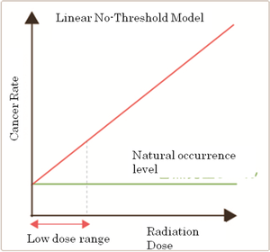
Linear Non Threshold

Slide 20
ALARA and the Technologist
Always wear your personal dosimeter
Utilize protective barriers
Fluoroscopy and mobiles wear a lead apron
Reduce time in vicinity of radiation
Distance from the source of the radiation is the most effective protection
Proper use of patient immobilization devices(avoid holding patient)

Slide 21
ALARA and the Student
Always wear your personal dosimeter in lab and on practicum
Utilize protective barriers, wear lead apron
Reduce time and maximize your distance from the source of the radiation
Limit repeat images and communicate
Same rules apply to a student, plus:
  Never expose without supervision
  Questions? Unsure? ASK!
There are no stupid questions when it comes to radiation safety!

Slide 22
ALARA and the Patient
Restrict beam to area of clinical interest.
X-ray beam should never exceed size of image receptor.
Appropriate technical factors.
Careful positioning to decrease repeats.
Ensure exam is required.
ALWAYS SHIELD whenever possible.

Slide 23
Achieving ALARA
Three basic ways to keep the routine exam as safe as possible:
Controlling the power of the X-ray beam
  Technical factors
Controlling the size of the field
  Collimation
Lead protection
  Patient
  Technologist
Notes:
Time
Reduce the exposure time.
If you are not needed in the room, leave.
Shielding
Always shield the patient and technologist with radiation-absorbent lead.
Distance
Keep as far away from the radiation source as possible

Slide 24
Risk Management
What are the radiation risks?
Radiobiological risk (radiobiology)
  Effect of ionizing radiation on biologic tissue.
Purpose or goal of radiobiology:
  Study of radiation damage on tissue.
  To determine an accurate description of the effects on humans.
  Ensure radiation is used more safely for diagnosis or more effectively in therapy.

Slide 25
Risk Management
Always use best practices and ALARA principles:
  Patients
  Caregivers
  Technologists
  Staff
Always be an advocate for radiation safety:
  Use protective and accessory devices
  Inquire about pregnancy status as required
  Consult with radiation or medical personnel if there is a question

Slide 26
Risk Management
Always practice in accordance with legislation and regulatory guidelines, but ethics are very important.
Practice patient care in a manner that protects patient’s dignity and legal rights.
  Privacy
  Confidentiality
  Lead protection
  Communication
  Proper documentation

Slide 27
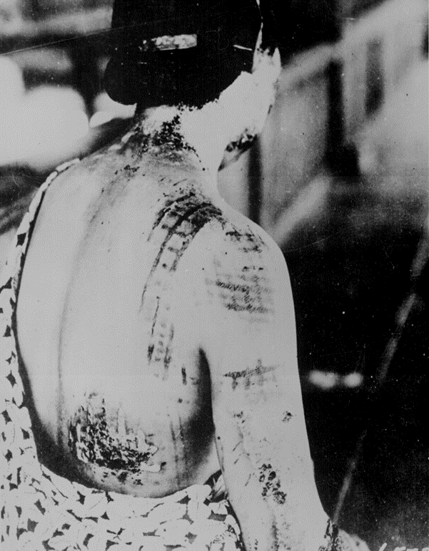
Harmful Potential
Ionizing radiation is harmful
Radiation can cause harm in tissue
Technologist must never forget the damage that can be inflicted with radiation
It’s never “just an X-ray”
Source: Statkiewicz Sherer, et al., 2013, p. 160. Reproduced and used in accordance with SAIT’s Fair Dealing Policy (Schedule A, Copyright of External Materials Procedure AC.2.12.1); further distribution may infringe copyright.

Slide 28
Benefits of Radiation
When used properly, radiation can offer:
  Important diagnostic information.
  Effective therapies.
Provides information that allows for better patient management.
Technologists are a vital part of the medical team and help save the lives of our patients.

