Slide 1
APPH 226:
Digital Radiography – DR
Objectives: 4.1, 4.2, 4.3, 6.3

Slide 2
Direct Radiography
In direct radiography, a detector array replaces the Bucky assembly
If it is a film department, typically the entire x-ray unit will need to be replaced
This comes at a higher cost, which not all facilities can afford
It is a larger investment than implementing CR technology into an existing department

Slide 3
TFT Arrays
Most common DR detectors are based on TFT (thin-film transistor) arrays
Transistor amplifies the electrical signal, which is then stored as an electrical charge
When a high potential is applied, the signal can be released
Each row is connected to the activating potential, and each column to a device which measure the charge

Slide 4
TFT Arrays
The potential is applied row by row, the timing of the detected signal determines the position of the pixel where it originated
  Like a grid-coordinate system
  E.g. @ 3ms = C1
  @ 12 ms = E2
 | A | B | C | D | E | F | G
1 | 1ms | 2ms | 3ms
2
3
4
5
6
7

Slide 5
Flat Panel Detectors
Large 2D array of pixels fastened to a glass backing (substrate)
Array is very efficient – measures x-ray absorption instead of quantity of x-rays
An x-ray absorbing material is attached to the array
  Choice of material determines whether this is direct conversion or indirect conversion DR
    Photoconductors (Direct DR)
      Absorbs x-rays and converts it into electrical charge
    Scintillators (Indirect DR)
      Absorbs x-rays and converts it into light

Slide 6
Two types of Detectors
Direct Conversion
  Immediate conversion into an electrical signal
Indirect Conversion
  Two step process
    Step 1: X-rays converted to light
    Step 2: Light converted to an electrical signal
X-ray photons
Electrical signal
X-ray photons
Light photons
Electrical signal

Slide 7
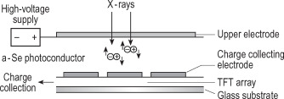
Direct Conversion
Directly converts incoming x-ray photons to an electronic digital signal
  Often referred to as a direct DR system
Uses amorphous selenium (a-Se) on a TFT (thin film transistor) array
Active layer is amorphous selenium
  Semi-conductor with excellent ability to detect x-rays
  Selenium layer is sandwiched between charged electrodes
https://ars.els-cdn.com/content/image/3-s2.0-B9780702028441500090-f05-09-9780702028441.jpg
Notes:
https://ars.els-cdn.com/content/image/3-s2.0-B9780702028441500090-f05-09-9780702028441.jpg

Slide 8
Direct Conversion
Before the exposure is taken, a charge is applied from the top surface of the selenium layer
During exposure, x-rays are absorbed by the selenium layer and electric charges are created in proportion to the exposure received
  X-rays will cause ionization (positive and negative charges) in the selenium layer
Due to the influence of the electrodes, the positive charges are drawn to the electrodes at the bottom of the selenium layer
Charges are collected by a storage capacitor, then the TFT reads the signal line by line and sends it to the computer for processing

Slide 9
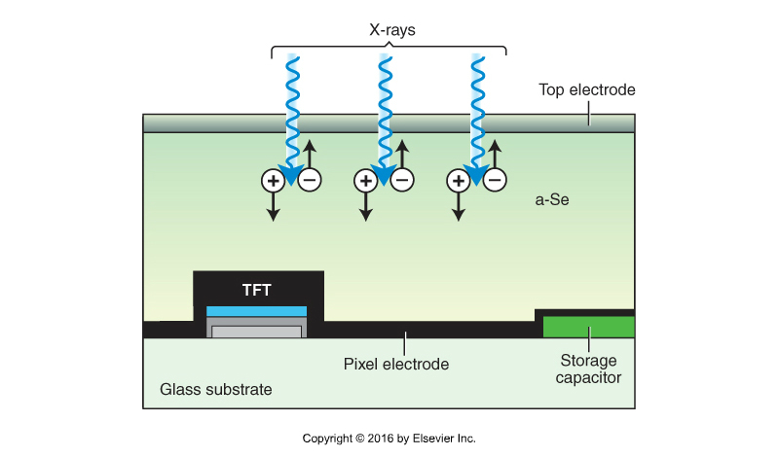
Direct Conversion

Slide 10
Sequence of Image Formation
X-ray photon absorbed by a-Se photoconductor
  X-rays cause ionization (negative and positive charges collected)
Electrode at the surface is positive, attracts and discards the electrons
Charge storage capacitor is at the bottom, attracts the positive charges – the positive charges create the latent image
Latent image (stored in capacitor) is read by TFT line by line
TFT sends the signal (image information) to the computer for processing

Slide 11
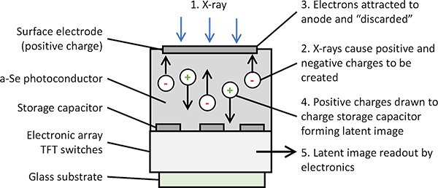
https://www.radiologycafe.com/images/physics/xray-directdr.png

Slide 12
Indirect Conversion
Two types:
  Utilizes flat panel TFT detector
  Utilizes a CCD (charged coupled device)
Both require a scintillator to convert x-ray photons to light
    CsI (Cesium Iodide)
    Gd₂O₂S (Gadolinium Oxysulfide)
Difference is how the light is converted to an electrical signal

Slide 13
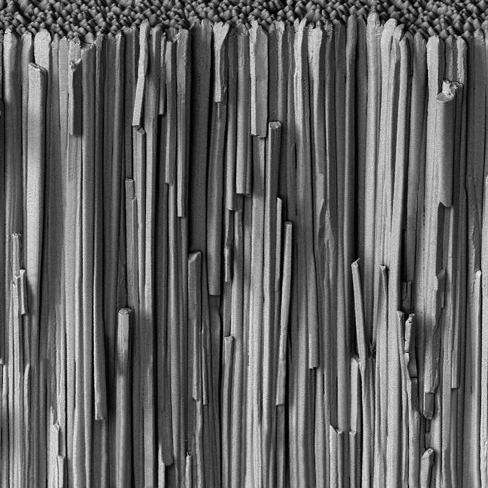
Cesium Iodide
Light is produced isotropically
CsI is manufactured by growing very thin structured crystals perpendicular to detector surface
  Works like fiber optics, directs light
  Allows for higher spatial resolution, due to less light spread
  Needles absorb the x-rays and convert into light, channeling it to the TFT
In the past, could not be used on portable detectors due to delicate nature of crystal structure
With advances in technology, it can be used portably

Slide 14
Gadolinium Oxysulfide
Gd₂O₂S is considered a turbid phosphor, crystals are bound with polyurethane in an unstructured layer
Crystal layer filled with air pockets where light could escape
Light can escape laterally before reaching TFT
  Decreases efficiency of phosphor and lowers spatial resolution
  More scattered light produced
Great for rugged applications – not as delicate as CsI

Slide 15
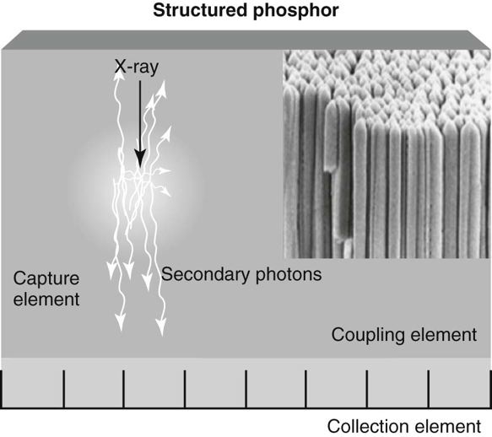
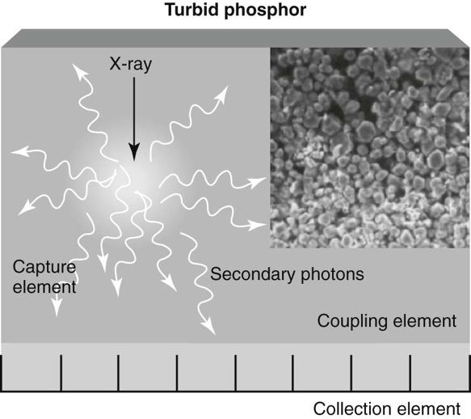

Slide 16
Indirect Conversion - TFT
X-ray photons converted to light
  X-rays hit phosphor (CsI or Gd₂O₂S), which rapidly absorb x-rays and produce light
    Scintillation layer
Light converted to an electrical signal
  Photodetector (amorphous silicon)
  Light hits photosensitive array made up of tiny pixels, and is converted into electrical charges
    Each pixel contains a
      photodiode face to absorb light and generate electrical charges
      TFT embedded into it
  TFT isolates each pixel element and reacts like a switch to send the electrical charges to the image processor

Slide 17
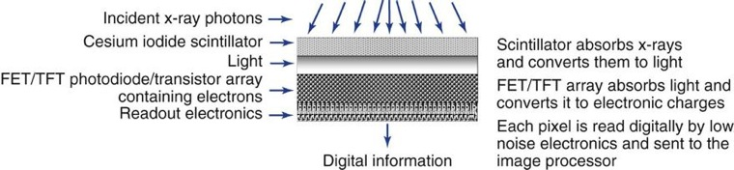

Slide 18
Image Formation Process
X-rays interact with scintillator (CsI or Gd₂O₂S), which absorb the x-rays and release light photons
Light photons are detected by the photodiodes and the signal is amplified
Signal/charge is stored in the storage capacitors located in each pixel
Latent image information is read out sequentially to TFT that produces voltage signal
Resulting voltage signal from TFT is digitized and transferred to the computer for processing

Slide 19
Fill Factor
Fill Factor: the % of the pixel face that is sensitive to x-rays
  Refers to the ‘sensing’ area compared to the ‘non-sensing’ area
Detector electronics that aren’t sensitive to x-rays take up a certain amount of space
If one pixel is magnified, a large portion is covered by electronic components and wires
Fill factor is approximately 80%, meaning 20% of the x-ray beam does not contribute to the image
  Can be improved by using larger pixel sizes, but this would be at the expense of spatial resolution

Slide 20
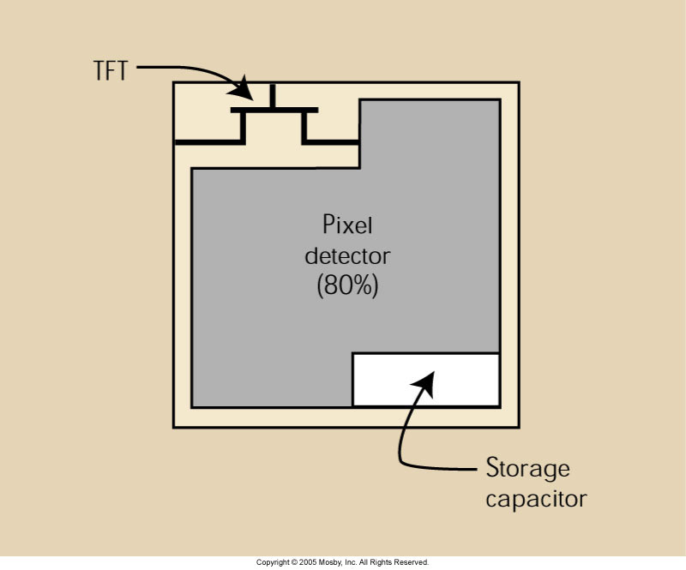
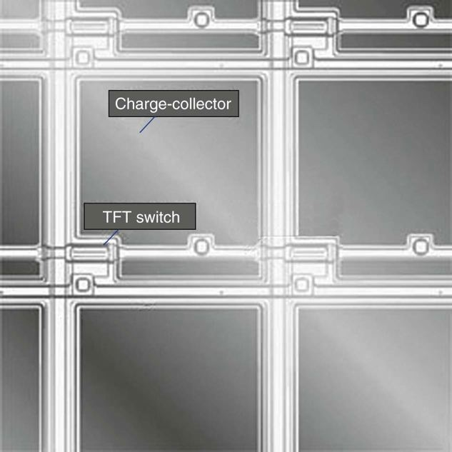
Fill Factor

Slide 21
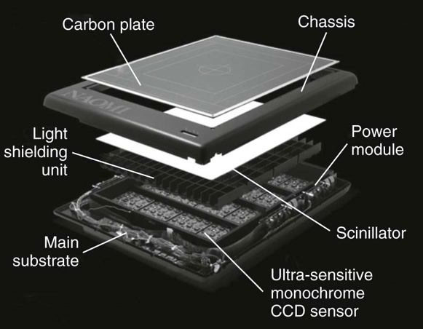
CCD (Charge Coupled Device)
Is a photodetector and electronics embedded into a silicon chip
  Device that converts visible light into an electric charge and stores it in a sequential pattern
  Stored charge is then released line by line to the ADC (Analog to digital converter)
  Light from the scintillator must be optically coupled to the CCD sensor via lenses or fiber optics
  Electric signal from CCD is then sent to the computer for image processing

Slide 22
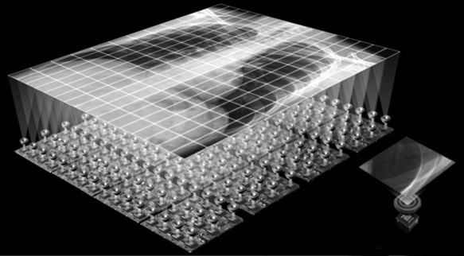
CCD
Is very small, works well in many applications to DR
Very small pixel sizes 100x100 µm
Built to be as efficient as possible
  Polysilicon layer must allow as much light through it as possible
  Spectrum sensitivity of CCD must match output of phosphor – color matching
Can assemble multiple CCDs together for the purpose of viewing a larger area (array)

Slide 23
CCD (Charge Coupled Device)
How it works is that the x-rays interact with a scintillation material (CsI or Gd₂O₂S) which will then emit light
Lenses or fiberoptics are used to focus the light onto the CCD chip
  Efficiency of the transportation of light to the chip is important – affects noise
  Ideal to have more light sent to the chip, and less noise- higher efficiency system
  Can affect distortion
Charge is stored in a sequential pattern, and eventually released to the ADC
X-ray beam/ photons
scintillator
light
CCD

Slide 24
Indirect Detectors
Direct Detectors
X-ray beam/ photons
X-ray beam/ photons
X-ray beam/ photons
scintillator
scintillator
photoconductor
TFT
light
light
Photodiode
CCD
TFT
ADC
ADC
ADC
Digital signal
Digital signal
Digital signal

Slide 25
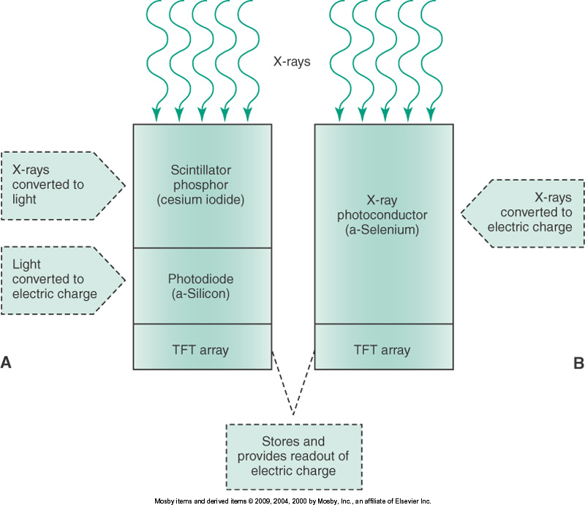
Summary
Direct
  Directly converts incoming x-rays to an electronic digital signal
Indirect
  Two steps
    Requires scintillator to change x-ray photons into light
    Light then converted to electronic signal via TFT or CCD

Slide 26
Direct vs Indirect
Advantage of direct DR
  No light spread from phosphor material
  No loss of spatial resolution
Advantages of indirect DR
  High quantum detection efficiency (can absorb more x-rays, lower dose to the patient)

Slide 27
Process: CR vs DR
CR DR
Imaging Plate
IP processed in Reader to convert to Digital Signal
Available for viewing on a monitor
Signal sent to computer
Detector
X-rays converted immediately into digital signal (indirect/direct)
Available for viewing on a monitor

Slide 28
Advantages of Digital vs Film
CR is compatible with existing x-ray equipment
Excellent image quality
Improved diagnostic accuracy
Wide dynamic range
  Demonstrates minute differences in x-ray absorption which provides highly detailed images
Wide exposure latitude
  permits diagnosis of an entire area of interest from bone to soft tissue in a single exposure
Reduction in repeat exams
Can compensate for over/under exposure
Environmentally friendly
  Eliminates processor chemicals

Slide 29
Disadvantages of Digital
Initial capital costs are high but can be recovered quickly
Concern regarding relaxation of professional standards
  Dose creep

Slide 30
Readings
Digital Radiography & PACS
  65-69, 73-78
Radiologic Science for Technologists
  297-301

