Slide 1


Medical Esthetics
Infection Control Lesson 4

Slide 2
Our Journey Today
Employ the Principles of Prevention
OUR JOURNEY TODAY

Slide 3
Proper infection control requires two steps: cleaning and then disinfecting with an appropriate EPA-registered disinfectant. When these two steps are followed correctly, virtually all pathogens of concern in the salon, spa, or barbershop can be effectively eliminated

Slide 4

Step 1
Cleaning
When you clean, you must remove all visible and surface dirt and debris from tools, implements, and equipment by washing them with liquid soap or detergent and warm water, or a chemical cleaner, and using a clean and disinfected brush to scrub any grooved or hinged portions of the item.
A surface must be properly cleaned before it can be properly disinfected. Using a disinfectant without cleaning first is like using mouthwash without brushing your teeth—it just does not work properly!

Slide 5
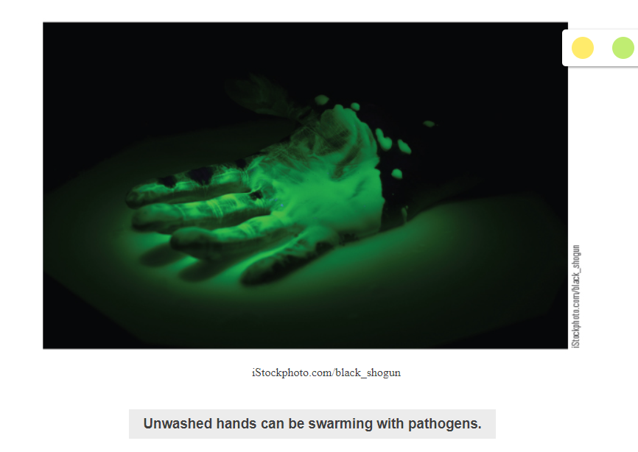

Slide 6
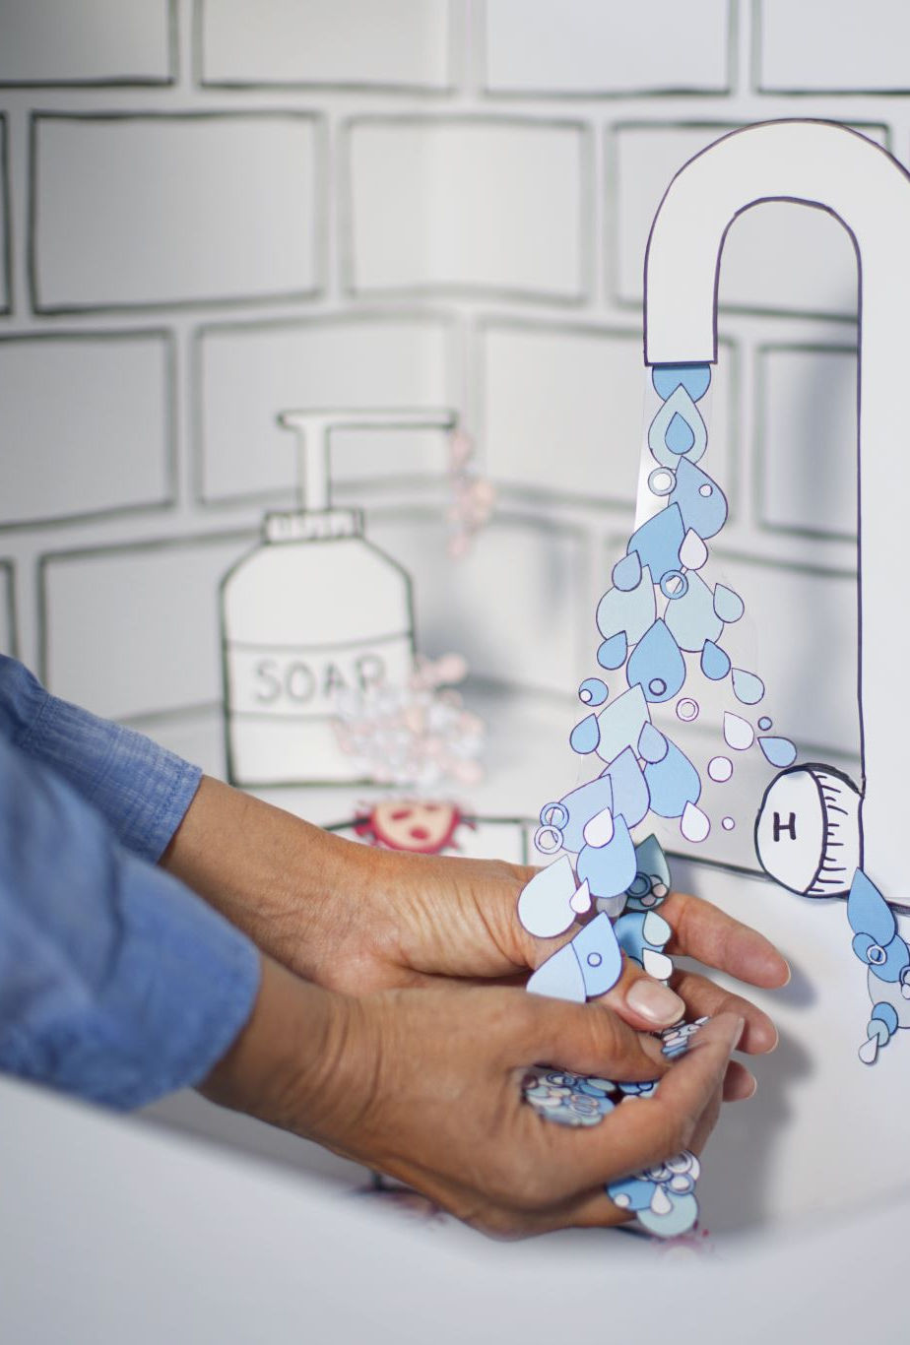
There are three ways to clean your tools and implements:
Washing with soap and warm water and then scrubbing them with a clean and properly disinfected nailbrush
Using an ultrasonic unit
Using a chemical cleaners

Slide 7
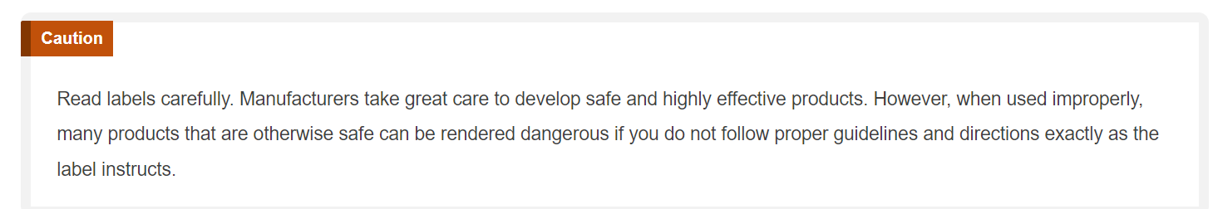

Slide 8
Procedure 5-1: Proper Hand Washing
Hand washing is one of the most important procedures in your infection control efforts and is required in most states before beginning any service and after eating, smoking, or using the restroom

Slide 9
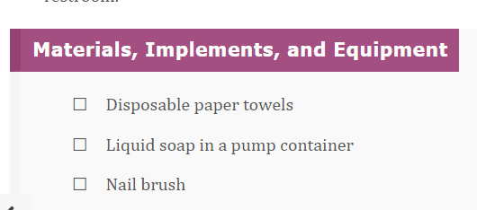

Slide 10
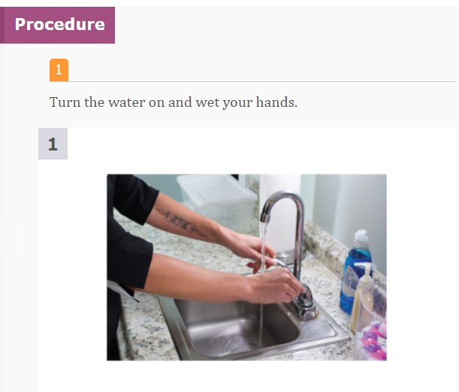

Slide 11
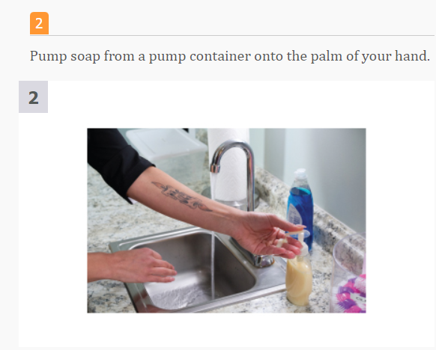

Slide 12
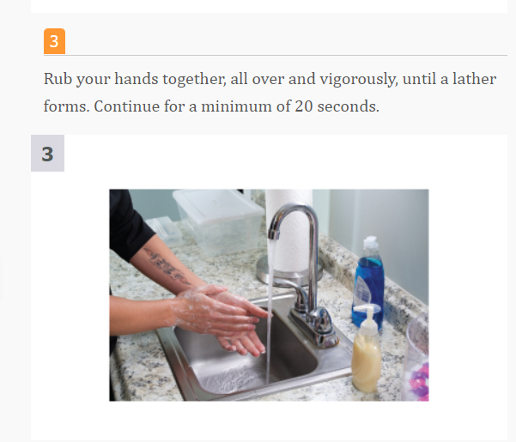

Slide 13
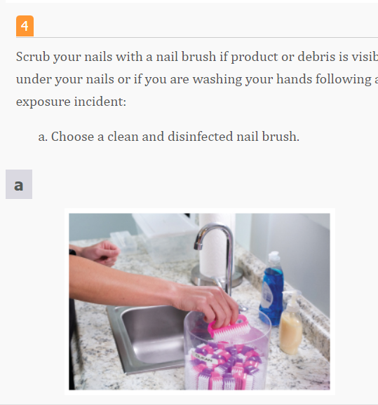

Slide 14
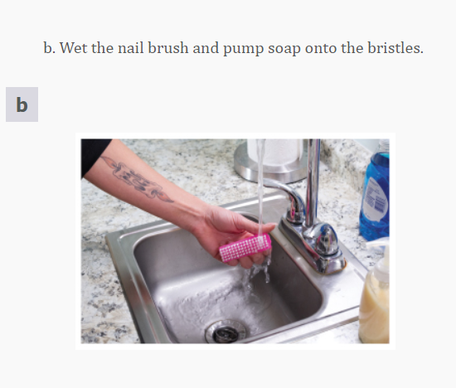

Slide 15
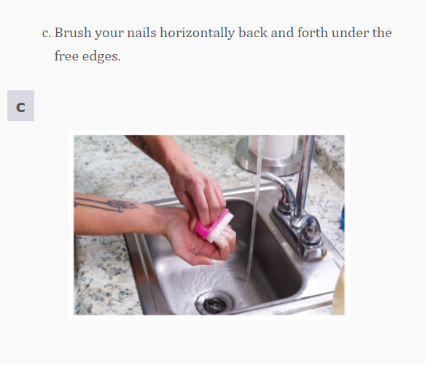

Slide 16
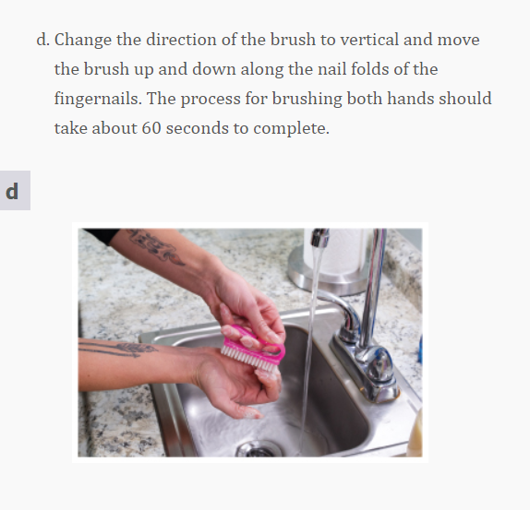

Slide 17
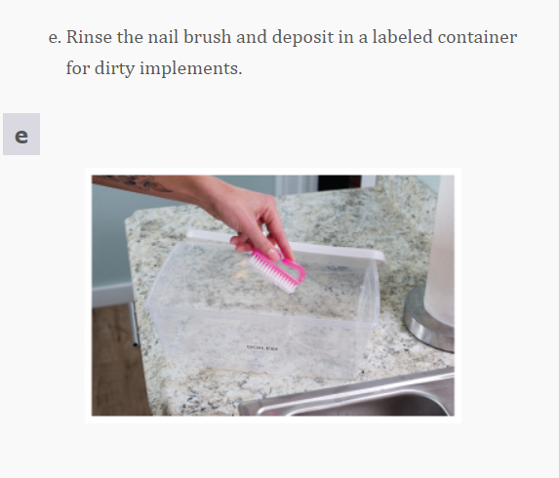

Slide 18
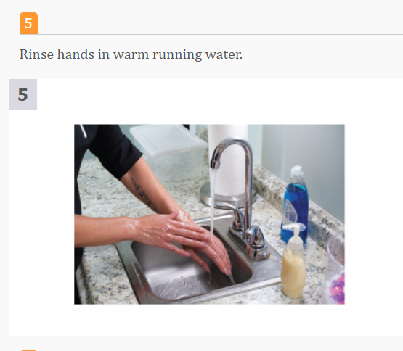

Slide 19
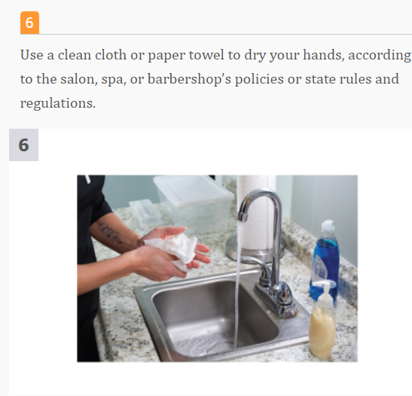

Slide 20
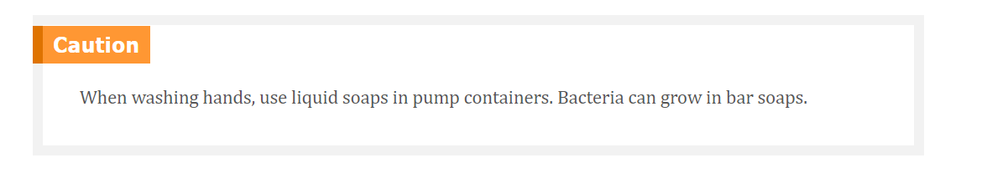
Let’s Review !

Slide 21

Antibacterial Soaps
While there are many marketing claims on soaps these days, antibacterial and antimicrobial soaps have been under the scrutiny of the FDA since 2014. In 2016, many of the chemicals used in these soaps were banned. What’s more, research has shown that repeated use of antibacterial products can actually increase the growth of some of the worst pathogens.
The true benefit of hand washing comes from the friction created by the soap bubbles that works to “pull” pathogens off the skin surface.

Slide 22
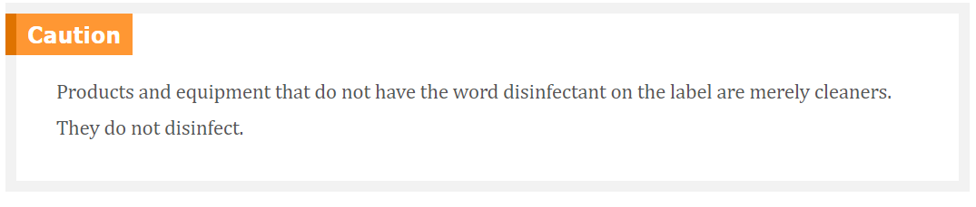

Slide 23
Common Antiseptics Used in the Salon and Spa
Hydrogen peroxide has been used in homes and the beauty industry virtually forever. It is generally used at 3 percent strength and works well as an antiseptic. However, it should never be used on an open cut, as it destroys the cells that begin the healing process in a wound.
Isopropyl alcohol is effective in cleaning the skin; however, it can be very drying and cause irritation of the skin. Alcohol is not a disinfectant for surfaces or implements and should be used only as a cleaner or antiseptic.

Slide 24
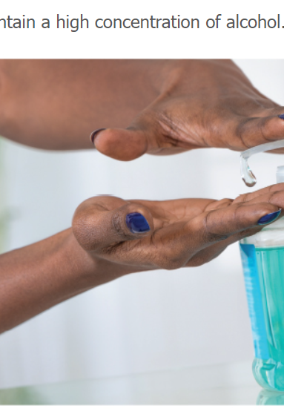
Waterless Hand Sanitizers
Antiseptics are chemical germicides formulated for use on skin and are registered and regulated by the Food and Drug Administration. Antiseptics generally contain a high volume of alcohol and are intended to reduce the numbers and slow the growth of microbes on the skin.
When there is visible dirt/debris on the hands, neither waterless hand sanitizers nor antiseptics will work until the dirt/debris is removed; this can be accomplished only with liquid soap, a soft-bristle brush, and water.

Slide 25
Step 2: Disinfecting
Disinfection is extremely effective in controlling microorganisms on surfaces such as shears, clippers, and other multiuse tools and equipment
A disinfectant used in the shop must carry an EPA registration number
Remember that disinfectants are products that destroy most bacteria (not including spores), fungi, and viruses on surfaces
Never use disinfectants as hand cleaners since this can cause skin irritation and allergic reactions.

Slide 26
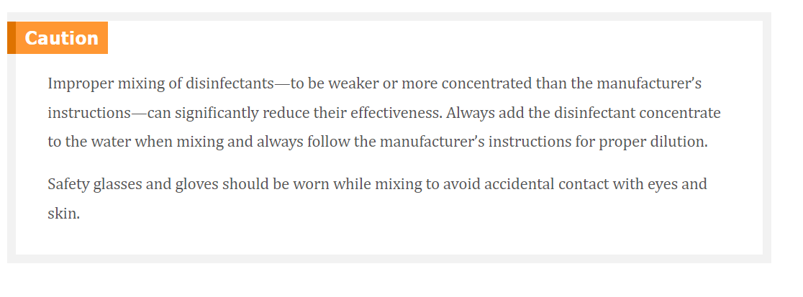

Slide 27
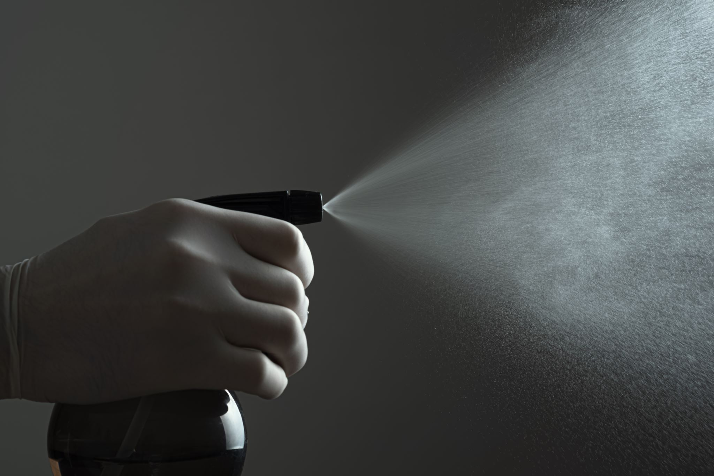
Choosing a Disinfectant
Read and follow the manufacturer’s instructions
Most concentrates have a 10-minute contact time, whereas most wipes have a 2-minute contact time
In general, as concentration goes up and contact times go down, disinfectants become more corrosive and damaging to implements.
Disinfectants must have efficacy claims on the label. Efficacy is the ability to produce the intended effect.

Slide 28
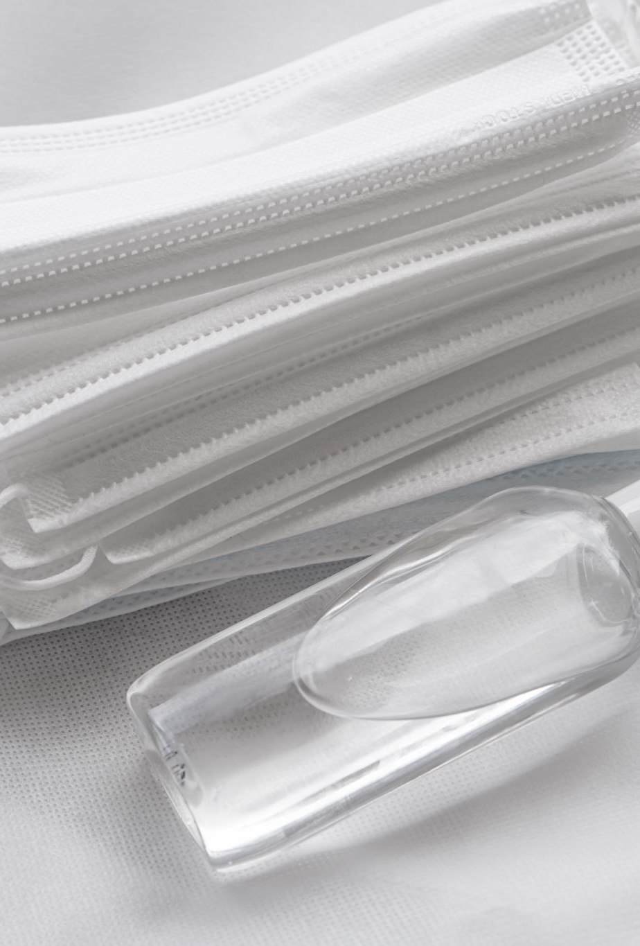
Proper Use of Disinfectants
Implements must be thoroughly cleaned of all visible matter or residue before being placed in disinfectant solution, residue will interfere with the disinfectant and prevent proper disinfection, properly cleaned implements and tools, free from all visible debris, must be completely immersed in disinfectant solution
When using a spray, wipe, or aerosol disinfectant, you must still look for and adhere to the contact time to ensure that all pathogens on the label are being effectively destroyed.

Slide 29
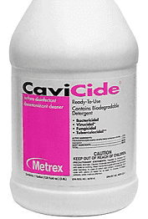
Types of Disinfectants
Quats
Quaternary ammonium compounds also known as quats , are disinfectants that are very effective when used properly on nonporous surfaces. The most advanced type of these formulations is called multiple quats. Multiple quats contain sophisticated blends of quats that work together to significantly increase the effectiveness of these disinfectants. Quat solutions usually disinfect implements in 10 minutes. As with all disinfectants, leaving tools in a quat solution for prolonged periods can cause dulling or damage. They should be removed from the solution after the specified period, rinsed (if required), dried, and stored in a clean, covered container.

Slide 30
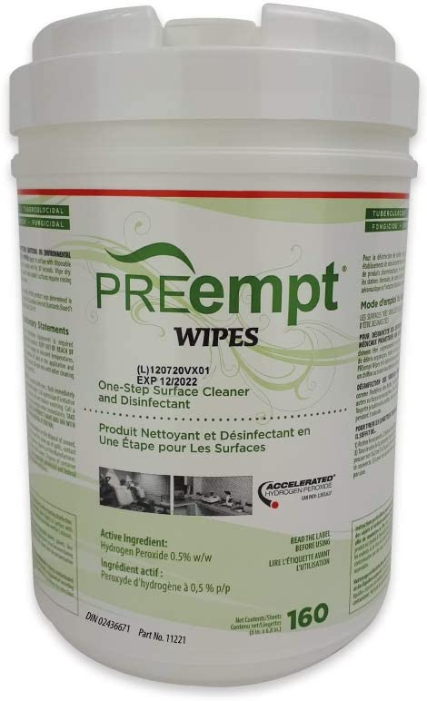
Tuberculocidal Disinfectants
Tuberculocidal disinfectants (tuh-bur-kyoo-LOH-syd-ahl dis-in-FEK-tents) are proven to kill the bacterium that causes tuberculosis (tuh-bur-kyoo-LO-sus), in addition to other pathogens destroyed through the use of hospital disinfectants. Tuberculosis is a disease caused by a bacterium that is transmitted through coughing or sneezing. It is passed through inhalation only and is not transmitted by the hands or picked up on surfaces.

Slide 31
Phenolic disinfectants are powerful tuberculocidal disinfectants; however, just because these disinfectants are effective against the pathogen does not mean that you should automatically reach for them. They are a form of formaldehyde, have a very high pH, and can damage the skin and eyes. Phenolic disinfectants can be harmful to the environment if put down the drain. They have been used reliably over the years to disinfect tools; however, they do have significant drawbacks. Phenol can damage plastic and rubber and cause certain metals to rust. Extra care should be taken to avoid skin contact with phenolic disinfectants. Phenolics are known carcinogens and as such should be used only in states that require their use. In those states, you should keep a tuberculocidal disinfectant readily available, but you should use it only when required.

Slide 32
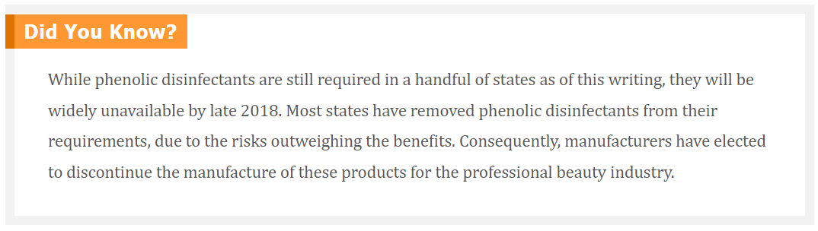

Slide 33
Bleach
Household bleach, 5.25 percent sodium hypochlorite, is an effective disinfectant and has been used extensively in salons, spas, and barbershops. Bleach used in the salon, spa, or barbershop must be EPA registered as a disinfectant. Chlorine bleach is the only bleach that disinfects, so it is wise to always look for disinfection instructions on the label to ensure that the bleach you use is actually disinfecting. Bleach is corrosive and can damage metals and plastics as well as cause skin irritation and eye damage.

Slide 34
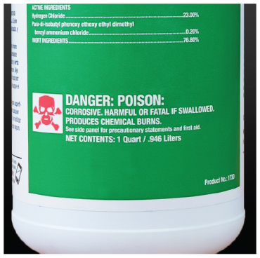

Slide 35
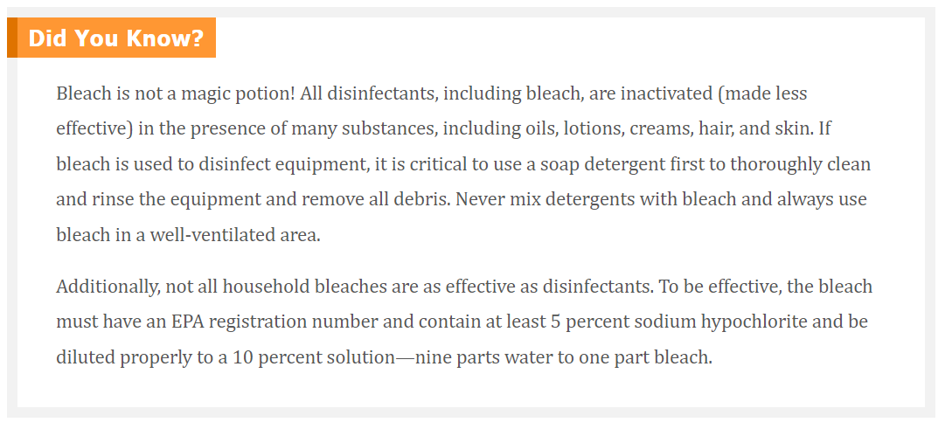

Slide 36
Disinfectant Tips and Safety
Always
Keep the SDS on hand for the disinfectant(s) you use.
Wear gloves and safety glasses
Avoid skin and eye contact.
Add disinfectant to water when diluting (rather than adding water to a disinfectant) to prevent foaming, which can result in an incorrect mixing ratio.
Use tongs, gloves, or a draining basket to remove implements from disinfectants.
Keep disinfectants out of reach of children.
Follow the manufacturer’s instructions for mixing, using, and disposing of disinfectants.
Use disinfectants only on clean, hard, nonporous surfaces.
Keep an item submerged in the disinfectant for 10 minutes unless the product label specifies differently.
Immerse the entire implement in disinfectant if the product label calls for “complete immersion.”
To disinfect large surfaces, such as countertops, carefully apply the disinfectant to the clean surface or use a disinfectant spray and allow it to remain moist for 10 minutes, unless state regulations say differently.
Strictly follow the manufacturer’s directions for when to replace the disinfectant solution in order to ensure the healthiest conditions for you and your client. Replace the disinfectant solution every day—more often if the solution becomes soiled or contaminated.

Slide 37
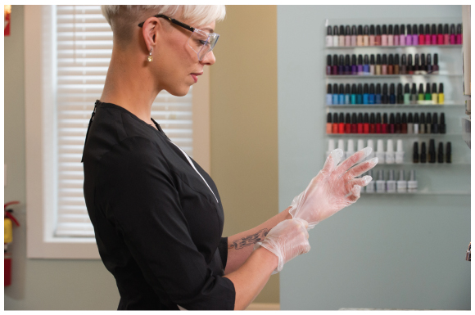
Wear gloves and safety glasses while handling disinfectants.

Slide 38
Never
Let quats, phenols, bleach, or any other disinfectant come in contact with your skin. If you do get disinfectant on your skin, immediately wash the area with liquid soap and warm water. Then rinse and dry the area thoroughly.
Place any disinfectant or other product in an unmarked container. All containers should be labeled with, at the least, product name, ingredients, date of mixing, and manufacturer’s information.
Mix chemicals together unless specified in the manufacturer’s instructions. (For example, mixing together bleach and ammonia products or bleach and vinegar creates potentially fatal toxic vapors!)

Slide 39
Disinfecting Containers
In the past, jars or containers used to disinfect implements were often incorrectly called “wet sanitizers.” Disinfectant containers contain disinfectant for disinfecting purposes, not for cleaning. The container you choose must be large enough to contain all items to be disinfected and covered, but not airtight. Remember to clean the container every day and to wear gloves when you do. Always follow the manufacturer’s label instructions for disinfecting products

Slide 40
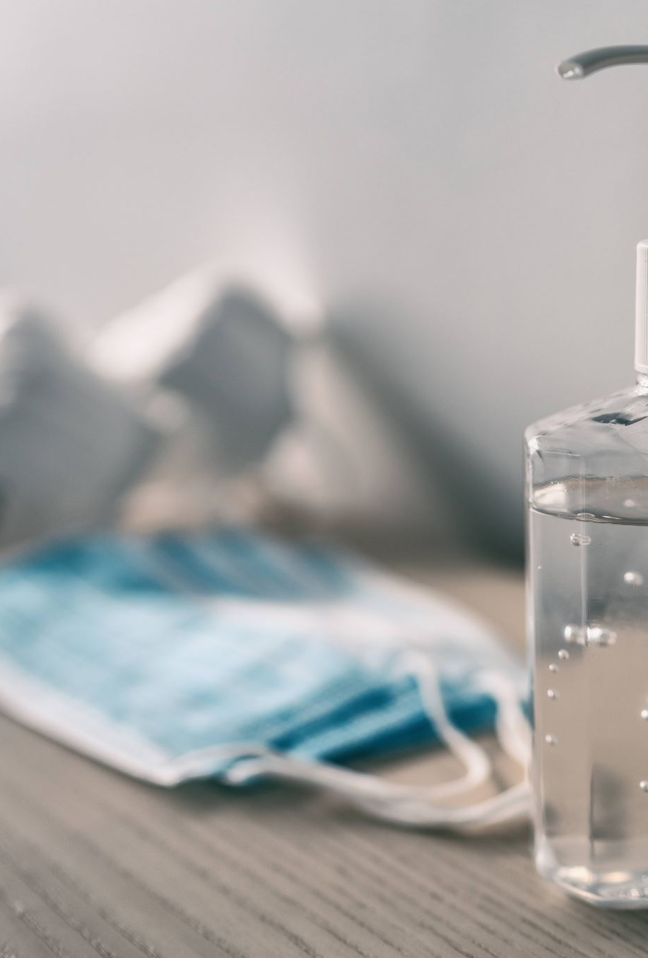
Keep a Logbook
Salons, spas, and barbershops should always follow manufacturers’ recommended schedules for cleaning and disinfecting tools and implements, disinfecting work surfaces, scheduling regular service visits for equipment, and replacing parts when needed. Although your state may not require you to keep a logbook of all equipment usage, cleaning, disinfecting, testing, and maintenance, it may be advisable to keep one.

Slide 41
Cleaning and Disinfecting Nonporous, Reusable Items
Rules require that all multiuse tools and implements be cleaned and disinfected before every service. Mix all disinfectants according to the manufacturer’s directions, always adding the disinfectant to the water, not the water to the disinfectant . Follow the cleaning and disinfecting nonporous, reusable items procedure described in Procedure 5-2.

Slide 42
Procedure 5-2: Cleaning and Disinfecting Nonporous, Reusable Items
Nonporous, reusable items include nonelectrical tools and implements that can be completely submerged, such as combs, brushes, shears, clips, hairpins, tweezers, and nippers, as well as larger equipment that cannot be submerged, all the way up to nonporous work surfaces

Slide 43
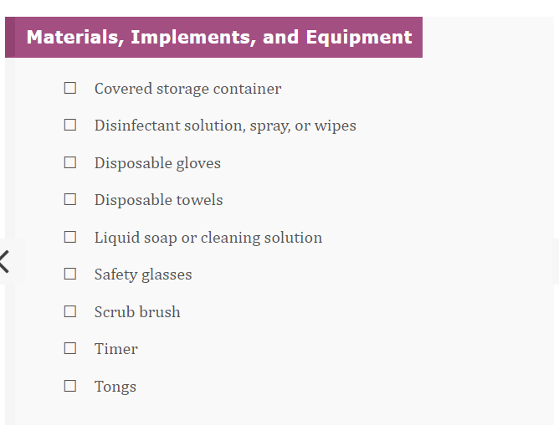

Slide 44
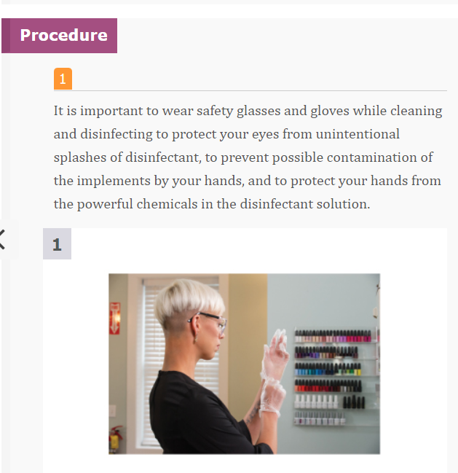

Slide 45
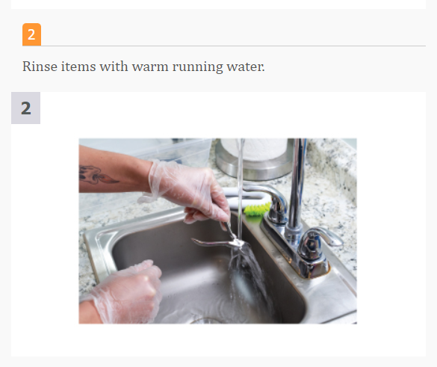

Slide 46
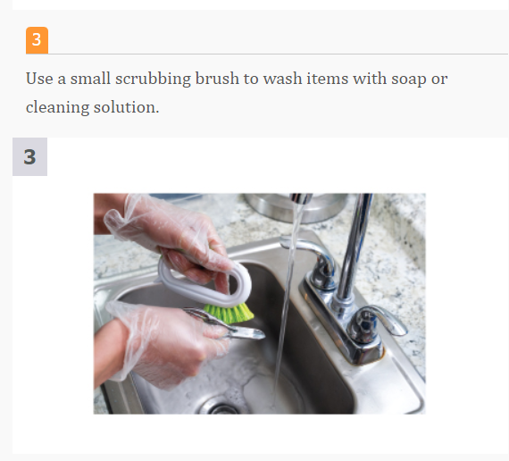

Slide 47
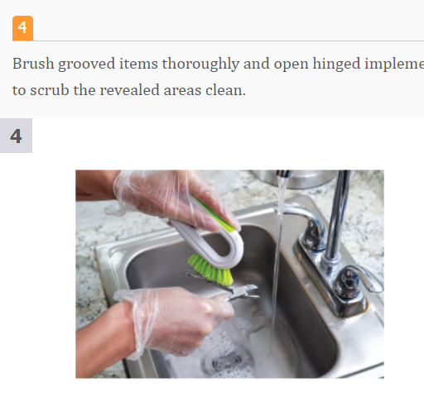

Slide 48
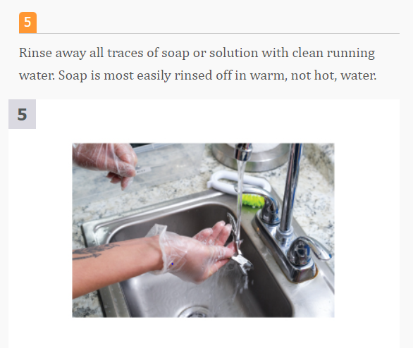

Slide 49
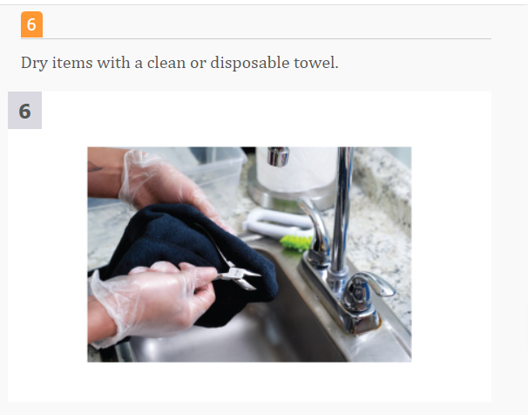

Slide 50
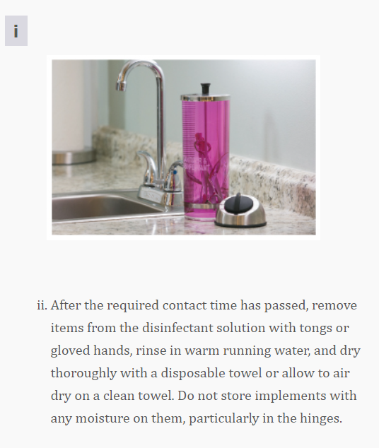
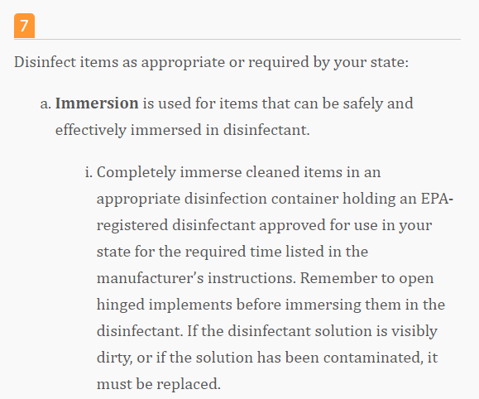

Slide 51
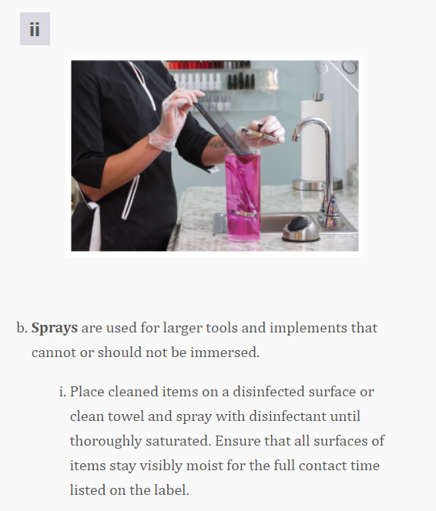
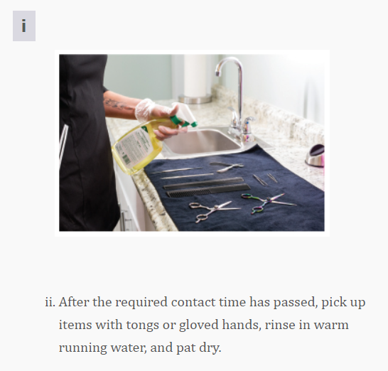

Slide 52
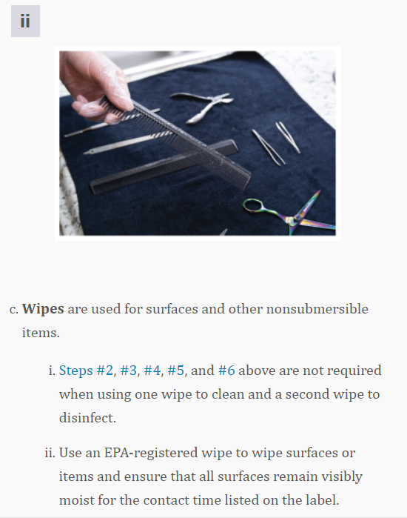
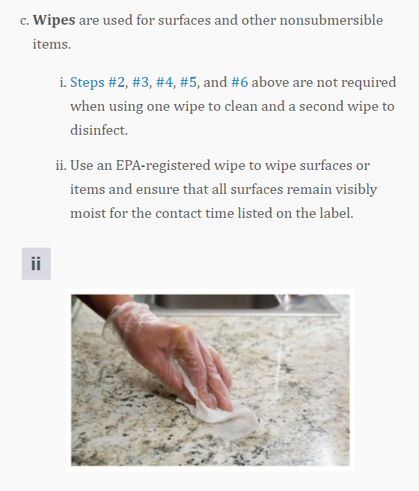

Slide 53
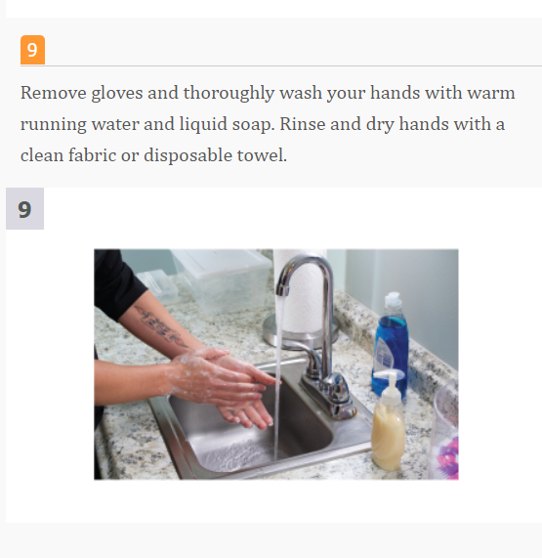
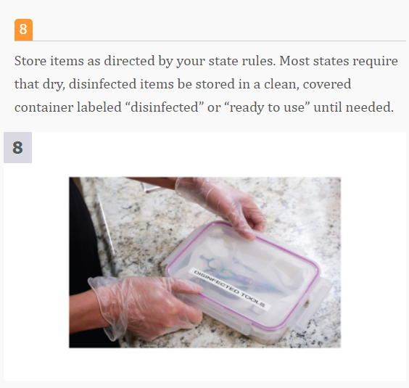

Slide 54
Disinfecting Electrical Tools and Equipment
Hair clippers and other types of electrical equipment have contact points that cannot be completely immersed in liquid. These items should be cleaned and disinfected using an EPA-registered disinfectant designed for use on these devices

Slide 55
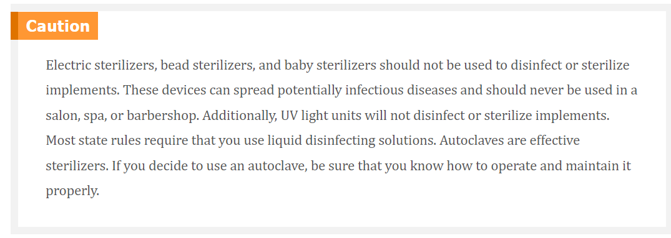

Slide 56

Disinfecting Work Surfaces
Most states require that all work surfaces be cleaned and disinfected before beginning a service. Be sure to clean and disinfect tables, stations, shampoo sinks, chairs, armrests, and any other surface that a customer’s skin may have touched. Clean doorknobs and handles daily to reduce transfer of germs to your hands.

Slide 57
Cleaning Towels, Linens, and Capes
Clean towels and linens should be used for each client, and some states require freshly laundered capes for every service. To clean towels, linens, and capes, launder according to the directions on the item’s label. Be sure that towels, linens, and capes are thoroughly dried. Items that are not dry may grow mildew and bacteria. Store soiled linens and towels in covered or closed containers, away from clean linens and towels, even if your state regulatory agency does not require that you do so. Whenever possible, use disposable towels, especially in restrooms. Do not allow the neckband of capes to touch the client’s skin. All states require the use of a barrier, such as disposable neck strips or towels, to prevent the client’s skin from touching the neckline of the cape.

Slide 58
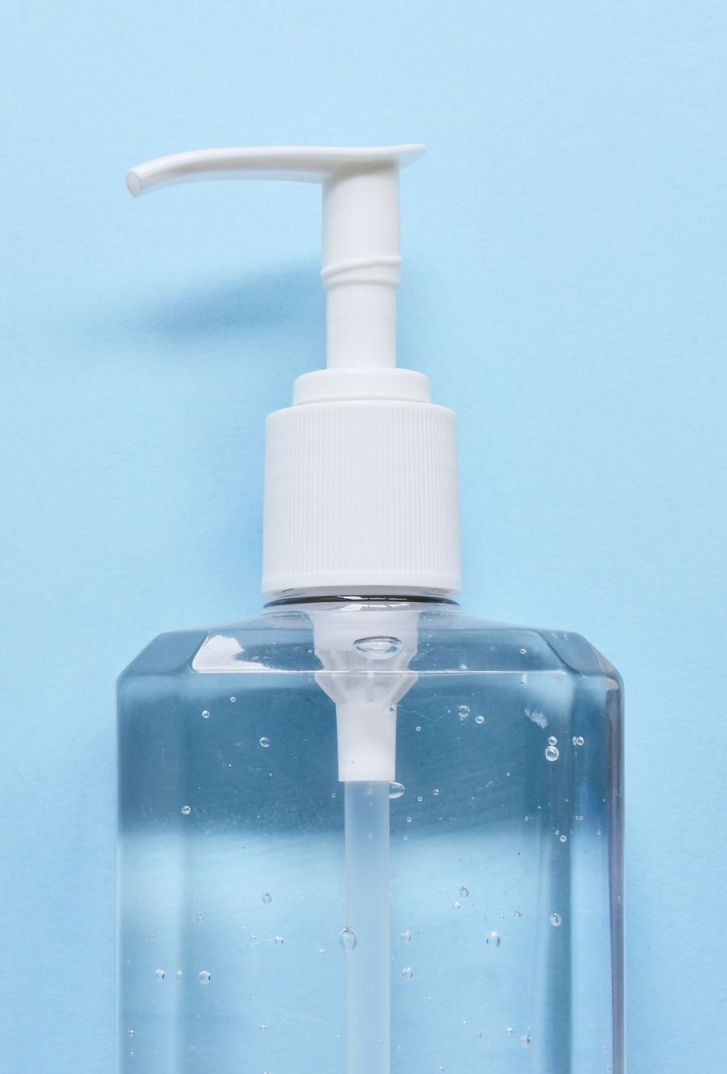
Multiuse Products
When using creams, lotions, gels, or any other product that is dispensed from a multiuse container, it is important not to contaminate the product. Always use a pump or shaker to dispense products when possible. For products in a tub-type container, always use a clean spatula (disposable or disinfectable) to remove the product—never use your fingers.

Slide 59
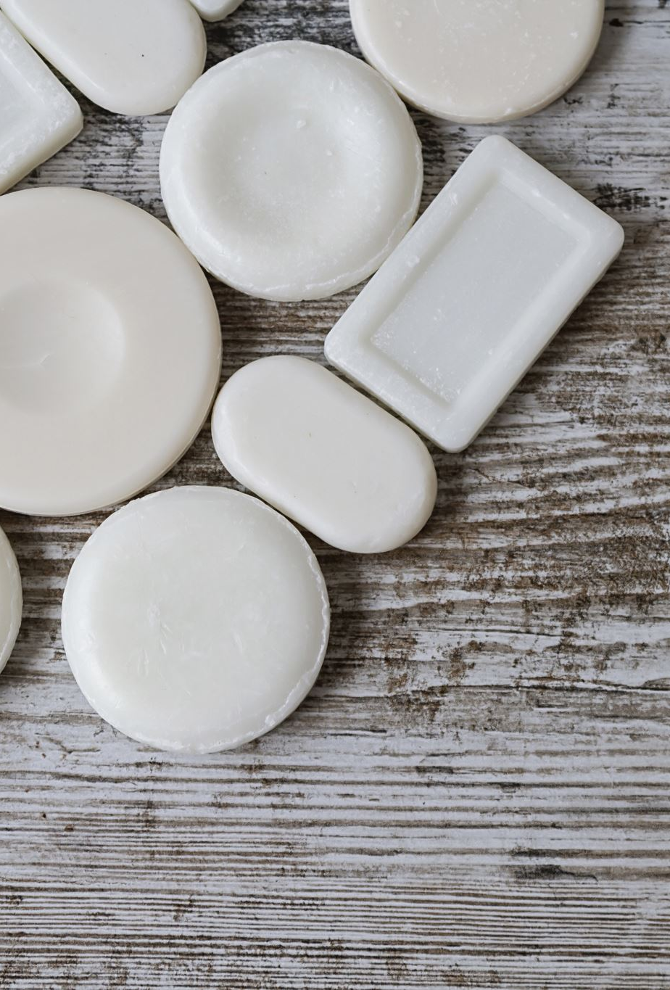
Soaps and Detergents
Chelating soaps, also known as chelating detergents, work to break down stubborn films and remove the residue of products such as scrubs, salts, and masks. The chelating agents in these soaps work in all types of water, are low Suding, and are specially formulated to work in areas with hard tap water. Hard tap water reduces the effectiveness of cleaners and disinfectants. If your area has hard water, ask your local distributor for soaps that are effective in hard water. This information will be stated on the product’s label.

Slide 60

QUESTIONS?

