Slide 1


Business Operations
Unit 13

Slide 2

We understand, this is a lot of work
But the most important obstacle to your business success is …….

Slide 3
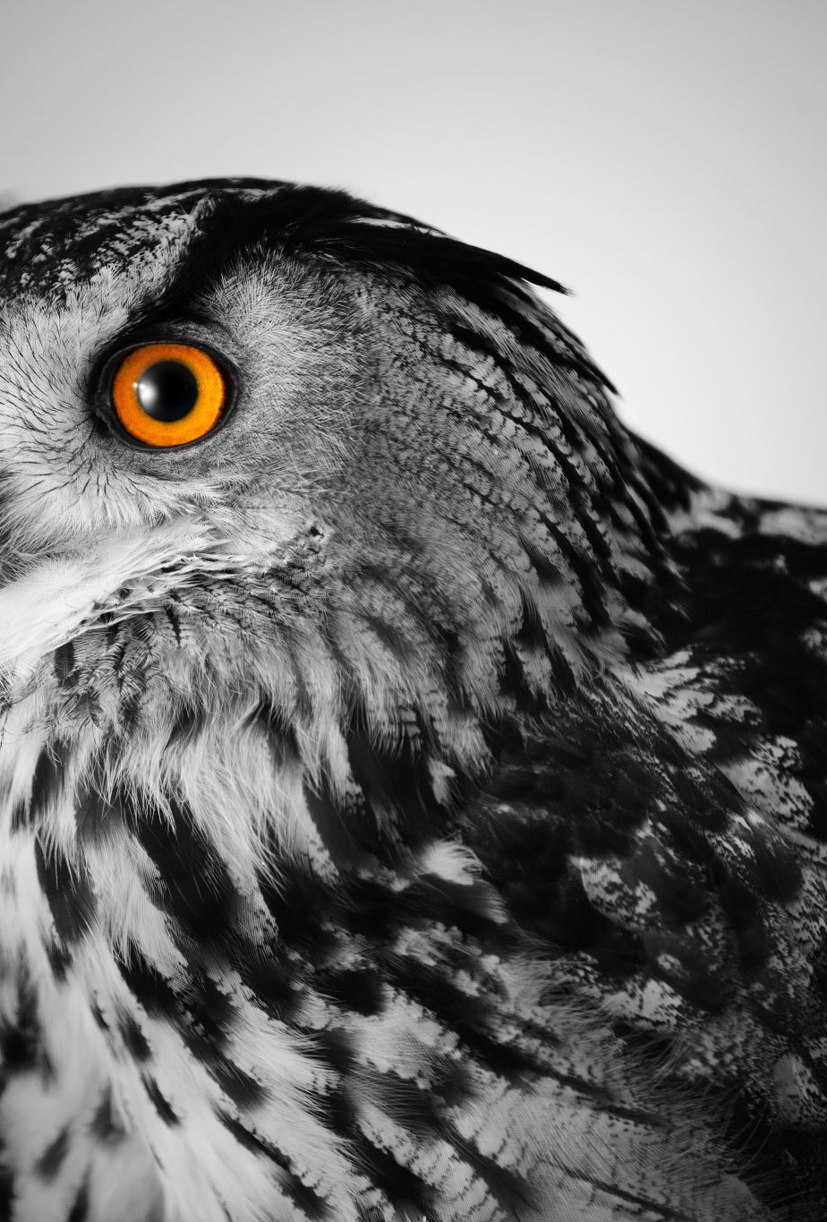
YOU?

Slide 4

Let’s see !
When thinking of opening a business there are a lot of anxieties and fears we might encounter
Financial fear
Fear of rejection
Fear of failure
Fear of the NO

Slide 5

Remember !
When making big decisions like being self employed, a lot of fear of the unknown can waken
But you are in control
By doing all the steps right you can dissect all this fears and rationalize them
Which brings us to the biggest one of all….the word NO!

Slide 6

Overcome the Fear of selling
Now we have established that in order to stay in business and remain open, you will need to market your products and be able to close the deals
Selling and closing the deals is not as hard as you think it would be

Slide 7

Overcoming the most common objections
“It’s just not a good time.”
Listen closely to determine if their response involves concrete timing issues or vague excuses. A way of overcoming this excuse is to ask, why is not a good time and what other priorities make this a bad timing
Once you have actively listen, then decide should the client go home with some samples and you can follow up later

Slide 8
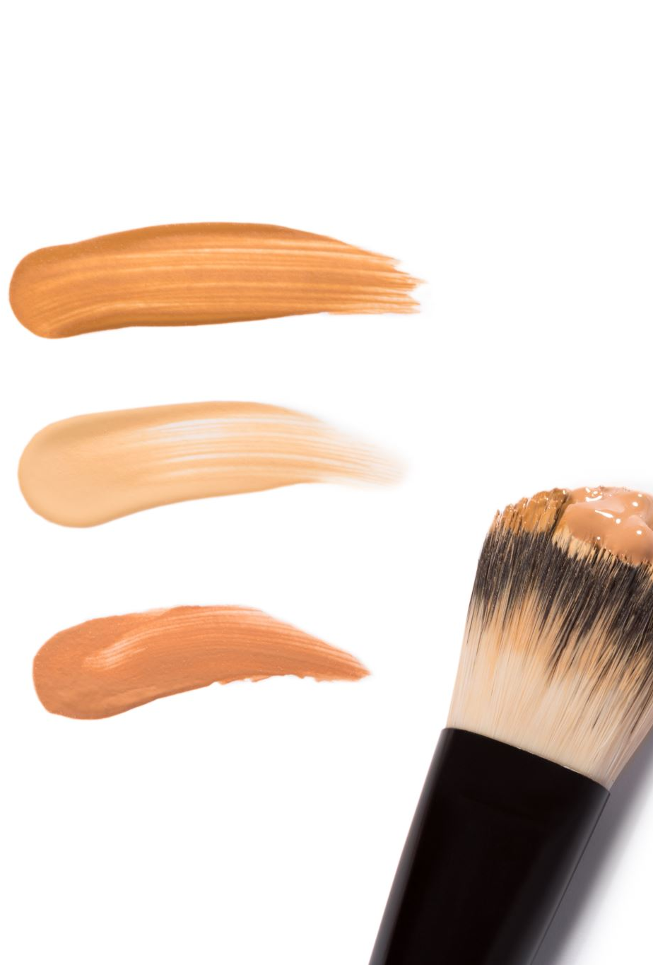
Lack of Budget
It’s too expensive
By providing value and painting a picture of where your solution will take them, they can be convinced that the reward is enough to justify the risk
For example, most clients spend more money at shoppers trying to find a good match for skin care, while if they buy your product, it will last them months and they will be much happier, this saving money on the long run

Slide 9

Lack of Trust
“I never heard of this company or this skin care”
This is the best opening door conversation and opportunity to show the benefits and features as of why your product is different

Slide 10
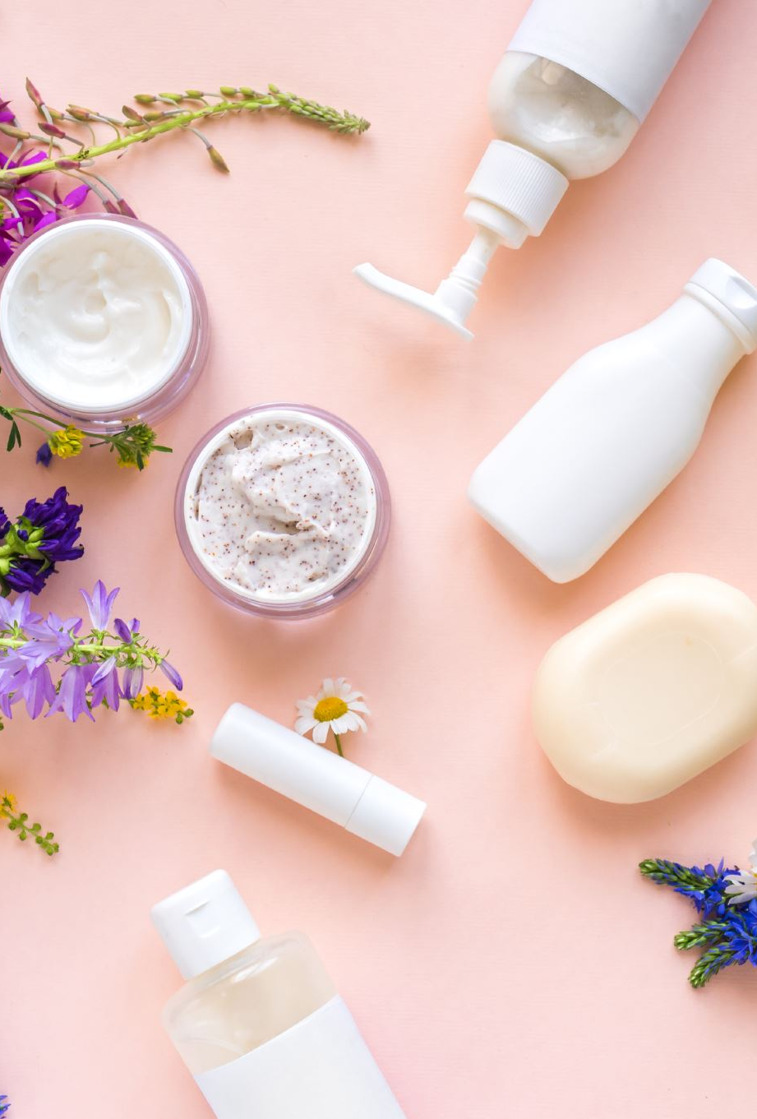
Lack of Need
“I do not need this, my grandmother used water and soap and she had beautiful skin”
The comeback would be?
“Well let’s image how much more beautiful would be under the right care” , “would you care to try it yourself and take some home?”

Slide 11
Group Discussion
Why do you think Objection handling important?
Divide your class in pairs
Play the role of objective customer and salesperson
Write down the objections and the responses
What have we learned ?

Slide 12

QUESTIONS?

