Slide 1
MRAD 204:
Radiographic Technique 1
Introduction to Adaptive Radiography

Slide 2
Affiliated Readings
Module Reading
Bontrager
Pgs: 34→37, 568 & 574→575
Pgs: 189→190
Pg: 291

Slide 3
Overview
Definition
When it should be considered
Guidelines
Examples

Slide 4
Adaptive - Definition
Changing routine imaging to accommodate patient condition
Often applies different CR angles and IR placement

Slide 5
When it should be considered
When a patient is not:
Average
In ideal condition
If a patient cannot maintain/move into a routine imaging position:
Mobility issues
Communication
Injury

Slide 6
Guidelines
Try to take two projections 90° from each other
  AP & cross-table lateral projections
Minimize further injury or discomfort to the patient
  Minimize palpation
  Use accessory equipment
  Do not remove patient accessory equipment (ex. catheters)
Try to maintain CR-Part-IR alignment
  Exceptions may include:
  Casts, Fractures, Foreign objects, surgical devices (such as traction)

Slide 7
Examples
AP Shoulder imaging:
  *Completed when the patient cannot sit/stand erect
  Supine AP Shoulder
  AP Scapular Y
  Inferosuperior axial shoulder
Humerus imaging:
  *Completed when the patient cannot sit/stand erect
  Supine AP Humerus
  X-table lateral for the distal portion of the humerus
  Transthoracic lateral for the proximal portion of the humerus

Slide 8
Examples
Hip imaging:
  *Completed when the patient cannot move lower limb(s)
  Inferosuperior Axiolateral Hip (Danelius-Miller Method)
  Modified Axiolateral (Clements-Nakayama Method)
PA Thumb projection:
  Alternate to AP thumb

Slide 9
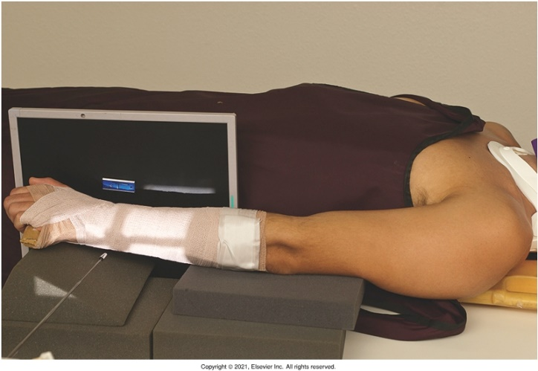
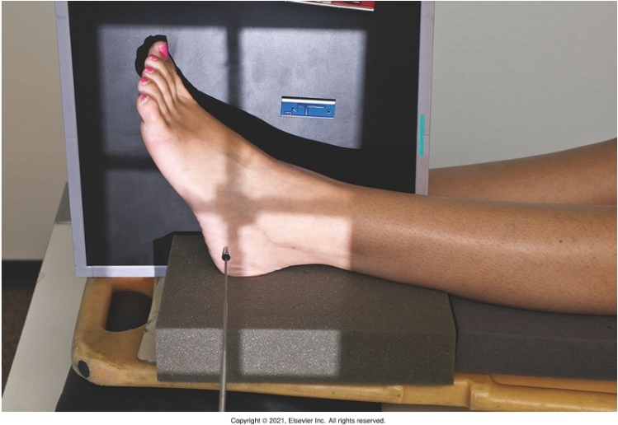
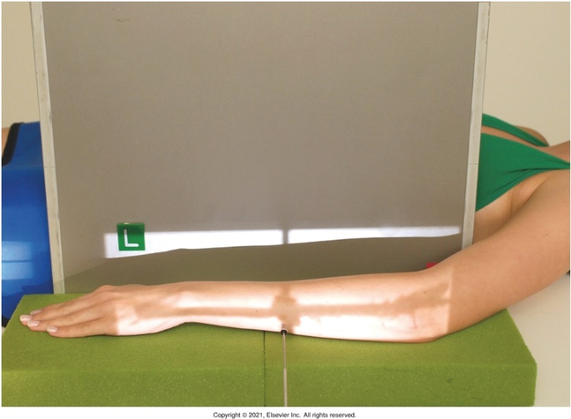
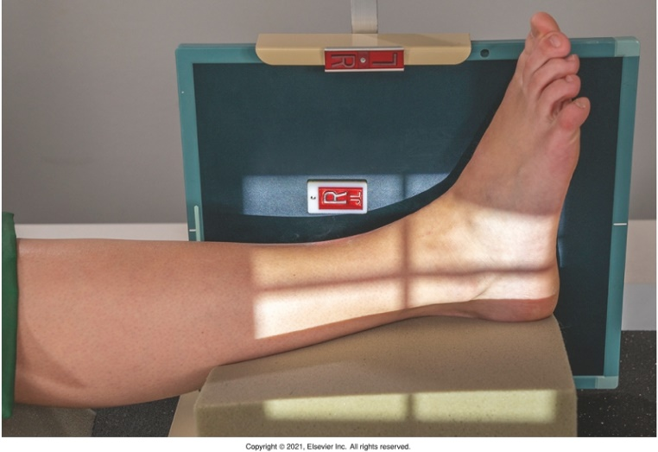
Examples
X-table lateral projections (horizontal beam)
(Mediolateral) Wrist
Bontrager pg. 574 Fig. 15.24
Bontrager pg. 568 Fig. 15.1
(Lateromedial) Foot
(Mediolateral) Forearm
Bontrager pg. 587 Fig. 15.62
Bontrager pg. 581 Fig. 15.37
(Lateromedial) Ankle

Slide 10
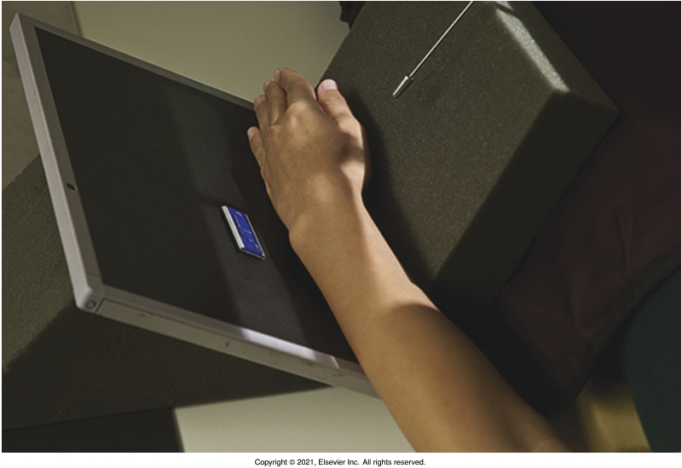
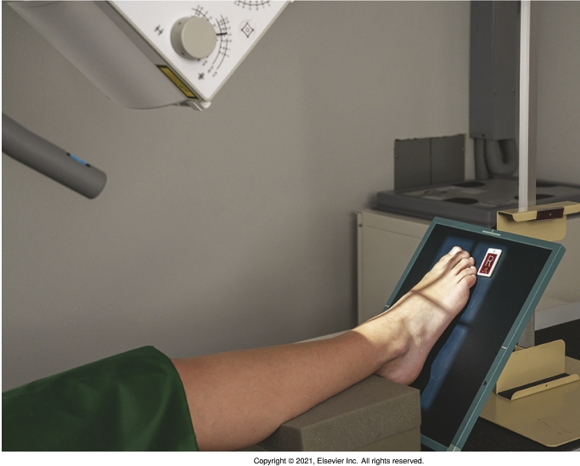
Examples
Adjusting CR & IR to obtain “trauma” projections
  When the tube and IR are adjusted to maintain their alignment, radiographs should appear as routine imaging radiographs would display
Note: tube is angled perpendicular to IR
Note: tube angle matched angle of IR, then a 10⁰ cephalad angle was added
AP Foot
Bontrager pg. 582 Fig. 15.42
(Lateromedial) Wrist
Bontrager pg. 587 Fig. 15.61

Slide 11
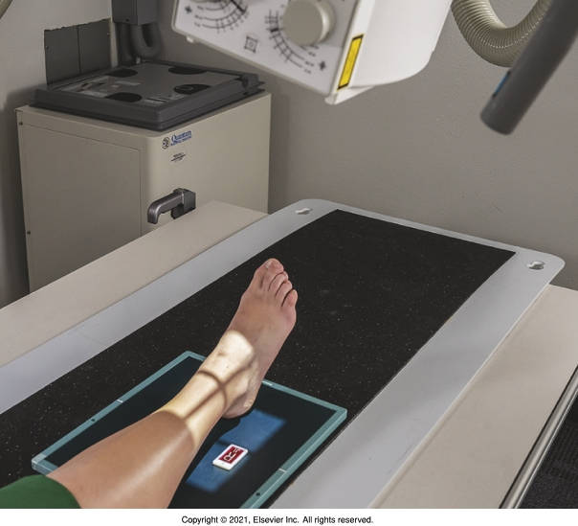
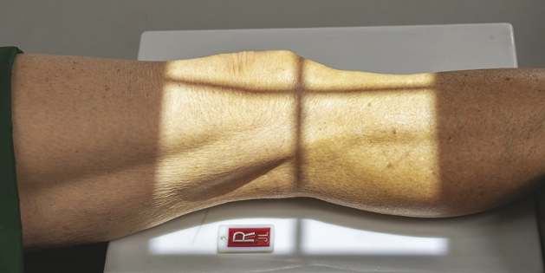
Examples
Note: tube is angled 15-20⁰ towards the medial side (in lieu of rotating the patients ankle 15-20⁰ medially)
When Part & CR alignment cannot be maintained
  i.e. when unable to move a patient into a routine position
Note: tube is angled 45⁰ towards the medial side (in lieu of rotating the patients leg 45⁰ medially)
Bontrager pg. 588 Fig. 15.65
Medial Oblique Knee
Bontrager pg. 587 Fig. 15.61
Mortise Ankle

