Slide 1


Advanced Facial Devices

Slide 2
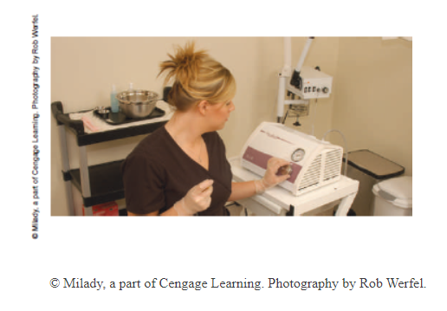
OUR JOURNEY TODAY
As the esthetician proceeds to using more sophisticated devices, he or she needs to become even more astute about treatment benefits for clients versus documented risks and hazards.
Each device presents many decision points in the research, evaluation, and purchasing process.
The media—print, Internet, and television—are flooded with advertisements of procedures and devices using false or inappropriate guarantees.
You, as the esthetician, must intervene as your client’s advocate and recommend only procedures and products that have shown clinical benefits and efficacy.
This Chapter describes the different types of devices and offers some sample protocols for using each.

Slide 3
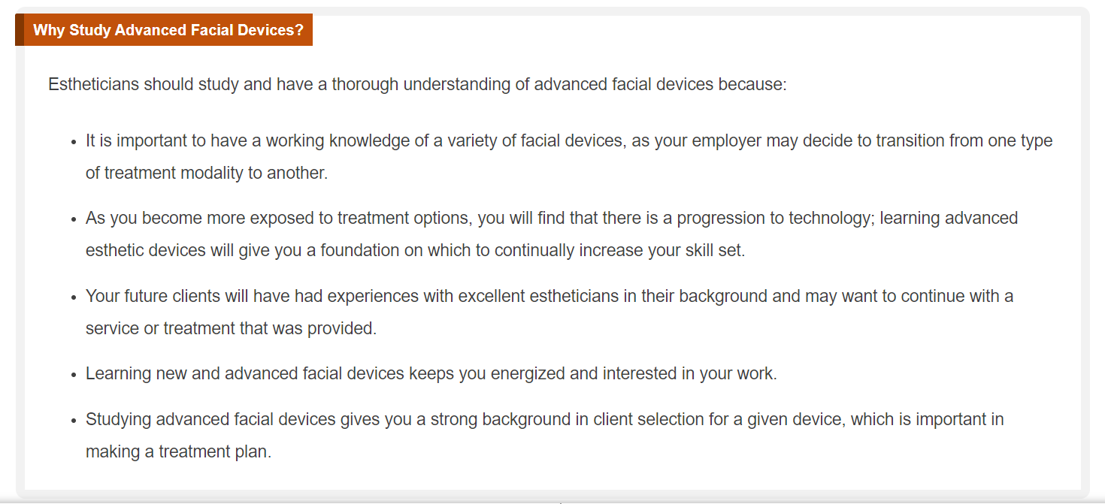

Slide 4
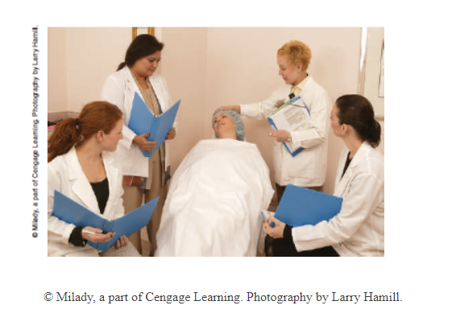
Education
Propper Training on device usage is of utmost importance
Estheticians should always know how to safely operate a device and how to maintain and clean the device
Proper training result in a certificate you can use to let your clients know you have been properly educated on this devices
Obviously, the more sophisticated the piece of equipment, the more extensive the training should be
Advanced training will offer you the theory behind the different types of equipment, and you will need the hands on supervised practical training in order to be job ready

Slide 5
Skin Analysis Devices
Numerous devices can enhance the skin analysis process and assist with client education.
Some allow the client to view his or her skin, showing problem areas and levels of pigmentation.
Other devices incorporate a camera that projects a client’s image onto a computer screen, showing problems, concerns, and skin disorders.
At school you will start with the magnifying lamp, and a woods lamp

Slide 6
The Consultation
The primary objectives of the consultation are education and the determination of candidacy.
After you have determined that the client is a good candidate, give him or her a brief, basic overview, including the variables affecting treatment.
It is important that the client understand the impact on the number of treatments needed, In particular, make sure the client understands what to expect and costs
Discuss post-treatment considerations and the fact that there may be increased discomfort if the procedure is performed just before or during menstruation.
Inform the client of the risks of hyperpigmentation for a particular skin type and in relation to the device being used.
Clients may have questions about information that they have researched on the Internet or read about in magazines. Your role is to debunk the inaccurate or misleading information.

Slide 7

An Exposure Incident: Contact with Blood or Body Fluid
You should never perform a service on any client who comes in with an open wound, a rash, or an abrasion!!

Slide 8
Contraindications
Couperouse Skin
Varicose Veins
Cancer patients
Lupus or any autoimmune skin disorders like eczema or psoriasis
Open bleeding cuts and wounds
Accutane or intra oral photosensitizing medications until cleared by a doctor
After Chemical peels
After waxing
After any deep tissue invading procedure
Pregnancy
Keloid Scaring
Skin Cancer
Pacemakers
People with epilepsy
People sensitive to light
Clients who suffer severe Migraines
Braces ( avoid the teeth area )
Metal implants on the face
Over the Thyroid gland
Over Eyeballs
Sores
Cold Sores
Infectious skin conditions

Slide 9

QUESTIONS?

