Slide 1


Medical Esthetics
Physiology and Histology of the Skin

Slide 2
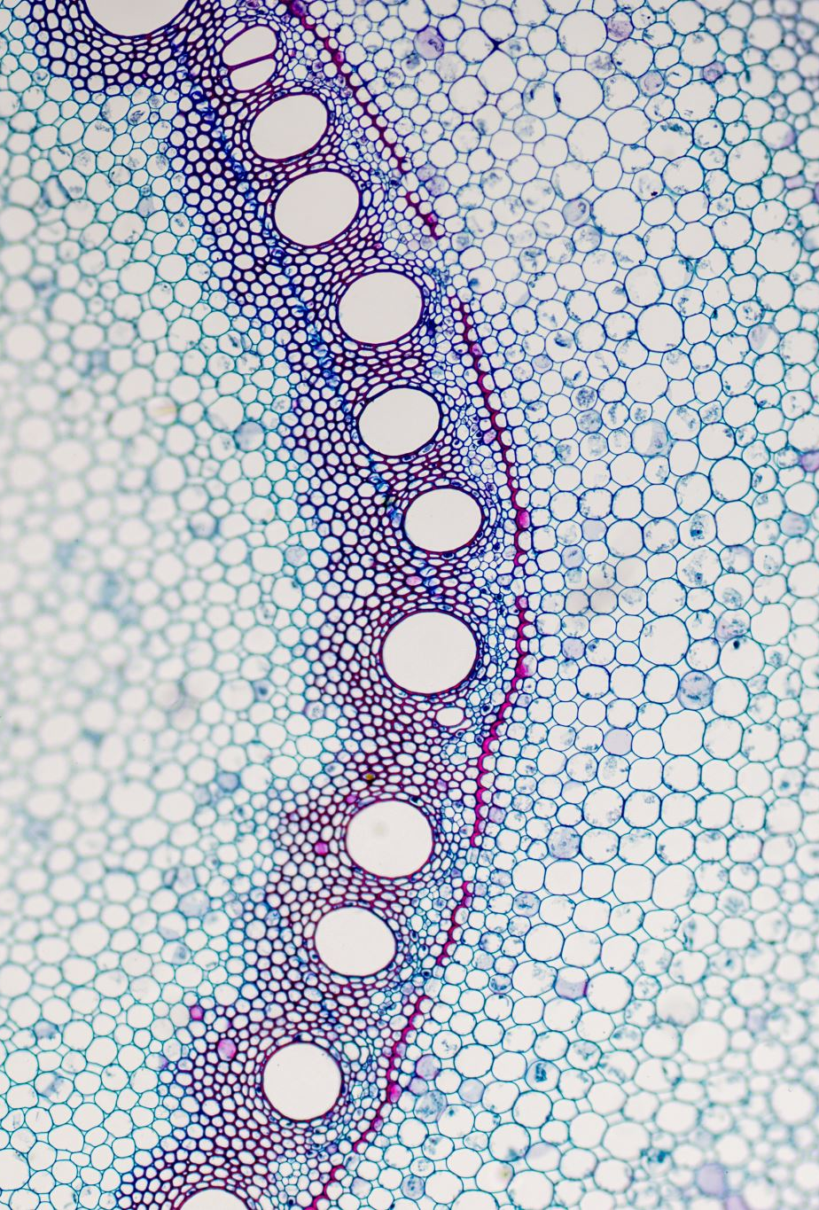
OUR JOURNEY TODAY
Skin physiology and histology involves the study of the structure and composition of the skin tissue.
Estheticians have an opportunity to study a most fascinating science. Skin histology and physiology involves the study of the anatomy, layers, and functions of the skin.
These are the foundational sciences estheticians need to have a solid grasp of before caring for the skin.
Estheticians who specialize in the health and beauty of skin are sometimes referred to as technicians, skin therapists, or specialists.
There is much more to being an esthetician than simply performing facials and selling products

Slide 3
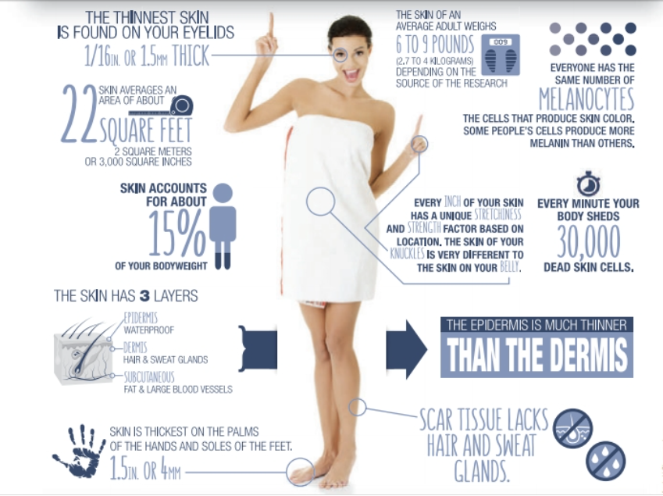

Slide 4
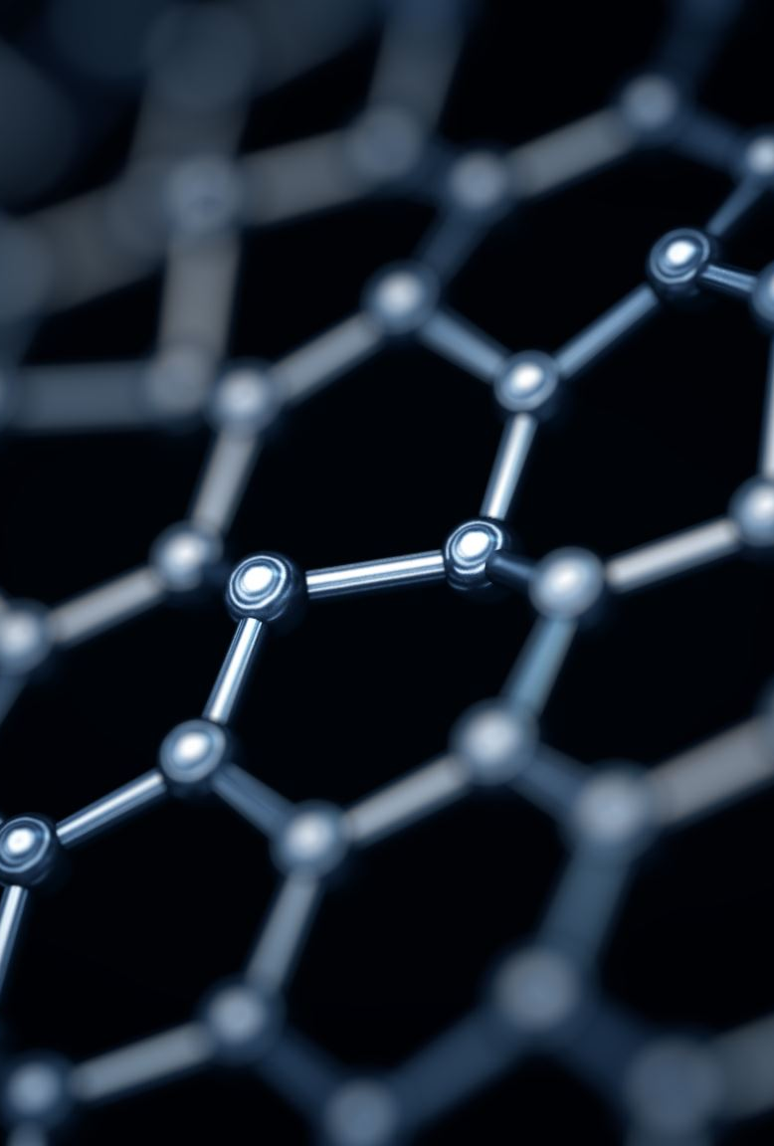
Why is important
How other body systems are integrally linked with the integumentary system are being revealed as researchers look for new ways to treat chronic diseases and disorders, work on anti-aging efforts, and battle cancer. Estheticians must commit to being lifelong learners. Clients value an esthetician’s comprehensive understanding of the skin in general
You can make personalized treatment recommendations and prescribe a home care regimen that will help keep the skin healthy and vibrant. By educating clients, estheticians are sharing their knowl-edge and expertise. An esthetician’s primary focus is on preserving, protecting, and nourishing the skin.

Slide 5

Estheticians should study and have a thorough understanding of the physiology and histology of the skin because
The complexity of the skin is astonishing. The layers, components, and functions all work with other body systems to protect and regulate the skin and other parts of the body.
The study of skin physiology and histology includes learning about the aging process as well as interpreting the effects of ultraviolet (UV) damage, hormonal influences, and nutrition on skin health. Each of these factors affect the skin’s health and appearance.
There is much to study about the body’s largest organ and how to best maintain its optimum health and with a deeper understanding, the skin therapist can confidently treat this sophisticated system.

Slide 6
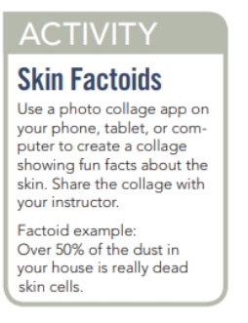

Slide 7
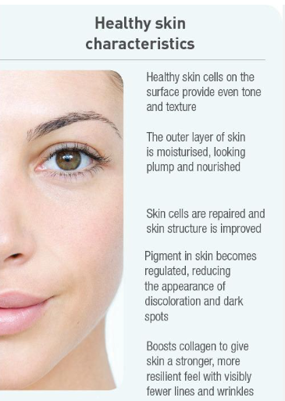
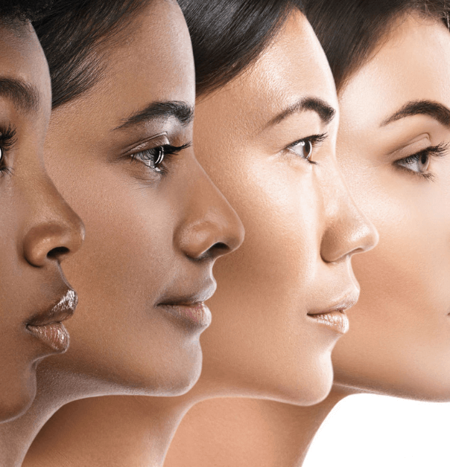

Slide 8
The Integumentary System
Is the largest organ in the body.
It is a strong barrier designed to protect us from the outside elements.
Skin layers, nerves, cellular functions, hair follicles, and glands all work together harmoniously to regulate temperature and protect the body.
Hormones, growth factors, and other biochemicals control the skin’s intricate functions
Our skin is an industrious manufacturer, with miles (kilometers) of blood vessels, millions of sweat glands, and an array of nerves within a network of fibers. Appendages of the skin include hair, nails, sweat glands, and oil glands. Healthy skin is slightly moist, soft, smooth, and somewhat acidic.

Slide 9
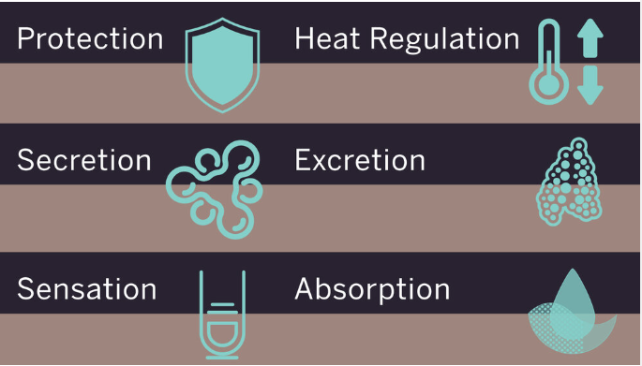

Functions

Slide 10
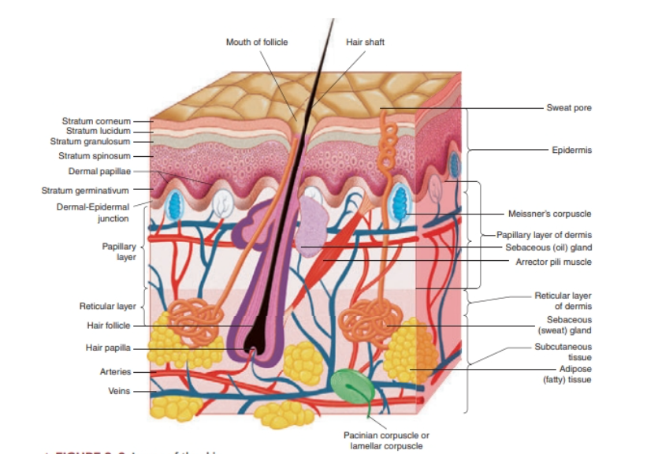

Slide 11
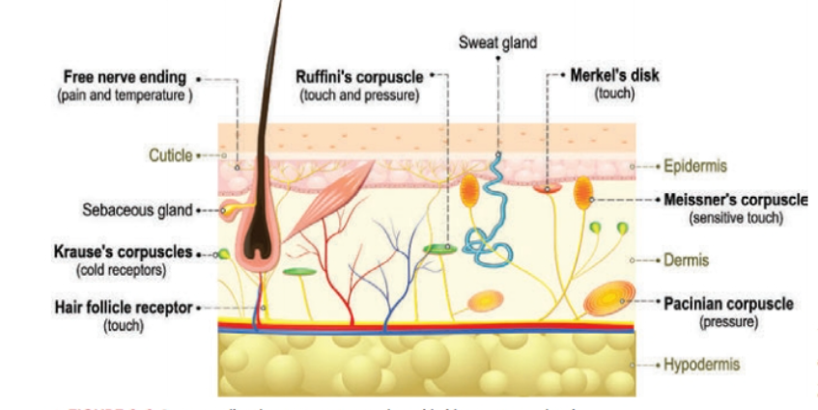
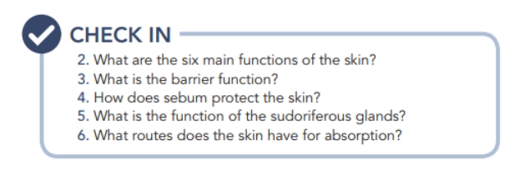

Slide 12
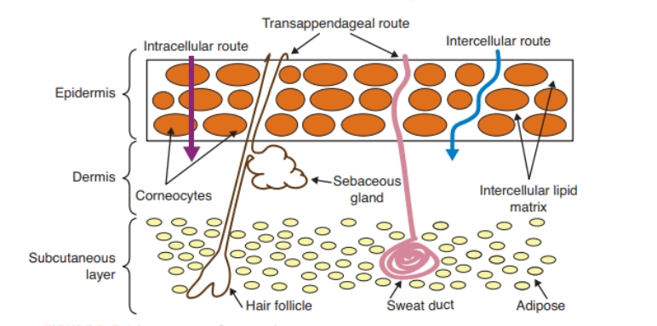
Primary routes of penetration.

Slide 13

QUESTIONS?

