Slide 1
CT Theory
Neck Anatomy

Slide 2
CT Imaging of the Neck
Module Objectives
Review anatomy of the neck
Label anatomical structures on a CT image
Scanning protocols including:
  Positioning
  Indications & Contraindications
  Exposure Factors
Most common CT Neck exams done

Slide 3
CT Imaging of the Neck
Review Anatomy
Kelley textbook goes into a lot of detail!
Focus on:
  Pharynx
  Larynx
  Esophagus & Trachea
  Glands
  Vasculature
Complete anatomy ID exercises on D2L Brightspace

Slide 4
CT Imaging of the Neck
Pharynx
Opening for the respiratory and digestive systems
Extends from the base of the skull and ends as the continuation of the esophagus
3 segments:
  Nasopharynx
  Oropharynx
  Laryngopharynx

Slide 5
CT Imaging of the Neck
Nasopharynx:
  Contains the nasal cavities
  Posterior border is the
  Inferior border is the
  Superior border is the pharyngeal tonsils (adenoids)
  Lateral wall contains the auditory tube.

Slide 6
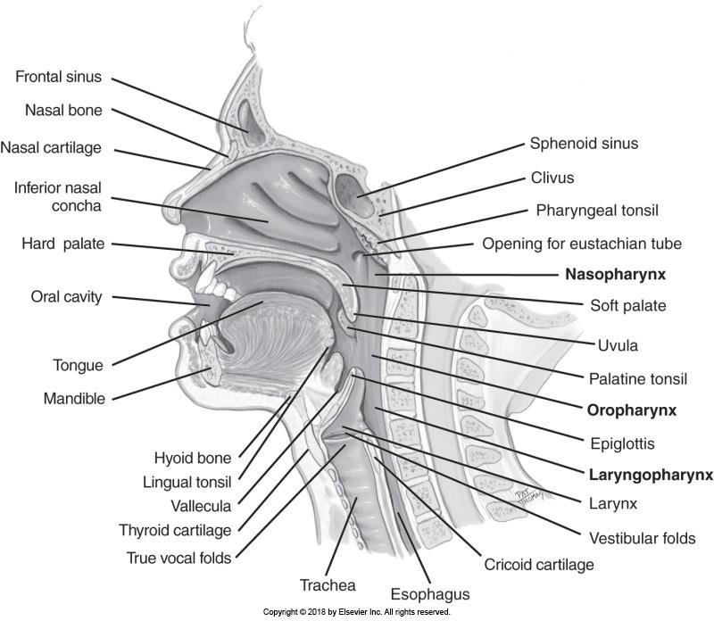
CT Imaging of the Neck

Slide 7
CT Imaging of the Neck
Oropharynx:
  Extends from the soft palate to the level of the .
  Separated from the larynx by the epiglottis
  Contains the palatine tonsils and the lingual tonsils

Slide 8
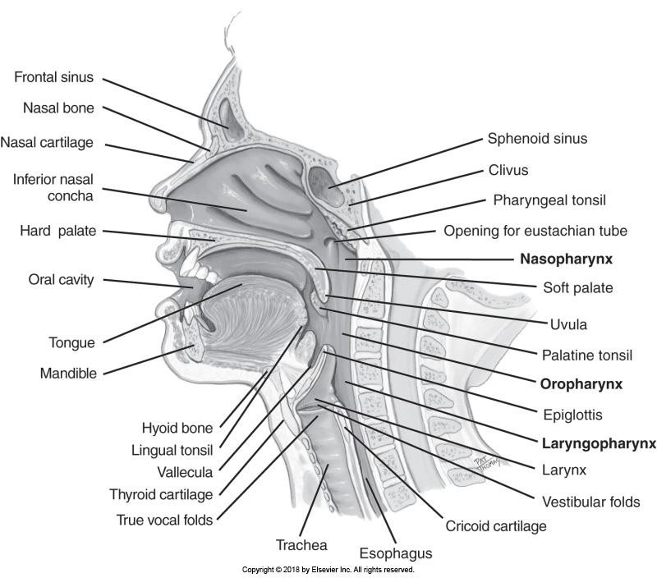
CT Imaging of the Neck

Slide 9
CT Imaging of the Neck
Laryngopharynx
  Continues from the oropharynx
  Extends from the level of the hyoid bone to the entrance to the larynx & esophagus.
  The are depressions within the lateral walls

Slide 10
CT Imaging of the Neck

Slide 11
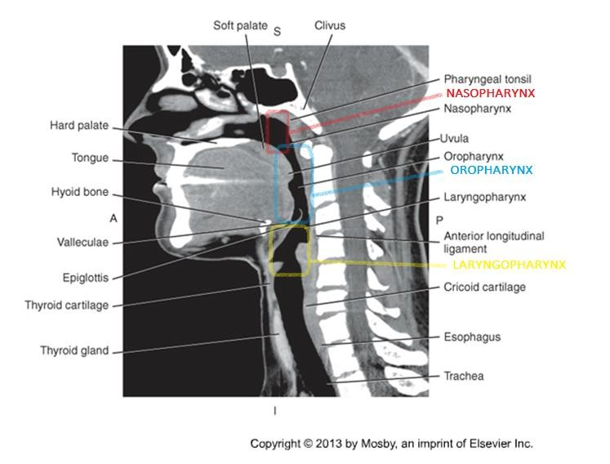
CT Imaging of the Neck

Slide 12
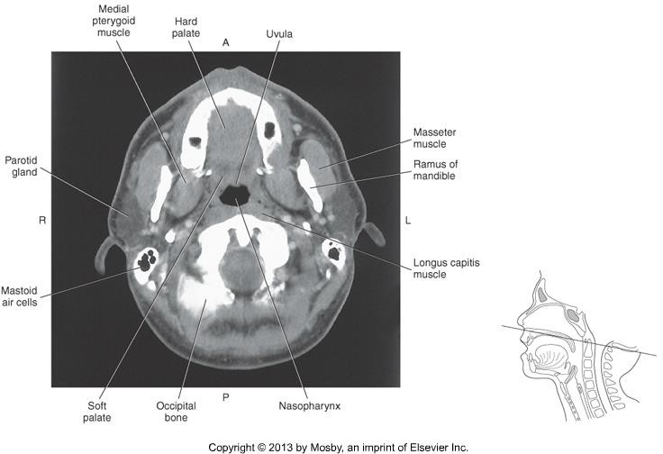
CT Imaging of the Neck
Use landmarks to determine what segment is demonstrated on axial slices:

Slide 13
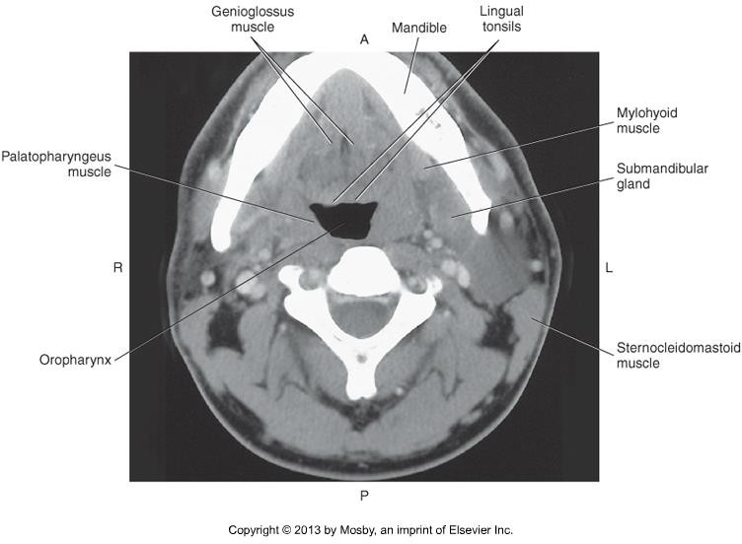
CT Imaging of the Neck

Slide 14
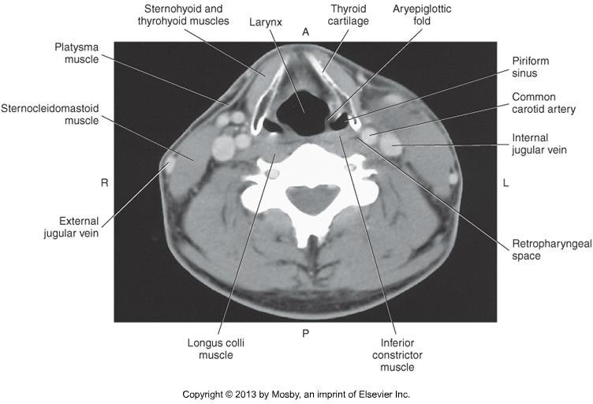
CT Imaging of the Neck

Slide 15
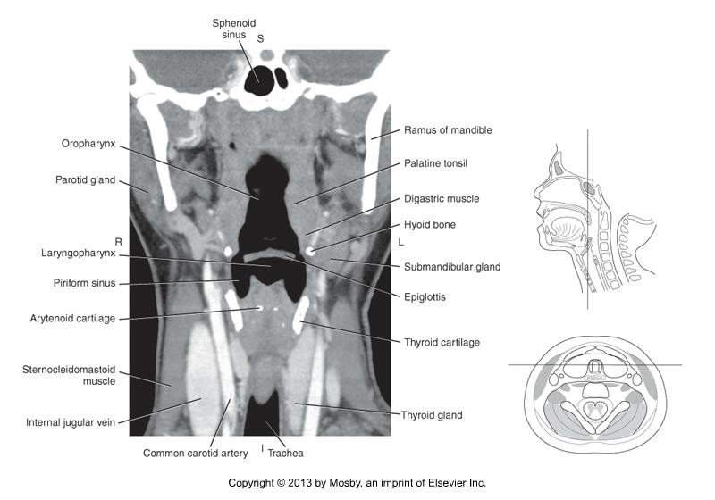
CT Imaging of the Neck

Slide 16
CT Imaging of the Neck
Larynx
  Bony structure that surrounds and protects the vocal chords (“voice box”)
  Extends from laryngopharynx – trachea.
  Consists of 9 cartilage rings
  Extends from .
  Largest and most superior ring is the thyroid cartilage.

Slide 17
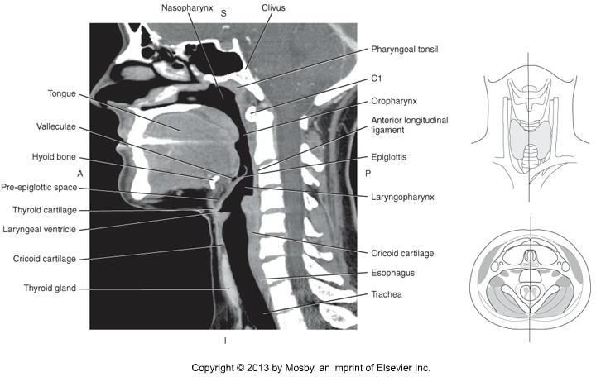
CT Imaging of the Neck

Slide 18
CT Imaging of the Neck
Esophagus
  Extends from the laryngopharynx to the cardiac orifice of the stomach.
  Begins posterior to the cricoid cartilage
  to the trachea
  Enters abdominal cavity through the esophageal hiatus.

Slide 19
CT Imaging of the Neck
Trachea
  Extends from the larynx to the lungs.
  Lies to the esophagus
  Protected by 16-20 c-shaped pieces of cartilage which close around the trachea posteriorly by elastic connective tissue.
  Bifurcation into the right and left mainstem bronchi at the level of
.

Slide 20
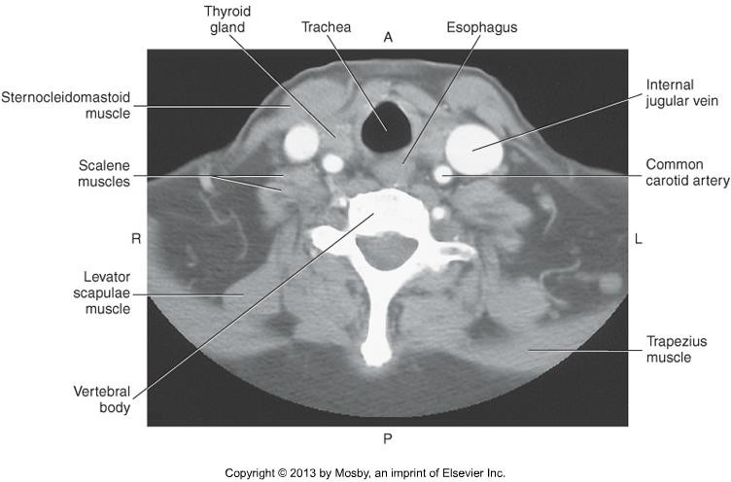
CT Imaging of the Neck

Slide 21
CT Imaging of the Neck
Salivary Glands
  Produce and empty saliva into the oral cavity via ducts
  Begin the process of digestion
  3 large, paired salivary glands:
    Parotid
    Submandibular
    Sublingual

Slide 22
CT Imaging of the Neck
Parotid glands
  Sits between the auricle and the ramus of the mandible
  Extend from the level of the EAM to the gonion
  Differs slightly in appearance from other salivary glands due to:

Slide 23
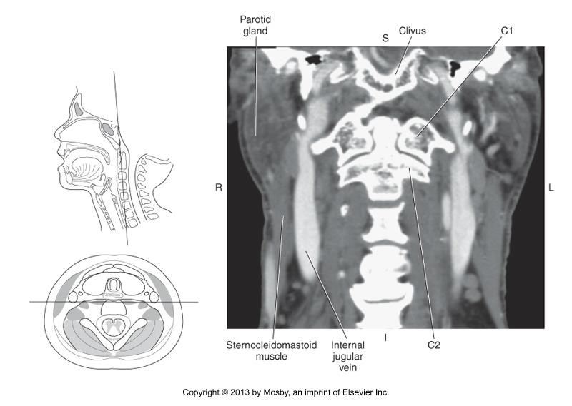
CT Imaging of the Neck

Slide 24
CT Imaging of the Neck
Submandibular glands
  Border the posterior half of the mandible
  Extend from the gonion to the level of the hyoid bone.

Slide 25
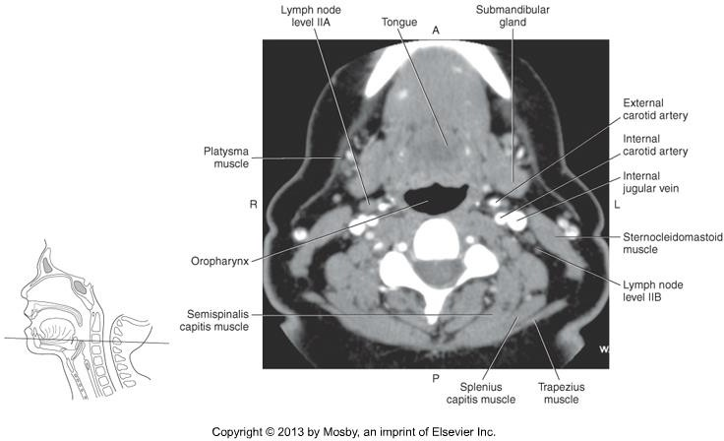
CT Imaging of the Neck

Slide 26
CT Imaging of the Neck
Sublingual gland
  Smallest
  Sit under the tongue on the floor of the mouth.

Slide 27
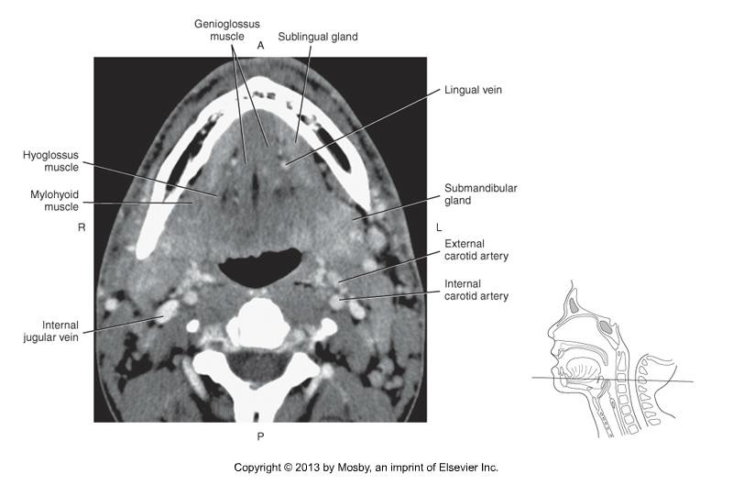
CT Imaging of the Neck

Slide 28
CT Imaging of the Neck
Thyroid Gland
  Located at the level of the cricoid cartilage
  Two lobes, joined anterior by the .
  On axial slices, appears wedge-shaped structure that wraps itself around the trachea.
  Parathyroid glands (4) are located on the posterior surface of the thyroid
lobes.

Slide 29
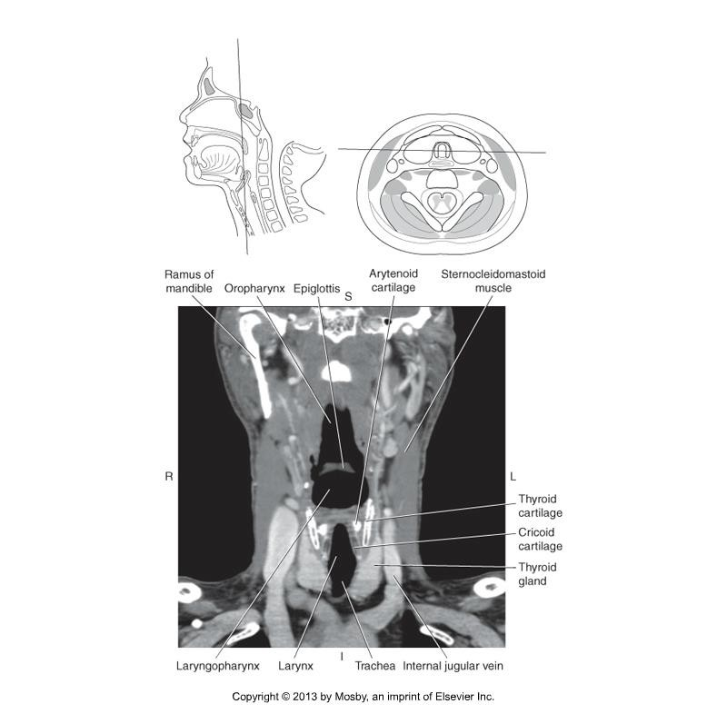
CT Imaging of the Neck

Slide 30
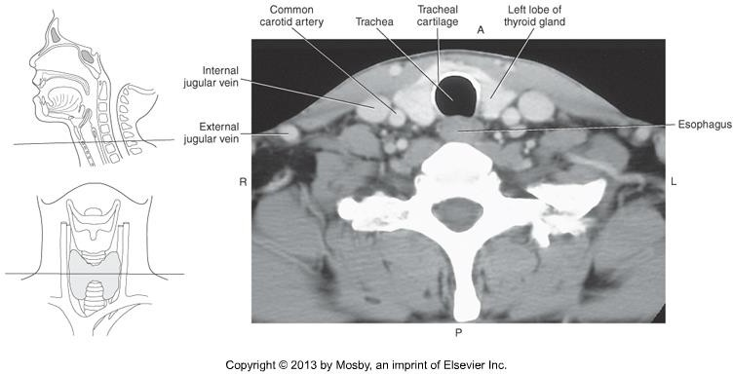
CT Imaging of the Neck

Slide 31
CT Imaging of the Neck
Carotid Arteries
Right Common Carotid artery arises from the brachiocephalic artery posterior to the SC joint.
Left Common Carotid artery arises directly from the aortic arch.
Common carotid arteries bifurcate into the internal and external carotid arteries at the level of: _ _ _ _ _ _.
Common carotid arteries lie medial to the jugular veins

Slide 32
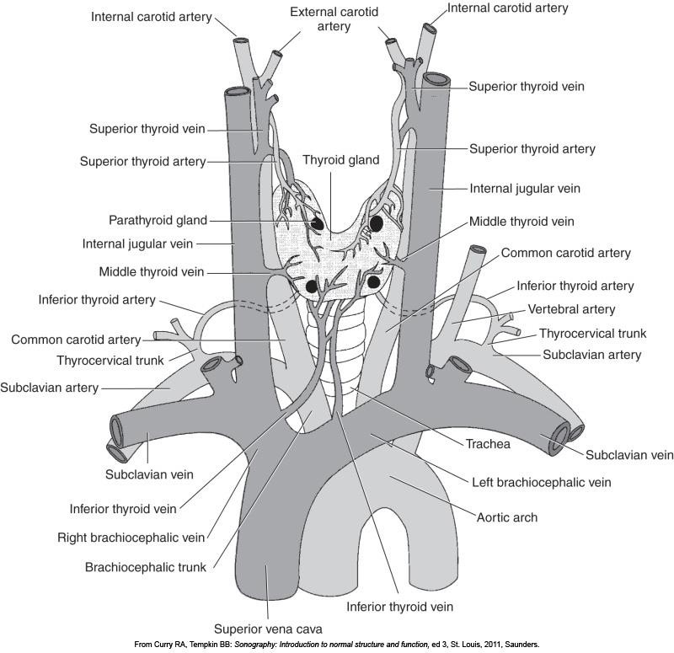
CT Imaging of the Neck

Slide 33
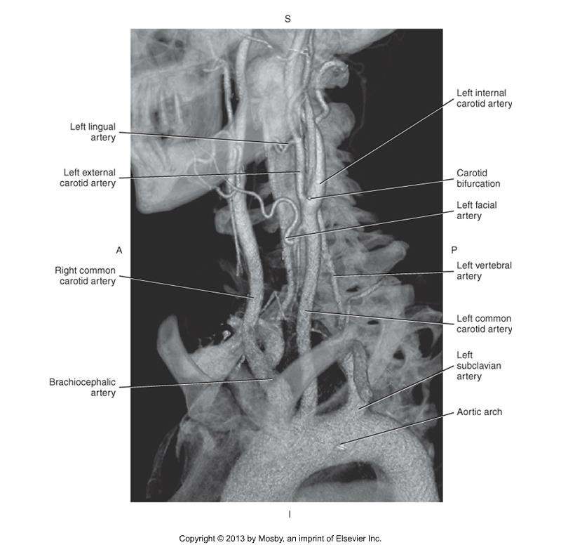
CT Imaging of the Neck

Slide 34
CT Imaging of the Neck
Carotid Arteries
Internal Carotid artery ascends the neck and enters the base of the skull through the carotid canal of the temporal bone.
External Carotid artery ascends through the neck, through the parotid gland, to the level of the TMJ.

Slide 35
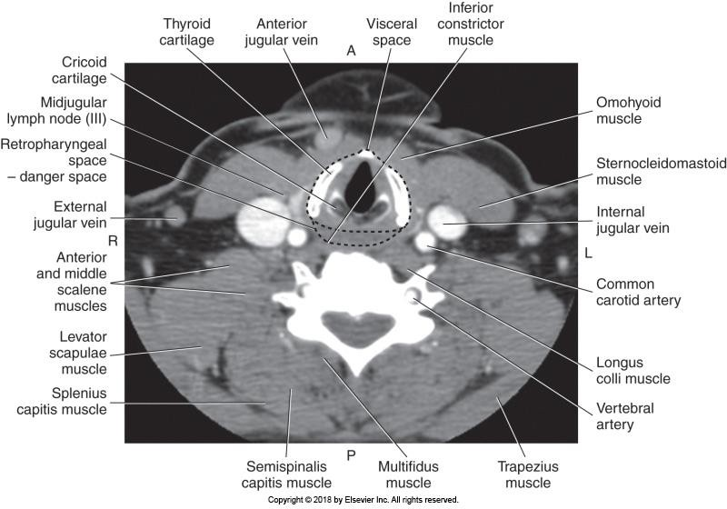
CT Imaging of the Neck

Slide 36
CT Imaging of the Neck
Carotid Arteries
The external carotid artery changes position in relation to the internal carotid artery as it ascends the neck.
  At the lower level the external carotid artery is anterior and medial to the
internal carotid artery
  At the higher level the external carotid artery is anterior and lateral to the internal carotid artery.

Slide 37
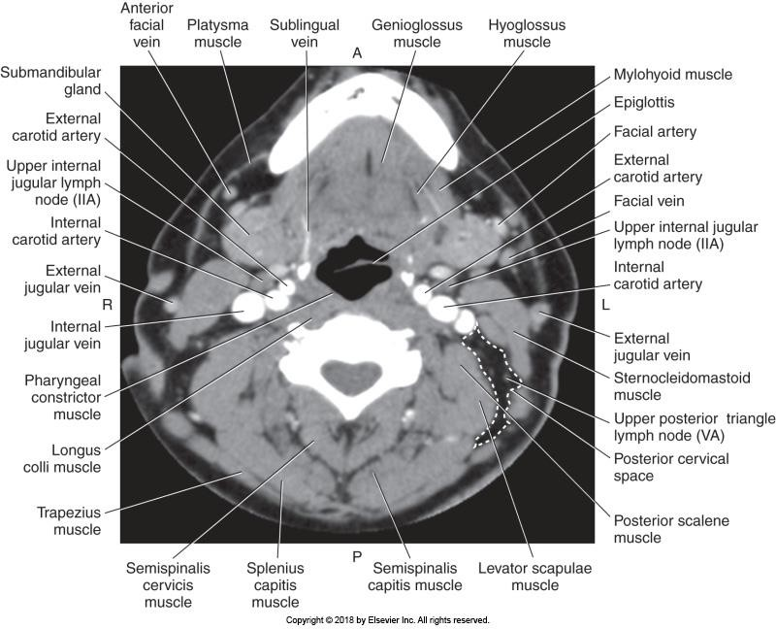
CT Imaging of the Neck

Slide 38
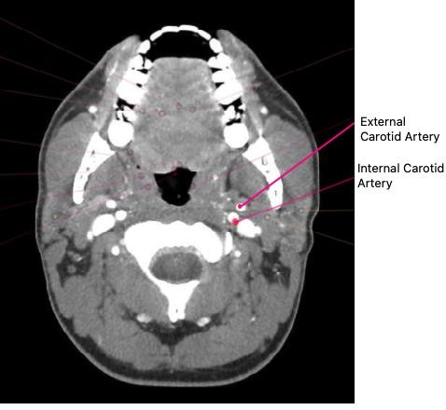
CT Imaging of the Neck

Slide 39
CT Imaging of the Neck
Vertebral Arteries
Begin as a branch of the subclavian artery.
Ascend through the transverse foramina of C6 – C1.
Enter the base of the skull through the foramen magnum.
Merge to form the _ _ _ _.

Slide 40
CT Imaging of the Neck

Slide 41
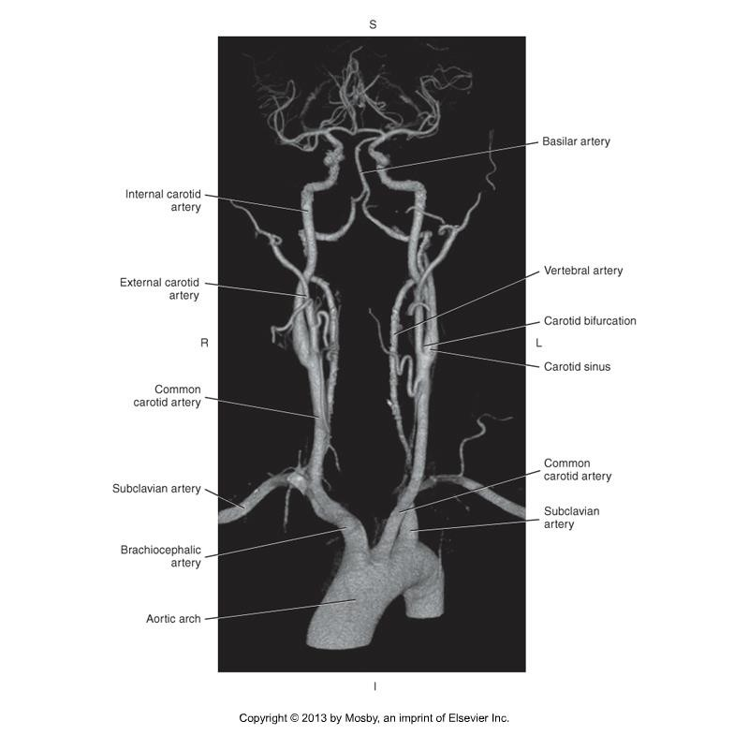

CT Imaging of the Neck

Slide 42
CT Imaging of the Neck
Jugular Veins
Internal Jugular veins are typically the largest vessel in the neck.
Extend from the posterior cranial fossa to unite with the
to form the brachiocephalic vein.
Typically sit lateral to the common carotid artery and posterior to the internal carotid artery.

Slide 43
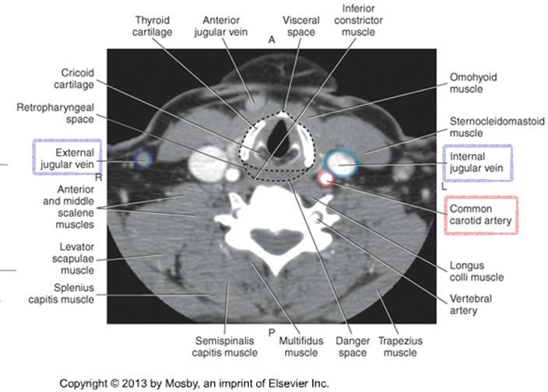
CT Imaging of the Neck

Slide 44
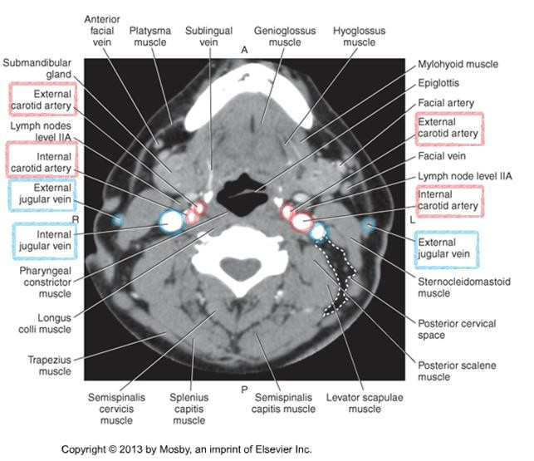
CT Imaging of the Neck

Slide 45
CT Imaging of the Neck
Jugular Veins
External Jugular veins begin near the angle of the mandible to empty into the subclavian vein.

Slide 46
CT Imaging of the Neck

Slide 47
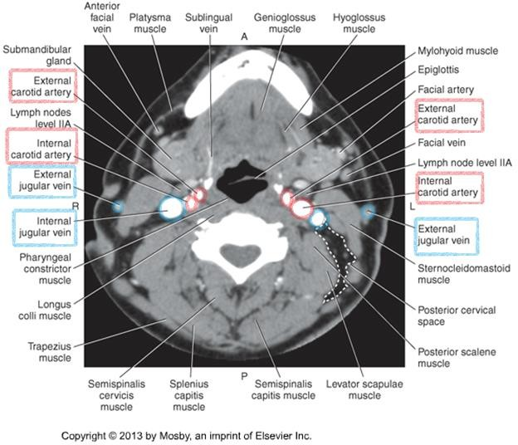
CT Imaging of the Neck

Slide 48
CT Imaging of the Neck
Vertebral Veins
Course through the transverse foramina of the cervical vertebrae.
Drain into the brachiocephalic vein.

Slide 49
CT Imaging of the Neck

Slide 50
CT Imaging of the Neck
TIPS!
  Common carotid arteries ascend through the neck and bifurcate at the level of C3-C4.
  At the level of bifurcation, the external carotid artery is anterior and medial to
the internal carotid artery.
  Above the level of bifurcation, this relationship changes. The external carotid artery becomes anterior and lateral to the internal carotid artery.
  Kelley, 4th edition, page 302

Slide 51
CT Imaging of the Neck
TIPS!
  Vertebral arteries are more posterior, and ascend through the transverse foramina of the C-spine
  Veins are generally bigger, fatter, “less round” than arteries.
  Internal jugular veins are lateral to the internal carotid arteries.
  External jugular vein is very external!

Slide 52
CT Imaging of the Neck
Summary
Review anatomy of the neck, and its vasculature.
The lymph nodes, facial planes and spaces, and muscles will not be tested on.
Use knowledge of relational anatomy to find structures when given a single CT image.
Next up – Activity & scanning procedures of the neck!

