Slide 1


Nonsurgical Body Contouring of Fat

Slide 2
Summary and Key Features
Cellulite is best considered a hormonally based structural phenomenon of adipocytes and fibrous septae
Excess fat is an overabundance of normal adipocytes.
• The treatment options for excess fat and cellulite are different
• Noninvasive body contouring is a rapidly expanding cosmetic field
• Topical agents, such as retinoids and methylxanthines, have theoretical benefits on the appearance of fat and cellulite, although objective clinical improvements are limited.
• Mesotherapy, and injection lipolysis
• Physical massage
• Radiofrequency devices
• Focused ultrasound
• Several laser devices using near-infrared
• Adipocyte targeting laser
• Cryolipolysis

Slide 3
Introduction
Although liposuction remains the true gold standard for treating excess fat, it is an invasive procedure with associated discomfort, bruising, and downtime. The last decade has witnessed the advent of many new technologies that have been developed to treat excess adipose tissue through noninvasive techniques. These noninvasive devices use a multitude of techniques to improve the appearance of excess adipose tissue, including a reduction in the overall volume of fat and improvement in the appearance of cellulite.

Slide 4
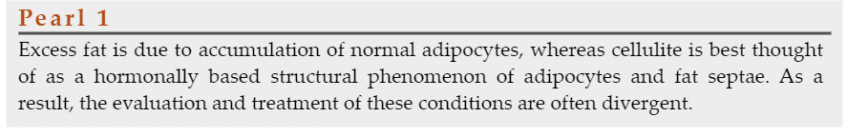
Fat vs. Cellulite

Slide 5
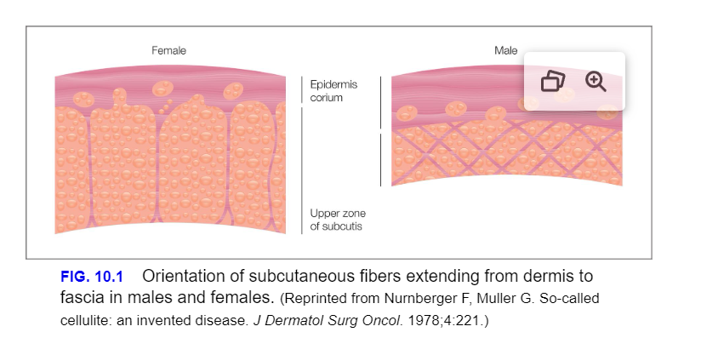

Slide 6
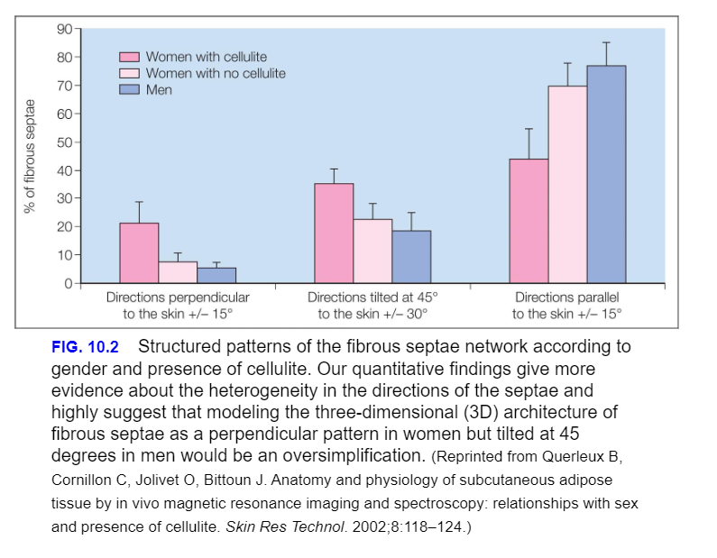

Slide 7
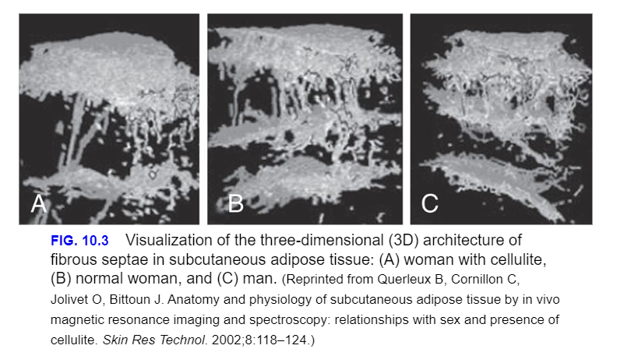

Slide 8
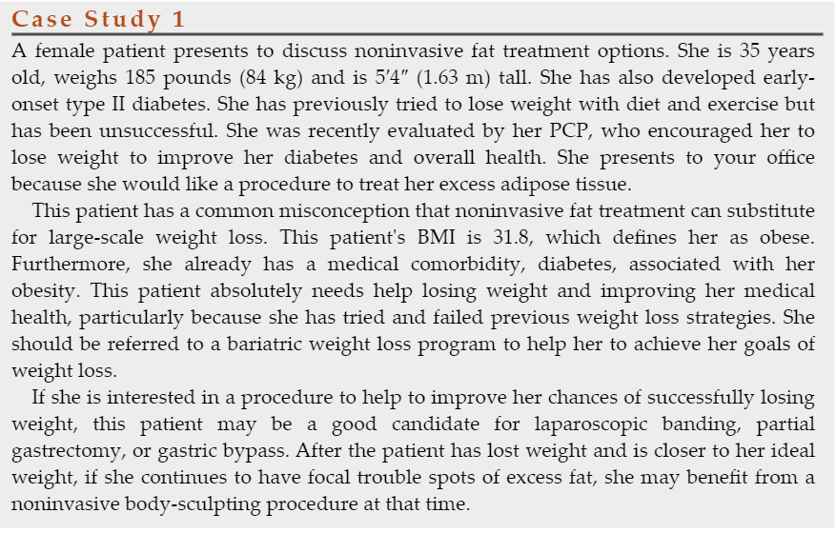
Evaluation of Fatty Tissue and Cellulite

Slide 9
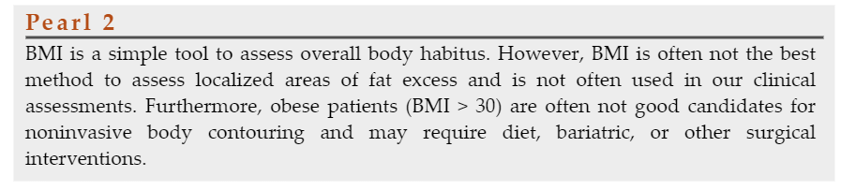

Slide 10
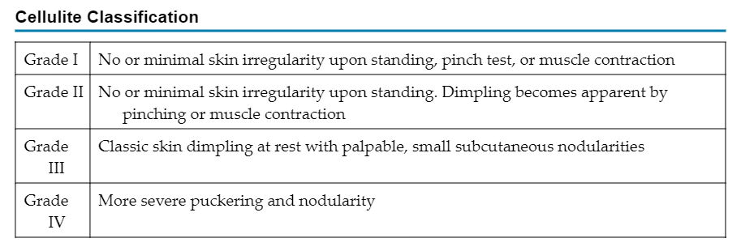

Slide 11
Therapeutic Options
Creams
Herbal Treatments
Injectable agents
Physical Manipulation
Subcision
Extracorporeal Shock Wave Therapy
Radiofrequency Devices
Ultrasound Devices
Lasers and Light Sources
Cryolipolysis

Slide 12
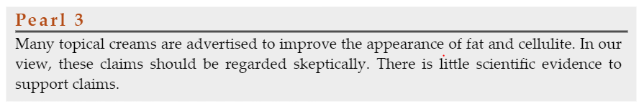

Slide 13
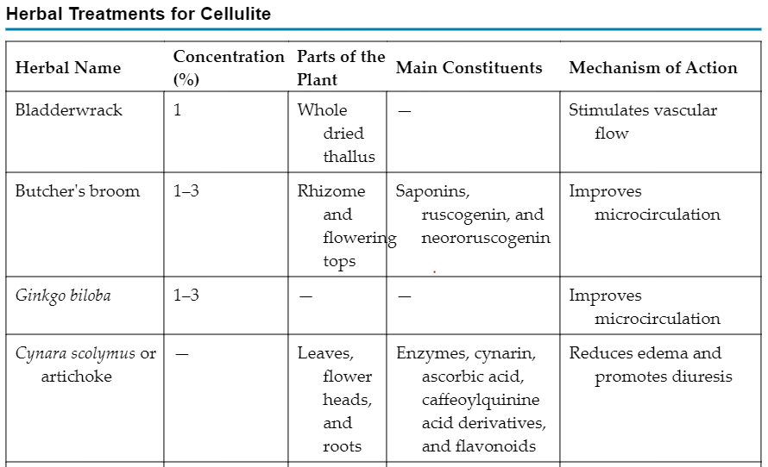

Slide 14
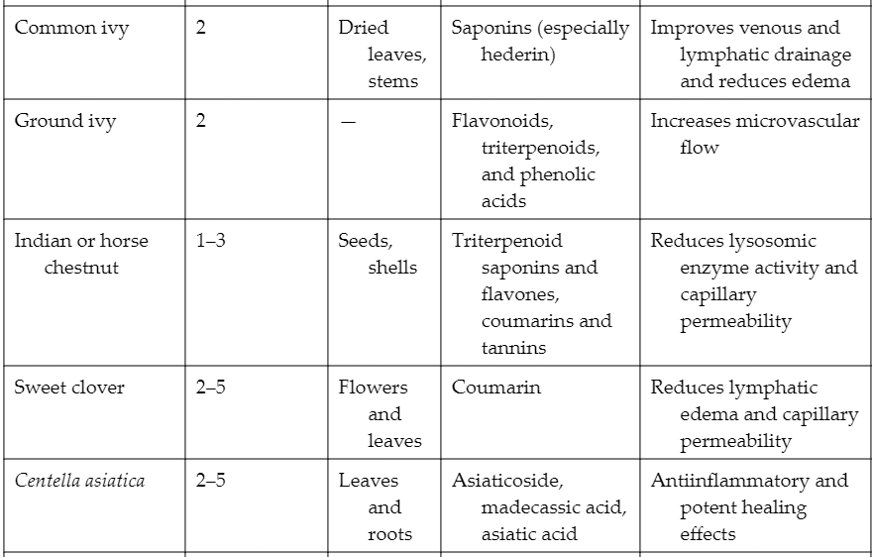

Slide 15
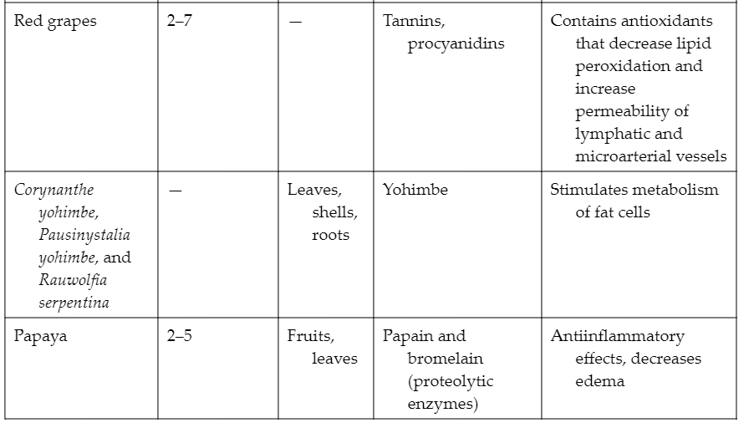

Slide 16
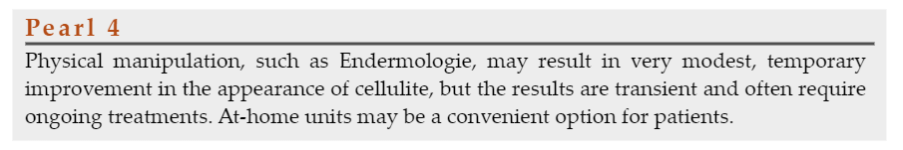

Slide 17
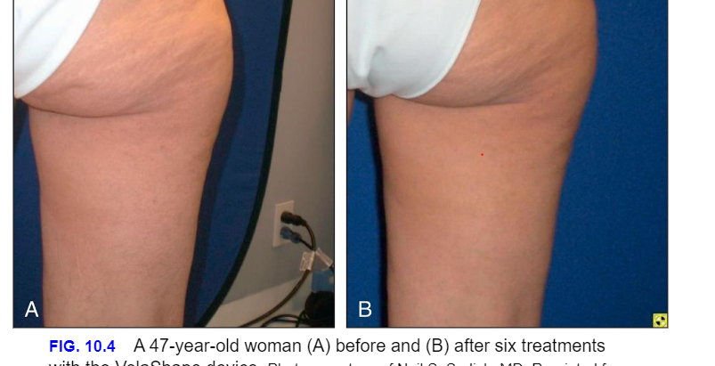

Slide 18
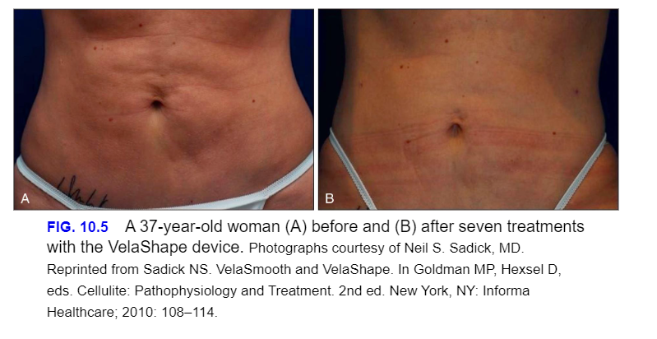

Slide 19
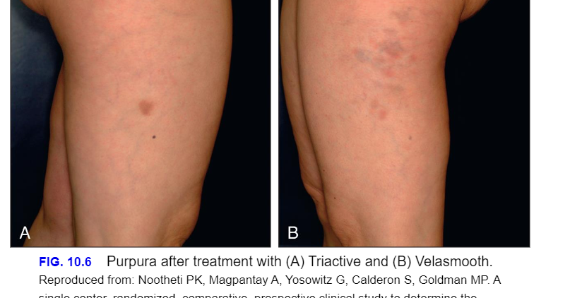

Slide 20
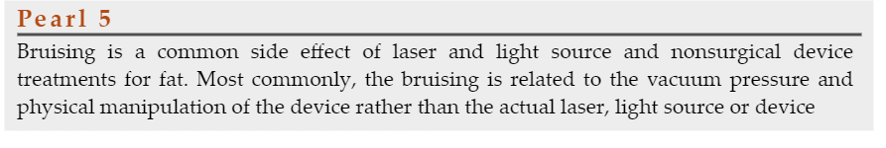

Slide 21
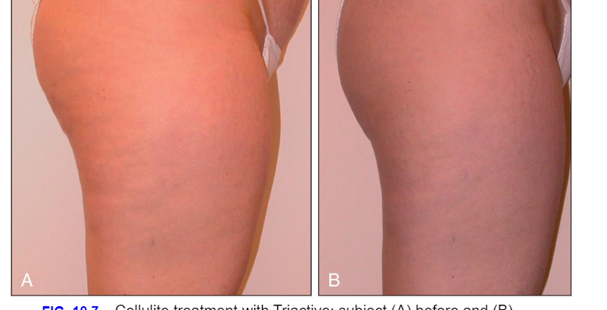

Slide 22
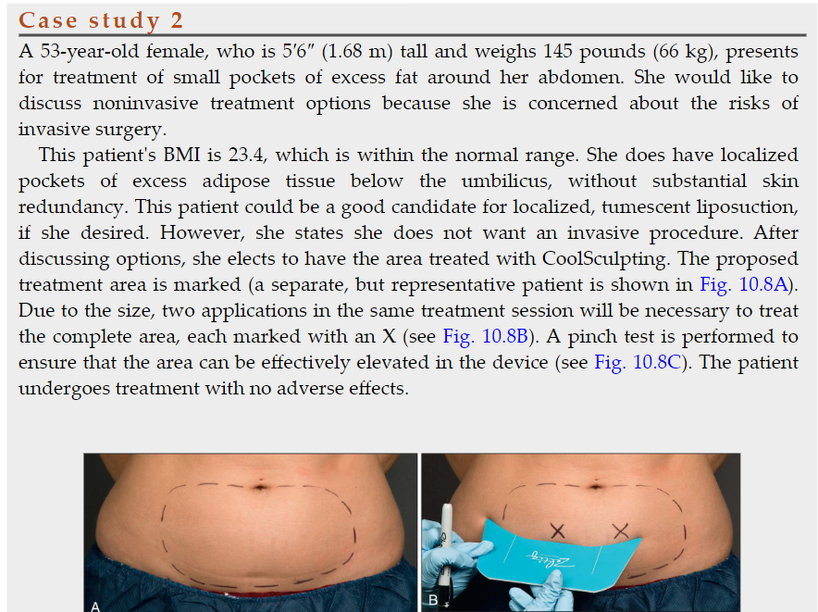
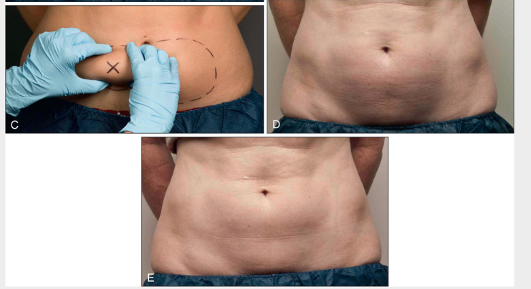

Slide 23
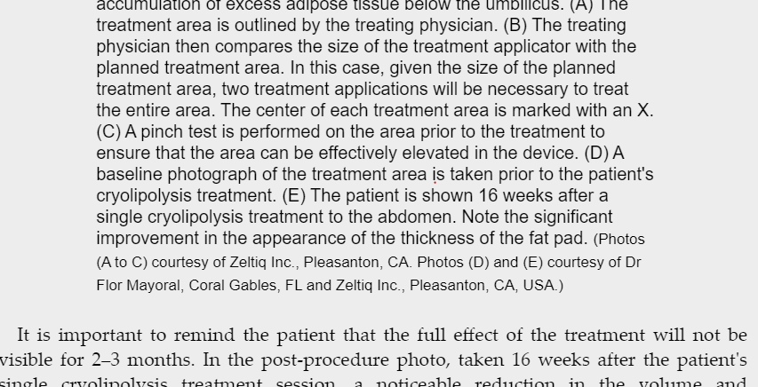

Slide 24
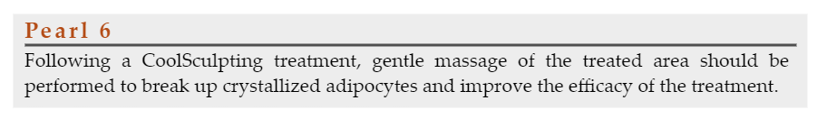

Slide 25
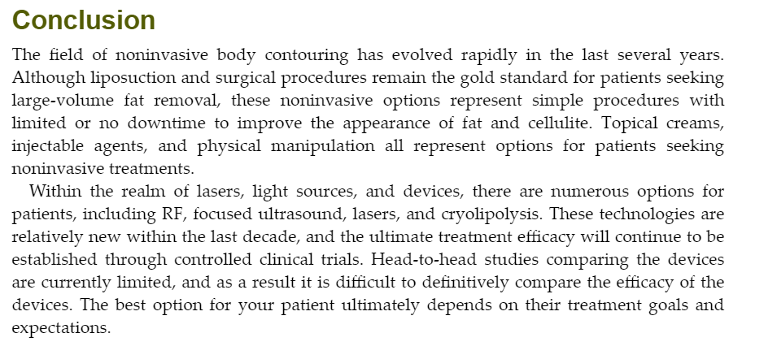

Slide 26

QUESTIONS?

