Slide 1


Disorders and Diseases of the Skin

Slide 2
Estheticians must be knowledgeable about skin disorders and diseases. As an esthetician, it is not within your scope of practice to diagnose skin diseases but being savvy enough to recognize common medical conditions can help you work with clients more effectively and safely. Estheticians can provide client education and help clients with many of their skin concerns.

Slide 3
Estheticians should study and have a thorough understanding of
disorders and diseases of the skin because:
· Recognizing a potentially contagious skin disorder can stop the spread of infection.
· You will help individuals that have skin problems and have been affected emotionally by dealing with such a visible problem.
· Learning when to stop a service and refer a client to a medical professional may save their life.

Slide 4
Esthetician and a Dermatologist Can Work Collaboratively
Dermatology is the branch of medical science that studies and treats the skin and its disorders and diseases.
A dermatologist is a physician who treats these disorders and diseases.
Recognizing skin disorders and diseases is important for the protection of both the technician and the client.
Estheticians may not perform services on clients who have contagious or infectious diseases
Dermatologists, physicians, and nurse practitioners are qualified to diagnose skin problems

Slide 5
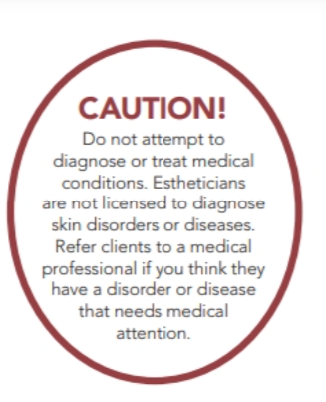
Estheticians may not diagnose disorders and diseases of the skin

Slide 6
Estheticians can help clients with
Rosacea
Acne
Hyperpigmentation
Dehydration
Superficial Treatments
We will cover this in the following weeks.

Slide 7
Caution and strict infection control practices are imperative when working with skin disorders.
Knowledge of skin conditions that contraindicate (prohibit) a treatment is also necessary.
Some lesions fit into more than one category and have more than one name or definition.
Skin disorders are not easy to categorize, as they can be as diverse as the individuals dealing with the conditions and symptoms.

Slide 8
Let’s Start with Lesions
Lesions are structural changes in the tissues caused by damage or injury.
Any mark, wound, or abnormality is described as a lesion.
The three types of lesions are primary, secondary, and tertiary.
Some references call tertiary, or third type of lesions, vascular lesions.
Vascular lesions involve the blood or circulatory system.

Slide 9
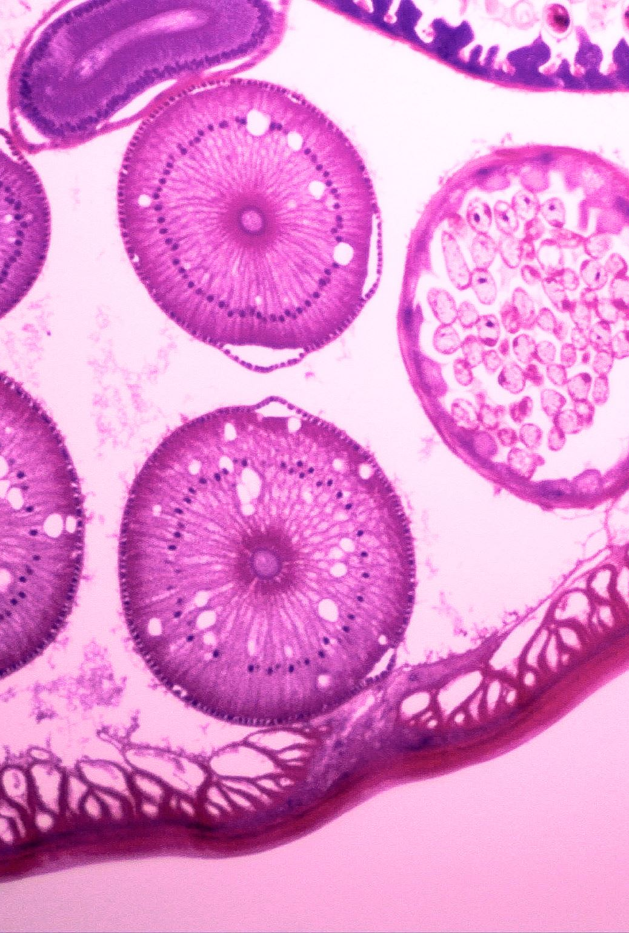
Identify the Differences Between
Primary
Secondary and
Tertiary Skin Lesions

Slide 10
Primary Lesions
Are lesions in the initial stages of development or change. Primary lesions are characterized by flat, nonpalpable changes in skin color or by elevations formed by fluid in a cavity, such as vesicles or pustules.

Slide 11
Secondary Lesions
Secondary skin lesions are characterized by piles of material on the skin surface, such as a crust or scab, or by depressions in the skin surface, such as an ulcer. These may require medical referral.

Slide 12
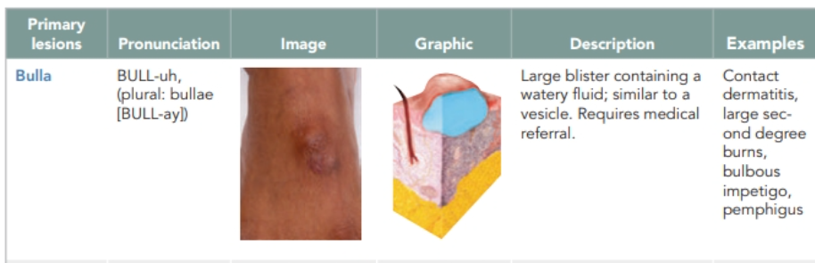

Slide 13
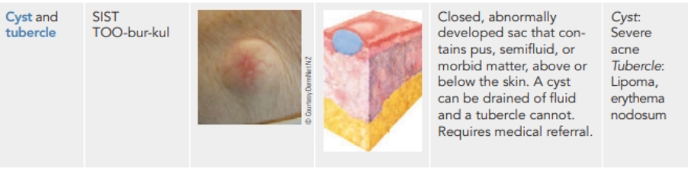

Slide 14
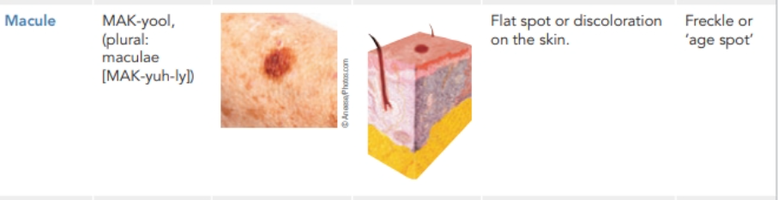

Slide 15
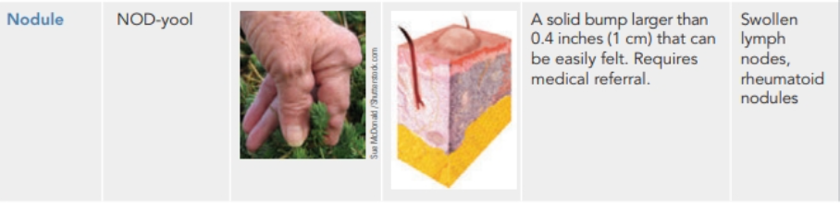

Slide 16
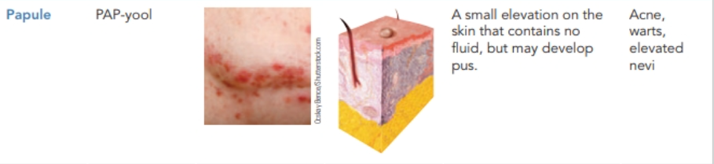

Slide 17
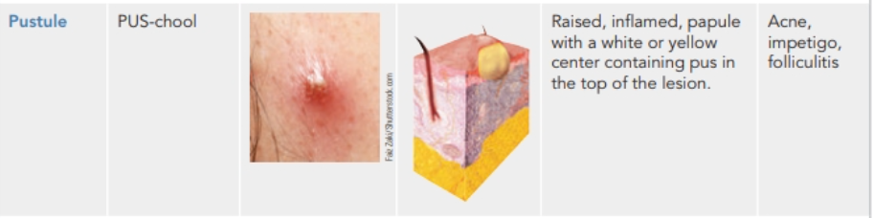

Slide 18
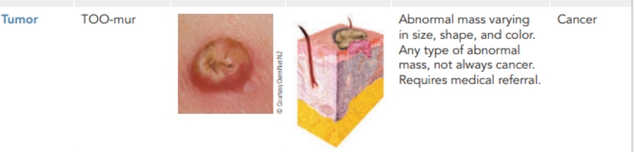

Slide 19
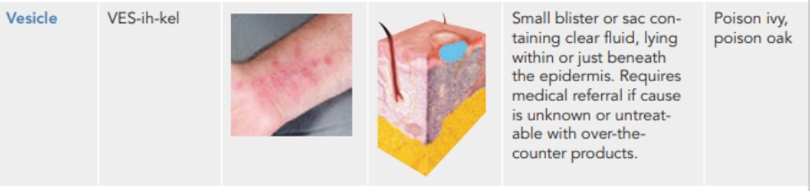

Slide 20
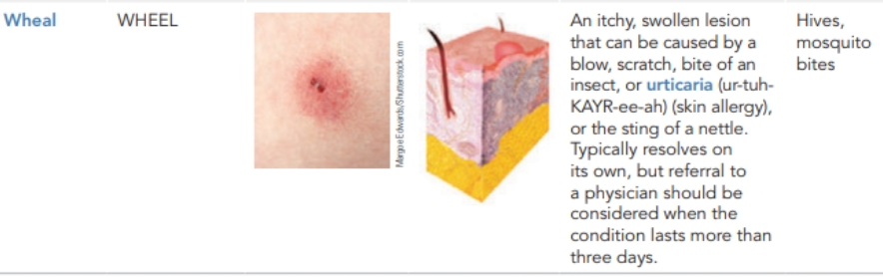

Slide 21
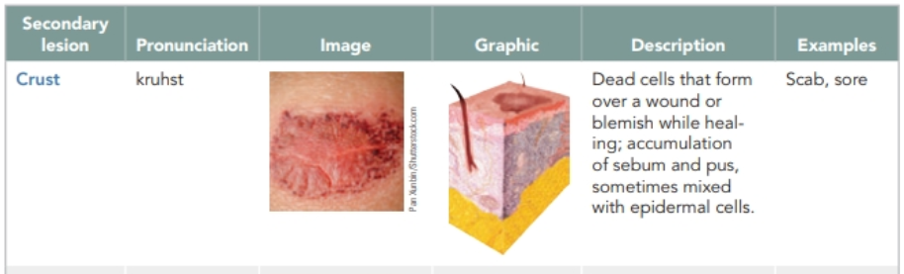

Slide 22
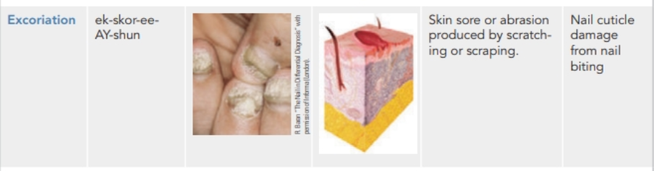

Slide 23
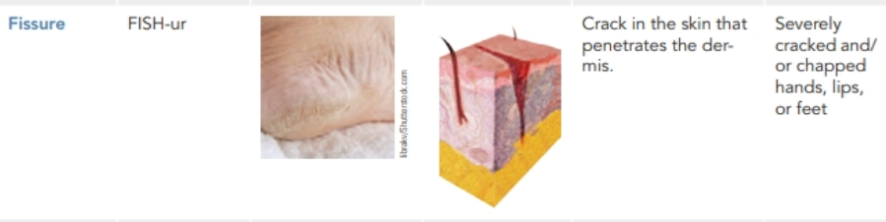

Slide 24
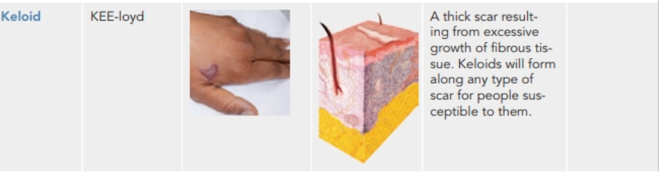

Slide 25
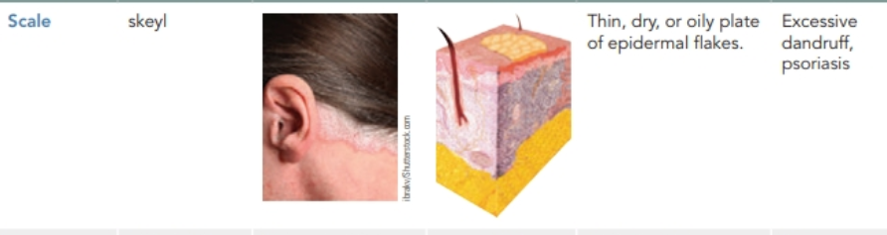

Slide 26
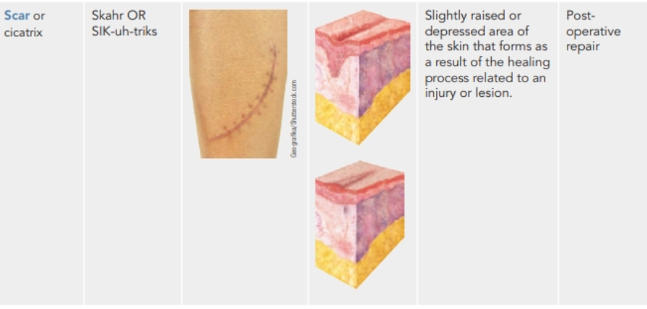

Slide 27
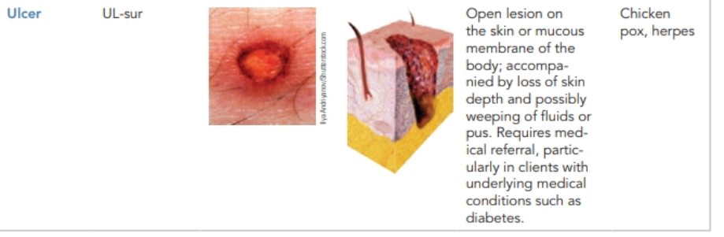

Slide 28


Slide 29

QUESTIONS?

