Slide 1


Types of Cosmetics and Their Uses

Slide 2
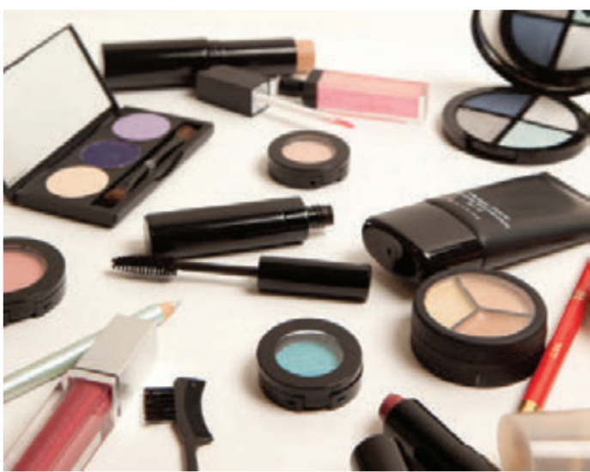
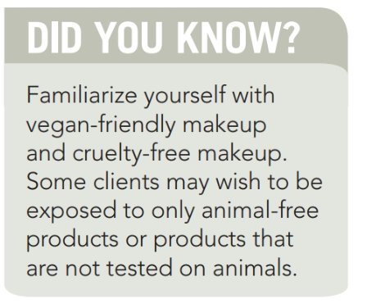
Most products come in several forms, including powders, creams, and liquids, in an assortment of containers and packages . Makeup formulations are evolving with a focus on maintaining healthier skin. Let’s take a look at the product formulations, application techniques, and facial features of each type of product currently available.

Slide 3
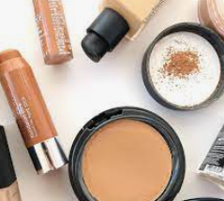
Foundation
Comes in different forms:
Cream
Liquid
Powder
Mineral
Most people may need different makeup colors in the summer (darker) and winter (lighter).

Slide 4

· Foundations that usually contain mineral oil or other oils are referred to as oil based . These products are a good choice for normal to dry skin.
· Oil-free products are referred to as water based. Water-based foundations generally give a more matte (MAT) finish and help conceal minor blemishes and discolorations. These foundations are preferred for oily skin and sensitive skin.
· Silicone-based products are good for occluding the skin and proving a more even surface. They can also diffuse imperfections. Silicone-based makeup is also more durable for prolonged wear and is an excellent choice for bridal makeup.
· Alcohol-based makeup is also available for extreme durability and is popular with special effects artists as well as for temporary tattoos. Alcohol-based makeup is not ideal for pro-longed wear as it can exacerbate dry skin.

Slide 5
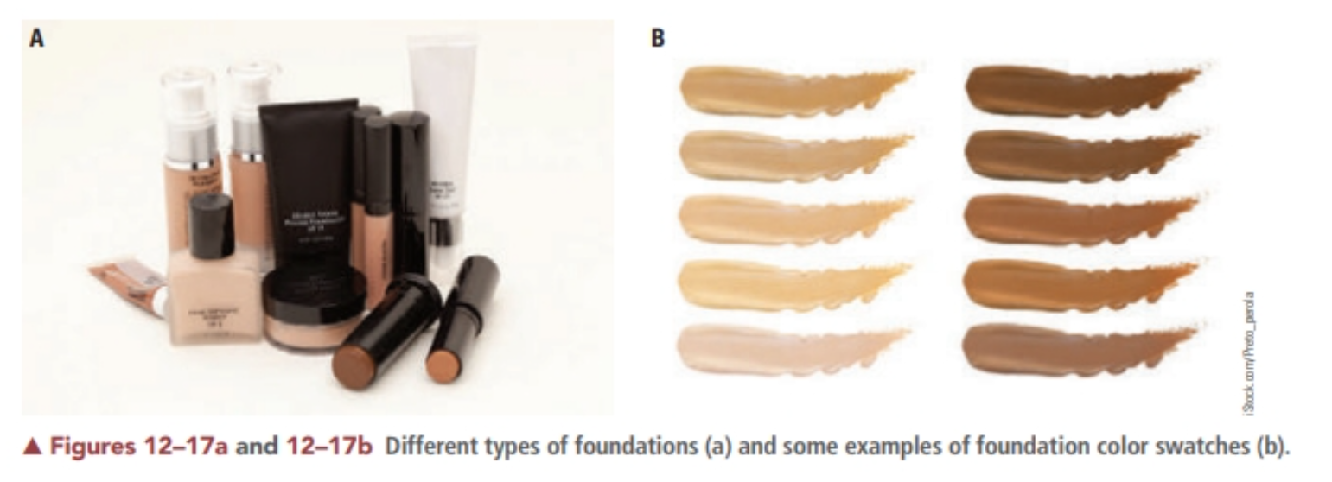
Some liquid foundations are combinations
of organic and inorganic pigments in alcohol-and water-based solutions. Bentonite (a clay base) is added to help keep the products blended and absorb excess oil. The liquid formulation is generally suited for clients with oily to normal skin conditions who desire sheer to medium coverage. Other liquid foundations are oil based.

Slide 6
Cream foundations are thicker and give medium to heavier coverage. They are generally suited for dry to normal skin.
Cake makeup also known as pancake makeup, is a heavy cream foundation. It is normally applied to the face with a moistened cosmetic sponge, and is used for theater and film, or when-ever extreme coverage is needed.
Greasepaint is a heavy cream makeup used for theatrical purposes. Certain makeup products are created for effect and work beautifully for short periods of time and for smaller areas of coverage. Most theatrical and effect makeup is made with alcohols and oils that can be comedogenic. Be sure to recommend a good skin care routine with an effective but gentle cleanser.
Powder foundations, consist of a powder base mixed with a coloring agent (pigment).
Cream-to-powder foundations are moist on application but dry to a powdery finish.

Slide 7
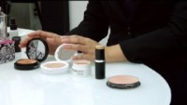

Slide 8
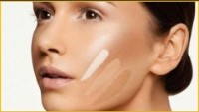

Slide 9


Slide 10
Primers are liquids or silicone-based formulas designed to go underneath foundation and other products to prepare the skin for makeup and to help keep the product on the skin. Primers provide a smooth surface for the makeup, while keeping product off the skin so that it is not broken down by the natural oils of the skin.
Mineral Makeup Mineral makeup is composed of minerals and other ingredients and is designed to be healthy for the skin. A mineral-based foundation is considered more noncomedogenic (less likely to clog pores) and natural than liquid foundations. This makeup is not as heavy as other type

Slide 11
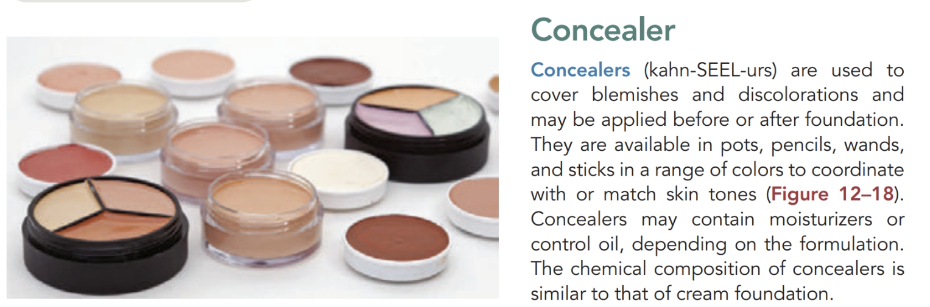

Slide 12
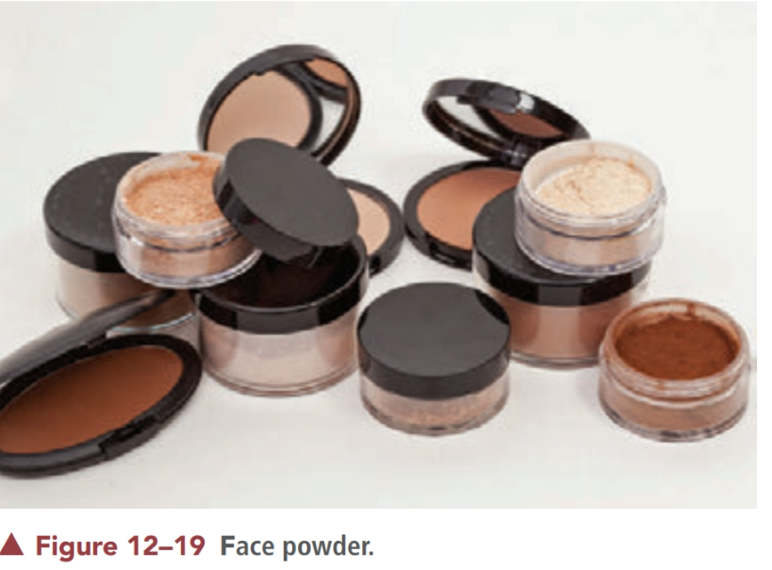
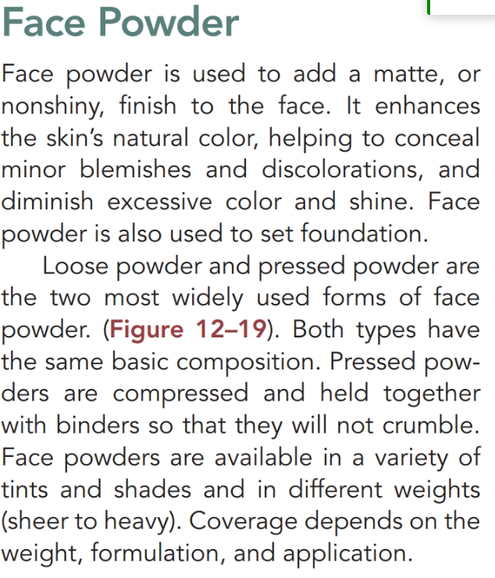

Slide 13
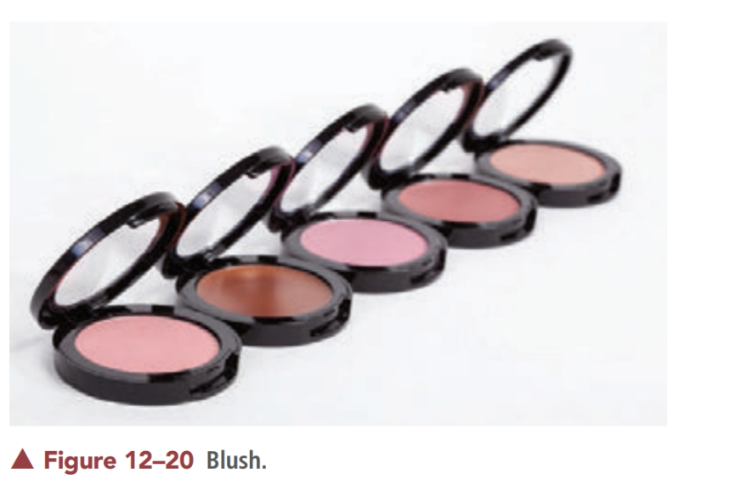
Blush gives the face a natural-looking glow and helps create facial balance .Powder blush is the most common cheek color and consists of ingredients similar to powders with colorants added. Cream or gel cheek colors resemble cream foundation and are generally preferred for dry and normal skin. Cream and liquid blush fall into two categories: oil based and emulsions. Oil-based formulations are combinations of pigments in an oil or fat base. Blends of waxes (carnauba wax and ozokerite) and oily liquids (isopropyl myristate and hexadecyl stearate) create a water-resistant product. In addition, cream cheek colors contain water, dyes, thickeners, and a variety of surfactants or detergents that enable particles to penetrate the hair follicles and cracks in the skin. Because these ingredients can potentially clog the follicles, it is important to remind clients to remove their makeup each night.

Slide 14
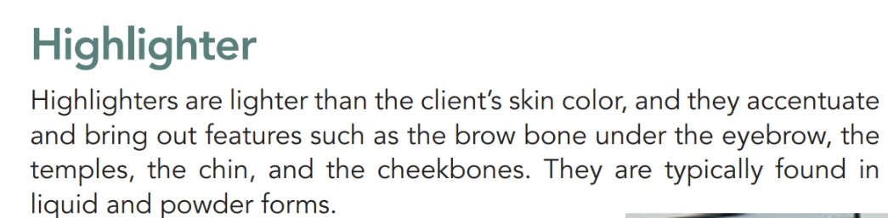

Slide 15
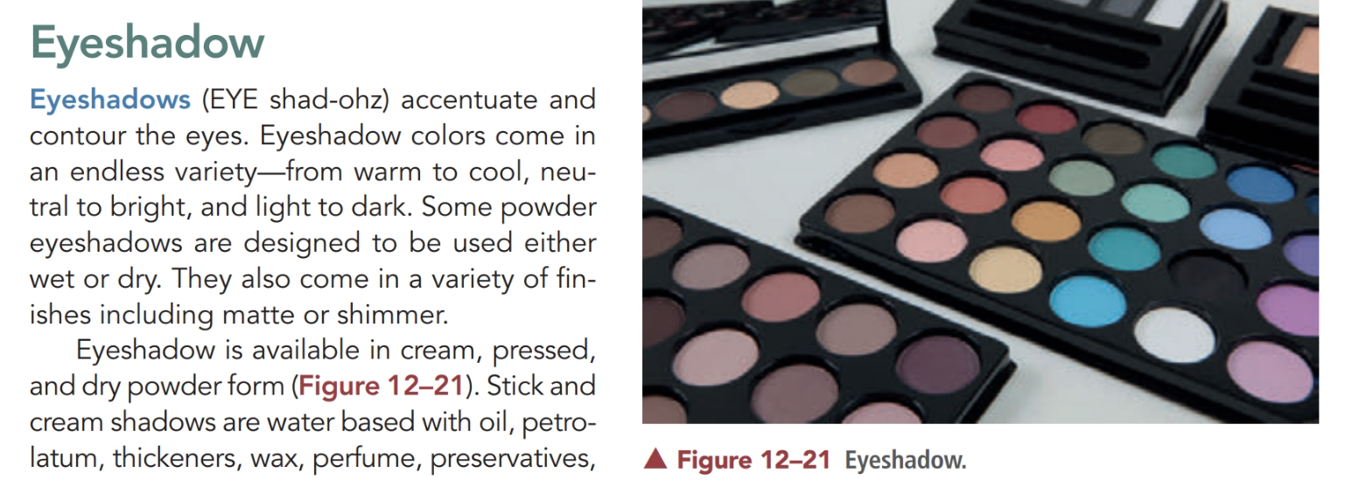

Slide 16
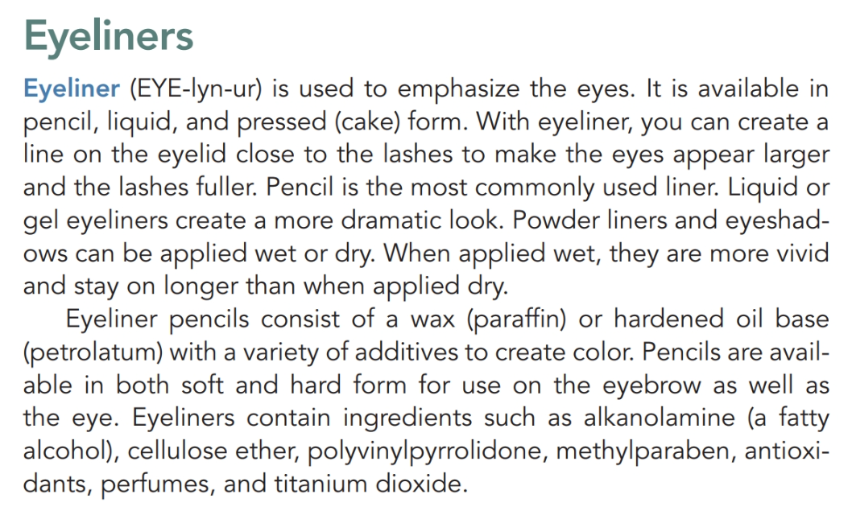

Slide 17
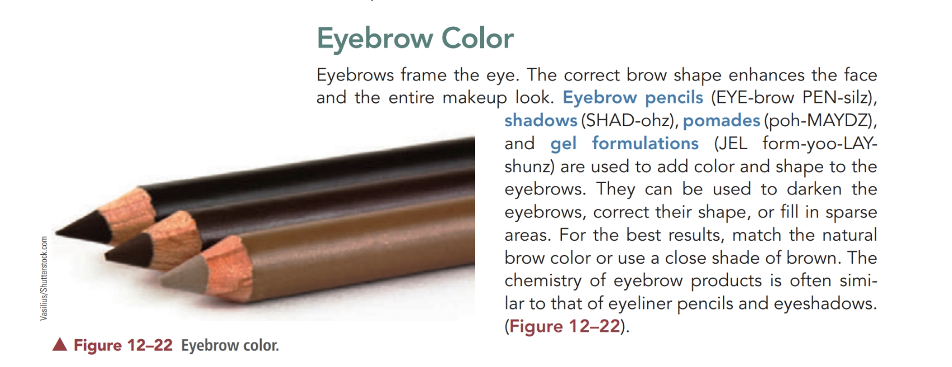

Slide 18
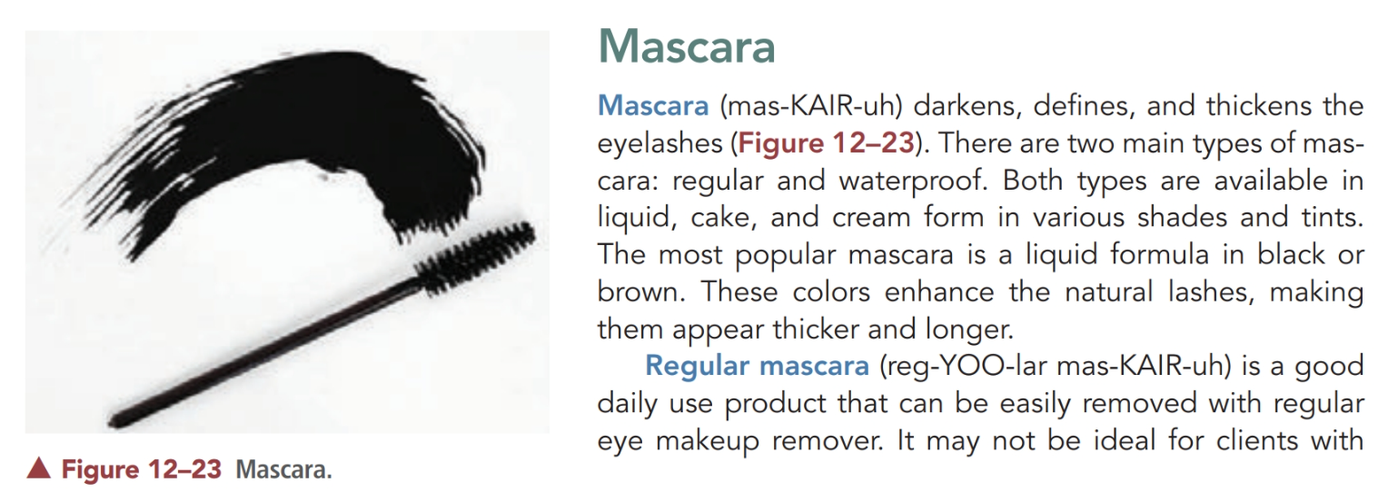

Slide 19
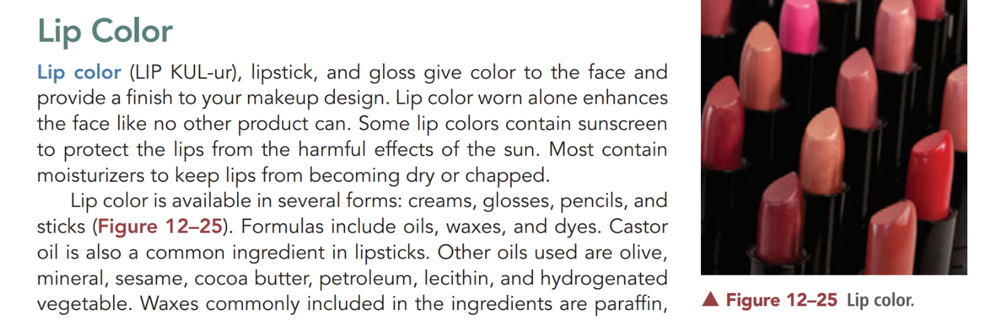

Slide 20
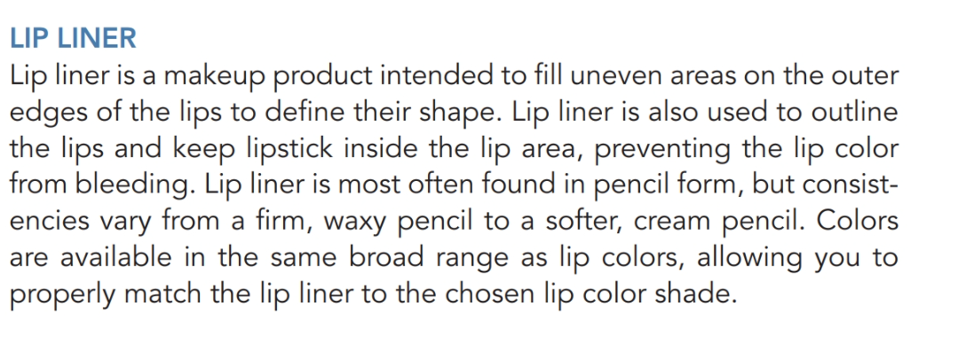

Slide 21


Slide 22

QUESTIONS?

