Slide 1
MRAD 285:
Applied Radiographic Skills
Mobile Chest Image Critique

Slide 2
For each of the following images, answer the following questions:
1. Identify the projection(s) / view(s).
2. Identify the anatomy visualized on the image.
3. Comment on the quality of positioning and recommend improvements.
4. Comment on the image centering.
5. Comment on the collimation.
6. Comment on the marker placement.
7. Identify any pathology present.
8. What technical factors would be appropriate?
9. Recommend any further imaging requirements.
Bonus!
10. What line/equipment is visible on the image?
11. What is its purpose?

Slide 3
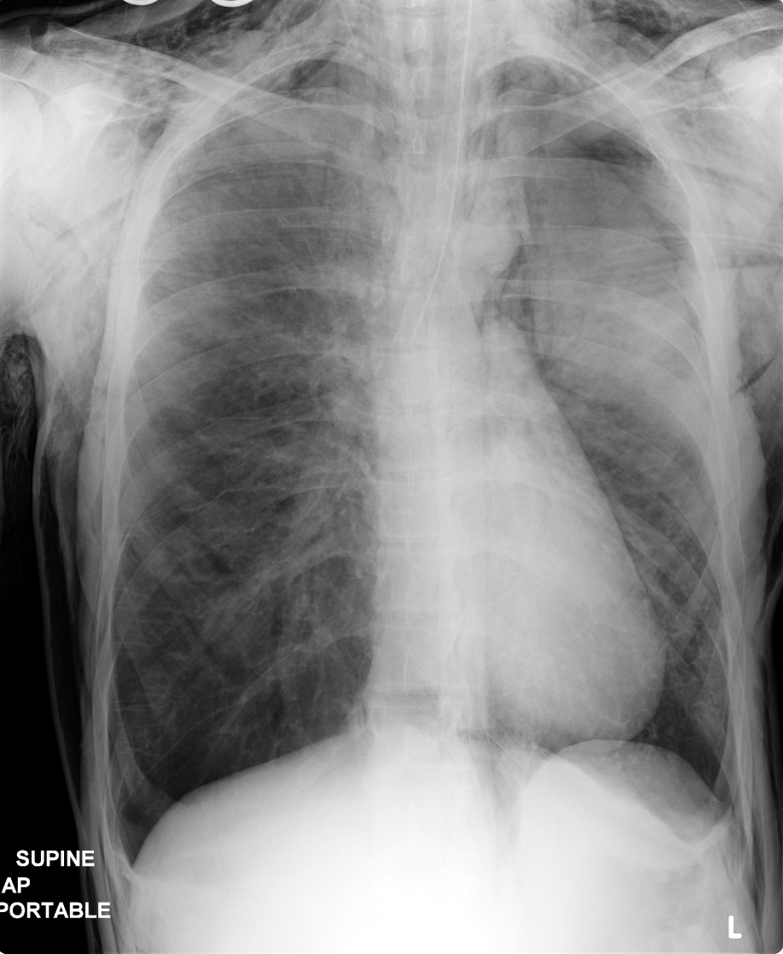
Image 1

Slide 4
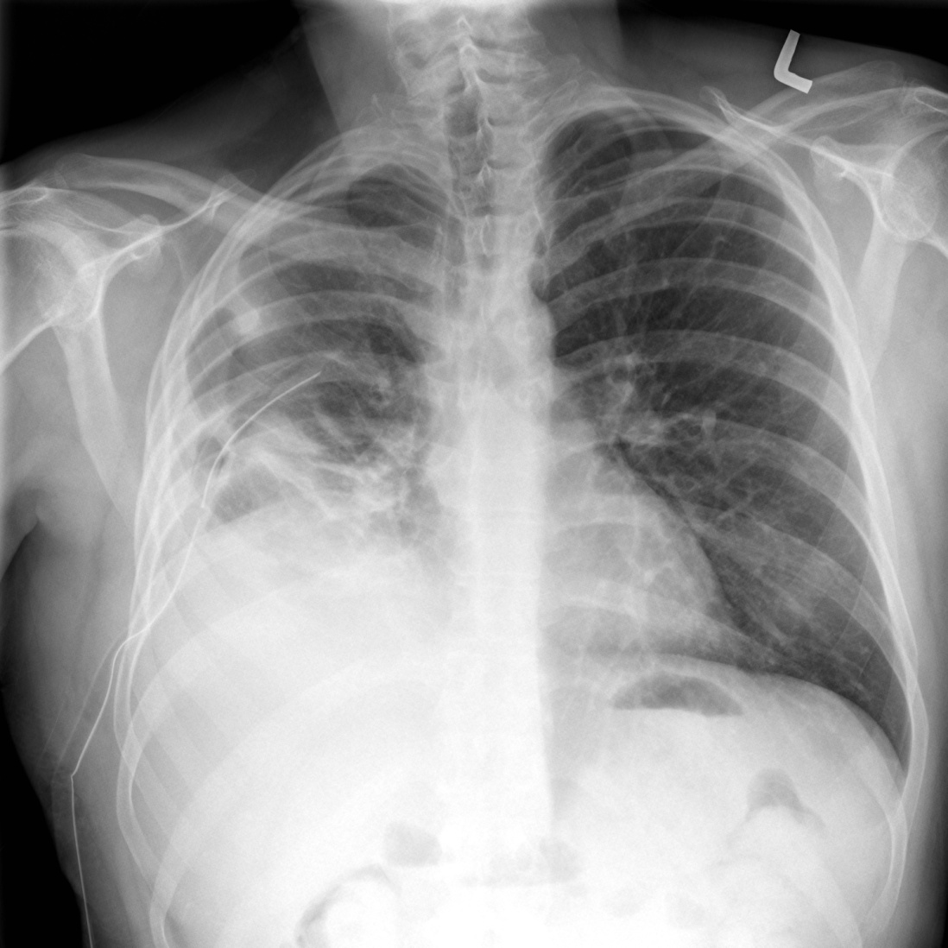
Image 2

Slide 5
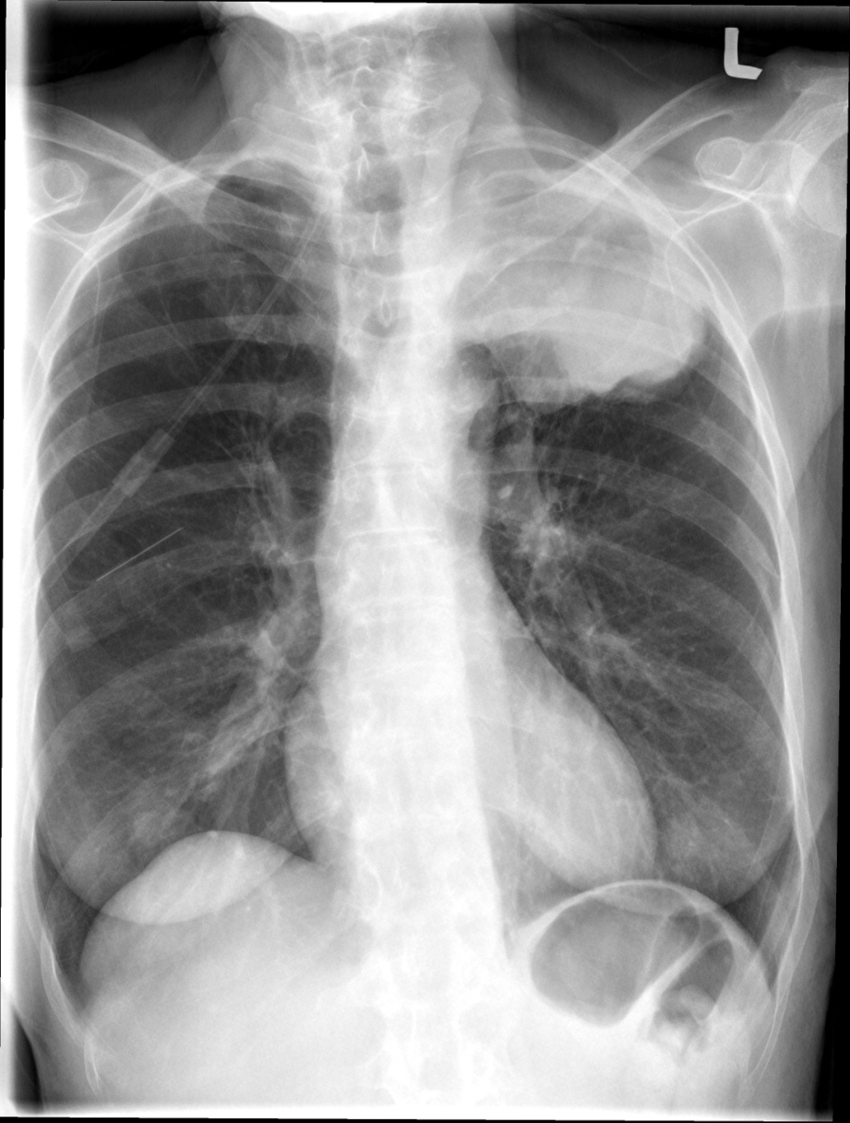
Image 3

Slide 6
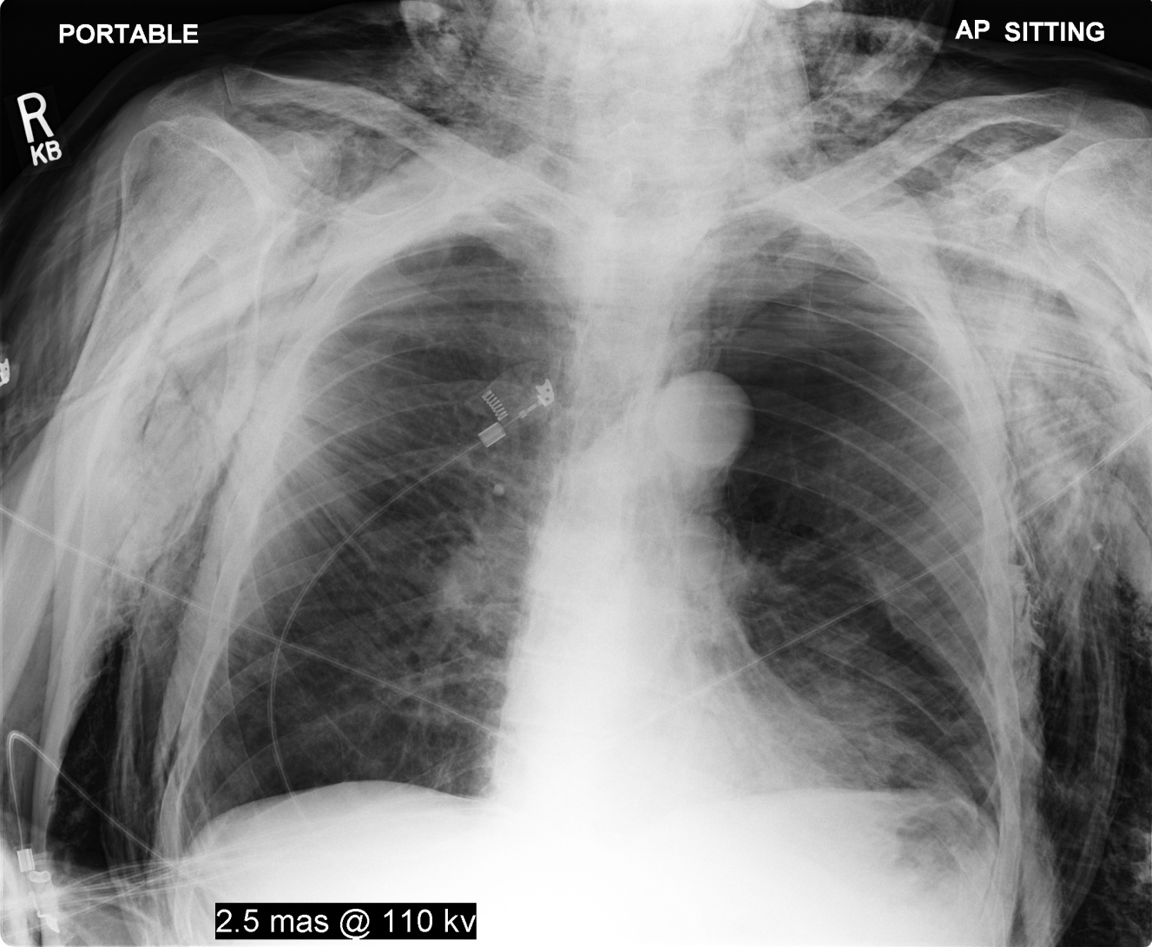
Image 4

Slide 7
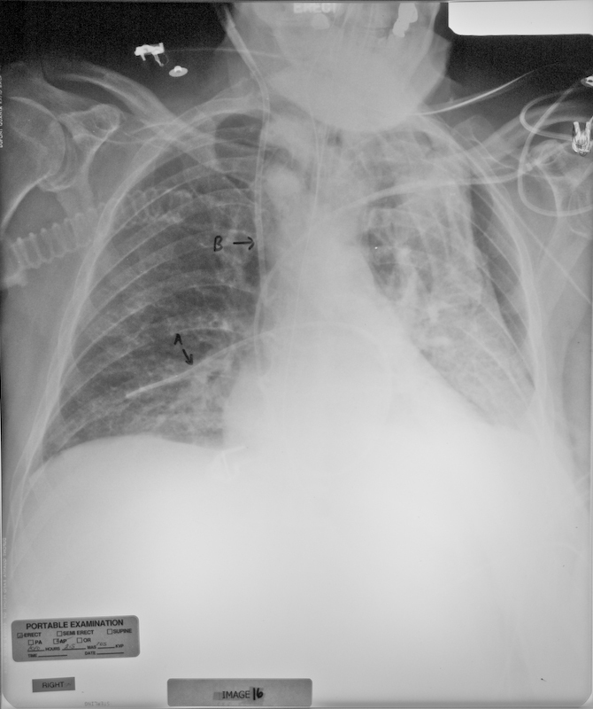
Image 5

Slide 8
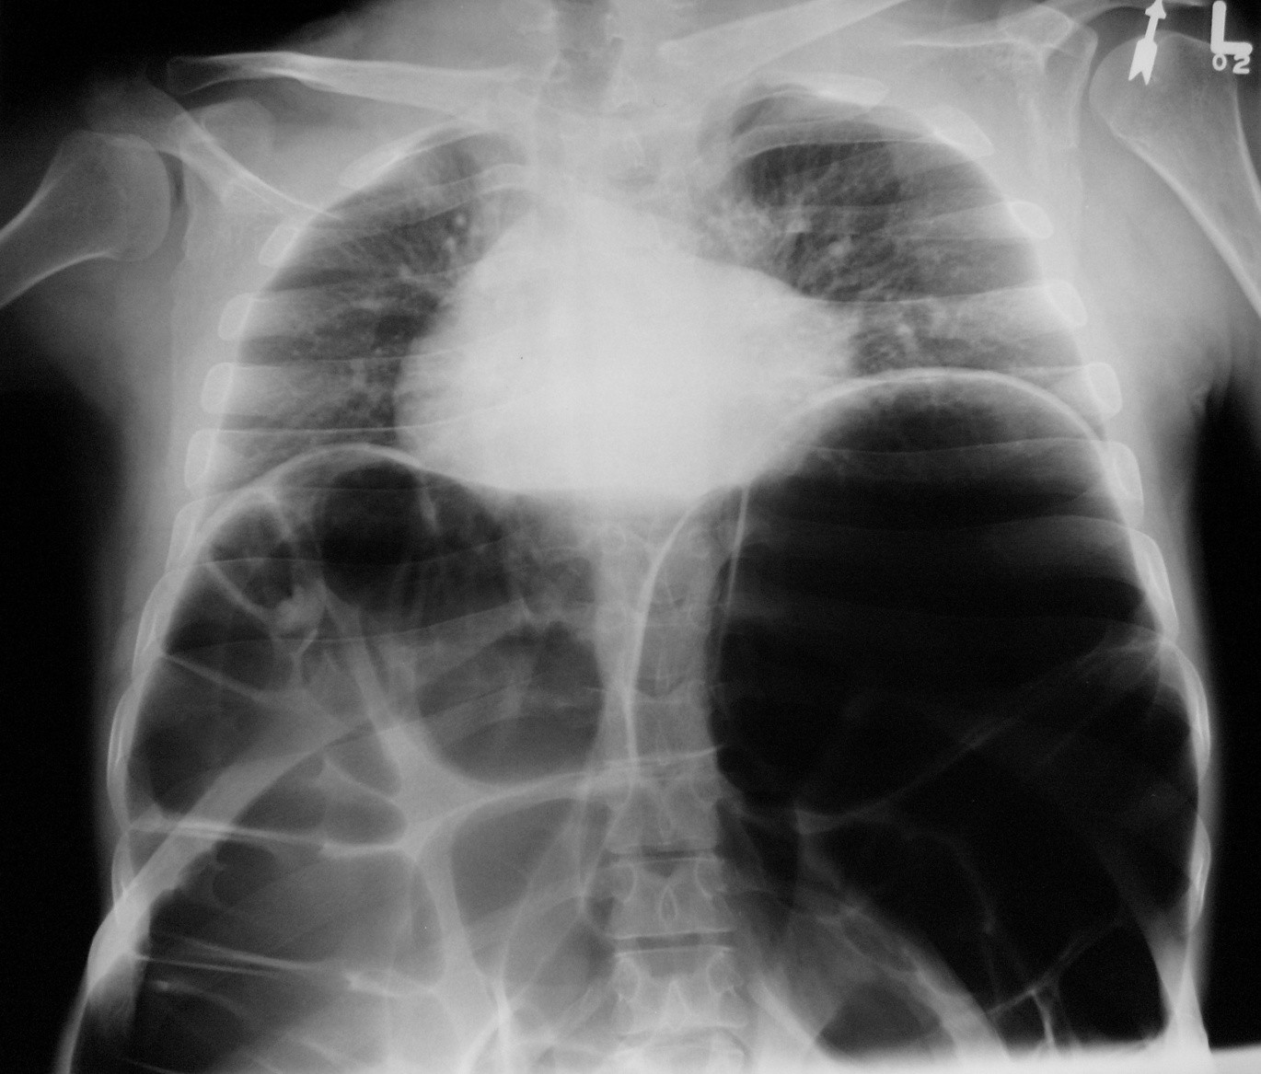
Image 6

