Slide 1
MRAD 256: Rad Tech 2
Sacrum, Coccyx and Sacroiliac Joints

Slide 2
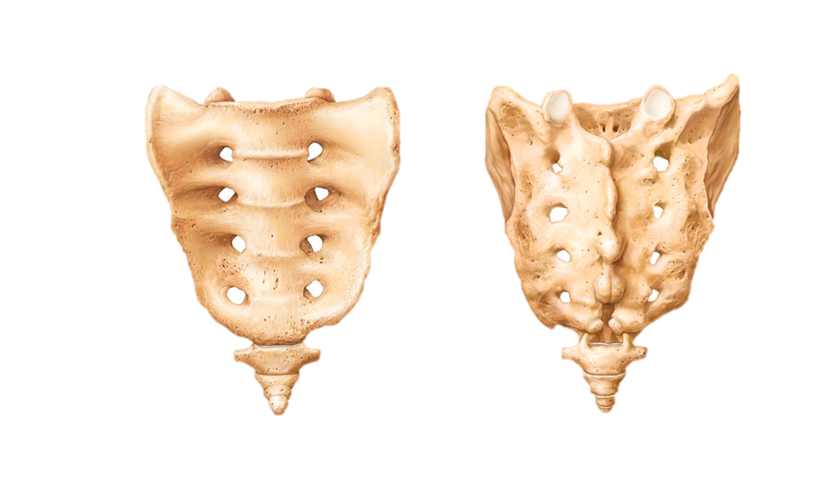
Sacrum and Coccyx

Slide 3
Sacrum
Triangular shaped bone helping form the posterior wall of the pelvis
Formed by 5 fused vertebrae
Articulates superiorly with L5 at the base and inferiorly with coccyx at its apex
Articulates laterally with the two hip bones forming the sacroiliac joints of the pelvis
The sacral canal is a continuation of the vertebral canal
Notes:
Formed by 5 fused vertebrae in adults
Articulates superiorly via superior articular processes
Articulates laterally via the auricular surfaces

Slide 4
Anterior Sacrum
Concave surface
Four transverse ridges mark the site of fusion of the individual sacral bodies
The ridges terminate at the anterior intervertebral foramina, with 4 on each side
Sacral foramina allow passage of nerves and blood vessels
Ala (one on each side)
  Large mass of bone lateral to the anterior sacral foramina
Notes:
4 sets of sacral foramina, they are similar to the intervertebral foramina

Slide 5
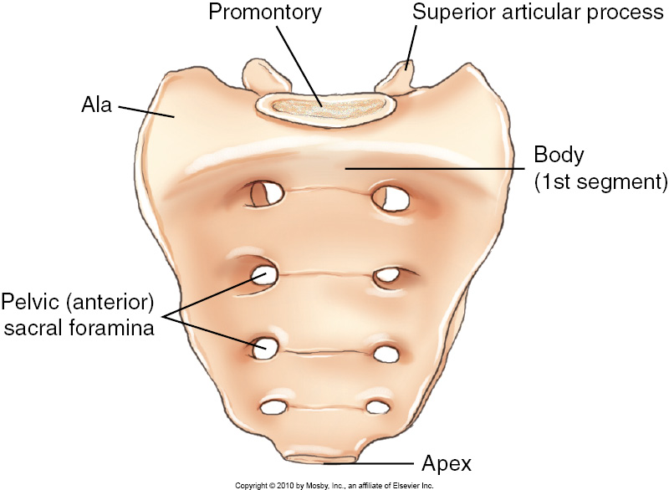

Slide 6
Sacrum-Posterior Surface
Convex
Superior articular processes
  Form zygapophyseal joints with the inferior articular processes of the L5
Median sacral crest
  Has 4 spinous tubercles

Slide 7
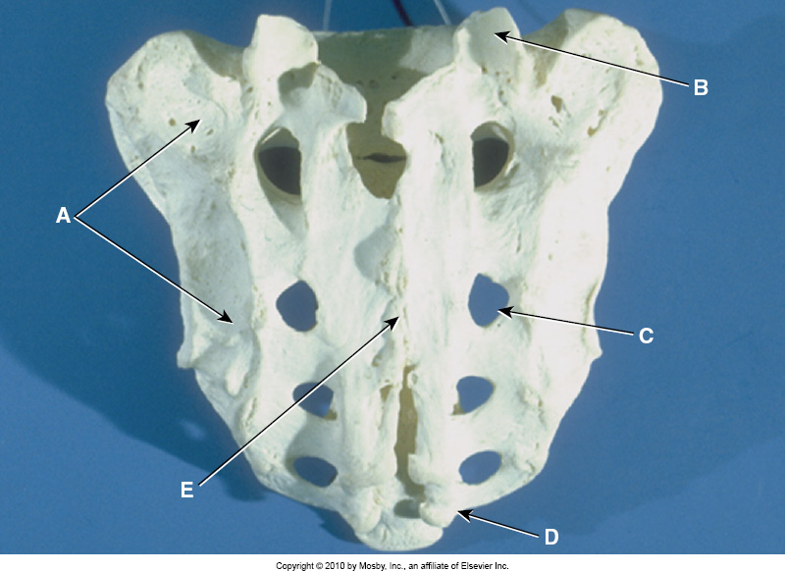
Sacrum Posterior View
Auricular Surface
Superior Articular Process
Posterior Sacral Foramina
Sacral Canal (visible due to bone deterioration on this specimen
Sacral Horns

Slide 8
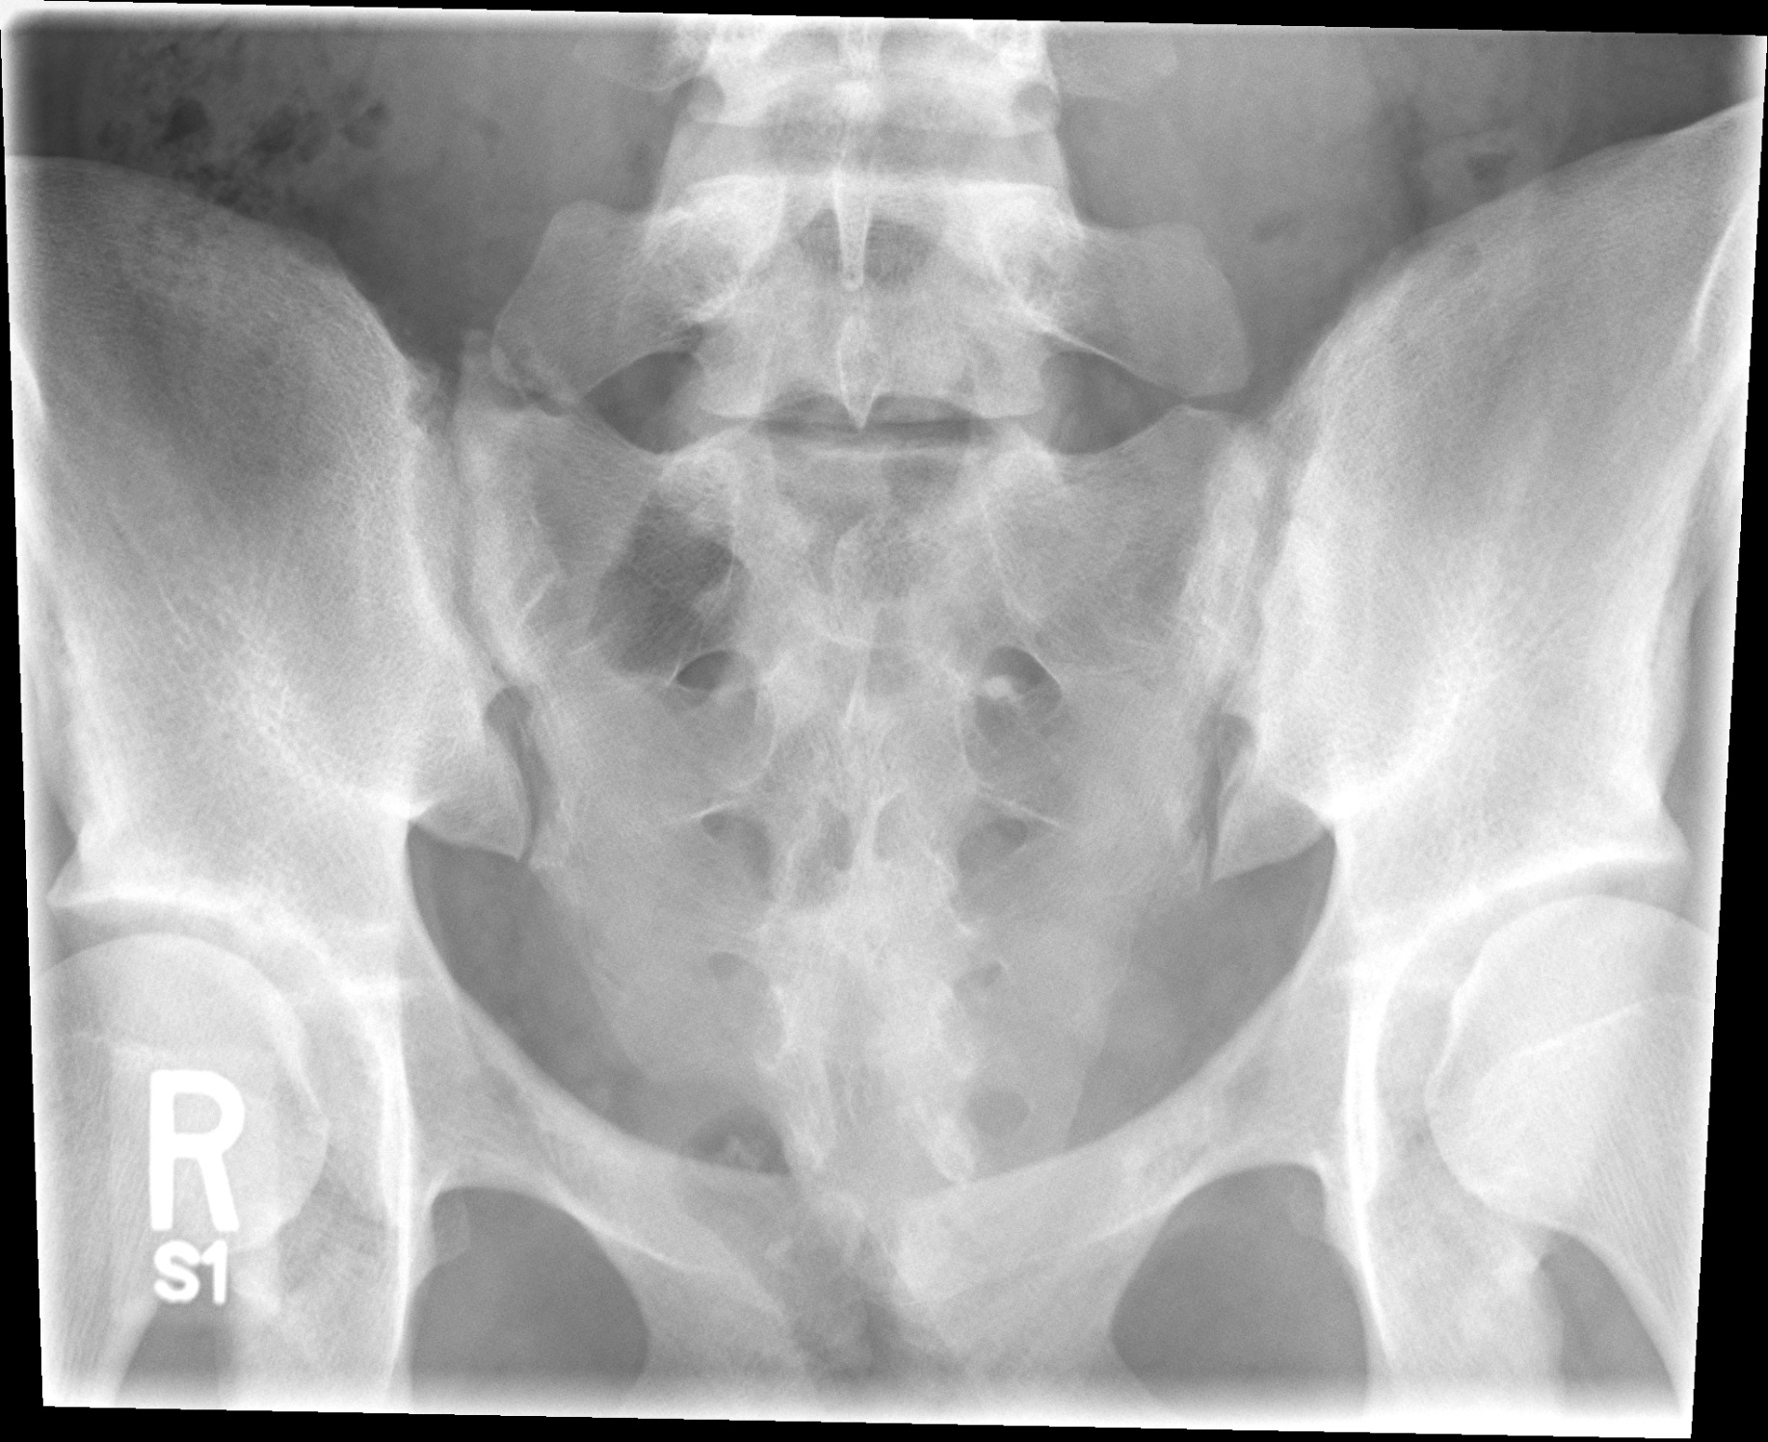
2
A
C
B
Notes:
Ala
Sacral intervertebral foramina
Median Sacral Crest

Slide 9
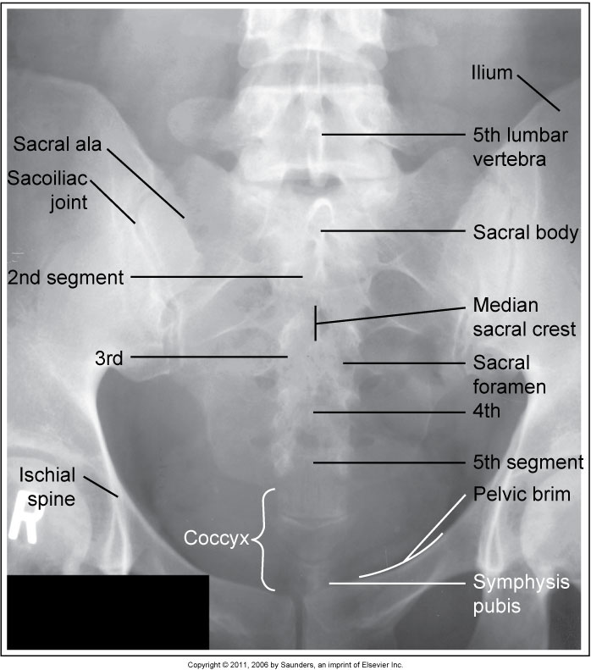

Slide 10
Lateral Sacrum
Sacral Promontory
  Anterior ridge of the body of first sacral segment
  Helps form the posterior wall of the true pelvis
  Body’s centre of gravity lies just posterior to this
Sacral Canal
  Posterior to the body of the first sacral segment
  Continuation of the vertebral canal
Median Sacral Crest
  Fused spinous processes of sacral vertebrae
Notes:
“Promontory” meaning “high point of land projecting into the sea”

Slide 11
Lateral Sacrum
Auricular Surface
  Articulates with the ilium of the pelvis
  Resembles auricle of the ear
Sacral Horns
  Cornua
  Small tubercles representing inferior articular processes
  Project inferiorly from fifth sacral segment
  Articulate with horns of coccyx
Notes:
“Auricle” meaning an ear like flap surrounding something. Found in the heart, as well as the ear

Slide 12
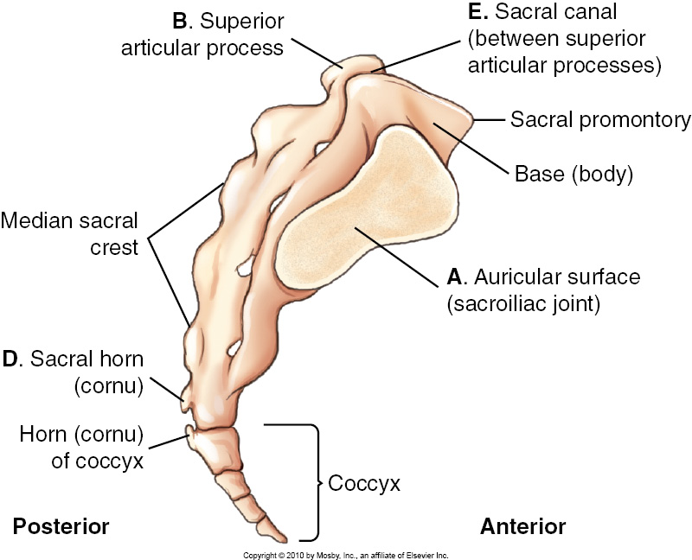
Sacrum and Coccyx

Slide 13
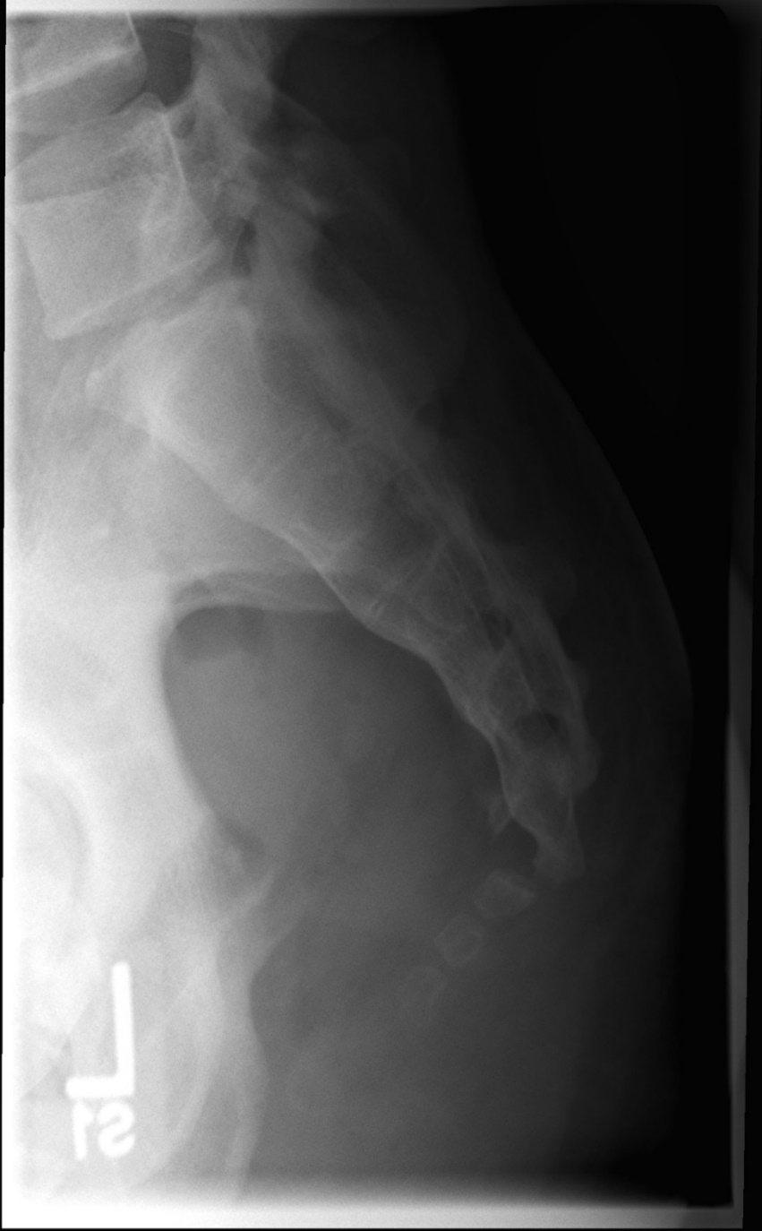

Slide 14
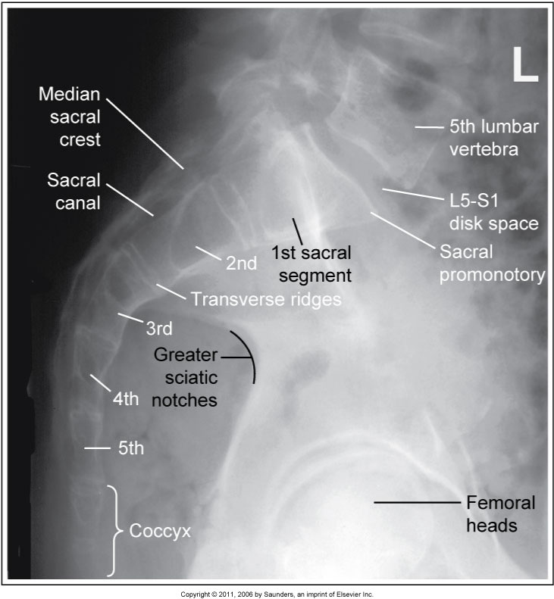

Slide 15
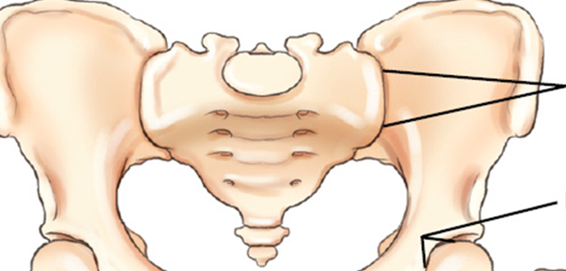
Sacroiliac Joints
Wide flat joints located on each side obliquely between the sacrum and each ilium, approximately 30 degrees.
Situated at an unusual oblique angle, requiring special positioning to visualize the joint spaces radiographically.
Sacroiliac Joints

Slide 16
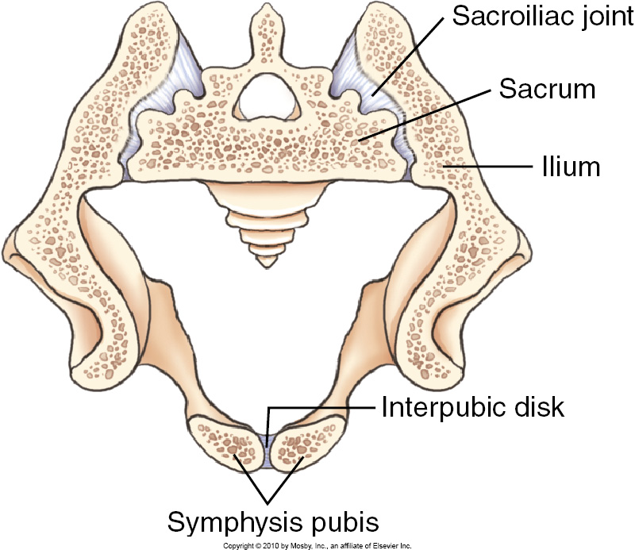
Classified as a synovial joint, but permits little movement and therefore is an amphiarthrodial, meaning limited movement.
The reason for this classification is that the joint surfaces are irregular in shape and the interconnecting bones are snugly fit because they serve a weight bearing function.
The shape restricts movement , and the joint space may be reduced in size in older persons, especially men.

Slide 17
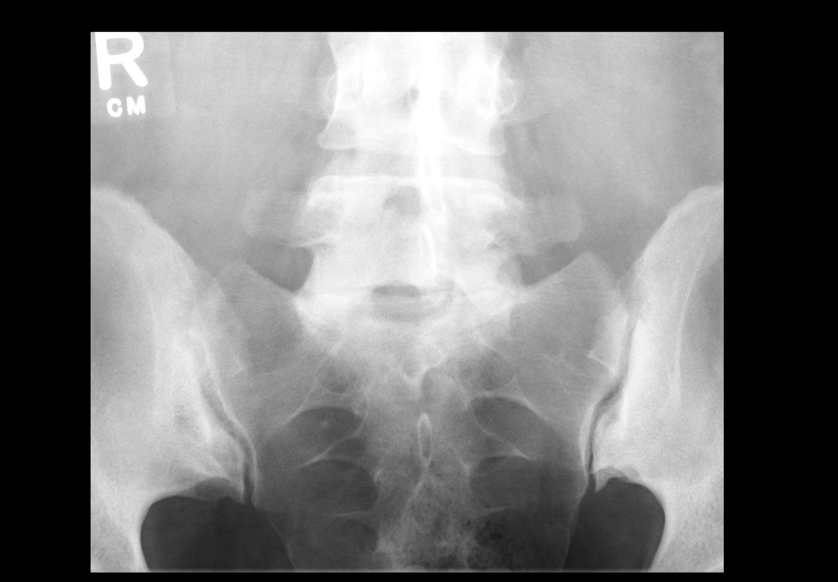

Slide 18
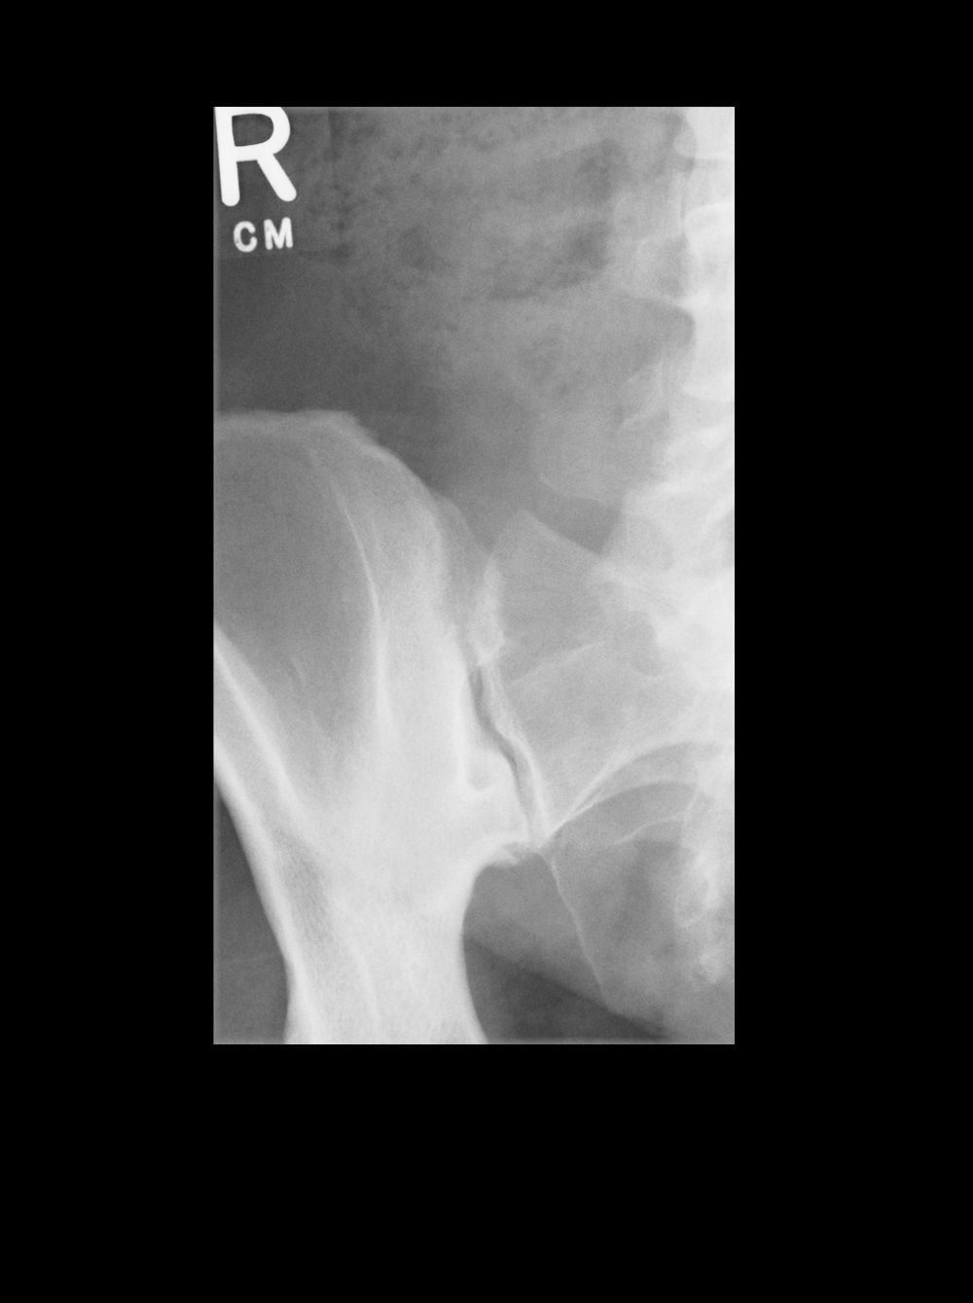
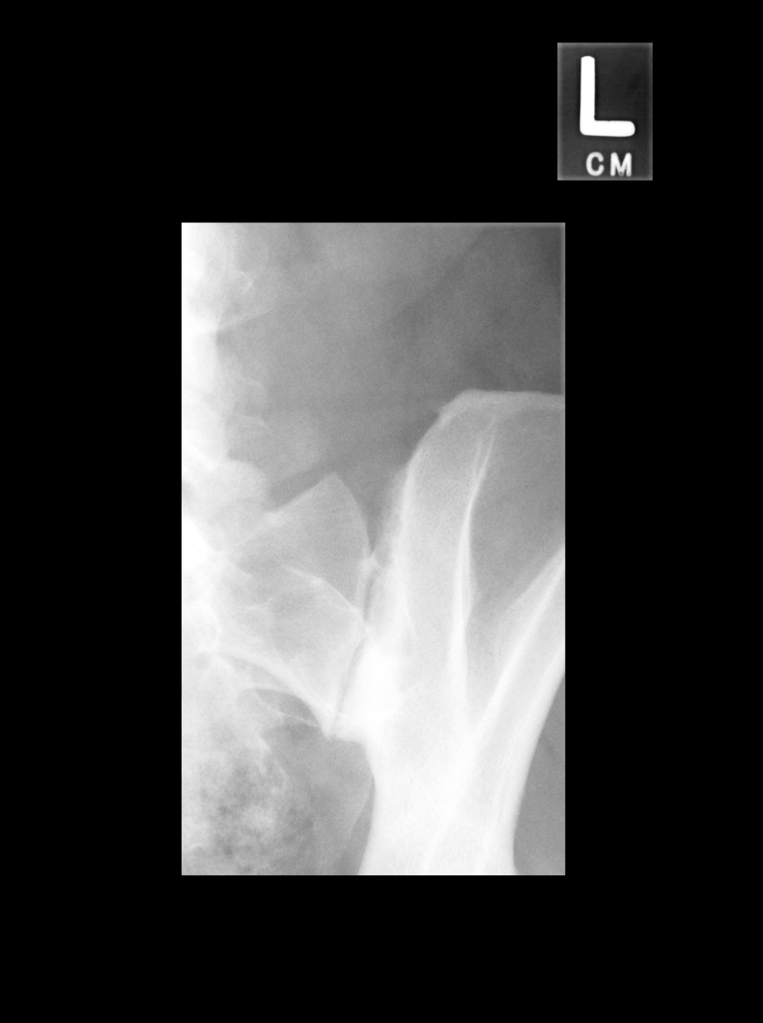

Slide 19
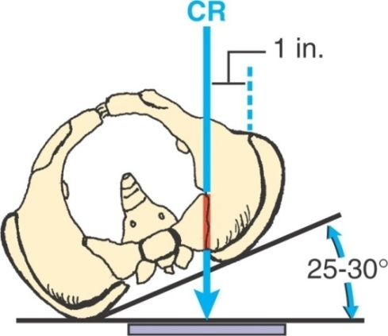

Slide 20
Coccyx
“Tailbone”
Small, triangular bone
3 – 5 fused vertebrae
Curved anteriorly
Base
  Broader, superior portion
  Contains 2 rudimentary transverse processes
  Horn (cornu ) of coccyx projects superiorly to articulate with the sacral horn
Apex
  Pointed tip
Notes:
Most distal portion of the vertebral column

Slide 21
Coccyx

Slide 22
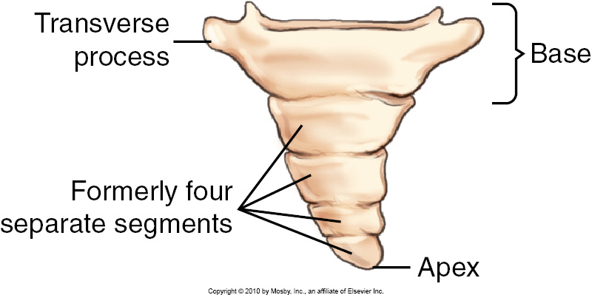
Coccyx Anterior View

Slide 23
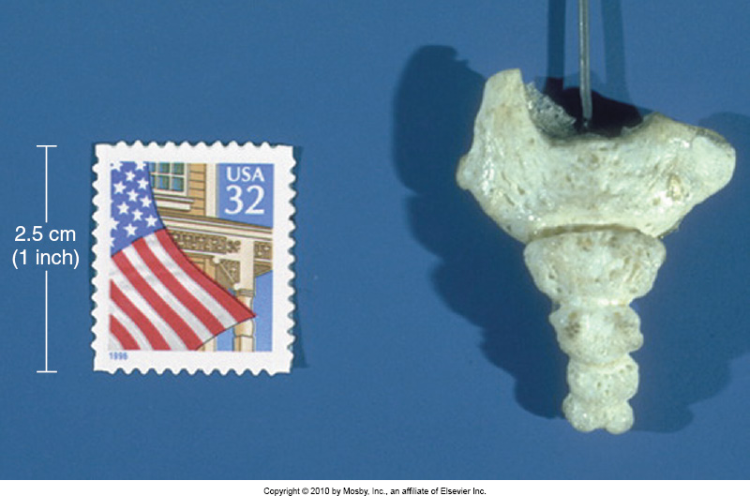
Coccyx
Posterior view depicting actual size of coccyx

Slide 24
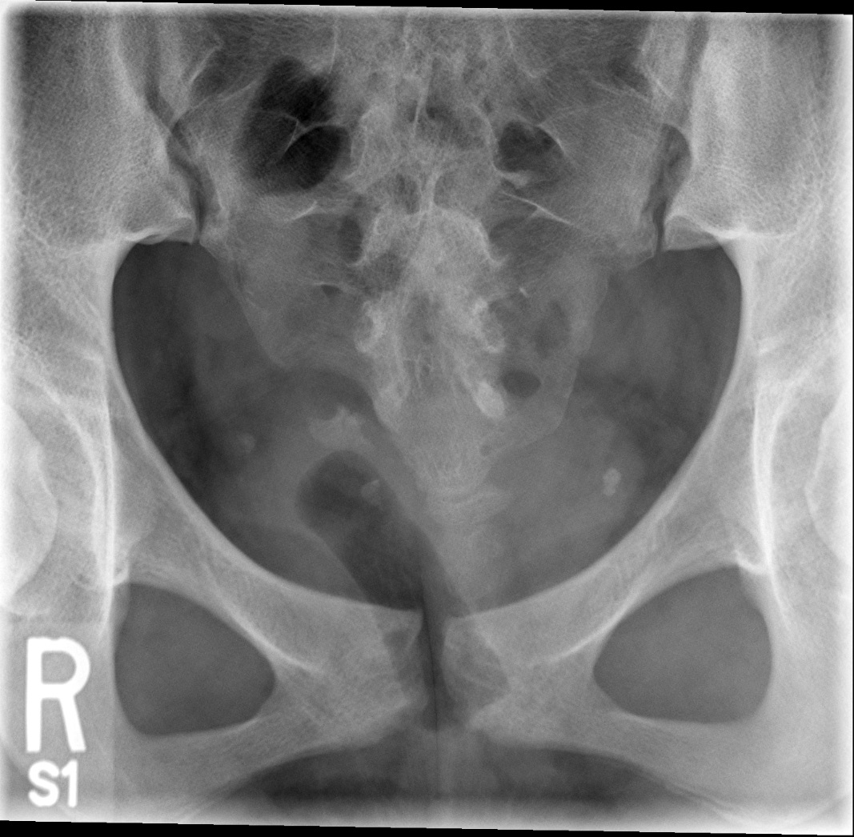

Slide 25
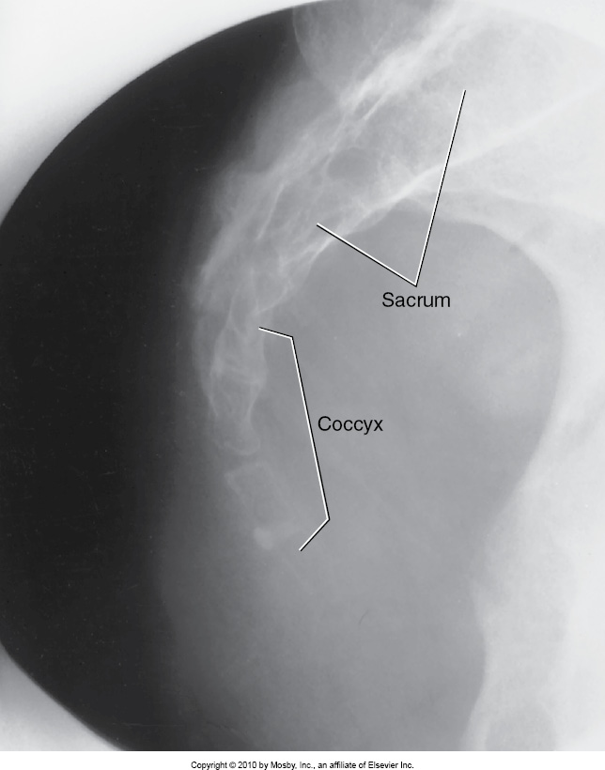

Slide 26
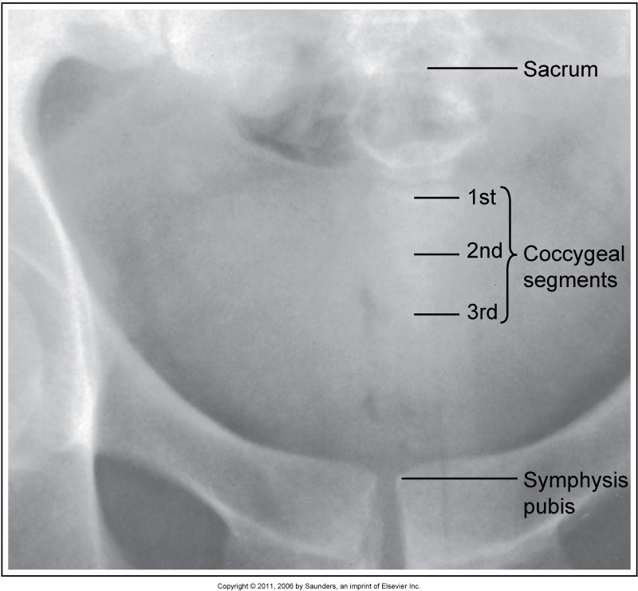

Slide 27


