Slide 1
APPH 226: Emission Spectrum
Objectives:
1.5 Explain how components of the x-ray tube may affect the beam
5.1 Explain the prime factors and their effect on the quantity and quality of the beam

Slide 2
Define Polyenergetic: many energies
The x-ray beam is polyenergetic and consists of a wide range of energies known as the x-ray emission spectrum
X-ray beam consists of:
  Bremsstrahlung
  Characteristic

Slide 3
Spectrum
Why do we need one in x-ray?
  At a glance, can see what was emitted most and least often
  With a spectrum of x-ray energy emissions, we can describe what is emitted from the x-ray tube
  As factors are modified, we can see what the effect is on the energy of the x-rays emitted
    E.g. techniques – mAs, kVp

Slide 4
Emission Spectrum
Simply put, it is a graph of the number of x-ray photons and the range of energies the photons possess at a given exposure setting
  _____________ Spectrum
    Contains only specific values
  _____________ Spectrum
    Contains all possible values

Slide 5
Emission Spectrum
Affected by changing several parameters
  kVp
  mAs
  Target material
  Filtration
  Voltage Waveform

Slide 6
kVp vs. keV
keV = kilo electron volt
  Measurement used for:
    Binding energies
    Energy of incident electron
When the technologist sets the kVp, they are setting the forces with which incident electrons interact with the tungsten target

Slide 7
kVp vs. keV
The projectile/incident electrons accelerated from cathode to anode do not all have the peak kinetic energy
kVp is the peak energy being sent across the tube
  E.g. if 80 kVp is set, it means the maximum energy crossing the tube is 80 keV

Slide 8
kVp vs. keV
Although some electrons are at the highest energy, majority are around 30-40% of the peak energy
Many of the low energy incident electrons end up creating heat
  In fact… 99% cause heat

Slide 9
kVp vs keV
  E.g. If the kVp set was 80 kVp
    What is the maximum energy?
    What would the average energy be?

Slide 10
Bremsstrahlung Emission Spectrum
If we could measure the energy contained in each Bremsstrahlung x-ray emitted from the tube, we would find the energy range to be from 0 to whatever the kVp was set at

Slide 11
Bremmstrahlung Emission Spectrum
How do we calculate the energy of Brems emitted radiation?
  Subtract the incoming vs the outgoing energy of the incident electron
  Maximum incoming it could be is the kVp set
  Provides a range of energies from 0 to the max kVp set

Slide 12
Bremmstrahlung Emission Spectrum
Maximum energy = kVp set
  Not very many
Average energy is about 30-40% of the maximum energy
  Majority of the x-ray are in this range
Minimum energy is 0
Creates a heterogenous or polyenergetic x-ray

Slide 13
Characteristic Emission Spectrum
Only occurs between certain energies, usually above 70 kVp
Why?
  An incident electron travelling below 70 keV cannot knock an electron out of the K shell of a tungsten atom.
    K-shell of tungsten – binding energy of 69.5 keV
How would we calculate the energy of each emitted photon?
  Find the difference between the binding energies of the electron ejected minus the one that took its place

Slide 14
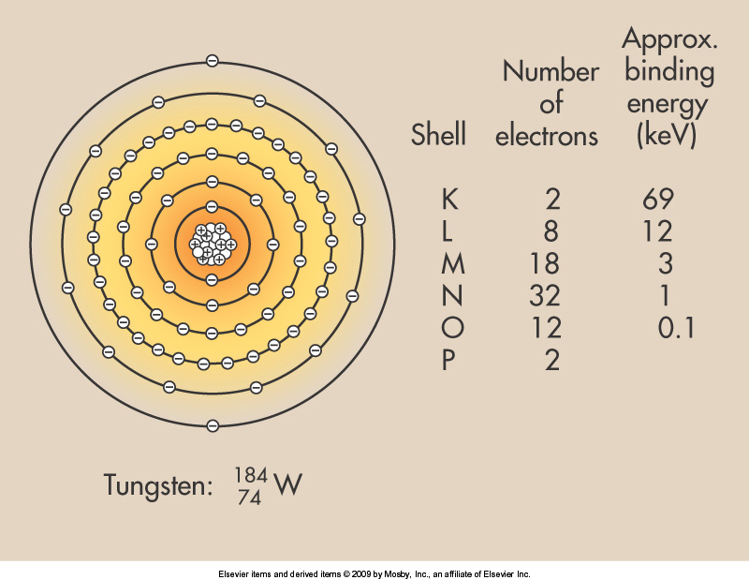
Tungsten
The binding energies are characteristic of the element which is Tungsten in this case.
K shell differences in binding energies are:
  K-L = 57 keV
  K-M = 66 keV
  K-N = 68 keV
  K-O = 69.4 keV
  K-P = 69.5 keV

Slide 15
Characteristic Emission Spectrum
There are many other energies, but the ones from the K shell are the only ones strong enough to make it out of the x-ray tube
Between all the shells, there are 15 possible energies produced – 5 of which are useful for x-ray

Slide 16
Characteristic Emission Spectrum
Because there are so few photon energies that can be created with characteristic
radiation and because they are
so close together, they are most often
represented by a spike or line at 69 keV

Slide 17
X-Ray Emission Spectrum
The general shape of an x-ray spectrum is always the same, but its relative position can change
The larger the area under the curve, the higher the x-ray intensity or quantity

Slide 18
mA - Quantity
mA- the number of electrons available to move from cathode to anode
As we increase our mA, we increase the number of electrons boiled off at the filament
Increasing mA, proportionally increases the # of photons at all energy levels
  Therefore, increasing the amplitude of the spectrum

Slide 19
mA
If we manually changed the technique from 200 mA to 400 mA
We would send a stronger current to the filament
Boil off 2X the amount of incident electrons
And create 2X the amount of x-rays

Slide 20
mAs
What is mAs?
  # of electrons that are sent in 1 second.
The number of x-rays reaching the target is also determined by the time we set
When we set the time we use seconds
    Some machines will have fractions on them instead of times
Exposure time determines how long the electrons will pass from cathode to anode.
Like mA, exposure time is directly proportional to the number of electrons crossing the tube
  therefore directly proportional to the number of x-rays created.

Slide 21
mAs
When we set the quantity of radiation we are setting the mAs
200 mA x 0.5 seconds = 100 mAs
  If this combination gave us 10,000 x-rays
200 mA x 0.25 seconds = 50 mAs
  This combination would give us 5000 x-rays
  mA, time and mAs all affect quantity of x-rays
  All are directly proportional

Slide 22
kVp
The kVp will affect the quality and the quantity of the x-rays

Slide 23
kVp
As we increase the kVp we are increasing the force with which the incident electrons hit the anode
As the kVp increases the curve moves to the right
Why?
  Because the maximum energy increases
  The average energy is 30-40% of that
  The average energy increases

Slide 24
kVp
This means that the average x-ray energy is higher as the kVp is increased.
This improves the __________ of the x-ray
  Quality refers to the strength of radiation
A stronger x-ray photon is better able to penetrate our patients.

Slide 25
kVp
As well as moving to the right the spectrum will grow in amplitude (height)
Why?
  Because when the incident electrons hit the anode at a greater speed they create more x-rays – a lot more

Slide 26
kVp
As the kVp increases
  We increase the quantity of the photons created
  There are more photons that will reach the image receptor
Because kVp will increase the number as well as the quality of the x-rays
  A technologist only has to increase the kVp by _____% to double the amount of photons hitting the receptor
-not directly proportional

Slide 27
Target Material
As we increase the atomic number of the target material, the efficiency of the CHARACTERISTIC RADIATION ______________
Why?
  Because the binding energy for each shell increases

Slide 28
Target Material
For example the K shell electron in a tungsten atom (Z=74)is bound more tightly than the K shell of Molybdenum (Z=42)
Therefore the difference in binding energies will create different strength and number of x-rays

Slide 29
Target Material
Notice the location of the characteristic radiation spike
  Will be characteristic to the binding energies of the target material
  Will happen at whatever energy level required to knock out the k-shell binding energy

Slide 30
Target Material
As the atomic number increases so does the efficiency with which the target produces brems xrays
  Most positive pull with more protons in nucleus
  Able to lose more energy in the form of x-rays
More x-rays increases the quantity of x-rays produced and therefore the amplitude of our spectrum will increase

Slide 31
Draw an Emission Spectrum at 90 kVp

Slide 32
Readings
Bushong: Radiologic Science for Technologists 11th Ed.
  Pg 127-132 (Skip “Effect of added filtration” and stop before “Effect of Voltage Waveform”)

