Slide 1
MRAD 204:
Radiographic Technique 1
Outcome 6-10:
Positioning – IC fossa, Patella, & Tib/fib

Slide 2
Affiliated Readings
Module Reading
Bontrager
Pgs: 244→245
Pgs: 253→255
Pgs: 256→261

Slide 3
Overview
Guidelines/Considerations
Protocol
Positioning

Slide 4
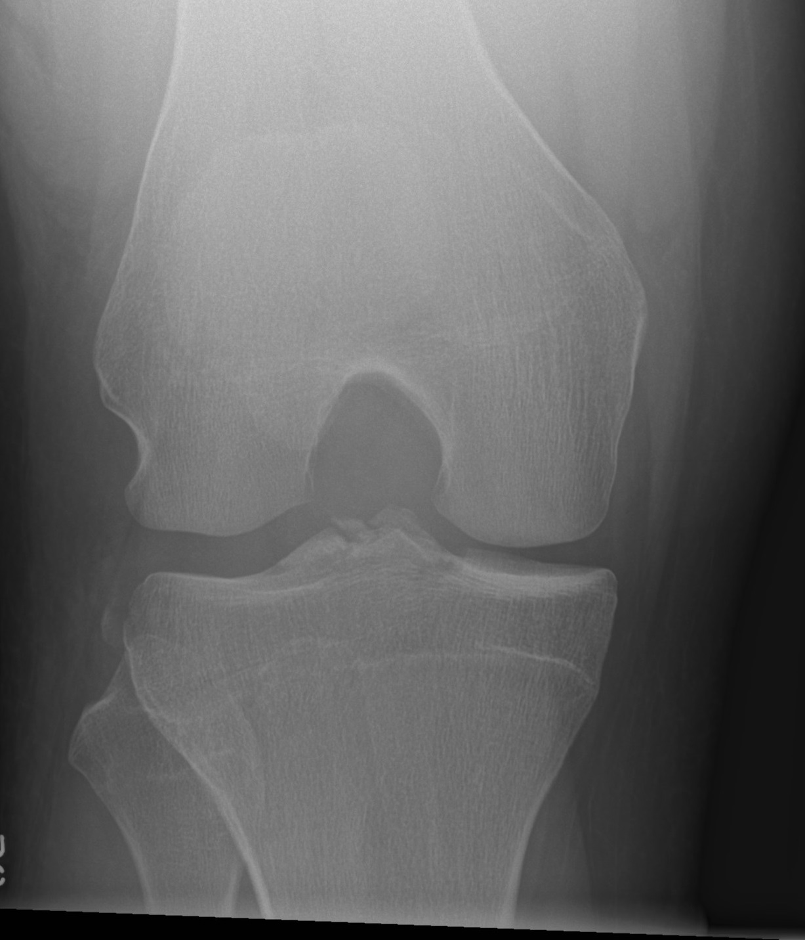
Guidelines/Considerations – IC Fossa
Identify required anatomy
R
https://radiopaedia.org/articles/knee-beclere-method-intercondylar-view-1?lang=us
Intercondylar Fossa projections require visualization of the fibular head distally, the femoral condyles medial/laterally, and the femoral epicondyles proximally

Slide 5
Guidelines/Considerations – IC Fossa
2. Select appropriate equipment/technical factors
*Using the smallest field size possible, collimation
110cm SID, measured electronically using détentes (i.e. blue lock must be engaged)
On the console, select:
  “Table IR”
  *your method of choice
IC Fossa technique = 70→80 kVp

Slide 6
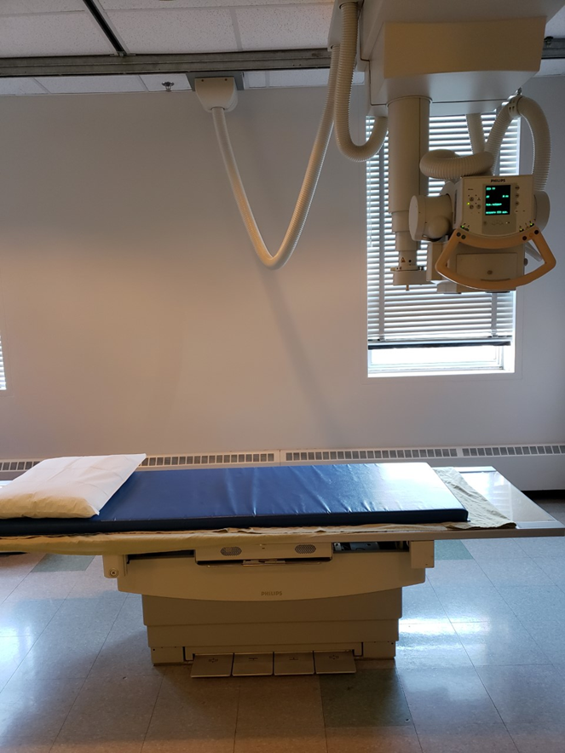
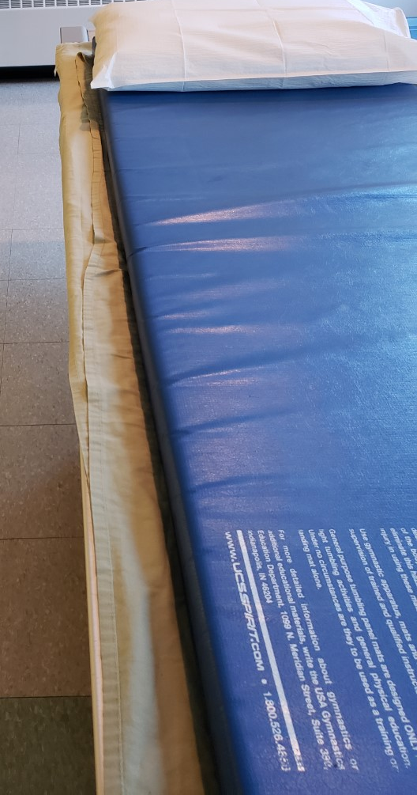
Guidelines/Considerations – IC Fossa
For table imaging: All locks must be “on” except yellow & green
Setup room before bringing the patient in
Tube and IR aligned @ 110cm SID (*set the tube angle first, then measure for SID)
  Lock: centers tube to IR laterally/medially
  Laser light: centers tube to IR superiorly/inferiorly
Correct anatomical marker selected
Ensure IR is covered completely prior to patient mount/dismount
*lock engaged

Slide 7
Guidelines/Considerations – IC Fossa
3. Artifact Removal
Any clothing or objects between the mid-femur to the “mid-calf”
*can be easier to ask your patient to remove their pants and provide them with a gown & housecoat
  Marker likely under soft-tissue anatomy shadow
Notes: when the patient is in the room:
Use external landmarks when positioning
  Femoral epicondyles determine correct patient position
    *when centering: remember the IC Fossa is part of the femur
  CR must be parallel to the Tib/Fib

Slide 8
Intercondylar (IC) Fossa Protocol
Routine:
PA axial
OR
AP axial

Slide 9
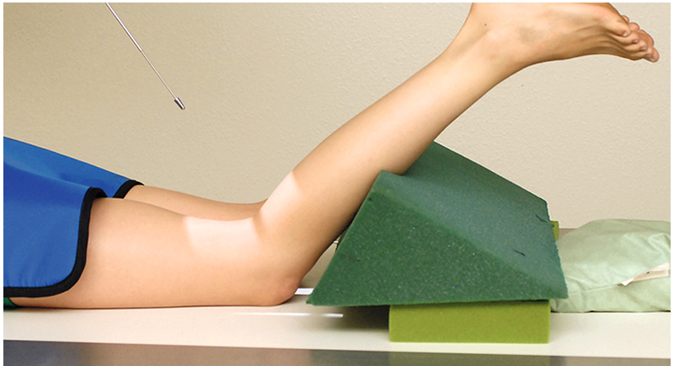
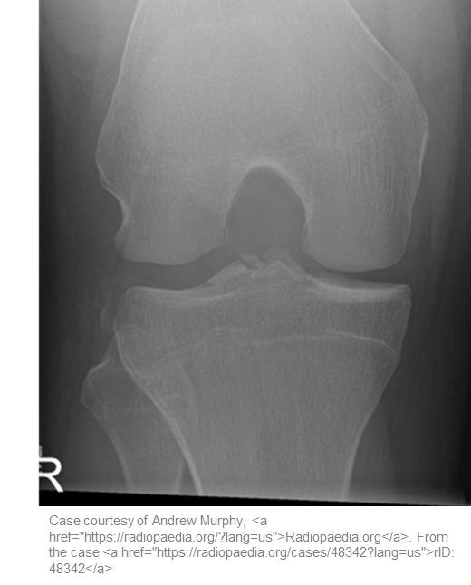
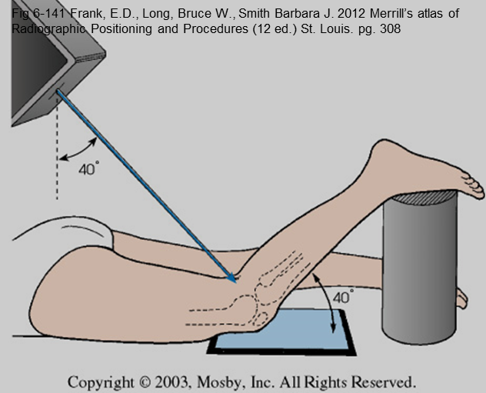
Positioning – PA axial (Camp Coventry Method)
Bontrager pg. 253 Fig. 6.118
Patient prone, knee flexed ~45⁰ with support under affected leg
Femur parallel to edge of IR
Knee must be positioned in true PA (aka. Femoral epicondyles parallel to IR)
CR angle matches knee flexion
Place an anatomical marker (using Anderson Marker Rules), at the inferior lateral edge of the light field, and make final adjustments
L
CR perpendicular to tib/fib

Slide 10
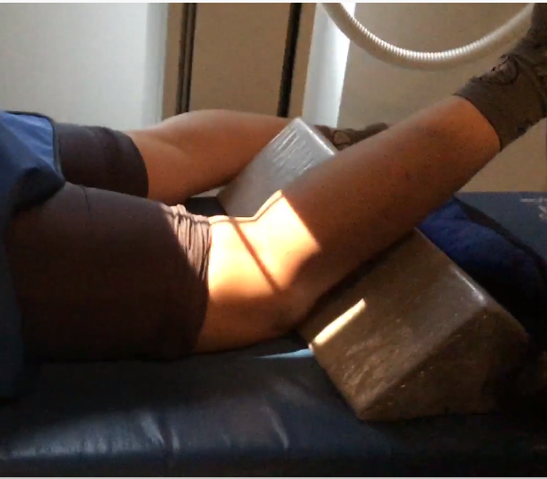
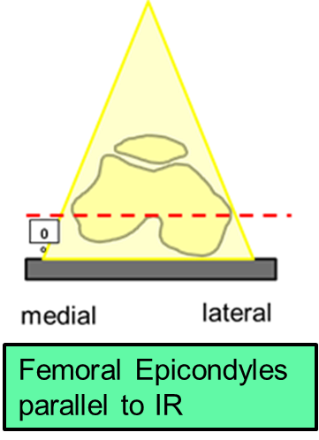

Positioning – PA axial (Camp Coventry Method)
CR & Knee flexion = ~45⁰ (i.e. CR perpendicular to tib/fib)
Note: When using “large” angles, check for CR crosshair in relation to anatomy as the light field will be distorted (i.e. crosshair should “hit” the lateral femoral epicondyle)
Crosswise crosshair should be located around knee joint
Lateral-medial collimation: @ least ½ inch beyond femoral epicondyles
Lengthwise crosshair centered between femoral epicondyles
“Bottom” of light field on pt. ~2.5-inches below knee joint (to include head of fibula)
“Top” of light field on IR at least ½ inch proximal to femoral epicondyles
Marker on lateral edge of light-field “femur-up”
Femur parallel to longitudinal edge of IR

Slide 11
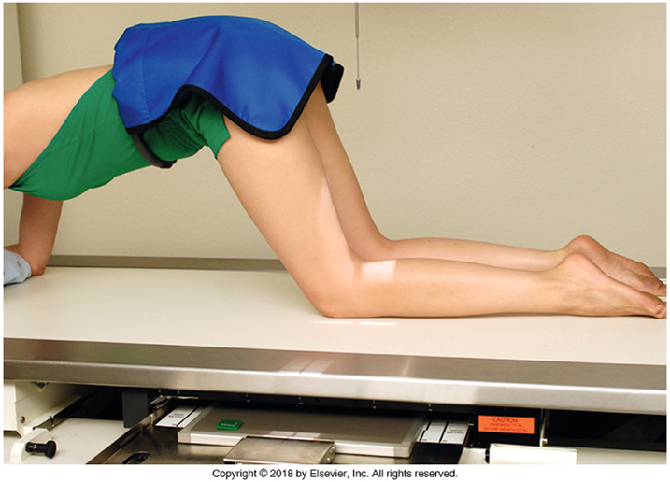

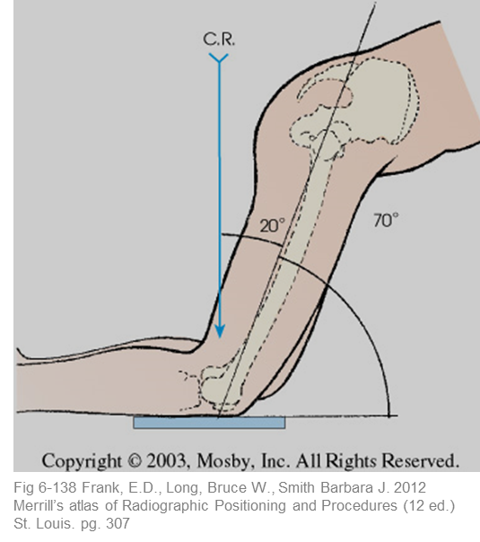
Positioning – PA (Holmblad Method)
Bontrager pg. 253 Fig. 6.119
Patient kneeling, and leaning forward ~20⁰ to remove soft-tissue superimposition
Femur parallel to edge of IR
Knee must be positioned in true PA (aka. Femoral epicondyles parallel to IR)
CR angle matches lower leg
Place an anatomical marker (using Anderson Marker Rules), at the inferior lateral edge of the light field, and make final adjustments
CR perpendicular to tib/fib

Slide 12
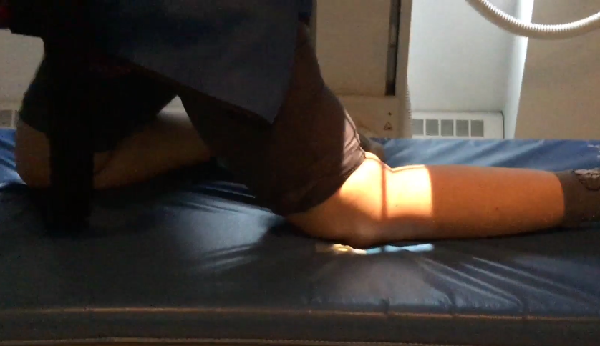
Positioning – PA (Holmblad Method)
CR perpendicular to tib/fib
Lateral-medial collimation: @ least ½ inch beyond femoral epicondyles
Lengthwise crosshair centered between femoral epicondyles
Crosswise crosshair should be located around knee joint
Patient weight placed on unaffected knee
“Bottom” of light field on IR ~2.5-inches below knee joint (to include head of fibula)
“Top” of light field on IR at least ½ inch proximal to femoral epicondyles
Marker on lateral edge of light-field “femur-up”
Femur parallel to longitudinal edge of IR

Slide 13
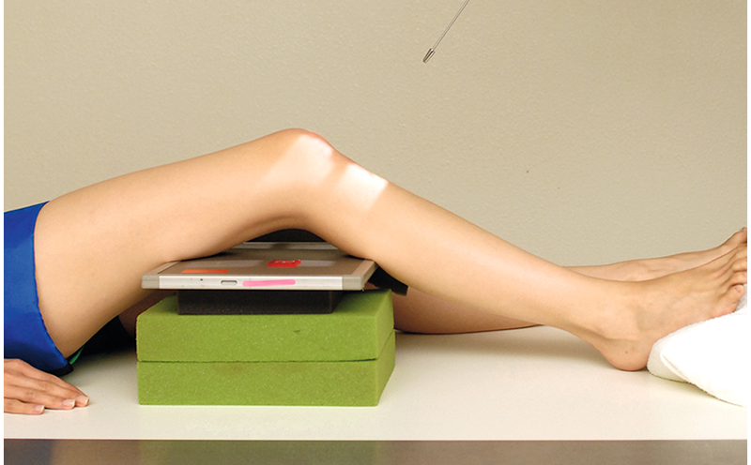
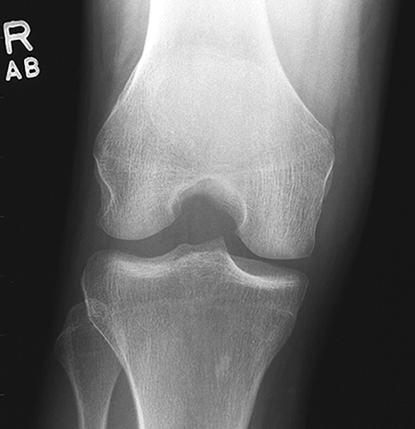
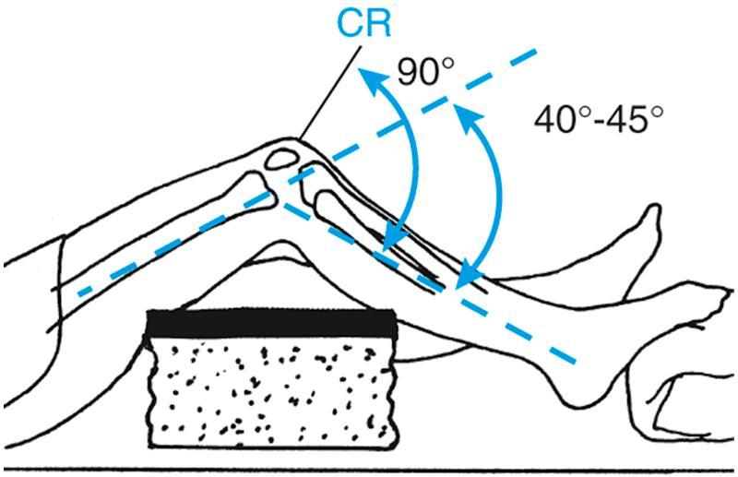
Positioning – AP axial (Béclere Method)
Worst method (due to distortion caused by OID)
Bontrager pg. 255 Fig. 6.124-6.126

Slide 14
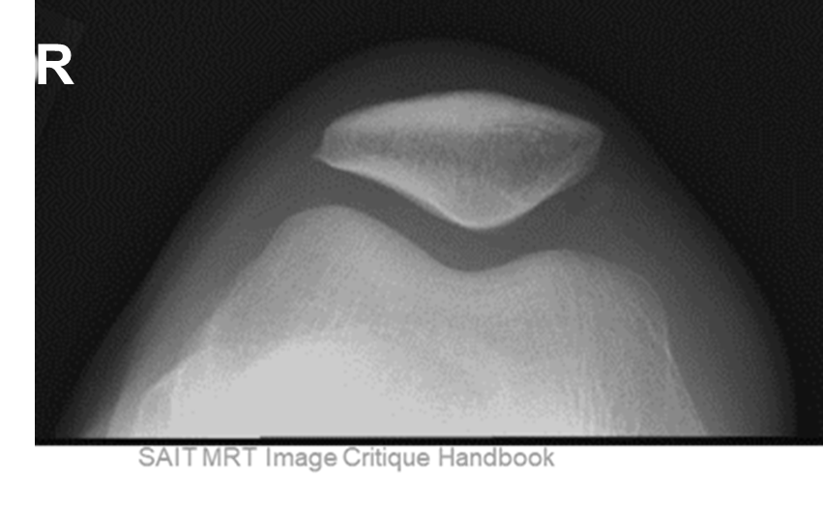
Guidelines/Considerations – Patella
1, 2 & 3. Same as IC Fossa EXCEPT:
Tangential patella projections require visualization of the entire patella, patellofemoral joint space, intercondylar sulcus of the femur, and the femoral condyles
CR cassette must be used for tangential patella projections
SID 100cm

Slide 15
Patella Protocol
Routine:
PA
Lateral
Tangential

Slide 16
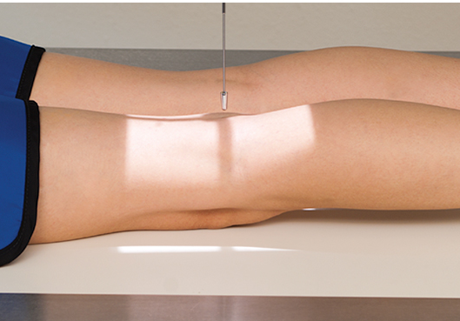
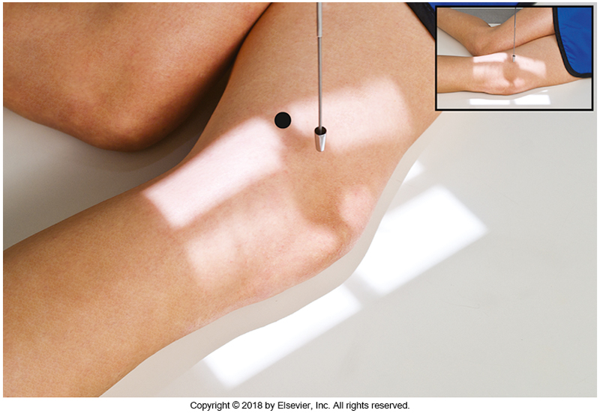
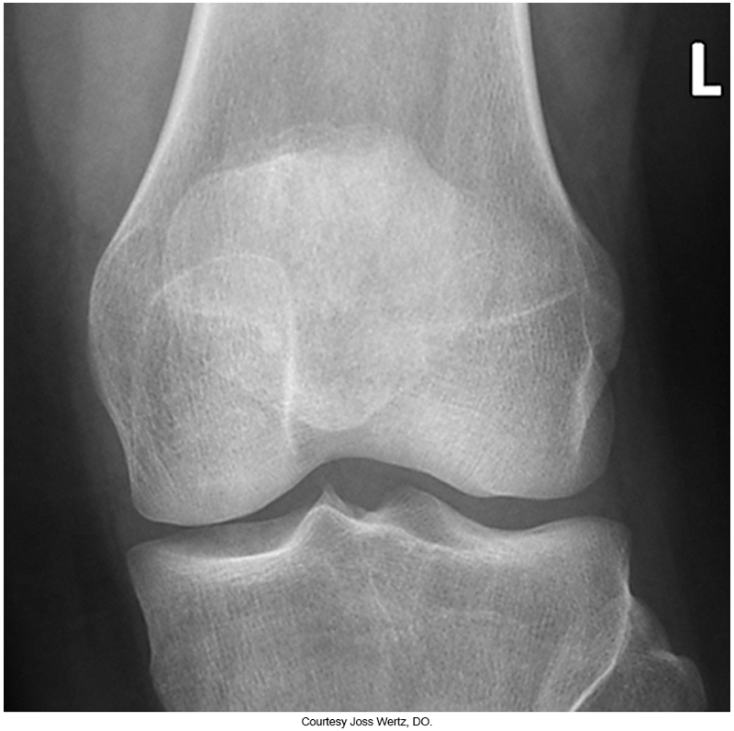
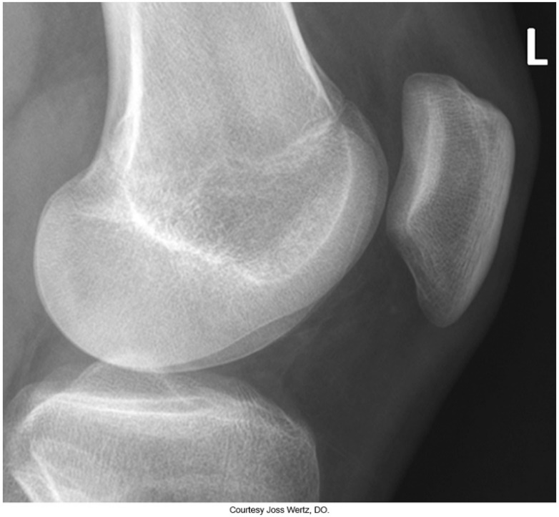
Positioning – PA & Lateral Patella
L
Small field size, centered to patella
L
Only 5-10⁰ knee flexion
Bontrager pg. 256-257 Fig. 6.127-6.130

Slide 17
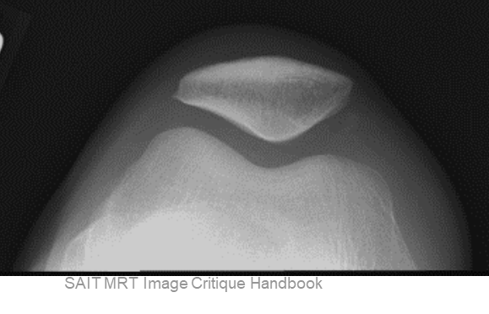
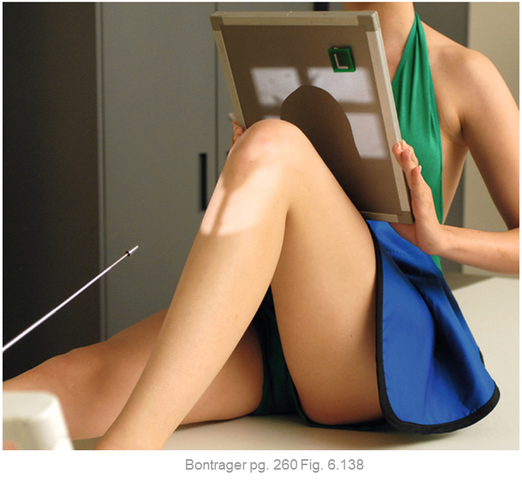
Positioning – Seated Settegast Method
Patient seated with feet at bottom edge of table
Femoral epicondyles parallel to IR)
Palpate borders of patella to determine specific CR angle required to pass through patellofemoral joint space
Pt. to hold IR perpendicular to CR
Place an anatomical marker, (using Anderson Marker Rules), and make final adjustments
R

Slide 18
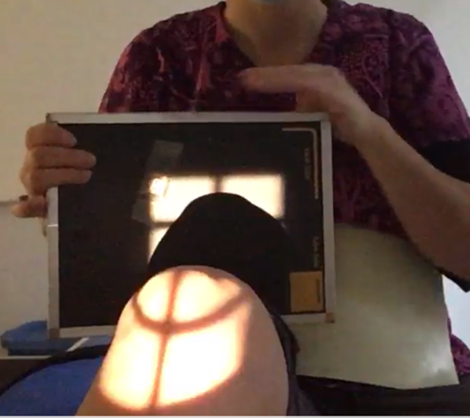
Positioning – Seated Settegast Method
CR parallel to patellofemoral joint space
Lateral-medial collimation: @ least ½ inch beyond femoral epicondyles
“Top” of light field on IR at least ½ inch beyond the patella shadow
Marker on lateral superior edge
Knee flexed 90⁰
R
IR held perpendicular to CR
Crosswise crosshair should appear to “wrap around” the patella
“Bottom” of light field on IR @ level of femoral epicondyles
Lengthwise crosshair centered between femoral epicondyles

Slide 19
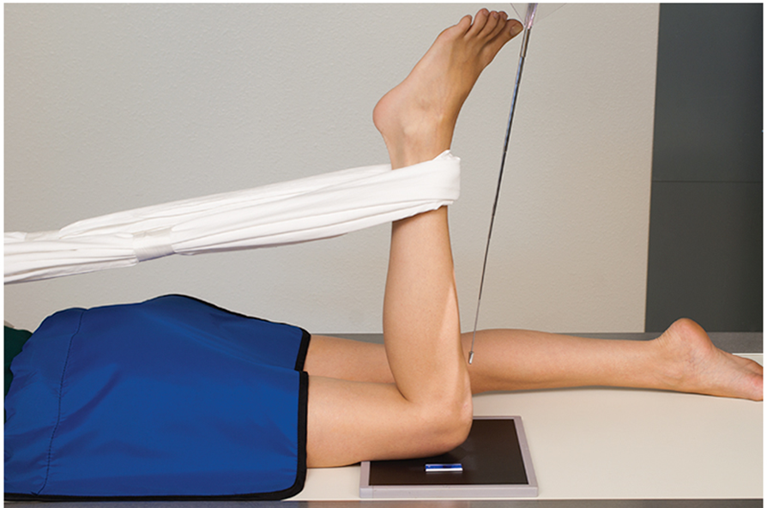
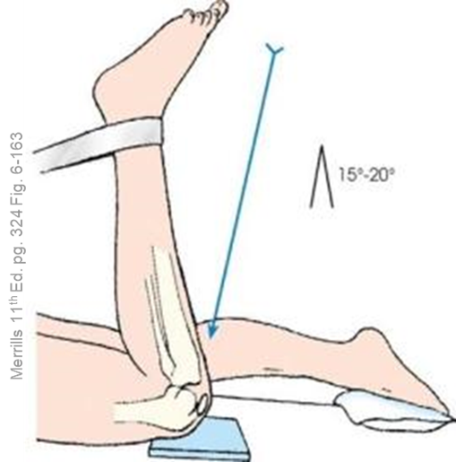
Positioning – 90/20 Settegast Method
Patient prone, knee flexed 90⁰ with support for affected leg as needed
Femur parallel to edge of IR
Femoral epicondyles parallel to IR)
CR angle matches angle of patella (~20⁰)
Place an anatomical marker, distal to the femur (using Anderson Marker Rules), and make final adjustments
Bontrager pg. 260 Fig. 6.137
R

Slide 20
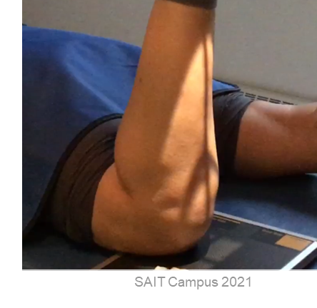
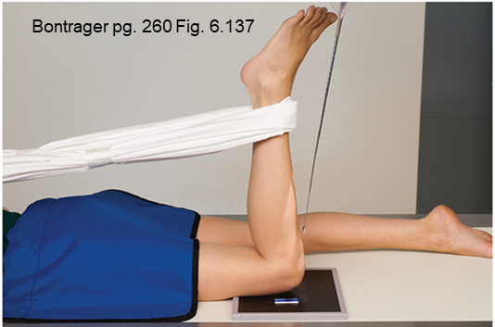
Positioning – 90/20 Settegast Method
CR parallel to patellofemoral joint space
Lateral-medial collimation: @ least ½ inch beyond femoral epicondyles
Lengthwise crosshair centered between femoral epicondyles
“Top” of light field on IR at least ½ inch beyond the patella shadow
Marker on lateral edge of light-field “patella-up”
Crosswise crosshair should appear to “wrap around” the patella
Knee flexed 90⁰
“Bottom” of light field on IR @ level of femoral epicondyles
Femur parallel to longitudinal edge of IR

Slide 21
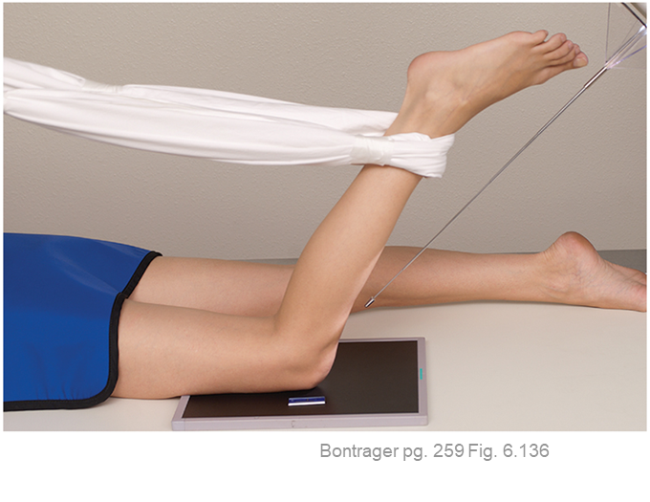
Positioning – Hughston Method
CR parallel to patellofemoral joint space
Lateral-medial collimation: @ least ½ inch beyond femoral epicondyles
Lengthwise crosshair centered between femoral epicondyles
Crosswise crosshair should appear to “wrap around” the patella
Knee flexed 50-60⁰
“Top” of light field on IR at least ½ inch beyond the patella shadow
Marker on lateral edge of light-field “patella-up”
“Bottom” of light field on IR @ level of femoral epicondyles
Femur parallel to longitudinal edge of IR

Slide 22
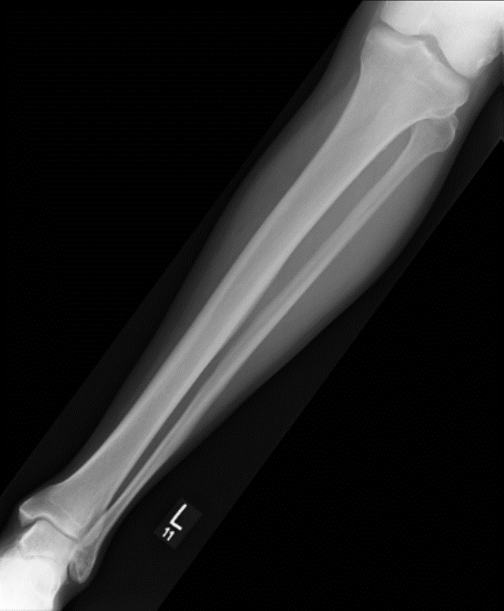
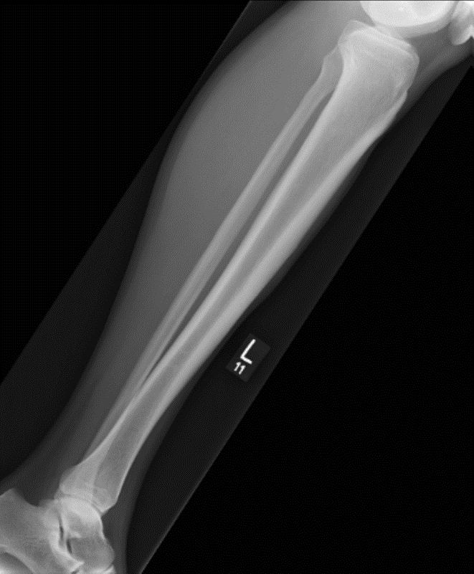
Guidelines/Considerations – Tib/Fib
Identify required anatomy
R
AP& lateral tib/fib radiographs require the knee joint, ankle joint, entire tibia and fibula, & surrounding soft-tissues
SAIT MRT Image Critique Handbook

Slide 23
Guidelines/Considerations – Tib/Fib
2 & 3. Same as IC Fossa except:
Patient must also be instructed to remove their socks
Wireless digital IR can be used to ensure entire tib/fib is imaged in one radiograph
  If this option is selected, SID must begin at 100cm, then increased (as needed) to ensure all required anatomy “fits” lengthwise into the maximum permissible light-field

Slide 24
Tibia/Fibula Protocol
Routine:
AP
Lateral

Slide 25
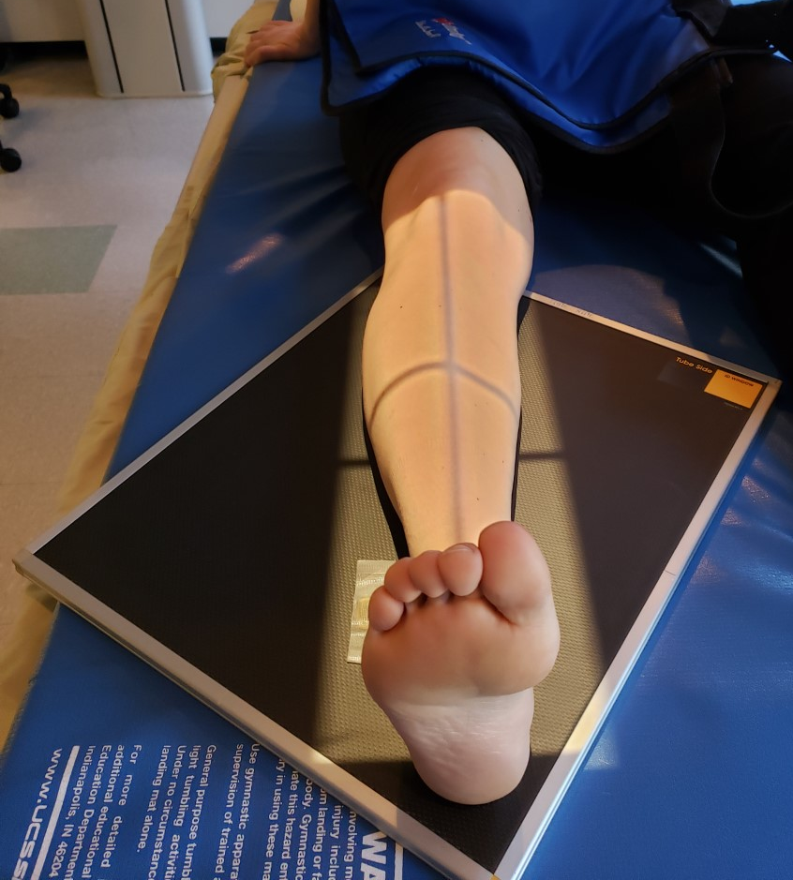
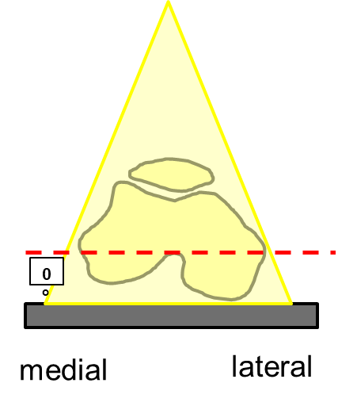
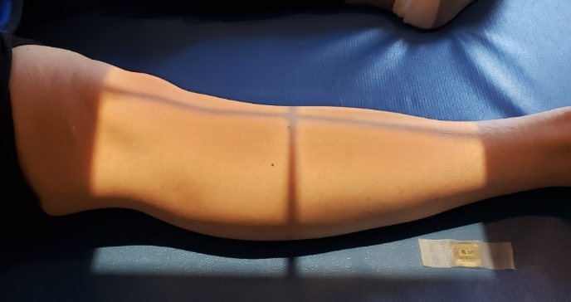
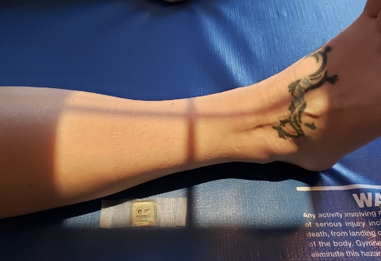
Positioning – AP Tibia/Fibula
Place leg diagonally across wireless IR (heel and knee in opposite corners) or take two portrait table IR images
Knee must be positioned in true AP
  Aka. Femoral epicondyles parallel to IR
Dorsiflex foot (if possible)
Place an anatomical marker (using Anderson Marker Rules), proving overlap as needed, and make final adjustments
Note: the longer field size should include site of injury, and the marker is used to prove overlap

Slide 26
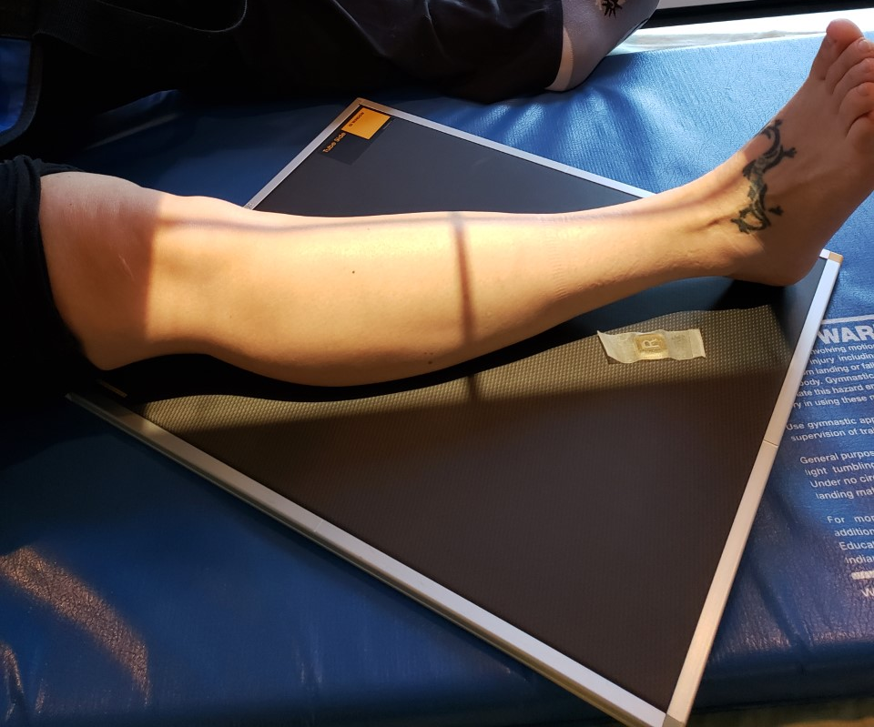
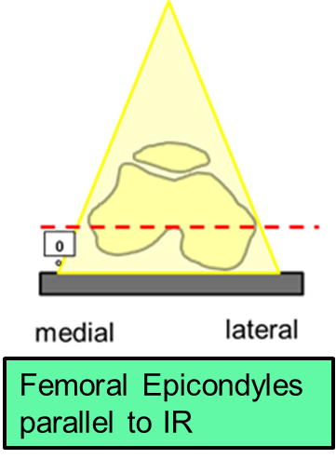
Positioning – AP Tibia/Fibula
Remember: wireless IR/cassette should be diagonal
Lengthwise crosshair ½ between femoral epicondyles
CR should be located around mid-tibia
Lateral-medial collimation: @ least ½ inch beyond soft-tissue
“Top” of light field on IR @ level of femoral epicondyles
Marker on lateral side, not under anatomy shadow
“Bottom” of light field on IR ~½ inch inferior to lateral malleolus
Foot dorsiflexed 90⁰

Slide 27
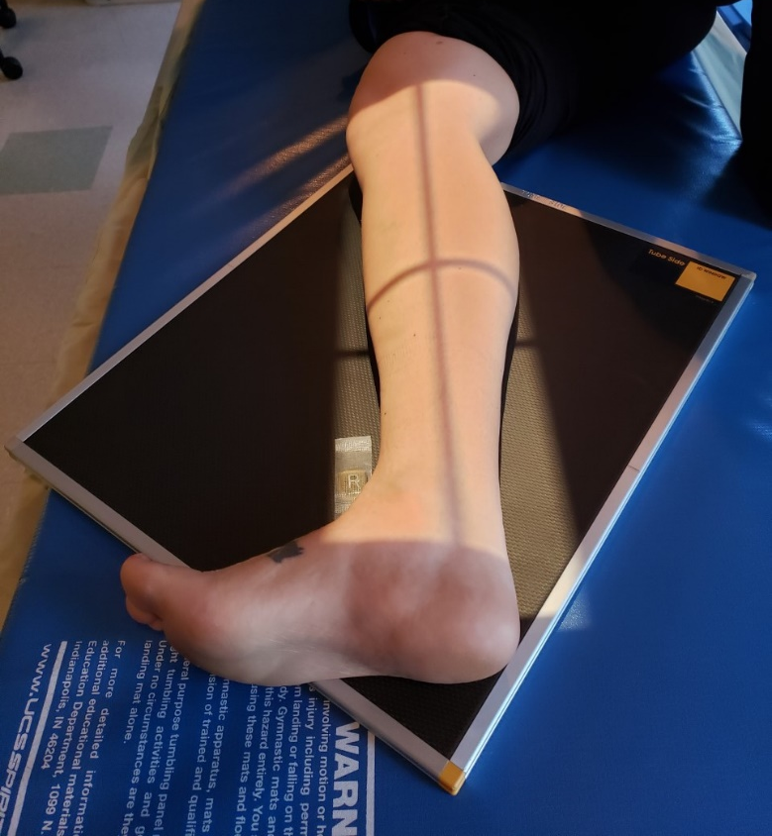
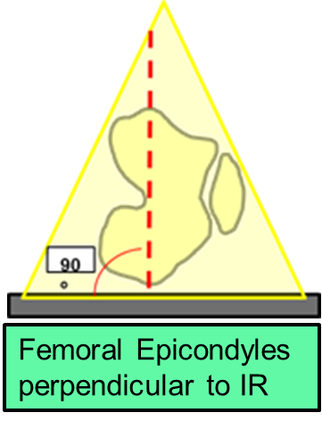
Positioning – Lateral Tibia/Fibula
Place leg diagonally across wireless IR (heel and knee in opposite corners) or take two portrait table IR images
Note: must have @ least ½-inch of light posterior to the soft-tissue of the calf muscle (not shown in this image)
Knee must be positioned in true Lateral
  Aka. Femoral epicondyles perpendicular to IR
Partially flex knee of affected side
Dorsiflex foot (if possible)
Place an anatomical marker (using Anderson Marker Rules), proving overlap as needed, and make final adjustments

Slide 28
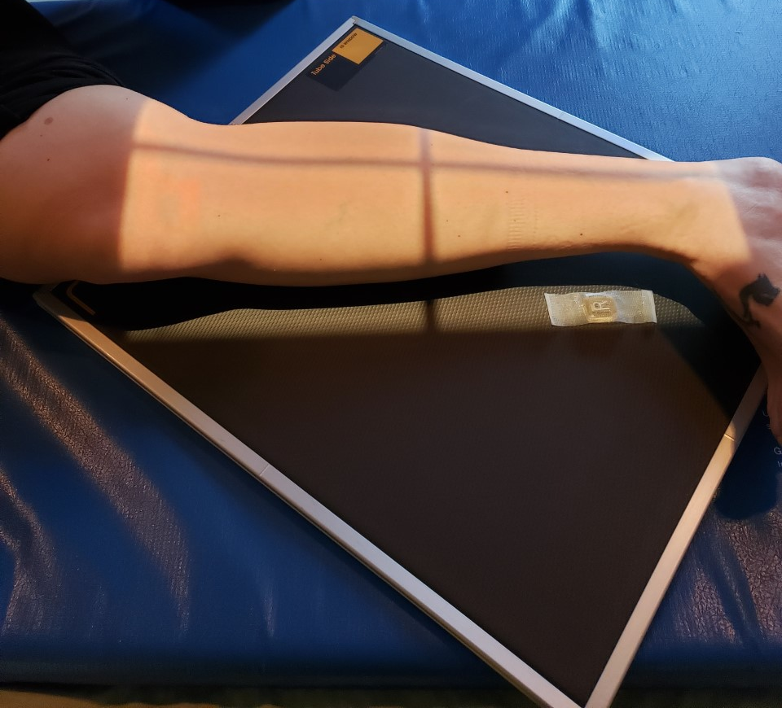
Positioning – Lateral Tibia/Fibula
Remember: wireless IR/cassette should be diagonal
Lengthwise crosshair ½ between femoral epicondyles
CR should be located around mid-tibia
Knee partially flexed
Anterior/posterior collimation: @ least ½ inch beyond patella
& soft-tissue
“Top” of light field on IR @ level of femoral epicondyles
Ensure unaffected leg is removed from ROI
Marker on anterior side, not under anatomy shadow
“Bottom” of light field on IR ~½ inch inferior to lateral malleolus (must check inferior/posteriorly)
Foot dorsiflexed 90⁰

