Slide 1
Lumbar Obliques
MRAD 256
Radiographic Technique 2

Slide 2
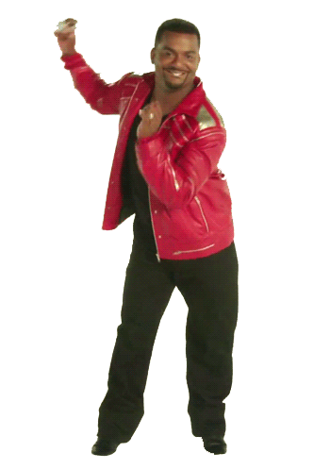

Slide 3
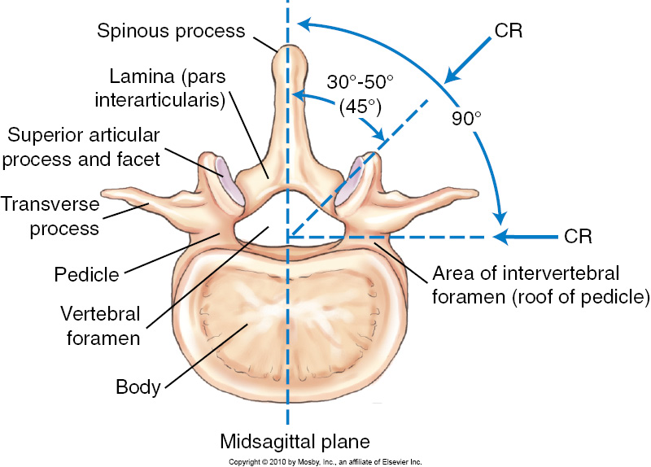
Lumbar Vertebra Superior View

Slide 4
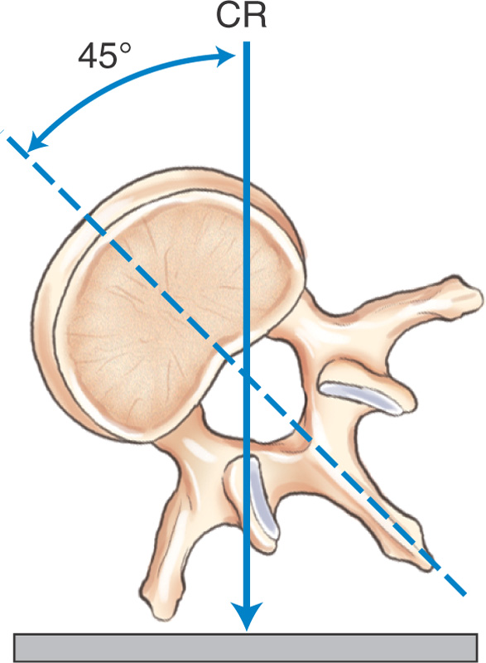
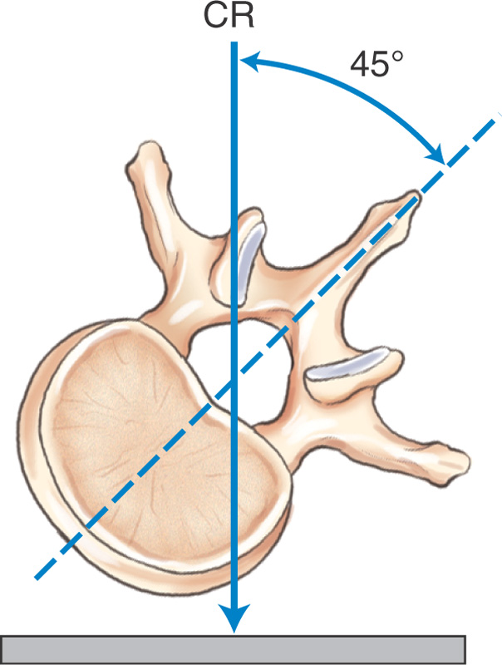
Zygapophyseal Joints
Downside joints (posterior oblique)
Upside joints (anterior oblique)

Slide 5
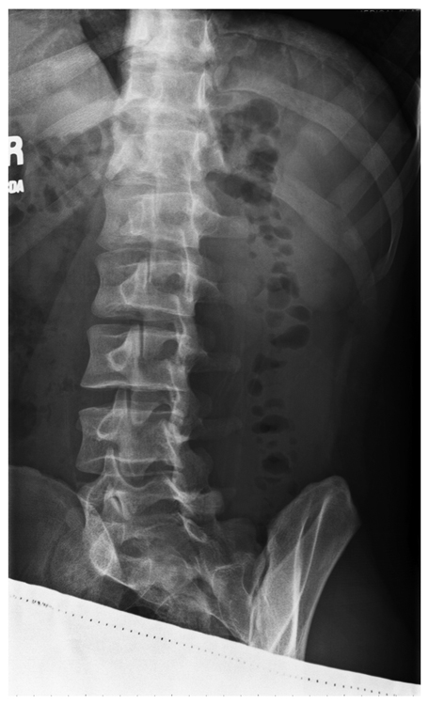
Evaluation Criteria: Oblique L-Spine
L1 to S1 demonstrated
Zygapophyseal joints visualized
Pedicle near center of vertebral body
Optimal exposure factors
RPO

Slide 6
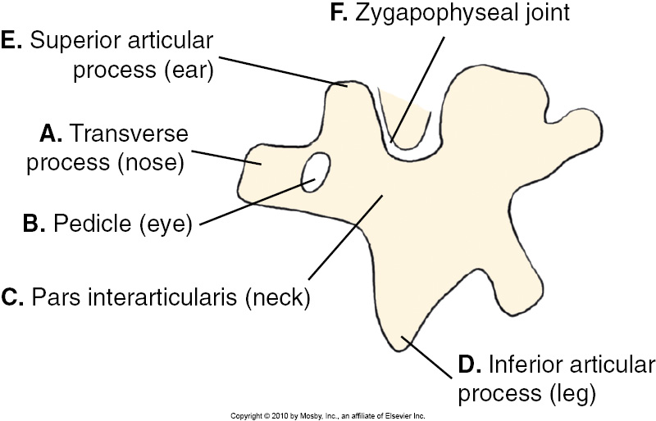
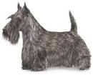
Scottie Dog
Notes:
On an anterior oblique radiograph of the lumbar spine, the pars is the neck of the imaginary Scottie dog; the Scottie dog's eye is the pedicle,^{[3]} its hindlegs the spinous process, its nose the transverse process, its ear the superior articular facet and its forelegs the inferior articular facet.^{[4]}

Slide 7
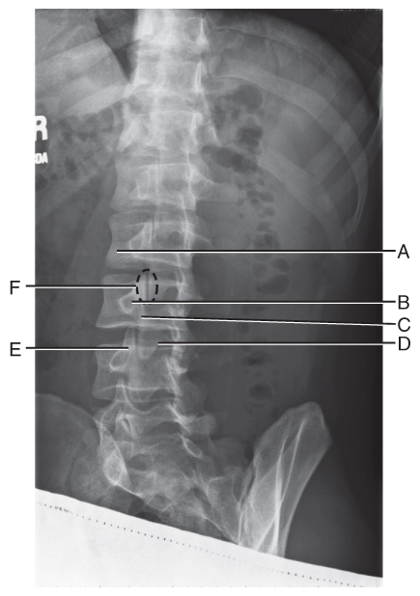
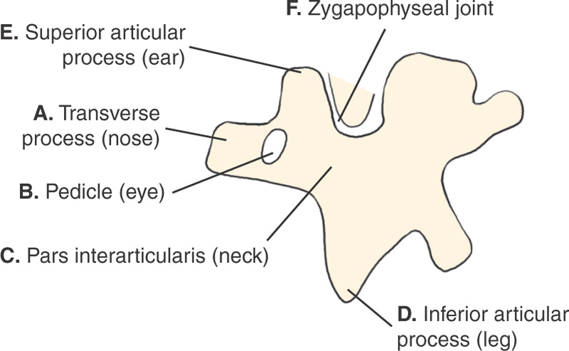
“Scottie Dog”

Slide 8
AP Oblique Projection RPO and LPO
The resulting image shows an oblique projection of the lumbar spine, demonstrating the articular processes of the closest to the IR
Properly positioned, the images of the vertebrae have a scottie dog appearance.

Slide 9
PA Oblique Projection RAO and LAO
The resulting image shows an oblique projection of the side farther from the IR

Slide 10
Lumbar Obliques
PROJECTION
AP Obliques
POSITION-DEGREES
LPO 45 deg
LAO 45 deg
STRUCTURES SHOWN
L: z joint (joints down)
R: z joint (joints down)
RPO 45 deg
PA Obliques
RAO 45 deg
R: z joint (joints up)
L: z joint (joints up)

Slide 11
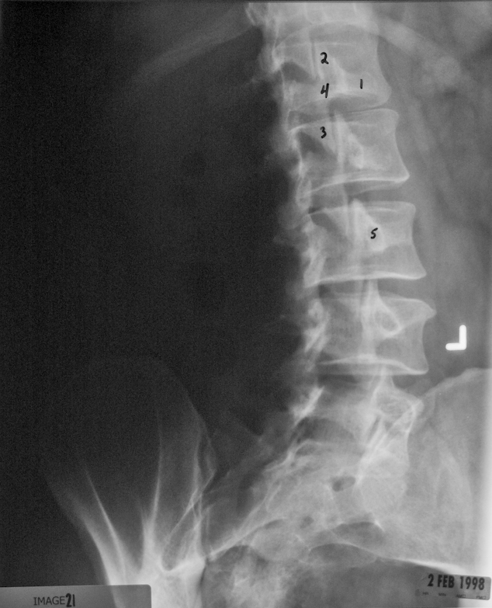

Slide 12
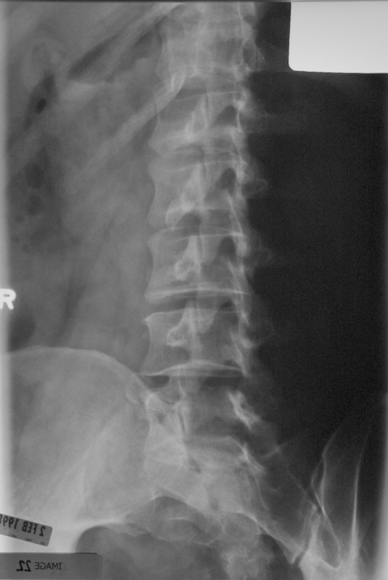

Slide 13


