Slide 1
MRAD 204:
Radiographic Technique 1
Outcome 6-10:
Anatomy of the Proximal Femur
MRT Program
Anderson College

Slide 2
Affiliated Readings
Module Reading
Bontrager
Pgs: 266, 271 & 273→274

Slide 3
Overview
Proximal Femur
Anatomic referencing
Effects of Lower Limb Rotations

Slide 4
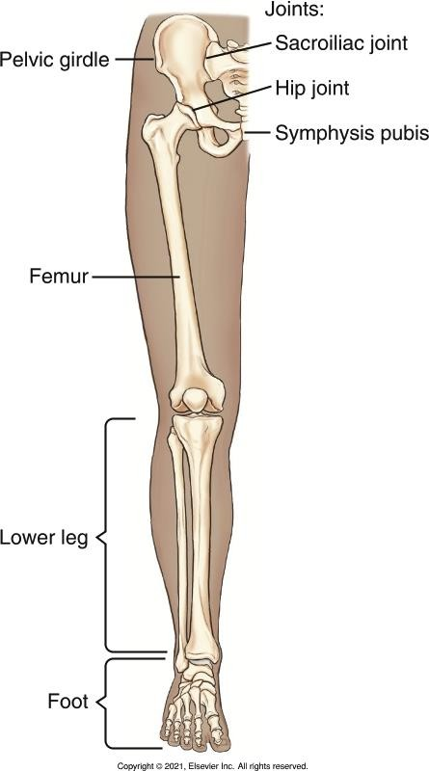
Proximal Femur
Longest, strongest bone in the body
Supports entire weight of the body

Slide 5
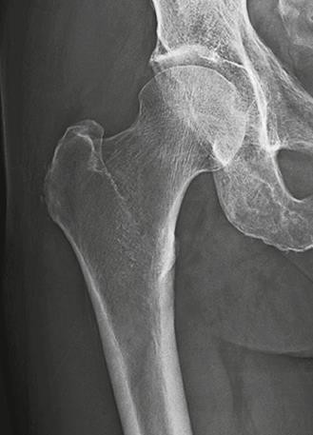
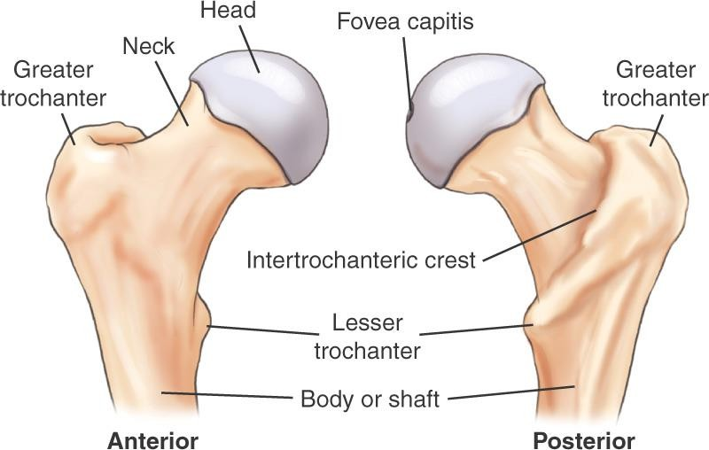
Proximal Femur
Bontrager pg. 266 Fig. 7.2
Bontrager pg. 288 Fig. 7.67

Slide 6
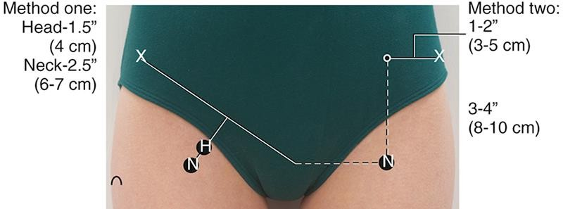
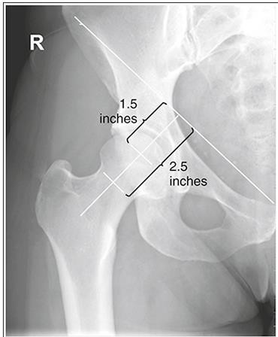
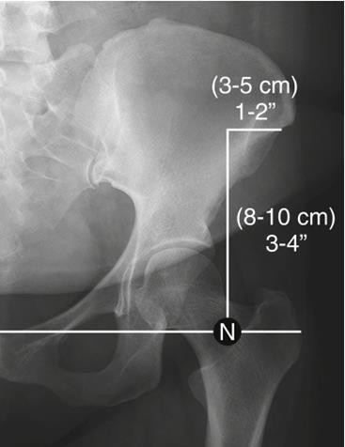
Anatomic Referencing
Locating the head and neck of the femur:
McQuillen Martensen 5th Ed. pg. 440 Fig. 7.35
Bontrager pg. 273 Fig. 7.21-7.22

Slide 7
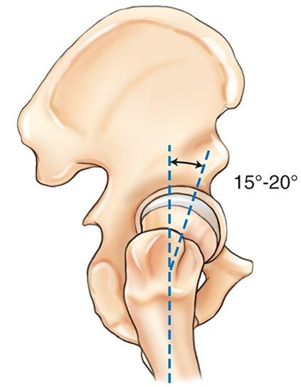
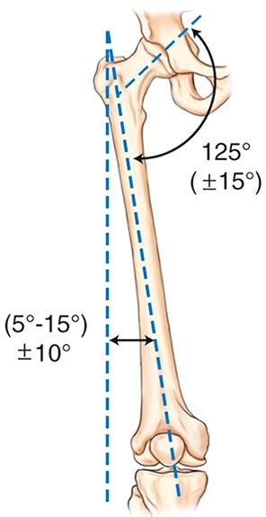
Orientation – in anatomic position
In an average adult, the longitudinal plane of the femur forms a 10º angle from vertical
  Less for tall patients with a narrow pelvis
Bontrager pg. 266 Fig. 7.3
The head & neck of the femur sit about 15→20º anterior to the body of the femur
  15→20º internal rotation required to place the femoral neck parallel to an IR
Bontrager pg. 266 Fig. 7.3

Slide 8
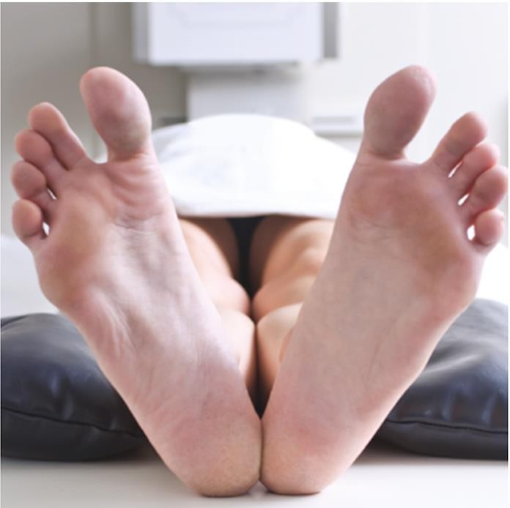
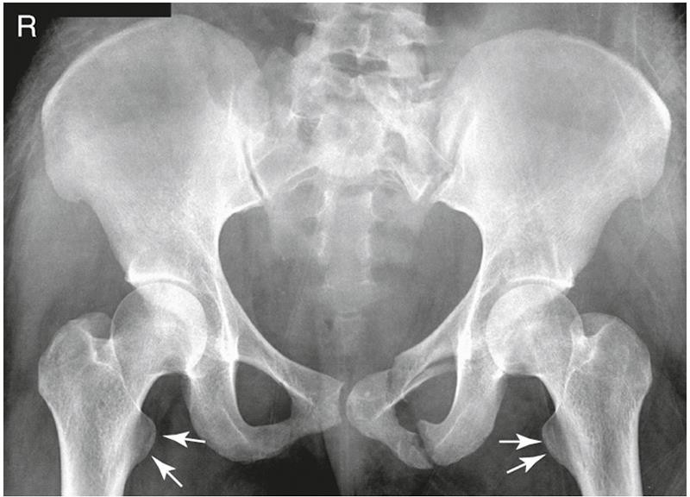
Effects of Lower Limb Rotations
Radiographic appearance of External Rotations
Femoral neck foreshortened
Lesser trochanter in profile, medially

Slide 9
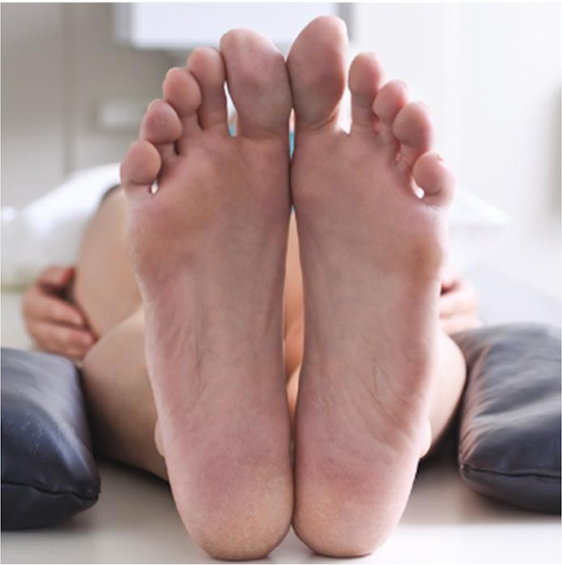
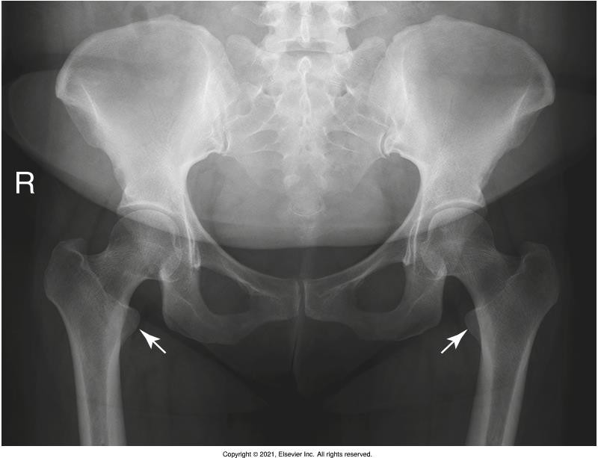
Effects of Lower Limb Rotations
Radiographic appearance of Anatomic Position
Femoral neck partially foreshortened
Lesser trochanter visible

Slide 10
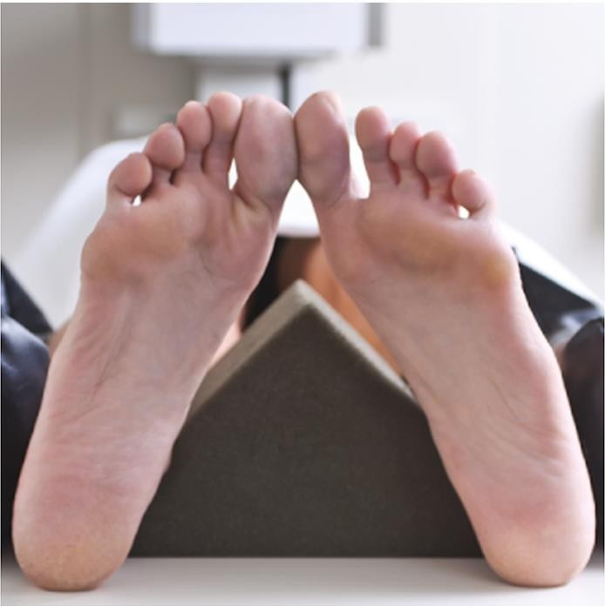
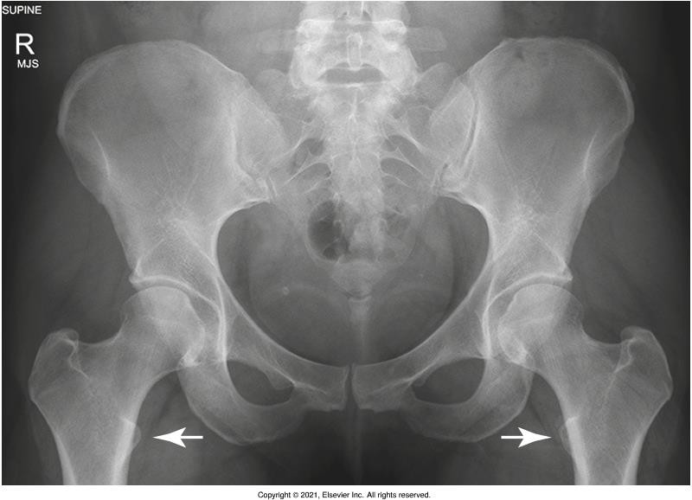
Effects of Lower Limb Rotations
Radiographic appearance of Internal Rotations
Femoral head & neck in profile
Lesser trochanters *not visible or only slightly visible

Slide 11
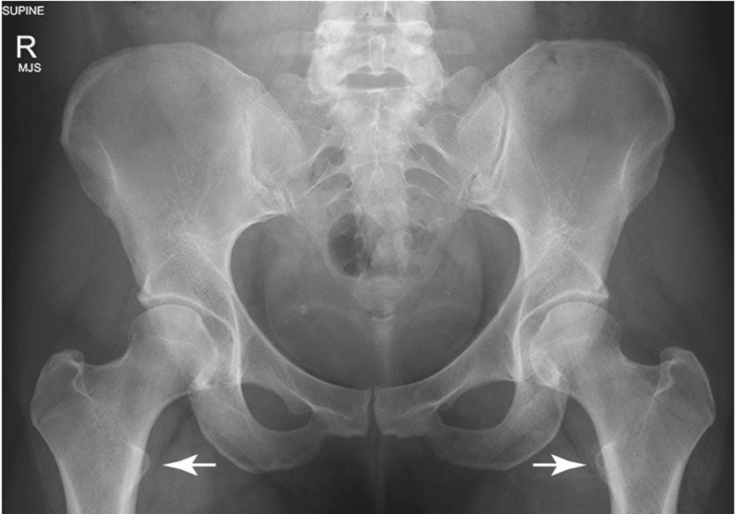
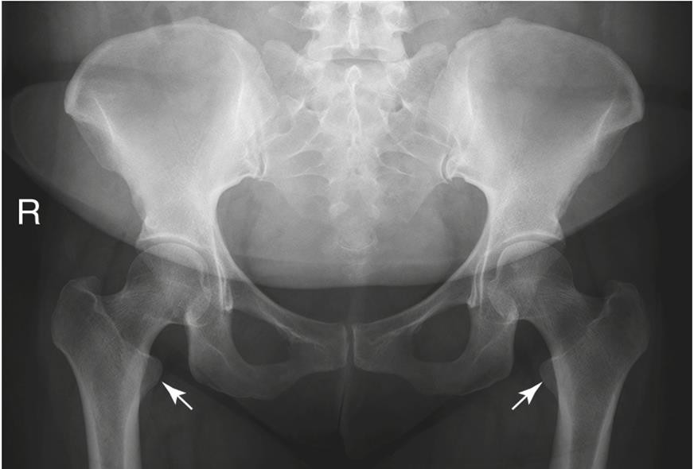
Rotation – Comparisons
Bontrager pg. 274 Fig. 7.26, 7.28, & 7.30

