Slide 1
MRAD 204:
Radiographic Technique 1
Outcome 1-5:
Anatomy of the Shoulder Girdle
MRT Program

Slide 2
Affiliated Readings
Module 4
Bontrager
Pgs: 179→181

Slide 3
Overview
Shoulder Girdle
Scapula
Clavicle

Slide 4
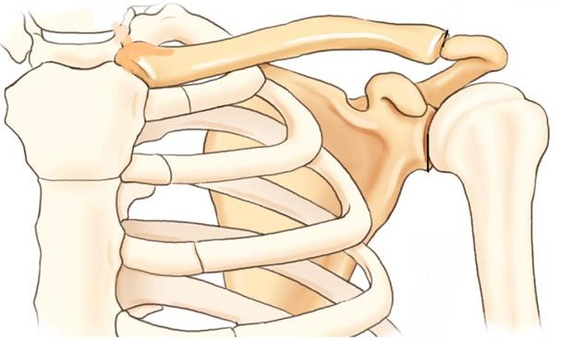
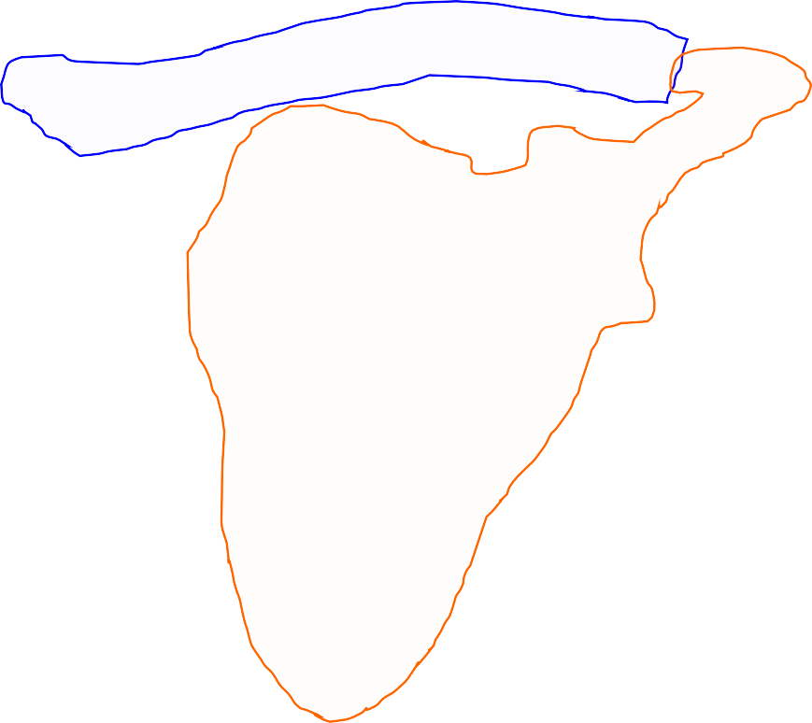
Shoulder Girdle
Includes the clavicle and scapula
Connects the upper limbs to the axial skeleton (at the
sternoclavicular joint)
The upper limb (humerus) articulates with the lateral scapula to form the scapulohumeral joint (aka. shoulder joint)
Bontrager 9th Ed. pg. 182 Fig. 5.14

Slide 5
Shoulder Girdle - Land marking
Clavicle:
Palpable throughout entirety
Medial end (articulates with manubrium) = SC joint
Lateral end (articulates with Acromion) = AC joint
Superior Angle of Scapula:
Corresponds to the level of T2 (second rib)
Medial Border:
Thinner, closer to spinal column
Inferior Angle of Scapula:
Corresponds to the level of T7 (seventh rib)
Scapulohumeral Joint:
Inferior to AC joint

Slide 6
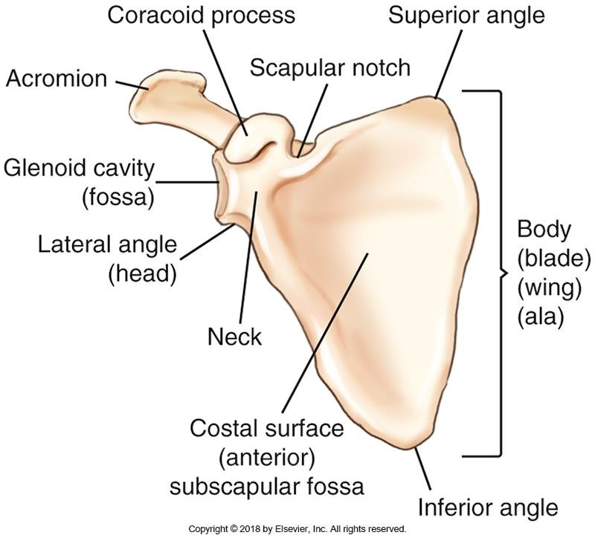
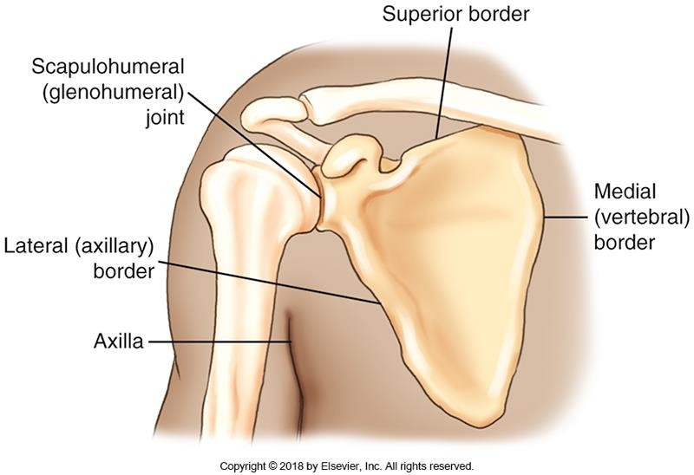
Scapula – General Anatomy
Teach yourself to recognize the following
parts of the scapula:
Lateral (axillary) border
Lateral angle (head of the scapula)
Superior border
Superior angle
Medial (vertebral) border
Inferior angle
Bontrager pg. 180 Fig. 5.6 & 5.7

Slide 7
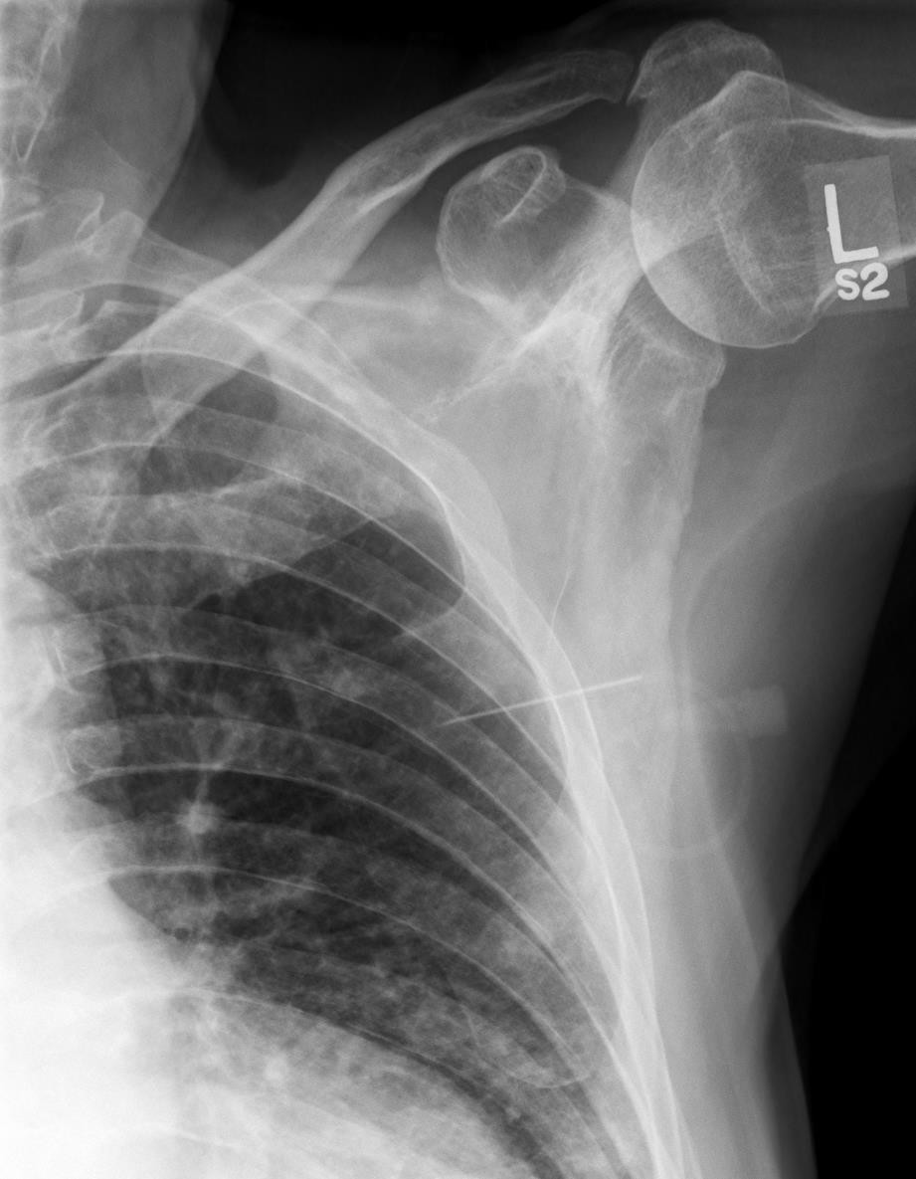
Scapula – General Anatomy
Bontrager pg. 180 Fig. 5.7
SAIT imaging library

Slide 8
Scapula – Anterior Anatomy
Teach yourself to recognize the following parts on an
anterior view of the scapula:
Neck (and head)
Glenoid cavity (or fossa)
Acromion
Scapular notch
Body (blade, wing, ala)
Subscapular fossa (costal surface)
Bontrager pg. 180 Fig. 5.7

Slide 9
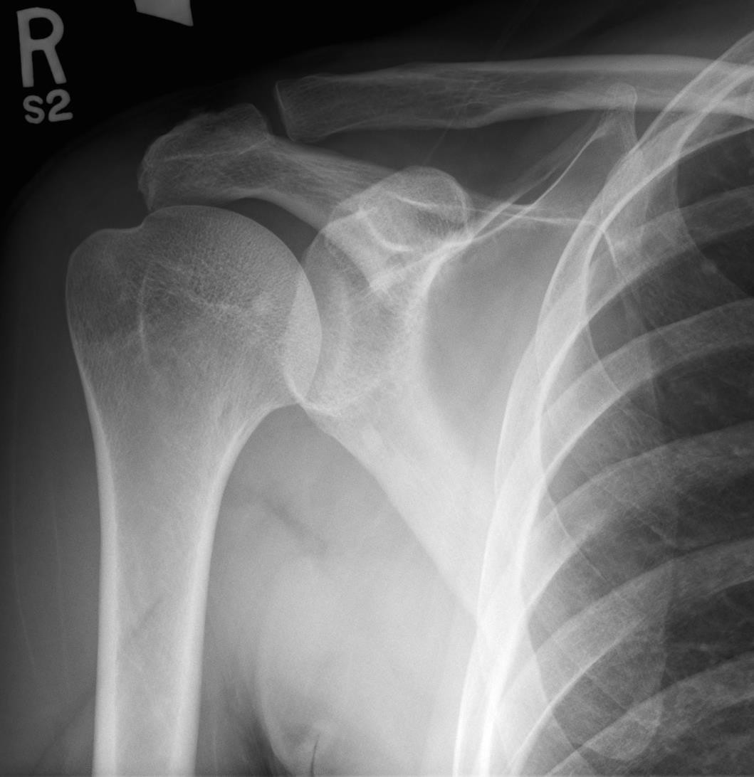
Scapula – Anterior Anatomy
Bontrager pg. 180 Fig. 5.7
SAIT imaging library

Slide 10
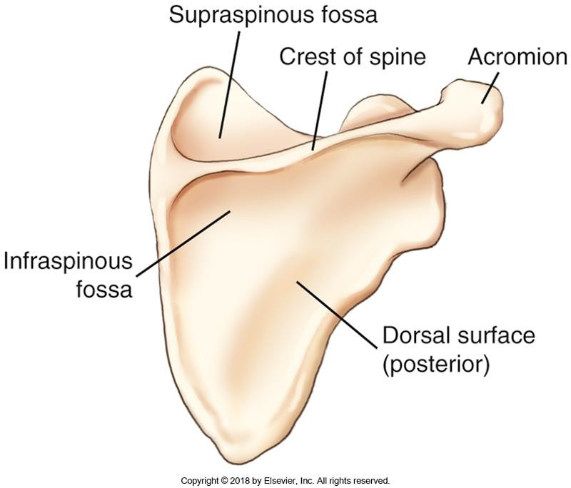
Scapula – Posterior Anatomy
Teach yourself to recognize the following parts on a posterior view of the scapula:
Acromion
Crest of spine
Infraspinous fossa
Supraspinous fossa
Bontrager pg. 180 Fig. 5.8

Slide 11
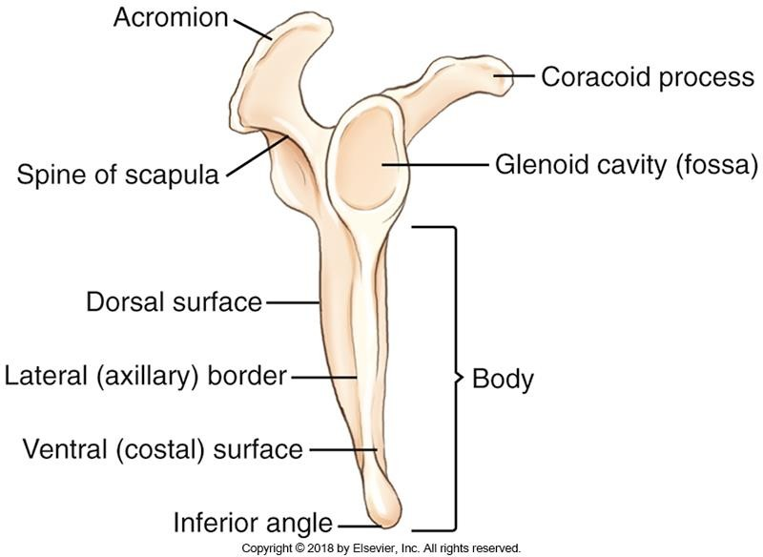
Scapula –Lateral Anatomy
Teach yourself to recognize the following parts on a lateral
view of the scapula:
Acromion
Coracoid process
Glenoid cavity (or fossa)
Body of the scapula
Lateral (axillary) border
Medial (vertebral) border
7. Spine of the scapula
Bontrager pg. 180 Fig. 5.9

Slide 12
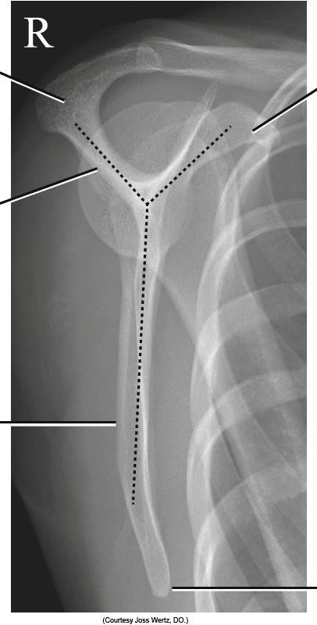
Scapula – Lateral Anatomy
Bontrager pg. 180 & 181 Fig. 5.9 & 5.11

Slide 13
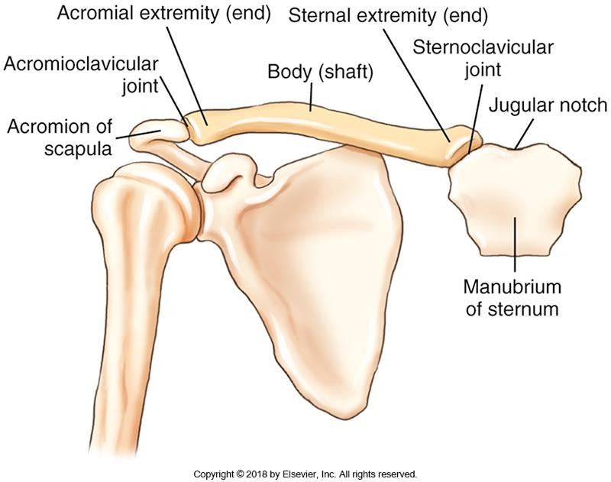
Clavicle
Teach yourself to recognize the following parts of the clavicle:
Acromial extremity (flat-”ish”)
Acromioclavicular joint (AC)
Sternal extremity (triangular-”ish”)
Sternoclavicular joint (SC)
Jugular notch
Body
Bontrager pg. 179 Fig. 5.4

Slide 14
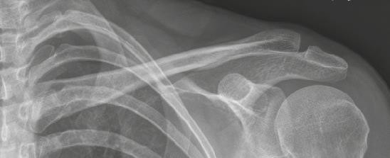
Clavicle
Bontrager pg. 179 & 204 Fig. 5.4 & 5.87A

