Slide 1
MRAD 240: Specialized
Imaging 1
Sterile Fields

Slide 2

Objectives
Apply proper surgical asepsis when establishing a sterile field using personal protective equipment
Discuss the role of the radiologic technologist as part of the surgical team

Slide 3
What is a sterile field?
A microorganism-free area prepared for the use of sterile supplies and equipment.
Sterile fields are used in many modalities such as Angiography, CT, U/S and MRI. Example- Biopsies
A sterile field is required for all invasive procedures because there are risks and complications such as infections

Slide 4
What is a sterile field?
A microorganism-free area prepared for the use of sterile supplies and equipment.
Sterile fields are used in many modalities such as Angiography, CT, U/S and MRI. Example- Biopsies
A sterile field is required for all invasive procedures because there are risks and complications such as infections

Slide 5
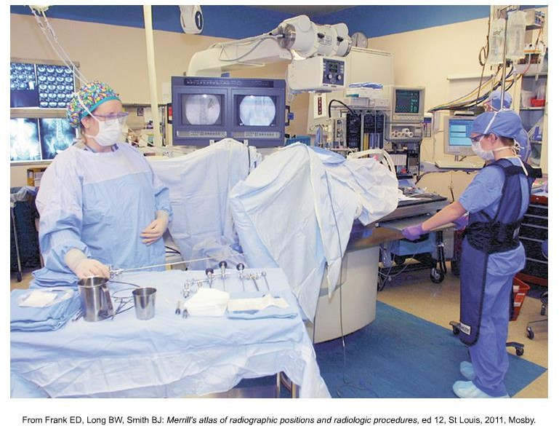
Large Sterile Field – Sterile Corridor

Slide 6
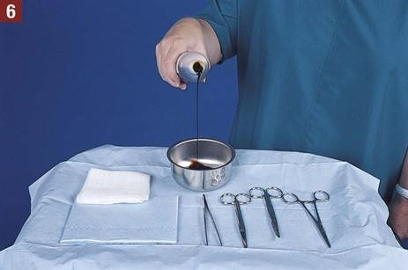
Small Sterile Field
https://nursekey.com/minor-office-surgery/#s0045

Slide 7
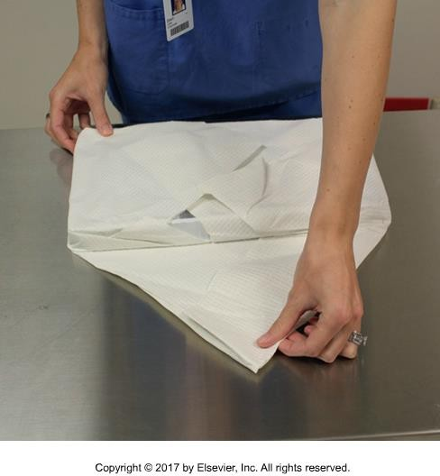
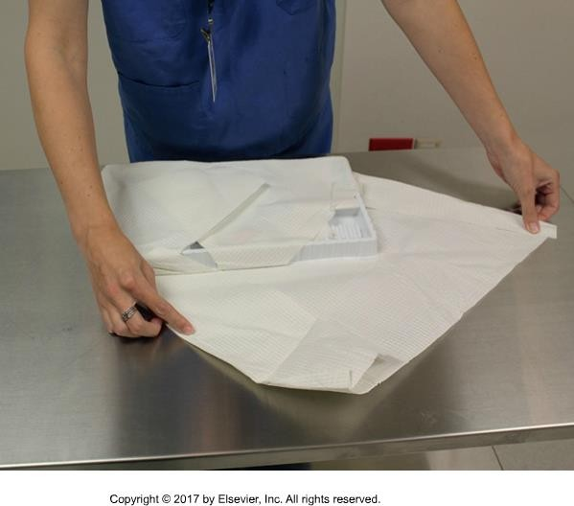
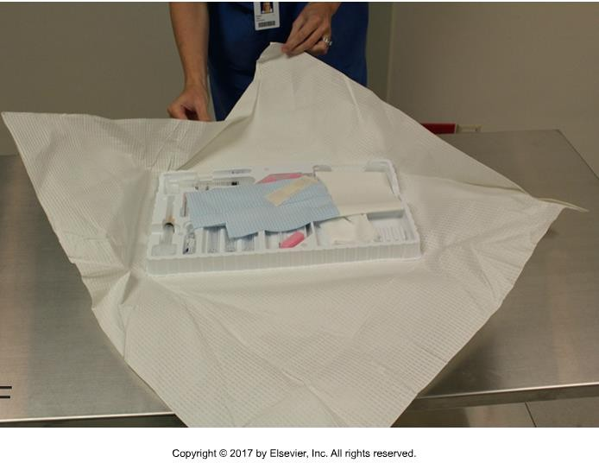
Creating a Sterile Field
Before you open anything:
Wash your hands, disinfect surface (allow to dry), and put on mask
Ensure integrity of tray packaging, reusable or disposable To open tray:

Slide 8
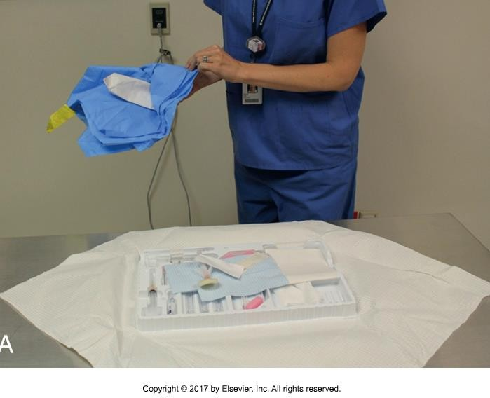
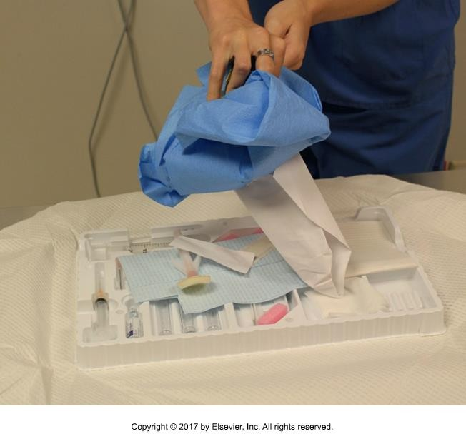
Adding Supplies to a Sterile Field
Non disposable sterile items
Standing back from the table, grasp the object through the wrapping with one hand.
With the other hand, unseal the wrappings, allowing them to fall over your wrist.
Hold the edges of the wrapper with your free hand, and drop the object onto the sterile field without releasing the wrapper.

Slide 9
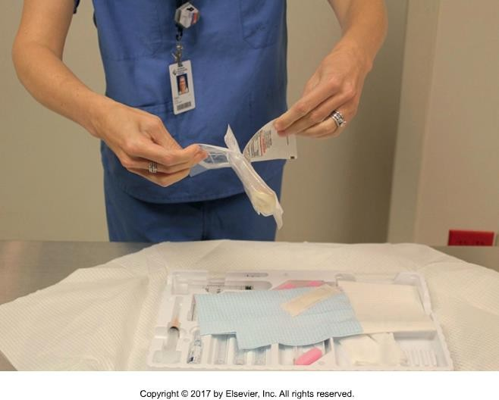
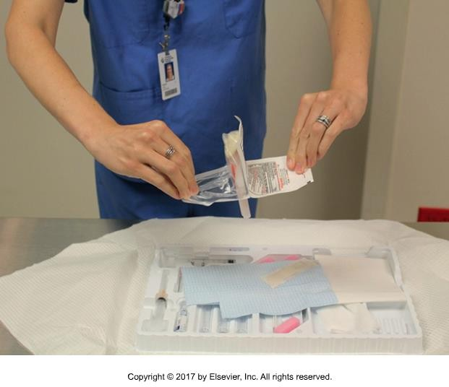
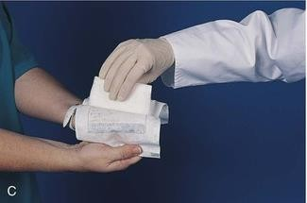
Adding Supplies to a Sterile Field
“Peel down” disposable sterile items
Locate opening end and grasp a flap in each hand.
Peel layers apart.
Invert hands and drop item onto field.
You may also hand the item to a gloved individual.

Slide 10
Moving Supplies Within a Sterile Field
When a radiographer must manipulate sterile items in a sterile field, a sterile transfer forceps are used.
Open packaging so only forceps handles are exposed.
Grasp the handles firmly without touching the remainder of the instrument.
Keep the forceps above your waist and in your sight at all times. After use, place the tips in a sterile field with the handles protruding so you can use them again.
Never reach across a sterile field.

Slide 11

Adding Solution to the Sterile Field
Read the label, check the expiry, read the label AGAIN
Hold bottle with hand over label
Remove lid, do not touch the inside of lid or rim of bottle
Pour a small amount of liquid into garbage
Pour liquid from about 6 inches of height. Be sure not to splash solution onto sterile field
Replace cap and check label again
https://www.surgo.com

Slide 12
Unattended Sterile Fields
Don’t establish sterile field too early. Wait until you need it.
However, sometimes sterile trays are pre-assembled without adding
any fluid. These trays are called dry vs.a tray with fluid (wet) the time
the tray is “deemed” sterile will depend on whether it’s a wet or dry
tray. Example- Angiography because several trays are assembled at once at the start of the day.
If the sterile field is already established, and procedure postponed, cover it immediately with a sterile drape.
  Be sure not to flip or fan the drape
  Handle drape as little as possible and only on corners
Airborne contamination is still contamination

Slide 13
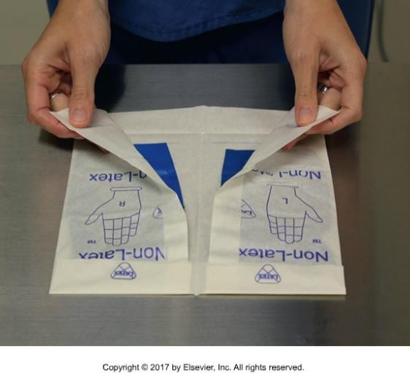
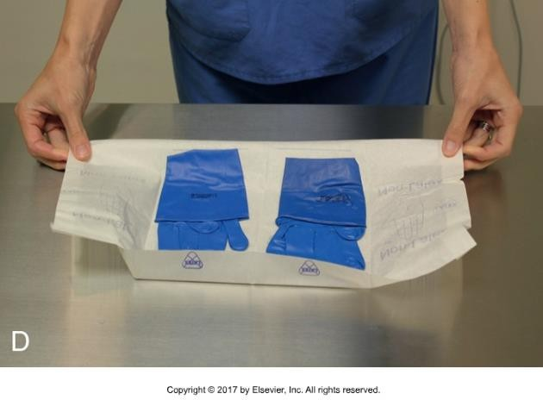
Open Sterile Gloving
What’s the difference between open and closed gloving? Which do you think you’ll be doing most often as a technologist?
Open gloving technique
Inspect packaging
Remove rings, bracelets, roll up sleeves. Perform hand hygiene
Open packaging like a book. Place in front of you so you can read the writing
Open flaps and fold bottom edge under so it doesn’t close again

Slide 14
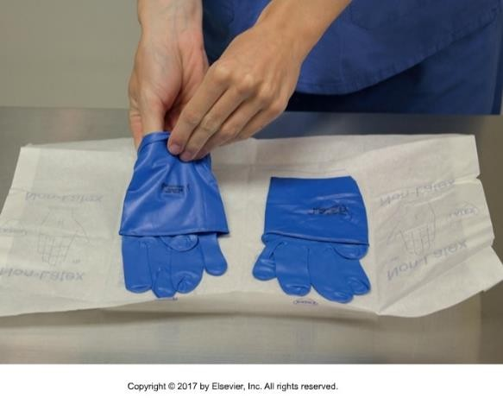
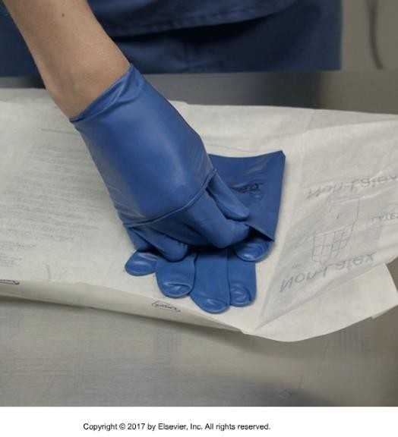
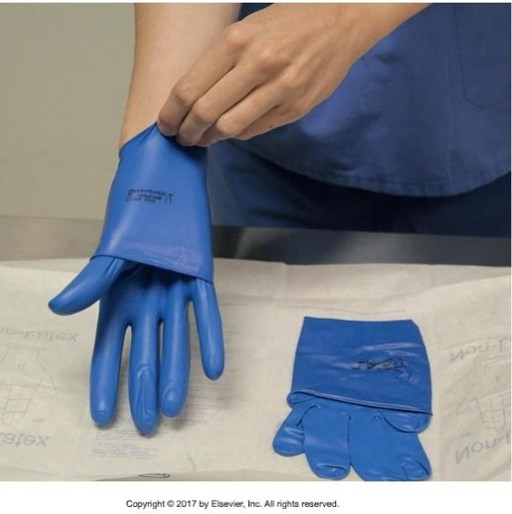
Open Sterile Gloving
Pick up one glove by the cuff end closest to you
Place hand into glove, aim for fingers
Slide gloved fingers under cuff of second glove and pick up.

Slide 15
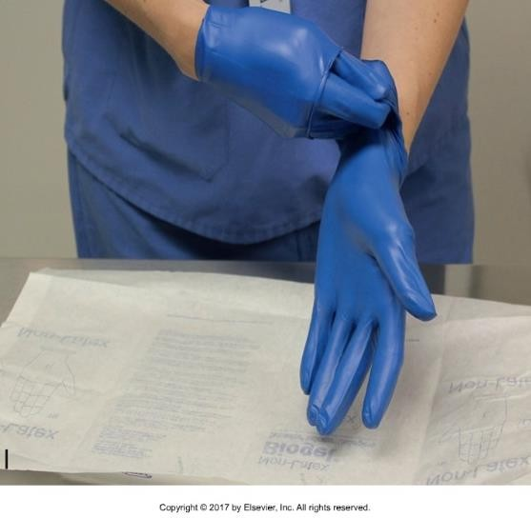
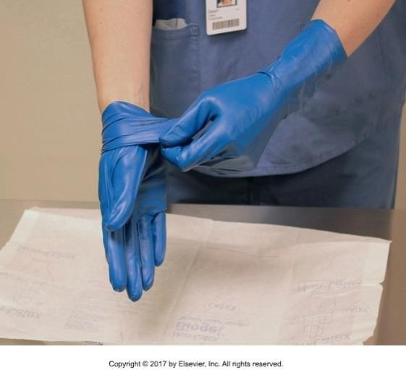
Open Sterile Gloving
Slide second hand into glove
Carefully pull down cuffs of gloves
Why do I dislike these two pictures?

Slide 16
Cleaning Up a Sterile Field
Always check for sharps. Typically it’s the Rads responsibility to dispose of properly but sharps can be missed.
Put in designated sharps bin. Use the appropriate size.
Discard pharmaceuticals in white pail and bodily fluids in yellow biohazard pail. All other refuse goes in garbage
Don gloves and thoroughly clean all reusable items before returning them to central sterile supply.
  Thorough cleaning is important because items must be free of all residue so the sterilizing agent can penetrate to all surfaces.

