Slide 1
MRAD 256
Radiographic Technique 2
Positioning of the Sternum,
Ribs and SC Joints

Slide 2
What will superimpose the sternum if we shoot straight AP or PA?

Slide 3
For an AP projection, which body position would cause the sternum to be projected over the heart?

Slide 4
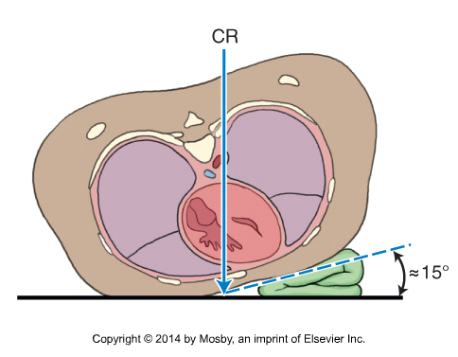
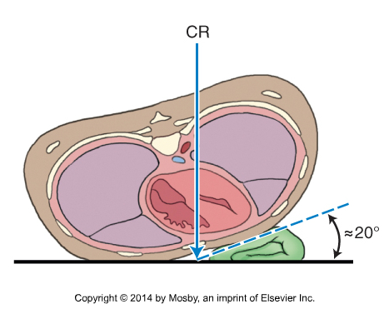
A hypersthenic patient requires less rotation than a smaller one
Bontrager 10-12

Slide 5
Routine Sternum Protocol
PA oblique (RAO)
Lateral

Slide 6
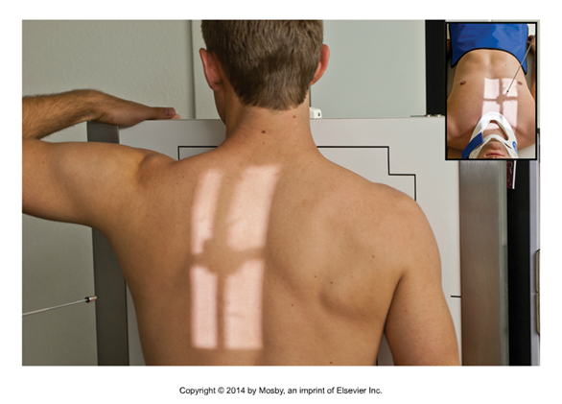
RAO Position- Sternum
SID 110 cm
Place patient into RAO position, with left arm resting on the detector
Align the long axis of the sternum with the long axis of the IR
Adjust patient to place the sternum between the spine and the medial border of the scapula by visualizing the jugular notch
The CR is directed to the center of the sternum midway between the jugular notch and the xiphoid process
Expose on expiration
You can confirm the size of the sternum first by having your patient stand in true AP against the IR, and set your collimation to include the jugular notch and xiphoid process

Slide 7

RAO Position- Sternum

Slide 8
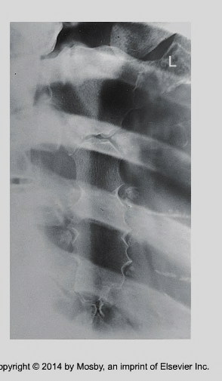
Evaluation criteria
Slightly obliqued image of the sternum projected over the heart
Lateral portion of the manubrium and sternoclavicular joint free of superimposition by the vertebrae
Bontrager 9-13

Slide 9
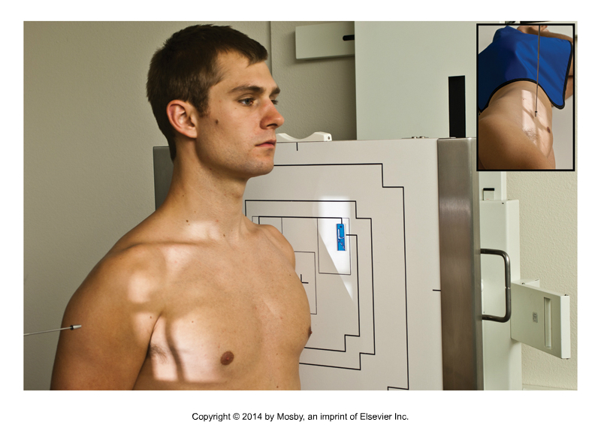
Lateral Position Sternum
SID 180cm due to OID
Use manual technique
Bontrager 10-22

Slide 10
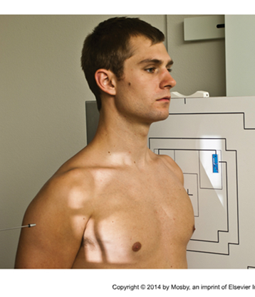
Lateral Position Sternum
Place patient in a lateral position with arms and shoulders pulled back
Direct central ray to mid sternum between jugular notch and xiphoid process
Rotate collimator to match the angle of the sternum
Collimate to include entire sternum
Have patient take deep breath to see where sternum ends up
Expose on full inspiration

Slide 11
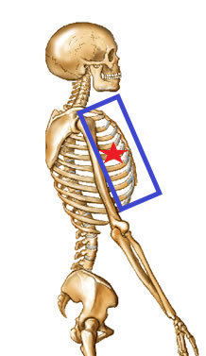
Lateral Sternum

Slide 12
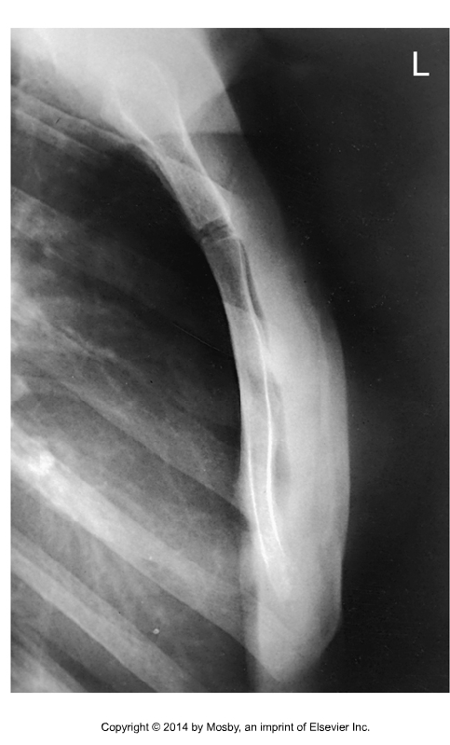
Evaluation criteria
Entire length of sternum free of superimposition
Superimposed SC joints and medial ends of the clavicles
Bontrager 10-24

Slide 13
Routine Rib Protocol
PA chest
AP or PA projection
45º AP or PA oblique

Slide 14
Breathing Instructions
Upper ribs (1-10) taken on inspiration
Lower ribs (8-12) taken on expiration

Slide 15
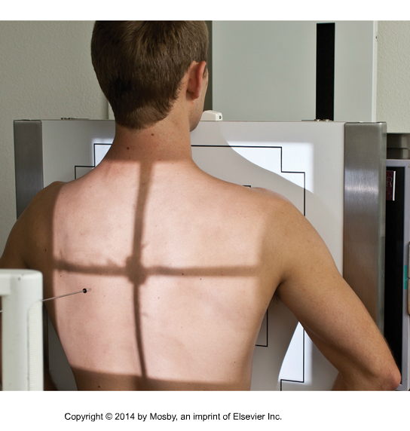
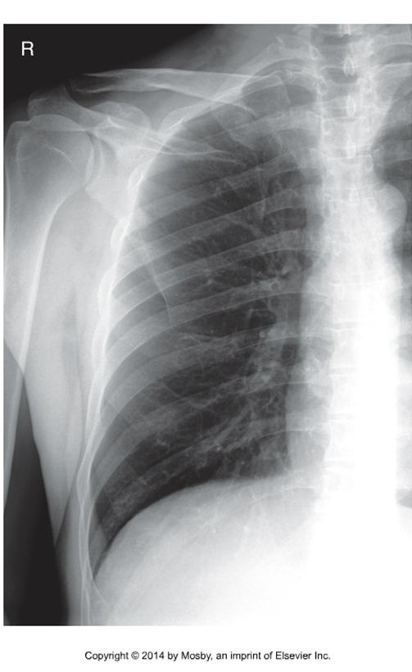
Upper (1-10) Anterior Ribs
Arm needs to be placed on top of detector to move scapula off of ribs
LCM
Bontrager 10-35 and 10-39

Slide 16
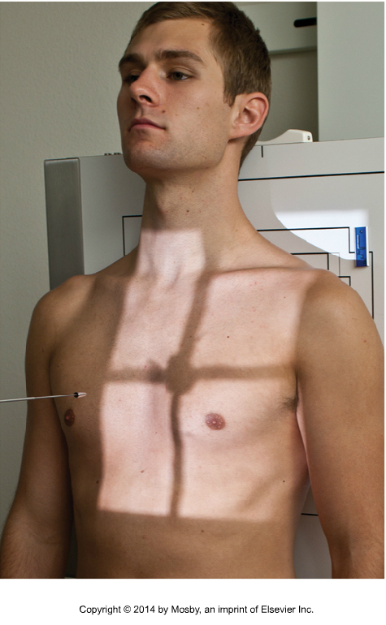
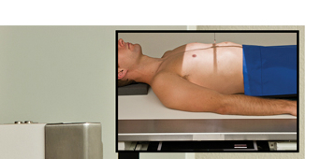
Upper (1-10) Posterior Ribs
L
Arm needs to be raised
to move scapula off of ribs
Bontrager 10-39 (flipped to appear as left ribs)
Bontrager 10-38

Slide 17
Lower (8-12) Posterior Ribs
Bontrager 10-38 and 10-39
L
MSP
T7
LCM = rib 10
The red box shows the collimation for the left lower posterior ribs

Slide 18
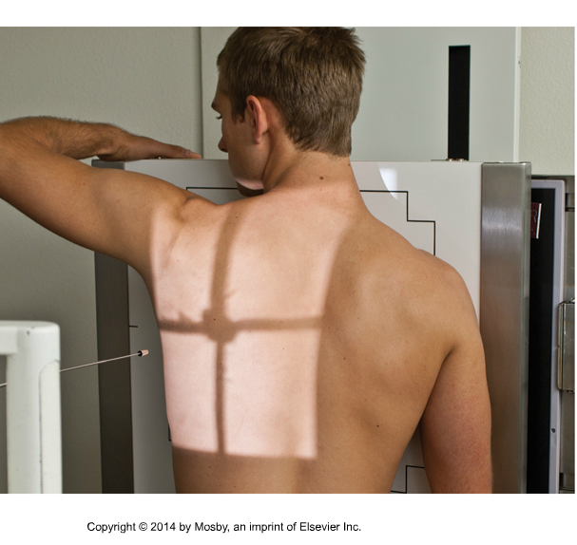
45° PA oblique projection
Elongates the axillary ribs farthest from the IR
Scapula off lung field
Spine off of affected ribs
Center affected side and ribs of interest (upper or lower) in the light field
Red box – lower axillary ribs
Green box- upper axillary ribs
Bontrager 10-41

Slide 19
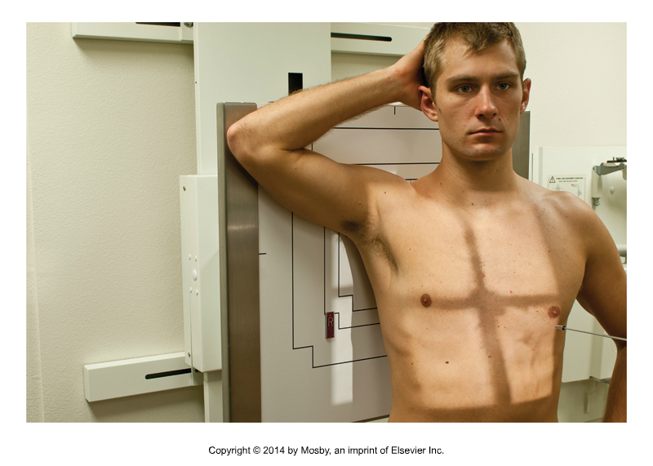
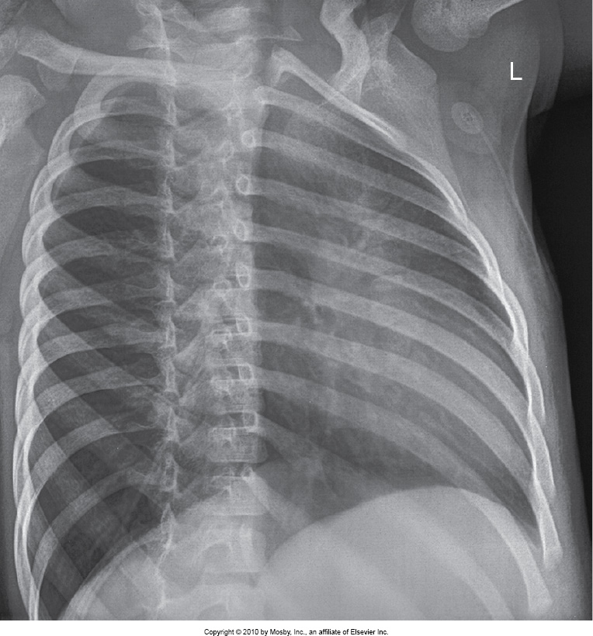
AP 45˚oblique upper ribs
Elongates the axillary ribs closest to the IR
Bontrager 10-40 and 10-42

Slide 20
Routine protocol SC joints
PA
15º PA oblique (bilateral)

Slide 21
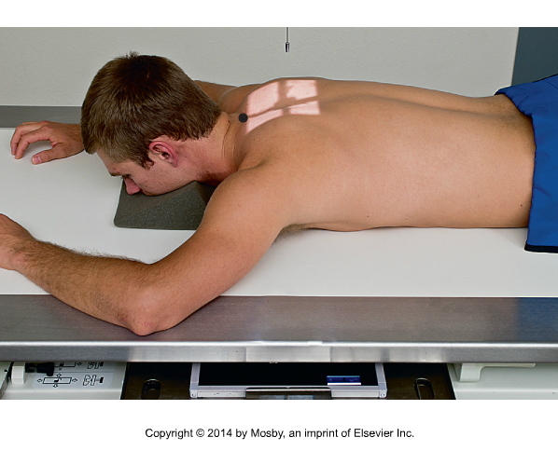
PA projection
110 cm SID
Upright or prone
Turn patient for a PA projection
Center on MSP 3” (7-8 cm) inferior to vertebral prominens (spinous process)
Collimate to include SC joints

Slide 22
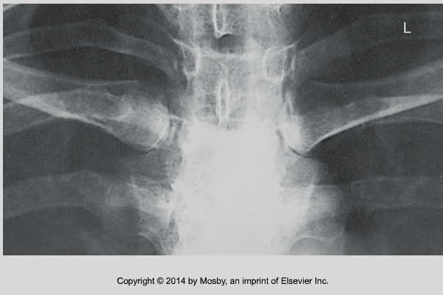
Evaluation criteria…
Bontrager 10-27
SC joints superimposed over vertebral column
No rotation : SC joints equidistant to spinous process

Slide 23
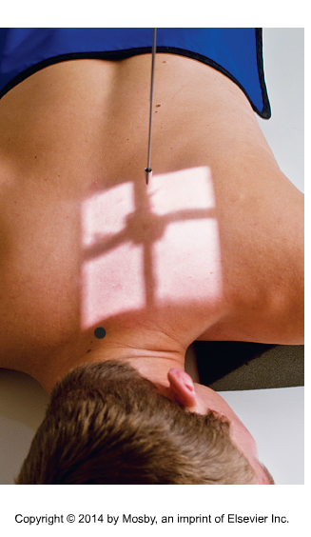
15° PA oblique
Position patient for a PA projection
Rotate MCP until the SC joints have been moved off of the spine to the side of the body farthest from the IR. (Eg. In RAO position the joints are moved to the left of the spine)
Center on the jugular notch 3” (7-8 cm) inferior to the vertebral prominens
Bontrager 10-29

Slide 24
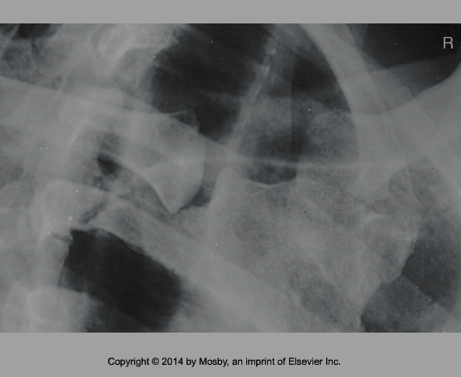
Evaluation criteria…
Manubrium and medial ends of clavicles are visualized
SC joints have been moved off of the spine to side of body farthest from the IR. (Eg. In an RAO position the SC joints appear to the left of the spine)
The SC joint closest to the IR is open (the one closest to the spine)
Patient in an RAO
L
Bontrager 10-30

Slide 25
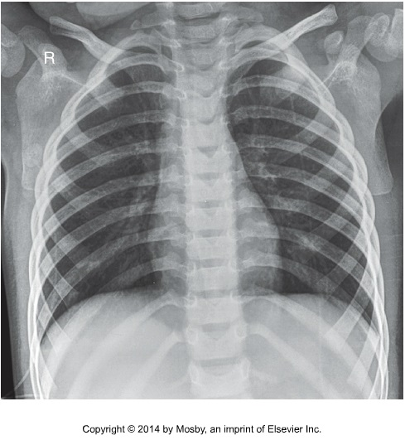

Slide 26
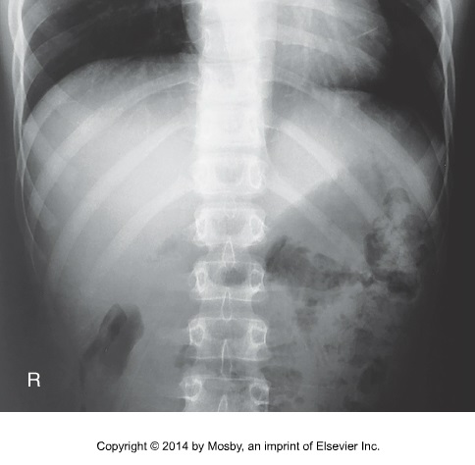

Slide 27
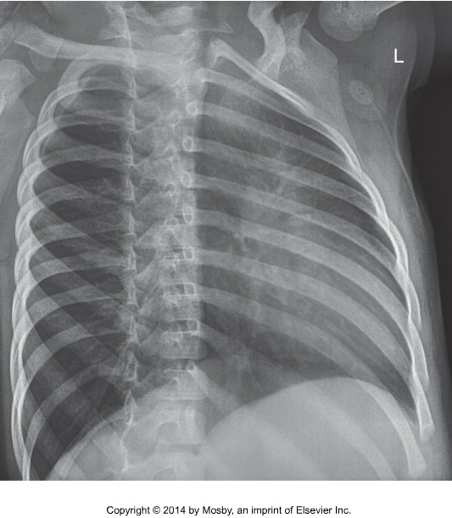
LPO

Slide 28
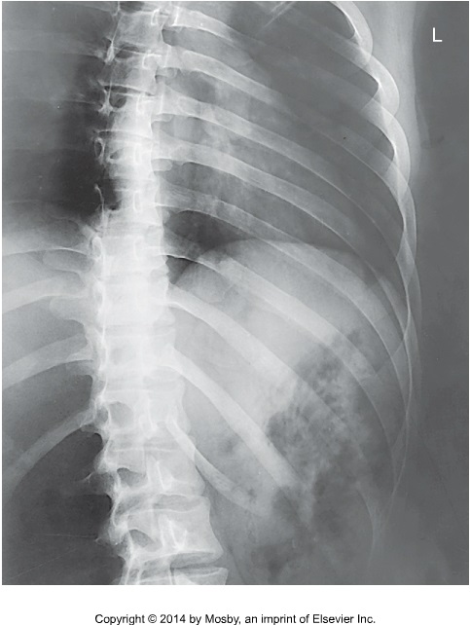
LPO below diapgragm

Slide 29
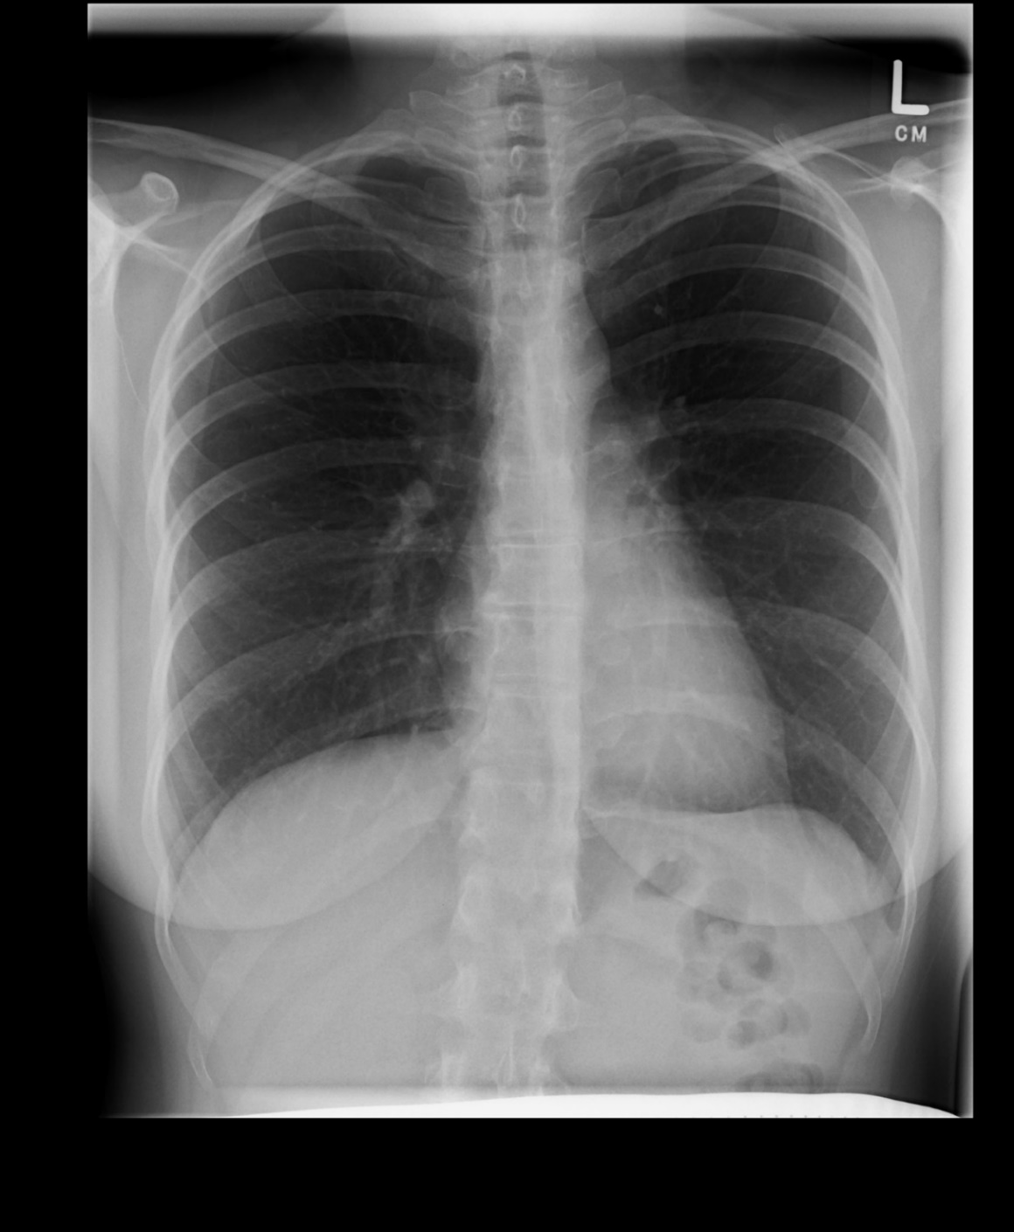

Slide 30
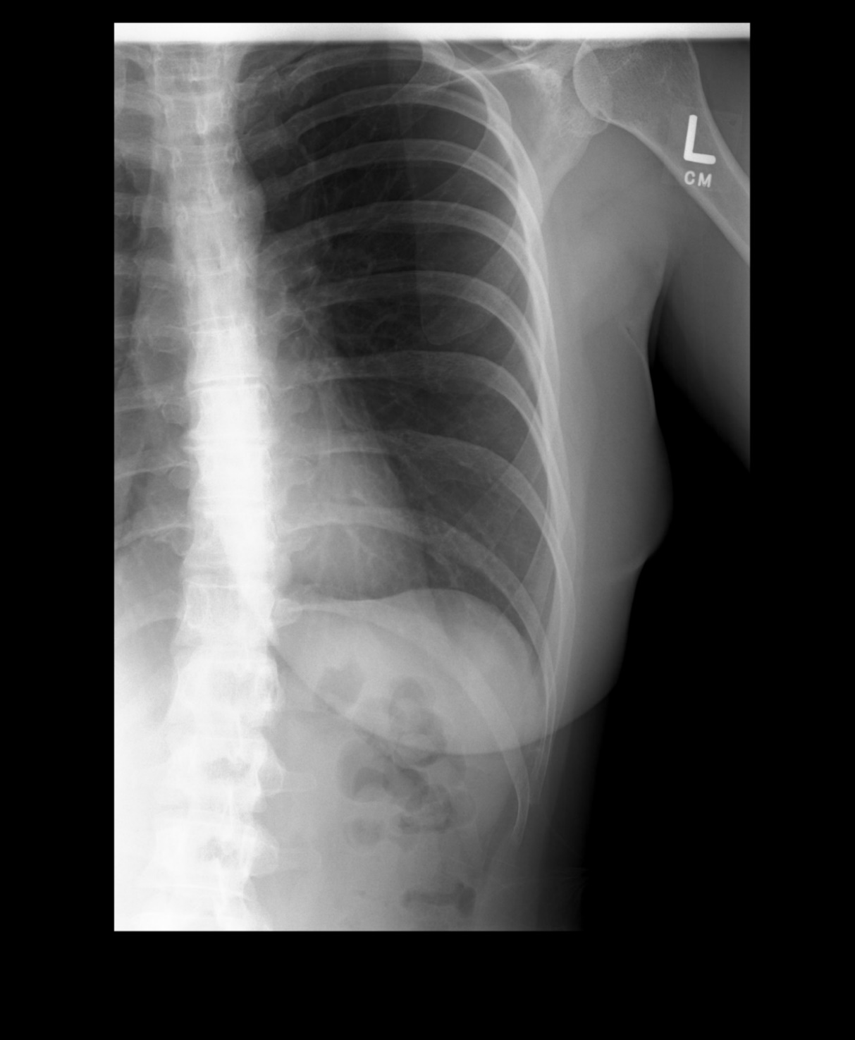

Slide 31
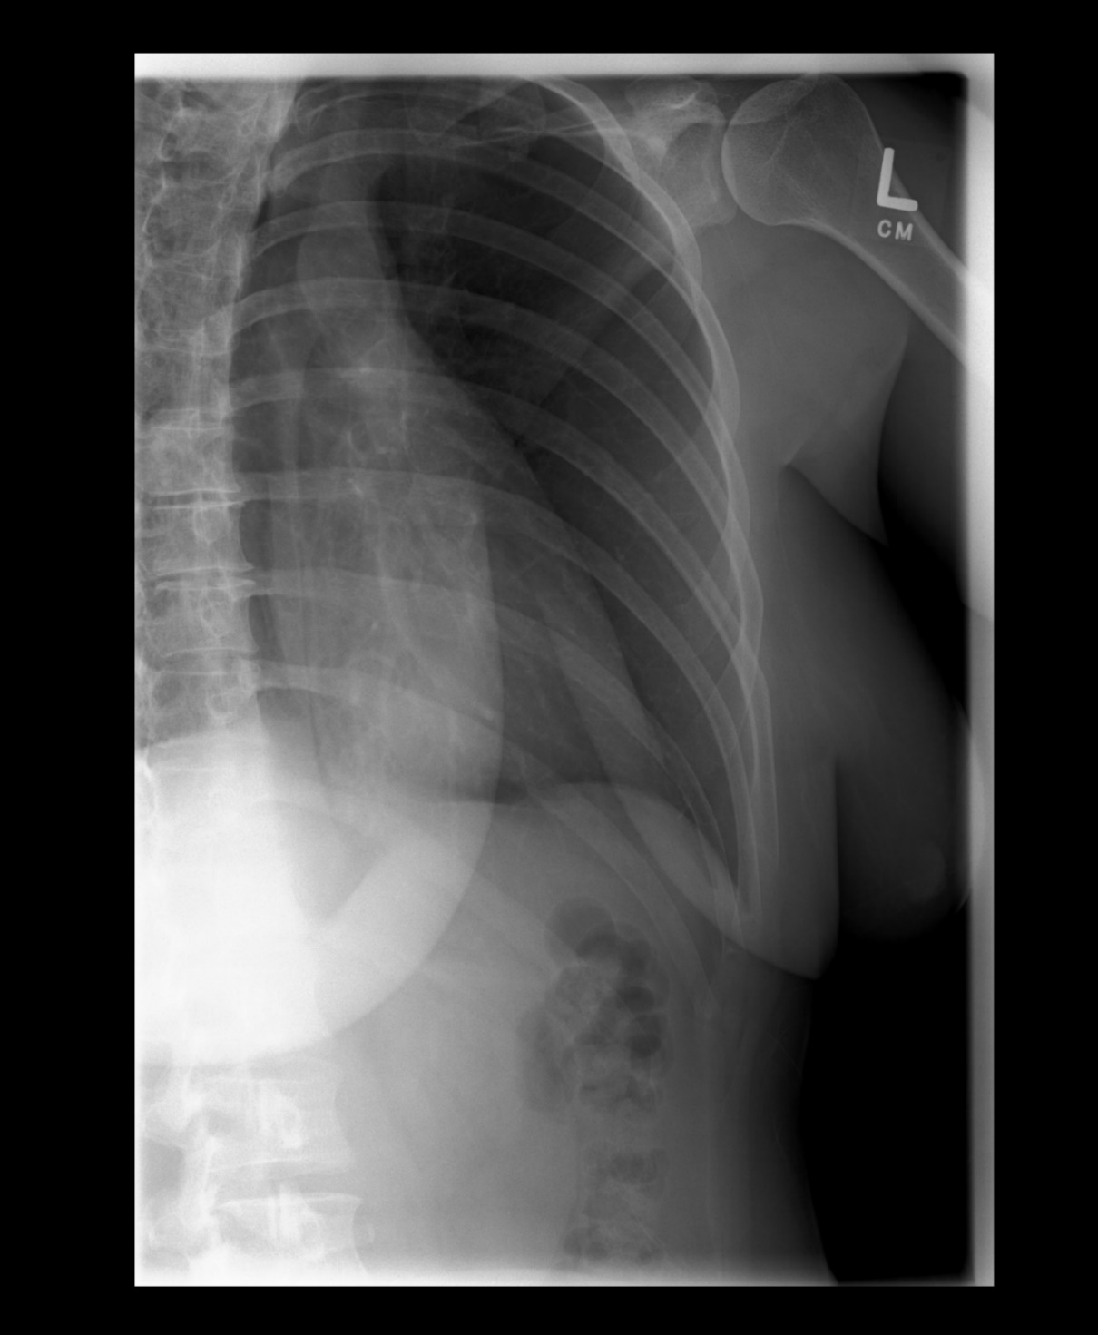

Slide 32
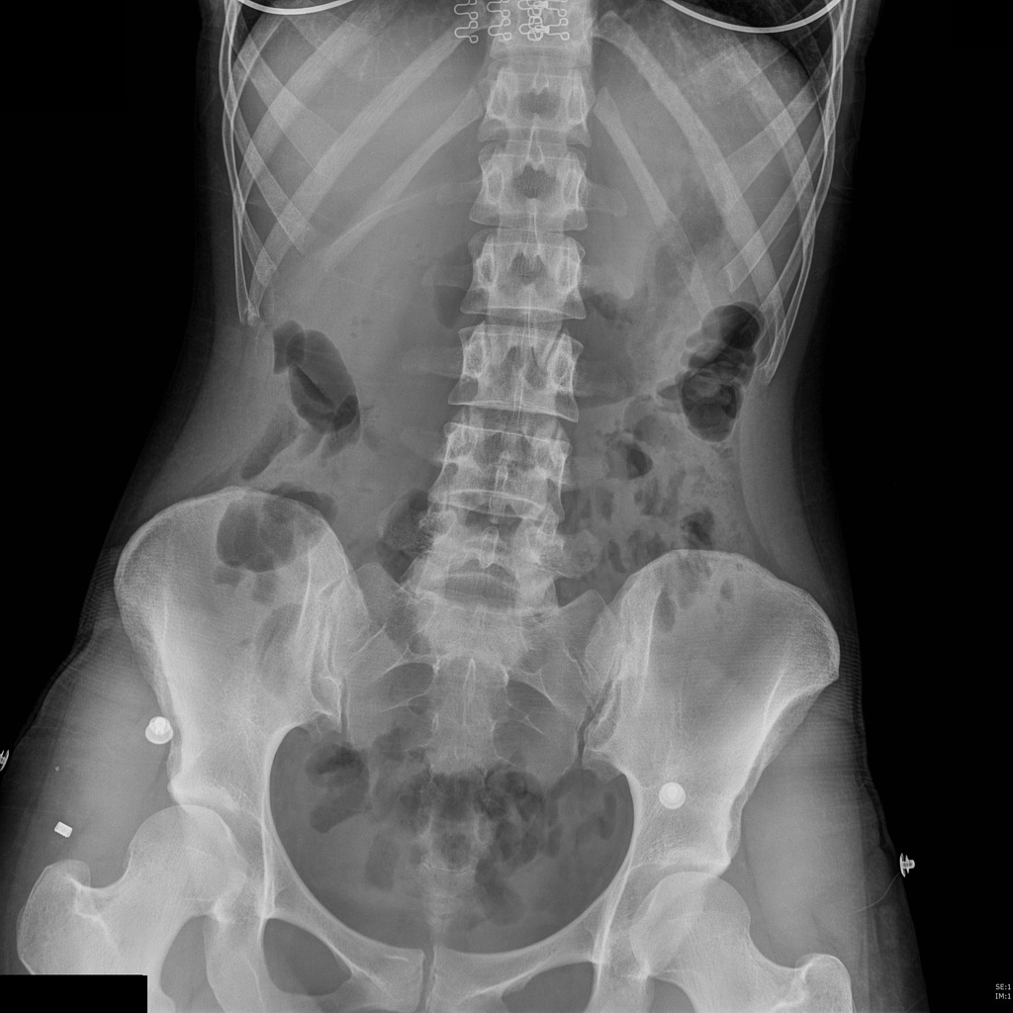
Case courtesy of Dr Antoni Boscà, Radiopaedia.org, rID: 49923

